Slide 1
01. Preparing an Environment for Smart Contract Development
Ricardo Almeida, May 23
r.almeida@studenti.unipi.it
Università di Pisa

Slide 2
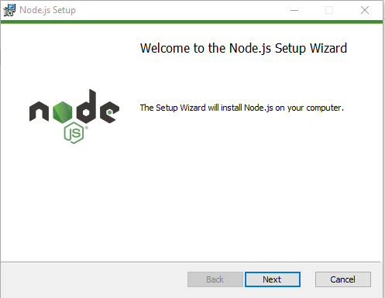
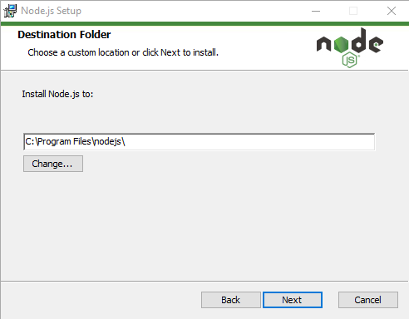
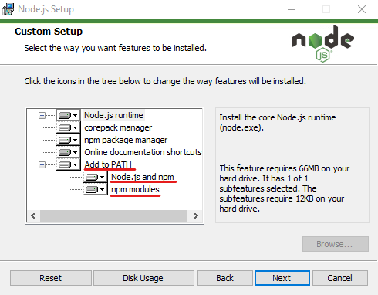
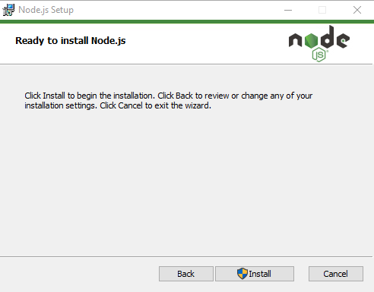
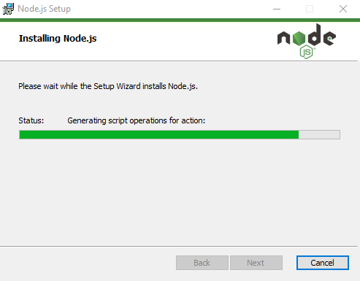
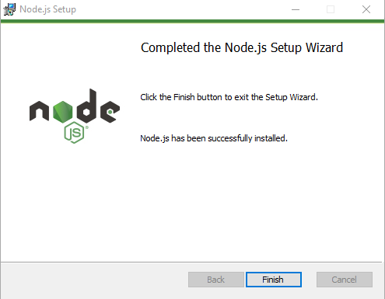
Download and install Node.js and npm
Download (Node.js installer file includes npm) from:
https://nodejs.org/en/download
according to your Operating System

Slide 3
Verify Node.js and npm install:
Open a command line (cmd, terminal, powershell, etc.)
Verify Node.js install:
$ node –v
Verify nmp install:
$ npm -v

Slide 4
Truffle Suite: use npm to install
Truffle – A Development Framework for Ethereum Blockchain Applications
On a admin terminal window, with npm installed, run:
$ npm install –global truffle
Verify installation:
$ truffle version

Slide 5
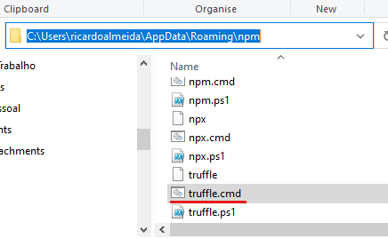
* If truffle command is not available:
Check folder where truffle.cmd script should be:
C:\Users\<user>\AppData\Roaming\npm\truffle.cmd

Slide 6
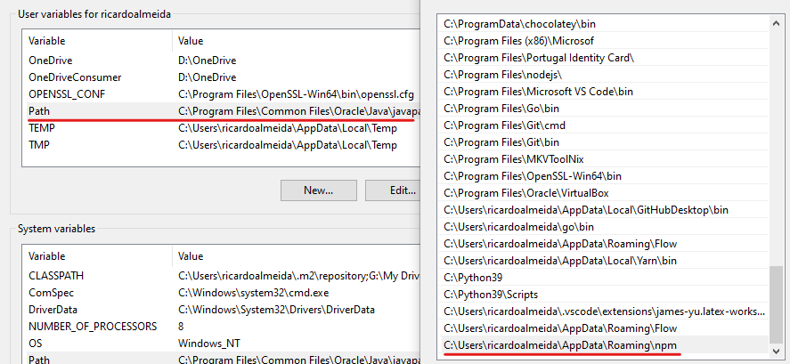
* If truffle command is not available:
Verify that the path is set in the Environmental Variables, under Path:

Slide 7
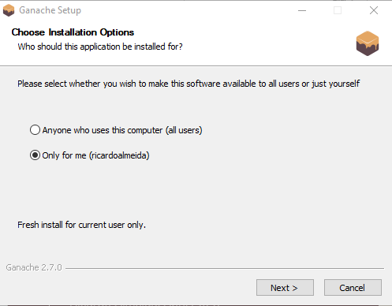
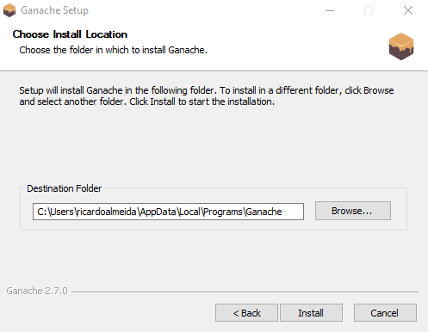
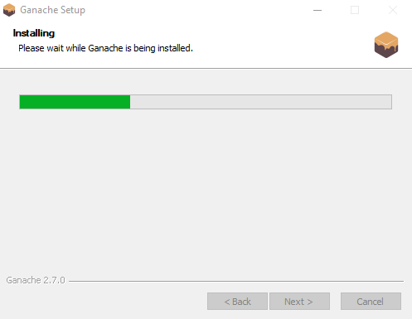
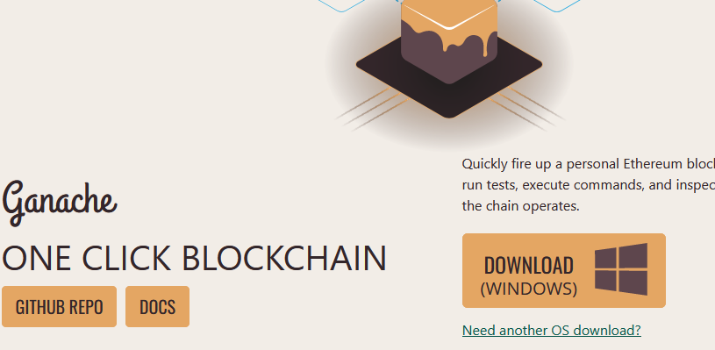
Ganache install
Ganache is a Ethereum blockchain emulator that runs locally.
Download and run installer from:
https://trufflesuite.com/ganache/

Slide 8
Web3.js install
Collection of libraries (API) to interact with local or remote Ethereum nodes.
Main reference:
https://web3js.readthedocs.io
Install the API interface in a project:
$ npm install web3

Slide 9
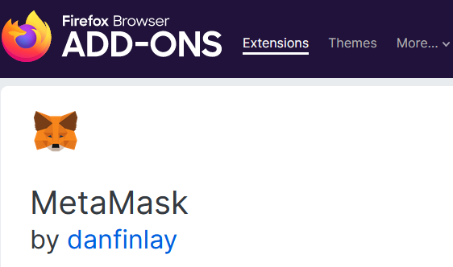
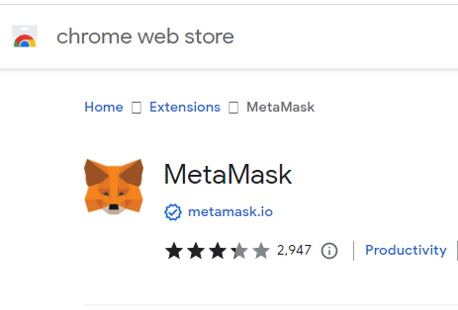
Metamask
Metamask is a crypto wallet and a gateway to interact with dApps.
It is available as a browser extension and mobile app.
Install the browser extension:

Slide 10
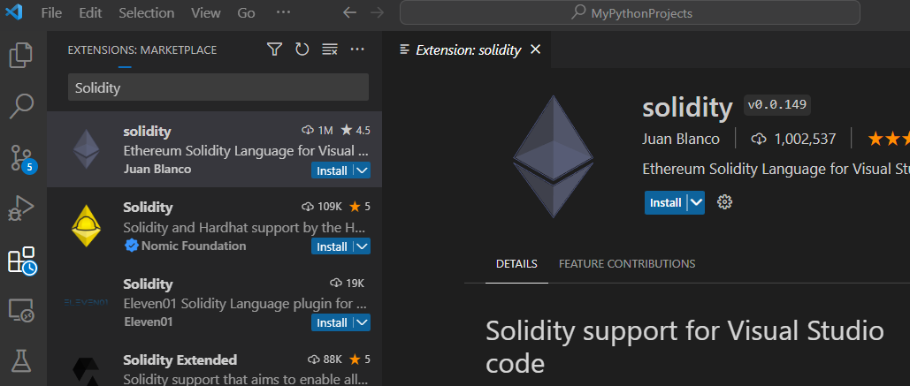
Source code editor: VSCode
Local editor: VSCode with Solidity extension
Download and install VSCode:
https://code.visualstudio.com/download
After install, search and install the Solidity extension:

Slide 11
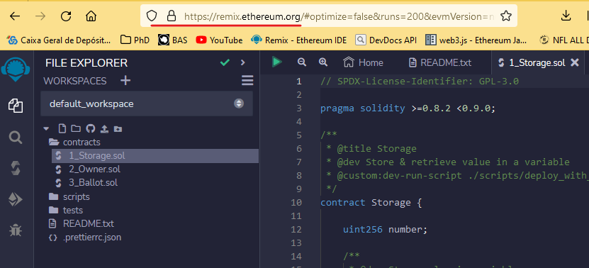
Source code editor: RemixIDE
Online editor in:
https://remix.ethereum.org
Requires additional configuration to work with local blockchain emulators

Slide 12
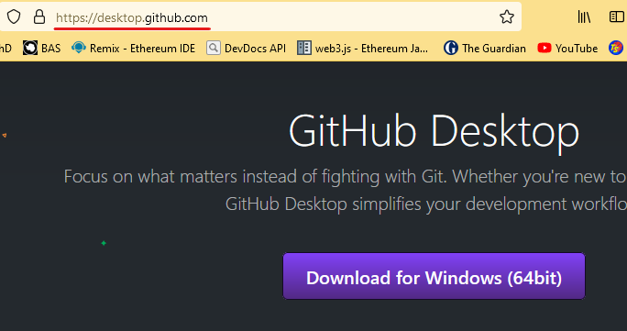
Additional: Code repository - Github
Create an account in:
https://github.com/
Easy mode: Download
and install the Gitub
application:

Slide 13
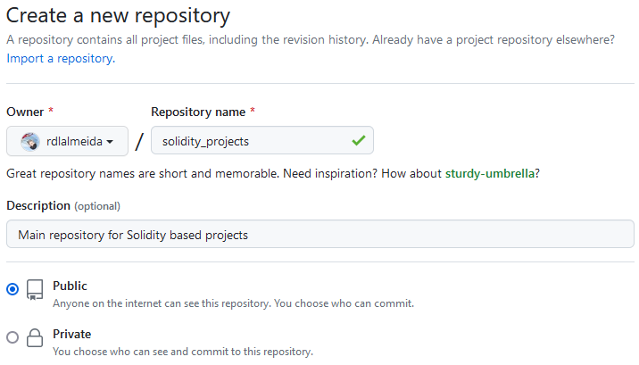
Github application:
Install the Github application
Login into github.com and create a new empty repository:

Slide 14
Github application:
After saving the new repository, finish the setup with Github’s Desktop application:

Slide 15
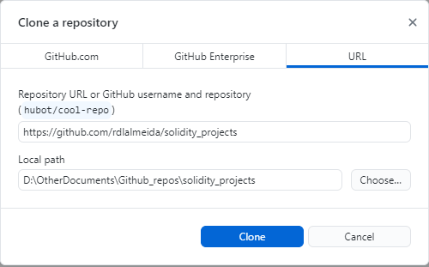
Github application:
Clone the remote repository to a local folder using the Desktop application:

Slide 16
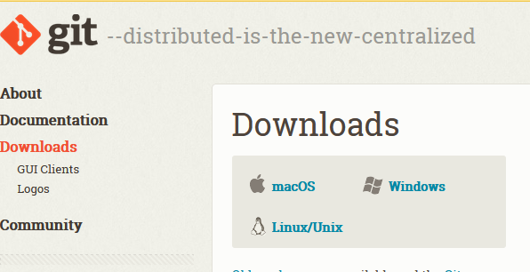
Additional: Code repository - Github
Hard mode: use the Git Command Line Interface (CLI)
Download and install Git:
https://git-scm.com/downloads

Slide 17
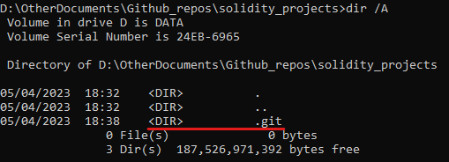
Git CLI:
Create a local folder in your machine and initialize a Git repository:
Open a command line in the folder and run:
$ git init
This creates a .git folder at folder root level

Slide 18
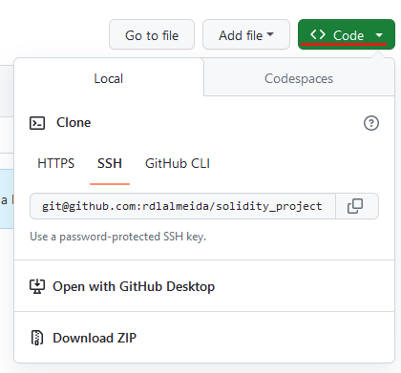
Git CLI:
Login into your Github account, create or access the remote repository to synchronize and copy the URL string that references ‘git’:

Slide 19
Git CLI:
Clone the remote repository:
In a command line opened at the root of the folder to synchronize, run:
$ git clone <Github_URL>

Slide 20
Git CLI: Basics
Get remote changes to local version:
$ git pull
Submit local changes to remote version:
$ git add . (Adds new local files, if any, to the remote repository)
$ git commit –m <commit_message>
$ git push

