Slide 1
02. HelloWorld Solidity + Ethereum local blockchain
Ricardo Almeida, May 23
r.almeida@studenti.unipi.it
Università di Pisa

Slide 2
How to write, compile and deploy a simple HelloWorld Solidity contract

Slide 3
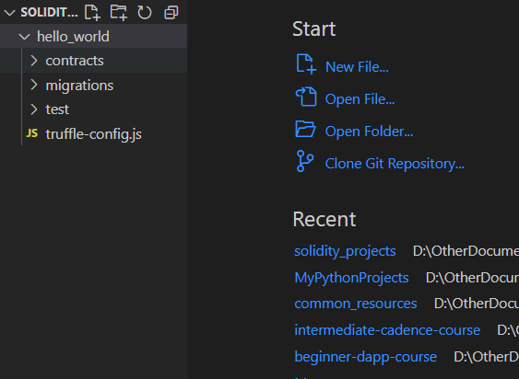
Solidity: Simple HelloWorld example
Open a command line where you want to create the new project and scaffold it using the truffle framework:
$ truffle init hello_world
Command creates:
Folder structure
Truffle-config.js

Slide 4
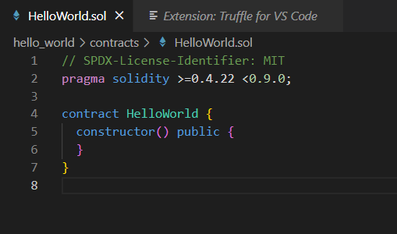
Solidity: Simple HelloWorld example
Get into the created folder:
$ cd hello_world
Create the base contract using the truffle framework:
$ truffle create contract HelloWorld
Creates a HelloWorld.sol contract skeleton.

Slide 5
Solidity: Simple HelloWorld example
Replace the constructor with a simple function that returns a simple greeting to the contract:
memory – the variable is stored temporarily in memory, i.e., it is destroyed once the function terminates.
pure – the function does not read nor modify state variables.
function sayHello(string memory greet) public pure returns (string memory) {
string memory hello = "Hello ";
return string.concat(hello, greet);
}

Slide 6
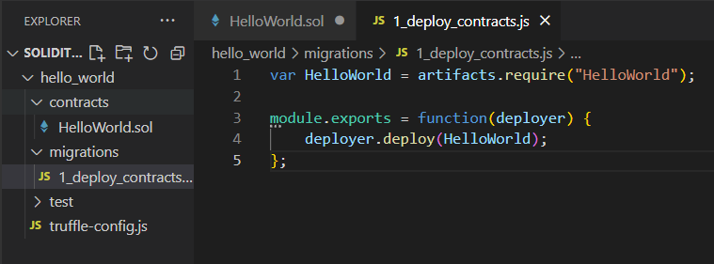
Solidity: Simple HelloWorld example
Create a migration file to deploy the HelloWorld.sol contract:
Create a new “1_deploy_contracts.js” file inside the migrations folder.
Add the migration instructions to it:

Slide 7
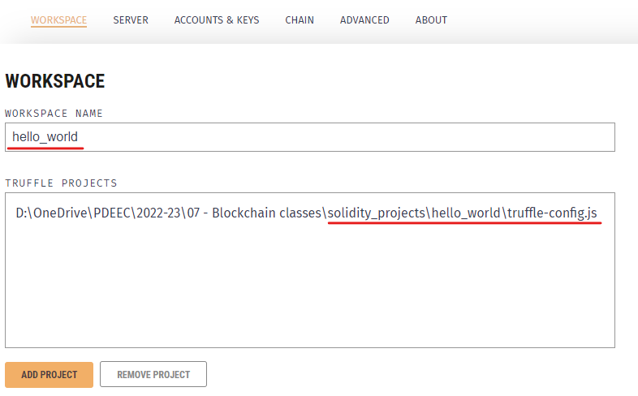
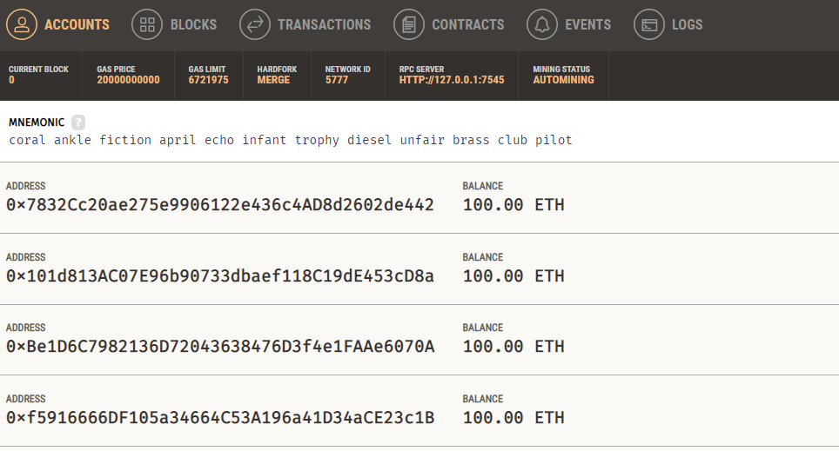
Solidity: Simple HelloWorld example
Deploy the contract to a local (Ganache) blockchain:
Open Ganache application.
Create a new Ethereum workspace and associate the HelloWorld project’s truffle-config.js to it:
Press start to initialize the local blockchain.

Slide 8
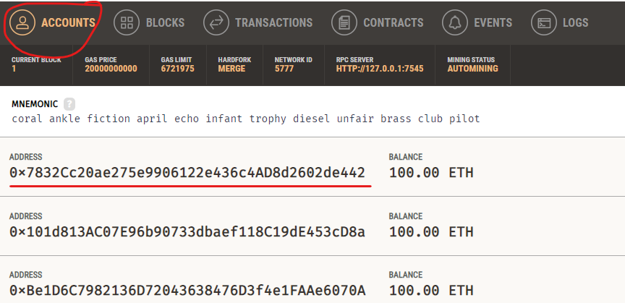
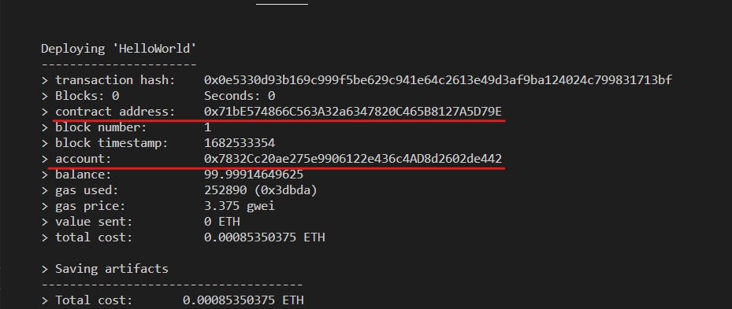
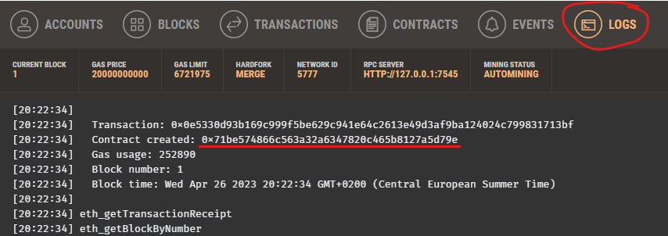
Solidity: Simple HelloWorld example
Deploy the contract to a local (Ganache) blockchain:
Use truffle to compile and deploy the project to the running local blockchain:
$ truffle migrate

Slide 9
Solidity: Simple HelloWorld example
Run the ‘sayHello()’ function:
Open a truffle console to interact directly with the local blockchain:
$ truffle console
Execute the function from a deployed instance:
truffle(ganache)> HelloWorld.deployed()
.then(function(instance) {
return instance.sayHello("Ricardo");
}
);

Slide 10
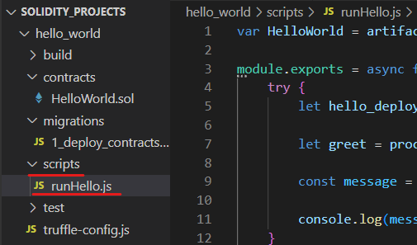
Solidity: run scripts
var HelloWorld = artifacts.require("HelloWorld");
module.exports = async function(callback) {
try {
let hello_deployed = await HelloWorld.deployed();
let greet = process.argv[4];
const message = await hello_deployed.sayHello(greet);
console.log(message);
}
catch(error) {
console.log("ERROR: " + error);
}
callback();
}
Create a new folder named “scripts” in the project folder.
Create a “runHello.js” file inside it.
Add the following data to it:

Slide 11
Solidity: run scripts
Run the script from a normal console (not a truffle one, though it is possible to do so). Do not forget to provide the ‘greet’ argument:
$ truffle exec .\scripts\runHello.js <greet_argument>

