Slide 1
Topics for Projects
Università di Pisa
Giuseppe Attardi
Dipartimento di Informatica
Università di Pisa

Slide 2
Challenges
Tensorflow 2.0 Question Answering (https://www.kaggle.com/c/tensorflow2-question-answering)
BioASQ (http://bioasq.org)
Alexa Prize 2019 (https://developer.amazon.com/alexaprize)
Pharma CoNER (http://temu.bsc.es/pharmaconer/)
Loop Q Prize (https://www.loopqprize.ai)
The Conversational Intelligence Challenge 2 (http://convai.io)

Slide 3
BERT and Parsing
Use BERT to guide dependency parser
https://nlp.stanford.edu/~johnhew/structural-probe.html

Slide 4
Interest by Italian Organizations
Italian Parliament
Summarization
Project Debater
INVALSI (https://www.invalsi.it/invalsi/)
Question generation from Wikipedia articles

Slide 5
Evalita 2016-2018
www.evalita.it/2016
POSTWITA
QA4FAQ
NEEL-IT
www.evalita.it/2018
ABSITA
HaSpeeDe
NLP4FUN (more statistics than linguistics?)
Timeline
Data Release: May 28, 2018
Evalutation: September 10-16, 2018

Slide 6
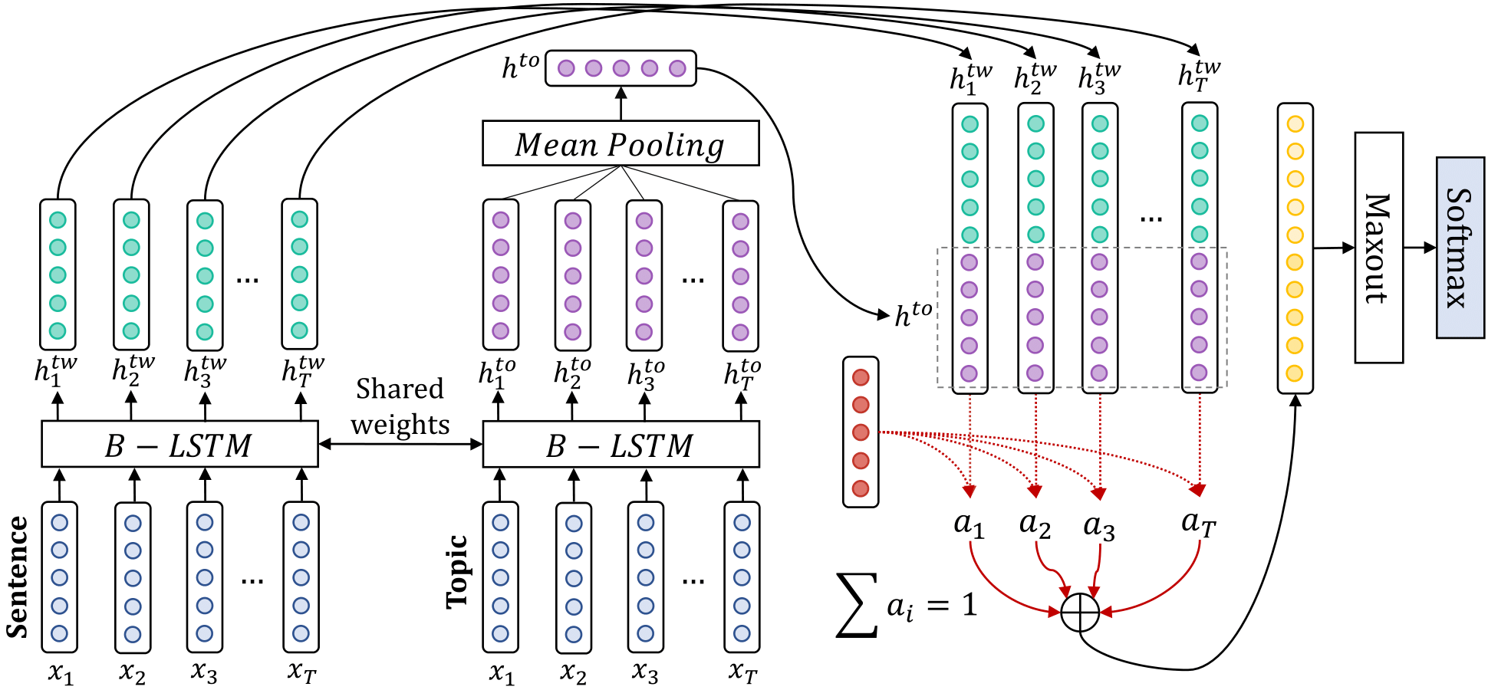
Possible Approach for ABSITA
A Siamese Bidirectional LSTM with context-aware attention.
Baziotis et al. DataStories at SemEval-2017 Task 4: Deep LSTM with Attention for Message-level and Topic-based Sentiment Analysis. www.aclweb.org/anthology/S17-2126
Code: https://github.com/cbaziotis/datastories-semeval2017-task4

Slide 7
Question Answering Tasks
Tensorflow 2.0 QA https://www.kaggle.com/c/tensorflow2-question-answering
SemEval 2017
Task 3
Evalita 2016
QA4FAQ
SQuAD
https://towardsdatascience.com/nlp-building-a-question-answering-model-ed0529a68c54
Movie QA
http://movieqa.cs.toronto.edu/home/
Natural Language Interfaces for Web of Data (NLIWoD4)
http://2018.nliwod.org/challenge

Slide 8
Chatbots
AWS Chatbot Challenge
https://aws.amazon.com/events/chatbot-challenge/
Ubuntu Dialog Corpus:
https://github.com/rkadlec/ubuntu-ranking-dataset-creator

Slide 9
Neural Machine Translation
English-Italian
Europarl Corpus
Ses2Seq TensorFlow Tutorial
References:
D. Bahdanau, K. Cho, Y. Bengio. Neural machine translation by jointly learning to align and translate. http://arxiv.org/pdf/1409.0473v6
Zhang, X., & LeCun, Y. (2015). Text Understanding from Scratch. http://arxiv.org/abs/1502.01710

Slide 10
Twitter
Modeling Political Bias
Use Italian Tweets collection
Detecting Toxic Comments
Use Italian Tweets collection and Evalita 2018 HaSpeeDe corpus
Fake News
Fake News Challenge Stage 1 (FNC-1) http://www.fakenewschallenge.org

Slide 11
Deep Learning for Sentiment Analysis
Annotated Data: SemEval training set
http://alt.qcri.org/semeval2017/task4/index.php?id=data-and-tools
Unannotated Data: 50 million tweets
CNN approach:
Code: DeepNL, https://github.com/attardi/deepnl
Article: A. Severyn, A. Moschitti.UNITN: Training Deep Convolutional Neural Network for Twitter Sentiment Classification
BiLSTM approach:
Baziotis et al. DataStories at SemEval-2017 Task 4: Deep LSTM with Attention for Message-level and Topic-based Sentiment Analysis. www.aclweb.org/anthology/S17-2126
Code: https://github.com/cbaziotis/datastories-semeval2017-task4

Slide 12
POS tagging using Word Embeddings
Data: Evalita 2016
Embeddings: http://tanl.di.unipi.it/embeddings/
Article: Stratos, M. Collins. Simple Semi-Supervised POS Tagging. http://www.cs.columbia.edu/~stratos/research/naacl15semipos.pdf

Slide 13
Medical texts
Predicting side effects of drugs
Using collection of Italian medical record on kidney and heart diseases
Negation/Speculative Scope Detection
BioScope Corpus: http://rgai.inf.u-szeged.hu/index.php?page=bioscope
Semantic QA on medical texts:
BioASQ datasets: bioasq.org/

Slide 14
Negation/Speculation Scope
Determine the scope of negative or speculative statements:
The lyso-platelet had no effect
MnlI-AluI could suppress the basal-level activity
Approach:
Classifier for identifying cues
Classifier to determine scope
Data
BioScope collection

Slide 15
Relation Extraction
Exploit word embeddings as features + extra hand-coded features
Use the Factor Based Compositional Embedding Model (FCM) http://www.cs.jhu.edu/~mrg/publications/finere-naacl-2015.pdf
SemEval 2014 Relation Extraction data

Slide 16
Entity Linking with Embeddings
Experiment with technique:
R. Blanco, G. Ottaviano, E. Meiji. 2014. Fast and Space-Efficient Entity Linking in Queries.
labs.yahoo.com/_c/uploads/WSDM-2015-blanco.pdf
Dataset: Neel-it (Evalita 2016)

Slide 17
Extraction of Semantic Hierarchies
Use word embeddings as measure of semantic distance
Use Wikipedia as source of text
http://ir.hit.edu.cn/~jguo/papers/acl2014-hypernym.pdf
Organism
Plant
Ranuncolacee
Aconitum

