Slide 1
Unsupervised & Generative DL
Davide Bacciu
Dipartimento di Informatica
Università di Pisa
Intelligent Systems for Pattern Recognition (ISPR)
Notes:
Generative Models Lecture FeiFei
https://documents.epfl.ch/users/f/fl/fleuret/www/dlc/

Slide 2
Lecture Outline
Introduction
Generative DL
Wrap-up
Outline
Introduction
DL Approach
Motivation
Why unsupervised?
Why generative?
The DL way to generative learning
Learning distributions with fully visible information (RNN)
Learning distributions with latent information (VAE)
Learning to sample (GAN)
Applications
Generating faces and bedrooms
Latent space arithmetic

Slide 3
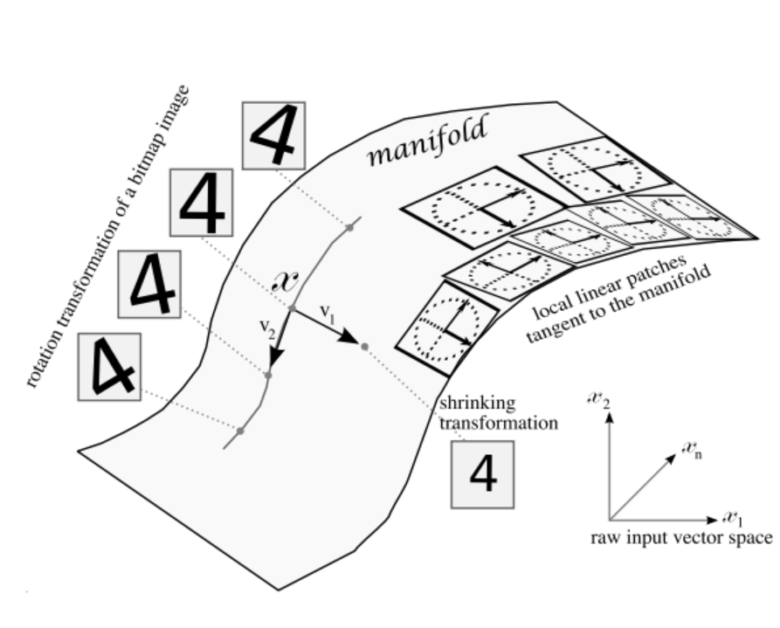
The Problem
Introduction
Generative DL
Wrap-up
Outline
Introduction
DL Approach
Characterize the data
Data distribution
Data variances
To allow
Understanding data
Generating new observations
..and ultimately reasoning
Autoencoders and Manifold Learning

Slide 4
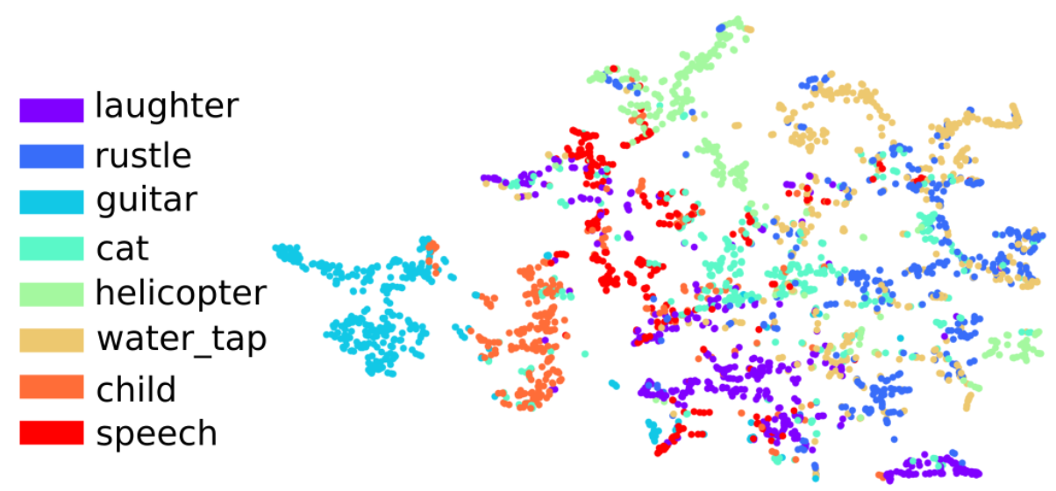
Why Unsupervised?
Introduction
Generative DL
Wrap-up
Outline
Introduction
DL Approach
Labelled data is costly and difficult to obtain
A sustainable future for deep learning
Learning the latent structure of data
Discover important features
Learn task independent representations
Introduce (if any) supervision only on few samples

Slide 5
Why Generative?
Introduction
Generative DL
Wrap-up
Outline
Introduction
DL Approach
Focusing too much on discrimination rather than on characterizing data can cause issues
Reduced interpretability
Adversarial examples
Generative models (try to) characterize data distribution
Understand the data $⟹$Understand the world
Understand data variances $⟹$Learn to steer them
Understand normality $⟹$Detect anomalies

Slide 6
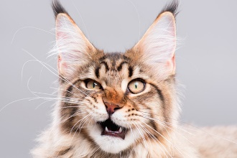
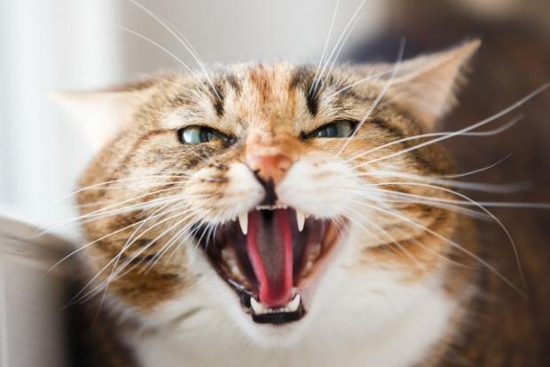
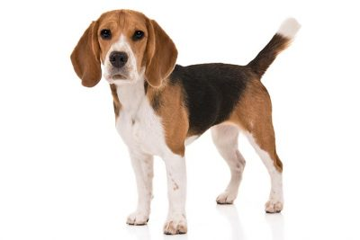
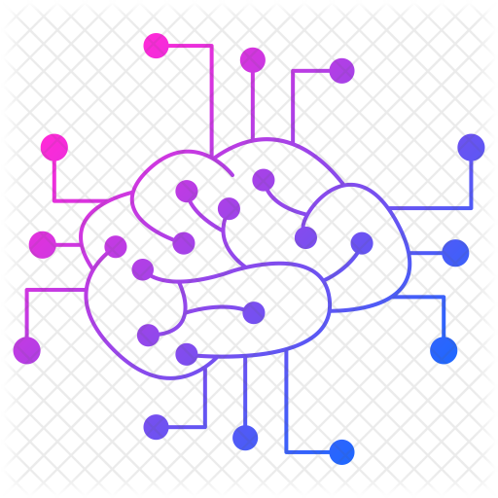
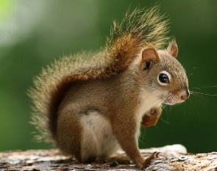
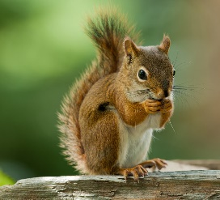
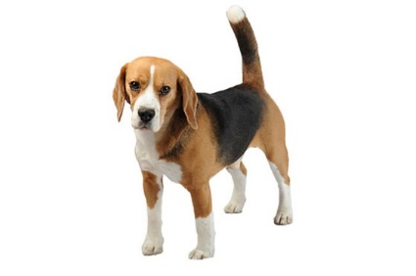
Approaching the Problem from a DL Perspective
Introduction
Generative DL
Wrap-up
Outline
Introduction
DL Approach
Given training data, learn a (deep) neural network that can generate new samples from (an approximation of) the data distribution
$$θ$$
Training data $\sim P(x)$
Generated data $\sim P_{θ}(x)$

Slide 7
Approaching the Problem from a DL Perspective
Introduction
Generative DL
Wrap-up
Outline
Introduction
DL Approach
Given training data, learn a (deep) neural network that can generate new samples from (an approximation of) the data distribution
Two approaches
Explicit $⟹$ Learn a model density $P_{θ}(x)$
Implicit $⟹$Learn a process that samples data from $P_{θ}(x)≈P(x)$

Slide 8
A Taxonomy
Introduction
Generative DL
Wrap-up
Outline
Introduction
DL Approach
Generative DL
Explicit
Implicit
Tractable densities
Intractable densities
Visible
Latent
Direct
Stochastic
Sampling RNN
Generative Adversarial Networks
Generative Stochastic Networks
Variational
Stochastic
Variational Autoencoder
Boltzmann Machines
Adapted from I. Goodfellow, Tutorial on Generative Adversarial Networks, 2017

Slide 9
Learning with Fully Visible Information
Introduction
Generative DL
Wrap-up
Fully Visible Information
Variational Autoencoder
Generative Adversarial Networks
If all information is fully visible the joint distribution can be computed from the chain rule factorization
$$P\left(x\right)=\prod_{i}^{N}{P(x_{i}|x_{1},…,x_{i−1}})$$
Bayesian Networks
Probability of a pixel having a certain intensity value, given the known intensity of its predecessor
Need to be able to define a sensible ordering for the chain rule
Conditional distribution difficult to compute
Notes:
Based on selective update of the state

Slide 10
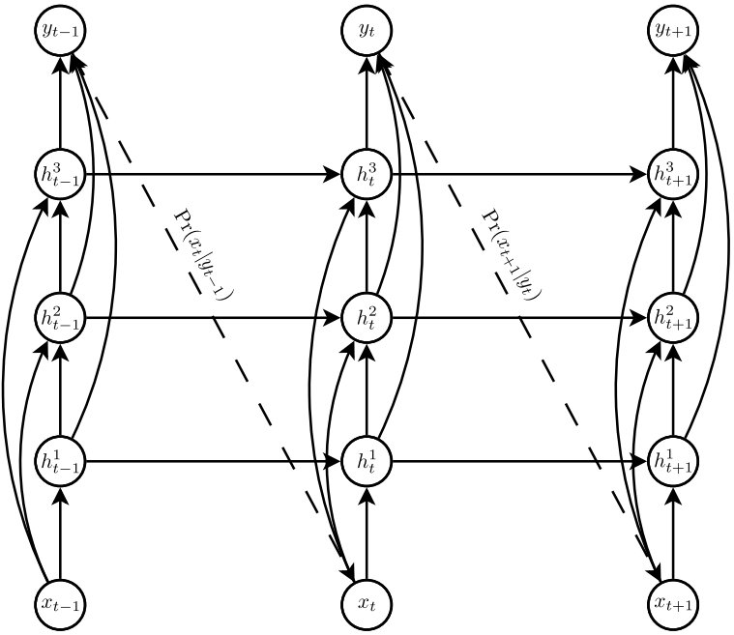
Approximating the Conditional Probability
Introduction
Generative DL
Wrap-up
Fully Visible Information
Variational Autoencoder
Generative Adversarial Networks
Using a deep learning approach that we have already encountered
Scan the image according to a schedule and encode the dependency from previous pixels in the states of an RNN
Notes:
Trained to predict intensity distribution – Softmax loss on each pixel (255 outputs x 3 channels)

Slide 11
Approximating the Conditional Probability
Introduction
Generative DL
Wrap-up
Fully Visible Information
Variational Autoencoder
Generative Adversarial Networks
Using a deep learning approach that we have already encountered
Scan the image according to a schedule and encode the dependency from previous pixels in the states of an RNN
Notes:
Based on selective update of the state

Slide 12
Approximating the Conditional Probability
Introduction
Generative DL
Wrap-up
Fully Visible Information
Variational Autoencoder
Generative Adversarial Networks
Using a deep learning approach that we have already encountered
Scan the image according to a schedule and encode the dependency from previous pixels in the states of an RNN
Notes:
Based on selective update of the state

Slide 13
Approximating the Conditional Probability
Introduction
Generative DL
Wrap-up
Fully Visible Information
Variational Autoencoder
Generative Adversarial Networks
Using a deep learning approach that we have already encountered
Scan the image according to a schedule and encode the dependency from previous pixels in the states of an RNN
Notes:
Based on selective update of the state

Slide 14
Approximating the Conditional Probability
Introduction
Generative DL
Wrap-up
Fully Visible Information
Variational Autoencoder
Generative Adversarial Networks
Using a deep learning approach that we have already encountered
Scan the image according to a schedule and encode the dependency from previous pixels in the states of an RNN
Notes:
Based on selective update of the state

Slide 15
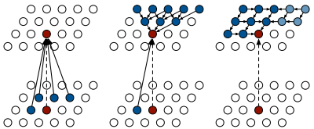
Generating Images Pixel by Pixel
Introduction
Generative DL
Wrap-up
Fully Visible Information
Variational Autoencoder
Generative Adversarial Networks
State
Input
PixelCNN
Row LSTM
Diagonal BiLSTM
A. van der Oord et al., Pixel Recurrent Neural Networks, 2016
Notes:
Pros: - Can explicitly compute likelihood p(x) - Explicit likelihood of training data gives good evaluation metric - Good samples
Con: - Sequential generation => slow

Slide 16
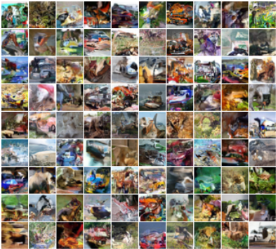
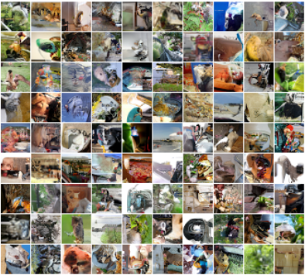
Generating Images Pixel by Pixel - Results
Introduction
Generative DL
Wrap-up
Fully Visible Information
Variational Autoencoder
Generative Adversarial Networks
32x32 CIFAR-10
32x32 ImageNet
A. van der Oord et al., Pixel Recurrent Neural Networks, 2016
Notes:
Se sembra piccolo è perchè è piccola l’imagine. Can keep only local visual coherency. Only small images

Slide 17
From Visible to Latent Information
Introduction
Generative DL
Wrap-up
Fully Visible Information
Variational Autoencoder
Generative Adversarial Networks
With only visible information, we try to learn the $θ$ parameterized model distribution
$$P_{θ}\left(x\right)=\prod_{i}^{N}{P_{θ}(x_{i}|x_{1},…,x_{i−1}})$$
Now we introduce a latent process regulated by unobservable variables $z$
$$P_{θ}\left(x\right)= \int{P_{θ}\left(x | z\right)P_{θ}\left(z\right)dz}$$
Typically intractable for non trivial models (cannot be computed for all $z$ assignments)
Notes:
Based on selective update of the state

Slide 18
A Neural Network with Latent Variables?
Introduction
Generative DL
Wrap-up
Fully Visible Information
Variational Autoencoder
Generative Adversarial Networks
We have already introduced a probabilistic twist on AE
$$\tilde{x}$$
Decoder
$$z$$
Encoder
$$x$$
$$z$$
$$P_{e}(z|x)$$
$$P_{d}(\tilde{x}|z)$$
Autoencoder (AE) neural networks
$$x$$
$$\tilde{x}$$
Notes:
Based on selective update of the state

Slide 19
A Deeper Probabilistic Push
Introduction
Generative DL
Wrap-up
Fully Visible Information
Variational Autoencoder
Generative Adversarial Networks
As an additional push in the probabilistic interpretation, we assume to be able to generate the reconstruction from a sampled latent representation
Sample from the true conditional $P(\tilde{x}|z)$
$$\tilde{x}$$
$$z$$
Sample latent variables from the true prior $P(z)$
Of course we don’t have access to the true distributions, so how do we approximate them?
Notes:
Based on selective update of the state

Slide 20
Variational Autoencoders (VAE) – The Catch
Introduction
Generative DL
Wrap-up
Fully Visible Information
Variational Autoencoder
Generative Adversarial Networks
Represent the $P(\tilde{x}|z)$ distribution through a neural network g
(remember the denoising autoencoder)
$$\tilde{x}$$
Decoder g
$$z$$
Sample $z$ from a simple distribution such as a Gaussian
At training time sample z conditioned on data x and train the decoder g to reconstruct x itself from z
$$z\sim 𝒩(μ\left(x\right),σ(x))$$
Notes:
Based on selective update of the state

Slide 21
VAE Training – Is it all this easy?
Introduction
Generative DL
Wrap-up
Fully Visible Information
Variational Autoencoder
Generative Adversarial Networks
Unfortunately for you: no!
Ideally, one would like to train maximizing
$$L\left(D\right)=\prod_{i=1}^{N}{P\left(x_{i}\right)}=\prod_{i=1}^{N}{\int{P\left(x_{i} | z\right)P\left(z\right)dz}}$$
Intractable
Non differentiable
Variational approximation
Reparameterization
Notes:
Based on selective update of the state

Slide 22
Reparameterization Trick
Introduction
Generative DL
Wrap-up
Fully Visible Information
Variational Autoencoder
Generative Adversarial Networks
$$\tilde{x}$$
$$\tilde{x}$$
$$z$$
$$z$$
Non-differentiable operation
Sample
$$z\sim 𝒩(μ\left(x\right),σ(x))$$
Sample
$$ε\sim 𝒩(0,1)$$
$$μ\left(x\right)$$
$$σ(x)$$
$$μ\left(x\right)$$
$$σ(x)$$
Sampling is limited to non differentiated variable $ε⟹$ Can backpropagate
Notes:
Based on selective update of the state

Slide 23
Variational Approximation
Introduction
Generative DL
Wrap-up
Fully Visible Information
Variational Autoencoder
Generative Adversarial Networks
The revenge of the ELBO (Evidence Lower BOund)
$$\log{P\left(x|θ\right)}≥ 𝔼_{Q}\left[\log{P(x,z)}\right]−𝔼_{Q}\left[\log{Q\left(z\right)}\right]=ℒ(x,θ,φ)$$
Maximizing the ELBO allows approximating from below the intractable log-likelihood $\log{P\left(x\right)}$
$$ℒ\left(x,θ,φ\right)=𝔼_{Q}\left[\log{P(x|z)}\right]{+ 𝔼}_{Q}\left[\log{P(z)}\right]−𝔼_{Q}\left[\log{Q\left(z\right)}\right]$$
$$KL\left(Q\left(z|φ\right)||P(z|θ)\right)$$
Decoder estimate of the conditional, made possible and differentiable through the reparameterization trick
Need a Q(z) function to approximate P(z)
Notes:
Based on selective update of the state

Slide 24
Variational Autoencoder – The Full Picture
Introduction
Generative DL
Wrap-up
Fully Visible Information
Variational Autoencoder
Generative Adversarial Networks
$$\tilde{x}$$
Decoder network $P(\tilde{x}|z,θ)$ with parameters $θ$
Encoder network $Q\left(z|x,φ\right)$ with parameters $φ$
Decoder g
$$z$$
$$+$$
$$×$$
Encoder Q
Sample
$$ε\sim 𝒩(0,1)$$
$$μ\left(x\right)$$
$$σ(x)$$
$$x$$
Training time architecture
Notes:
Based on selective update of the state

Slide 25
VAE Training
Introduction
Generative DL
Wrap-up
Fully Visible Information
Variational Autoencoder
Generative Adversarial Networks
Training is performed by backpropagation on $θ,φ$ to optimize the ELBO
reconstruction
$$ℒ\left(x,θ,φ\right)=𝔼_{Q}\left[\log{P(x|z=μ\left(x\right)+σ^{1/2}\left(x\right)∗ε, θ)}\right]$$
- $KL\left(Q\left(z|x,φ\right)||P(z|θ)\right)$
regularization
Can be computed in closed form when both Q(z) and P(z) are Gaussians
Train the encoder to behave like a Gaussian prior with zero-mean and unit-variance
$$KL\left(𝒩(μ(x),σ(x)) ||𝒩(0,1) \right)$$
Notes:
Based on selective update of the state

Slide 26
Sampling the VAE (a.k.a. testing)
Introduction
Generative DL
Wrap-up
Fully Visible Information
Variational Autoencoder
Generative Adversarial Networks
$$\tilde{x}$$
Sample $\tilde{x} \sim 𝒩(μ\left(z\right),σ(z))$
$$μ\left(z\right)$$
$$σ(z)$$
Decoder g
At test time detach the encoder, sample a random encoding and generate the sample as the corresponding reconstruction
Sample
$$z\sim 𝒩(0,1)$$
Notes:
Based on selective update of the state

Slide 27
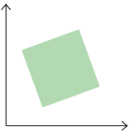
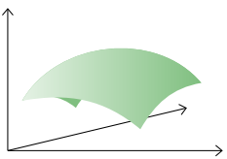
VAE vs Denoising/Contractive AE
Introduction
Generative DL
Wrap-up
Fully Visible Information
Variational Autoencoder
Generative Adversarial Networks
Contractive AE
x noisy samples
x original sample
x
x
x
x
x
x
x
Variational AE
x
x
Notes:
Based on selective update of the state

Slide 28
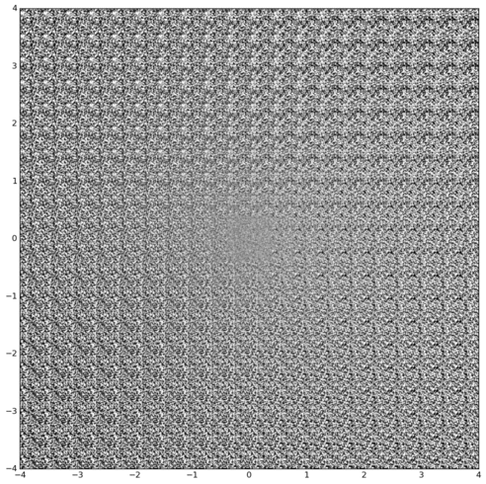
VAE Examples - Digits
Introduction
Generative DL
Wrap-up
Fully Visible Information
Variational Autoencoder
Generative Adversarial Networks
Organization of data in the latent space
Reconstruction of points sampled from latent space
Image credits @ fastfowardlabs.com
Notes:
http://blog.fastforwardlabs.com/2016/08/12/introducing-variational-autoencoders-in-prose-and.html
we are sampling evenly-spaced percentiles along the latent manifold and plotting their corresponding output from the decoder, with the same axis labels as above.

Slide 29
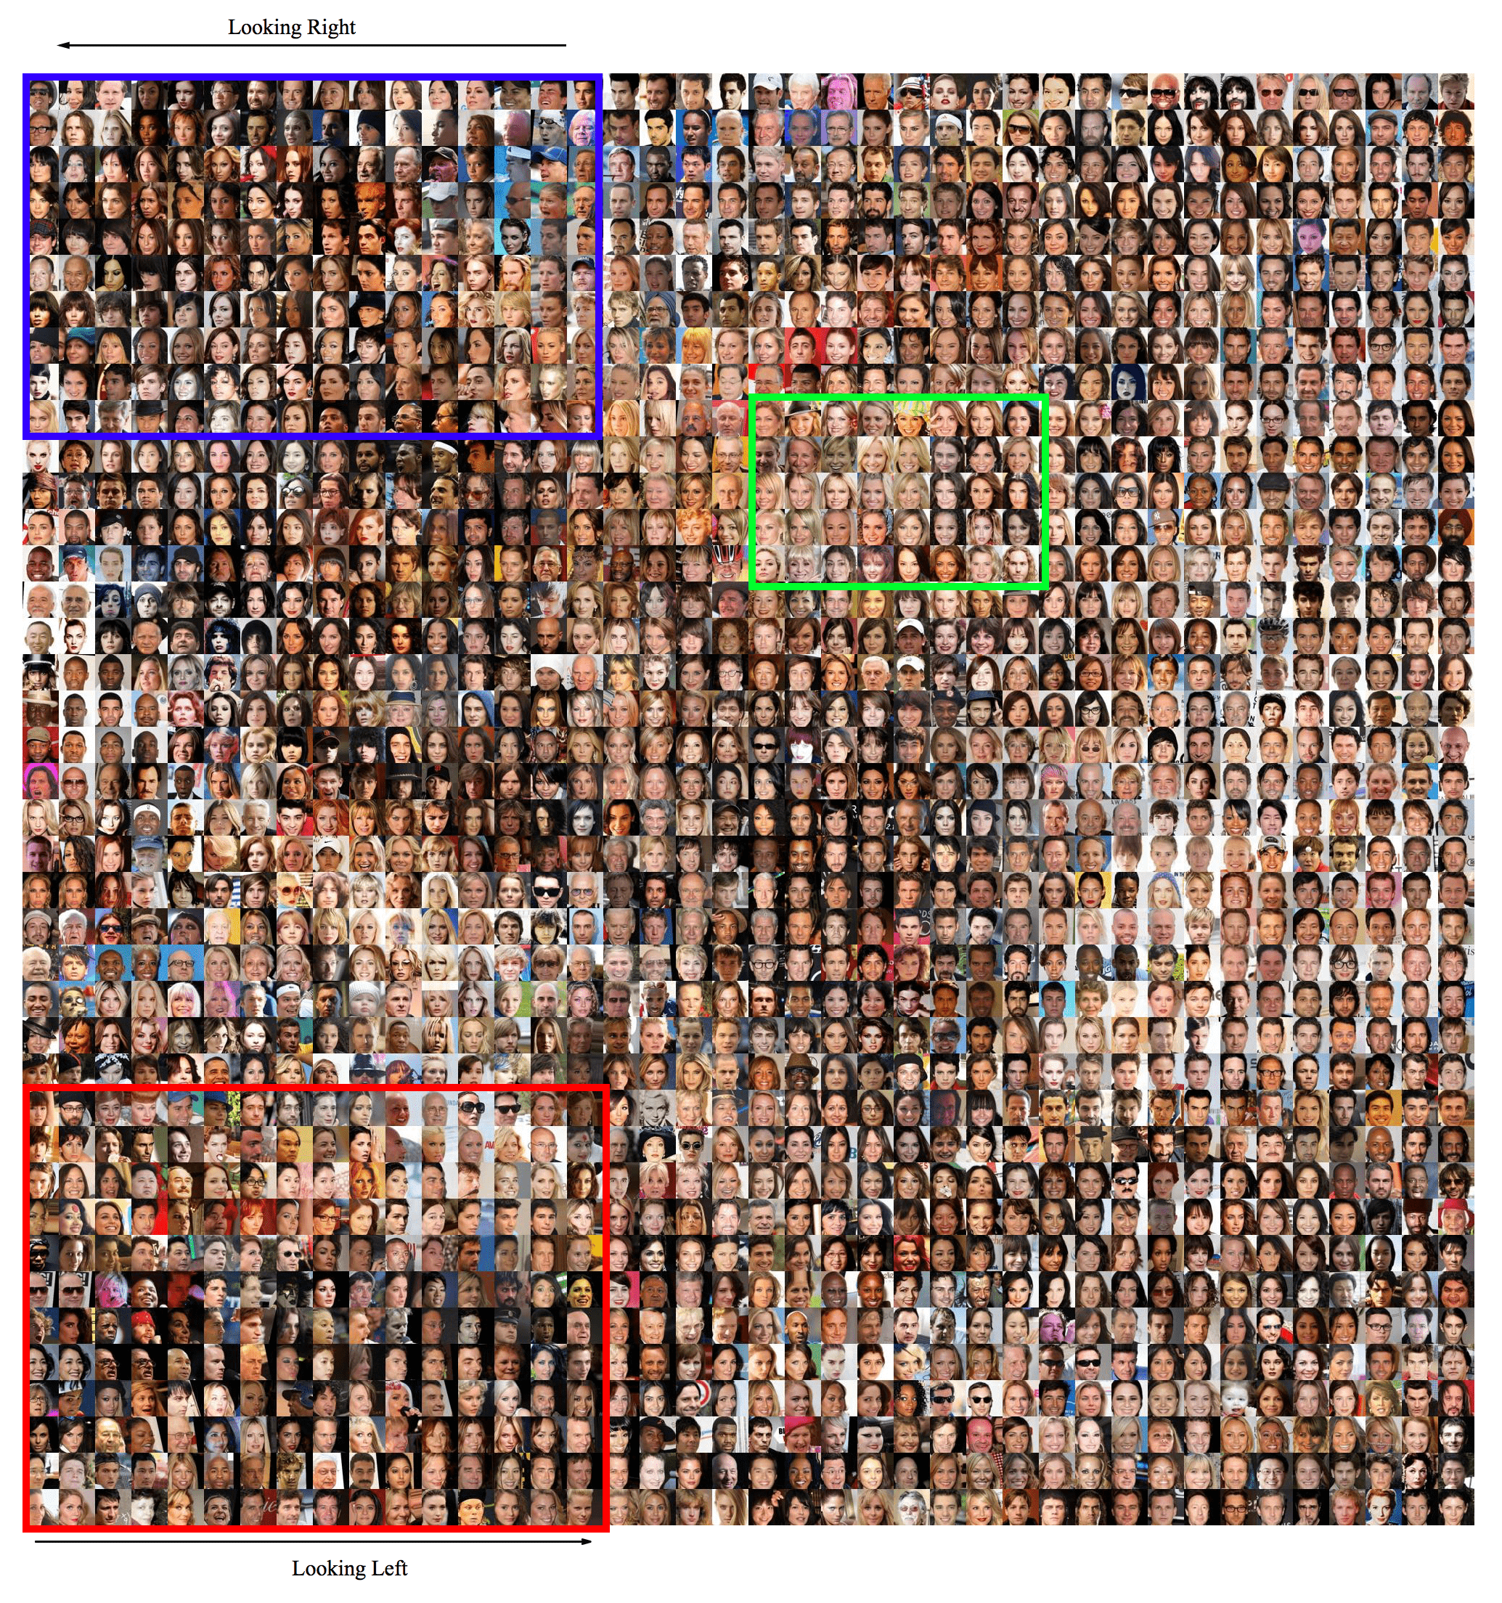
VAE Examples - Faces
Introduction
Generative DL
Wrap-up
Fully Visible Information
Variational Autoencoder
Generative Adversarial Networks
Latent space interpolation
Hou et al, Deep Feature Consistent Variational Autoencoder, 2017

Slide 30
Distribution Learning Vs Learning to Sample
Introduction
Generative DL
Wrap-up
Fully Visible Information
Variational Autoencoder
Generative Adversarial Networks
Variational AEs learn to approximate an intractable distribution
$$P_{θ}\left(x\right)= \int{P_{θ}\left(x | z\right)P_{θ}\left(z\right)dz}$$
then sample it to generate the output
What if we learn to generate samples rather than learning the distribution?
Generative Adversarial Networks (GAN)
Game theoretic approach
Notes:
Based on selective update of the state

Slide 31
The GAN Catch
Introduction
Generative DL
Wrap-up
Fully Visible Information
Variational Autoencoder
Generative Adversarial Networks
We need to learn to sample from a complex, high-dimensional training distribution
No straightforward way to do this
The catch
Sample from a simple distribution: random noise
Train a differentiable function (neural network) to transform random noise to the training distribution
Notes:
Based on selective update of the state

Slide 32
Generative Adversarial Networks
Introduction
Generative DL
Wrap-up
Fully Visible Information
Variational Autoencoder
Generative Adversarial Networks
Again, a two-steps architecture
Original or Fake
Try to tell original samples from fake
Discriminator Network
Fake images
Original images
$$G(z)$$
$$x$$
z size $≥$ x size to allow the G distribution full support on x
Generator Network
Dataset
$$z$$
Random Noise
Try to generate real looking samples that can fool discriminator
Notes:
Based on selective update of the state

Slide 33
GAN Training - A Game for 2 Players
Introduction
Generative DL
Wrap-up
Fully Visible Information
Variational Autoencoder
Generative Adversarial Networks
$$C=\min_{θ_{G}}{\max_{θ_{D}}\left[𝔼_{x}\left[\log{D_{θ_{D}}\left(x\right)}\right]−𝔼_{z}\left[\log{({1−D}_{θ_{D}}\left(G_{θ_{G}}(z)\right)})\right]\right]}$$
Discriminator output for real data x
Discriminator output for fake data G(z)
Discriminator output is likelihood of input being real
Discriminator tries to maximize $C$ s.t.
$D_{θ_{D}}\left(x\right)→1$ and $D_{θ_{D}}\left(G_{θ_{G}}(z)\right)→0$
Generator tries to minimize $C$ s.t.
$D_{θ_{D}}\left(G_{θ_{G}}(z)\right)→1$
Notes:
Based on selective update of the state

Slide 34
Alternate Optimization
Introduction
Generative DL
Wrap-up
Fully Visible Information
Variational Autoencoder
Generative Adversarial Networks
$$C=\min_{θ_{G}}{\max_{θ_{D}}\left[𝔼_{x}\left[\log{D_{θ_{D}}\left(x\right)}\right]−𝔼_{z}\left[\log{({1−D}_{θ_{D}}\left(G_{θ_{G}}(z)\right)})\right]\right]}$$
Discriminator gradient ascent
Generator gradient descent
$$C_{D}=\max_{θ_{D}}\left[𝔼_{x}\left[\log{D_{θ_{D}}\left(x\right)}\right]−𝔼_{z}\left[\log{({1−D}_{θ_{D}}\left(G_{θ_{G}}(z)\right)})\right]\right]$$
$$C_{G}=\min_{θ_{G}}\left[𝔼_{z}\left[\log{({1−D}_{θ_{D}}\left(G_{θ_{G}}(z)\right)})\right]\right]$$
Optimizing this doesn’t really work
Notes:
Based on selective update of the state

Slide 35
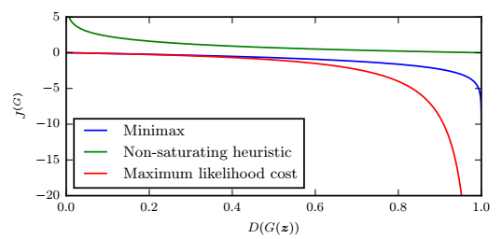
The Issue and a Solution
Introduction
Generative DL
Wrap-up
Fully Visible Information
Variational Autoencoder
Generative Adversarial Networks
The cost that the Generator receives in response to generate G(z) depends only on the Discriminator response
Flat gradient when sample is plainly fake
$$C_{G}=\max_{θ_{G}}\left[𝔼_{z}\left[\log{(D_{θ_{D}}\left(G_{θ_{G}}(z)\right)})\right]\right]$$
maximize likelihood of discriminator being wrong
Notes:
Based on selective update of the state

Slide 36
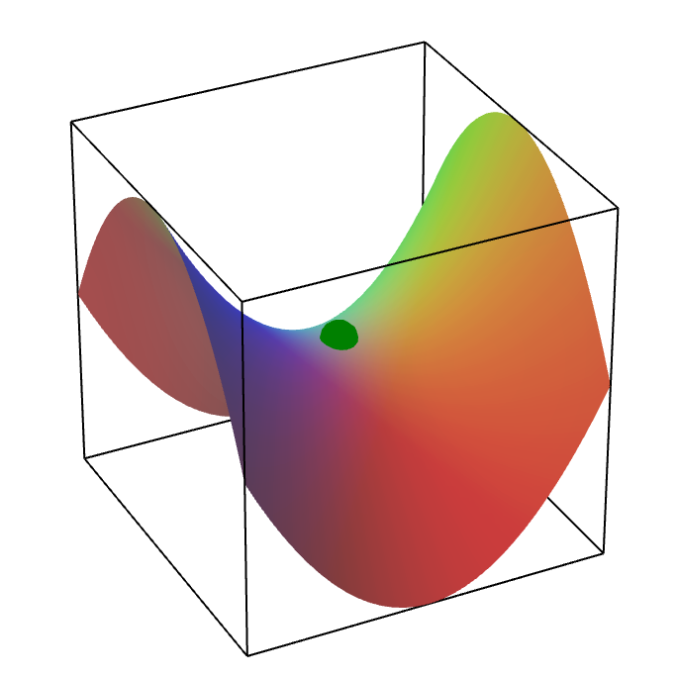
A Hard Two-Player Game
Introduction
Generative DL
Wrap-up
Fully Visible Information
Variational Autoencoder
Generative Adversarial Networks
The optimal solution of the min-max problem is a saddle point
Little stability
Lot of heuristic work
Open problem
Notes:
The infamous “mode collapse”, whenGmodels very well a smallsub-population, concentrating on a few modes.

Slide 37
GAN Training Pseudo-Algorithm
Introduction
Generative DL
Wrap-up
Fully Visible Information
Variational Autoencoder
Generative Adversarial Networks
Stability trick but difficult to choose k
Expectation
Notes:
Based on selective update of the state

Slide 38
The DCGAN Architecture
Introduction
Generative DL
Wrap-up
Fully Visible Information
Variational Autoencoder
Generative Adversarial Networks
Generator for image sampling
Random vector
Upconvolution + batch normalization
Fake image
Radford et al, “Unsupervised Representation Learning with Deep Convolutional Generative Adversarial Networks”, ICLR 2016
Notes:
No pooling no batch norm on last layer.

Slide 39
GAN and Images
Introduction
Generative DL
Wrap-up
Fully Visible Information
Variational Autoencoder
Generative Adversarial Networks
Radford et al, “Unsupervised Representation Learning with Deep Convolutional Generative Adversarial Networks”, ICLR 2016
Notes:
Based on selective update of the state

Slide 40
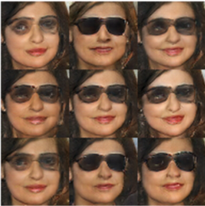
Latent Space Arithmetic
Introduction
Generative DL
Wrap-up
Fully Visible Information
Variational Autoencoder
Generative Adversarial Networks
Can do sensible linear operations on noise vectors (arithmetic, interpolation)
$$z_{G}=z_{1}−z_{2}+z_{3}$$
$$z_{1}$$
$$z_{2}$$
$$z_{G}$$
$$z_{3}$$
Radford et al, “Unsupervised Representation Learning with Deep Convolutional Generative Adversarial Networks”, ICLR 2016
Notes:
Uniform noise sampled in +- 0.25 to generate more images around z_g

Slide 41
Conditional Generation
Introduction
Generative DL
Wrap-up
Fully Visible Information
Variational Autoencoder
Generative Adversarial Networks
Learn a mapping from an observed side information x and a random noise vector z to the fooling samples y
$$G:\left\{x,z\right\}→y$$
Antipov et al, “Face Aging With Conditional Generative Adversarial Networks”, ICIP 2017
Notes:
Based on selective update of the state

Slide 42
Conditional Generation – Image2Image
Introduction
Generative DL
Wrap-up
Fully Visible Information
Variational Autoencoder
Generative Adversarial Networks
Isola et al, “Image-to-Image Translation with Conditional Adversarial Networks”, 2016
Notes:
Based on selective update of the state

Slide 43
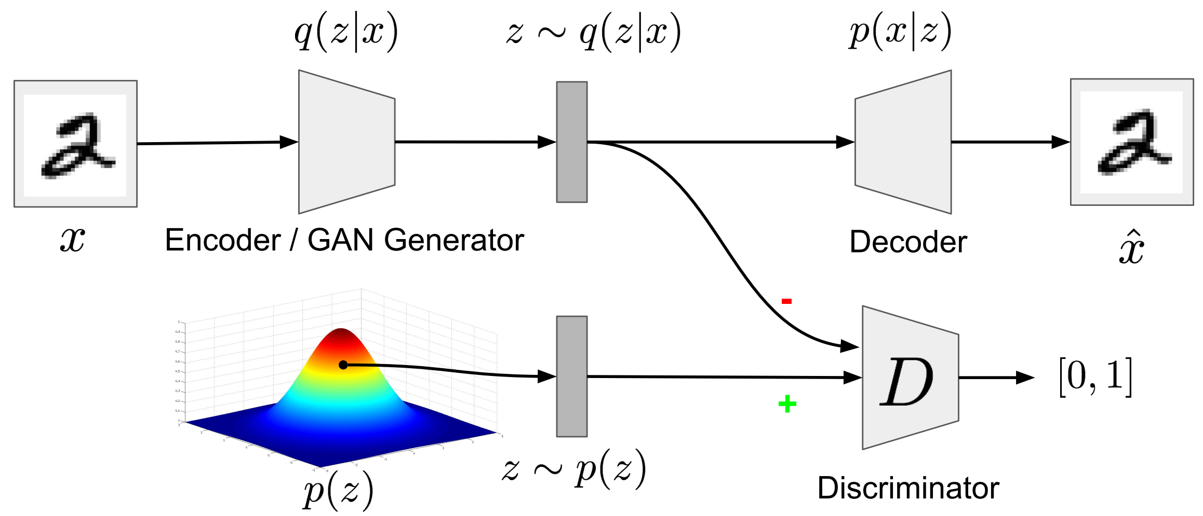
Best of 2 worlds?
Introduction
Generative DL
Wrap-up
Fully Visible Information
Variational Autoencoder
Generative Adversarial Networks
Adversarial autoencoders (AAE)
Force the latent codes to be indistinguishable from samples of a priori distribution

Slide 44
Training AAE
Introduction
Generative DL
Wrap-up
Fully Visible Information
Variational Autoencoder
Generative Adversarial Networks
$ℒ\left(x\right)=𝔼_{Q}\left[\log{P(x|z)}\right]$- $KL\left(Q\left(z|x\right)||P(z)\right)$
Replaced by an adversarial loss
Reconstruction phase - Update the encoder and decoder to minimize reconstruction error
Regularization phase - Update discriminator to distinguish true prior samples from generated samples; update generator to fool the discriminator
Adversarial regularization allows to impose priors for which we cannot compute the KL divergence

Slide 45
Wasserstein Distance Models
Introduction
Generative DL
Wrap-up
Fully Visible Information
Variational Autoencoder
Generative Adversarial Networks
Attempts to solve the hardness of training adversarial generators by optimizing the Wasserstein distance (EMD) between the generator and empirical distribution filtered trough the discriminator function D
$$G^{∗}=\underset{G}{argmin}{W(μ,μ_{G}) }$$
$$=\underset{G}{argmin}\max_{{\left\|D\right\|}_{L}≤1}\left[𝔼_{x\sim μ}\left[D(x)\right]−𝔼_{x\sim μ_{G}}\left[D(x)\right]\right]$$
$${\left\|D\right\|}_{L}≤1$$
Requires optimizing D under a constraint on Lipschitz seminorm
Clipping D weights (slow to converge)

Slide 46
Software
Introduction
Generative DL
Wrap-up
Software
Conclusions
A TF implementation of PixelCNN
A list of acknowledged VAE implementations is kept by Kingma here
Plenty of DCGAN implementations
Torch
Tensorflow
Conditional GAN for image-to-image
Pytorch code
Demo
So many GANs: check out the GAN-Zoo

Slide 47
Take Home Messages
Introduction
Deep Gated RNN
Wrap-up
Software
Conclusions
PixelRNN/ PixelCNN – Learn explicit distributions by optimizing exact likelihood
Yields good samples
Inefficient sequential generation
VAE – Learn complex distributions over latent variables through a variational approximation using neural networks
Learns a latent representation useful for inference
Can lead to poor generated sample quality
GAN – Learn to sample rather than learn the distribution
State of the art generated sample quality
Unstable/difficult to train
Cannot perform inference (no distribution learning)
Needs differentiable generator

