Slide 1
Human Language Technologies
Università di Pisa
Giuseppe Attardi
Dipartimento di Informatica
Università di Pisa

Slide 2
Instructor
Giuseppe Attardi
Office: 292
mail: attardi@di.unipi.it
web: www.di.unipi.it/~attardi

Slide 3
Course Info
Course Page:
https://elearning.di.unipi.it/course/view.php?id=112
Hours:
Monday 11-13, Room L1
Tuesday 9-11, Room L1
Friday 14-16, Room L1

Slide 4
Exam
Project

Slide 5
Motivation
Language is the most distinctive feature of human intelligence
Language shapes thought
Emulating language capabilities is a scientific challenge
Keystone for intelligent systems

Slide 6
Structured vs Unstructured Data
85% of business-relevant information originates in unstructured form, primarily text, according to Anant Jhingran of IBM Research.
Information is mostly communicated by reading or writing e-mails, reports, or articles and the like, in conversations, or by listening/watching media
Attempts to turn text into structured (HTML) or microformat only scratch the surface
Problems:
Requires universal agreed ontologies
Additional effort
Entity linking attempts to provide a bridge

Slide 7
NLP
Computers would be a lot more useful if they could handle our email, do our library research, chat to us …
But they are fazed by natural languages
Or at least their programmers are … most people just avoid the problem and get into XML, or menus and drop boxes, or …
Big challenge
How can we teach language to computers?
Or help them learn it as kids do?

Slide 8
Human Language Technology State of the art

Slide 9
Early history of NLP: 1950s
Early NLP (Machine Translation) on machines less powerful than pocket calculators
Foundational work on automata, formal languages, probabilities, and information theory
First speech systems (Davis et al., Bell Labs)
MT heavily funded by military – a lot of it was just word substitution programs but there were a few seeds of later successes, e.g., trigrams
Little understanding of natural language syntax, semantics, pragmatics
Problem soon appeared intractable

Slide 10
Why now?
Hans Moravec in 1978 was saying that it was impossible to achieve AI because of insufficient computing power
10⁹ increase required
expected to be available by 40 years

Slide 11
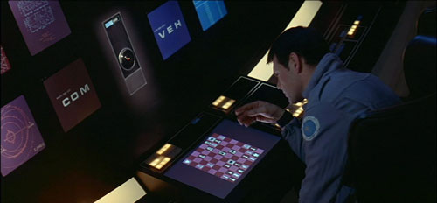
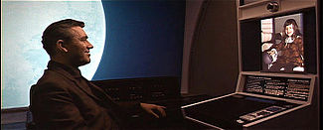
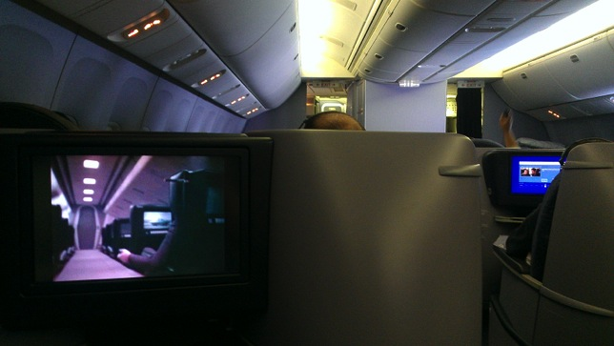
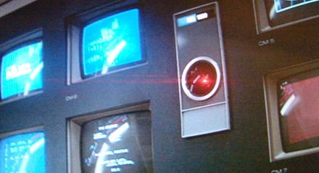
2001 a space Odyssey: 40 years later
Technology surpassed the vision
Internet
The Web
Smartphones
Genomics
Unmanned space exploration
Home computing
Big data
Computer chess
Audio-video communication
On board entertainment
Computer graphics
Except for
Tablet devices
Computer Speech
…and bad airline food
Computer Vision
Computer cognition

Slide 12
Speech technology in 2001: the vision

Slide 13
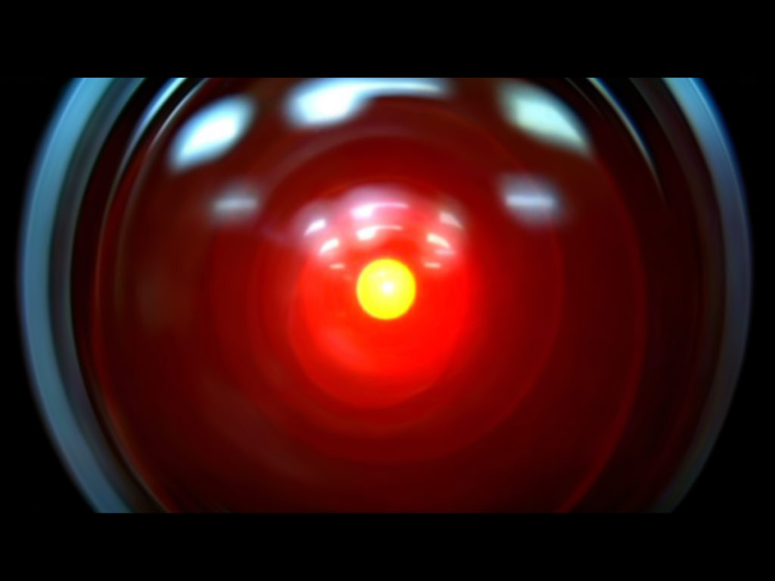
Speech technology in 2001: the reality
Design: Jonathan Bloom
Realization: Peter Krogh

Slide 14
Speech Assistants: today

Slide 15
Machine Translation, circa 2001
Lo spirito è forte ma la carne è debole
tradotto in russo
La vodka è forte ma la bistecca è tenera
apocrifo

Slide 16
Machine Translation Progress
Gli chiese di riorganizzare Forza Italia
The churches to reorganize Italy Force (Altavista)
She asked him to reorganize Forza Italia (Google)
Il ministro Stanca si è laureato alla Bocconi
The Minister Stanca graduated at Mouthfuls (Altavista)
The Minister Stanca is a graduate of Bocconi (Google)

Slide 17
How to learn natural language
Children learn to speak naturally, by interacting with others
Nobody teaches them grammar
Is it possible to let computer learn language in a similarly natural way?

Slide 18
Thirty Million Words
The number of words a child hears in early life will determine their academic success and IQ in later life.
Researchers Betty Hart and Todd Risley (1995) found that children from professional families heard thirty million more words in their first 3 years
http://www.youtube.com/watch?v=qLoEUEDqagQ

Slide 19
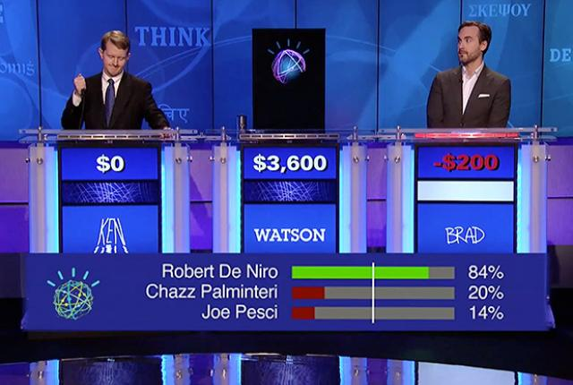
Recent Breakthroughs
Speech to text
Apple Siri, Google Now
Machine Translation
Google translate
Question Answering
IBM Watson
Beated the human champions at the TV quiz Jeopardy!

Slide 20
Quiz Bowl Competition
Iyyer et al. 2014: A Neural Network for Factoid Question Answering over Paragraphs
QUESTION:
He left unfinished a novel whose title character forges his father’s signature to get out of school and avoids the draft by feigning desire to join.
One of his novels features the jesuit Naptha and his opponent Settembrini, while his most famous work depicts the aging writer Gustav von Aschenbach.
Name this German author of The Magic Mountain and Death in Venice.
ANSWER: Thomas Mann

Slide 21
QANTA vs Ken Jennings
QUESTION:
Along with Evangelista Torricelli, this man is the namesake of a point the minimizes the distances to the vertices of a triangle.
He developed a factorization method …
ANSWER: Fermat
QUESTION:
A movie by this director contains several scenes set in the Yoshiwara Nightclub.
In a movie by this director a man is recognized by a blind beggar because he is wistling In the hall of the mountain king.
ANSWER: Fritz Lang

Slide 22
NL: Science Fiction
Star Trek
universal translator: Babel Fish
Language Interaction

Slide 23
Quiz Bowl Competition
Iyyer et al. 2014: A Neural Network for Factoid Question Answering over Paragraphs
QUESTION:
He left unfinished a novel whose title character forges his father’s signature to get out of school and avoids the draft by feigning desire to join.
One of his novels features the Jesuit Naptha and his opponent Settembrini, while his most famous work depicts the aging writer Gustav von Aschenbach.
Name this German author of The Magic Mountain and Death in Venice.
ANSWER: Thomas Mann

Slide 24
QANTA vs Ken Jennings
QUESTION:
Along with Evangelista Torricelli, this man is the namesake of a point the minimizes the distances to the vertices of a triangle.
He developed a factorization method …
ANSWER: Fermat
QUESTION:
A movie by this director contains several scenes set in the Yoshiwara Nightclub.
In a movie by this director a man is recognized by a blind beggar because he is wistlin In the hall of the mountain king.
ANSWER: Fritz Lang

Slide 25
Recent Breakthroughs
Watson at Jeopardy! Quiz:
http://www.aaai.org/Magazine/Watson/watson.php
Final Game
PBS report
Google Translate on iPhone
http://googleblog.blogspot.com/2011/02/introducing-google-translate-app-for.html
Apple SIRI

Slide 26
Smartest Machine on Earth
IBM Watson beats human champions at TV quiz Jeopardy!
State of the art Question Answering system

Slide 27
What is still missing?
AI winter is over because we now have processing power and data
10⁹ MIPS or 100 million activations/sec
Techniques have become successful
Software is available
Lack of talent
Lack of annotated data
Lack of widespread computational resources

Slide 28
Technological Breakthrough
Machine learning
Huge amount of data
Large processing capabilities

Slide 29
Statistical Machine Learning
Supervised Training
Annotated document collections
Ability to process Big Data
If we used same algorithms 10 years ago they would still be running
Similar techniques for speech and text

Slide 30
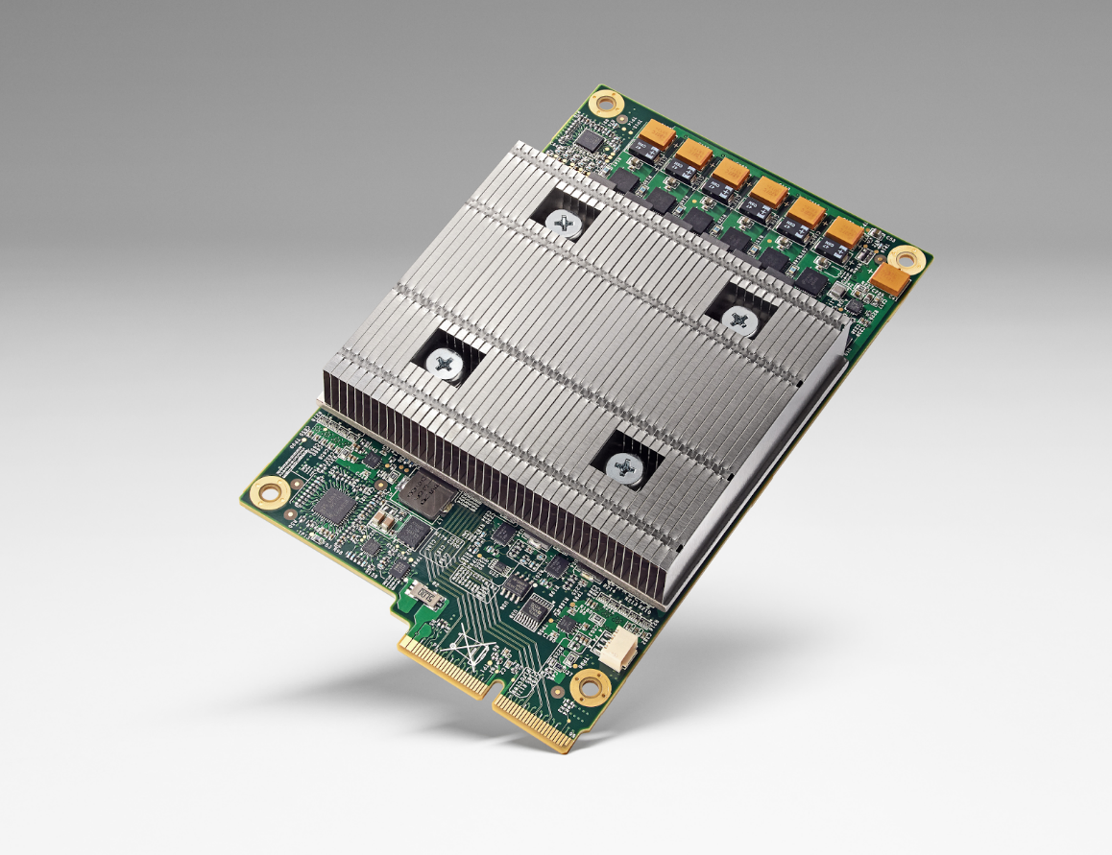
Big Data & Deep Learning
Requires high speed computing
Typical using GPUs
Eg. NVIDIA TESLA
Google custom chip TPU
10x more power per watt
Half precision floats

Slide 31
AlphaGo
Exploiting Deep Learning and Reinforcement Learning, running on TPU equipped machines, the program AlphaGo by DeepMind has beaten the world champion at the game of Go, on March 9, 2016.
The story has been told in a movie.

Slide 32
Digression

Slide 33
Big Data Science & Artificial Intelligence
Both use Big Data
Different kind and different use
Statistical Analysis of Big Data use raw data and extract correlations or statistical indicators
AI needs data annotated by humans, from which to learn behaviors to perform similar tasks in other situations
Human in the loop in data used for ML in AI:
data produced by humans and annotated by humans, enter the learning cycle of human behaviors

Slide 34
Difference between Data Science, ML and AI
Data science produces insights
Machine learning produces predictions
Artificial Intelligence produces behaviours
See David Robinson’s post

Slide 35
Human in the Loop
Data Science exploits human in the end, whose intelligence is involved for sifting among statistical correlation hints to produce insights. Intelligence lays in the humans that interpret the output of statistical analysis.
ML provides generalizations that can be used to make predictions
AI uses ML with human in the loop to extract a model of a human intelligence ability. AI embeds the human intelligence in the system itself.

Slide 36
Role of Data

Slide 37
Unreasonable Effectiveness of Data
Halevy, Norvig, and Pereira argue that we should stop acting as if our goal is to author extremely elegant theories, and instead embrace complexity and make use of the best ally we have: the unreasonable effectiveness of data.
A simpler technique on more data beat a more sophisticated technique on less data.
Language in the wild, just like human behavior in general, is messy.

Slide 38
Scientific Dispute: is it science?
Prof. Noam Chomsky, Linguist, MIT
Peter Norvig, Director of research, Google

Slide 39
Chomsky
It's true there's been a lot of work on trying to apply statistical models to various linguistic problems. I think there have been some successes, but a lot of failures. There is a notion of success ... which I think is novel in the history of science. It interprets success as approximating unanalyzed data.
http://norvig.com/chomsky.html

Slide 40
Norvig
I agree that engineering success is not the goal or the measure of science. But I observe that science and engineering develop together, and that engineering success shows that something is working right, and so is evidence (but not proof) of a scientifically successful model.
Science is a combination of gathering facts and making theories; neither can progress on its own. I think Chomsky is wrong to push the needle so far towards theory over facts; in the history of science, the laborious accumulation of facts is the dominant mode, not a novelty. The science of understanding language is no different than other sciences in this respect.
I agree that it can be difficult to make sense of a model containing billions of parameters. Certainly a human can't understand such a model by inspecting the values of each parameter individually. But one can gain insight by examining the properties of the model—where it succeeds and fails, how well it learns as a function of data, etc.

Slide 41
Norvig (2)
Einstein said to make everything as simple as possible, but no simpler. Many phenomena in science are stochastic, and the simplest model of them is a probabilistic model; I believe language is such a phenomenon and therefore that probabilistic models are our best tool for representing facts about language, for algorithmically processing language, and for understanding how humans process language.
I agree with Chomsky that it is undeniable that humans have some innate capability to learn natural language, but we don't know enough about that capability to rule out probabilistic language representations, nor statistical learning. I think it is much more likely that human language learning involves something like probabilistic and statistical inference, but we just don't know yet.

Slide 42
HLT in Industry

Slide 43
HLT in Industry
Advanced Search
Advertisement, preference analysis
Machine Translation
Speech Interfaces
Assistants, Chatbots:
Customer support
Controlling devices
Home devices (Amazon, Google, Apple)
Sales assistant

Slide 44
Tsunami of Deep Learning
AlphaGo beats human champion at Go.
RankBrain is third most important factor in the ranking algorithm along with links and content at Google
RankBrain is given batches of historical searches and learns to make predictions from these
It learns to deal also with queries and words never seen before
Most likely it is using Word Embeddings

Slide 45
Dependency Parsing
DeSR is online since 2007
Stanford Parser
Google Parsey McParseFace in 2016

Slide 46
Google
“At Google, we spend a lot of time thinking about how computer systems can read and understand human language in order to process it in intelligent ways.”
Parser used to analyze most of text processed
Parser used in Machine Translation

Slide 47
Apple SIRI
ASR (Automated Speech Recognition) integrated in mobile phone
Special signal processing chip for noise reduction
Custom GPU
SIRI ASR
Cloud service for analysis
Integration with applications

Slide 48
Google Voice Actions
Google: what is the population of Rome?
Google: how tall is Berlusconi
How old is Lady Gaga
Who is the CEO of Tiscali
Who won the Champions League
Send text to Gervasi Please lend me your tablet
Navigate to Palazzo Pitti in Florence
Call Antonio Cisternino
Map of Pisa
Note to self publish course slides
Listen to Dylan

Slide 49
Personal Assistants
Siri, Alexa, Google Home
Jibo, by Roberto Pieraccini, formerly from CSELT, Torino
They will invade our houses, behaving as mediators, sales persons, advisers, entertaining us, etc.

Slide 50
Why to study human language?

Slide 51
AI is fascinating since it is a discipline where the mind studies itself
Luigi Stringa, director FBK

Slide 52
Language and Intelligence
“Understanding cannot be measured by external behavior; it is an internal metric of how the brain remembers things and uses its memories to make predictions”.
“The difference between the intelligence of humans and other mammals is that we have language”.
Jeff Hawkins, “On Intelligence”, 2004

Slide 53
Hawkins’ Memory-Prediction Framework
The brain uses vast amounts of memory to create a model of the world.
Everything you know and have learned is stored in this model.
The brain uses this memory-based model to make continuous predictions of future events.
It is the ability to make predictions about the future that is the crux of intelligence.

Slide 54
More …
“Spoken and written words are just patterns in the world…
The syntax and semantics of language are not different from the hierarchical structure of everyday objects.
We associate spoken words with our memory of their physical and semantic counterparts.
Through language one human can invoke memories and create next justapositions of mental objects in another human.”

Slide 55
Exploiting Knowledge

Slide 56
Knowledge is Power
But only if you know how to acquire it …
The Economist, May 8, 2003
Requires
Knowledge Extraction
Repositories of knowledge
Inference mechanisms for using that knowledge

Slide 57
Knowledge Based Approach
Common Sense requires an immense amount of knowledge about the world
Mostly subjective and intuitive: hard and complex to formalize
Computer can apply logical inference rules to statements in a formal language:
Logical inference is computationally expensive
Rules can be hundreds of thousands

Slide 58
Machine Learning
Relies on feature representation
Input is transformed into a set of features
Designing features for a complex task requires a great deal of human time and effort
Feature selection or feature engineering
Possible solution: representation learning

Slide 59
Deep Learning
Deep learning is an approach to AI
A particular kind of machine learning that relies on representing the world as
nested hierarchy of concepts
each concept defined in relation to simpler concepts
more abstract representations computed in terms of less abstract ones.

Slide 60
Representation Learning
WRT standard ML
Representation Learning attempts to learn automatically good representations
Deep Learning algorithms aim at producing representations at several levels of abstraction
Automatically from raw data
End-to-end task learning capability

Slide 61
Deep Learning for NLP
Human language is a symbolic/discrete communication system
Symbols/Concepts may have different encodings:
Deep Learning explores a continuous encoding
sound | continuous
gesture | continuous
image | continuous
text | discrete

Slide 62
Deep Learning Success
Deep Learning has grown in success and popularity, largely as the result of
more powerful computers
Faster CPUs and GPUs
larger datasets
better techniques to train deep networks
Libraries
Transferring models between tasks
Regularization and optimization methods

Slide 63
Linguistic Applications
So far self referential: from language to language
Classification
Extraction
Summarization
Translation
More challenging:
Derive conclusion
Perform actions
Challenge:
Find a universal learning mechanism capable of learning from observations and interactions, adequate to make predictions
Yann LeCunn. How could machines learn as efficiently as humans?

Slide 64
Text Analytics
Need to analyze large amounts of text to discover useful information
Examples:
monitoring how the public discusses a product in social media
Anti-terrorism intelligence
Sentiment analysis

Slide 65
Text Mining
The process of deriving high-quality information from text
High-quality information is typically derived through the devising of patterns and trends through means such as statistical pattern learning
aims to turn text into data for analysis, via application of natural language processing (NLP) and analytical methods.

Slide 66
NLP is Difficult

Slide 67
NLP hard
Natural language is:
highly ambiguous at all levels
complex and subtle use of context to convey meaning
fuzzy?, probabilistic
involves reasoning about the world
a key part of people interacting with other people (a social system):
persuading, insulting and amusing them
But NLP can also be surprisingly easy sometimes:
rough text features can often do half the job
Information Retrieval and similar superficial techniques have been in widespread use

Slide 68
Natural Language Understanding is difficult
The hidden structure of language is highly ambiguous
Structures for: Fed raises interest rates 0.5% in effort to control inflation (NYT headline 5/17/00)
Slide by C. Manning

Slide 69
Where are the ambiguities?
Slide by C. Manning

Slide 70
Newspaper Headlines
Minister Accused Of Having 8 Wives In Jail
Juvenile Court to Try Shooting Defendant
Teacher Strikes Idle Kids
China to Orbit Human on Oct. 15
Local High School Dropouts Cut in Half
Red Tape Holds Up New Bridges
Clinton Wins on Budget, but More Lies Ahead
Hospitals Are Sued by 7 Foot Doctors
Police: Crack Found in Man's Buttocks

Slide 71
Coreference Resolution
U: Where is The Green Hornet playing in Mountain View?
S: The Green Hornet is playing at the Century 16 theater.
U: When is it playing there?
S: It’s playing at 2pm, 5pm, and 8pm.
U: I’d like 1 adult and 2 children for the first show. How much would that cost?
Knowledge sources:
Domain knowledge
Discourse knowledge
World knowledge

Slide 72
Hidden Structure of Language
Going beneath the surface…
Not just string processing
Not just keyword matching in a search engine
Search Google on “tennis racquet” and “tennis racquets” or “laptop” and “notebook” and the results are quite different … though these days Google does lots of subtle stuff beyond keyword matching itself
Not just converting a sound stream to a string of words
Like Nuance/IBM/Dragon/Philips speech recognition
To recover and manipulate at least some aspects of language structure and meaning

Slide 73
Deep Learning for NLP
Achieving goals of NLP by using representation learning and deep learning to build end-to-end systems

Slide 74
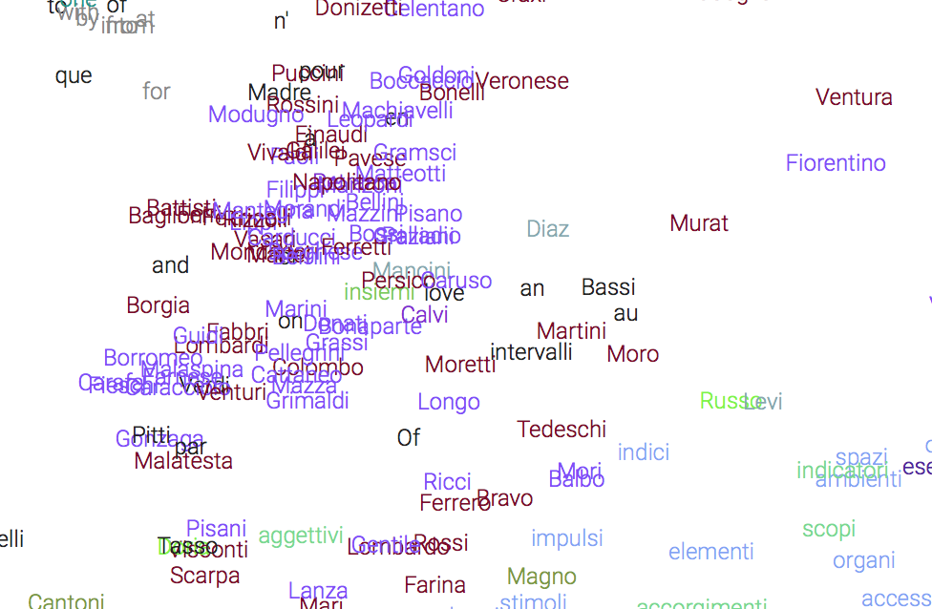
Continuous representation of Words
Learning vectors in large dimensional space that represents all aspects of word meaning
Word embeddings

Slide 75
Word Similarities
Nearest word to ‘rana’:
farfalla
tartaruga
delfino
zampa
scimmia

Slide 76
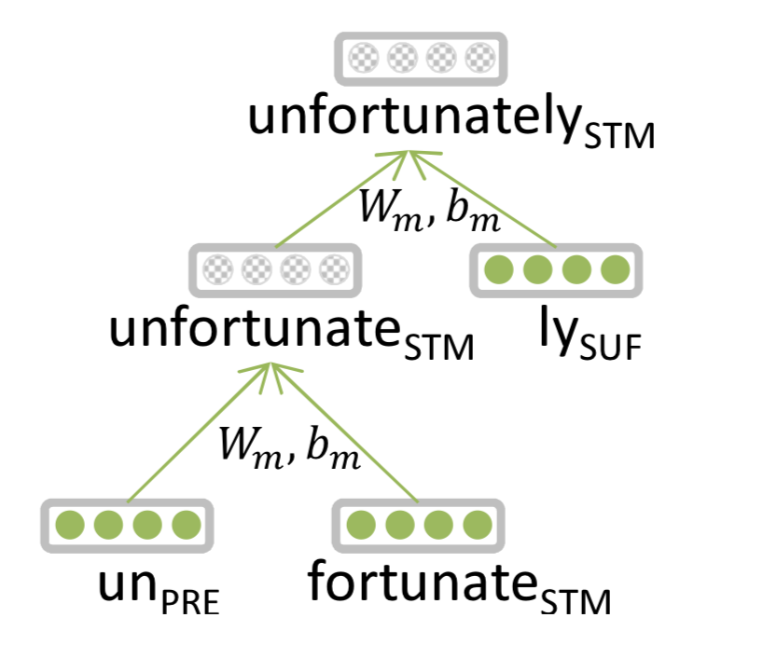
Entails Morphology
Words are made of morphemes:
Prefix stem suffix
un interest ed
DL:
Every morpheme is a vector
A NN combines vectors
Luong et al. 2013

Slide 77
Parsing for Sentence Structure
Dependency Parser can determine grammatical structure of sentences
Useful for interpretation and relation extraction
See demo

Slide 78
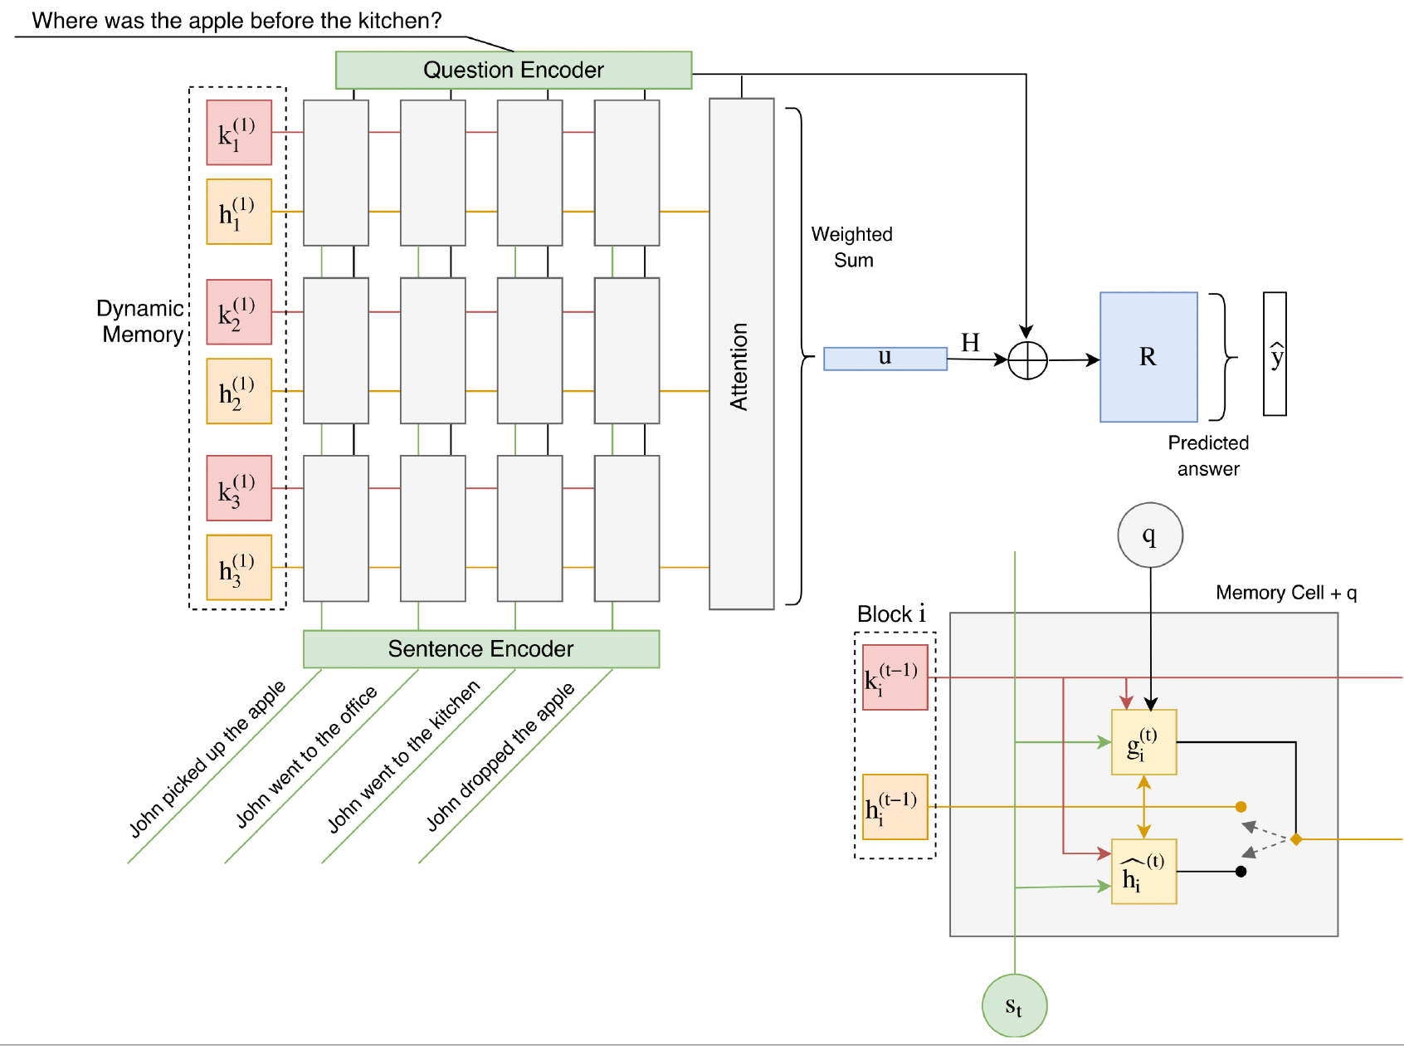
Question Answering
Traditional: A lot of feature engineering to capture world and other knowledge, e.g., regular expressions, Berant et al. (2014)
Deep Learning: embeddings represent words, a Recurrent Neural Network extracts entities and their relations and output module extracts the answer Madotto, Attardi. 2017. Question Dependent Recurrent Entity Network for QA

Slide 79
Neural Reasoner
Next frontier for AI
Overcome the dichotomy between
Perceptive Tasks (voice, images): Deep Learning
Inference: rule based systems, logic
Single Neural Network Model for both tasks
Learning like children, who do not know neither grammar nor differential equations for:
Learning to speak interacting with adults
Learn a simple model of the physical world starting from perceptual experiences

Slide 80
Course Overview

Slide 81
About the Course
Assumes some skills…
basic linear algebra, probability, and statistics
decent programming skills
willingness to learn missing knowledge
Teaches key theory and methods for Statistical NLP
Useful for building practical, robust systems capable of interpreting human language
Experimental approach:
Lots of problem-based learning
Often practical issues are as important as theoretical niceties

Slide 82
Experimental Approach
Formulate Hypothesis
Implement Technique
Train and Test
Apply Evaluation Metric
If not improved:
Perform error analysis
Revise Hypothesis
Repeat

Slide 83
Aims of the Course
Teach an understanding of technologies used for dealing with human language and Deep Learning in particular
Understanding the difficulties and the way to overcome them
Approaches to the basic NLP problems:
Word similarities, entity recognition, parsing, machine translation, question answering, sentence comprehension
Skills in using modern tools and techniques in building NLP applications

Slide 84
Program
Introduction
History
Present and Future
NL Processing and Human Interactions
Statistical Methods
Language Model
Hidden Markov Model
Viterbi Algorithm
Generative vs Discriminative Models
Linguistic Essentials
Words, Lemmas, Part of Speech and Morphology
Collocations
Word Sense Disambiguation
Word Embeddings

Slide 85
Preprocessing
Encoding
Regular Expressions
Segmentation
Tokenization
Normalization
Lexical semantics
Collocations
Corpora
Thesauri
Gazetteers

Slide 86
Distributional Semantics
Word embeddings
Character embeddings
Neural Language Models
Classification
Bayesian Networks
Perceptron
SVM
Maximum Entropy
Applications: spam, phishing, fake news detection

Slide 87
Tagging
Part of Speech
Named Entity
Sentence Structure
Constituency Parsing
Dependency Parsing
Semantic Analysis
Semantic Role Labeling
Coreference resolution
Statistical Machine Translation
Phrase-Based Models
Neural Network Models
Evaluation metrics

Slide 88
Deep Learning
MLP, CNN, RNN, LSTM
Libraries
NLTK
Theano
Tensorflow
Keras
Applications
Entity Linking
Semantic Search
Question Answering
Language Inference

Slide 89
Opinion Mining
Introduction to sentiment analysis
Sentiment classification
Lexical resources for sentiment analysis
Question answering
Language inference
Dialogic interfaces (chatbots)

Slide 90
Exam
Project
Seminar

Slide 91
Previous Year Projects
Participation to Evalita 2011
Task POS + Lemmatization: 1st position
Task Domain Adaptation: 1st position
Task SuperSense: 1st position
Task Dependency Parsing: 2nd position
Task NER: 3rd position
SemEval 2012
Sentiment Analysis on tweets
Participation to Evalita 2014
Sentiment Analysis on tweets
Disaster Reports in Tweets

Slide 92
Previous Year Projects
Participation to Evalita 2016
Task POS on Tweets:
Task Sentipolc on Twitter: 1st position
Task Named Entity Linking:

Slide 93
Books
D. Jurafsky, J.H. Martin, Speech and Language Processing. 2nd edition, Prentice-Hall, 2008.
I. Goodfellow, Yoshua Bengio and A. Courville, Deep Learning, http://www.deeplearningbook.org, 2016.
S. Bird, E. Klein, E. Loper. Natural Language Processing with Python.
S. Kubler, R. McDonald, J. Nivre. Dependency Parsing. 2010.
P. Koehn. Statistical Machine Translation. Cambridge University Press, 2010.
C. Manning, H. Schutze. Foundations of Statistical Natural Language Processing. MIT Press, 2000.

