Slide 1

Human Language Technologies
Università di Pisa
Giuseppe Attardi
Language Modeling
IP notice: some slides from: Dan Jurafsky, Jim Martin, Sandiway Fong, Dan Klein

Slide 2
Outline
Language Modeling (N-grams)
  N-gram Intro
  The Chain Rule
  The Shannon Visualization Method
  Evaluation:
    Perplexity
  Smoothing:
    Laplace (Add-1)
    Add-prior

Slide 3
Probabilistic Language Model
Goal: assign a probability to a sentence
Machine Translation:
  P(high winds tonite) > P(large winds tonite)
Spell Correction
  “The oﬃce is about ﬁfteen minuets from my house"
    P(about ﬁfteen minutes from) > P(about ﬁfteen minuets from)
Speech Recognition
  P(I saw a van) >> P(eyes awe of an)
Summarization, question-­answering, etc.

Slide 4
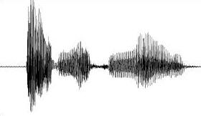
Why Language Models
We have an English speech recognition system, which answer is better?
Speech Interpretation
speech recognition system
speech cognition system
speck podcast histamine
スピーチ が 救出 ストン
Language models tell us the answer!

Slide 5
Language Modeling
We want to compute
  P(w₁,w₂,w₃,w₄,w₅…w_{n}) = P(W)
  = the probability of a sequence
Alternatively we want to compute
  P(w₅|w₁,w₂,w₃,w₄)
  = the probability of a word given some previous words
The model that computes
  P(W) or
  P(w_{n}|w₁,w₂…w_{n-1})
  is called the language model.
A better term for this would be “The Grammar”
But “Language model” or LM is standard

Slide 6
Computing P(W)
How to compute this joint probability:
  P(“the”, “other”, “day”, “I”, “was”, “walking”, “along”, “and”, “saw”, “a”, “lizard”)
Intuition: let’s rely on the Chain Rule of Probability

Slide 7
The Chain Rule
Recall the definition of conditional probabilities
Rewriting:
More generally
P(A,B,C,D) = P(A)P(B|A)P(C|A,B)P(D|A,B,C)
In general
P(x₁,x₂,x₃,…x_{n}) = P(x₁)P(x₂|x₁)P(x₃|x₁,x₂)…P(x_{n}|x₁…x_{n-1})

Slide 8
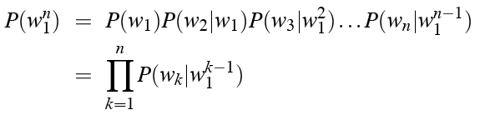
The Chain Rule applied to joint probability of words in sentence
P(“the big red dog was”) =
P(the) • P(big|the) • P(red|the big) • P(dog|the big red) • P(was|the big red dog)

Slide 9
Obvious estimate
How to estimate?
  P(the | its water is so transparent that)
P(the | its water is so transparent that) =
  C(its water is so transparent that the)
  ____________________________________________________________________________________________
  C(its water is so transparent that)

Slide 10
Unfortunately
There are a lot of possible sentences
We will never be able to get enough data to compute the statistics for those long prefixes
P(lizard|the,other,day,I,was,walking,along,and,saw,a)
or
P(the|its water is so transparent that)

Slide 11
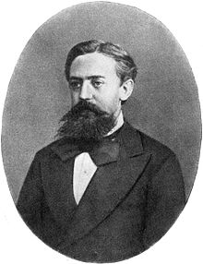
Markov Assumption
Make the simplifying assumption
  P(lizard|the,other,day,I,was,walking,along,and,saw,a) = P(lizard|a)
or maybe
  P(lizard|the,other,day,I,was,walking,along,and,saw,a) = P(lizard|saw,a)

Slide 12
Markov Assumption
So for each component in the product, replace with the approximation (assuming a prefix of N)
Bigram model

Slide 13
N-gram models
We can extend to trigrams, 4-­grams, 5-­grams
In general this is an insuﬃcient model of language
  because language has long-­distance dependencies:
  “The computer which I had just put into the machine room on the ﬁfth ﬂoor crashed.”
But we can often get away with N-­gram models

Slide 14
Estimating bigram probabilities
The Maximum Likelihood Estimate

Slide 15


An example
<s> I am Sam </s>
<s> Sam I am </s>
<s> I do not like green eggs and ham </s>
This is the Maximum Likelihood Estimate, because it is the one which maximizes P(Training set|Model)

Slide 16
Maximum Likelihood Estimates
The Maximum Likelihood Estimate of some parameter of a model M from a training set T
  is the estimate that
  maximizes the likelihood of the training set T given the model M
Suppose the word “Chinese” occurs 400 times in a corpus of a million words (e.g. the Brown corpus)
What is the probability that a random word from some other text will be “Chinese”
MLE estimate is 400/1000000 = .004
  This may be a bad estimate for some other corpus
But it is the estimate that makes it most likely that “Chinese” will occur 400 times in a million word corpus.

Slide 17
Maximum Likelihood
We want to estimate the probability, p, that individuals are infected with a certain kind of parasite.
The maximum likelihood method (discrete distribution):
Write down the probability of each observation by using the model parameters
Write down the probability of all the data
Find the value parameter(s) that maximize this probability
Ind. | Infected | Probability of observation
1 | 1 | p
2 | 0 | 1 – p
3 | 1 | p
4 | 1 | p
5 | 0 | 1 – p
6 | 1 | p
7 | 1 | p
8 | 0 | 1 – p
9 | 0 | 1 – p
10 | 1 | p

Slide 18
Maximum likelihood
We want to estimate the probability, p, that individuals are infected with a certain kind of parasite.
Ind. | Infected | Probability of observation
1 | 1 | p
2 | 0 | 1 – p
3 | 1 | p
4 | 1 | p
5 | 0 | 1 – p
6 | 1 | p
7 | 1 | p
8 | 0 | 1 – p
9 | 0 | 1 – p
10 | 1 | p
Likelihood function:
- Find the value parameter(s) that maximize this probability

Slide 19
Computing the MLE
Set the derivative to 0:
Solutions:
  p = 0 (minimum)
  p = 1 (minimum)
  p = 0.6 (maximum)

Slide 20
More examples: Berkeley Restaurant Project
can you tell me about any good cantonese restaurants close by
mid priced thai food is what i’m looking for
tell me about chez panisse
can you give me a listing of the kinds of food that are available
i’m looking for a good place to eat breakfast
when is caffe venezia open during the day

Slide 21
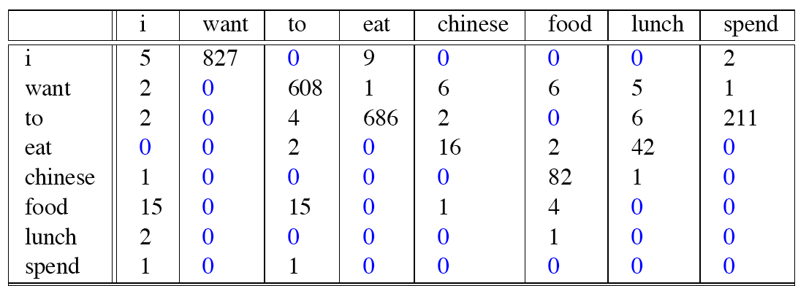
Raw bigram counts
Out of 9222 sentences

Slide 22
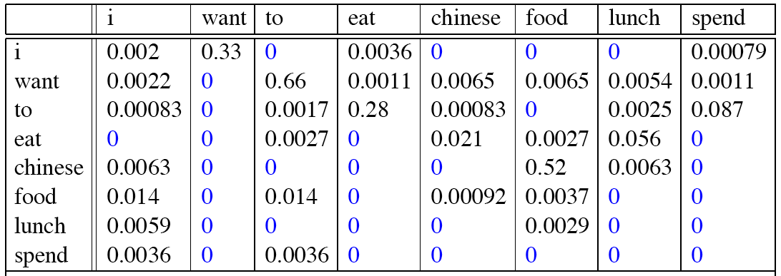
Raw bigram probabilities
Normalize by unigrams (divide by C(w₋₁)):
Result:

Slide 23
Bigram estimates of sentence probabilities
P(<s> I want english food </s>) =
P(i|<s>) x
P(want|I) x
P(english|want) x
P(food|english) x
P(</s>|food)
=.000031

Slide 24
What kinds of knowledge?
  P(english|want) = .0011
  P(chinese|want) = .0065
  P(to|want) = .66
  P(eat | to) = .28
  P(food | to) = 0
  P(want | spend) = 0
  P(i | <s>) = .25

Slide 25
Practical Issues
Compute in log space
  Avoid underflow
  Adding is faster than multiplying
  log(p₁ • p₂ • p₃ • p₄) = log(p₁) + log(p₂) + log(p₃) + log(p₄)

Slide 26
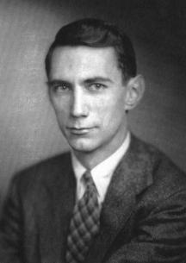
Shannon’s Game
What if we turn these models around and use them to generate random sentences that are like the sentences from which the model was derived.

Slide 27
The Shannon Visualization Method
Generate random sentences:
Choose a random bigram <s>, w according to its probability
Now choose a random bigram (w, x) according to its probability
And so on until we choose </s>
Then string the words together
<s> I
I want
  want to
  to eat
  eat Chinese
  Chinese food
  food </s>

Slide 28
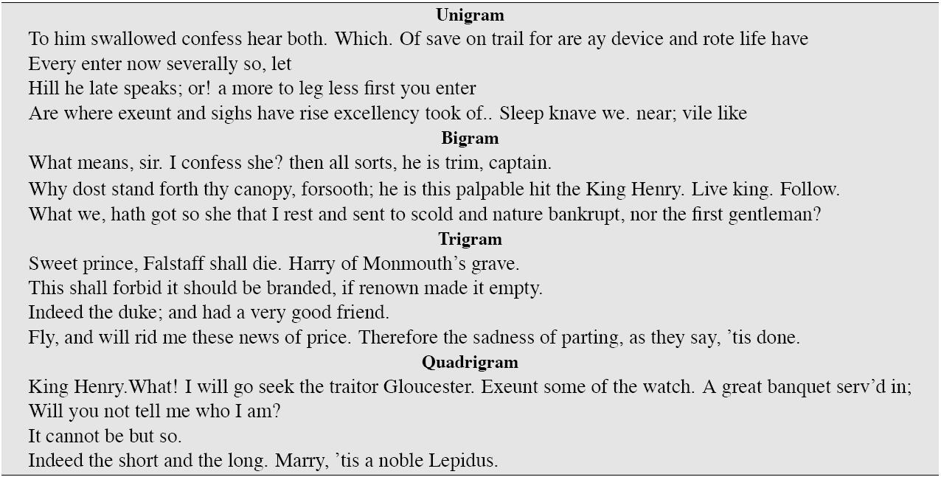
Approximating Shakespeare

Slide 29
Shakespeare as corpus
N=884,647 tokens, V=29,066
Shakespeare produced 300,000 bigram types out of V²= 844 million possible bigrams: so, 99.96% of the possible bigrams were never seen (have zero entries in the table)
Quadrigrams:
  What's coming out looks like Shakespeare because it is Shakespeare

Slide 30
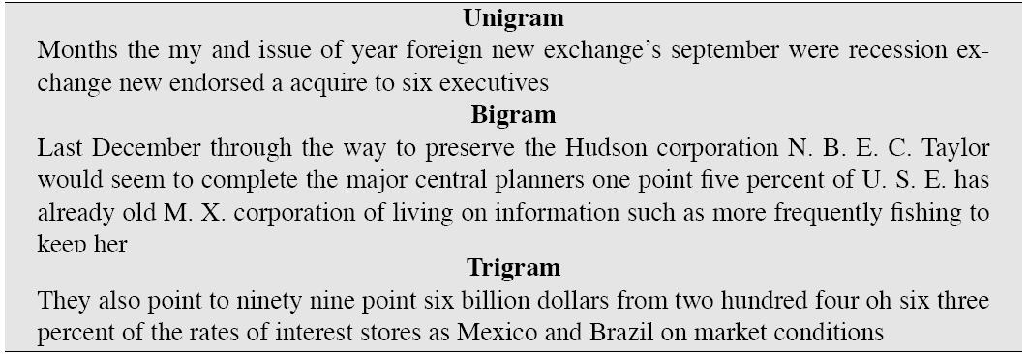
The Wall Street Journal is not Shakespeare (no offense)

Slide 31
Lesson 1: the perils of overfitting
N-grams only work well for word prediction if the test corpus looks like the training corpus
  In real life, it often doesn’t
  We need to train robust models, adapt to test set, etc.

Slide 32
Train and Test Corpora
A language model must be trained on a large corpus of text to estimate good parameter values.
Model can be evaluated based on its ability to predict a high probability for a disjoint (held-out) test corpus (testing on the training corpus would give an optimistically biased estimate).
Ideally, the training (and test) corpus should be representative of the actual application data.
May need to adapt a general model to a small amount of new (in-domain) data by adding highly weighted small corpus to original training data.

Slide 33
Smoothing

Slide 34
Smoothing
Since there are a combinatorial number of possible word sequences, many rare (but not impossible) combinations never occur in training, so MLE incorrectly assigns zero to many parameters (aka sparse data).
If a new combination occurs during testing, it is given a probability of zero and the entire sequence gets a probability of zero (i.e. infinite perplexity).
In practice, parameters are smoothed (aka regularized) to reassign some probability mass to unseen events.
  Adding probability mass to unseen events requires removing it from seen ones (discounting) in order to maintain a joint distribution that sums to 1.

Slide 35
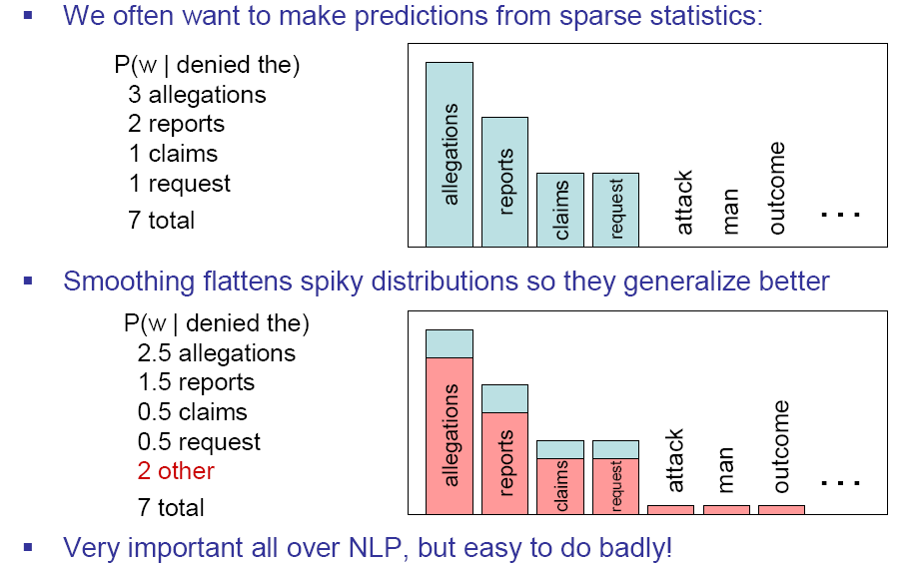
Smoothing is like Robin Hood:
Steal from the rich and give to the poor (in probability mass)
Slide from Dan Klein

Slide 36
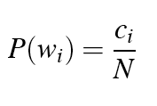

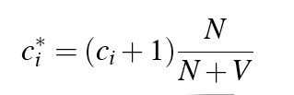
Laplace smoothing
Also called add-one smoothing
Just add one to all the counts!
Very simple
MLE estimate:
Laplace estimate:
Reconstructed counts:

Slide 37
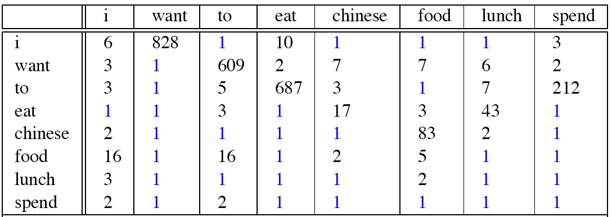
Laplace smoothed bigram counts
Berkeley Restaurant Corpus

Slide 38

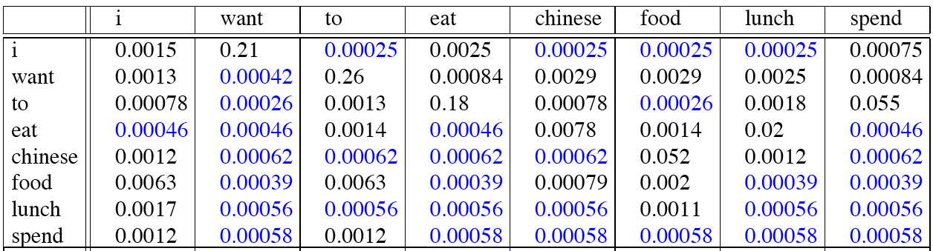
Laplace-smoothed bigrams

Slide 39
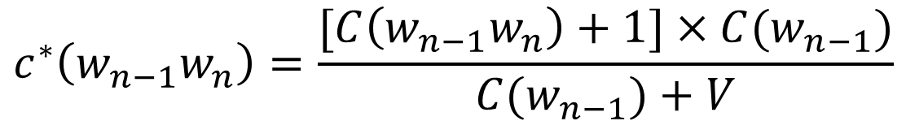
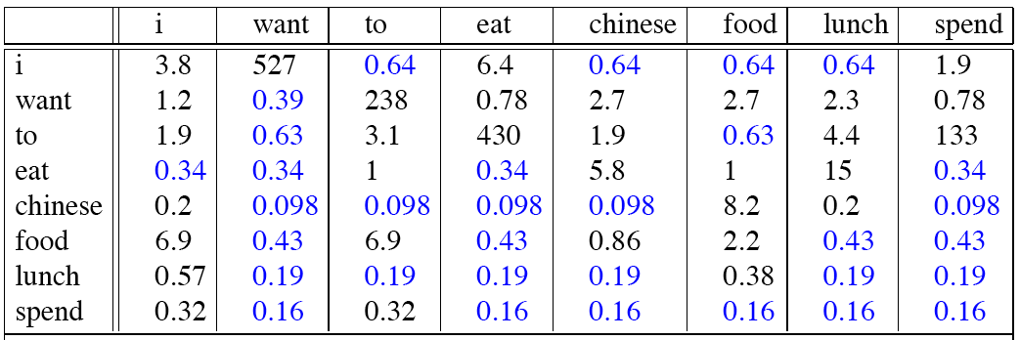
Reconstituted counts

Slide 40
Note big change to counts
C(want to) went from 608 to 238!
P(to|want) from .66 to .26!
Discount d = c*/c
  d for “chinese food” = .10 A 10x reduction!
  So in general, Laplace is a blunt instrument
But Laplace smoothing not used for N-grams, as we have much better methods
Despite its flaws Laplace (add-k) is however still used to smooth other probabilistic models in NLP, especially
  For pilot studies
  in domains where the number of zeros isn’t so huge.

Slide 41
Add-k
Add a small fraction instead of 1
k = 0.01

Slide 42
Even better: Bayesian unigram prior smoothing for bigrams
Maximum Likelihood Estimation
Laplace Smoothing
Bayesian Prior Smoothing

Slide 43
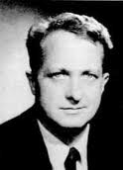
Lesson 2: zeros or not?
Zipf’s Law:
  A small number of events occur with high frequency
  A large number of events occur with low frequency
  You can quickly collect statistics on the high frequency events
  You might have to wait an arbitrarily long time to get valid statistics on low frequency events
Result:
  Our estimates are sparse! no counts at all for the vast bulk of things we want to estimate!
  Some of the zeroes in the table are really zeros But others are simply low frequency events you haven't seen yet. After all, ANYTHING CAN HAPPEN!
  How to address?
Answer:
  Estimate the likelihood of unseen N-grams!
Slide from B. Dorr and J. Hirschberg

Slide 44
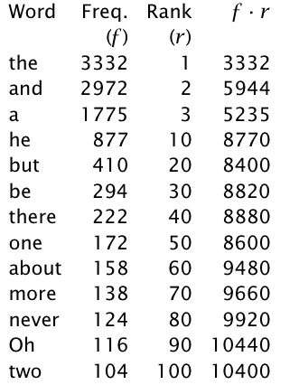
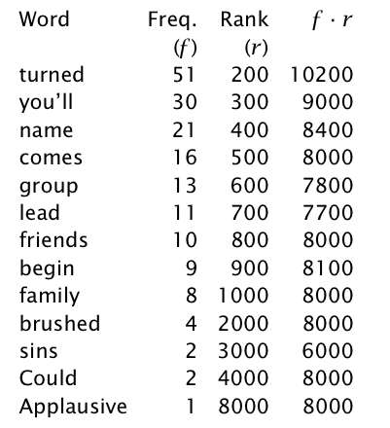
Zipf's law
f ∝ 1/r (f proportional to 1/r)
there is a constant k such that
f . r = k

Slide 45
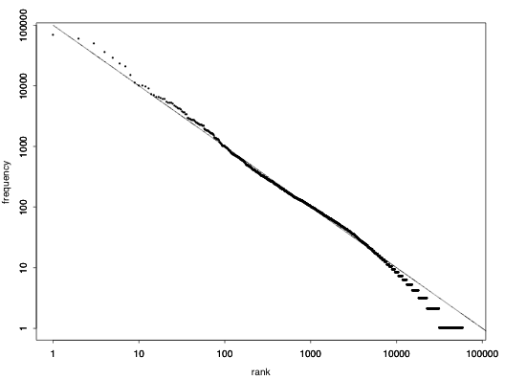
Zipf's Law for the Brown Corpus

Slide 46
Zipf law: interpretation
Principle of least effort: both the speaker and the hearer in communication try to minimize effort:
  Speakers tend to use a small vocabulary of common (shorter) words
  Hearers prefer a large vocabulary of rarer less ambiguous words
  Zipf's law is the result of this compromise
Other laws …
  Number of meanings m of a word obeys the law: m ∝ 1/√f
  Inverse relationship between frequency and length

Slide 47
Practical Issues
We do everything in log space
  Avoid underflow
  (also adding is faster than multiplying)

Slide 48
Language Modeling Toolkits
SRILM
  http://www.speech.sri.com/projects/srilm/
IRSTLM
Ken LM

Slide 49
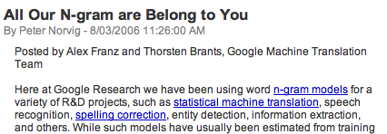

Google N-Gram Release

Slide 50
Google Book N-grams
http://ngrams.googlelabs.com/

Slide 51
Google N-Gram Release
serve as the incoming 92
serve as the incubator 99
serve as the independent 794
serve as the index 223
serve as the indication 72
serve as the indicator 120
serve as the indicators 45
serve as the indispensable 111
serve as the indispensible 40
serve as the individual 234
http://googleresearch.blogspot.com/2006/08/all-our-n-gram-are-belong-to-you.html

Slide 52
Evaluation and Perplexity

Slide 53
Evaluation
Train parameters of our model on a training set.
How do we evaluate how well our model works?
Look at the models performance on some new data
This is what happens in the real world; we want to know how our model performs on data we haven’t seen
Use a test set. A dataset which is different than our training set
Then we need an evaluation metric to tell us how well our model is doing on the test set.
One such metric is perplexity

Slide 54
Evaluating N-gram models
Best evaluation for an N-gram
  Put model A in a task (language identification, speech recognizer, machine translation system)
  Run the task, get an accuracy for A (how many langs identified correctly, or Word Error Rate, or etc)
  Put model B in task, get accuracy for B
  Compare accuracy for A and B
  Extrinsic evaluation

Slide 55
Language Identification task
Create an N-gram model for each language
Compute the probability of a given text
  P_{lang1}(text)
  P_{lang2}(text)
  P_{lang3}(text)
Select language with highest probability
  lang = argmax_{l} P_{l}(text)

Slide 56
Difficulty of extrinsic (in-vivo) evaluation of N-gram models
Extrinsic evaluation
  This is really time-consuming
  Can take days to run an experiment
So
  As a temporary solution, in order to run experiments
  To evaluate N-grams we often use an intrinsic evaluation, an approximation called perplexity
  But perplexity is a poor approximation unless the test data looks just like the training data
  So is generally only useful in pilot experiments (generally is not sufficient to publish)

Slide 57
Perplexity
The intuition behind perplexity as a measure is the notion of surprise.
How surprised is the language model when it sees the test set?
  Where surprise is a measure of...
    Gee, I didn’t see that coming...
  The more surprised the model is, the lower the probability it assigned to the test set
  The higher the probability, the less surprised it was

Slide 58
Perplexity
Measures of how well a model “fits” the test data.
Uses the probability that the model assigns to the test corpus.
Normalizes for the number of words in the test corpus and takes the inverse.
Measures the weighted average branching factor in predicting the next word (lower is better).

Slide 59
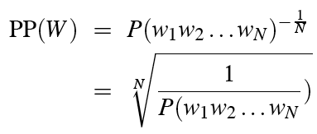
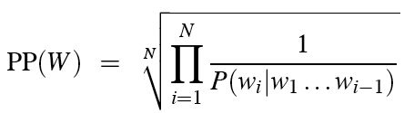
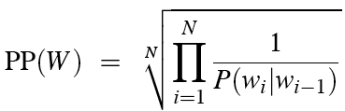
Perplexity
Perplexity:
Chain rule:
For bigrams:
Minimizing perplexity is the same as maximizing probability
  The best language model is one that best predicts an unseen test set

Slide 60
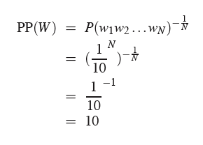
Perplexity as branching factor
How hard is the task of recognizing digits ‘0,1,2,3,4,5,6,7,8,9’
Perplexity: 10

Slide 61
Lower perplexity = better model
Model trained on 38 million words from the Wall Street Journal (WSJ) using a 19,979 word vocabulary.
Evaluation on a disjoint set of 1.5 million WSJ words.
N-gram Order | Unigram | Bigram | Trigram
Perplexity | 962 | 170 | 109

Slide 62
Unknown Words
How to handle words in the test corpus that did not occur in the training data, i.e. out of vocabulary (OOV) words?
Train a model that includes an explicit symbol for an unknown word (<UNK>):
  Choose a vocabulary in advance and replace other words in the training corpus with <UNK>, or
  Replace the first occurrence of each word in the training data with <UNK>.

Slide 63
Unknown Words handling
Training of <UNK> probabilities
  Create a fixed lexicon L of size V
  Any training word not in L changed to <UNK>
  Now we train its probabilities like a normal word
At decoding time
  In text input: use <UNK> probabilities for any word not in training

Slide 64
Smoothing

Slide 65
Advanced LM stuff
Current best smoothing algorithm
  Kneser-Ney smoothing
Other stuff
  Interpolation
  Backoff
  Variable-length n-grams
  Class-based n-grams
    Clustering
    Hand-built classes
  Cache LMs
  Topic-based LMs
  Sentence mixture models
  Skipping LMs
  Parser-based LMs
  Word Embeddings

Slide 66
Backoff and Interpolation
If we are estimating:
  Trigram P(z|xy)
  but C(xyz) is zero
Use info from:
  Bigram P(z|y)
Or even:
  Unigram P(z)
How to combine the trigram/bigram/unigram info?

Slide 67
Backoff versus interpolation
Backoff: use trigram if you have it, otherwise bigram, otherwise unigram
Interpolation: mix all three

Slide 68
Backoff
Only use lower-order model when data for higher-order model is unavailable
Recursively back-off to weaker models until data is available
Where P* is a discounted probability estimate to reserve mass for unseen events and α’s are back-off weights (see book for details).

Slide 69
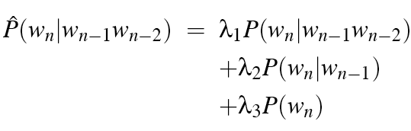

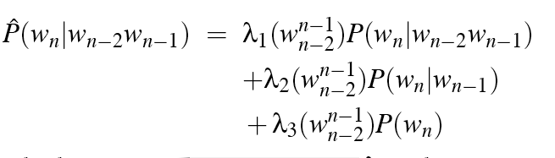
Interpolation
Simple interpolation
Lambdas conditional on context:

Slide 70
How to set the lambdas?
Use a held-out corpus
Choose lambdas which maximize the probability of data
  i.e. fix the N-gram probabilities
  then search for lambda values that,
  when plugged into previous equation,
  give largest probability for held-out set
  Can use EM (Expectation Maximization) to do this search
Training Data
Held-Out Data
Test
Data

Slide 71
Intuition of backoff+discounting
How much probability to assign to all the zero trigrams?
  Use Good-Turing or other discounting algorithm
How to divide that probability mass among different contexts?
  Use the N-1 gram estimates
What do we do for the unigram words not seen in training?
  Out Of Vocabulary = OOV words

Slide 72
Problem for N-Grams: Long Distance Dependencies
Sometimes local context does not provide enough predictive clues, due to the presence of long-distance dependencies.
  Syntactic dependencies
    “The man next to the large oak tree near the grocery store on the corner is tall.”
    “The men next to the large oak tree near the grocery store on the corner are tall.”
  Semantic dependencies
    “The bird next to the large oak tree near the grocery store on the corner flies rapidly.”
    “The man next to the large oak tree near the grocery store on the corner talks rapidly.”
More complex models of language are needed to handle such dependencies.

Slide 73
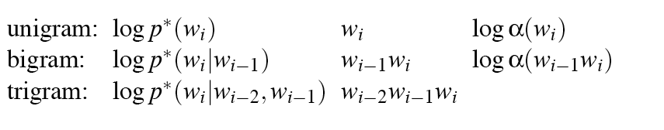
ARPA format

Slide 74
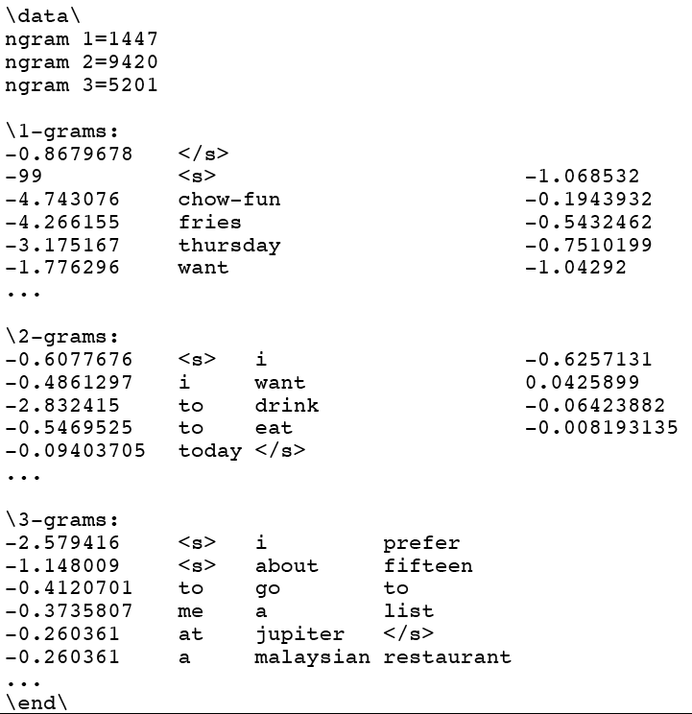

Slide 75
Language Models
Language models assign a probability that a sentence is a legal string in a language.
They are useful as a component of many NLP systems, such as ASR, OCR, and MT.
Simple N-gram models are easy to train on unsupervised corpora and can provide useful estimates of sentence likelihood.
MLE gives inaccurate parameters for models trained on sparse data.
Smoothing techniques adjust parameter estimates to account for unseen (but not impossible) events.

Slide 76
Exercise
Write two programs
  train-unigram: Creates a unigram model
  test-unigram: Reads a unigram model and calculates entropy and coverage for the test set
Test them test/01-train-input.txt test/01-test-input.txt
Train the model on data/wiki-en-train.word
Calculate entropy and coverage on data/wiki-entest.word
Report your scores next week

Slide 77
Pseudo code: train-unigram
create a map counts
create a variable total_count = 0
for each line in the training_file
split line into an array of words
append “</s>” to the end of words
for each word in words
add 1 to counts[word]
add 1 to total_count
open the model_file for writing
for each word, count in counts
probability = counts[word]/total_count
print word, probability to model_file

Slide 78
Pseudo-code: test-unigram
Load model
Test and print
create a map probabilities
for each line in model_file
split line into w and P
set probabilities[w] = P
for each line in test_file
split line into an array of words
append “</s>” to the end of words
for each w in words
add 1 to W
set P = λunk / V
if probabilities[w] exists
set P += λ1 * probabilities[w]
else
add 1 to unk
add -log2 P to H
print “entropy = ”+H/W
print “coverage = ” + (W-unk)/W

Slide 79
Summary
Language Modeling (N-grams)
  N-grams
  The Chain Rule
  The Shannon Visualization Method
  Evaluation:
    Perplexity
  Smoothing:
    Laplace (Add-1)
    Add-k
    Add-prior

