Slide 1
Text Classification
The Naïve Bayes algorithm
IP notice: most slides from: Chris Manning, plus some from William Cohen, Chien Chin Chen, Jason Eisner, David Yarowsky, Dan Jurafsky, P. Nakov, Marti Hearst, Barbara Rosario

Slide 2
Outline
Introduction to Text Classification
Also called “text categorization”
Naïve Bayes text classification

Slide 3
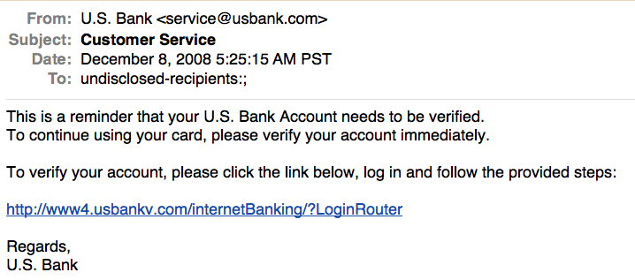
Is this spam?

Slide 4
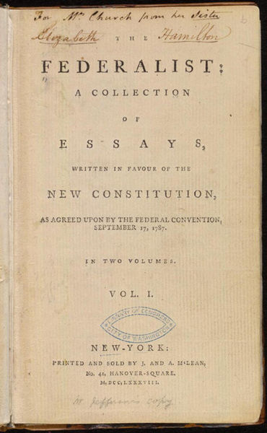
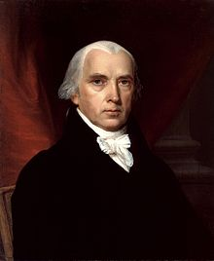
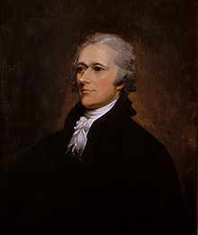
Who wrote which Federalist papers?
1787-8: anonymous essays try to convince New York to ratify U.S Constitution: Jay, Madison, Hamilton.
Authorship of 12 of the letters in dispute
1963: solved by Mosteller and Wallace using Bayesian methods
James Madison
Alexander Hamilton

Slide 5
Male or female author?
By 1925 present-day Vietnam was divided into three parts under French colonial rule. The southern region embracing Saigon and the Mekong delta was the colony of Cochin-China; the central area with its imperial capital at Hue was the protectorate of Annam…
Clara never failed to be astonished by the extraordinary felicity of her own name. She found it hard to trust herself to the mercy of fate, which had managed over the years to convert her greatest shame into one of her greatest assets…
S. Argamon, M. Koppel, J. Fine, A. R. Shimoni, 2003. “Gender, Genre, and Writing Style in Formal Written Texts,” Text, volume 23, number 3, pp. 321–346
Notes:
#1: Saigon. Grey, Anthony
#2: Jerusalem the Golden. Drabble, Margaret
From shlomo argamon

Slide 6
Positive or negative movie review?
unbelievably disappointing
Full of zany characters and richly applied satire, and some great plot twists
this is the greatest screwball comedy ever filmed
It was pathetic. The worst part about it was the boxing scenes.

Slide 7
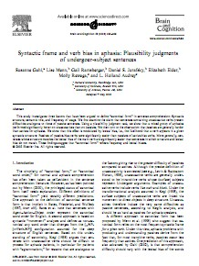
What is the subject of this article?
MeSH Subject Category Hierarchy
MEDLINE Article
Antogonists and Inhibitors
Blood Supply
Chemistry
Drug Therapy
Embryology
Epidemiology
…
?

Slide 8
More Applications
Authorship identification
Age/gender identification
Language Identification
Assigning topics such as Yahoo-categories
e.g., "finance," "sports," "news>world>asia>business"
Genre-detection
e.g., "editorials" "movie-reviews" "news“
Opinion/sentiment analysis on a person/product
e.g., “like”, “hate”, “neutral”
Labels may be domain-specific
e.g., “contains adult language” : “doesn’t”

Slide 9
Text Classification: definition
The classifier:
f: D → C
Input: a document d ∈ D
fixed set of classes C = {c₁,...,c_{K}}
Output: a predicted class c ∈ C
The learner:
Input: a set of N hand-labeled documents T = { (d₁,c₁),....,(d_{N},c_{N}) }
Output: a learned classifier f: D → C

Slide 10
Document Classification
“planning
language
proof
intelligence”
Test
Data:
(AI)
(Programming)
(HCI)
Classes:
ML
Planning
Semantics
Garb.Coll.
Multimedia
GUI
Training
Data:
learning
intelligence
algorithm
reinforcement
network...
planning
temporal
reasoning
plan
language...
programming
semantics
language
proof...
garbage
collection
memory
optimization
region...
...
...

Slide 11
Classification Methods: Hand-coded rules
Some spam/email filters, etc.
E.g., assign category if document contains a given boolean combination of words
spam: black-list-address OR (“dollars” AND “have been selected”)
Accuracy is often very high
if a rule has been carefully refined over time by a subject expert
Building and maintaining these rules is expensive

Slide 12
Classification Methods: Supervised Machine Learning
Input:
a document d ∈ D
a fixed set of classes C = {c₁, c₂,…, c_{K}}
A training set of N hand-labeled documents T = { (d₁,c₁),....,(d_{N},c_{N}) }
Output:
a learned classifier γ: D → C

Slide 13
Classification Methods: Supervised Machine Learning
Any kind of classifier
Naïve Bayes
Logistic regression
Support-vector machines
k-Nearest Neighbors
Deep Neural Networks
…

Slide 14
Naïve Bayes Intuition

Slide 15
Naïve Bayes Intuition
Simple (“naïve”) classification method based on Bayes rule
Relies on very simple representation of document
Bag of words

Slide 16
Bag of words representation
ARGENTINE 1986/87 GRAIN/OILSEED REGISTRATIONS
BUENOS AIRES, Feb 26
Argentine grain board figures show crop registrations of grains, oilseeds and their products to February 11, in thousands of tonnes, showing those for future shipments month, 1986/87 total and 1985/86 total to February 12, 1986, in brackets:
Bread wheat prev 1,655.8, Feb 872.0, March 164.6, total 2,692.4 (4,161.0).
Maize Mar 48.0, total 48.0 (nil).
Sorghum nil (nil)
Oilseed export registrations were:
Sunflowerseed total 15.0 (7.9)
Soybean May 20.0, total 20.0 (nil)
The board also detailed export registrations for subproducts, as follows....
Categories: grain, wheat

Slide 17
The Bag of Words Representation

Slide 18
Representing text for classification
f(
ARGENTINE 1986/87 GRAIN/OILSEED REGISTRATIONS
BUENOS AIRES, Feb 26
Argentine grain board figures show crop registrations of grains, oilseeds and their products to February 11, in thousands of tonnes, showing those for future shipments month, 1986/87 total and 1985/86 total to February 12, 1986, in brackets:
Bread wheat prev 1,655.8, Feb 872.0, March 164.6, total 2,692.4 (4,161.0).
Maize Mar 48.0, total 48.0 (nil).
Sorghum nil (nil)
Oilseed export registrations were:
Sunflowerseed total 15.0 (7.9)
Soybean May 20.0, total 20.0 (nil)
The board also detailed export registrations for subproducts, as follows....
)=c
simplest useful
?
What is the best representation for the document d being classified?

Slide 19
Bag of words representation
word
freq
xxxxxxxxxxxxxxxxxxx GRAIN/OILSEED xxxxxxxxxxxxx
xxxxxxxxxxxxxxxxxxxxxxx
xxxxxxxxx grain xxxxxxxxxxxxxxxxxxxxxxxxxxxxxxxx grains, oilseeds xxxxxxxxxx xxxxxxxxxxxxxxxxxxxxxxxxxxx tonnes, xxxxxxxxxxxxxxxxx shipments xxxxxxxxxxxx total xxxxxxxxx total xxxxxxxx xxxxxxxxxxxxxxxxxxxx:
Xxxxx wheat xxxxxxxxxxxxxxxxxxxxxxxxxxxxxxxx, total xxxxxxxxxxxxxxxx
Maize xxxxxxxxxxxxxxxxx
Sorghum xxxxxxxxxx
Oilseed xxxxxxxxxxxxxxxxxxxxx
Sunflowerseed xxxxxxxxxxxxxx
Soybean xxxxxxxxxxxxxxxxxxxxxx
xxxxxxxxxxxxxxxxxxxxxxxxxxxxxxxxxxxxxxxxxxxxxxxxxxx....
grain(s) | 3
oilseed(s) | 2
total | 3
wheat | 1
maize | 1
soybean | 1
tonnes | 1
... | ...
Categories: grain, wheat
Slide from William Cohen

Slide 20
Formalizing Naïve Bayes

Slide 21
Bayes’ Rule
$$P(B|A)=\frac{P(A|B)P(B)}{P(A)}$$
Allows us to swap the conditioning
Sometimes easier to estimate one kind of dependence than the other

Slide 22
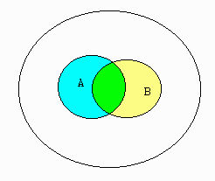
Conditional Probability
let A and B be events
P(B|A) = the probability of event B occurring given event A occurs
definition:
P(B|A) = P(A ∩ B) / P(A)
S

Slide 23
Deriving Bayes’ Rule
$$P(B|A)=\frac{P(A∩B)}{P(A)}$$
$$P(A|B)=\frac{P(A∩B)}{P(B)}$$
$$P(B|A)P(A)=P(A∩B)$$
$$P(A|B)P(B)=P(A∩B)$$
$$P\left(B | A\right)P\left(A\right)=P(A|B)P(B)$$
$$P(B|A)=\frac{P(A|B)P(B)}{P(A)}$$

Slide 24
Bayes Rule Applied to Documents and Classes
$$P\left(c,d\right)=P\left(c | d\right)P\left(d\right)=P\left(d | c\right)P(c)$$
$$P(c|d)=\frac{P(d|c)P(c)}{P(d)}$$

Slide 25
The Text Classification Problem
Using a supervised learning method, we want to learn a classifier (or classification function): γ
We denote the supervised learning method by Γ:
Γ(T) = γ
The learning method Γ takes the training set T as input and returns the learned classifier γ
Once we have learned γ, we can apply it to the test set (or test data)
$$γ$$
$$γ:{X}→C$$

Slide 26
Naïve Bayes Text Classification
The Multinomial Naïve Bayes model (NB) is a probabilistic learning method.
In text classification, our goal is to find the “best” class for the document:
$$c_{map}=\underset{c∈C}{argmax}P(c|d)$$
The probability of a
document d being in class c.
$$=\underset{c∈C}{argmax}\frac{P(c)P(d|c)}{P(d)}$$
Bayes’ Rule
$$=\underset{c∈C}{argmax} P(c)P(d|c)$$
We can ignore the denominator

Slide 27
Naive Bayes Classifiers
We represent an instance D based on some attributes.
Task: Classify a new instance D based on a tuple of attribute values into one of the classes c_{j} ∈ C
$$D=\left\langle x_{1},x_{2},…,x_{n}\right\rangle$$
$$c_{MAP}=\underset{c_{j}∈C}{\text{argmax}}P(c_{j}|x_{1},x_{2},…,x_{n})$$
The probability of a
document d being in class c.
$$=\underset{c_{j}∈C}{\text{argmax}}\frac{P(x_{1},x_{2},…,x_{n}|c_{j})P(c_{j})}{P(x_{1},x_{2},…,x_{n})}$$
Bayes’ Rule
$$=\underset{c_{j}∈C}{\text{argmax}}P(x_{1},x_{2},…,x_{n}|c_{j})P(c_{j})$$
We can ignore the denominator

Slide 28
Naïve Bayes Assumption
P(c_{j})
Can be estimated from the frequency of classes in the training examples.
P(x₁,x₂,…,x_{n}|c_{j})
O(|X|^{n}•|C|) parameters
Could only be estimated if a very, very large number of training examples was available.
Naïve Bayes Conditional Independence Assumption:
Assume that the probability of observing the conjunction of attributes is equal to the product of the individual probabilities P(x_{i}|c_{j}).

Slide 29
The Naïve Bayes Classifier
Flu
X₁
X₂
X₃
X₄
X₅
runnynose
sinus
cough
fever
muscle-ache
Conditional Independence Assumption:
features are independent of each other given the class:
P(X₁, …, X₅ | C) = P(X₁ | C) ∙ P(X₁ | C) ∙ … P(X₅ | C)
Slide from Chris Manning

Slide 30
Multinomial Naive Bayes Text Classification
Attributes are text positions, values are words.
$$c_{NB}=\underset{c_{j}∈C}{\text{argmax}} P(c_{j})\prod_{i}{P(x_{i}|c_{j})} \\ =\underset{c_{j}∈C}{\text{argmax}} P(c_{j})P(x_{1}=\text{"}\text{our}\text{"}|c_{j})⋯P(x_{n}=\text{"}\text{text}\text{"}|c_{j})$$
Still too many possibilities
Assume that classification is independent of the positions of the words
Use same parameters for each position
Result is bag of words model (over tokens not types)
Slide from Chris Manning

Slide 31
Learning the Model
C
X₁
X₂
X₃
X₄
X₅
X₆
Simplest: maximum likelihood estimate
simply use the frequencies in the data
$$\hat{P}(c_{j})=\frac{N(C=c_{j})}{N(T)}$$
$$\hat{P}(x_{i}|c_{j})=\frac{N(X_{i}=x_{i},C=c_{j})}{N(X_{i}=x_{i})}$$
Slide from Chris Manning

Slide 32
Problem with Max Likelihood
Flu
X₁
X₂
X₃
X₄
X₅
runnynose
sinus
cough
fever
muscle-ache
P(X₁, …, X₅ | C) = P(X₁ | C) ∙ P(X₁ | C) ∙ … P(X₅ | C)
What if we have seen no training cases where patient had no flu and muscle aches?
Zero probabilities cannot be conditioned away, no matter the other evidence!
$$\hat{P}(X_{5}=t|C=nf)=\frac{N(X_{5}=t,C=nf)}{N(C=nf)}=0$$
$$ℓ=\hat{{argmax}_{c}{P}}(c)\prod_{i}{\hat{P}(x_{i}|c)}$$
Slide from Chris Manning

Slide 33
Smoothing to Avoid Overfitting
Laplace:
$$\hat{P}(x_{i}|c_{j})=\frac{N(X_{i}=x_{i},C=c_{j})+1}{N(C=c_{j})+k}$$
# of values of X_{i}
overall fraction in data where X_{i}=x_{i,k}
Bayesian Unigram Prior:
$$\hat{P}(x_{i,k}|c_{j})=\frac{N(X_{i}=x_{i,k},C=c_{j})+mp_{i,k}}{N(C=c_{j})+m}$$
extent of
“smoothing”

Slide 34
Naïve Bayes: Learning
From training corpus, extract Vocabulary
Calculate required P(c_{j}) and P(w_{k} | c_{j}) terms
For each c_{j} in C do
docs_{j} = subset of documents for which the target class is c_{j}
$$P(c_{j})←\frac{|docs_{j}|}{\text{total}\text{ \# }\text{documents}}$$
Text_{j} = single document containing all docs_{j}
for each word w_{k} in Vocabulary
n_{kj} = number of occurrences of w_{k} in Text_{j}
n_{k} = number of occurrences of w_{k} in all docs
$$P(w_{k}|c_{j})←\frac{n_{kj}+α}{n_{k}+α|Vocabulary|}$$
Slide from Chris Manning

Slide 35
Naïve Bayes: Classifying
positions = all word positions in current document which contain tokens found in Vocabulary
Return c_{NB}, where
$$c_{NB}=\underset{c_{j}∈C}{\text{argmax}} P(c_{j})\prod_{i∈positions}{P(w_{i}|c_{j})}$$
Slide from Chris Manning

Slide 36
Underflow Prevention: log space
Multiplying lots of probabilities, which are between 0 and 1 by definition, can result in floating-point underflow.
Since log(xy) = log(x) + log(y), it is better to perform all computations by summing logs of probabilities rather than multiplying probabilities.
Class with highest final un-normalized log probability score is still the most probable.
Note that model is now just max of sum of weights…
$$c_{NB}=\underset{c_{j}∈C}{\text{argmax}}\log{P}(c_{j})+\sum_{i∈positions}{\log{P}(x_{i}|c_{j})}$$
Slide from Chris Manning

Slide 37
Naïve Bayes Generative Model for Text
$$c_{NB}=\underset{c_{j}∈C}{\text{argmax}} P(c_{j})\prod_{i∈positions}{P(w_{i}|c_{j})}$$
spam
ham
Choose a class c according to P(c)
spam
spam
ham
ham
Essentially model probability of each class as class-specific unigram language model
spam
spam
ham
Viagra
Category
science
win
PM
!!
Then choose a word from that class with probability P(x|c)
computer
Friday
hot
!!
hot
!
Nigeria
deal
test
deal
homework
lottery
nude
March
score
Viagra
!
Viagra
May
exam
$
spam
ham
Slide from Ray Mooney

Slide 38
Naïve Bayes and Language Modeling
Naïve Bayes classifiers can use any sort of features
URL, email address, dictionary
But, if:
We use only word features
We use all of the words in the text (not subset)
Then
Naïve Bayes bears similarity to language modeling

Slide 39
Each class = Unigram language model
Assign to each word: P(word | c)
Assign to each sentence: P(c | s) = P(c)∏P(w_{i} | c)
w | P(w | c)
I | 0.1
love | 0.1
this | 0.01
fun | 0.05
film | 0.1
I | love | this | fun | film
0.1 | 0.1 | 0.05 | 0.01 | 0.1
P(s | c) = 0.0000005

Slide 40
Naïve Bayes Language Model
Two classes: in language, out language
In Language
I | 0.1
love | 0.1
this | 0.01
fun | 0.05
film | 0.1
Out Language
I | 0.2
love | 0.001
this | 0.01
fun | 0.005
film | 0.1
I | love | this | fun | film
0.1 | 0.1 | 0.05 | 0.01 | 0.1
0.2 | 0.001 | 0.01 | 0.005 | 0.1
P(s | in) > P(s | out)

Slide 41
Naïve Bayes Classification
Win lotttery $ !
?? ??
spam
ham
spam
spam
ham
ham
spam
spam
Viagra
ham
win
PM
!!
Category
computer
Friday
hot
!!
hot
!
Nigeria
deal
test
deal
lottery
nude
March
score
Viagra
!
Viagra
May
exam
$
spam
ham
Slide from Ray Mooney

Slide 42
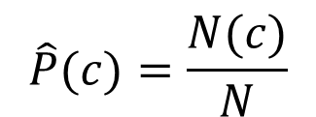
NB Text Classification Example
$$\hat{P}(c)=\frac{N(c)}{N}$$
Set | Doc | Words | Class
Train | 1 | Chinese Bejing Chinese | c
 | 2 | Chinese Chinese Shanghai | c
 | 3 | Chinese Macao | c
 | 4 | Tokyo Japan Chinese | ~c
Test | 5 | Chinese Chinese Chinese Tokyo Japan | ?
$$\hat{P}(w|c)=\frac{N(w,c)+1}{N(c)+|V|}$$
Training:
Vocabulary V = {Chinese, Beijing, Shanghai, Macao, Tokyo, Japan} and |V | = 6.
P(c) = 3/4 and P(~c) = 1/4.
P(Chinese|c) = (5+1) / (8+6) = 6/14 = 3/7
P(Chinese|~c) = (1+1) / (3+6) = 2/9
P(Tokyo|c) = P(Japan|c) = (0+1)/(8+6) =1/14
P(Chinese|~c) = (1+1)/(3+6) = 2/9
P(Tokyo|~c) = p(Japan|~c) = (1+1/)3+6) = 2/9
Testing:
P(c|d) 3/4 * (3/7)³ * 1/14 * 1/14
≈ 0.0003
P(~c|d) 1/4 * (2/9)³ * 2/9 * 2/9
≈ 0.0001
$$∝$$

Slide 43
Naïve Bayes Text Classification
Naïve Bayes algorithm – training phase.
TrainMultinomialNB(C, D)
V = ExtractVocabulary(D)
N = CountDocs(D)
for each c in C
N_{c} = CountDocsInClass(D, c)
prior[c] = N_{c} / Count(C)
text_{c} = TextOfAllDocsInClass(D, c)
for each t in V
F_{tc} = CountOccurrencesOfTerm(t, text_{c})
for each t in V
condprob[t][c] = (F_{tc}+1) / ∑(F_{t’c}+1)
return V, prior, condprob

Slide 44
Naïve Bayes Text Classification
Naïve Bayes algorithm – prediction phase.
ApplyMultinomialNB(C, V, prior, condProb, d)
W = ExtractTokensFromDoc(V, d)
for each c in C
score[c] = log prior[c]
for each t in W
score[c] += log condprob[t][c]
return argmax_{c} score[c]

Slide 45
Evaluating Categorization
Evaluation must be done on test data that are independent of the training data
usually a disjoint set of instances
Classification accuracy: c/n where n is the total number of test instances and c is the number of test instances correctly classified by the system.
Adequate if one class per document
Results can vary based on sampling error due to different training and test sets.
Average results over multiple training and test sets (splits of the overall data) for the best results.

Slide 46
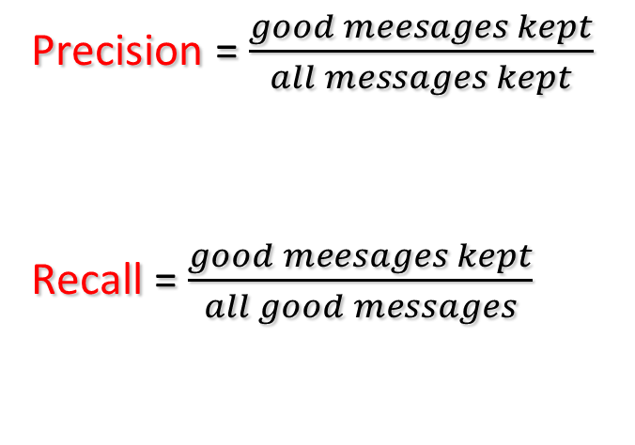
Measuring Performance
Precision = $\frac{good meesages kept}{all messages kept}$
Recall = $\frac{good meesages kept}{all good messages}$
Trade off precision vs. recall by setting threshold
Measure the curve on annotated dev data (or test data)
Choose a threshold where user is comfortable
Slide from Jason Eisner

Slide 47
Measuring Performance
OK for search engines (maybe)
high threshold:
all we keep is good,
but we don’t keep much
would prefer to be here!
point where
precision=recall
(often reported)
low threshold:
keep all the good stuff, but a lot of the bad too
OK for spam filtering and legal search

Slide 48
The 2-by-2 contingency table
 | Correct | Incorrect
Selected | True Positive | False Positive
Not selected | False Negative | True Negative

Slide 49
Precision and Recall
Precision: % of selected items that are correct
Recall: % of correct items that are selected

Slide 50
A Combined measure: F
The F measure assesses the P/R tradeoff, through the weighted harmonic mean:
$$F=\frac{(b^{2}+1) precision∙recall}{b^{2}precision+recall}$$
$$F1=\frac{2 precision∙recall}{precision+recall}$$

Slide 51
Multiclass Classification
Dealing with > 2 classes
For each class c ∈ C
Build a binary classifier Y_{c} to distinguish c from ~c
Given a test document d
Evaluate membership in each class using Y_{c}
Assign d to each class c for which Y_{c} returns true

Slide 52
Micro- vs. Macro-Averaging
If we have more than one class, how do we combine multiple performance measures into one quantity
Macroaveraging: compute performance for each class, then average
Microaveraging: collect decision for all classes, compute contingency table, evaluate

Slide 53
Micro- vs. Macro-Averaging: Example
Class 1
Class 2
Micro Ave. Table
 | Truth: yes | Truth: no
Classifier: yes | 10 | 10
Classifier: no | 10 | 970
 | Truth: yes | Truth: no
Classifier: yes | 90 | 10
Classifier: no | 10 | 890
 | Truth: yes | Truth: no
Classifier: yes | 100 | 20
Classifier: no | 20 | 1860
Macroaveraged precision: (0.5 + 0.9)/2 = 0.7
Microaveraged precision: 100/120 = .83
Microaveraged score is dominated by score on common classes
Notes:
Because f1 ignores true negs and its magnitude is mostly determined by the number of true positives, large classes dominate small classes in microaverage.

Slide 54
More Complicated Cases of Measuring Performance
For multiclass classifiers:
Average accuracy (or precision or recall) of 2-way distinctions: Sports or not, News or not, etc.
Better, estimate the cost of different kinds of errors
e.g., how bad is each of the following?
putting Sports articles in the News section
putting Fashion articles in the News section
putting News articles in the Fashion section
Now tune system to minimize total cost
For ranking systems:
Correlate with human rankings?
Get active feedback from user?
Measure user’s wasted time by tracking clicks?
Which articles are most Sports-like?
Which articles / webpages most relevant?

Slide 55
Evaluation Benchmark
Reuters-21578 Data Set
Most (over)used data set, 21,578 docs (each 90 types, 200 tokens)
9603 training, 3299 test articles (ModApte/Lewis split)
118 categories
An article can be in more than one category
Learn 118 binary category distinctions
Average document (with at least one category) has 1.24 classes
Only about 10 out of 118 categories are large

Slide 56
Evaluation: Classic Reuters-21578 Data Set
Most (over)used data set, 21,578 docs (each 90 types, 200 toknens)
9603 training, 3299 test articles (ModApte/Lewis split)
118 categories
An article can be in more than one category
Learn 118 binary category distinctions
Average document (with at least one category) has 1.24 classes
Only about 10 out of 118 categories are large
Common categories
(#train, #test)
Earn (2877, 1087)
Acquisitions (1650, 179)
Money-fx (538, 179)
Grain (433, 149)
Crude (389, 189)
Trade (369,119)
Interest (347, 131)
Ship (197, 89)
Wheat (212, 71)
Corn (182, 56)

Slide 57
Reuters Text Categorization data set
<REUTERS TOPICS="YES" LEWISSPLIT="TRAIN" CGISPLIT="TRAINING-SET" OLDID="12981" NEWID="798">
<DATE> 2-MAR-1987 16:51:43.42</DATE>
<TOPICS><D>livestock</D><D>hog</D></TOPICS>
<TITLE>AMERICAN PORK CONGRESS KICKS OFF TOMORROW</TITLE>
<DATELINE> CHICAGO, March 2 - </DATELINE><BODY>The American Pork Congress kicks off tomorrow, March 3, in Indianapolis with 160 of the nations pork producers from 44 member states determining industry positions on a number of issues, according to the National Pork Producers Council, NPPC.
Delegates to the three day Congress will be considering 26 resolutions concerning various issues, including the future direction of farm policy and the tax law as it applies to the agriculture sector. The delegates will also debate whether to endorse concepts of a national PRV (pseudorabies virus) control and eradication program, the NPPC said.
A large trade show, in conjunction with the congress, will feature the latest in technology in all areas of the industry, the NPPC added. Reuter
&#3;</BODY></TEXT></REUTERS>

Slide 58
Confusion matrix c
For each pair of classes <c₁,c₂> how many documents from c₁ were incorrectly assigned to c₂?
c_{3,2}: 90 wheat documents incorrectly assigned to poultry
Docs in test set | Assigned UK | Assigned poultry | Assigned wheat | Assigned coffee | Assigned interest | Assigned trade
True UK | 95 | 1 | 13 | 0 | 1 | 0
True poultry | 0 | 1 | 0 | 0 | 0 | 0
True wheat | 10 | 90 | 0 | 1 | 0 | 0
True coffee | 0 | 0 | 0 | 34 | 3 | 7
True interest | - | 1 | 2 | 13 | 26 | 5
True trade | 0 | 0 | 2 | 14 | 5 | 10

Slide 59
Development Test Sets and Cross-validation
Training set
Development Test Set
Test Set
Metric: P/R/F1 or Accuracy
Unseen test set
avoid overfitting (‘tuning to the test set’)
more conservative estimate of performance
Cross-validation over multiple splits
Handle sampling errors from different datasets
Pool results over each split
Compute pooled dev set performance
Training Set
Dev Test
Training Set
Dev Test
Training Set
Dev Test
Test Set

Slide 60
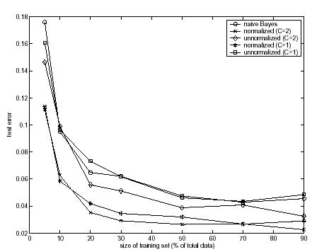
Training size
The more the better! (usually)
Results for text classification*
Test error vs training size on the newsgroups rec.sport.baseball and rec.sport.hockey
Slide from Nakov/Hearst/Rosario

Slide 61
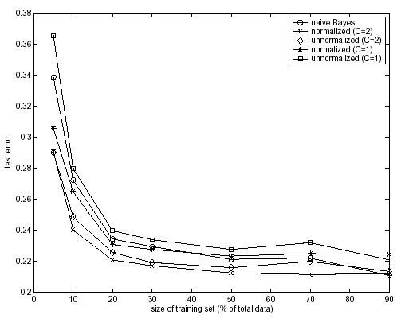
Training size
Test error vs training size on the newsgroups alt.atheism and talk.religion.misc
Slide from Nakov/Hearst/Rosario

Slide 62
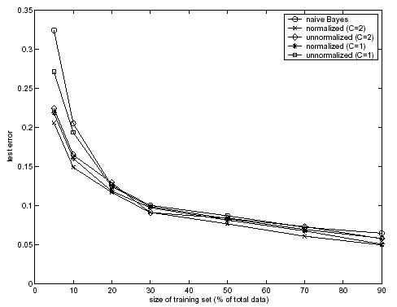
Training size
Slide from Nakov/Hearst/Rosario

Slide 63
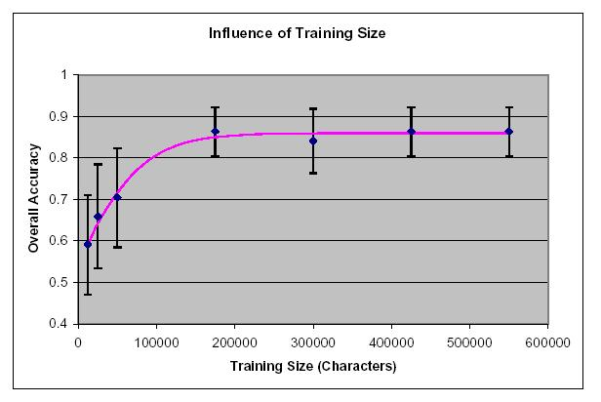
Training Size
Author identification
Slide from Nakov/Hearst/Rosario

Slide 64
Violation of NB Assumptions
Conditional independence
“Positional independence”
Examples?

Slide 65
Naïve Bayes is Not So Naïve
Naïve Bayes: first and second place in KDD-CUP 97 competition, among 16 (then) state of the art algorithms
Goal: Financial services industry direct mail response prediction model: Predict if the recipient of mail will actually respond to the advertisement – 750,000 records.
Robust to Irrelevant Features
Irrelevant Features cancel each other without affecting results
Instead Decision Trees can heavily suffer from this.
Very good in domains with many equally important features
Decision Trees suffer from fragmentation in such cases – especially if little data
A good dependable baseline for text classification (but not the best)!

Slide 66
Naïve Bayes is Not So Naïve
Optimal if the Independence Assumptions hold:
If assumed independence is correct, then it is the Bayes Optimal Classifier for problem
Very Fast:
Learning with one pass of counting over the data; testing linear in the number of attributes, and document collection size
Low Storage requirements
Online Learning Algorithm
Can be trained incrementally, on new examples

Slide 67
SpamAssassin
Naïve Bayes widely used in spam filtering
Paul Graham’s A Plan for Spam
A mutant with more mutant offspring...
Naive Bayes-like classifier with weird parameter estimation
But also many other things: black hole lists, etc.
Many email topic filters also use NB classifiers

Slide 68
SpamAssassin Tests
Mentions Generic Viagra
Online Pharmacy
No prescription needed
Mentions millions of (dollar) ((dollar) NN,NNN,NNN.NN)
Talks about Oprah with an exclamation!
Phrase: impress ... girl
From: starts with many numbers
Subject contains "Your Family”
Subject is all capitals
HTML has a low ratio of text to image area
One hundred percent guaranteed
Claims you can be removed from the list
'Prestigious Non-Accredited Universities'
http://spamassassin.apache.org/old/tests_3_3_x.html

Slide 69
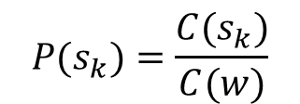
Naïve Bayes: Word Sense Disambiguation
w an ambiguous word
s₁, …, s_{K} senses for word w
v₁, …, v_{J} words in the context of w
P(s_{j}) prior probability of sense s_{j}
P(v_{j}|s_{k}) probability that word v_{j} occurs in context of sense s_{k}
$$P(s_{k})=\frac{C(s_{k})}{C(w)}$$
$$P(v_{j}|s_{k})=\frac{C(v_{j},s_{k})}{C(s_{k})}$$
$$s=\underset{s_{k}}{\text{argmax}}P(s_{k})\prod_{v_{j}}{P(v_{j}|s_{k})}$$

