Slide 1

Human Language Technologies
Università di Pisa
Giuseppe Attardi
Dipartimento di Informatica
Università di Pisa

Slide 2
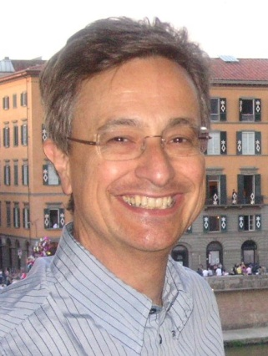
Instructor
Giuseppe Attardi
Office: 292
mail: attardi@di.unipi.it
web: www.di.unipi.it/~attardi

Slide 3
Course Info
Course Page:
  https://elearning.di.unipi.it/course/view.php?id=152
Hours:
  Monday 11-13, Room L1
  Tuesday 9-11, Room C1
  Friday 14-16, Room A1

Slide 4
Prerequisites
Proficiency in Python
  Assignments, projects will be in Python, using NLP and Deep Learning libraries
Calculus, Linear Algebra
  Basic knowledge of derivatives and vector/matrix operations
  See course “Computational Mathematics for learning and data analysis” (646AA)
  https://esami.unipi.it/esami2/programma.php?c=39132&aa=2018&cid=69&did=13
Basic Probability and Statistics
  Basic concepts of probability distributions, mean, standard deviation.
  See course “Calcolo delle Probabilità e Statistica” (269AA)
  https://elearning.di.unipi.it/enrol/index.php?id=101
Machine Learning
  Machine learning notions like cost functions, optimization with backpropagation.
  See course “Machine Learning” (654AA)
  https://esami.unipi.it/esami2/programma.php?c=36545&aa=2018&cid=69&did=13

Slide 5
What you will learn?
Understanding of and ability to use effective modern methods for Natural Language Processing
  From traditional methods used in NLP to current advanced methods like Recurrent networks, attention, etc.
Understanding the difficulties in dealing with NL and the capabilities of current technologies
Experience with modern tools
Ability to build systems for some of the major NLP tasks:
  Word similarities, parsing, machine translation, entity recognition, question answering, sentiment analysis, dialogue system

Slide 6
Books
D. Jurafsky, J.H. Martin. Speech and Language Processing. 2nd edition, Prentice-Hall, 2008.
I. Goodfellow, Yoshua Bengio and A. Courville. Deep Learning, http://www.deeplearningbook.org, 2016.
S. Bird, E. Klein, E. Loper. Natural Language Processing with Python.
S. Kubler, R. McDonald, J. Nivre. Dependency Parsing. 2010.
P. Koehn. Statistical Machine Translation. Cambridge University Press, 2010.

Slide 7
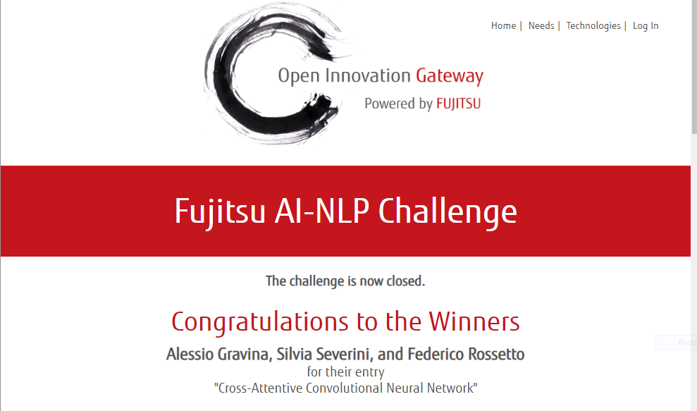

Exam
Project
  alone or in a small team
Aim
  Experiment with techniques in a realistic setting, e.g.
  Using data from competitions
  (Kaggle, CoNLL, SemEval, Evalita)
Topics
  List of suggestions
  Proposed by team
Price: 20,000 $

Slide 8
Previous Year Projects
Participation to Evalita 2011
  Task POS + Lemmatization: 1st position
  Task Domain Adaptation: 1st position
  Task SuperSense: 1st position
  Task Dependency Parsing: 2nd position
  Task NER: 3rd position
SemEval 2012
  Sentiment Analysis on tweets
Participation to Evalita 2014
  Sentiment Analysis on tweets
Disaster Alarm from Tweets
Participation to Evalita 2016
  Task POS on Tweets:
  Task Sentipolc on Twitter: 1st position
  Task Named Entity Linking: 1st position
Fujitsu AI NLP Challenge 2018
  Winners of 20,000 $ prize
Neural Machine Translator
Voice Guide for the Museo degli Strumenti di Calcolo
Chatbot for Persona.AI

Slide 9
Motivation
Language is the most distinctive feature of human intelligence
Language shapes thought
Emulating language capabilities is a scientific challenge
Keystone for intelligent systems

Slide 10
Structured vs Unstructured Data
85% of business-relevant information originates in unstructured form, primarily text, according to Anant Jhingran of IBM Research.
Information is mostly communicated by reading or writing e-mails, reports, or articles and the like, in conversations, or by listening/watching media
Attempts to turn text into structured (HTML) or microformat only scratch the surface
Problems:
  Requires universal agreed ontologies
  Additional effort
Entity linking attempts to provide a bridge

Slide 11
Human Language Technology
State of the art

Slide 12
Early history of NLP: 1950s
Early NLP (Machine Translation) on machines less powerful than pocket calculators
Foundational work on automata, formal languages, probabilities, and information theory
First speech systems (Davis et al., Bell Labs)
MT heavily funded by military – a lot of it was just word substitution programs but there were a few seeds of later successes, e.g., trigrams
Little understanding of natural language syntax, semantics, pragmatics
Problem soon appeared intractable
AI Winter: discipline mostly neglected

Slide 13
Resurgence
‘90s: introduction of statistical methods
Challenges: NIST (speech, Trec, MT), Netflix, DARPA Grand Challenge
2010’s: Deep Learning
Hans Moravec in 1978 was saying that it was impossible to achieve AI because of insufficient computing power
  10⁹ increase required
  expected to be available by 40 years

Slide 14
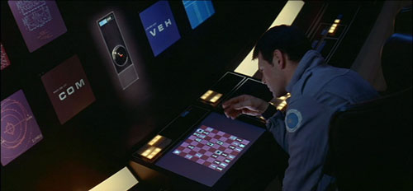
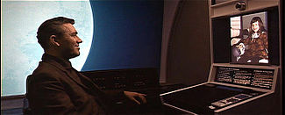
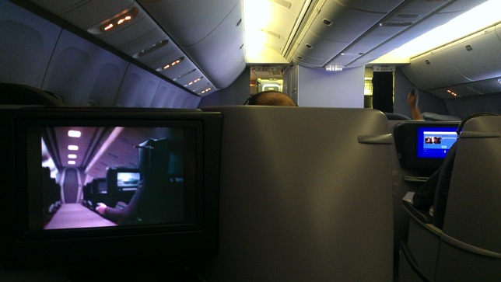
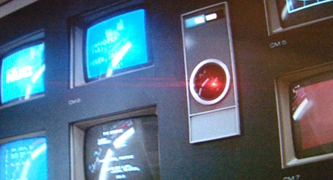

2001 a space Odyssey: 40 years later
Technology surpassed the vision
Internet
The Web
Smartphones
Genomics
Unmanned space exploration
Home computing
Big data
Computer chess
Audio-video communication
On board entertainment
Computer graphics
Except for
Tablet devices
Computer Speech
…and bad airline food
Computer Vision
Computer cognition

Slide 15
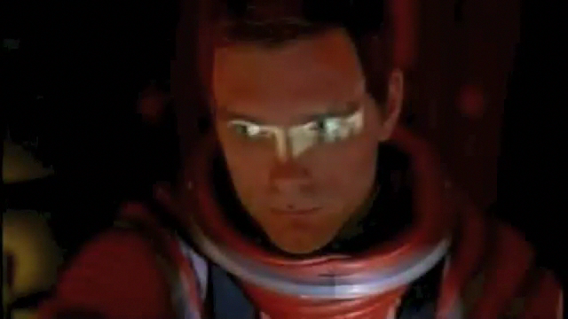
Speech technology in 2001: the vision

Slide 16
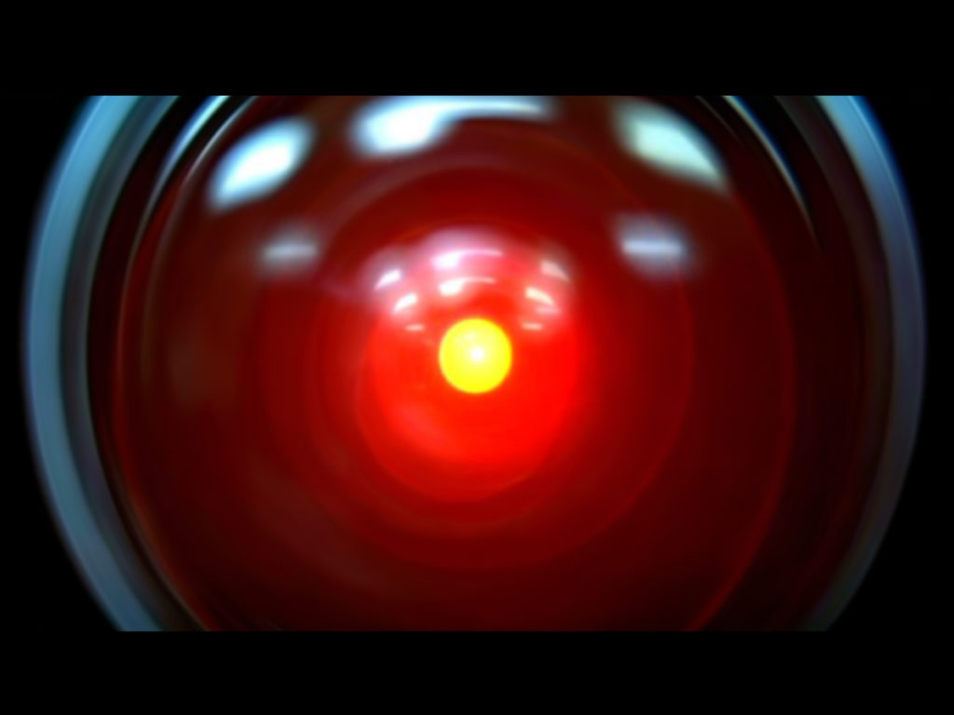

Speech technology in 2001: the reality
Design: Jonathan Bloom
Realization: Peter Krogh

Slide 17

Speech Assistants: today

Slide 18
Machine Translation, circa 2001
Lo spirito è forte ma la carne è debole
tradotto in russo
La vodka è forte ma la bistecca è tenera
apocrifo

Slide 19
Machine Translation Progress
Gli chiese di riorganizzare Forza Italia
  The churches to reorganize Italy Force (Altavista)
  She asked him to reorganize Forza Italia (Google)
Il ministro Stanca si è laureato alla Bocconi
  The Minister Stanca graduated at Mouthfuls (Altavista)
  The Minister Stanca is a graduate of Bocconi (Google)

Slide 20
How to teach natural language to computers
Children learn to speak naturally, by interacting with others
Nobody teaches them grammar
Is it possible to let computer learn language in a similarly natural way?

Slide 21
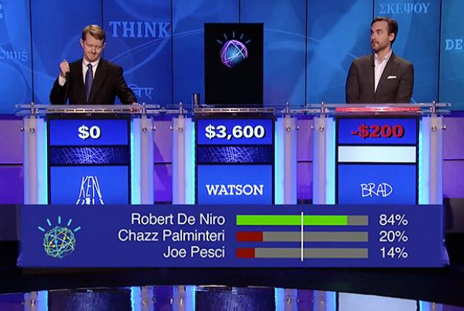



Recent Breakthroughs
Speech to text
    Apple Siri, Google Now
Machine Translation
  Google translate
Question Answering
  IBM Watson
  Beated the human champions at the TV quiz Jeopardy!

Slide 22
Quiz Bowl Competition
Iyyer et al. 2014: A Neural Network for Factoid Question Answering over Paragraphs
QUESTION:
  He left unfinished a novel whose title character forges his father’s signature to get out of school and avoids the draft by feigning desire to join.
  One of his novels features the jesuit Naptha and his opponent Settembrini, while his most famous work depicts the aging writer Gustav von Aschenbach.
  Name this German author of The Magic Mountain and Death in Venice.
ANSWER: Thomas Mann

Slide 23
QANTA vs Ken Jennings
QUESTION:
  Along with Evangelista Torricelli, this man is the namesake of a point the minimizes the distances to the vertices of a triangle.
  He developed a factorization method …
  ANSWER: Fermat
QUESTION:
  A movie by this director contains several scenes set in the Yoshiwara Nightclub.
  In a movie by this director a man is recognized by a blind beggar because he is wistling In the hall of the mountain king.
  ANSWER: Fritz Lang

Slide 24
NL: Science Fiction
Star Trek
  universal translator: Babel Fish
  Language Interaction

Slide 25
Quiz Bowl Competition
Iyyer et al. 2014: A Neural Network for Factoid Question Answering over Paragraphs
QUESTION:
  He left unfinished a novel whose title character forges his father’s signature to get out of school and avoids the draft by feigning desire to join.
  One of his novels features the Jesuit Naptha and his opponent Settembrini, while his most famous work depicts the aging writer Gustav von Aschenbach.
  Name this German author of The Magic Mountain and Death in Venice.
ANSWER: Thomas Mann

Slide 26
QANTA vs Ken Jennings
QUESTION:
  Along with Evangelista Torricelli, this man is the namesake of a point the minimizes the distances to the vertices of a triangle.
  He developed a factorization method …
  ANSWER: Fermat
QUESTION:
  A movie by this director contains several scenes set in the Yoshiwara Nightclub.
  In a movie by this director a man is recognized by a blind beggar because he is wistlin In the hall of the mountain king.
  ANSWER: Fritz Lang

Slide 27
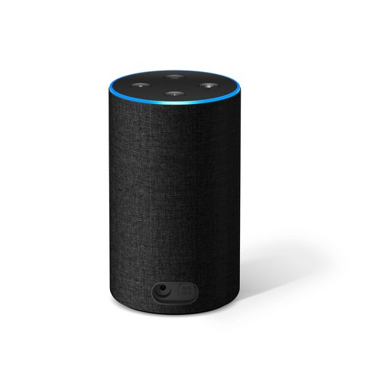
Recent Breakthroughs
IBM Watson beats human champions at TV quiz Jeopardy!:
  http://www.aaai.org/Magazine/Watson/watson.php
  Final Game
  PBS report
Google Translate on iPhone
  http://googleblog.blogspot.com/2011/02/introducing-google-translate-app-for.html
Apple SIRI
Amazon Alexa (Echo)
Google Home

Slide 28
IBM Project Debater
IBM Debater, went head-to-head with one of the world’s most decorated practitioners.
After a 25-minute rapid-fire exchange about pre-school subsidies, the audience handed the victory to Harish Natarajan.

Slide 29
Technological Breakthroughs
Available
Missing
Machine learning
Lrage amount of annotated data
Large processing capabilities
Lack of talent
Lack of annotated data
Lack of widespread computational resources

Slide 30
Statistical Machine Learning
Supervised Training
Annotated document collections
Ability to process Big Data
  If we used same algorithms 10 years ago they would still be running
Similar techniques for both speech and text

Slide 31
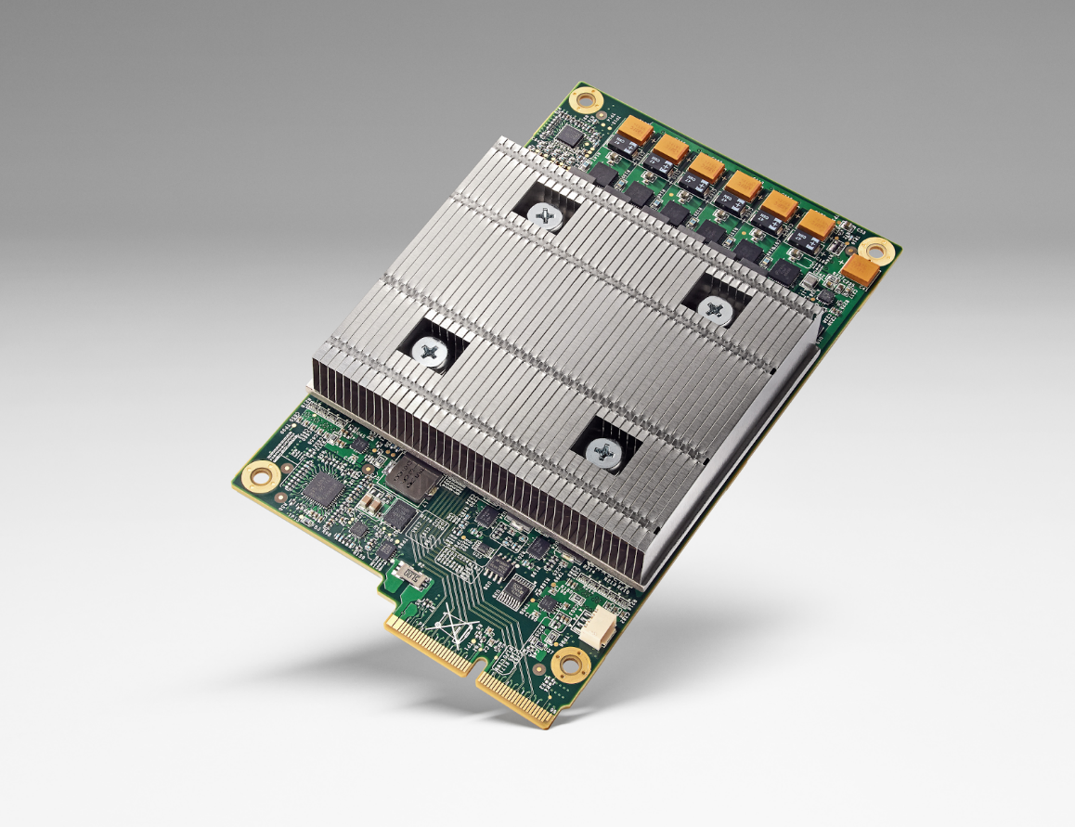
Big Data & Deep Learning
Requires high speed computing
Typical using GPUs
  Eg. NVIDIA Tesla
Google custom chip TPU
10x more power per watt
Half precision floats

Slide 32
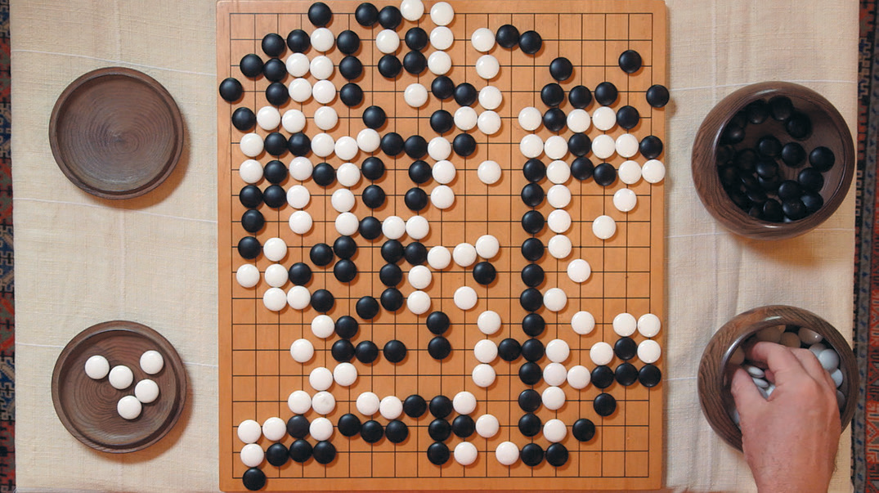
AlphaGo
Exploiting Deep Learning and Reinforcement Learning, running on TPU equipped machines, the program AlphaGo by DeepMind has beaten the world champion at the game of Go, on March 9, 2016.
The story has been
told in a movie.
AlphaGo evolved into
AlphaGo Zero in 2017,
which learns by itself,
without playing with
humans.

Slide 33
Digression

Slide 34
Big Data Science & Artificial Intelligence
Both use Big Data
Different kinds and different use
Statistical Analysis of Big Data use raw data and extract correlations or statistical indicators
AI needs data annotated by humans, from which to learn behaviors to perform similar tasks in other situations
Human in the loop in data used for ML in AI:
  data produced by humans and annotated by humans, enter the learning cycle of human behaviors

Slide 35
Difference between Data Science, ML and AI
Data science produces insights
Machine learning produces predictions
Artificial Intelligence produces behaviours
See David Robinson’s post
A model is required to make predictions
Example:
  Statistics about whether are not enough to make weather forecasting
  An atmosphere model is needed for forecasting

Slide 36
Human in the Loop
Data Science exploits human in the end, whose intelligence is involved for sifting among statistical correlation hints to produce insights. Intelligence lays in the humans that interpret the output of statistical analysis.
ML provides generalizations that can be used to make predictions
AI uses ML with human in the loop to extract a model of a human intelligence ability. AI embeds the human intelligence in the system itself.
Chris Manning:
When you take a product off the supermarket shelf, data is collected and stored into logs.
Analysis proceeds from such business process exhaust data.
With language human has some information to communicate and construct a message to convey meaning to other humans.
Deliberate form of expressing intent, facts, opinion, etc.

Slide 37
Text Analytics vs. Text Mining
Text Analytics
Text Mining
Need to analyze large amounts of text to discover useful information
Examples:
  monitoring how the public discusses a product in social media
  Anti-terrorism intelligence
  Sentiment analysis
The process of deriving high-quality information from text
High-quality information is typically derived through the devising of patterns and trends through means such as statistical pattern learning
aims to turn text into data for analysis, via application of natural language processing (NLP) and analytical methods.

Slide 38
Role of Data

Slide 39
Unreasonable Effectiveness of Data
Halevy, Norvig, and Pereira argue that we should stop acting as if our goal is to author extremely elegant theories, and instead embrace complexity and make use of the best ally we have: the unreasonable effectiveness of data.
A simpler technique on more data beat a more sophisticated technique on less data.
Language in the wild, just like human behavior in general, is messy.

Slide 40
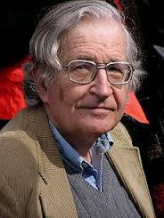

Scientific Dispute: is it science?
Prof. Noam Chomsky, Linguist, MIT
Peter Norvig, Director of research, Google

Slide 41
Chomsky
It's true there's been a lot of work on trying to apply statistical models to various linguistic problems. I think there have been some successes, but a lot of failures. There is a notion of success ... which I think is novel in the history of science. It interprets success as approximating unanalyzed data.
http://norvig.com/chomsky.html

Slide 42
Norvig
I agree that engineering success is not the goal or the measure of science. But I observe that science and engineering develop together, and that engineering success shows that something is working right, and so is evidence (but not proof) of a scientifically successful model.
Science is a combination of gathering facts and making theories; neither can progress on its own. I think Chomsky is wrong to push the needle so far towards theory over facts; in the history of science, the laborious accumulation of facts is the dominant mode, not a novelty. The science of understanding language is no different than other sciences in this respect.
I agree that it can be difficult to make sense of a model containing billions of parameters. Certainly a human can't understand such a model by inspecting the values of each parameter individually. But one can gain insight by examining the properties of the model—where it succeeds and fails, how well it learns as a function of data, etc.

Slide 43
Norvig (2)
Einstein said to make everything as simple as possible, but no simpler. Many phenomena in science are stochastic, and the simplest model of them is a probabilistic model; I believe language is such a phenomenon and therefore that probabilistic models are our best tool for representing facts about language, for algorithmically processing language, and for understanding how humans process language.
I agree with Chomsky that it is undeniable that humans have some innate capability to learn natural language, but we don't know enough about that capability to rule out probabilistic language representations, nor statistical learning. I think it is much more likely that human language learning involves something like probabilistic and statistical inference, but we just don't know yet.

Slide 44
HLT in Industry

Slide 45
HLT in Industry
Advanced Search
Advertisement, preference analysis
Machine Translation
Speech Interfaces
Assistants, Chatbots:
  Customer support
  Controlling devices
  Home devices (Amazon, Google, Apple)
  Sales assistants

Slide 46
Tsunami of Deep Learning
AlphaGo beats human champion at Go.
RankBrain is third most important factor in the ranking algorithm along with links and content at Google
RankBrain is given batches of historical searches and learns to make predictions from these
It learns to deal also with queries and words never seen before
Most likely it is using Word Embeddings

Slide 47
Dependency Parsing
DeSR is online since 2007
Stanford Parser
Google Parsey McParseFace in 2016

Slide 48
Google
“At Google, we spend a lot of time thinking about how computer systems can read and understand human language in order to process it in intelligent ways.”
Parser used to analyze most of text processed
Parser used in Machine Translation

Slide 49
Apple SIRI
ASR (Automated Speech Recognition) integrated in mobile phone
Special signal processing chip for noise reduction
Custom GPU
SIRI ASR
Cloud service for analysis
Integration with applications

Slide 50
Google Voice Actions
Google: what is the population of Rome?
Google: how tall is Berlusconi
How old is Lady Gaga
Who is the CEO of Tiscali
Who won the Champions League
Send text to Gervasi Please lend me your tablet
Navigate to Palazzo Pitti in Florence
Call Antonio Cisternino
Map of Pisa
Note to self publish course slides
Listen to Dylan

Slide 51
Personal Assistants
Siri, Alexa, Google Home
Jibo, by Roberto Pieraccini, formerly from CSELT, Torino
They will invade our houses, behaving as mediators, sales persons, advisers, entertaining us, etc.

Slide 52
Why to study human language?

Slide 53
AI is fascinating since it is a discipline where the mind studies itself.
Luigi Stringa, director FBK

Slide 54
Thirty Million Words
The number of words a child hears in early life will determine their academic success and IQ in later life.
Researchers Betty Hart and Todd Risley (1995) found that children from professional families heard thirty million more words in their first 3 years
http://www.youtube.com/watch?v=qLoEUEDqagQ

Slide 55
Language and Intelligence
“Understanding cannot be measured by external behavior; it is an internal metric of how the brain remembers things and uses its memories to make predictions”.
“The difference between the intelligence of humans and other mammals is that we have language”.
  Jeff Hawkins, “On Intelligence”, 2004

Slide 56
Hawkins’ Memory-Prediction Framework
The brain uses vast amounts of memory to create a model of the world.
Everything you know and have learned is stored in this model.
The brain uses this memory-based model to make continuous predictions of future events.
It is the ability to make predictions about the future that is the crux of intelligence.

Slide 57
Exploiting Knowledge

Slide 58
Knowledge is Power
But only if you know how to acquire it …
The Economist, May 8, 2003
Requires
  Knowledge Extraction
  Repositories of knowledge
  Inference mechanisms for using that knowledge

Slide 59
Knowledge Based Approach
Common Sense requires an immense amount of knowledge about the world
Mostly subjective and intuitive: hard and complex to formalize
Computer can apply logical inference rules to statements in a formal language:
  Logical inference is computationally expensive
  Rules can be hundreds of thousands

Slide 60
Machine Learning
Relies on feature representation
Input is transformed into a vector of features
Designing features for a complex task requires a great deal of human time and effort
Feature selection or feature engineering
Possible solution: representation learning
Feature | NER
Current Word | 
Previous Word | 
Next Word | 
Current Word Character n-gram | all
length | 
Current POS Tag | 
Surrounding POS Tag Sequence | 
Current Word Shape | 
Surrounding Word Shape Sequence | 
…
Features for finding
named entities like locations or
organization names (Finkel et al., 2010

Slide 61
Deep Learning
Deep learning is a particular kind of machine learning that relies on representation learning
End-to-end task learning capability
Representation Learning attempts to learn automatically good representations
Deep Learning algorithms aim at producing representations at several levels of abstraction
Automatically from raw data
  (e.g. sound, pixels, characters, or words)
Rely on Machine Learning to optimize weights to best make a final prediction

Slide 62
Deep Learning for Speech
The first breakthrough results of “deep learning” on large datasets happened in speech recognition
Context-Dependent Pre-trained Deep Neural Networks for Large Vocabulary Speech Recognition Dahl et al. (2010)
Acoustic model and WER | RT03S FSH | Hub5 SWB
Traditional features | 27.4 | 23.6
Deep Learning | 18.5 (−33%) | 16.1 (−32%)

Slide 63
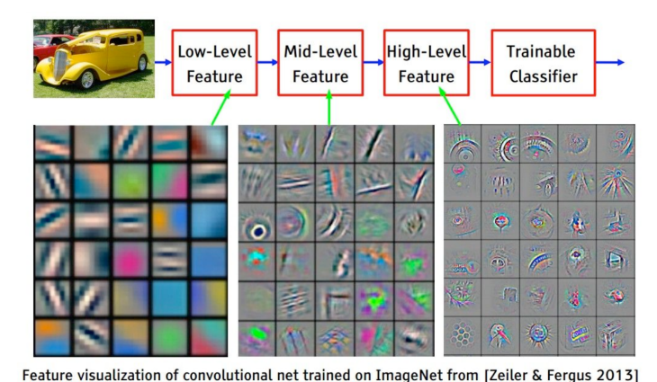
Deep Learning for Computer Vision
ImageNet Classification with Deep Convolutional Neural Networks by Krizhevsky, Sutskever, & Hinton, 2012, U. Toronto. -37% error

Slide 64
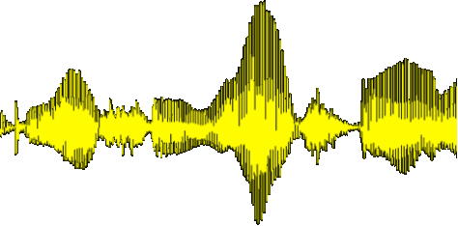
Deep Learning for NLP
Human language is a symbolic/discrete communication system
Symbols/Concepts may have different encodings:
Deep Learning explores a continuous encoding
sound | continuous
gesture | continuous
image | continuous
text | discrete
Afg a ghg ahj ajk al kl akl akla kla kl akl akl akl w io sd jio e op eo po eop e oppo po e[ p[p[pe p[ p[p

Slide 65
Deep Learning Success
Deep Learning has grown in success and popularity, largely due to:
  more powerful computers
    Faster CPUs and GPUs
  larger datasets
  better techniques to train deep networks
    Libraries
    Transferring models between tasks
    Regularization and optimization methods

Slide 66
Linguistic Tasks
Easy
  Spell Checking
  Keyword Search
  Finding Synonyms
Medium
  Parsing information from websites, documents, etc.
Hard
  Machine Translation
  Semantic Analysis (What is the meaning of query statement?)
  Coreference (e.g. What does "he" or "it" refer to given a document?)
  Question Answering.

Slide 67
Linguistic Applications
So far self referential: from language to language
  Classification
  Extraction
  Summarization
  Translation
More challenging:
  Derive conclusion
  Perform actions
Challenge:
  Find a universal learning mechanism capable of learning from observations and interactions, adequate to make predictions
  Yann LeCunn. How could machines learn as efficiently as humans?

Slide 68
NLP is Difficult

Slide 69
NLP hard
Natural language is:
  highly ambiguous at all levels
  complex and subtle use of context to convey meaning
  fuzzy?, probabilistic
  involves reasoning about the world
  a key part of people interacting with other people (a social system):
    persuading, insulting and amusing them
But NLP can also be surprisingly easy sometimes:
  rough text features can often do half the job
  Information Retrieval and similar superficial techniques have been in widespread use

Slide 70
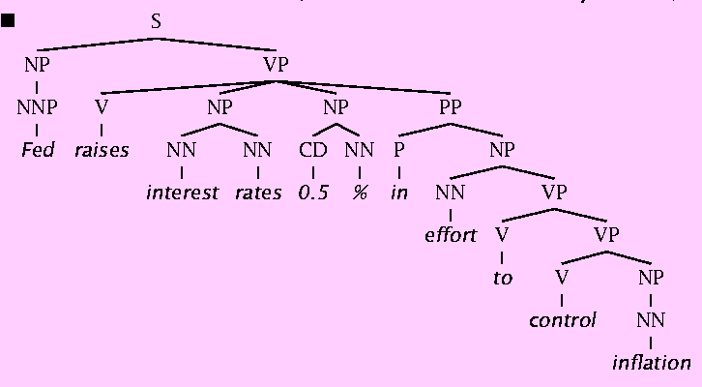
Natural Language Understanding is difficult
The hidden structure of language is highly ambiguous
Structures for: Fed raises interest rates 0.5% in effort to control inflation (NYT headline 5/17/00)
Slide by C. Manning

Slide 71
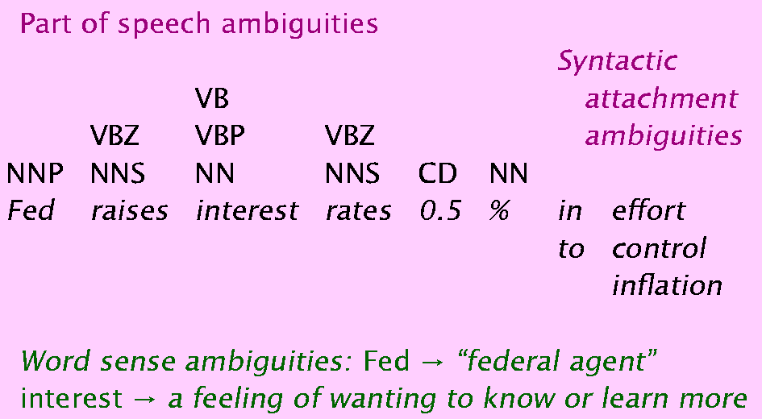
Where are the ambiguities?
Slide by C. Manning

Slide 72
Newspaper Headlines
Minister Accused Of Having 8 Wives In Jail
Pope’s baby steps on gays
Juvenile Court to Try Shooting Defendant
Teacher Strikes Idle Kids
China to Orbit Human on Oct. 15
Local High School Dropouts Cut in Half
Red Tape Holds Up New Bridges
Clinton Wins on Budget, but More Lies Ahead
Hospitals Are Sued by 7 Foot Doctors
Police: Crack Found in Man's Buttocks

Slide 73
Coreference Resolution
U: Where is The Green Hornet playing in Mountain View?
S: The Green Hornet is playing at the Century 16 theater.
U: When is it playing there?
S: It’s playing at 2pm, 5pm, and 8pm.
U: I’d like 1 adult and 2 children for the first show.
How much would that cost?
Knowledge sources:
  Domain knowledge
  Discourse knowledge
  World knowledge

Slide 74
Hidden Structure of Language
Going beneath the surface…
  Not just string processing
  Not just keyword matching in a search engine
    Search Google on “tennis racquet” and “tennis racquets” or “laptop” and “notebook” and the results are quite different …
    though these days Google does lots of subtle stuff beyond keyword matching itself
  Not just converting a sound stream to a string of words
    Like Nuance/IBM/Dragon/Philips speech recognition
To recover and manipulate at least some aspects of language structure and meaning

Slide 75
Deep Learning for NLP
Achieving goals of NLP by using representation learning and deep learning to build end-to-end systems

Slide 76
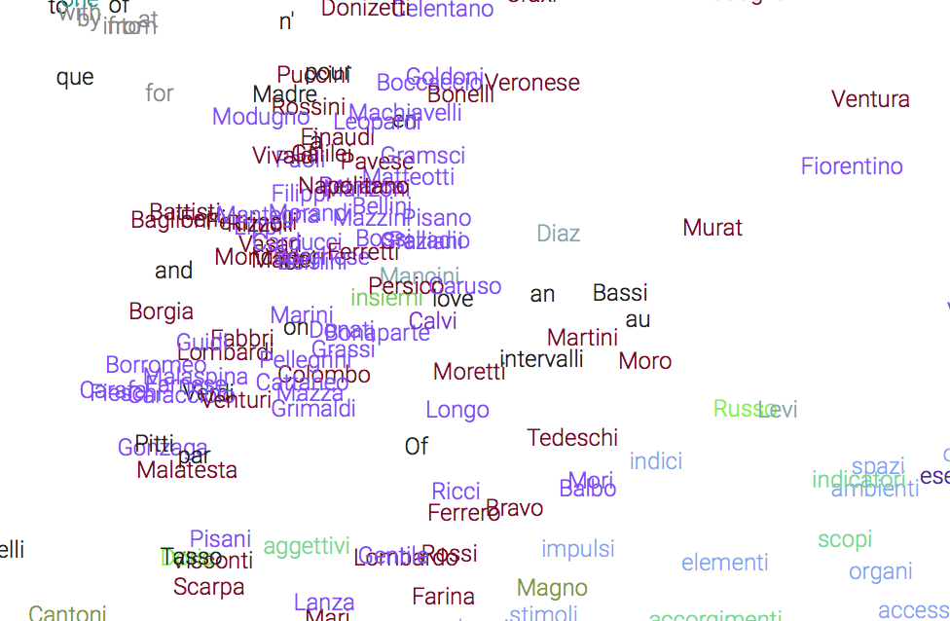
Continuous representation of Words
Learning vectors in large dimensional space that represents all aspects of word meaning
Word embeddings

Slide 77
Word Similarities
Nearest word to ‘rana’:
farfalla
tartaruga
delfino
zampa
scimmia

Slide 78
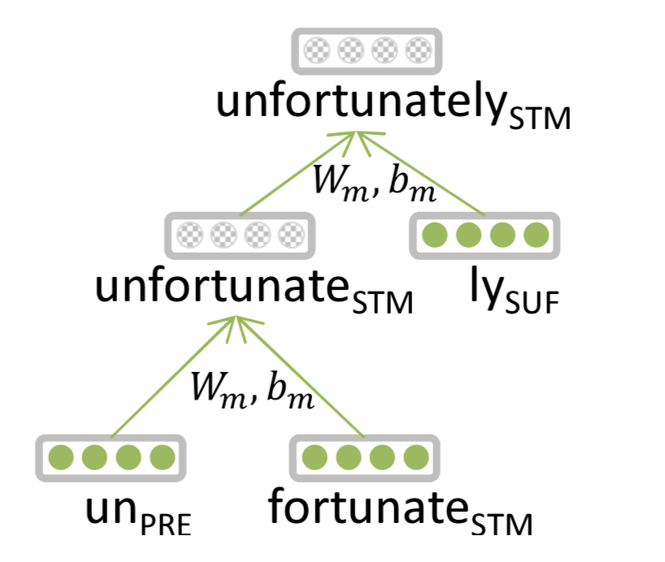
Entails Morphology
Words are made of morphemes:
  Prefix stem suffix
  un interest ed
DL:
  Every morpheme is a vector
  A NN combines vectors
  Luong et al. 2013

Slide 79
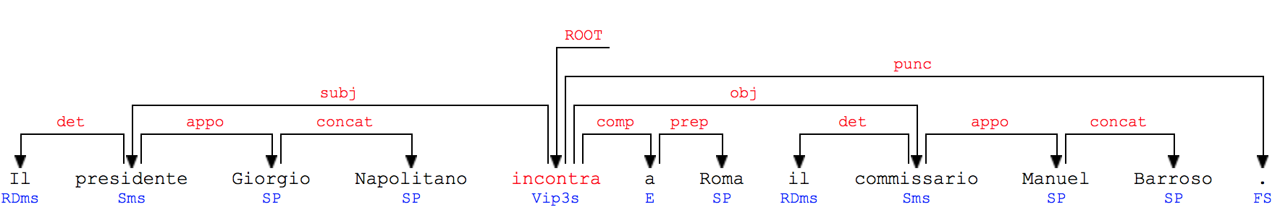
Parsing for Sentence Structure
Dependency Parser can determine grammatical structure of sentences
Useful for interpretation and relation extraction
See demo

Slide 80
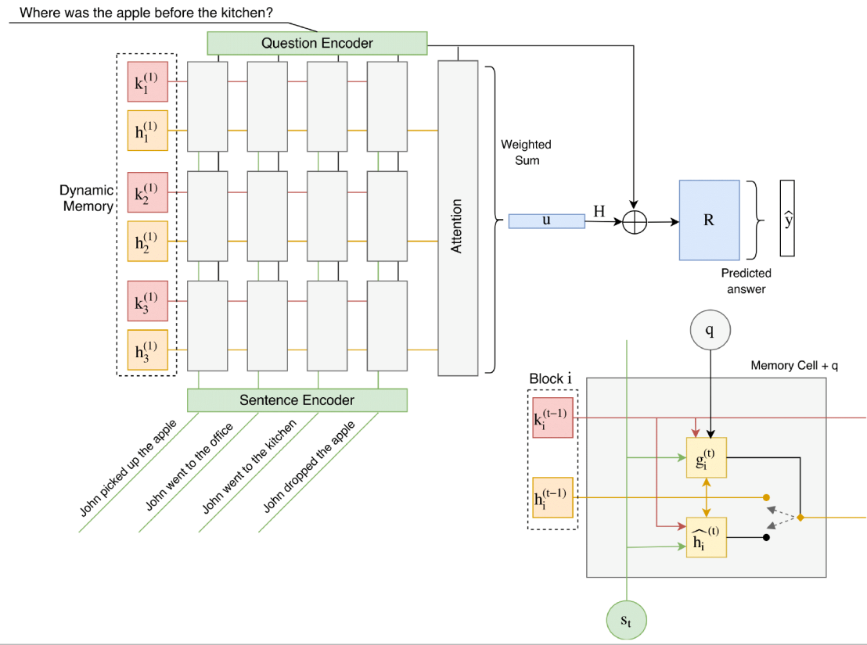
Question Answering
Traditional: A lot of feature engineering to capture world and other knowledge, e.g., regular expressions, Berant et al. (2014)
Deep Learning: embeddings represent words, a Recurrent Neural Network extracts entities and their relations and output module extracts the answer.
Madotto, Attardi. 2017. Question Dependent Recurrent Entity Network for QA

Slide 81
Neural Reasoner
Next frontier for AI
Overcome the dichotomy between
  Perceptive Tasks (voice, images): Deep Learning
  Inference: rule based systems, logic
Single Neural Network Model for both tasks
Learning like children, who do not know neither grammar nor differential equations for:
  Learning to speak interacting with adults
  Learn a simple model of the physical world starting from perceptual experiences

Slide 82
Course Overview

Slide 83
About the Course
Assumes some skills…
  basic linear algebra, probability, and statistics
  decent programming skills
  willingness to learn missing knowledge
Teaches key theory and methods for Statistical NLP
  Useful for building practical, robust systems capable of interpreting human language
Experimental approach:
  Lots of problem-based learning
  Often practical issues are as important as theoretical niceties

Slide 84
Experimental Approach
Formulate Hypothesis
Implement Technique
Train and Test
Apply Evaluation Metric
If not improved:
  Perform error analysis
  Revise Hypothesis
Repeat

Slide 85
Aims of the Course
Teach an understanding of technologies used for dealing with human language and Deep Learning in particular
Understanding the difficulties and the way to overcome them
Approaches to the basic NLP problems:
  Word similarities, entity recognition, parsing, machine translation, question answering, sentence comprehension
Skills in using modern tools and techniques in building NLP applications

Slide 86
Program
Introduction
  History
  Present and Future
  NL Processing and Human Interactions
Statistical Methods
  Language Model
  Hidden Markov Model
  Viterbi Algorithm
  Generative vs Discriminative Models
Linguistic Essentials
  Words, Lemmas, Part of Speech and Morphology
  Collocations
  Word Sense Disambiguation
  Word Embeddings

Slide 87
Preprocessing
  Encoding
  Regular Expressions
  Segmentation
  Tokenization
  Normalization
Lexical semantics
  Collocations
  Corpora
  Thesauri
  Gazetteers

Slide 88
Distributional Semantics
  Word embeddings
  Character embeddings
  Neural Language Models
Classification
  Bayesian Networks
  Perceptron
  SVM
  Maximum Entropy
  Applications: spam, phishing, fake news detection

Slide 89
Tagging
  Part of Speech
  Named Entity
Sentence Structure
  Constituency Parsing
  Dependency Parsing
Semantic Analysis
  Semantic Role Labeling
  Coreference resolution
Statistical Machine Translation
  Phrase-Based Models
  Neural Network Models
  Evaluation metrics
Deep Learning
  MLP, CNN, RNN, LSTM
Libraries
  NLTK
  Theano
  Tensorflow
  Keras
Applications
  Entity Linking
  Semantic Search
  Question Answering
  Language Inference

Slide 90
Opinion Mining
  Introduction to sentiment analysis
  Sentiment classification
  Lexical resources for sentiment analysis
Question answering
  Language inference
  Dialogic interfaces (chatbots)

