Slide 1
Chatbots

Slide 2
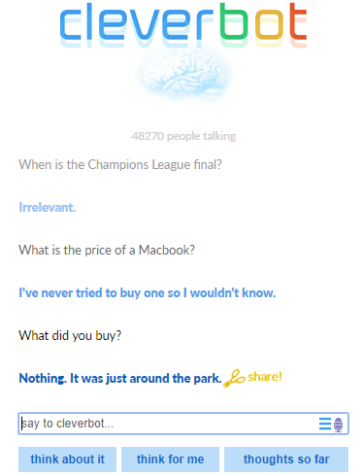
Early Approaches
ELIZA (Weizenbaum, 1966)
  Used clever hand-written templates to generate replies that resemble the user’s input utterances
  Several programming frameworks available today for building dialog agents d (Marietto et al., 2013, Microsoft, 2017b), Google Assistant

Slide 3
Templates and Rules
hand-written rules to generate replies.
simple pattern matching or keyword retrieval techniques are employed to handle the user’s input utterances.
rules are used to transform a matching pattern or a keyword into a predefined reply.
<category>
<pattern>What is your name?</pattern>
<template>My name is Alice</template>
</category >
<category>
<pattern>I like *</pattern>
<template>I too like <star/>.</template>
</category >

Slide 4
Build Actions with Google Assistant
Experiment with Dialogflow:
  https://codelabs.developers.google.com/codelabs/actions-1
  https://codelabs.developers.google.com/codelabs/actions-2
Actions Console
  https://console.actions.google.com/u/0/
  Once the action has been

Slide 5
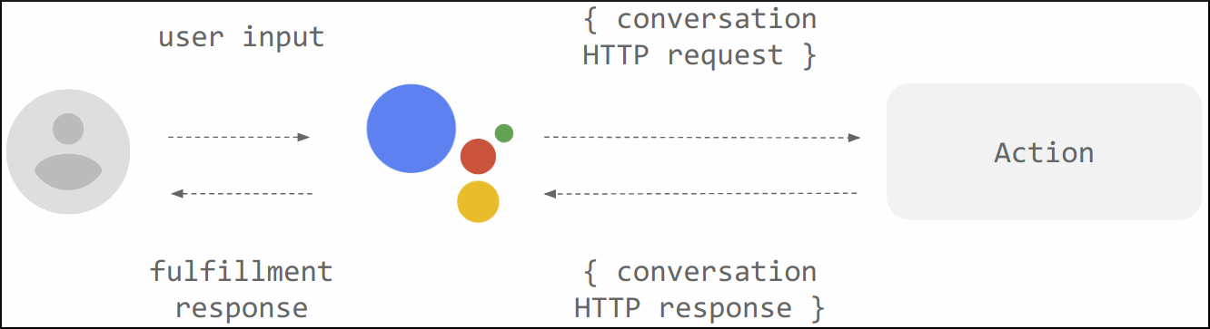
Key Concepts
Action: An Action is an entry point into an interaction that you build for the Assistant. Users can request your Action by typing or speaking to the Assistant.
Intent: An underlying goal or task the user wants to do; for example, ordering coffee or finding a piece of music. In Actions on Google, this is represented as a unique identifier and the corresponding user utterances that can trigger the intent.
Fulfillment: A service, app, feed, conversation, or other logic that handles an intent and carries out the corresponding Action.

Slide 6
Tools Used
Google Actions
  https://console.actions.google.com/
Dialogflow
  https://console.dialogflow.com/api-client/

Slide 7
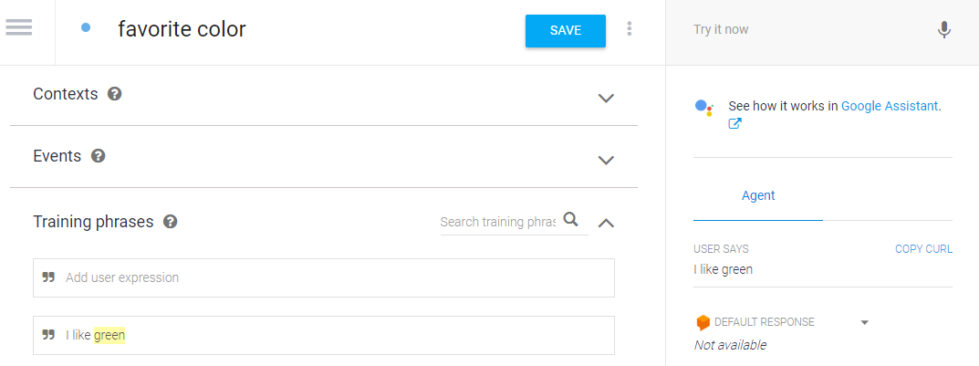
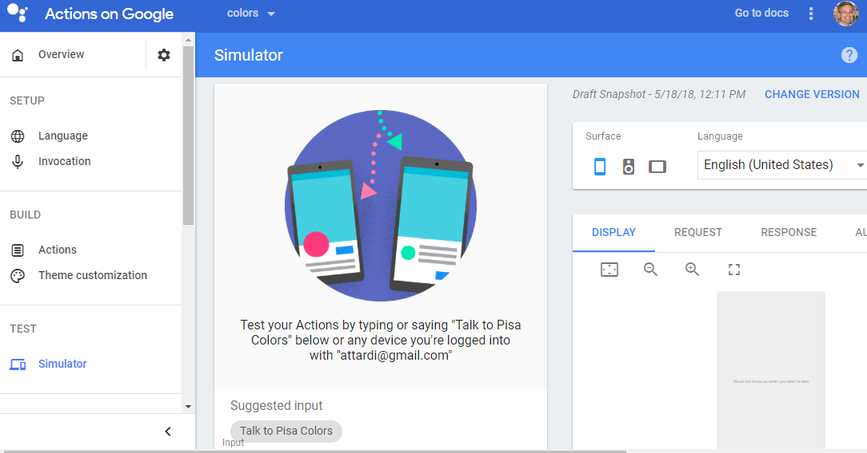
Test the action on Google Home
Once the action has been setup, click on See how it works on Google Assistant
Now the action can be tested also on Google Home

Slide 8
Open Domain
Closed Domain
open domain (harder) setting the user can take the conversation anywhere
There isn’t necessarily a well-defined goal or intention.
Conversations on social media sites like Twitter and Reddit are typically open domain
closed domain (easier) setting the space of possible inputs and outputs is somewhat limited
The system is trying to achieve a very specific goal.
Technical Customer Support or Shopping Assistants are examples of closed domain problems.

Slide 9
Open-Domain vs Closed-Domain
Conversations | Open Domain | Impossible | General AI
 | Closed Domain | Rule-based | Machine Learning
 |  | Retrieval-Based | Generative
 |  | Responses

Slide 10
Retrieval-based vs Generative Models
Retrieval based
Generative
Retrieval-based models (easier) use a repository of predefined responses and some kind of heuristic to pick an appropriate response based on the input and context.
The heuristic could be as simple as a rule-based expression match, or as complex as an ensemble of ML classifiers.
These systems don’t generate any new text, they just pick a response from a fixed set.
Generative models (harder) don’t rely on pre-defined responses.
They generate new responses from scratch.
Generative models are typically based on Machine Translation techniques
Instead of translating from one language to another, they “translate” from an input to an output (response).

Slide 11
Retrival-based
Generative
No grammatical mistakes.
Unable to handle unseen cases for which no appropriate predefined response exists.
Can’t refer back to contextual entity information like names mentioned earlier in the conversation.
can refer back to entities in the input and give the impression that you’re talking to a human
Hard to train
Likely to make grammatical mistakes (especially on longer sentences),
Typically require huge amounts of training data.

Slide 12
Long vs Short Conversations
The longer the conversation the more difficult to automate it.
Short Conversation
Long Conversation
Short-Text Conversations (easier) where the goal is to create a single response to a single input.
  For example, answering a specific question from a user with an appropriate answer.
Long conversations (harder) where you go through multiple turns and need to keep track of what has been said.
  Customer support conversations are typically long conversational threads with multiple questions.

Slide 13
Deep Learning for Chatbots
Deep Learning techniques can be used for both retrieval-based or generative models, but research seems to be moving into the generative direction
Deep Learning architectures like Sequence to Sequence are uniquely suited for generating text and researchers are hoping to make rapid progress in this area.
Still at the early stages of building generative models that work reasonably well.
Production systems are more likely to be retrieval-based for now.

Slide 14
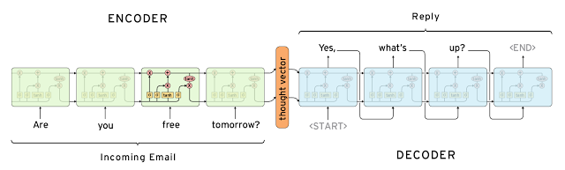
MT model

Slide 15
Twitter bot
Query | Reply
donald trump won last nights presidential debate according to snap online polls | thought he was a joke
trump campaign please never delete this | he was a joke
s new scoop is unk the castro connection how trumps company violated the us embargo against cuba | trump is a disgrace to the debate and the media is not a liar
who won the first presidential debate | trump will be a better time for a man
just wanna live in unk everything is 10x better there | i was just on the same side and i was like it was a good time
the lil girl i forgot her name scares the shit out of me n probably always will lmaooo | she was so cute and she was so cute and she was a bitch
question of the day who do you think won last nights debate weigh in using | hillary is a trump supporter and a woman who has a better job than a woman
trump is a total embarrassment hes like a unk child who happens to be a professional liar and con man | trump is a lot of money to get a great country
chill the fuck out | thats what i said
so fun to see what the special effects team created for | wow that is the best thing ive ever seen
she was fine too unk voice | she is a good guy
the important ones are still here | i dont think so
been drinking pumpkin spice protein shake every morning for a week and now i literally cannot even | me too i just got it
lmao i just lost my job and i cant even leave early to be in the unk video today | literally the same thing
hey happy birthday have a nice day | thank you

Slide 16
Cornell Movie Dialog Corpus
Query | Reply
when are you going to let the police know | you dont know what youre talking about
you can do it | yeah i think so
wait are you saying that i dont appreciate | i know you know what i mean
youre terrible | yeah but im not
nah i dont think so | why not
hes pissing in our faces again and were just taking it | i cant
im sorry i dont know what else to say except im sorry | why would you like to be
nobodys gonna get you now get inside | i cant go back
shall i leave | of course
well i really think hes got a chance | i know
youd better be quiet sandy | shut up
jesus christ you scared the shit out of me | whats going on
well im sorry im really sorry ellie | its okay
my lady this play will end badly i will tell | lets get out of here
im going to miss you | no youre not
what do you mean | i dont know i dont know what i mean
my god these people are insane | we dont know what they are
this isnt a date | no what is it
you ought to go home and take care of that | i cant do that
is something wrong | no no no

Slide 17
Implementation
basic_cell = tf.nn.rnn_cell.DropoutWrapper(
tf.nn.rnn_cell.BasicLSTMCell(emb_dim, state_is_tuple=True),
output_keep_prob=self.keep_prob)
# stack cells together: n layered model
stacked_lstm = tf.nn.rnn_cell.MultiRNNCell([basic_cell]*num_layers, state_is_tuple=True)

Slide 18
Loss Function
loss_weights = [ tf.ones_like(label, dtype=tf.float32)
for label in self.labels ]
self.loss = tf.nn.seq2seq.sequence_loss(self.decode_outputs,
self.labels, loss_weights, yvocab_size)
self.train_op = tf.train.AdamOptimizer(learning_rate=lr).minimize(self.loss)

Slide 19
Training
model = seq2seq_wrapper.Seq2Seq(xseq_len=xseq_len,
yseq_len=yseq_len,
xvocab_size=xvocab_size,
yvocab_size=yvocab_size,
ckpt_path='ckpt/twitter/',
emb_dim=emb_dim,
num_layers=3
)
val_batch_gen = data_utils.rand_batch_gen(validX, validY, 32)
train_batch_gen = data_utils.rand_batch_gen(trainX, trainY, batch_size)
#sess = model.restore_last_session()
sess = model.train(train_batch_gen, val_batch_gen)

Slide 20
Seq2seq model with embeddings
self.decode_outputs, self.decode_states
= tf.nn.seq2seq.embedding_rnn_seq2seq(
self.enc_ip,self.dec_ip, stacked_lstm,
xvocab_size, yvocab_size, emb_dim)

Slide 21
Challenges

Slide 22
Incorporating Context
To produce sensible responses systems may need to incorporate both linguistic context and physical context.
In long dialogs people keep track of what has been said and what information has been exchanged.
Experiments in Building End-To-End Dialogue Systems Using Generative Hierarchical Neural Network Models and Attention with Intention for a Neural Network Conversation Model try to embed a conversation into vectors.
Can you tell me why truth is not lie?
You perceive truth to be not lie, but is that true?
They are very different.
Good to know! I will store that info in y database.
Don’t you think so?
I kind of do, but it depends on the right context

Slide 23
Coherent Personality

Slide 24
Evaluation of Models

Slide 25
A Retrieval-based Model in TensorFlow

Slide 26
The Ubuntu Dialog Corpus
Ubuntu Dialog Corpus (github).
One of the largest public dialog datasets available.
Based on chat logs from the Ubuntu channels on a public IRC network.
This paper goes into detail on how exactly the corpus was created.
The training data consists of 1,000,000 examples
  50% positive (label 1) and 50% negative (label 0)
Each example consists of a context, the conversation up to this point, and an utterance, a response to the context
  A positive label means that an utterance was an actual response to a context,
  a negative label means that the utterance wasn’t — it was picked randomly from somewhere in the corpus.

Slide 27
The dataset has been preprocessed— it has been tokenized, stemmed, and lemmatized using the NLTK tool.
Replaced entities like names, locations, organizations, URLs, and system paths with special tokens.
This preprocessing is likely to improve performance by a few percent.
The average context is 86 words long and the average utterance is 17 words long.

Slide 28
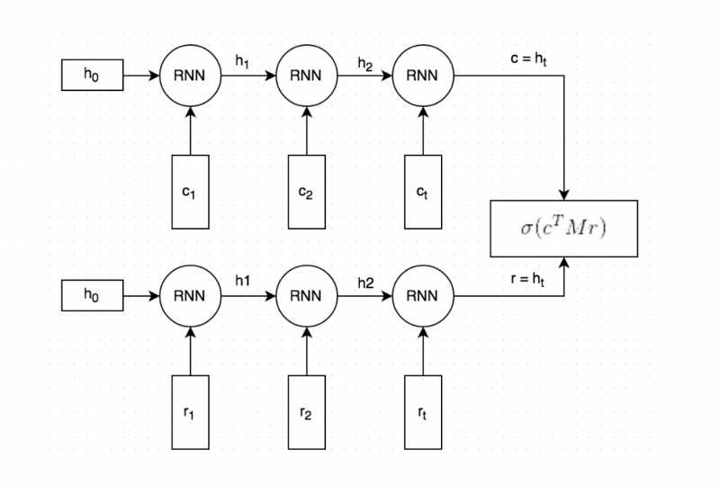
Dual Encoder LSTM
Dual Encoder has been reported to give decent performance on this data set.
Applying other models to this problem would be an interesting project.

Slide 29
Training
Both the context and the response text are split by words, and each word is embedded into a vector. The word embeddings are initialized with Stanford’s GloVe vectors and are fine-tuned during training.
Both the embedded context and response are fed into the same RNN word-by-word. The RNN generates a vector representation that captures the “meaning” of the context and response (c and r in the picture). We can choose how large these vectors should be, but let’s say we pick 256 dimensions.
We multiply c with a matrix M to “predict” a response r’. If c is a 256-dimensional vector, then M is a 256×256 dimensional matrix, and the result is another 256-dimensional vector, which we can interpret as a generated response. The matrix M is learned during training.
The similarity of the predicted response r’ and the actual response r is measured by taking the dot product of these two vectors, aka cosine similarity. We then apply a sigmoid function to convert that score into a probability.

Slide 30
Loss Function
Cross entropy loss between predicted ŷ and expected y:
L = −y ⋅ log(ŷ) − (1 − y) ⋅ log(1−ŷ)

Slide 31
Data Preprocessing
The dataset originally comes in CSV format.
It is better to convert our data into TensorFlow’s proprietary Example format.
The main benefit of this format is that it allows us to load tensors directly from the input files and let TensorFlow handle all the shuffling, batching and queuing of inputs.
As part of the preprocessing we also create a vocabulary. This means we map each word to an integer number, e.g. “cat” may become 2631.
The TFRecord files we will generate store these integer numbers instead of the word strings.
We will also save the vocabulary so that we can map back from integers to words later on.
The preprocessing is done by the prepare_data.py Python script, which generates 3 files:train.tfrecords, validation.tfrecords and test.tfrecords.

Slide 32
‘Example’ Format
Field | Description
context | A sequence of word ids representing the context text, e.g. [231, 2190, 737, 0, 912]
context_len | The length of the context, e.g. 5 for the above example
Utterance | A sequence of word ids representing the utterance (response
utterance_len | The length of the utterance
label | Only in the training data. 0 or 1.
distractor_[N] | Only in the test/validation data. N ranges from 0 to 8. A sequence of word ids representing the distractor utterance.
distractor_[N]_len | Only in the test/validation data. N ranges from 0 to 8. The length of the utterance.

Slide 33
Creating an Input Function
In order to use TensorFlow’s built-in support for training and evaluation we need to create an input function — a function that returns batches of our input data.
Since our training and test data have different formats, we need different input functions for them.
The input function should return a batch of features and labels
On a high level, the function does the following:
  Create a feature definition that describes the fields in our Example file
  Read records from the input_files with tf.TFRecordReader
  Parse the records according to the feature definition
  Extract the training labels
  Batch multiple examples and training labels
  Return the batched examples and training labels

Slide 34
Evaluation Metrics
TensorFlow already comes with many standard evaluation metrics that we can use, including recall@k.
To use these metrics we need to create a dictionary that maps from a metric name to a function that takes the predictions and label as arguments:
    def create_evaluation_metrics():
    eval_metrics = {}
    for k in [1, 2, 5, 10]:
    eval_metrics[“recall_at_%d” % k] = functools.partial(
    tf.contrib.metrics.streaming_sparse_recall_at_k, k=k)
    return eval_metrics

Slide 35
streaming_sparse_recall_at_k
f.contrib.metrics.streaming_sparse_recall_at_k(
predictions,
labels,
k,
class_id=None,
weights=None,
metrics_collections=None,
updates_collections=None,
name=None
)
Computes recall@k of the predictions with respect to sparse labels.
https://www.tensorflow.org/api_docs/python/tf/contrib/metrics/streaming_sparse_recall_at_k

Slide 36
Creating the Model
model_fn = udc_model.create_model_fn(
hparams=hparams,
model_impl=dual_encoder_model)

Slide 37
Advanced Features
Speaker Embeddings may learns general facts associated with the specific speaker.
For example to the question Where do you live? it might reply with different answers depending on the speaker embedding

Slide 38
Integration with KB
Useful for task oriented dialogs. Not trivial to integrate.

Slide 39
Survey

Slide 40
Wit.AI
API converts words and phrases into structured data for further processing.
Plataform allows creating conversatinoal interfaces, improving over time by means of ML.
The developer community has grown to over 100 thousands.
Most of them have builts bots for Messenger, Slack, Telegram and similar platforms.
Facebook has released a NLP platform integrated with Facebook Messenger, which will supercede the one by Wit.AI.

Slide 41
IBM Watson

Slide 42
Microsoft LUIS
Provides an API to obtain intents and entities from a natural language input.
Helps building intelligent applications.
LUIS ogni frase è un'espressione all'interno di cui si cela un determinato intento su cosa l'oratore intenda fare.
Integrates ML techniques in order to improve over time its abilities to recongize intents.

Slide 43
Chatfuel
One of the most popular and easy-to-use chatbot building platforms
Used on Telegram and Facebook
a bot can display video, audio, and pictures
you can create answer templates

Slide 44
Summary
The Need
  Rising inclination towards better customer experience and user involvement
The Catalyst
  Rise of AI, Bot building platforms and availability of NLP resources
The Restraint
  Lack of awareness ad large dependency on humans for customer interaction

