Slide 1
Basic Text Processing
IP notices: slides from D. Jurafsy, C. Manning and S. Batzoglou

Slide 2
Outline
Regular Expressions
Tokenization
Word Tokenization
Normalization
Lemmatization and stemming
Sentence Tokenization
Minimum Edit Distance
Levenshtein distance

Slide 3
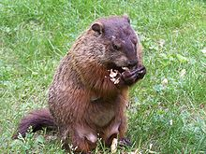
Regular expressions
A formal language for specifying text strings
How can we search for any of these?
woodchuck
woodchucks
Woodchuck
Woodchucks

Slide 4
Regular Expressions: Disjunctions
Letters inside square brackets []
Ranges [A-Z]
Pattern | Matches
[wW]oodchuck | Woodchuck, woodchuck
[1234567890] | Any digit
Pattern | Matches | Text
[A-Z] | An upper case letter | Drenched Blossoms
[a-z] | A lower case letter | my beans were impatient
[0-9] | A single digit | Chapter 1: Down the Rabbit Hole

Slide 5
Regular Expressions: Negation in Disjunction
Negations: [^Ss]
Carat means negation only when first in []
Pattern | Matches | Text
[^A-Z] | Not an upper case letter | Oyfn pripetchik
[^Ss] | Neither ‘S’ nor ‘s’ | I have no exquisite reason”
[^e^] | Neither e nor ^ | Look here
a^b | The pattern a carat b | Look up a^b now

Slide 6
Regular Expressions: More Disjunction
Woodchucks is another name for groundhog!
The pipe | for disjunction
Pattern | Matches
groundhog|woodchuck | groundhog woodchuck
yours|mine | yours mine
a|b|c | = [abc]
[gG]roundhog|[Ww]oodchuck | Groundhog woodchuck

Slide 7
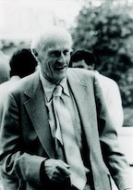
Regular Expressions: ? * + .
Pattern | Matches | Text
colou?r | Optional previous char | color colour
oo*h! | 0 or more of previous char | oh! ooh! oooh! ooooh!
o+h! | 1 or more of previous char | oh! ooh! oooh! ooooh!
baa+ |  | baa baaa baaaa baaaaa
beg.n |  | begin begun begun beg3n
Stephen C Kleene
Kleene *, Kleene +

Slide 8
Regular Expressions: anchors ^ $
Pattern | Matches
^[A-Z] | Palo Alto
^[^A-Za-z] | 1 “Hello”
\.$ | The end.
.$ | The end? The end!

Slide 9
Example
Find me all instances of the word “the” in a text.
the
Misses capitalized examples
[tT]he
Incorrectly returns other or theology
[^a-zA-Z][tT]he[^a-zA-Z]

Slide 10
Errors
The process we just went through was based on fixing two kinds of errors
Matching strings that we should not have matched (there, then, other)
False positives (Type I)
Not matching things that we should have matched (The)
False negatives (Type II)

Slide 11
Errors (cont.)
In NLP we are always dealing with these kinds of errors.
Reducing the error rate for an application often involves two antagonistic efforts:
Increasing accuracy or precision (minimizing false positives)
Increasing coverage or recall (minimizing false negatives).

Slide 12
Exercise
Write a RE that matches a simple (not nested) HTML element
Write a RE that matches email addresses
Write a RE that matches URLs

Slide 13
Summary
Regular expressions play a surprisingly large role
Sophisticated sequences of regular expressions are often the first model for any text processing text
For many hard tasks, we use machine learning classifiers
But regular expressions are used as features in the classifiers
Can be very useful in capturing generalizations

Slide 14
Tokenization

Slide 15
Text Normalization
Text normalization before text analysis:
Segmenting/tokenizing words in running text
Normalizing word formats
Segmenting sentences in running text

Slide 16
Tokenization
For
Information retrieval
Information extraction (detecting named entities, etc.)
Spell-checking
3 tasks
Segmenting/tokenizing words in running text
Normalizing word formats
Segmenting sentences in running text
Why not just periods and white-space?
Mr. Sherwood said reaction to Sea Containers’ proposal has been "very positive." In New York Stock Exchange composite trading yesterday, Sea Containers closed at $62.625, up 62.5 cents.
“I said, ‘what’re you? Crazy?’ “ said Sadowsky. “I can’t afford to do that.’’

Slide 17
What’s a word?
I do uh main- mainly business data processing
Fragments
Filled pauses
Are cat and cats the same word?
Some terminology
Lemma: a set of lexical forms having the same stem, major part of speech, and rough word sense
Cat and cats = same lemma
Wordform: the full inflected surface form.
Cat and cats = different wordforms
Token/Type

Slide 18
How many words?
they lay back on the San Francisco grass and looked at the stars and their
Type/Form: an element of the vocabulary.
Token: an instance of that type in running text.
How many?
15 tokens (or 14)
13 types (or 12?)

Slide 19
How many words?
N = number of tokens
V = vocabulary = set of types
|V| is the size of the vocabulary
Church and Gale (1990): |V| > O(N^{½})
 | Tokens = N | Types = |V|
Switchboard phone conversations | 2.4 million | 20 thousand
Shakespeare | 884,000 | 31 thousand
Google N-grams | 1 trillion | 13 million

Slide 20
Simple Tokenization in Unix
Inspired by Ken Church’s “UNIX for Poets”.
Given a text file, output the word tokens and their frequencies
tr -sc 'A-Za-z' '\n' < shakes.txt
| sort
| uniq –c
1945 A
72 AARON
19 ABBESS
5 ABBOT
... ...
Change non-alpha to newlines
Sort in alphabetical order
Merge and count each type

Slide 21
The first step: tokenizing
tr -sc 'A-Za-z' '\n' < shakes.txt | head
THE
SONNETS
by
William
Shakespeare
From
fairest
creatures
We
...

Slide 22
The second step: sorting
tr -sc 'A-Za-z' '\n' < shakes.txt | sort | head
A
A
A
A
A
A
A
A
A
...

Slide 23
More counting
Merging upper and lower case
tr 'A-Z' 'a-z' < shakes.txt | tr –sc 'A-Za-z' '\n' | sort | uniq –c
Sorting the counts
tr 'A-Z' 'a-z' < shakes.txt | tr –sc 'A-Za-z' '\n' | sort | uniq –c | sort –n –r
23243 the
22225 i
18618 and
16339 to
15687 of
12780 a
12163 you
10839 my
10005 in
8954 d
What happened here?

Slide 24
Issues in Tokenization
Finland’s capital?
Finland? Finlands? Finland’s
what’re, I’m, isn’t?
What are, I am, is not
Hewlett-Packard?
Hewlett and Packard as two tokens?
state-of-the-art:
Break up?
lowercase, lower-case, lower case?
San Francisco, New York: one token or two?
Words with punctuation
m.p.h., PhD.
Slide from Chris Manning

Slide 25
Tokenization: language issues
Italian
L’insieme? one token or two?
L ? L’ ? Lo ?
Want l’insieme to match with un insieme
German noun compounds are not segmented
Lebensversicherungsgesellschaftsangestellter Leben’s+versicherung’s+gesellschaft’s+angestellter
‘life insurance company employee’
German text processing benefits greatly from a compound splitter module
Slide from Chris Manning

Slide 26
Tokenization: language issues
Chinese and Japanese no spaces between words:
莎拉波娃现在居住在美国东南部的佛罗里达。
莎拉波娃 现在 居住 在 美国 东南部 的 佛罗里达
Sharapova now lives in US southeastern Florida
Further complicated in Japanese, with multiple alphabets intermingled
Dates/amounts in multiple formats
フォーチュン500社は情報不足のため時間あた$500K(約6,000万円)
Katakana
Hiragana
Kanji
Romaji
End-user can express query entirely in hiragana!
Slide from Chris Manning

Slide 27
Word Tokenization in Chinese
Words composed of characters
Characters are generally 1 syllable and 1 morpheme.
Average word is 2.4 characters long.
Standard segmentation algorithm:
Maximum Matching
(also called Greedy)

Slide 28
Maximum Matching Word Segmentation Algorithm
Given a wordlist of Chinese, and a string.
Start a pointer at the beginning of the string
Find the longest word in dictionary that matches the string starting at pointer
Move the pointer over the word in string
Go to 2

Slide 29
English failure example (Palmer 2000)
the table down there
thetabledownthere
Theta bled own there
But works astonishingly well in Chinese
莎拉波娃现在居住在美国东南部的佛罗里达。
莎拉波娃 现在 居住 在 美国 东南部 的 佛罗里达
Modern algorithms better still:
probabilistic segmentation
Using “sequence models” like HMMs

Slide 30
Word Normalization and Stemming

Slide 31
Normalization
Need to “normalize” terms
For IR, indexed text & query terms must have same form.
We want to match U.S.A. and USA
We most commonly implicitly define equivalence classes of terms
e.g., by deleting periods in a term
Alternative is to do asymmetric expansion:
Enter: window Search: window, windows
Enter: windows Search: Windows, windows, window
Enter: Windows Search: Windows
Potentially more powerful, but less efficient
Slide from Chris Manning

Slide 32
Case folding
For Information Retrieval: reduce all letters to lower case
exception: upper case in mid-sentence?
e.g., General Motors
Fed vs. fed
SAIL vs. sail
Often best to lower case everything, since users will use lowercase regardless of ‘correct’ capitalization…
For sentiment analysis, MT, Info extraction
Case is helpful (“US” versus “us” is important)
Slide from Chris Manning

Slide 33
Lemmatization
Reduce inflectional/variant forms to base form
am, are, is → be
car, cars, car's, cars’ → car
the boy's cars are different colors → the boy car be different color
Lemmatization: find correct dictionary headword form
Machine translation
Spanish quiero (‘I want’), quieres (‘you want’) same lemma as querer ‘want’
Slide from Chris Manning

Slide 34
Morphology
Morphemes:
smaller meaningful units that make up words:
Stems: The core meaning bearing units
Affixes: Bits and pieces that adhere to stems to change their meanings and grammatical functions

Slide 35
Stemming
Reduce terms to their “roots” before indexing
“Stemming” is crude chopping of “affixes”
language dependent
e.g., automate(s), automatic, automation all reduced to automat.
for example compressed
and compression are both
accepted as equivalent to
compress.
for exampl compress and
compress ar both accept
as equival to compress
Slide from Chris Manning

Slide 36
Porter’s algorithm
Commonest algorithm for stemming English
A sequence of phases
each phase consists of a set of rules
sses → ss
ies → i
ational → ate
tional → tion
Some rules only apply to multi-syllable words
(syl > 1) EMENT → ø
replacement → replac
cement → cement
Slide from Chris Manning

Slide 37
Porter’s algorithm
Step 1a
sses → ss caresses → caress
ies → I ponies → poni
ss → ss caress → caress
s → ø cats → cat
Step 1b
(*v*)ing → ø walking → walk
sing → sing
(*v*)ed → ø plastered → plaster
…
Step 2 (for long stems)
ational → ate relational → relate
izer → ize digitizer → digitize
ator → ate operator → operate
…
Step 3 (for longer stems)
al → ø revival → reviv
able → ø adjustable → adjust
ate → ø activate → activ
…

Slide 38
Viewing morphology in a corpus
Vowel present
(*v*)ing → ø walking → walk
sing → sing

Slide 39
Viewing morphology in a corpus
Why only strip -ing if there is a vowel?
(*v*)ing → ø walking → walk
sing → sing
Vowel present
tr -sc 'A-Za-z' '\n' < shakes.txt | grep ’ing$' | sort | uniq -c | sort –nr
tr -sc 'A-Za-z' '\n' < shakes.txt | grep '[aeiou].*ing$' | sort | uniq -c | sort –nr
1312 King
548 being
541 nothing
388 king
375 bring
358 thing
307 ring
152 something
145 coming
130 morning
548 being
541 nothing
152 something
145 coming
130 morning
122 having
120 living
117 loving
116 Being
102 going

Slide 40
Dealing with complex morphology
Some languages require segmenting morphemes
Turkish
Uygarlastiramadiklarimizdanmissinizcasina
‘(behaving) as if you are among those whom we could not civilize’
Uygar `civilized’ + las `become’
+ tir `cause’ + ama `not able’
+ dik `past’ + lar ‘plural’
+ imiz ‘p1pl’ + dan ‘abl’
+ mis ‘past’ + siniz ‘2pl’ + casina ‘as if’

Slide 41
Sentence Segmentation

Slide 42
Sentence Segmentation
!, ? relatively unambiguous
Period “.” is quite ambiguous
Sentence boundary
Abbreviations like Inc. or Dr.
General idea:
Build a binary classifier:
Looks at a “.”
Decides EndOfSentence/NotEOS
Classifiers: hand-written rules, regular expressions, or machine-learning

Slide 43
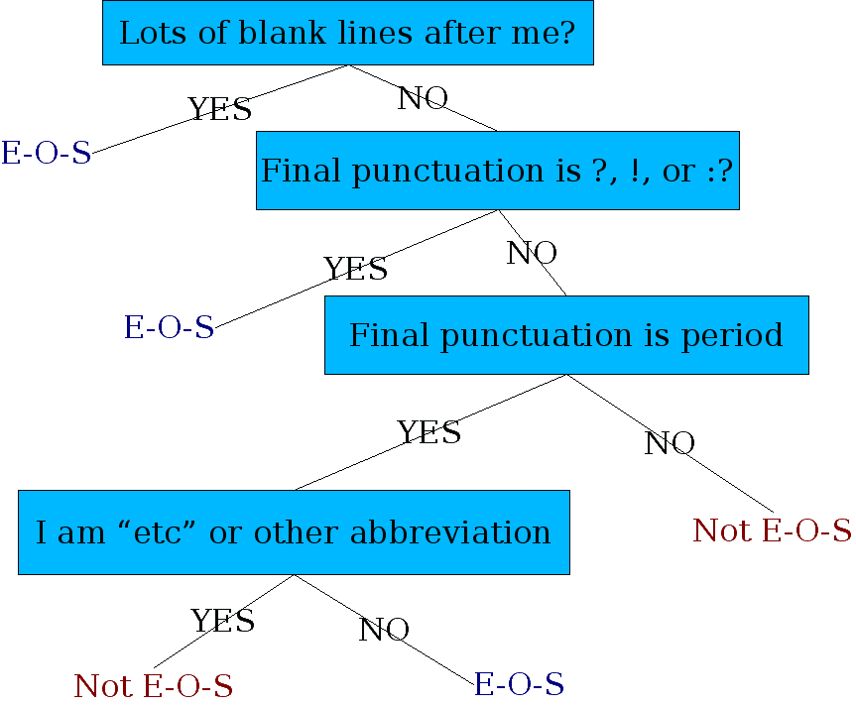
Decision Tree Classifier for EOS

Slide 44
More sophisticated decision tree features
Prob(word with “.” occurs at end-of-s)
Prob(word after “.” occurs at begin-of-s)
Length of word with “.”
Length of word after “.”
Case of word with “.”: Upper, Lower, Cap, Number
Case of word after “.”: Upper, Lower, Cap, Number
Punctuation after “.” (if any)
Abbreviation class of word with “.” (month name, unit-of-measure, title, address name, etc)
Slide from Richard Sproat

Slide 45
Learning Decision Trees
DTs are rarely built by hand
Hand-building only possible for very simple features, domains
Several algorithms available for DT induction:
S. Ruggieri. Efficient C4.5

Slide 46
Alternative: using a ML classifier
Train a classifier to determine whether a punctuation character is an end of sentence
Training set:
A list of sentences
Features
Example: Splitta (uses SVM classifier)
Error on Corpus | SVM | Naive Bayes
WSJ | 0.25% | 0.35%
Brown | 0.36% | 0.45%
Complete Works of Edgar Allen Poe | 0.52% | 0.44

Slide 47
Punkt Sentence Splitter
Sentence splitting
import nltk.data
splitter = nltk.data.load(
'tokenizers/punkt/english.pickle')
for line in file:
for sent in splitter.tokenize(line.strip()):
print sent
Tokenizer
tokenizer = splitter._lang_vars.word_tokenize
print ' '.join(tokenizer(sent))

Slide 48
Word Distance

Slide 49
String similarity measures
Spell checking
Non-word error detection:
detecting “graffe”
Non-word error correction:
figuring out that “graffe” should be “giraffe”
Context-dependent error detection and correction:
Figuring out that “war and piece” should be peace
Computational Biology
Align two sequences of nucleotides AGGCTATCACCTGACCTCCAGGCCGATGCCC TAGCTATCACGACCGCGGTCGATTTGCCCGAC
Resulting alignment: -AGGCTATCACCTGACCTCCAGGCCGA--TGCCC--- TAG-CTATCAC--GACCGC--GGTCGATTTGCCCGAC

Slide 50
Non-word error detection
Any word not in a dictionary
Assume it’s a spelling error
Need a big dictionary!

Slide 51
Isolated word error correction
How do I fix “graffe”?
Search through all words:
graf
craft
grail
giraffe
Pick the one that’s closest to graffe
What does “closest” mean?
We need a distance metric.
The simplest one: edit distance.
(More sophisticated probabilistic ones: noisy channel)

Slide 52
Edit Distance
The minimum edit distance between two strings
Is the minimum number of editing operations
Insertion
Deletion
Substitution
Needed to transform one into the other

Slide 53
Minimum Edit Distance

Slide 54
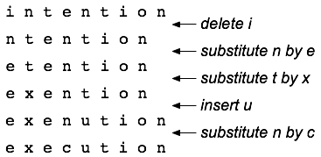
Edit transcript

Slide 55
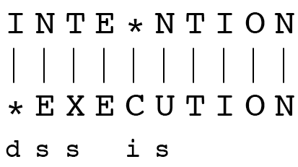
Minimum Edit Distance
If each operation has cost of 1
Distance between these is 5
If substitutions cost 2 (Levenshtein)
Distance between them is 8

Slide 56
Alignment in Computational Biology
Given a sequence of bases AGGCTATCACCTGACCTCCAGGCCGATGCCC TAGCTATCACGACCGCGGTCGATTTGCCCGAC
An alignment: -AGGCTATCACCTGACCTCCAGGCCGA--TGCCC--- TAG-CTATCAC--GACCGC--GGTCGATTTGCCCGAC
Given two sequences, align each letter to a letter or gap

Slide 57
Other uses of Edit Distance in NLP
Evaluating Machine Translation and speech recognition R Spokesman confirms senior government adviser was shot H Spokesman said the senior adviser was shot dead S I D I
Named Entity Extraction and Entity Coreference
IBM Inc. announced today
IBM profits
Stanford President John Hennessy announced yesterday
for Stanford University President John Hennessy

Slide 58
How to find the Min Edit Distance?
Searching for a path (sequence of edits) from the start string to the final string:
Initial state: the word we’re transforming
Operators: insert, delete, substitute
Goal state: the word we’re trying to get to
Path cost: what we want to minimize: the number of edits

Slide 59
Minimum Edit as Search
But the space of all edit sequences is huge!
We can’t afford to navigate naïvely
Lots of distinct paths wind up at the same state.
We don’t have to keep track of all of them
Just the shortest path to each of those revisited states.

Slide 60
Defining Min Edit Distance
For two strings
X of length n
Y of length m
We define D(i,j)
the edit distance between X[1..i] and Y[1..j]
i.e., the first i characters of X and the first j characters of Y
The edit distance between X and Y is thus D(n,m)

Slide 61
Minimum Edit Distance
Definition of Minimum Edit Distance

Slide 62
Dynamic Programming for Minimum Edit Distance
Dynamic programming: A tabular computation of D(n,m)
Solving problems by combining solutions to sub-problems.
Bottom-up
We compute D(i,j) for small i,j
And compute larger D(i,j) based on previously computed smaller values
i.e., compute D(i,j) for all i (0 < i < n) and j (0 < j < m)

Slide 63
Defining Min Edit Distance
Base conditions:
D(i, 0) = i
D(0, j) = j
Recurrence Relation:
D(i-1, j) + 1
D(i, j) = min D(i, j-1) + 1
D(i-1, j-1) + 2 if S₁(i) ≠ S₂(j)
0 if S₁(i) = S₂(j)

Slide 64
Complexity
Computational cost of recursively computing D(n, m):
O(3^{min(n, m)})

Slide 65
Dynamic Programming
A tabular computation of D(n, m)
Bottom-up
We compute D(i, j) for small i, j
And compute increase D(i, j) based on previously computed smaller values

Slide 66
The Edit Distance Table
N | 9
O | 8
I | 7
T | 6
N | 5
E | 4
T | 3
N | 2
I | 1
# | 0 | 1 | 2 | 3 | 4 | 5 | 6 | 7 | 8 | 9
 | # | E | X | E | C | U | T | I | O | N

Slide 67
N | 9
O | 8
I | 7
T | 6
N | 5
E | 4
T | 3
N | 2
I | 1
# | 0 | 1 | 2 | 3 | 4 | 5 | 6 | 7 | 8 | 9
 | # | E | X | E | C | U | T | I | O | N

Slide 68
N | 9 | 8 | 9 | 10 | 11 | 12 | 11 | 10 | 9 | 8
O | 8 | 7 | 8 | 9 | 10 | 11 | 10 | 9 | 8 | 9
I | 7 | 6 | 7 | 8 | 9 | 10 | 9 | 8 | 9 | 10
T | 6 | 5 | 6 | 7 | 8 | 9 | 8 | 9 | 10 | 11
N | 5 | 4 | 5 | 6 | 7 | 8 | 9 | 10 | 11 | 10
E | 4 | 3 | 4 | 5 | 6 | 7 | 8 | 9 | 10 | 9
T | 3 | 4 | 5 | 6 | 7 | 8 | 7 | 8 | 9 | 8
N | 2 | 3 | 4 | 5 | 6 | 7 | 8 | 7 | 8 | 7
I | 1 | 2 | 3 | 4 | 5 | 6 | 7 | 6 | 7 | 8
# | 0 | 1 | 2 | 3 | 4 | 5 | 6 | 7 | 8 | 9
 | # | E | X | E | C | U | T | I | O | N

Slide 69
Suppose we want the alignment too
We can keep a “backtrace”
Every time we enter a cell, remember where we came from
Then when we reach the end, we can trace back from the upper right corner to get an alignment

Slide 70
Backtrace
N | 9 | 8 | 9 | 10 | 11 | 12 | 11 | 10 | 9 | 8
O | 8 | 7 | 8 | 9 | 10 | 11 | 10 | 9 | 8 | 9
I | 7 | 6 | 7 | 8 | 9 | 10 | 9 | 8 | 9 | 10
T | 6 | 5 | 6 | 7 | 8 | 9 | 8 | 9 | 10 | 11
N | 5 | 4 | 5 | 6 | 7 | 8 | 9 | 10 | 11 | 10
E | 4 | 3 | 4 | 5 | 6 | 7 | 8 | 9 | 10 | 9
T | 3 | 4 | 5 | 6 | 7 | 8 | 7 | 8 | 9 | 8
N | 2 | 3 | 4 | 5 | 6 | 7 | 8 | 7 | 8 | 7
I | 1 | 2 | 3 | 4 | 5 | 6 | 7 | 6 | 7 | 8
# | 0 | 1 | 2 | 3 | 4 | 5 | 6 | 7 | 8 | 9
 | # | E | X | E | C | U | T | I | O | N

Slide 71
Adding Backtrace to MinEdit
Base conditions:
D(i,0) = i
D(0,j) = j
Recurrence Relation:
D(i-1,j) + 1
D(i, j) = min D(i, j-1) + 1
D(i-1, j-1) + 1; if S₁(i) ≠ S₂(j)
0; if S₁(i) = S₂(j)
LEFT
ptr(i, j) DOWN
DIAG
Case 1
Case 2
Case 3
Case 1
Case 2
Case 3

Slide 72
The Distance Matrix
Every non-decreasing path
from (0,0) to (M, N)
corresponds to
an alignment
of the two sequences
x₀ …………………… x_{N}
y₀ ……………………………… y_{M}
An optimal alignment is composed of optimal subalignments

Slide 73
Result of Backtrace
Two strings and their alignment:

Slide 74
Performance
Time: O(nm)
Space: O(nm)
Backtrace: O(n+m)

Slide 75
Weighted Edit Distance
Why would we add weights to the computation?
How?

Slide 76
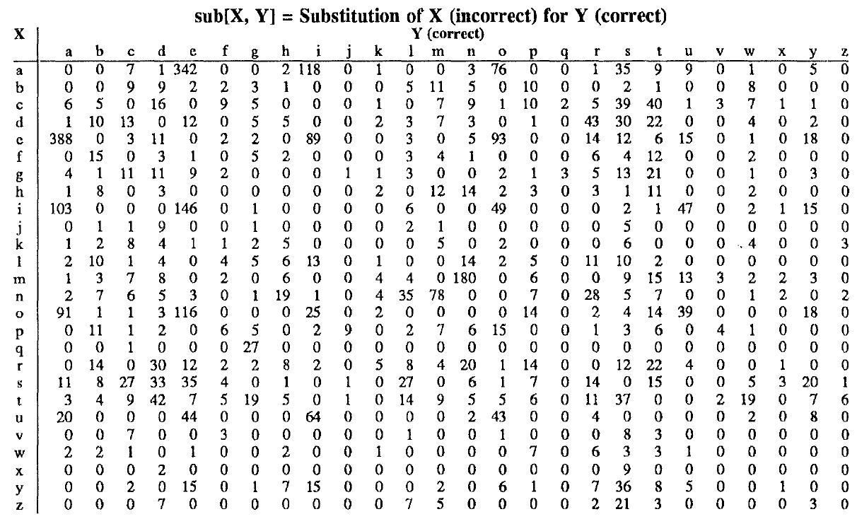
Confusion matrix

Slide 77
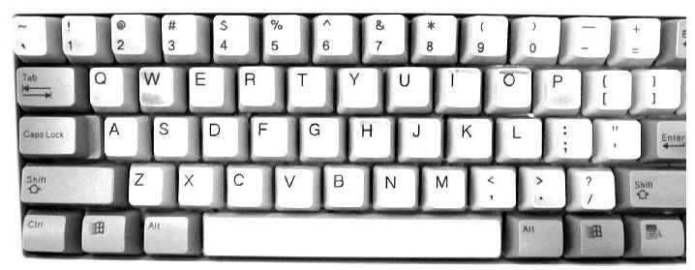
Errors more likely for close keys

Slide 78
Weighted Minimum Edit Distance
function Min-Edit-Distance(target, source) returns min-distance
n = Length(target)
m = Length(source)
Create a distance matrix distance[n+1, m+1]
Initialize the zero-th row and column to the distance from the empty string
distance[0, 0] = 0
for each column i from 1 to n do
distance [i, 0] = distance[i-1, 0] + ins-cost(target[i])
for each row j from 1 to m do
distance[0,j] = distance[0, j-1] + del-const(source[j])
for each column i from 1 to n do
for each row j from 1 to m do
distance[i, j] = Min(distance[i-1, j] + ins-cost(target[i-1]),
distance[i-1, j-1] + sub-cost(source[j-1], target[i-1]),
distance[i, j-1] + del-cost(source[j-1]))
return distance[n, m]

Slide 79
Why “Dynamic Programming”
“I spent the Fall quarter (of 1950) at RAND. My first task was to find a name for multistage decision processes. An interesting question is: Where did the name, dynamic programming, come from?
The 1950s were not good years for mathematical research. We had a very interesting gentleman in Washington named Wilson. He was Secretary of Defense, and he actually had a pathological fear and hatred of the word, research.
In the first place I was interested in planning, in decision making, in thinking. But planning, is not a good word for various reasons.
I decided therefore to use the word, “programming” I wanted to get across the idea that this was dynamic, this was multistage, this was time-varying I thought, lets kill two birds with one stone. Lets take a word that has an absolutely precise meaning, namely dynamic, in the classical physical sense. It also has a very interesting property as an adjective, and that is its impossible to use the word, dynamic, in a pejorative sense. Try thinking of some combination that will possibly give it a pejorative meaning. It’s impossible.
Thus, I thought dynamic programming was a good name. It was something not even a Congressman could object to. So I used it as an umbrella for my activities.”
Richard Bellman, “Eye of the Hurricane: an autobiography”, 1984.

Slide 80
Other uses of Edit Distance in text processing
Evaluating Machine Translation and speech recognition
R Spokesman confirms senior government adviser was shot
H Spokesman said the senior adviser was shot dead
S I D I
Entity Extraction and Co-reference
IBM Inc. announced today
IBM’s profits
Stanford President John Hennessy announced yesterday
for Stanford University President John Hennessy

Slide 81
Summary
Regular Expressions
Tokenization
Word Tokenization
Normalization
Lemmatization and stemming
Sentence Tokenization
Minimum Edit Distance
Levenshtein distance
Applications to:
spell correction, machine translation, entity extraction
DNA fragment combination, evolutionary similarity, mutation detection

