Slide 1
Named Entity Tagging
Thanks to Dan Jurafsky, Jim Martin, Ray Mooney, Tom Mitchell for slides

Slide 2
Outline
Named Entities and the basic idea
IOB Tagging
A new classifier: Logistic Regression
  Linear regression
  Logistic regression
  Multinomial logistic regression = MaxEnt
Why classifiers aren’t as good as sequence models
A new sequence model:
  MEMM = Maximum Entropy Markov Model

Slide 3
Named Entity Tagging
CHICAGO (AP) — Citing high fuel prices, United Airlines said Friday it has increased fares by $6 per round trip on flights to some cities also served by lower-cost carriers. American Airlines, a unit AMR, immediately matched the move, spokesman Tim Wagner said. United, a unit of UAL, said the increase took effect Thursday night and applies to most routes where it competes against discount carriers, such as Chicago to Dallas and Atlanta and Denver to San Francisco, Los Angeles and New York.

Slide 4
Named Entity Tagging
CHICAGO (AP) — Citing high fuel prices, United Airlines said Friday it has increased fares by $6 per round trip on flights to some cities also served by lower-cost carriers. American Airlines, a unit AMR, immediately matched the move, spokesman Tim Wagner said. United, a unit of UAL, said the increase took effect Thursday night and applies to most routes where it competes against discount carriers, such as Chicago to Dallas and Atlanta and Denver to San Francisco, Los Angeles and New York.

Slide 5
Named Entity Recognition
Find the named entities and classify them by type
Typical approach
  Acquire training data
  Encode using IOB labeling
  Train a sequential supervised classifier
  Augment with pre- and post-processing using available list resources (census data, gazetteers, etc.)
Slide from Jim Martin

Slide 6
Temporal and Numerical Expressions
Temporals
  Find all the temporal expressions
  “May 1st”, "next Friday", "Easter eve", "my birthday"
  Normalize them based on some reference point
Numerical Expressions
  Find all the expressions
  Classify by type
  Normalize
Slide from Jim Martin

Slide 7
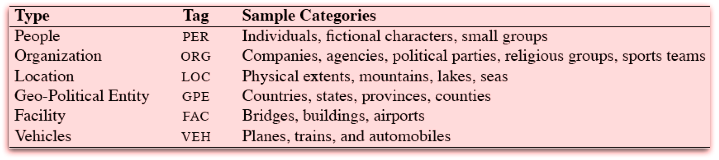
NE Types
Slide from Jim Martin

Slide 8
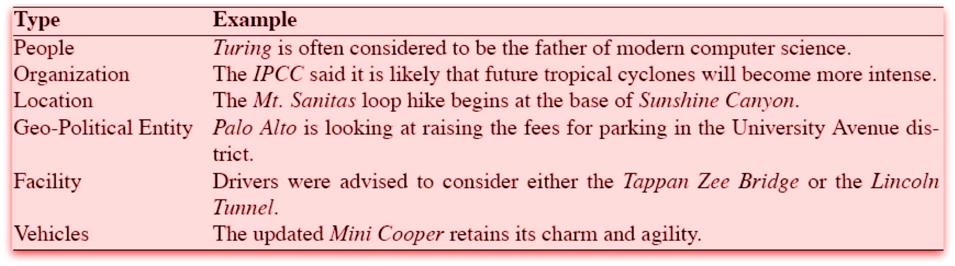
NE Types: Examples
Slide from Jim Martin

Slide 9
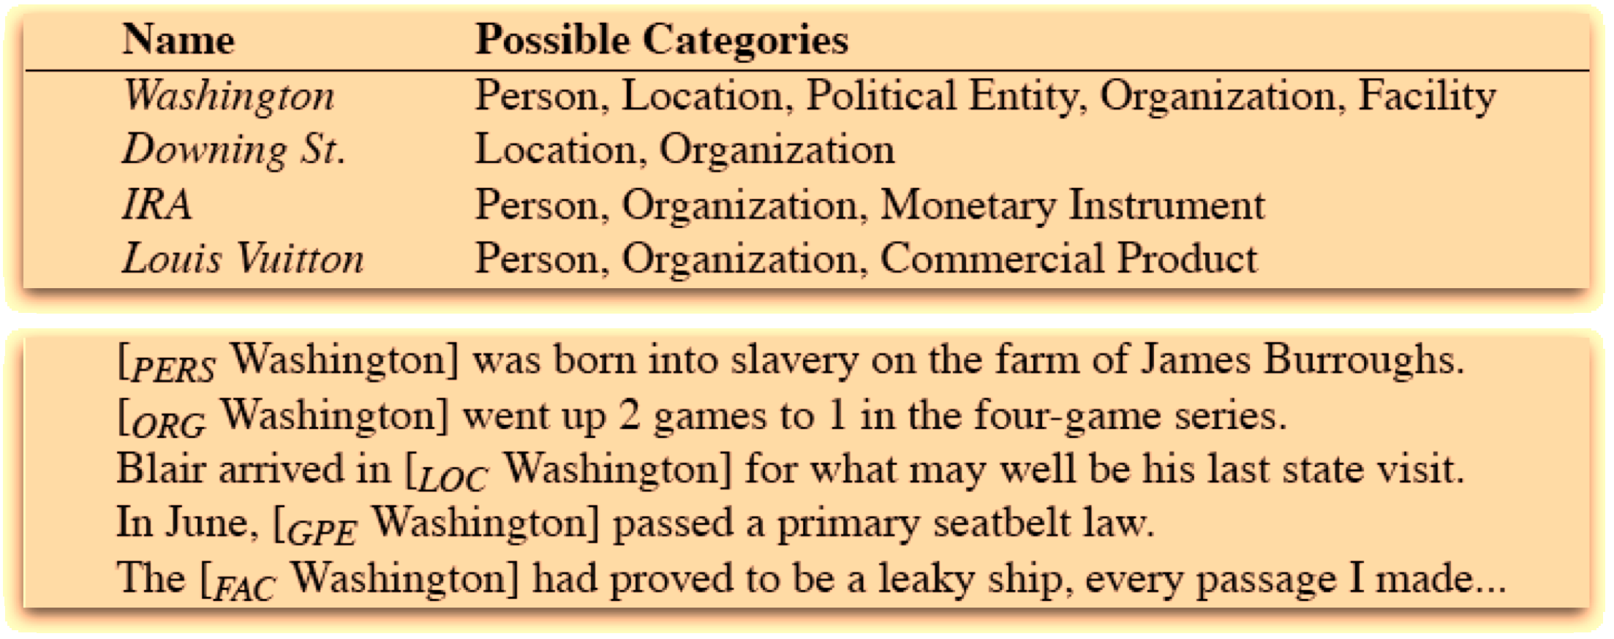
Ambiguity
Slide from Jim Martin

Slide 10
Biomedical Entities
Disease
Symptom
Drug
Body Part
Treatment
Enzime
Protein
Difficulty: discontiguous or overlapping mentions
  Abdomen is soft, nontender, nondistended, negative bruits

Slide 11
NER Approaches
As with partial parsing and chunking there are two basic approaches (and hybrids)
  Rule-based (regular expressions)
    Lists of names
    Patterns to match things that look like names
    Patterns to match the environments that classes of names tend to occur in.
  ML-based approaches
    Get annotated training data
    Extract features
    Train systems to replicate the annotation
Slide from Jim Martin

Slide 12
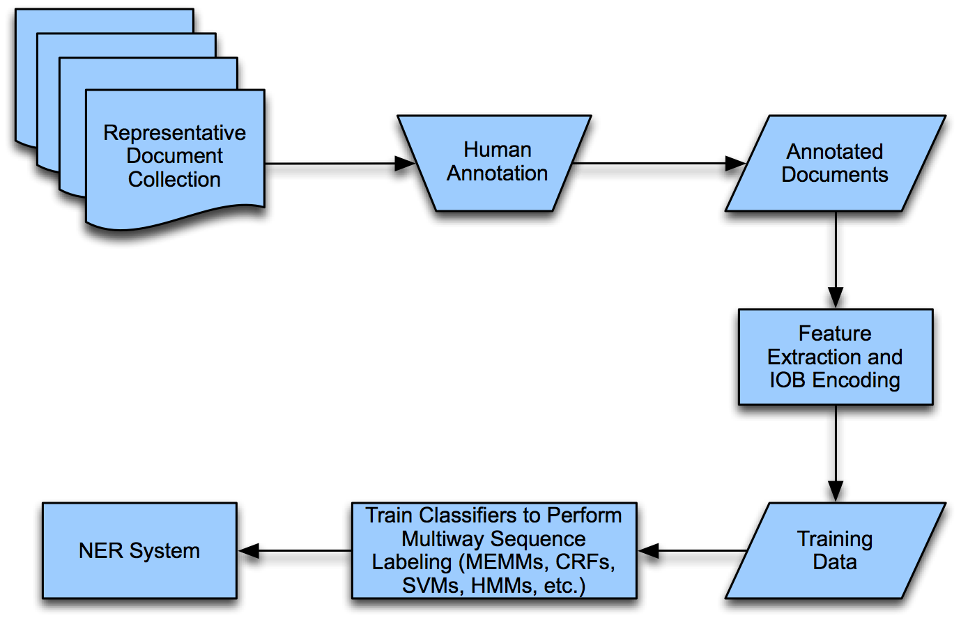
ML Approach
Slide from Jim Martin

Slide 13
Encoding for Sequence Labeling
We can use IOB encoding:
…United Airlines said Friday it has increased
  B_ORG I_ORG O O O O O
  the move , spokesman Tim Wagner said.
  O O O O B_PER I_PER O
How many tags?
  For N classes we have 2*N+1 tags
    An I and B for each class and one O for no-class
Each token in a text gets a tag
Can use simpler IO tagging if what?

Slide 14
NER Features
Token | Features |  |  | Label
American | NNP | B_{NP} | cap | B_{ORG}
Airlines | NNPS | I_{NP} | cap | I_{ORG}
, | PUNC | O | punc | O
a | DT | B_{NP} | lower | O
unit | NN | I_{NP} | lower | O
of | IN | B_{PP} | lower | O
AMR | NNP | B_{NP} | upper | B_{ORG}
Corp. | NNP | I_{NP} | cap_punc | I_{ORG}
, | PUNC | O | punc | O
immediately | RB | B_{ADV} | lower | O
matched | VBD | B_{VP} | lower | O
the | DT | B_{NP} | lower | O
move | NN | I_{NP} | lower | O
, | PUNC | O | punc | O
spokesman | NN | B_{NP} | lower | O
Tim | NNP | I_{NP} | cap | B_{ORG}
Wagner | NNP | I_{NP} | cap | I_{ORG}
said | VBD | B_{VP} | lower | O
. | PUNC | O | punc | O
Slide from Jim Martin

Slide 15
Feature Engineering
Zhou and Su (2002)
Agerri and Rigau (2016)
11 orthographic features (1 numeral, 2 numeral, 4 numeral, all caps, numerals and alphabets, contains underscore or not, etc.) a list of trigger words for the named entities (e.g., 36 trigger words and affixes, like river, for the location entity class), and a list of words (10000 for the person entity class) from various gazetteers.
orthography, character n-grams, lexicons, prefixes, suffixes, bigrams, trigrams, cluster features from the Brown corpus, Clark corpus and k-means clustering of word embeddings

Slide 16
State of the Art
Feature engineered ML | Dict | Accuracy
Li et al. (2005) SVM | Yes | 88.30
Passos et al. (2014) CRF | Yes | 90.90
Agerri and Rigau (2016) | Yes | 91.36
Feature-inferred NN Word
Collobert et al. (2011) Conv-CRF (SENNA+Gazetteer) | Yes | 89.59
Huang et al. (2015) Bi-LSTM+CRF+ (SENNA+Gazetteer) | Yes | 90.10
Feature-inferred NN Character
Gillick et al. (2015) – BTS | No | 86.50
Feature-inferred NN word + character
Chiu and Nichols (2015) | Yes | 91.62
Ma and Hovy (2016) | No | 91.21
Lample et al. (2016) | No | 90.94
V. Yadav, R, Bethard. A Survey of Recent Advances in NER from Deep NN models. Proc. of COLING 2018. 2018

Slide 17
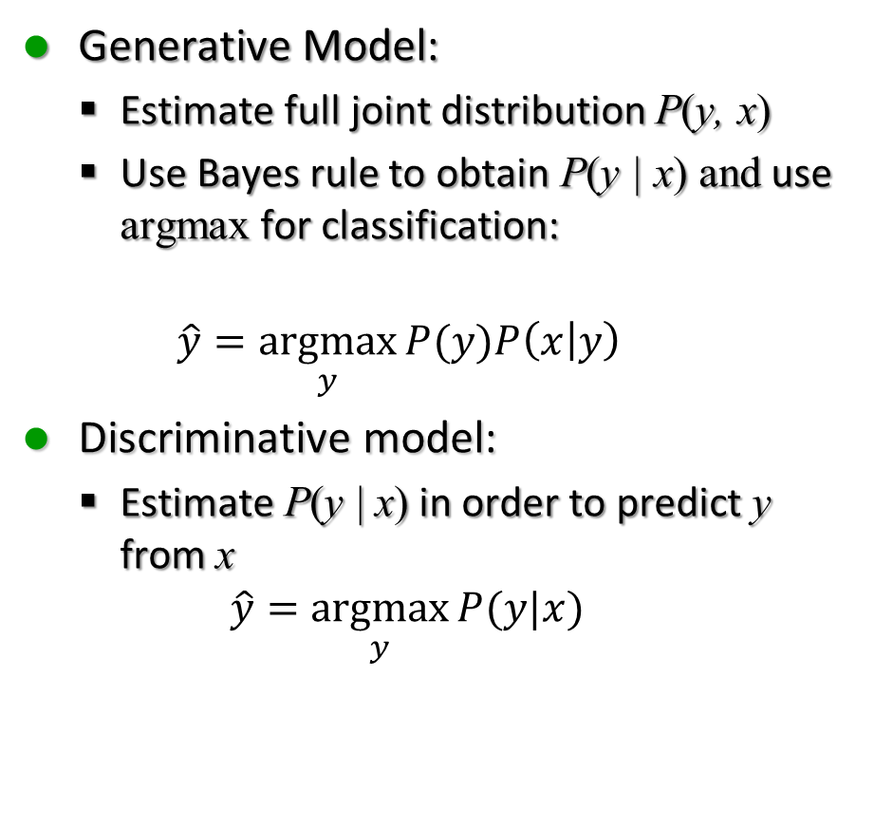
Discriminative vs Generative
Generative Model:
  Estimate full joint distribution P(y, x)
  Use Bayes rule to obtain P(y | x) and use argmax for classification:
  $$\hat{y}=\underset{y}{argmax}{P(y)P\left(x | y\right)}$$
Discriminative model:
  Estimate P(y | x) in order to predict y from x
  $$\hat{y}=\underset{y}{argmax}{P(y|x)}$$
Generative:
  Naïve Bayes
  HMM
Discriminative:
  Max Entropy, Logistic Regression
  Conditional Random Fields
  Support Vector Machines
  CNN

Slide 18
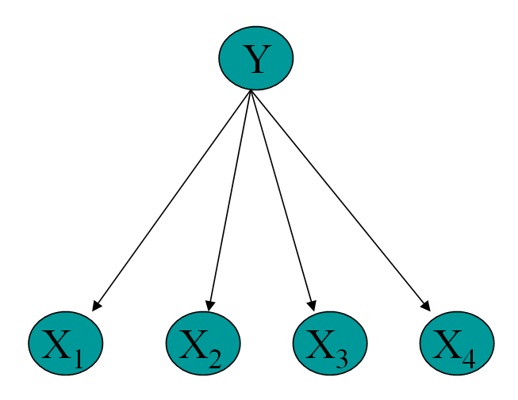
Reminder: Naïve Bayes Learner
Train:
For each class c_{j} of documents
1. Estimate P(c_{j})
2. For each word w_{i} estimate P(w_{i} | c_{j})
Classify (doc):
  Assign doc to most probable class
Slide from Jim Martin

Slide 19
Logistic Regression
How to compute:
Naïve Bayes:
  Use Bayes rule:
Logistic Regression
  Compute posterior probability directly:

Slide 20
How to do NE tagging?
Classifiers
  Naïve Bayes
  Logistic Regression
Sequence Models
  HMMs
  MEMMs
  CRFs
  Convolutional Neural Network
Sequence models work better

Slide 21
Linear Regression
Example from Freakonomics (Levitt and Dubner 2005)
  Fantastic/cute/charming versus granite/maple
Can we predict price from # of adjs?
# vague adjective | Price increase
4 | 0
3 | $1000
2 | $1500
2 | $6000
1 | $14000
0 | $18000

Slide 22
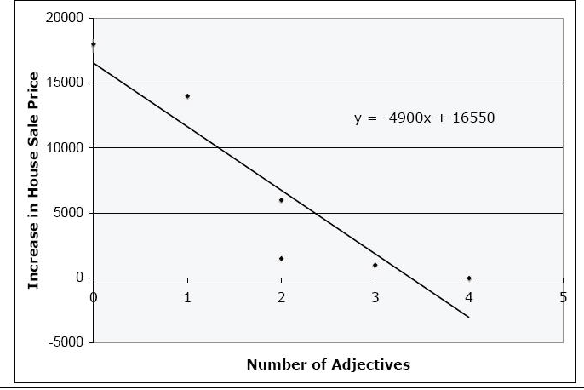
Linear Regression

Slide 23
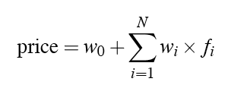
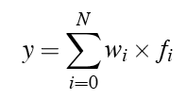
Muliple Linear Regression
Predicting values:
In general:
  Let’s pretend an extra “intercept” feature f₀ with value 1
Multiple Linear Regression

Slide 24
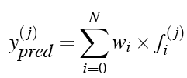
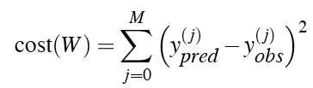
Learning in Linear Regression
Consider one instance x_{j}
We would like to choose weights to minimize the difference between predicted and observed value for x_{j}:
This is an optimization problem that turns out to have a closed-form solution

Slide 25
Put the weight from the training set into matrix X of observations f^{(i)}
Put the observed values in a vector y
Formula that minimizes the cost:
W = (X^{T}X)⁻¹X^{T}y

Slide 26
Logistic Regression

Slide 27
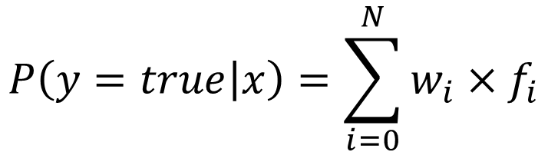
Logistic Regression
But in language problems we are doing classification
  Predicting one of a small set of discrete values
Could we just use linear regression for this?
$$P\left(y=true | x\right)=\sum_{i=0}^{N}{w_{i}×f_{i}}$$

Slide 28
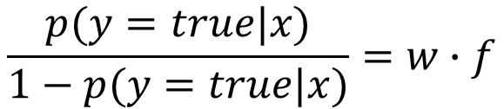
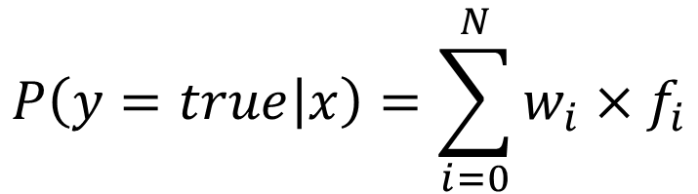
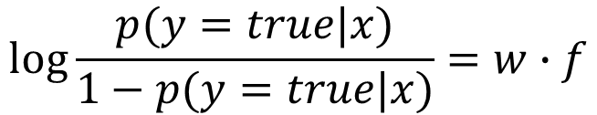
Logistic Regression
Not possible: the result doesn’t fall between 0 and 1
Instead of predicting prob, predict ratio of probs:
  but still not good: does not lie between 0 and 1
So how about if we predict the log:
$$P\left(y=true | x\right)=\sum_{i=0}^{N}{w_{i}×f_{i}}$$
$$\frac{p(y=true|x)}{1−p(y=true|x)}=w∙f$$
$$\log{\frac{p(y=true|x)}{1−p(y=true|x)}}=w∙f$$

Slide 29
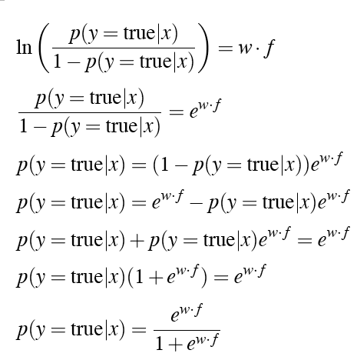
Logistic Regression
Solving this for p(y=true)

Slide 30
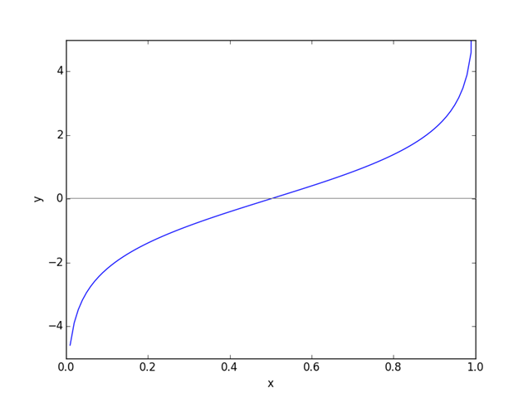
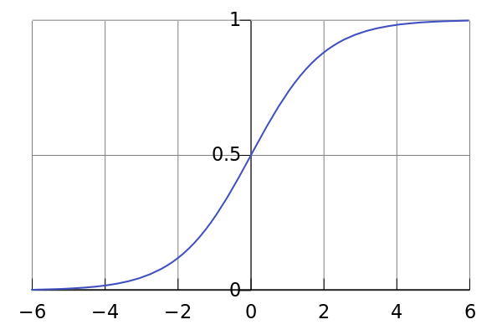
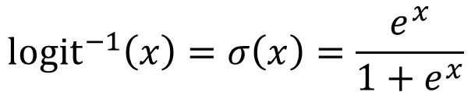
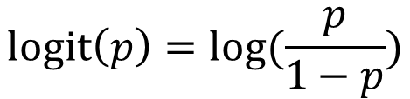
Logistic Function
$$logit\left(p\right)=log⁡(\frac{p}{1−p})$$
$${logit}^{−1}\left(x\right)=σ\left(x\right)=\frac{e^{x}}{1+e^{x}}$$
Logistic function: maps x to range [0-1]

Slide 31
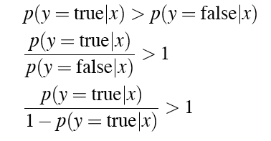

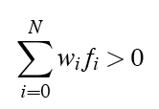
Logistic Regression
How do we do classification?
Or:
Or, in explicit sum notation:

Slide 32
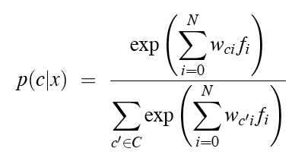
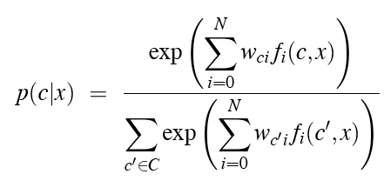
Multinomial Logistic Regression
Multiple classes:
One change: indicator functions f(c,x) instead of real values

Slide 33
Estimating the weights
Gradient Iterative Scaling

Slide 34


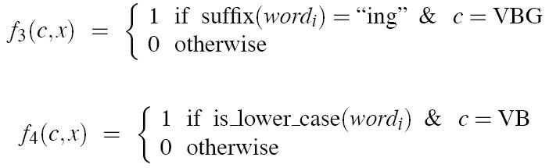
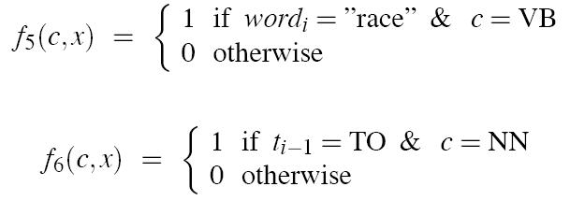
Features

Slide 35
Summary so far
Naïve Bayes Classifier
Logistic Regression Classifier
  Sometimes called MaxEnt classifiers

Slide 36
How do we apply classification to sequences?

Slide 37
Sequence Labeling as Classification
Classify each token independently but use as input features, information about the surrounding tokens (sliding window).
John saw the saw and decided to take it to the table.
classifier
NNP

Slide 38
Sequence Labeling as Classification
Classify each token independently but use as input features, information about the surrounding tokens (sliding window).
John saw the saw and decided to take it to the table.
classifier
VBD
Slide from Ray Mooney

Slide 39
Sequence Labeling as Classification
Classify each token independently but use as input features, information about the surrounding tokens (sliding window).
John saw the saw and decided to take it to the table.
classifier
DT
Slide from Ray Mooney

Slide 40
Sequence Labeling as Classification
Classify each token independently but use as input features, information about the surrounding tokens (sliding window).
John saw the saw and decided to take it to the table.
classifier
NN
Slide from Ray Mooney

Slide 41
Sequence Labeling as Classification
Classify each token independently but use as input features, information about the surrounding tokens (sliding window).
John saw the saw and decided to take it to the table.
classifier
CC
Slide from Ray Mooney

Slide 42
Sequence Labeling as Classification
Classify each token independently but use as input features, information about the surrounding tokens (sliding window).
John saw the saw and decided to take it to the table.
classifier
VBD
Slide from Ray Mooney

Slide 43
Sequence Labeling as Classification
Classify each token independently but use as input features, information about the surrounding tokens (sliding window).
John saw the saw and decided to take it to the table.
classifier
TO
Slide from Ray Mooney

Slide 44
Sequence Labeling as Classification
Classify each token independently but use as input features, information about the surrounding tokens (sliding window).
John saw the saw and decided to take it to the table.
classifier
VB
Slide from Ray Mooney

Slide 45
Sequence Labeling as Classification
Classify each token independently but use as input features, information about the surrounding tokens (sliding window).
John saw the saw and decided to take it to the table.
classifier
PRP
Slide from Ray Mooney

Slide 46
Sequence Labeling as Classification
Classify each token independently but use as input features, information about the surrounding tokens (sliding window).
John saw the saw and decided to take it to the table.
classifier
IN
Slide from Ray Mooney

Slide 47
Sequence Labeling as Classification
Classify each token independently but use as input features, information about the surrounding tokens (sliding window).
John saw the saw and decided to take it to the table.
classifier
DT
Slide from Ray Mooney

Slide 48
Sequence Labeling as Classification
Classify each token independently but use as input features, information about the surrounding tokens (sliding window).
John saw the saw and decided to take it to the table.
classifier
NN
Slide from Ray Mooney

Slide 49
Using Outputs as Inputs
Better input features are usually the categories of the surrounding tokens, but these are not available yet
Can use category of either the preceding or succeeding tokens by going forward or back and using previous output
Slide from Ray Mooney

Slide 50
Forward Classification
John saw the saw and decided to take it to the table.
classifier
NNP
Slide from Ray Mooney

Slide 51
Forward Classification
NNP
John saw the saw and decided to take it to the table.
classifier
VBD
Slide from Ray Mooney

Slide 52
Forward Classification
NNP VBD
John saw the saw and decided to take it to the table.
classifier
DT
Slide from Ray Mooney

Slide 53
Forward Classification
NNP VBD DT
John saw the saw and decided to take it to the table.
classifier
NN
Slide from Ray Mooney

Slide 54
Forward Classification
NNP VBD DT NN
John saw the saw and decided to take it to the table.
classifier
CC
Slide from Ray Mooney

Slide 55
Forward Classification
NNP VBD DT NN CC
John saw the saw and decided to take it to the table.
classifier
VBD
Slide from Ray Mooney

Slide 56
Forward Classification
NNP VBD DT NN CC VBD
John saw the saw and decided to take it to the table.
classifier
TO
Slide from Ray Mooney

Slide 57
Forward Classification
NNP VBD DT NN CC VBD TO
John saw the saw and decided to take it to the table.
classifier
VB
Slide from Ray Mooney

Slide 58
Backward Classification
Disambiguating “to” in this case would be even easier backward.
DT NN
John saw the saw and decided to take it to the table.
classifier
IN
Slide from Ray Mooney

Slide 59
Backward Classification
Disambiguating “to” in this case would be even easier backward.
IN DT NN
John saw the saw and decided to take it to the table.
classifier
PRP
Slide from Ray Mooney

Slide 60
Backward Classification
Disambiguating “to” in this case would be even easier backward.
PRP IN DT NN
John saw the saw and decided to take it to the table.
classifier
VB
Slide from Ray Mooney

Slide 61
Backward Classification
Disambiguating “to” in this case would be even easier backward.
VB PRP IN DT NN
John saw the saw and decided to take it to the table.
classifier
TO
Slide from Ray Mooney

Slide 62
Backward Classification
Disambiguating “to” in this case would be even easier backward.
TO VB PRP IN DT NN
John saw the saw and decided to take it to the table.
classifier
VBD
Slide from Ray Mooney

Slide 63
Backward Classification
Disambiguating “to” in this case would be even easier backward.
VBD TO VB PRP IN DT NN
John saw the saw and decided to take it to the table.
classifier
CC
Slide from Ray Mooney

Slide 64
Backward Classification
Disambiguating “to” in this case would be even easier backward.
CC VBD TO VB PRP IN DT NN
John saw the saw and decided to take it to the table.
classifier
VBD
Slide from Ray Mooney

Slide 65
Backward Classification
Disambiguating “to” in this case would be even easier backward.
VBD CC VBD TO VB PRP IN DT NN
John saw the saw and decided to take it to the table.
classifier
DT
Slide from Ray Mooney

Slide 66
Backward Classification
Disambiguating “to” in this case would be even easier backward.
DT VBD CC VBD TO VB PRP IN DT NN
John saw the saw and decided to take it to the table.
classifier
VBD
Slide from Ray Mooney

Slide 67
Backward Classification
Disambiguating “to” in this case would be even easier backward.
VBD DT VBD CC VBD TO VB PRP IN DT NN
John saw the saw and decided to take it to the table.
classifier
NNP
Slide from Ray Mooney

Slide 68
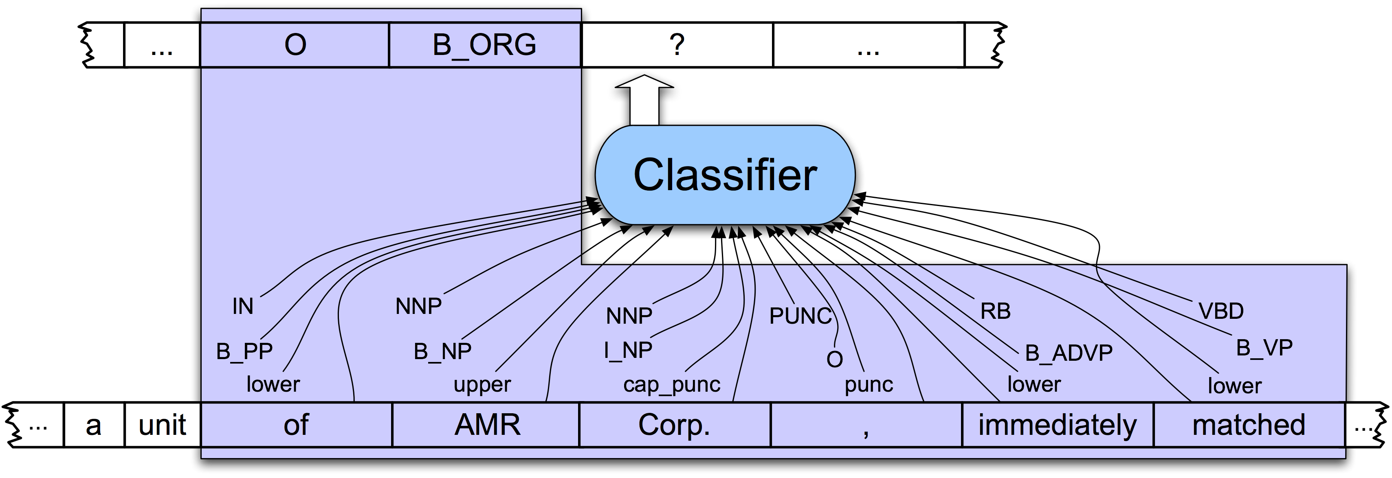
NER as Sequence Labeling

Slide 69
Why classifiers are not as good as sequence models

Slide 70
Problems with using Classifiers for Sequence Labeling
It is not easy to integrate information from hidden labels on both sides
We make a hard decision on each token
  We should rather choose a global optimum
  The best labeling for the whole sequence
  Keeping each local decision as just a probability, not a hard decision

Slide 71
Probabilistic Sequence Models
Probabilistic sequence models allow integrating uncertainty over multiple, interdependent classifications and collectively determine the most likely global assignment
Common approaches
  Hidden Markov Model (HMM)
  Conditional Random Field (CRF)
  Maximum Entropy Markov Model (MEMM) is a simplified version of CRF
  Recurrent Neural Networks (RNN)

Slide 72
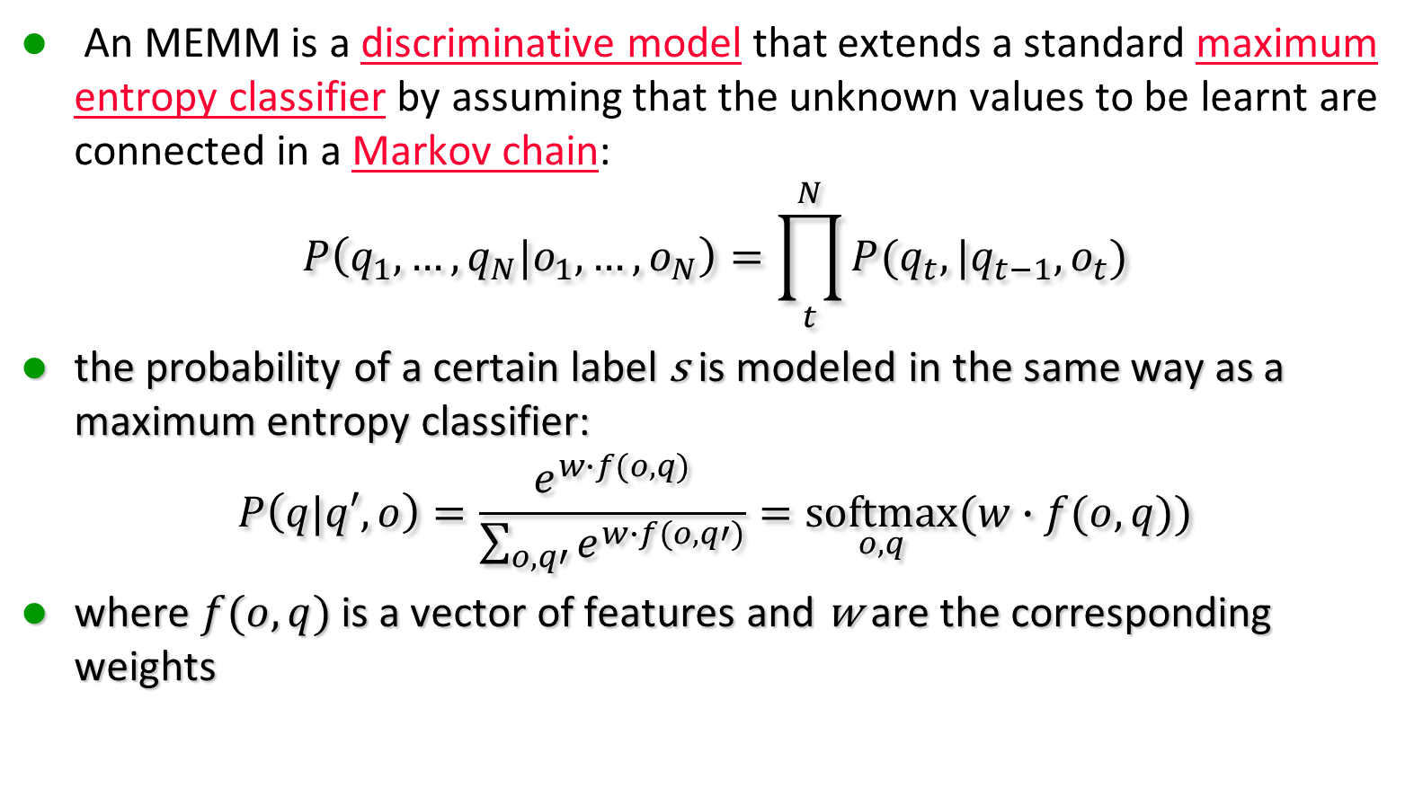
Maximum Entropy Markov Model
An MEMM is a discriminative model that extends a standard maximum entropy classifier by assuming that the unknown values to be learnt are connected in a Markov chain:
$$P\left(q_{1},…,q_{N}|o_{1},…,o_{N}\right)=\prod_{t}^{N}{P(q_{t},|q_{t−1},o_{t})}$$
the probability of a certain label s is modeled in the same way as a maximum entropy classifier:
$$P\left(q|q′,o\right)=\frac{e^{w∙f(o,q)}}{\sum_{o,q′}{e^{w∙f(o,q′)}}}=\underset{o,q}{softmax}{(w∙f(o,q))}$$
where $f(o,q)$ is a vector of features and w are the corresponding weights
Chain Rule +
Markov Assumption

Slide 73
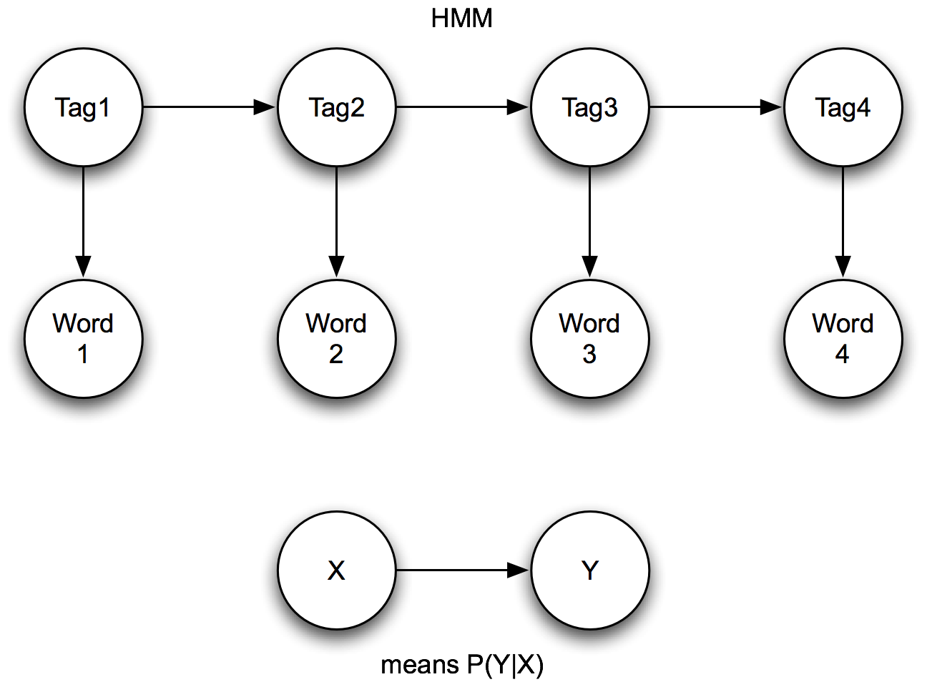
HMMs vs. MEMMs

Slide 74
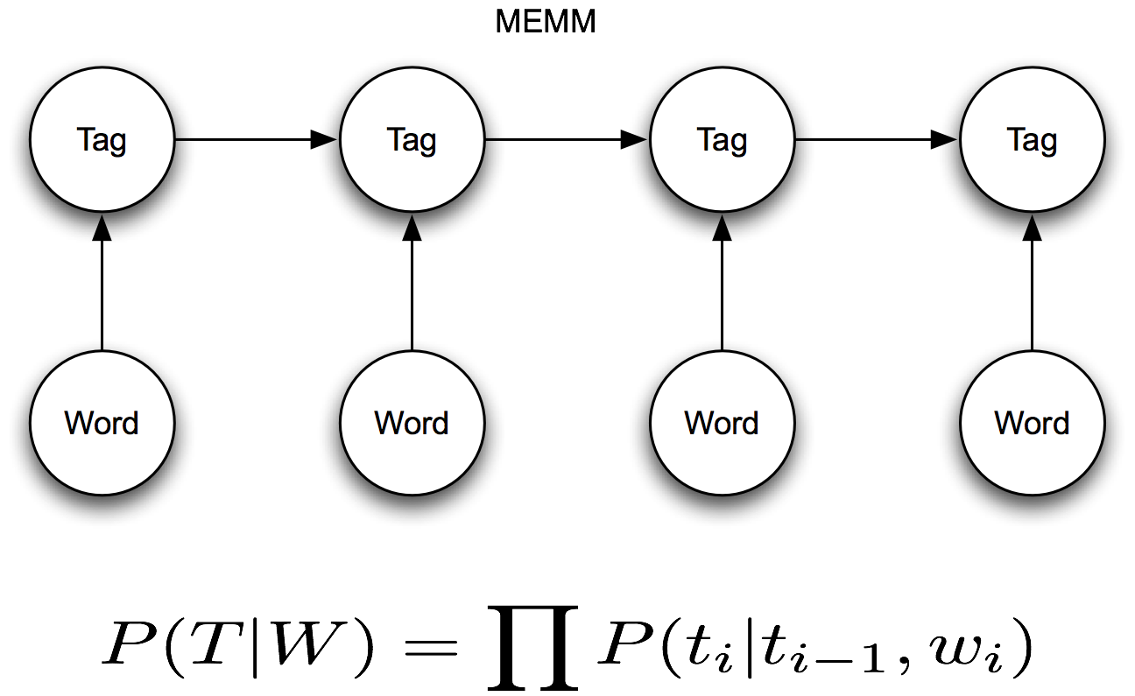
HMMs vs. MEMMs

Slide 75
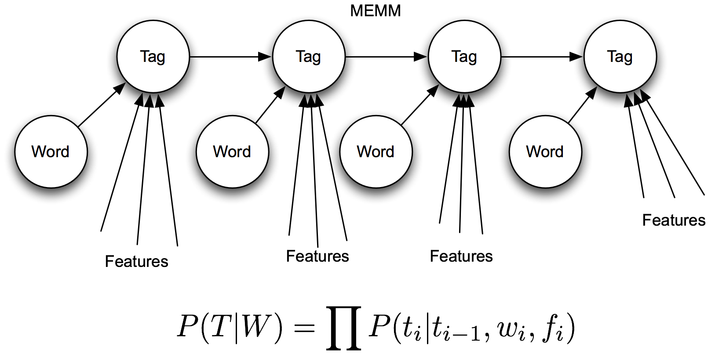
HMMs vs. MEMMs

Slide 76
HMM vs MEMM
Varenne
Varenne

Slide 77
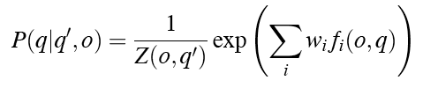


Viterbi in MEMMs
We condition on the observation AND the previous state:
HMM decoding:
which is the HMM version of:
MEMM decoding:

Slide 78
Decoding in MEMMs

Slide 79
Outline
Named Entities and the basic idea
IOB Tagging
A new classifier: Logistic Regression
  Linear regression
  Logistic regression
  Multinomial logistic regression = MaxEnt
Why classifiers are not as good as sequence models
A new sequence model:
  MEMM = Maximum Entropy Markov Model

