Slide 1

Text Analytics
Università di Pisa
Giuseppe Attardi
Language Modeling
IP notice: some slides from: Dan Jurafsky, Jim Martin, Sandiway Fong, Dan Klein

Slide 2
Outline
Language Modeling (N-grams)
  N-gram Intro
  The Chain Rule
  The Shannon Visualization Method
  Evaluation:
    Perplexity
  Smoothing:
    Laplace (Add-1)
    Add-prior

Slide 3
Probabilistic Language Model
Goal: assign a probability to a sentence
Machine Translation:
  P(high winds tonite) > P(large winds tonite)
Spell Correction
  “The oﬃce is about ﬁfteen minuets from my house"
  P(about ﬁfteen minutes from) > P(about ﬁfteen minuets from)
Speech Recognition
  P(I saw a van) >> P(eyes awe of an)
Summarization, question-­answering, etc.

Slide 4
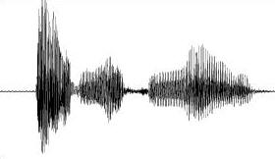
Why Language Models
We have an English speech recognition system, which answer is better?
Speech Interpretation
speech recognition system
speech cognition system
speck podcast histamine
スピーチ が 救出 ストン
Language models tell us the answer!

Slide 5
Language Modeling
We want to compute
  P(w₁,w₂,w₃,w₄,w₅…w_{n}) = P(W)
  = the probability of a sequence
Alternatively we want to compute
  P(w₅|w₁,w₂,w₃,w₄)
  = the probability of a word given some previous words
The model that computes
  P(W) or
  P(w_{n}|w₁,w₂…w_{n-1})
  is called the language model.
A better term for this would be “The Grammar”
But “Language model” or LM is standard

Slide 6
Computing P(W)
How to compute this joint probability:
  P(“the”, “other”, “day”, “I”, “was”, “walking”, “along”, “and”, “saw”, “a”, “lizard”)
Intuition: let’s rely on the Chain Rule of Probability

Slide 7
The Chain Rule
Recall the definition of conditional probabilities
Rewriting:
More generally
P(A,B,C,D) = P(A)P(B|A)P(C|A,B)P(D|A,B,C)
In general
P(x₁,x₂,x₃,…x_{n}) = P(x₁)P(x₂|x₁)P(x₃|x₁,x₂)…P(x_{n}|x₁…x_{n-1})

Slide 8
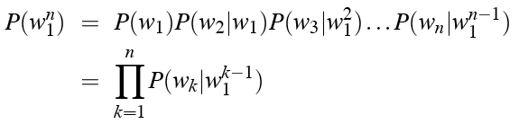
The Chain Rule applied to joint probability of words in sentence
P(“the big red dog was”) =
P(the) • P(big|the) • P(red|the big) • P(dog|the big red) • P(was|the big red dog)

Slide 9
Obvious estimate
How to estimate?
  P(the | its water is so transparent that)
P(the | its water is so transparent that) =
  C(its water is so transparent that the)
  ____________________________________________________________________________________________
  C(its water is so transparent that)

Slide 10
Unfortunately
There are a lot of possible sentences
We will never be able to get enough data to compute the statistics for those long prefixes
P(lizard|the,other,day,I,was,walking,along,and,saw,a)
or
P(the|its water is so transparent that)

Slide 11
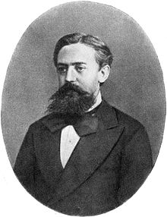
Markov Assumption
Make the simplifying assumption
  P(lizard|the,other,day,I,was,walking,along,and,saw,a) = P(lizard|a)
or maybe
  P(lizard|the,other,day,I,was,walking,along,and,saw,a) = P(lizard|saw,a)

Slide 12
Markov Assumption
So for each component in the product, replace with the approximation (assuming a prefix of N)
Bigram model

Slide 13
N-gram models
We can extend to trigrams, 4-­grams, 5-­grams
In general this is an insuﬃcient model of language
  because language has long-­distance dependencies:
  “The computer which I had just put into the machine room on the ﬁfth ﬂoor crashed.”
But we can often get away with N-­gram models

Slide 14
Estimating bigram probabilities
The Maximum Likelihood Estimate

Slide 15


An example
<s> I am Sam </s>
<s> Sam I am </s>
<s> I do not like green eggs and ham </s>
This is the Maximum Likelihood Estimate, because it is the one which maximizes P(Training set|Model)

Slide 16
Maximum Likelihood Estimates
The Maximum Likelihood Estimate of some parameter of a model M from a training set T
  is the estimate that
  maximizes the likelihood of the training set T given the model M
Suppose the word “Chinese” occurs 400 times in a corpus of a million words (e.g. the Brown corpus)
What is the probability that a random word from some other text will be “Chinese”
MLE estimate is 400/1000000 = .004
  This may be a bad estimate for some other corpus
But it is the estimate that makes it most likely that “Chinese” will occur 400 times in a million word corpus.

Slide 17
Maximum Likelihood
We want to estimate the probability, p, that individuals are infected with a certain kind of parasite.
The maximum likelihood method (discrete distribution):
Write down the probability of each observation by using the model parameters
Write down the probability of all the data
Find the value parameter(s) that maximize this probability
Ind. | Infected | Probability of observation
1 | 1 | p
2 | 0 | 1 – p
3 | 1 | p
4 | 1 | p
5 | 0 | 1 – p
6 | 1 | p
7 | 1 | p
8 | 0 | 1 – p
9 | 0 | 1 – p
10 | 1 | p

Slide 18
Maximum likelihood
We want to estimate the probability, p, that individuals are infected with a certain kind of parasite.
Ind. | Infected | Probability of observation
1 | 1 | p
2 | 0 | 1 – p
3 | 1 | p
4 | 1 | p
5 | 0 | 1 – p
6 | 1 | p
7 | 1 | p
8 | 0 | 1 – p
9 | 0 | 1 – p
10 | 1 | p
Likelihood function:
- Find the value parameter(s) that maximize this probability

Slide 19
Computing the MLE
Set the derivative to 0:
Solutions:
  p = 0 (minimum)
  p = 1 (minimum)
  p = 0.6 (maximum)

Slide 20
More examples: Berkeley Restaurant Project
can you tell me about any good cantonese restaurants close by
mid priced thai food is what i’m looking for
tell me about chez panisse
can you give me a listing of the kinds of food that are available
i’m looking for a good place to eat breakfast
when is caffe venezia open during the day

Slide 21
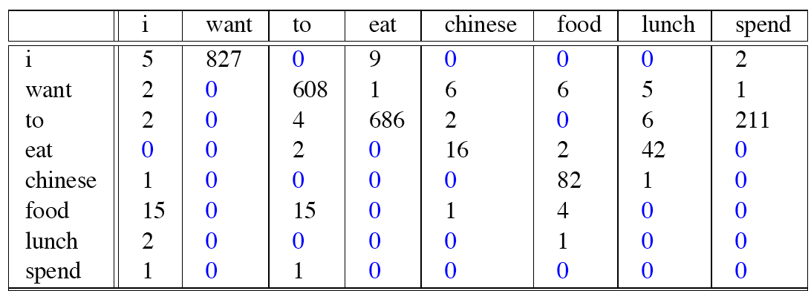
Raw bigram counts
Out of 9222 sentences

Slide 22
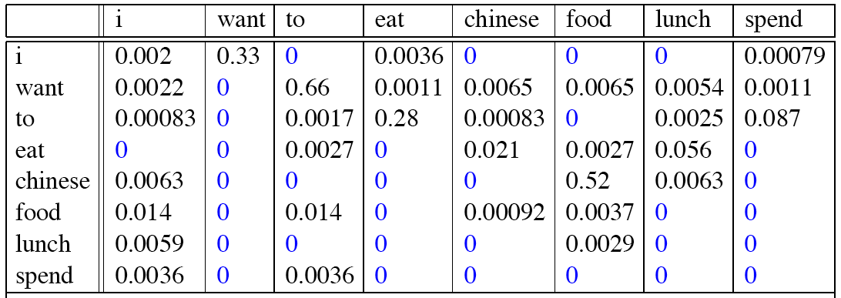
Raw bigram probabilities
Normalize by unigrams (divide by C(w₋₁)):
Result:

Slide 23
Bigram estimates of sentence probabilities
P(<s> I want english food </s>) =
P(i|<s>) x
P(want|I) x
P(english|want) x
P(food|english) x
P(</s>|food)
=.000031

Slide 24
What kinds of knowledge?
  P(english|want) = 0.0011
  P(chinese|want) = 0.0065
  P(to|want) = 0.66
  P(eat | to) = 0.28
  P(food | to) = 0
  P(want | spend) = 0
  P(i | <s>) = 0.25

Slide 25
Practical Issues
Compute in log space
  Avoid underflow
  Adding is faster than multiplying
  log(p₁ • p₂ • p₃ • p₄) = log(p₁) + log(p₂) + log(p₃) + log(p₄)

Slide 26
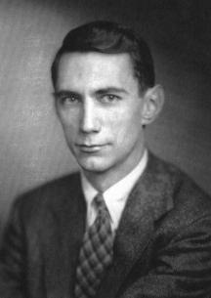
Shannon’s Game
What if we turn these models around and use them to generate random sentences that are like the sentences from which the model was derived.

Slide 27
The Shannon Visualization Method
Generate random sentences:
Choose a random bigram <s>, w according to its probability
Now choose a random bigram (w, x) according to its probability
And so on until we choose </s>
Then string the words together
<s> I
I want
  want to
  to eat
  eat Chinese
  Chinese food
  food </s>

Slide 28
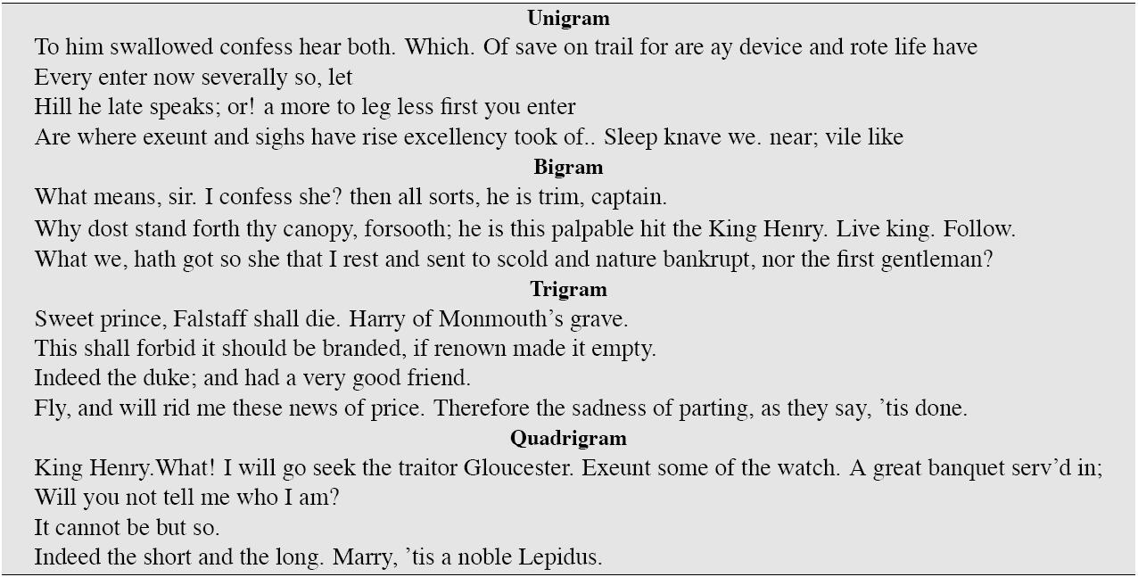
Approximating Shakespeare

Slide 29
Shakespeare as corpus
N=884,647 tokens, V=29,066
Shakespeare produced 300,000 bigram types out of V²= 844 million possible bigrams
  99.96% of the possible bigrams were never seen (have zero entries in the table)
Quadrigrams:
  What's coming out looks like Shakespeare because it is Shakespeare

Slide 30
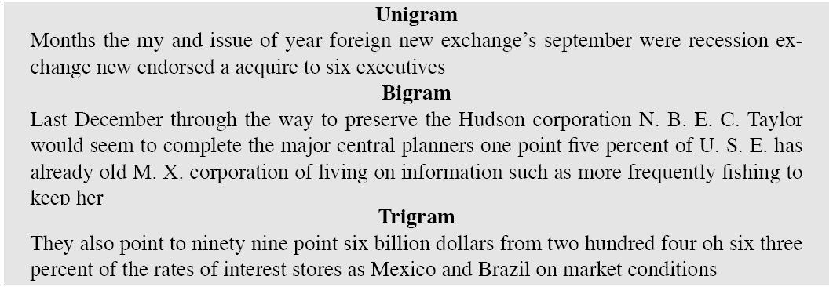
The Wall Street Journal is not Shakespeare (no offense)

Slide 31
Lesson 1: the Perils of Overfitting
N-grams only work well for word prediction if the test corpus looks like the training corpus
  In real life, it often doesn’t
  We need to train robust models, adapt to test set, etc.

Slide 32
Train and Test Corpora
A language model must be trained on a large corpus of text to estimate good parameter values.
Model can be evaluated based on its ability to predict a high probability for a disjoint (held-out) test corpus (testing on the training corpus would give an optimistically biased estimate).
Ideally, the training (and test) corpus should be representative of the actual application data.
May need to adapt a general model to a small amount of new (in-domain) data by adding highly weighted small corpus to original training data.

Slide 33
Lesson 1: the perils of overfitting
N-grams only work well for word prediction if the test corpus looks like the training corpus
  In real life, it often doesn’t
  We need to train robust models, adapt to test set, etc.

Slide 34
Train and Test Corpora
A language model must be trained on a large corpus of text to estimate good parameter values.
Model can be evaluated based on its ability to predict a high probability for a disjoint (held-out) test corpus (testing on the training corpus would give an optimistically biased estimate).
Ideally, the training (and test) corpus should be representative of the actual application data.
May need to adapt a general model to a small amount of new (in-domain) data by adding highly weighted small corpus to original training data.

Slide 35
Smoothing

Slide 36
Smoothing
Since there are a combinatorial number of possible word sequences, many rare (but not impossible) combinations never occur in training, so MLE incorrectly assigns zero to many parameters (aka sparse data).
If a new combination occurs during testing, it is given a probability of zero and the entire sequence gets a probability of zero (i.e. infinite perplexity).
In practice, parameters are smoothed (aka regularized) to reassign some probability mass to unseen events.
  Adding probability mass to unseen events requires removing it from seen ones (discounting) in order to maintain a joint distribution that sums to 1.

Slide 37
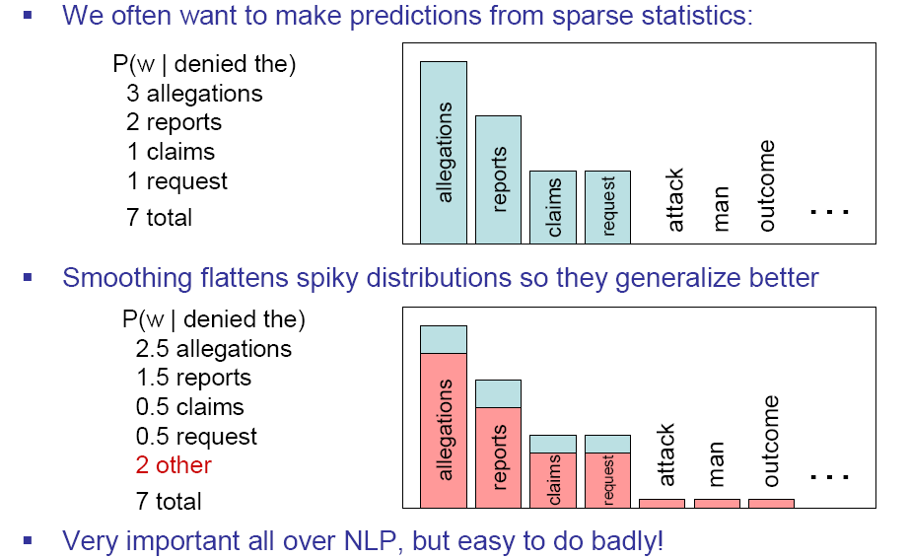
Smoothing is like Robin Hood
Slide from Dan Klein

Slide 38
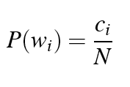

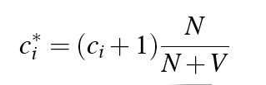
Laplace smoothing
Also called add-one smoothing
Just add one to all the counts!
Very simple
MLE estimate:
Laplace estimate:
Reconstructed counts:

Slide 39
Laplace smoothed bigram counts
Berkeley Restaurant Corpus
 | I | want | to | eat | chinese | food | lunch | spend
I | 6 | 828 | 1 | 10 | 1 | 1 | 1 | 3
want | 3 | 1 | 609 | 2 | 7 | 7 | 6 | 2
to | 3 | 1 | 5 | 687 | 3 | 1 | 7 | 212
eat | 1 | 1 | 3 | 1 | 17 | 3 | 43 | 1
chinese | 2 | 1 | 1 | 1 | 1 | 83 | 2 | 1
food | 16 | 1 | 16 | 1 | 2 | 5 | 1 | 1
lunch | 3 | 1 | 1 | 1 | 1 | 2 | 1 | 1
spend | 2 | 1 | 2 | 1 | 1 | 1 | 1 | 1

Slide 40
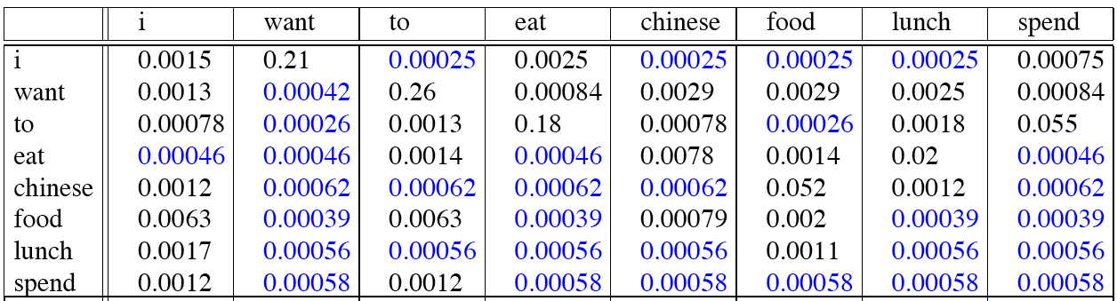
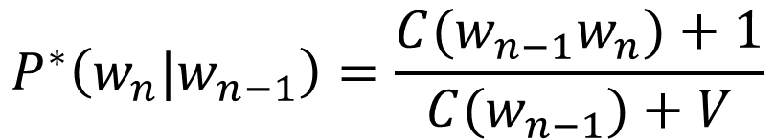
Laplace-smoothed bigrams
$$P^{∗}\left(w_{n}|w_{n−1}\right)=\frac{{C(w}_{n−1}w_{n})+1}{{C(w}_{n−1})+V}$$

Slide 41
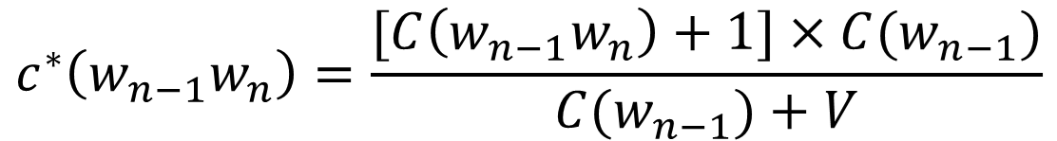
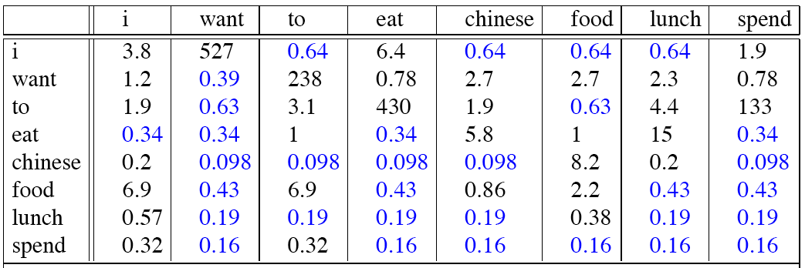
Reconstituted counts

Slide 42
Note big change to counts
C(want to) went from 608 to 238!
P(to|want) from 0.66 to 0.26!
Discount d = c*/c
  d for “chinese food” = 0.10 A 10x reduction!
  So in general, Laplace is a blunt instrument
But Laplace smoothing not used for N-grams, as we have much better methods
Despite its flaws Laplace (add-k) is however still used to smooth other probabilistic models in NLP, especially
  For pilot studies
  in domains where the number of zeros isn’t so huge.

Slide 43
Add-k
Add a small fraction instead of 1
k = 0.01

Slide 44
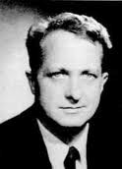
Lesson 2: zeros or not?
Zipf’s Law:
  A small number of events occur with high frequency
  A large number of events occur with low frequency
  You can quickly collect statistics on the high frequency events
  You might have to wait an arbitrarily long time to get valid statistics on low frequency events
Result:
  Our estimates are sparse! no counts at all for the vast bulk of things we want to estimate!
  Some of the zeroes in the table are really zeros. But others are simply low frequency events you haven't seen yet. After all, ANYTHING CAN HAPPEN!
  How to address?
Answer:
  Estimate the likelihood of unseen N-grams!
Slide from B. Dorr and J. Hirschberg

Slide 45
Even better: Bayesian unigram prior smoothing for bigrams
Maximum Likelihood Estimation
Laplace Smoothing
Bayesian Prior Smoothing

Slide 46
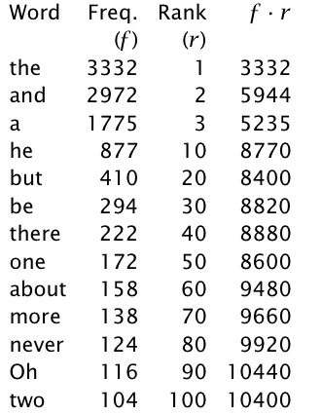
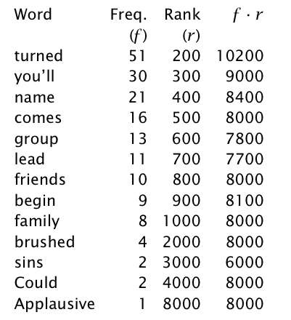
Zipf's law
f ∝ 1/r (f proportional to 1/r)
there is a constant k such that
f . r = k

Slide 47
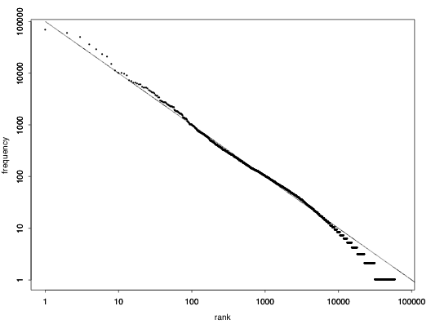
Zipf's Law for the Brown Corpus

Slide 48
Zipf law: interpretation
Principle of least effort: both the speaker and the hearer in communication try to minimize effort:
  Speakers tend to use a small vocabulary of common (shorter) words
  Hearers prefer a large vocabulary of rarer less ambiguous words
  Zipf's law is the result of this compromise
Other laws …
  Number of meanings m of a word obeys the law: m ∝ 1/√f
  Inverse relationship between frequency and length

Slide 49
Neural Language Models

Slide 50
OpenAI Model (2019)
Large-scale unsupervised language model which generates coherent paragraphs of text, achieves state-of-the-art performance on many language modeling benchmarks, and performs rudimentary reading comprehension, machine translation, question answering, and summarization — all without task-specific training.
Model, called GPT-2, was trained simply to predict the next word in 40GB of Internet text.
Due to our concerns about malicious applications of the technology, we are not releasing the trained model.
https://blog.openai.com/better-language-models/

Slide 51
GPT-2 Samples
SYSTEM PROMPT (HUMAN-WRITTEN)
MODEL COMPLETION (MACHINE-WRITTEN, 10 TRIES)
In a shocking finding, scientist discovered a herd of unicorns living in a remote, previously unexplored valley, in the Andes Mountains. Even more surprising to the researchers was the fact that the unicorns spoke perfect English.
The scientist named the population, after their distinctive horn, Ovid’s Unicorn. These four-horned, silver-white unicorns were previously unknown to science.
Now, after almost two centuries, the mystery of what sparked this odd phenomenon is finally solved.
Dr. Jorge Pérez, an evolutionary biologist from the University of La Paz, and several companions, were exploring the Andes Mountains when they found a small valley, with no other animals or humans. Pérez noticed that the valley had what appeared to be a natural fountain, surrounded by two peaks of rock and silver snow.

Slide 52
Practical Issues
We do everything in log space
  Avoid underflow
  (also adding is faster than multiplying)

Slide 53
Language Modeling Toolkits
SRILM
  http://www.speech.sri.com/projects/srilm/
IRSTLM
Ken LM

Slide 54
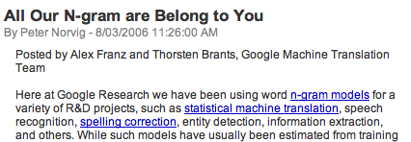

Google N-Gram Release

Slide 55
Google Book N-grams
http://ngrams.googlelabs.com/

Slide 56
Google N-Gram Release
serve as the incoming 92
serve as the incubator 99
serve as the independent 794
serve as the index 223
serve as the indication 72
serve as the indicator 120
serve as the indicators 45
serve as the indispensable 111
serve as the indispensible 40
serve as the individual 234
http://googleresearch.blogspot.com/2006/08/all-our-n-gram-are-belong-to-you.html

Slide 57
Evaluation and Perplexity

Slide 58
Evaluation
Train parameters of our model on a training set.
How do we evaluate how well our model works?
Look at the models performance on some new data
This is what happens in the real world; we want to know how our model performs on data we haven’t seen
Use a test set. A dataset which is different than our training set
Then we need an evaluation metric to tell us how well our model is doing on the test set.
One such metric is perplexity

Slide 59
Evaluating N-gram models
Best evaluation for an N-gram
  Put model A in a task (language identification, speech recognizer, machine translation system)
  Run the task, get an accuracy for A (how many langs identified correctly, or Word Error Rate, or etc)
  Put model B in task, get accuracy for B
  Compare accuracy for A and B
This is Extrinsic evaluation

Slide 60
Language Identification task
Create an N-gram model for each language
Compute the probability of a given text
  P_{lang1}(text)
  P_{lang2}(text)
  P_{lang3}(text)
Select language with highest probability
  lang = argmax_{l} P_{l}(text)

Slide 61
Difficulty of extrinsic (in-vivo) evaluation of N-gram models
Extrinsic evaluation
  This is really time-consuming
  Can take days to run an experiment
So
  As a temporary solution, in order to run experiments
  To evaluate N-grams we often use an intrinsic evaluation, an approximation called perplexity
  But perplexity is a poor approximation unless the test data looks just like the training data
  So is generally only useful in pilot experiments (generally is not sufficient to publish)

Slide 62
Perplexity
The intuition behind perplexity as a measure is the notion of surprise.
How surprised is the language model when it sees the test set?
  Where surprise is a measure of...
    Gee, I didn’t see that coming...
  The more surprised the model is, the lower the probability it assigned to the test set
  The higher the probability, the less surprised it was

Slide 63
Perplexity
Measures of how well a model “fits” the test data.
Uses the probability that the model assigns to the test corpus.
Normalizes for the number of words in the test corpus and takes the inverse.
Measures the weighted average branching factor in predicting the next word (lower is better).

Slide 64
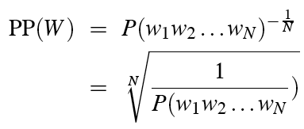
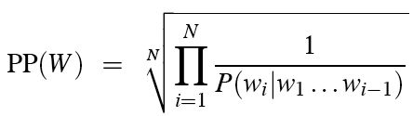
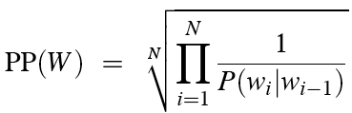
Perplexity
Perplexity:
Chain rule:
For bigrams:
Minimizing perplexity is the same as maximizing probability
  The best language model is one that best predicts an unseen test set

Slide 65
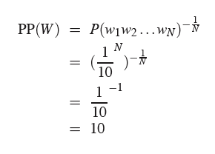
Perplexity as branching factor
How hard is the task of recognizing digits ‘0,1,2,3,4,5,6,7,8,9’
Perplexity: 10

Slide 66
Lower perplexity = better model
Model trained on 38 million words from the Wall Street Journal (WSJ) using a 19,979 word vocabulary.
Evaluation on a disjoint set of 1.5 million WSJ words.
N-gram Order | Unigram | Bigram | Trigram
Perplexity | 962 | 170 | 109

Slide 67
Unknown Words
How to handle words in the test corpus that did not occur in the training data, i.e. out of vocabulary (OOV) words?
Train a model that includes an explicit symbol for an unknown word (<UNK>):
  Choose a vocabulary in advance and replace other words in the training corpus with <UNK>, or
  Replace the first occurrence of each word in the training data with <UNK>.

Slide 68
Unknown Words handling
Training of <UNK> probabilities
  Create a fixed lexicon L of size V
  Any training word not in L changed to <UNK>
  Now we train its probabilities like a normal word
At decoding time
  In text input: use <UNK> probabilities for any word not in training

Slide 69
Problem for N-Grams: Long Distance Dependencies
Sometimes local context does not provide enough predictive clues, due to the presence of long-distance dependencies.
  Syntactic dependencies
    “The man next to the large oak tree near the grocery store on the corner is tall.”
    “The men next to the large oak tree near the grocery store on the corner are tall.”
  Semantic dependencies
    “The bird next to the large oak tree near the grocery store on the corner flies rapidly.”
    “The man next to the large oak tree near the grocery store on the corner talks rapidly.”
More complex models of language are needed to handle such dependencies.

Slide 70
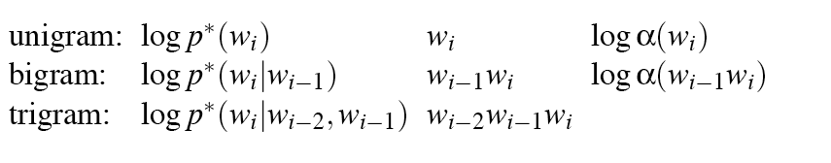
ARPA format

Slide 71
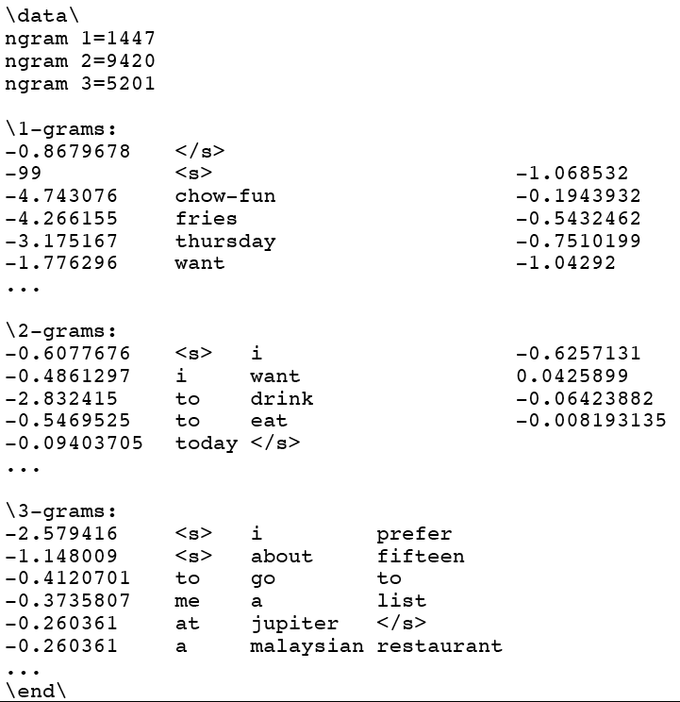

Slide 72
Language Models
Language models assign a probability that a sentence is a legal string in a language.
They are useful as a component of many NLP systems, such as ASR, OCR, and MT.
Simple N-gram models are easy to train on unsupervised corpora and can provide useful estimates of sentence likelihood.
MLE gives inaccurate parameters for models trained on sparse data.
Smoothing techniques adjust parameter estimates to account for unseen (but not impossible) events.

Slide 73
Exercise
Write two programs
  train-unigram: Creates a unigram model
  test-unigram: Reads a unigram model and calculates entropy and coverage for the test set
Train the model on NLTK Brown Corpus
Calculate entropy and coverage on data/wiki-entest.word

Slide 74
Pseudo code: train-unigram
counts = {}
total_count = 0
for line in the training_file:
words = line.split()
words.append(“</s>”)
for word in words:
counts[word] += 1
total_count += 1
open the model_file for writing
for word, count in counts:
probability = counts[word]/total_count
print word, probability to model_file

Slide 75
Pseudo-code: test-unigram
Load model
Test and print
probabilities = {}
for line in model_file:
w, P = line.split()
probabilities[w] = P
W = 0
unk = 0
H = 0
for line in test_file:
words = line.split()
words.append(“</s>”)
for w in words:
W += 1
P = λ_{unk} / V
if probabilities[w] exists
P += λ₁ * probabilities[w]
else
unk += 1
H += -log₂(P)
print “entropy = ” + H/W
print “coverage = ” + (W - unk)/W

Slide 76
Summary
Language Modeling (N-grams)
  N-grams
  The Chain Rule
  The Shannon Visualization Method
  Evaluation:
    Perplexity
  Smoothing:
    Laplace (Add-1)
    Add-k
    Add-prior

