Slide 1

Representation of Words
Università di Pisa
Text Analytics
Dipartimento di Informatica
Giuseppe Attardi, Andrea Esuli

Slide 2
Word Meaning
Definition: meaning (Webster dictionary)
the idea that is represented by a word, phrase, etc.
the idea that a person wants to express by using words, signs, etc.
the idea that is expressed in a work of writing, art, etc.
Philosophy of Language (Frege, Quine, Caplan, Kripke, Montague):
signifier (symbol) ⟺ signified (idea or concept) = denotation

Slide 3
Linguistic Solution
Dictionary or lexical resources like Wordnet provide word definitions, as well as synonyms, hypernyms, antonyms
from nltk.corpus import wordnet as wn
for synset in wn.synsets('good'):
print synset.pos(),
print ', '.join([l.name() for l in synset.lemmas()])
panda = wn.synset('panda.n.01')
hyper = lambda s: s.hypernyms()
list(panda.closure(hyper))
n good, goodness
n commodity, trade_good, good
a adept, expert, good, practiced, proficient, skillful
a full, good
a estimable, good, honorable, respectable
a beneficial, good
a good, just, upright
…
r well, good
r thoroughly, soundly, good
[Synset('procyonid.n.01'), Synset('carnivore.n.01'), Synset('placental.n.01'), Synset('mammal.n.01'), Synset('vertebrate.n.01'), Synset('chordate.n.01'), Synset('animal.n.01'), Synset('organism.n.01'), Synset('living_thing.n.01'), Synset('whole.n.02’),
Synset('object.n.01'), Synset('physical_entity.n.01'), Synset('entity.n.01')]

Slide 4
Problem with Lexica
Imperfect
  e.g. “proficient” is listed as a synonym for “good”.
  Correct only in some contexts.
Missing new meanings of words
  e.g. wicked, badass, nifty, wizard, genius, ninja, bombest
  Impossible to keep up-to-date!
Subjective
Require human labor to create and adapt
Hard to compute accurate word similarity
Slide by R. Socher

Slide 5
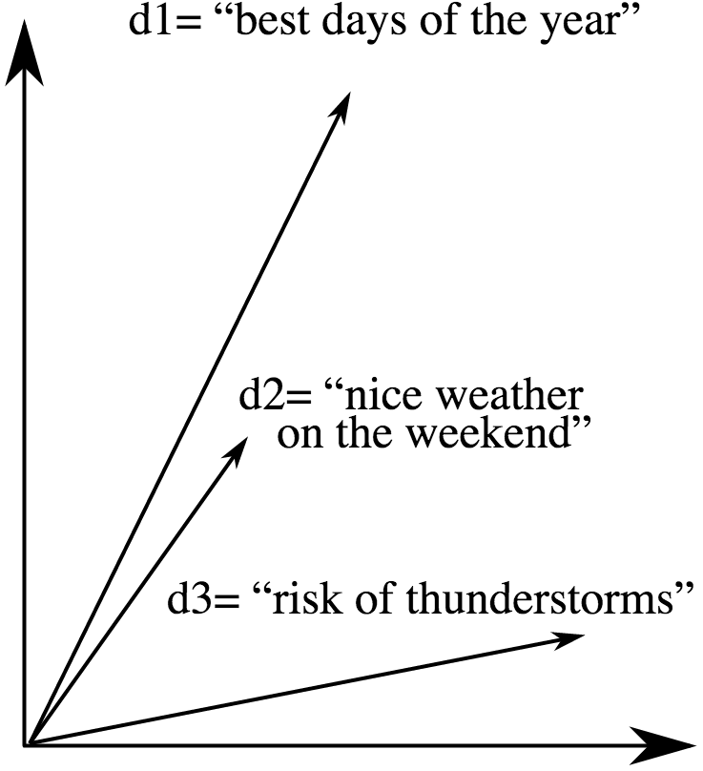
Vector Space Model
The Vector Space Model (VSM) is a representation for text used in Information Retrieval.
A document is represented by a vector in an n-dimensional space
v(d₁) = [t₁, t₂… …, t_{n-1}, t_{n}]
Each dimension corresponds to a separate term.

Slide 6
Linear Algebra

Slide 7
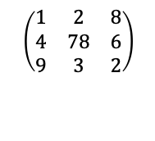
Basic concepts
Vector in R^{n} is an ordered set of n real numbers:
  v = (1, 6, 3, 4) is in R⁴
Matrix in R^{mxn} has m rows and n columns
$$\left(\begin{matrix}1 & 2 & 8 \\ 4 & 78 & 6 \\ 9 & 3 & 2\end{matrix}\right)$$

Slide 8
Vector Addition
x + y = [x₁, x₂, ..., x_{n}] + [y₁, y₂, ..., y_{n}] = [ ... x_{i} + y_{i} + ...]
Commutative:
x + y = y + x
x+y
x
y

Slide 9
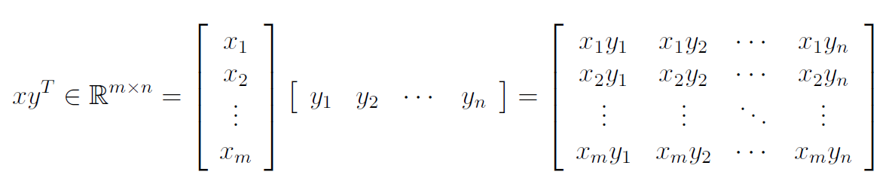
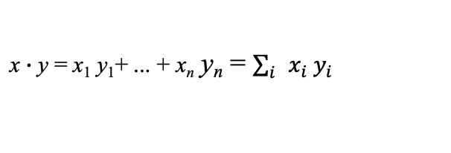
Vector Products
Vector dot (inner) product:
Vector outer product:
x $∙$ y = x₁ y₁+ ... + x_{n} y_{n} = $\sum_{i}{x_{i} y_{i}}$

Slide 10
Geometrical Interpretation
Vector norm: A norm of a vector ||x|| is a measure of the “length” of the vector
Angle between vectors:
v
α
w

Slide 11



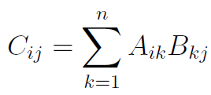
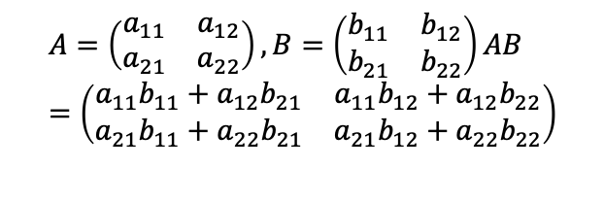
Matrix Product
Matrix product:
Example:
$$A=\left(\begin{matrix}a_{11} & a_{12} \\ a_{21} & a_{22}\end{matrix}\right),B=\left(\begin{matrix}b_{11} & b_{12} \\ b_{21} & b_{22}\end{matrix}\right)AB=\left(\begin{matrix}a_{11}b_{11}+a_{12}b_{21} & a_{11}b_{12}+a_{12}b_{22} \\ a_{21}b_{11}+a_{22}b_{21} & a_{21}b_{12}+a_{22}b_{22}\end{matrix}\right)$$

Slide 12
Vector-Matrix Product

Slide 13
Hyperplane
Hyperplane equation: wx + b = 0
wx + b > 0
wx + b = 0
-b/w₂
w
wx + b < 0

Slide 14
Word Vector Representation

Slide 15

One Hot Representation
Information Retrieval considers words as discrete symbols:
hotel, city, motel
A word occurrence is represented by one-hot vectors:
motel = [0 0 0 0 0 0 0 0 0 0 1 0 0 0 0]
hotel = [0 0 0 0 0 0 0 1 0 0 0 0 0 0 0]
Vector dimension = number of words in vocabulary (e.g. 500,000)
Represent a document by the sum of its word occurrence vectors
Document similarity measured by cosine distance
A 1 at a different position for each word
motel
α
hotel
$$cos(α)=\frac{x∙y}{\left\|x∙y\right\|}$$

Slide 16
Vector Space Model
A document is represented as vector in ℝ^{|V|}, where V is the vocabulary of documents.
Each word corresponds to a different dimension in ℝ^{|V|} with a corresponding term weight:
v('played') = [tw_{played}, 0, 0, … , 0, 0, … , 0, 0]
v('game') = [0, tw_{game}, 0, … , 0, 0, … , 0, 0]
v('match') = [0, 0, tw_{match}, … , 0, 0, … , 0, 0]
⁞
v('trumpet') = [0, 0, 0, … , 0, tw_{trumpet}, … , 0, 0]

Slide 17
Problems with Discrete Symbols
All vectors are orthogonal
No notion of similarity: words hotel, motel have nothing in common
Search Engines try to address the issue using WordNet synonyms
This leads to further problems. Which ones?
Alternative solution:
Encode similarity in the vector themselves

Slide 18

tf * idf for measuring similarity
Term frequency (Luhn 1957): frequency of the word
Inverse document frequency (idf) Sparck Jones 1972)
  N is the total number of documents
  df_{i} = “document frequency of word i”
  = # of documents containing word i
$${idf}_{i}=\log{\frac{N}{{df}_{i}}}$$

Slide 19
Vector Space Model
Salton et al. suggested the tf * idf weighting to represent documents
Use a vector for each term t:
v(t) = [0, idf_{t}, …, 0]
Sum the vectors of all terms in a document.
For example:
d = 'you played a game'
v(d) = v(‘you’) + v(‘played’) + v(‘a’) + v(‘game’)
= [0, tf_{you,d}∙idf_{you}, …, tf_{played,d}∙idf_{played}, …, tf_{game,d}∙idf_{game}, …, 0]
The resulting document vectors are sparse:
|{i | v_{i}(d) ≠ 0 }| << n

Slide 20
Sparse Representations
d₁ = 'you played a game'
d₂ = 'you played a match'
d₃ = 'you played a trumpet'
v(d₁) = [w_{you,d1}, w_{played,d1} , w_{game,d1} , 0 , 0, … , 0, 0 , 0]
v(d₂) = [w_{you,d2}, w_{played,d2} , 0 , w_{match,d2} , 0, … , 0, 0 , 0]
v(d₃) = [w_{you,d3}, w_{played,d3} , 0 , 0 , 0, … , 0, w_{trumpet,d3} , 0]
Semantic similarity between terms (game, match) is not captured:
sim(v(d₁), v(d₂)) ~ sim(v(d₁), v(d₃)) ~ sim(v(d₂), v(d₃))

Slide 21
Modeling Word Similarity
How do we model that game and match are related terms and trumpet is not?
Using linguistic resources: building them requires a lot of human work.
Hypothesis: co-occurring words are semantically related?
Pisa is a province of Tuscany
Red is a color of the rainbow
Wheels are a component of the bicycle
Red is a province of the bicycle
We can exploit this propriety of language, e.g., following the distributional hypothesis.

Slide 22
Distributional Hypothesis
A word’s meaning is given by the words that frequently appear close-by
“You shall know a word by the company it keeps” (J. R. Firth 1957)
  Old idea but not quite successful until the rise of modern statistical NLP
When a word w appears in a text, its context is the set of words that appear nearby (within a fixed-size window), aka collocations.
Use the many contexts of w to build up a representation of w
...government debt problems turning into | banking | crises as happened in 2009...
...saying that Europe needs unified | banking | regulation to replace the hodgepodge...
..India has just given its | banking | system a shot in the arm...

Slide 23
Word-Context Matrix
A word-context (or word-word) matrix is a |V|×|V| matrix C that counts the frequencies of co-occurrence of words in a collection of contexts (i.e, text spans of a given length).
You cook the cake twenty minutes in the oven at 220 C.
I eat my steak rare.
I'll throw the steak if you cook it too much.
The engine broke due to stress.
I broke a tire hitting a curb, I changed the tire.
Context_{-2,+2}('cake') = {['cook', 'the', 'twenty', 'minutes']}
Context_{-2,+2}('tire') = {['broke', 'a', 'hitting', 'a'], ['changed', 'the']}

Slide 24
Co-occurrence Matrix
One row per word with counts of co-occurrences with any other word
 |  | Context words
 |  | … | cook | eat | … | changed | broke | …
Words | cake | … | 10 | 20 | … | 0 | 0 | …
 | steak | … | 12 | 22 | … | 0 | 0 | …
 | engine | … | 0 | 0 | … | 3 | 10 | …
 | tire | … | 0 | 0 | … | 10 | 1 | …
 | … | … | … | … | … | … | … | …
Rows of C capture similarity, yet C is still high dimensional and sparse.

Slide 25


Distance between Co-occurrence Vectors
Hypothesis:
Use the distance between co-occurrence vectors as a measure of similarity
Distance:
Cosine
Euclidean distance
x
x-y
α
y
$$cos(α)=\frac{x∙y}{\left\|x∙y\right\|}$$
$$d\left(x,y\right)=\left\|x−y\right\|$$

Slide 26
Distance between Vectors of Co-occorring Words
FRANCE 454 | JESUS 1973 | XBOX 6909 | REDDISH 11724 | SCRATCHED 29869 | MEGABITS 87025
PERSUADE | THICKETS | DECADENT | WIDESCREEN | ODD | PPA
FAW | SAVARY | DIVO | ANTICA | ANCHIETA | UDDIN
BLACKSTOCK | SYMPATHETIC | VERUS | SHABBY | EMIGRATION | BIOLOGICALLY
GIORGI | JFK | OXIDE | AWE | MARKING | KAYAK
SHAFFEED | KHWARAZM | URBINA | THUD | HEUER | MCLARENS
RUMELLA | STATIONERY | EPOS | OCCUPANT | SAMBHAJI | GLADWIN
PLANUM | GSNUMBER | EGLINTON | REVISED | WORSHIPPERS | CENTRALLY
GOA’ULD | OPERATOR | EDGING | LEAVENED | RITSUKO | INDONESIA
COLLATION | OPERATOR | FRG | PANDIONIDAE | LIFELESS | MONEO
BACHA | W.J. | NAMSOS | SHIRT | MAHAN | NILGRIS
neighboring words are not semantically related

Slide 27
Word Embeddings

Slide 28
Intuition
Model the meaning of a word by “embedding” it in a vector space.
The meaning of a word is a vector of numbers
  Vector representations are also called “embeddings”
Contrast: words represented by a vocabulary index (“word number 545”)

Slide 29
Dense Representations
Project word vectors v(t) into a low dimensional space ℝ^{k}, k ≪ |V|, of continuous space word representations (a.k.a. embeddings).
Embed: ℝ^{|V|} → ℝ^{k}
Embed(v(t)) = e(t)
Desired properties:
remaining dimensions represent most salient features
↓
words with syntactic/semantic similarities group close in space

Slide 30
Word Embeddings
Collobert et al. (2011). Natural Language Processing (Almost) from Scratch. JMLR.
Context window
Train a neural network to predict whether a word is in the right context
Positive example: from text
Negative example: replace center word with random one
proper/improper
sentence
i.e. Language Model
f_{𝜃}(w)
U
●●●●●● | ●●●●●● | ●●●●●● | ●●●●●● | ●●●●●●
Word vector
●●●●●●
●●●●●●
●●●●●●
●●●●●●
●●●●●●
w_{t-2}
w_{t-1}
w_{t}
w_{t+1}
w_{t+2}
now the cat sits on

Slide 31
Word2Vec
Word2vec (Mikolov et al. 2013) is a library for learning word vectors
Idea:
Collect a large corpus of text
Start with a random vector for each word
Go through each position t in the text, which has a center word c and context (“outside”) words o
Use the similarity of the word vectors for c and o to estimate the probability of o given c
  P(o|c)
Keep adjusting the word vectors to maximize this probability

Slide 32
Word2Vec Models
Skip-gram: predict context words within window of width m, surrounding center word w_{t}
CBoW: predict center word w_{t} given context words within window of width m
P(w_{t}|w_{t−2},…, w_{t+2})
P(w_{t−2}|w_{t})
P(w_{t−1}|w_{t})
P(w_{t+1}|w_{t})
P(w_{t+2}|w_{t})
U
h
U
𝚺
w_{t}
w_{t−2}
w_{t−1}
w_{t+1}
w_{t+2}

Slide 33
Word2Vec
Embeddings are a by-product of the word prediction task.
Even though it is a prediction tasks the network can be trained on any text, no need for human-labeled data!
Usual context window size is 5 words before, 5 words after.
Features can be also multi-word expressions.
Longer windows capture more semantics, less syntax.
A typical size for h is 200-300.

Slide 34
Skip-Gram
w ∈ ℝ^{|V|} are high dimensional
h ∈ ℝ^{d} is low dimensional: size of the embedding space d
W_{I} ∈ ℝ^{|V| × d} input word matrix
row t of W_{I} input vector representation for center word w_{t}
W_{O} ∈ ℝ^{d × |V|} output word matrix
column o of W_{O} output vector representation for context word w_{o}
P(w_{t−m}|w_{t})
...
P(w_{t+m}|w_{t})
softmax
z
W_{O}
h_{t}
W_{I}
One hot representation
w_{t}

Slide 35

Skip-Gram
h_{t} = w_{t}W_{I} embedding of word w_{t}
z = h_{t}W_{O} z_{i} is the similarity of w_{t} with
context word w_{i}
Softmax converts z to a prob distribution p:
P(w_{t−m}|w_{t})
...
P(w_{t+m}|w_{t})
softmax
z
W_{O}
$$p_{i}=\frac{e^{z_{i}}}{\sum_{j∈V}{e^{z_{j}}}}$$
h_{t}
W_{I}
w_{t}

Slide 36
Procedure
Lookup the embedded word vector for the center word v_{c} = V[c] ∈ R^{n}
Generate a score vector z = v_{c}U
Turn the score vector into probabilities
ŷ = softmax(z)
ŷ_{c−m},…, ŷ_{c− 1}, ŷ_{c+1}, … , ŷ_{c+m} are estimates of the probabilities of observing each context word
These should match the true probabilities which is:
y^{(c−m)}, …, y^{(c− 1)}, y^{(c+1)}, … , y^{(c+m)}
the one hot vectors of the actual output.

Slide 37
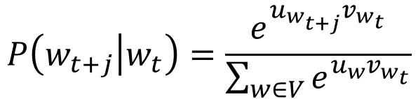
Word2Vec Training
Iterate through each word of the whole corpus
Predict surrounding words using word vectors
outside context words
in window of size 2
center word
at position t
outside context words
in window of size 2
$$P\left(w_{t+j} | w_{t}\right)=\frac{e^{u_{w_{t+j}}v_{w_{t}}}}{\sum_{w∈V}{e^{u_{w}v_{w_{t}}}}}$$

Slide 38
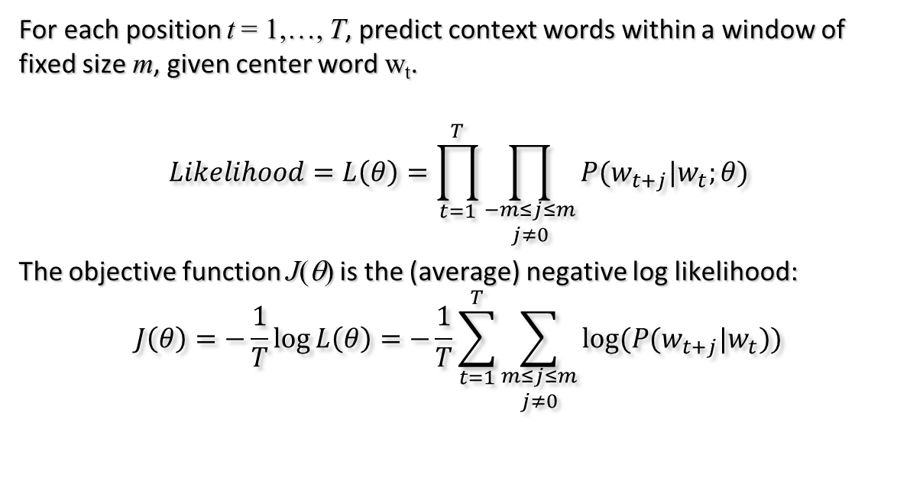
Word2Vec: Objective Function
For each position t = 1,…, T, predict context words within a window of fixed size m, given center word w_{t}.
$$Likelihood=L\left(θ\right)=\prod_{t=1}^{T}{\prod_{\begin{aligned}−m≤j≤m \\ j≠0\end{aligned}}{P(w_{t+j}|w_{t};θ)}}$$
The objective function J(θ) is the (average) negative log likelihood:
$$J\left(θ\right)=−\frac{1}{T}\log{L\left(θ\right)}=−\frac{1}{T}\sum_{t=1}^{T}{\sum_{\begin{aligned}m≤j≤m \\ j≠0\end{aligned}}{\log{(P(w_{t+j}|w_{t}))}}}$$

Slide 39
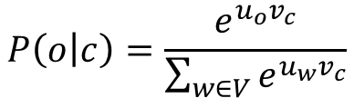
Minimize Objective Function
Use two vectors per word w:
v_{w} when w is a center word
u_{w} when w is a context word
For a center word c and a context word o:
$$P\left(o | c\right)=\frac{e^{u_{o}v_{c}}}{\sum_{w∈V}{e^{u_{w}v_{c}}}}$$

Slide 40

Word2Vect Prediction Function
$$p_{i}=softmax(x_{i})=\frac{e^{x_{i}}}{\sum_{k=1}^{V}{e^{x_{k}}}}$$
The softmax function maps arbitrary values x_{i} to a probability distribution p_{i}
“max” because amplifies probability of largest x_{i}
“soft” because still assigns some probability to smaller x_{i}
Frequently used in Deep Learning

Slide 41
Word Embeddings (http://tanl.di.unipi.it/embeddings/)
FRANCE 454 | JESUS 1973 | XBOX 6909 | REDDISH 11724 | SCRATCHED 29869 | MEGABITS 87025
AUSTRIA | GOD | AMIGA | GREENISH | NAILED | OCTETS
BELGIUM | SATI | PLAYSTATION | BLUISH | SMASHED | MB/S
GERMANY | CHRIST | MSX | PINKISH | PUNSHED | BITS/S
ITALY | SATAN | IPOD | PURPLISH | POPPED | BAUD
GREECE | KALI | SEGA | BROWNISH | CRIMPED | CARATS
SWEDEN | INDRA | PSNUMBER | GREYSH | SCRAPED | KBIT/S
NORWAY | VISHNU | HD | GRAYSH | SCREWED | MEGAHERTZ
EUROPE | ANANDA | DREAMCAST | WITISH | SECTIONED | MEGAPIXEL
HUNGARY | PARVATI | GEFORCE | SILVERY | SLASHED | GBIT/S
SWITZERLAND | GRACE | CAPCOM | YELLOWISH | RIPPED | AMPERE
neighboring words are semantically related

Slide 42
Discussion
What is a concept?
Old philosophical debate:
  Aristoteles, Plato, Kant, Frege, Wittgenstein, Quine, Chomsky
Knowledge Representation, Ontologies
https://www.smithsonianmag.com/innovation/will-ai-ever-be-smarter-than-four-year-old-180971259/

Slide 43
CBoW
Continuous Bag of Words
It's a mirror formulation of the skip-gram model, as context words are used to predict a target word.
h is computed from the average of the embeddings of the input context words.
u_{i} is the similarity of h with the word embedding of w_{i} from W_{O}
P(w_{t}|w_{t-2}, w_{t-1}, w_{t+1}, w_{t+2})
softmax
u
W_{O}
h
W_{I}
𝚺
w_{t-2}
w_{t-1}
w_{t+1}
w_{t+2}

Slide 44
Which embeddings?
Both W_{I} and W_{O} define embeddings, which one to use?
Usually just W_{I} is used.
Average pairs of vectors from W_{I} and W_{O} into a single one.
Append one embedding vector after the other, doubling the length.

Slide 45
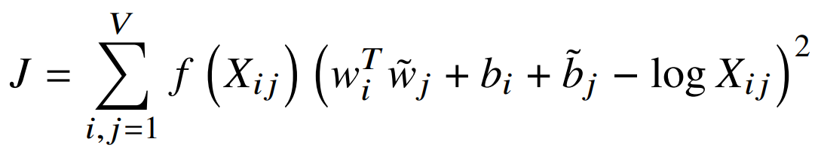
GloVe
GloVe: Global Vectors for Word Representation
Insight: the ratio of conditional probabilities may capture meaning
 | x = solid | x = gas | x = water | x =random
P(x|ice) | large | small | large | small
P(x|steam) | small | large | large | small
P(x|ice)/P(x|steam) | large | small | ~1 | ~1
← eqn 8 of GloVe paper

Slide 46
fastText
Similar to CBoW
Word embeddings can be averaged to obtain a good sentence representation
Pretrained models:
https://fasttext.cc/docs/en/english-vectors.html
https://fasttext.cc/docs/en/crawl-vectors.html
Model | Analogy | RW | Squad
GloVe Wiki | 72 | 0.38 | 77.7%
fastText Wiki | 87 | 0.50 | 78.8%
GloVe Crawl | 75 | 0.52 | 78.9%
fastText Crawl | 85 | 0.58 | 79.8%

Slide 47
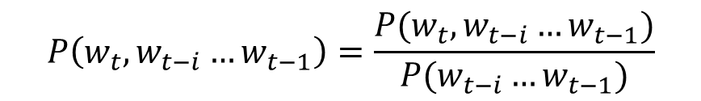
Back to Co-occurrence Counts
$$P\left(w_{t}, w_{t−i}…w_{t−1}\right)=\frac{P(w_{t}, w_{t−i}…w_{t−1})}{P(w_{t−i}…w_{t−1})}$$
 | breeds | computing | cover | food | is | meat | named | as
cat | 0.04 | 0.0 | 0.0 | 0.13 | 0.53 | 0.02 | 0.16 | 0.1
dog | 0.11 | 0.0 | 0.0 | 0.12 | 0.39 | 0.06 | 0.18 | 0.17
cloud | 0/0 | 0.29 | 0.19 | 0.0 | 0.12 | 0.0 | 0.0 | 0.4
Big matrix |V| × |V| (~ 100k × 100k)
Dimensionality reduction:
  Principal Component Analysis, Hellinger PCA, SVD
Reduce to: 100k × 50, 100k × 100

Slide 48
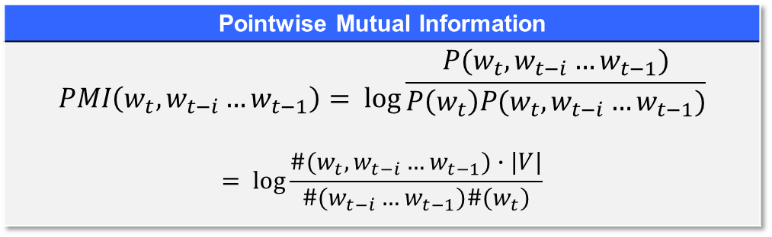
Weighting
Weight the counts using corpus-level statistics to reflect
co-occurrence significance
(Levy and Goldberg 2014) proved that skip-gram model implicitly factorizes a (shifted) PMI matrix
Pointwise Mutual Information
$$PMI\left(w_{t}, w_{t−i}…w_{t−1}\right)= \log{\begin{aligned}\frac{P(w_{t}, w_{t−i}…w_{t−1})}{P\left(w_{t}\right)P(w_{t}, w_{t−i}…w_{t−1})} \\ \end{aligned}}$$ $$= \log{\frac{\#(w_{t}, w_{t−i}…w_{t−1})∙|V|}{\#(w_{t−i}…w_{t−1})\#(w_{t})}}$$

Slide 49
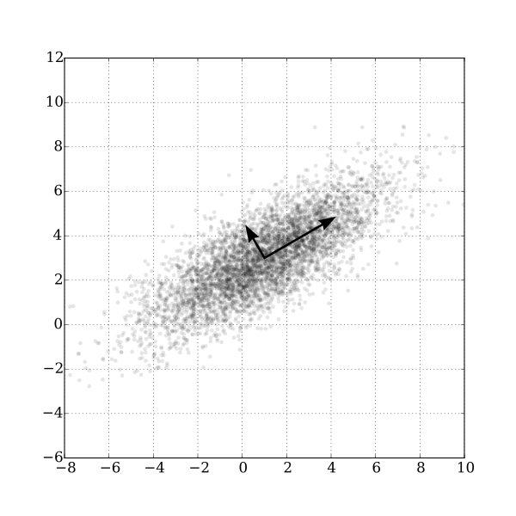
Singular Value Decomposition
n
n
n
U
𝛴
V
n
n
m
k
k
n
U
𝛴
V
k
k
m
By Nicoguaro [CC BY 4.0], via Wikimedia Commons

Slide 50
Singular Value Decomposition
Singular Value Decomposition is a method to decompose a matrix X of size m × n into three matrices UΣV*, where:
U is an orthonormal matrix of size m × n
Σ is a diagonal matrix of size n × n
V is an orthonormal matrix of size n × n, V* is its conjugate transpose
σ₁, σ₂… σ_{n} values of Σ are the singular values of X
Sort the rows by values of σ
Keeping the top k values is a least-square approximation of X
Rows of U_{k} of size m × k are the dense representations of the features

Slide 51
Which one?
Levy and Goldberg proved that Word2Vec skip-gram with negative sampling (SGNS) implicitly computes a factorization of a variant of X.
Levy, Goldberg and Dagan ran an extensive comparison of SVD, CBoW, SGNS, GloVe.
Results indicate no clear overall winner.
Parameters play a relevant role in the outcome of each method.
Both SVD and SGNS performed well on most tasks, never underperforming significantly.
SGNS is suggested to be a good baseline, given its lower computational cost in time and memory.

Slide 52
Computing Embeddings
The training cost of Word2Vec is linear in the size of the input.
The training algorithm works well in parallel, given the sparsity of words in contexts and the use of negative sampling.
The probability of concurrent update of the same values by two processes is minimal → let's ignore it when it happens (a.k.a., asynchronous stochastic gradient descent).
Can be halted/restarted at any time.
The model can be updated with any data (concept drift/domain adaptation).

Slide 53
Computing Embeddings
Gensim provides an efficient implementation of Word2Vec in Cython.
sentences = [['this','is','a','sentence'],
['this','is','another','sentence']]
from gensim.models import Word2Vec
model = Word2Vec(sentences)
Fang provides an alternative implementation of Skip-Grams using pyTorch.

Slide 54
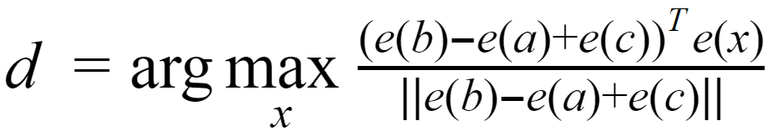
Testing Embeddings
France
Testing if embeddings capture
syntactic/semantic properties.
Analogy test:
Paris stands to France as Rome stands to ?
Writer stands to book as painter stands to ?
Cat stands to cats as mouse stands to ?
e('France') - e('Paris') + e('Rome') ~ e('Italy')
a : b = c : d
Italy
Paris
Rome
Minimum of cosine

Slide 55
Precomputed Embeddings
Google's embeddings trained on English news dataset (100 billion of words occurrences)
Embeddings for German
Embeddings for Italian
Embeddings for French

Slide 56
Impact of Training Data
The collection on which a model is trained influences what semantics is captured.
WIKI | BOOKS | WIKI | BOOKS
sega |  | chianti
dreamcast | motosega | radda | merlot
genesis | seghe | gaiole | lambrusco
megadrive | seghetto | montespertoli | grignolino
snes | trapano | carmignano | sangiovese
nintendo | smerigliatrice | greve | vermentino
sonic | segare | castellina | sauvignon

Slide 57
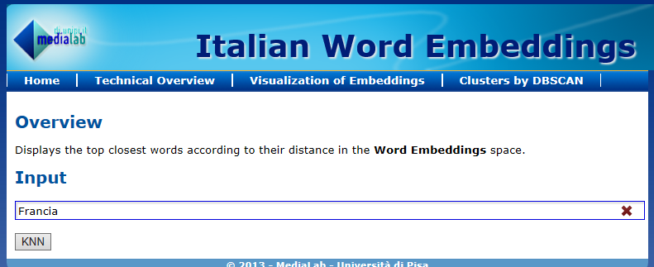
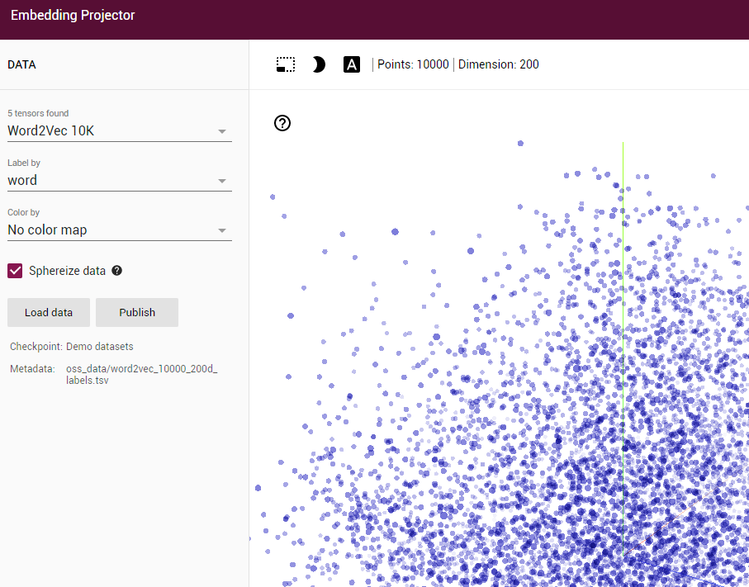
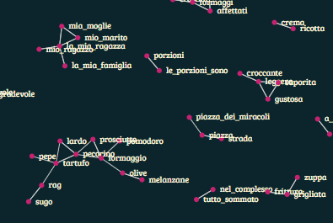
Exploring embeddings

Slide 58
Evaluation

Slide 59
Intrinsic Embeddings Evaluation
Analogy evaluation vs hyperparameters
Word Vector Analogies
Find the x. given an incomplete analogy of the form:
a : b : : c : x
Using intrinsic evaluation techniques such as word-vector analogies should be handled with care
Model | Dim. | Size | Sem. | Syn. | Tot.
ivLBL | 100 | 1.5B | 55.9 | 50.1 | 53.2
HPCA | 100 | 1.6B | 4.2 | 16.4 | 10.8
GloVe | 100 | 1.6B | 67.5 | 54.3 | 60.3
SG | 300 | 1B | 61 | 61 | 61
CBOW | 300 | 1.6B | 16.1 | 52.6 | 36.1
vLBL | 300 | 1.5B | 54.2 | 64.8 | 60.0
ivLBL | 300 | 1.5B | 65.2 | 63.0 | 64.0
GloVe | 300 | 1.6B | 80.8 | 61.5 | 70.3
SVD | 300 | 6B | 6.3 | 8.1 | 7.3
SVD-S | 300 | 6B | 36.7 | 46.6 | 42.1
SVD-L | 300 | 6B | 56.6 | 63.0 | 60.1
CBOW | 300 | 6B | 63.6 | 67.4 | 65.7
SG† | 300 | 6B | 73.0 | 66.0 | 69.1
GloVe | 300 | 6B | 77.4 | 67.0 | 71.7
CBOW | 1000 | 6B | 57.3 | 68.9 | 63.7
SG | 1000 | 6B | 66.1 | 65.1 | 65.6
SVD-L | 300 | 42B | 38.4 | 58.2 | 49.2
GloVe | 300 | 42B | 81.9 | 69.3 | 75.0

Slide 60
Extrinsic Vector Evaluation
The proof of the pudding is in the eating
Test on a task, e.g. NER (Named Entity Recognition)
Model | Dev | Test | ACE | MUC7
Discrete | 91.0 | 85.4 | 77.4 | 73.4
SVD | 90.8 | 85.7 | 77.3 | 73.7
HPCA | 92.6 | 88.7 | 81.7 | 80.7
CW | 92.2 | 87.4 | 81.7 | 80.2
CBOW | 93.1 | 88.2 | 82.2 | 81.1
GloVe | 93.2 | 88.3 | 82.9 | 82.2

Slide 61
Embeddings in Neural Networks
An embedding layer is often used as the first layer in a neural network for processing text.
It consists of a matrix W of size |V|×d, where d is the size of the embedding space.
W maps words to dense representations.
It is initialized either with random weights or pretrained embeddings.
During learning weights can be
  kept fixed (it makes sense only when using pre-trained weights) or
  updated, to adapt embeddings to the task.

Slide 62
Embeddings in Neural Networks
Pretrained values
Convolutional
Text:
"all work and no play..."
Sequence of embedding vectors:
[ [0.2,-0.3,0.9,-0.2...0.8],
[-0.1,0.7,0.7,-0.1…-0.1],
[0.2,-0.3,0.9,-0.2...0.8],
[0.1,0.2,0.3,0.1…0.5],
...
[0,0,0,0,0,0,0...0]]
Embeddings
Sequence of word ids:
[2,4,1,8,10,5,0,0,0,0,0,0]
Recurrent
Example: https://github.com/fchollet/keras/blob/master/examples/imdb_cnn.py
Another example: https://machinelearningmastery.com/use-word-embedding-layers-deep-learning-keras/

Slide 63
Limits of Word Embeddings
Polysemous words
Limited to words (neither multi words nor phrases)
Represent similarity: antinomies often appear similar
  Not good for sentiment analysis
  Not good for polysemous words
Examples:
  The movie was exciting
  The movie was boring

Slide 64
Word Senses and Ambiguity
Often words have multiple meanings
Does one vector capture all these meanings?
pike
• A sharp point or staff
• A type of elongated fish
• A railroad line or system
• A type of road
• The future (coming down the pike)
• A type of body position (as in diving)
• To kill or pierce with a pike
• To make one’s way (pike along)
• In Australian English, to pull out from doing something

Slide 65
ELMo (Embeddings from Language Models)
ELMo generates embeddings for a word based on the context it appears.
Contextual: representation for each word depends on the entire context in which it is used.
Deep: word representations combine all layers of a deep pre-trained neural network.
Character based: ELMo representations are character based, allowing the network to use morphological clues
Task | SoA | ELMo
SQuAD | 84.4 | 85.8
SNLI | 88.6 | 88.7
SRL | 81.7 | 84.6
Coref | 67.92 | 70.4
NER | 91.93 | 92.22
Sentiment | 53.7 | 54.7

Slide 66
Context Aware Word Embeddings
LM likelihood
U
W
Σ
the cat sits on
G. Attardi. 2015. Representation of Word Sentiment, Idiom and Senses. Proc. of 6th Italian Information Retrieval Workshop.
Applications:
  Word sense disambiguation
  Document Classification
  Polarity detection
  Adwords matching

Slide 67
Sense Specific Word Embeddings
Sentiment Specific Word Embeddings
Uses an annotated corpus with polarities (e.g. tweets)
SS Word Embeddings achieve SotA accuracy on tweet sentiment classification
LM likelihood + Polarity
U
the cat sits on

Slide 68
Appendix

Slide 69
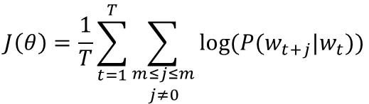



Training the Skip-Gram model
Maximize the objective function, the log likelihood of context words w_{t-m}, …, w_{t+m}, given word w_{t}:
Compute the gradients
$$J\left(θ\right)=\frac{1}{T}\sum_{t=1}^{T}{\sum_{\begin{aligned}m≤j≤m \\ j≠0\end{aligned}}{\log{(P(w_{t+j}|w_{t}))}}}$$
$$P\left(o | c\right)=\frac{e^{u_{o}v_{c}}}{\sum_{w∈V}{e^{u_{w}v_{c}}}}$$
$$\frac{∂J(θ)}{∂v_{c}}$$
$$\frac{∂J(θ)}{∂u_{o}}$$

Slide 70
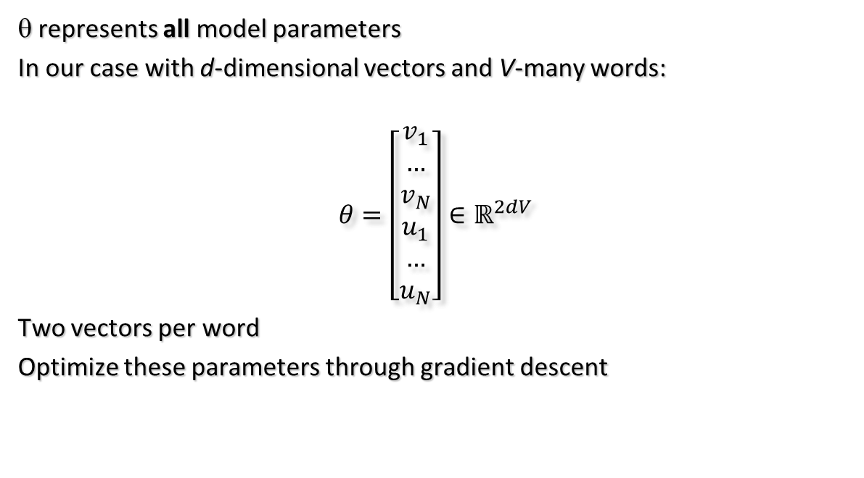
Train the model parameters
θ represents all model parameters
In our case with d-dimensional vectors and V-many words:
$$θ=\left[\begin{aligned}v_{1} \\ … \\ v_{N} \\ u_{1} \\ … \\ u_{N}\end{aligned}\right]∈ℝ^{2dV}$$
Two vectors per word
Optimize these parameters through gradient descent

Slide 71






Calculus Recap
$$\frac{d}{dx}f\left(g\left(x\right)\right)=\frac{d}{dy}f(y)\frac{d}{dx}g(x)$$
Chain Rule:
Sum Rule:
Product Rule:
Power Rule:
Exponential:
Logarithm:
$$\frac{d}{dx}f+g=\frac{d}{dx}f+\frac{d}{dx}g$$
$$\frac{d}{dx}f\left(x\right)g\left(x\right)=(\frac{d}{dx}f\left(x\right))g\left(x\right)+f(x)\frac{d}{dx}g(x)$$
$$\frac{d}{dx}x^{n}=n\frac{d}{dx}x^{n−1}$$
$$\frac{d}{dx}e^{x}=e^{x}$$
$$\frac{d}{dx}\log{x}=\frac{1}{x}$$

Slide 72
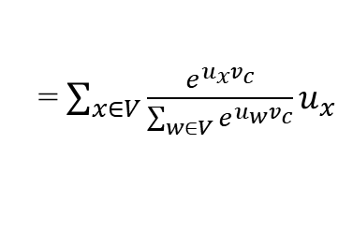
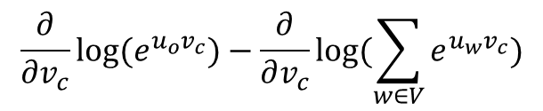
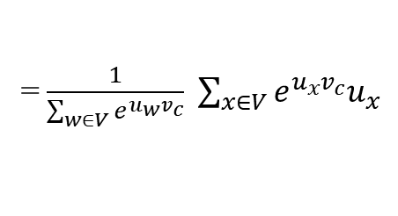

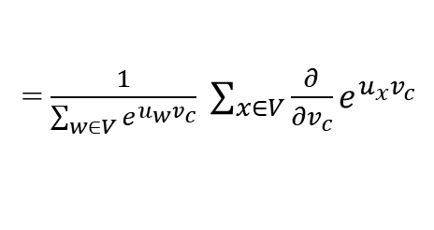
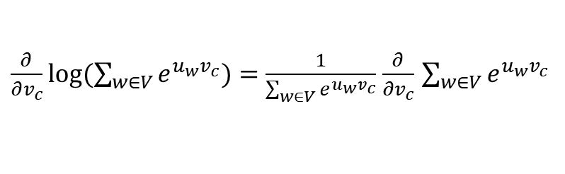
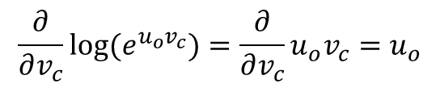
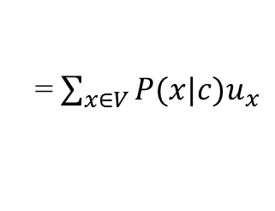
Gradients
$$\frac{∂\log{P(o|c)}}{∂v_{c}}=\frac{∂}{∂v_{c}}log⁡(\frac{e^{u_{o}v_{c}}}{\sum_{w∈V}{e^{u_{w}v_{c}}}})=$$
$$\frac{∂}{∂v_{c}}{{log⁡(e}^{u_{o}v_{c}})}−\frac{∂}{∂v_{c}}log⁡(\sum_{w∈V}{e^{u_{w}v_{c}})}$$
$$\frac{∂}{∂v_{c}}{{log⁡(e}^{u_{o}v_{c}})}=\frac{∂}{∂v_{c}}{u_{o}v_{c}}=u_{o}$$
$\frac{∂}{∂v_{c}}log⁡(\sum_{w∈V}{e^{u_{w}v_{c}})=\frac{1}{\sum_{w∈V}{e^{u_{w}v_{c}}}}}$ $\frac{∂}{∂v_{c}}$ $\sum_{w∈V}{e^{u_{w}v_{c}}}$
= $\frac{1}{\sum_{w∈V}{e^{u_{w}v_{c}}}} \sum_{x∈V}{{\frac{∂}{∂v_{c}}e}^{u_{x}v_{c}}}$
= $\frac{1}{\sum_{w∈V}{e^{u_{w}v_{c}}}} \sum_{x∈V}{e^{u_{x}v_{c}}u_{x}}$
= $\sum_{x∈V}{\frac{e^{u_{x}v_{c}}}{\sum_{w∈V}{e^{u_{w}v_{c}}}}u_{x}}$
= $\sum_{x∈V}{P(x|c)u_{x}}$

Slide 73



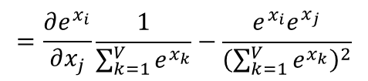
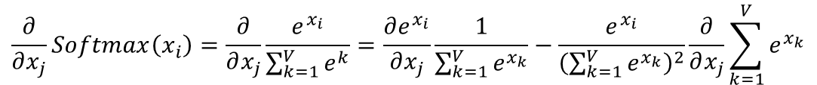
Gradient of softmax
$$Softmax(x_{i})=\frac{e^{x_{i}}}{\sum_{k=1}^{V}{e^{x_{k}}}}$$
$$\frac{∂}{∂x_{j}}Softmax\left(x_{i}\right)=\frac{∂}{∂x_{j}}\frac{e^{x_{i}}}{\sum_{k=1}^{V}{e^{k}}}=\frac{∂e^{x_{i}}}{∂x_{j}}\frac{1}{\sum_{k=1}^{V}{e^{x_{k}}}}−\frac{e^{x_{i}}}{{\left(\sum_{k=1}^{V}{e^{x_{k}}}\right)}^{2}}\frac{∂}{∂x_{j}}\sum_{k=1}^{V}{e^{x_{k}}}$$
$$=\frac{∂e^{x_{i}}}{∂x_{j}}\frac{1}{\sum_{k=1}^{V}{e^{x_{k}}}}−\frac{e^{x_{i}}e^{x_{j}}}{{\left(\sum_{k=1}^{V}{e^{x_{k}}}\right)}^{2}}$$
For i = j:
For i ≠ j:
$$=\frac{e^{x_{i}^{}}}{\sum_{k=1}^{V}{e^{x_{k}}}}−\frac{e^{x_{i}}e^{x_{j}}}{{\left(\sum_{k=1}^{V}{e^{x_{k}}}\right)}^{2}}=$$
$$p_{i}(1−p_{j})$$
$$=0−\frac{e^{x_{i}}e^{x_{j}}}{{\left(\sum_{k=1}^{V}{e^{x_{k}}}\right)}^{2}}=$$
$$−p_{i}p_{j}$$

Slide 74
Gradient Descent
Given cost function J(𝛳) to minimize
Iteratively update 𝛳 by:
𝛳^{new} = 𝛳^{old}- 𝛼 ∇_{𝛳}J(𝛳)
Learning rate
while True:
grad = gradient(J, corpus, theta)
theta -= alpha * grad

Slide 75
Cross Entropy Loss
def cross_entropy(X, y):
"""
X is the output from fully connected layer
(num_examples x num_classes)
y is labels, index of correct class
(num_examples x 1)
"""
m = y.shape[0] # num_examples
p = softmax(X)
# p[range(m),y] slices estimates for the correct classes
log_likelihood = -np.log(p[range(m), y])
loss = np.sum(log_likelihood) / m
return loss
X[i,j] score for example i to be in class j
p[i,j] estimate of P(j | i)
classes
y
2
1
6
examples

Slide 76
Stochastic Gradient Descent
J(𝛳) is a function of all windows in the corpus (potentially billions!)
Too expensive to compute
Long wait before making a single update!
Solution: Stochastic gradient descent (SGD)
  sample windows randomly, and update after each one.
Algorithm:
while True:
window = sample_window(corpus)
grad = gradient(J, window, theta)
theta -= alpha * grad

Slide 77
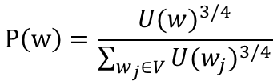
Negative sampling
The log ∑_{j∊F} exp(u_{j}) factor has a lots of terms and it is costly to compute.
Solution: compute it only on a small sample of negative examples, i.e.,
log ∑_{j∊E} exp(u_{j})
where words in E are just a few (e.g., 5) and they are sampled using a biased unigram distribution U computed on training data:
P(w₀|w_{t})
...
P(w_{t+2}|w_{t})
softmax
u
W_{O}
h_{t}
W_{I}
$$P\left(w\right)=\frac{{U(w)}^{3/4}}{\sum_{w_{j}∈V}{{U(w_{j})}^{3/4}}}$$
w_{t}

