Slide 1
Project Advice
Adapted from: http://web.stanford.edu/class/cs224n/slides/cs224n-2020-lecture11-convnets.pdf
Christopher Manning
Stanford University

Slide 2
Use of datasets
Many publicly available datasets are released with a train/dev/test structure. We're all on the honor system to do test-set runs only when development is complete.
Splits like this presuppose a fairly large dataset.
If there is no dev set or you want a separate tune set, then you create one by splitting the training data, though you have to weigh its size/usefulness against the reduction in train-set size.
Having a fixed test set ensures that all systems are assessed against the same gold data. This is generally good, but:
• It is problematic where the test set turns out to have unusual properties that distort progress on the task.
• It doesn’t give any measure of variance. • It’s only an unbiased estimate of the mean if only used once.

Slide 3
Dealing with overfit
When training, models overfit to what you are training on
The model correctly describes what happened to occur in particular data you trained on, but the patterns are not general enough patterns to be likely to apply to new data
The way to avoid problematic overfitting (lack of generalization) is using independent validation and test sets ...

Slide 4
Don’t touch the test set
You build (estimate/train) a model on a training set.
Often, you then set further hyperparameters on another,
independent set of data, the tuning set
The tuning set is the training set for the hyperparameters!
You measure progress as you go on a dev set (development test set or validation set)
If you do that a lot you overfit to the dev set so it can be good to have a second dev set, the dev2 set
Only at the end, you evaluate and present final numbers on a test set
Use the final test set extremely few times ... ideally only once

Slide 5
Separate datasets
The train, tune, dev, and test sets need to be completely distinct
It is invalid to test on material you have trained on
You will get a falsely good performance. We usually overfit on train
You need an independent tuning set
The hyperparameters won’t be set right if tune is same as train
If you keep running on the same evaluation set, you begin to overfit to that evaluation set
Effectivelyyouare“training”ontheevaluationset...youarelearning things that do and don’t work on that particular eval set and using the info
To get a valid measure of system performance you need another untrained on, independent test set ... hence dev2 and final test

Slide 6
Training Experiments
Start with a positive attitude!
Neural networks want to learn!
If the network isn’t learning, you’re doing something to prevent it from learning successfully
Realize the grim reality:
There are lots of things that can cause neural nets to not learn at all or to not learn very well
Finding and fixing them (“debugging and tuning”) can often take more time than implementing your model
It’s hard to work out what these things are
But experience, experimental care, and rules of thumb help!

Slide 7
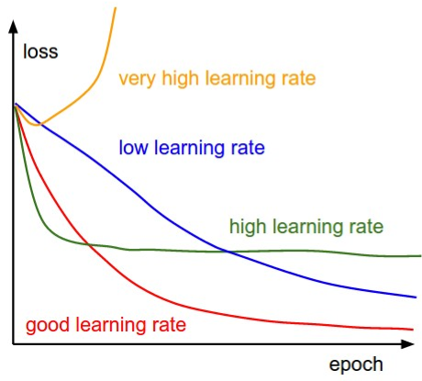
Models are sensitive to learning rates
From Andrej Karpathy, CS231n course notes

Slide 8
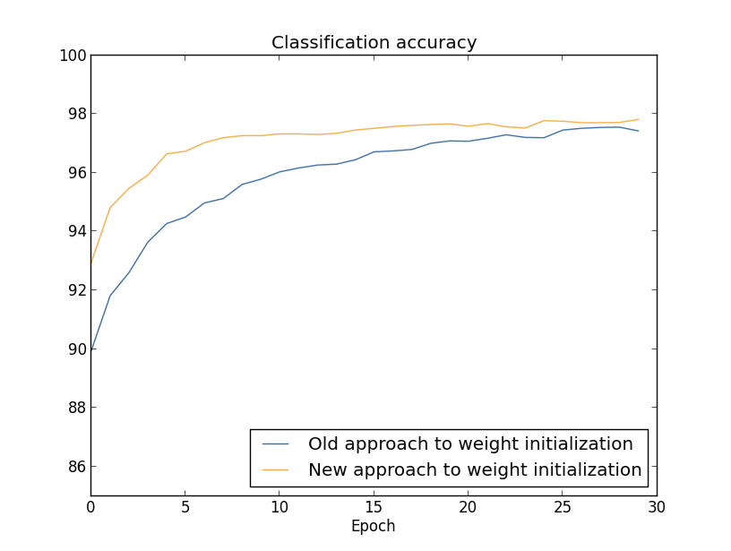
Models are sensitive to initialization
From Michael Nielsen http://neuralnetworksanddeeplearning.com/chap3.htm

Slide 9
Training a gated RNN
Use an LSTM or GRU: it makes your life so much simpler!
Initialize recurrent matrices to be orthogonal
Initialize other matrices with a sensible (small!) scale
Initialize forget gate bias to 1: default to remembering
Use adaptive learning rate algorithms: Adam, AdaDelta, ...
Clip the norm of the gradient: 1–5 seems to be a reasonable
threshold when used together with Adam or AdaDelta.
Either only dropout vertically or look into using Bayesian Dropout (Gal & Gahramani)
Be patient! Optimization takes time

Slide 10
Experimnetal strategy
Work incrementally!
Start with a very simple model and get it to work!
It’s hard to fix a complex but broken model
Add bells and whistles one-by-one and get the model working
with each of them (or abandon them)
Initially run on a tiny amount of data
You will see bugs much more easily on a tiny dataset
Something like 4–8 examples is good
Often synthetic data is useful for this
Make sure you can get 100% on this data
Otherwise your model is definitely either not powerful enough or it is broken

Slide 11
Experimental strategy
Run your model on a large dataset
It should still score close to 100% on the training data after optimization
Otherwise, you probably want to consider a more powerful model
Overfitting to training data Is not something to be scared of when doing deep learning
These models are usually good at generalizing because of the way distributed representations share statistical strength regardless of overfitting to training data
But, still, you now want good generalization performance:
Regularize your model until it doesn’t overfit on dev data
Strategies like L2 regularization can be useful
But normally generous dropout is the secret to success

Slide 12
Details matter!
Be very familiar with your (train and dev) data, don’t treat it as arbitrary bytes in a file!
Look at your data, collect summary statistics
Look at your model’s outputs, do error analysis
Tuning hyperparameters is really important to almost all of the successes of NNets

Slide 13
Good luck with your projects!

