Slide 1

Human Language Technologies
Università di Pisa
Giuseppe Attardi
Dipartimento di Informatica
Università di Pisa

Slide 2
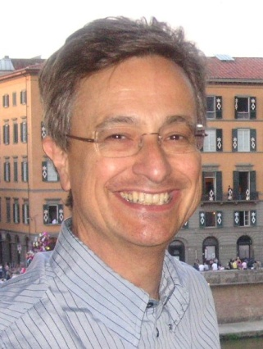
Instructor
Giuseppe Attardi
Office: 292
mail: attardi@di.unipi.it
web: www.di.unipi.it/~attardi

Slide 3
Course Info
Course Page:
  https://elearning.di.unipi.it/course/view.php?id=180
Day | Time | Room
Monday | 14-16 | C1
Thursday | 9-11 | C1
Friday | 9-11 | C1

Slide 4
Prerequisites
Proficiency in Python
  Assignments, projects will be in Python, using NLP and Deep Learning libraries
Calculus, Linear Algebra
  Basic knowledge of derivatives and vector/matrix operations
  See course “Computational Mathematics for learning and data analysis” (646AA)
  https://esami.unipi.it/esami2/programma.php?c=39132&aa=2018&cid=69&did=13
Basic Probability and Statistics
  Basic concepts of probability distributions, mean, standard deviation.
  See course “Calcolo delle Probabilità e Statistica” (269AA)
  https://elearning.di.unipi.it/enrol/index.php?id=101
Machine Learning
  Machine learning notions like cost functions, optimization with backpropagation.
  See course “Machine Learning” (654AA)
  https://esami.unipi.it/esami2/programma.php?c=36545&aa=2018&cid=69&did=13

Slide 5
What you will learn?
Understanding of and ability to use effective modern methods for Natural Language Processing
  From traditional methods used in NLP to current advanced methods like Recurrent networks, attention, etc.
Understanding the difficulties in dealing with NL and the capabilities of current technologies
Experience with modern tools
Ability to build systems for some of the major NLP tasks:
  Word similarities, parsing, machine translation, entity recognition, question answering, sentiment analysis, dialogue system

Slide 6
Books
Textbooks
D. Jurafsky, J.H. Martin. Speech and Language Processing. 3rd edition, Prentice-Hall, 2019.
I. Goodfellow, Yoshua Bengio and A. Courville. Deep Learning, http://www.deeplearningbook.org, 2016.
S. Bird, E. Klein, E. Loper. Natural Language Processing with Python.
Further readings:
S. Kubler, R. McDonald, J. Nivre. Dependency Parsing. 2010.
P. Koehn. Statistical Machine Translation. Cambridge University Press, 2010.

Slide 7
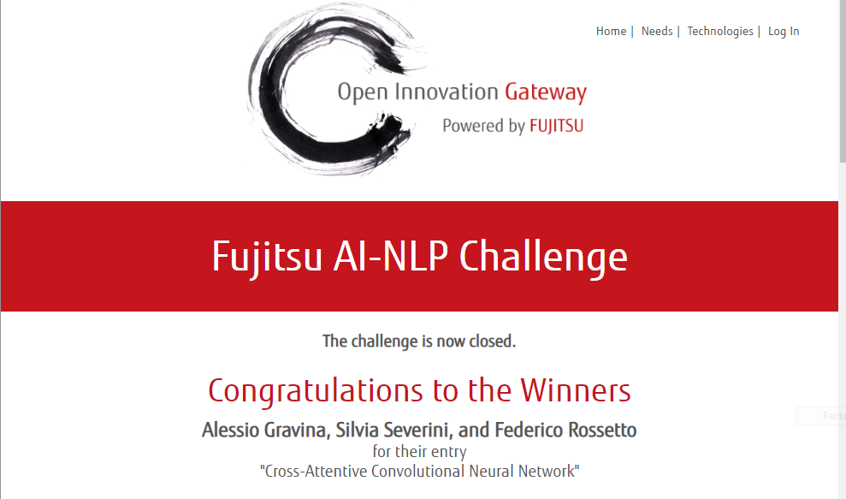
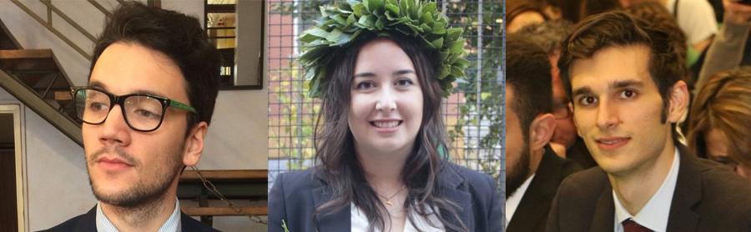
Exam
Project
  alone or in a small team
Aim
  Experiment with techniques in a realistic setting, e.g.
  Using data from competitions
  (Kaggle, CoNLL, SemEval, Evalita)
Topics
  List of suggestions
  Proposed by team
Price: 20,000 $

Slide 8
Previous Year Projects
Participation to Evalita 2011
  Task POS + Lemmatization: 1st position
  Task Domain Adaptation: 1st position
  Task SuperSense: 1st position
  Task Dependency Parsing: 2nd position
  Task NER: 3rd position
SemEval 2012
  Sentiment Analysis on tweets
Participation to Evalita 2014
  Sentiment Analysis on tweets
Disaster Alarm from Tweets
Participation to Evalita 2016
  Task POS on Tweets:
  Task Sentipolc on Twitter: 1st position
  Task Named Entity Linking: 1st position
Fujitsu AI NLP Challenge 2018
  Winners of 20,000 $ prize
Neural Machine Translator
Voice Guide for the Museo degli Strumenti di Calcolo
Chatbot for Persona.AI
BioASQ 2019
Fake News Detection

Slide 9
Course Overview

Slide 10
About the Course
Assumes some skills…
  basic linear algebra, probability, and statistics
  decent programming skills
  willingness to learn missing knowledge
Teaches key theory and methods for Statistical NLP
  Useful for building practical, robust systems capable of interpreting human language
Experimental approach:
  Lots of problem-based learning
  Often practical issues are as important as theoretical niceties

Slide 11
Experimental Approach
Formulate Hypothesis
Implement Technique
Train and Test
Apply Evaluation Metric
If not improved:
  Perform error analysis
  Revise Hypothesis
Repeat

Slide 12
Program
Introduction
  History
  Present and Future
  NL Processing and Human Interactions
Statistical Methods
  Language Model
  Hidden Markov Model
  Viterbi Algorithm
  Generative vs Discriminative Models
Linguistic Essentials
  Words, Lemmas, Part of Speech and Morphology
  Collocations
  Word Sense Disambiguation
  Word Embeddings
Preprocessing
  Encoding
  Regular Expressions
  Segmentation
  Tokenization
  Normalization
Lexical semantics
  Collocations
  Corpora
  Thesauri
  Gazetteers

Slide 13
Distributional Semantics
  Word embeddings
  Character embeddings
  Neural Language Models
Classification
  Perceptron
  SVM
  Applications: spam, phishing, fake news detection
Tagging
  Part of Speech
  Named Entity
Sentence Structure
  Constituency Parsing
  Dependency Parsing
Semantic Analysis
  Semantic Role Labeling
  Coreference resolution
Statistical Machine Translation
  Phrase-Based Models
  Neural Network Models
  Evaluation metrics

Slide 14
Deep Learning
  MLP, CNN, RNN, LSTM
Libraries
  NLTK
  Tensorflow
  Keras
Applications
  Entity Linking
  Semantic Search
  Question Answering
  Language Inference
Opinion Mining
  Introduction to sentiment analysis
  Sentiment classification
  Lexical resources for sentiment analysis
Question answering
  Language inference
  Dialogic interfaces (chatbots)

Slide 15
Motivations
Language is the most distinctive feature of human intelligence
  Orangutan’s intelligence:
    vision, use of tools, making plans, but they lack language to express and to communicate
Language shapes thought
Emulating language capabilities is a scientific challenge
Keystone for intelligent systems (see Turing test)

Slide 16
Structured vs Unstructured Data
85% of business-relevant information originates in unstructured form, primarily text, according to Anant Jhingran of IBM Research.
Information is mostly communicated by reading or writing e-mails, reports, or articles and the like, in conversations, or by listening/watching media
Attempts to turn text into structured (HTML) or microformat only scratch the surface
Problems:
  Requires universal agreed ontologies
  Additional effort
Entity linking attempts to provide a bridge

Slide 17
Human Language Technology
State of the art

Slide 18
Early history of NLP: 1950s
Early NLP (Machine Translation) on machines less powerful than pocket calculators
Foundational work on automata, formal languages, probabilities, and information theory
First speech systems (Davis et al., Bell Labs)
MT heavily funded by military – a lot of it was just word substitution programs but there were a few seeds of later successes, e.g., trigrams
Little understanding of natural language syntax, semantics, pragmatics
Problem soon appeared intractable
AI Winter: discipline mostly neglected

Slide 19
Resurgence
‘90s: introduction of statistical methods
Challenges: NIST (speech, Trec, MT), Netflix, DARPA Grand Challenge
2012: Deep Learning
2016: Neural Machine Translation
2019: Attention is all you need
Hans Moravec in 1978 was saying that it was impossible to achieve AI because of insufficient computing power
  10⁹ increase required
  expected to be available by 40 years, i.e. in 2018!

Slide 20
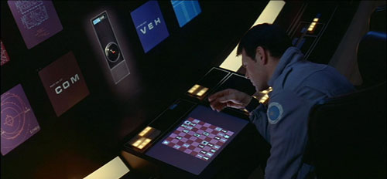
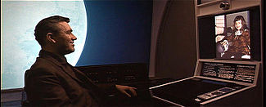
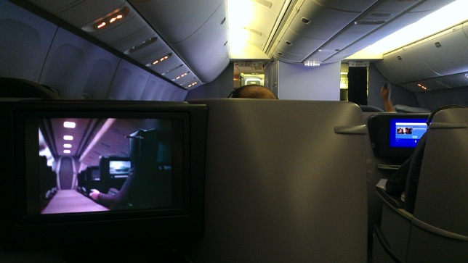
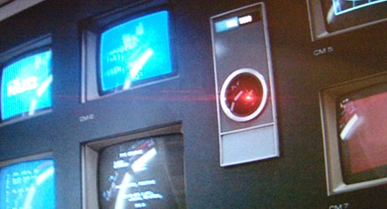
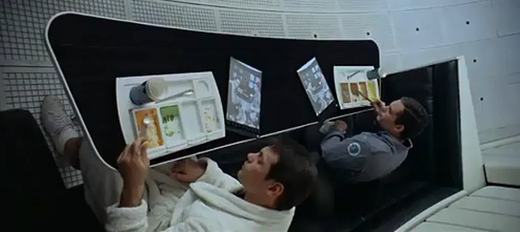
2001 a space Odyssey: 40 years later
Technology surpassed the vision
Internet
The Web
Smartphones
Genomics
Unmanned space exploration
Home computing
Big data
Computer chess
Audio-video communication
On board entertainment
Computer graphics
Except for
Tablet devices
Computer Speech
…and bad airline food
Computer Vision
Computer cognition

Slide 21
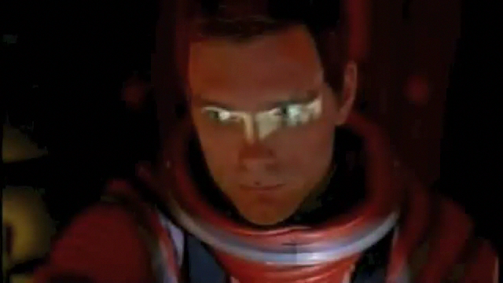
Speech technology in 2001: the vision

Slide 22
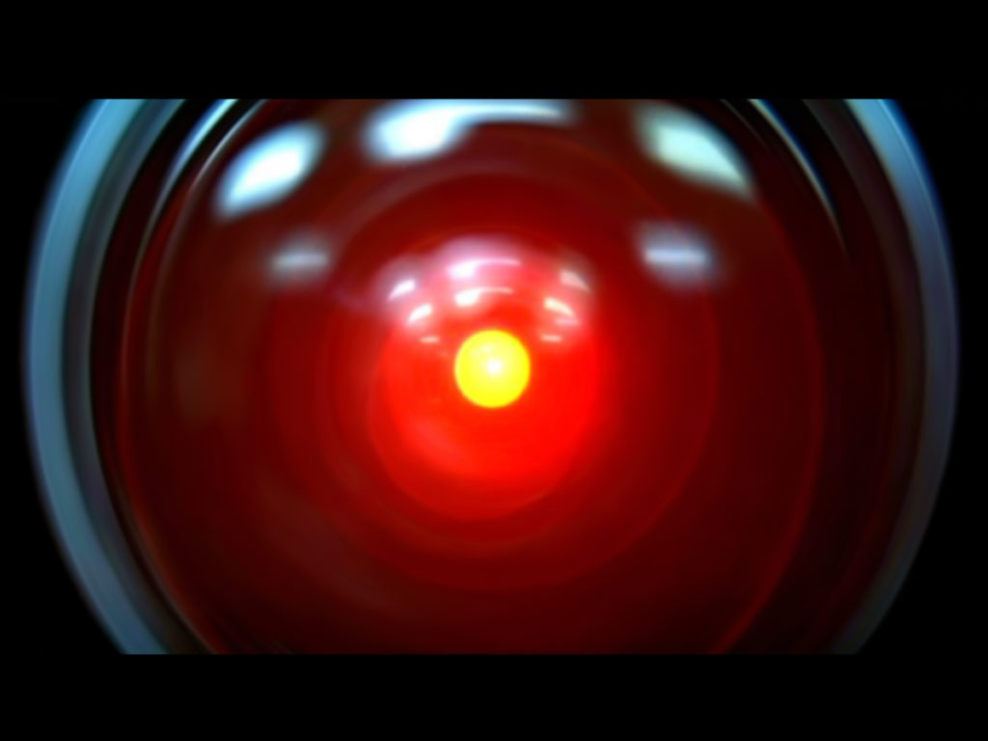

Speech technology in 2001: the reality
Design: Jonathan Bloom
Realization: Peter Krogh

Slide 23

Speech Assistants: today

Slide 24
Machine Translation Progress
Original | Altavista | Google
Gli chiese di riorganizzare Forza Italia | The churches to reorganize Italy Force | She asked him to reorganize Forza Italia
Il ministro Stanca si è laureato alla Bocconi | The Minister Stanca graduated at Mouthfuls | The Minister Stanca is a graduate of Bocconi

Slide 25
I sinonimi di Altavista, Umberto Eco, 2007
Babelfish 2004
Google 2007
Originale inglese | Traduzione italiana
The Works of Shakespeare | Gli impianti di Shakespeare
Hartcourt Brace | sostegno di Hartcourt
Speaker of the chamber of deputies | Altoparlante dell’alloggiamento dei delegati
Studies in the logic of Charles Sanders Pierce | Studi nella logica delle sabbiatrici Pierce del Charles
Originale inglese | Traduzione italiana
The Works of Shakespeare | Le opere di Shakespeare
Hartcourt Brace | Harcourt Brace
Speaker of the chamber of deputies | Presidente della Camera dei deputati
Studies in the logic of Charles Sanders Pierce | Studi nella logica di Charles Sanders Peirce

Slide 26

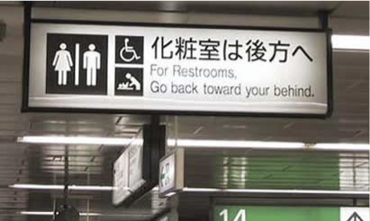
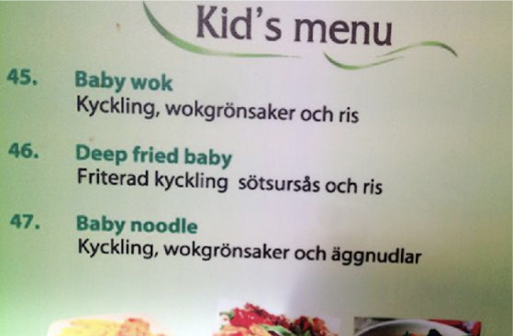
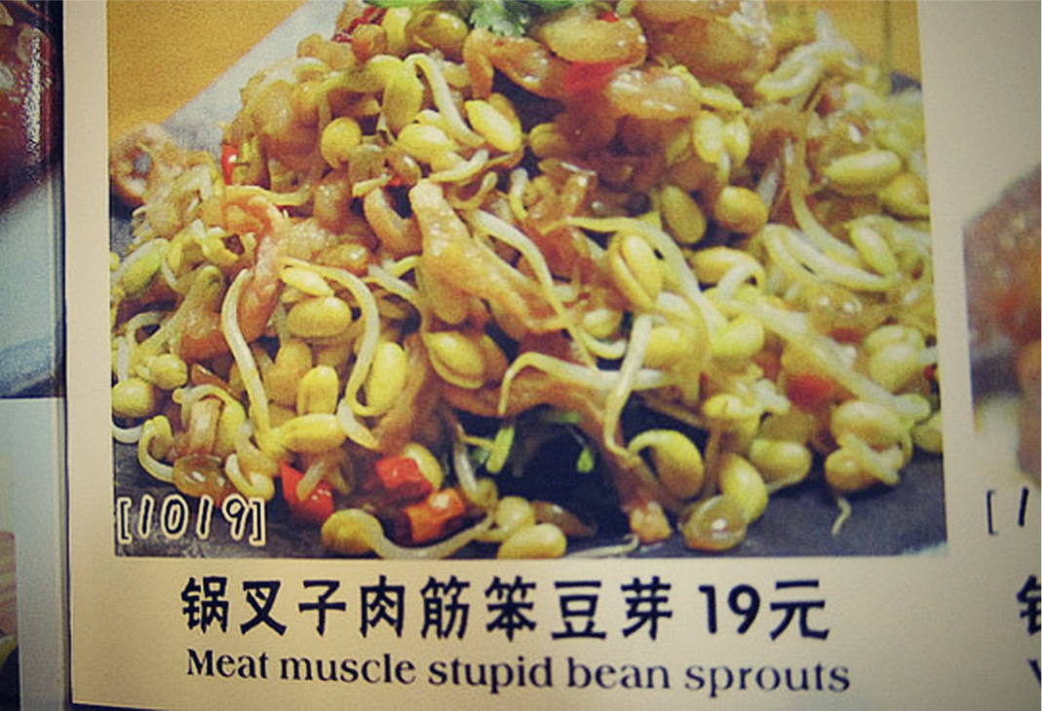

Slide 27
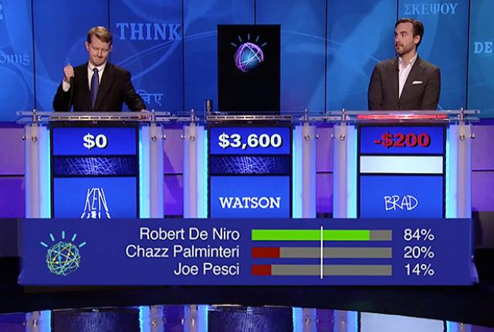



Recent Breakthroughs
Speech to text
    Apple Siri, Google Now
Machine Translation
  Google translate
Question Answering
  IBM Watson
  Beat the human champions at the TV quiz Jeopardy!

Slide 28
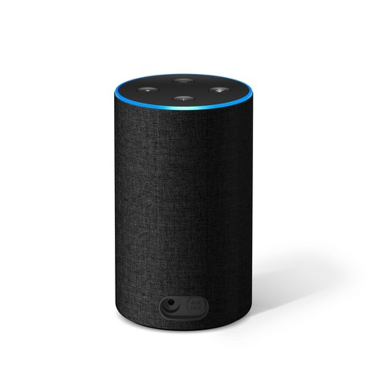
Recent Breakthroughs
IBM Watson beats human champions at TV quiz Jeopardy!:
  http://www.aaai.org/Magazine/Watson/watson.php
  Final Game
  PBS report
Google Translate on iPhone
  http://googleblog.blogspot.com/2011/02/introducing-google-translate-app-for.html
Apple SIRI
Amazon Alexa (Echo)
Google Home

Slide 29
IBM Project Debater
IBM Debater went head-to-head with an expert practitioner
After a 25-minute rapid-fire exchange about pre-school subsidies, the audience handed the victory to Harish Natarajan.

Slide 30
Statistical Methods

Slide 31
Statistical Machine Learning
Supervised Training
Annotated document collections
Ability to process large amounts of data
  If we used same algorithms 10 years ago, they would still be running
Similar techniques for both speech and text

Slide 32
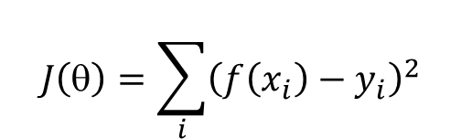
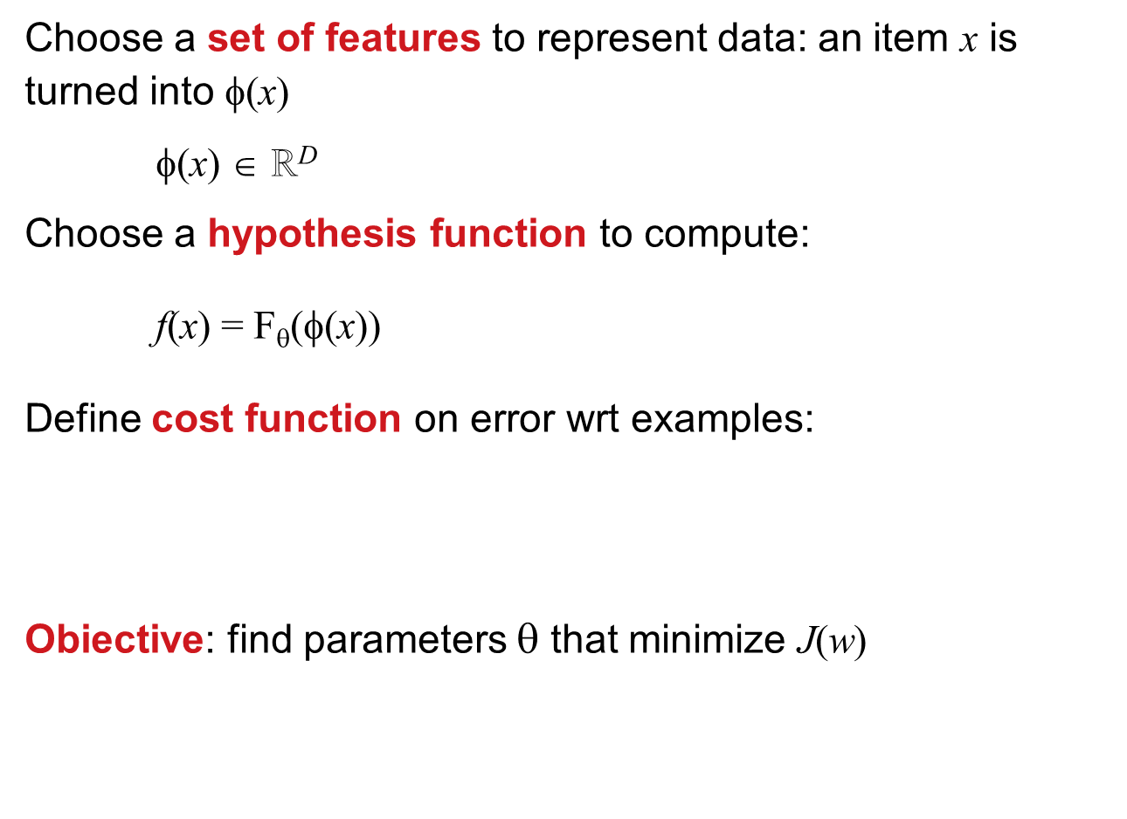
Paradigm of Statistical Machine Learning
Choose a set of features to represent data: an item x is turned into φ(x)
φ(x) ∈ ℝ^{D}
Choose a hypothesis function to compute:
f(x) = F_{θ}(φ(x))
Define cost function on error wrt examples:
Obiective: find parameters $$ that minimize J(w)
Representation
Model
$$J\left(θ\right)=\sum_{i}{{\left(f\left(x_{i}\right)−y_{i}\right)}^{2}}$$
Evaluation
Optimization

Slide 33
Traditional Supervised Machine Learning Approach
Freed us from devising rules or algorithms
Requires creation of annotated training corpora
Imposed the tyranny of feature engineering
Standard approach, for each new problem:
  Gather as much LABELED data as one can get/handle
  Throw a bunch of algorithms at it
  Pick the best
  Spend hours hand engineering some features/doing feature selection/dimensionality reduction (PCA, SVD, etc)
  RINSE AND REPEAT…

Slide 34
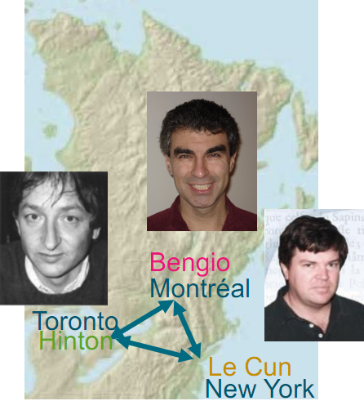
Deep Learning Breakthrough: 2006
Recognized only in 2012
LeCun tells that his paper on Convolutional Neural Network was rejected in 2012.
In 2013 no article at the same conference wasn't using CNN.
ACM Turing Award 2019

Slide 35
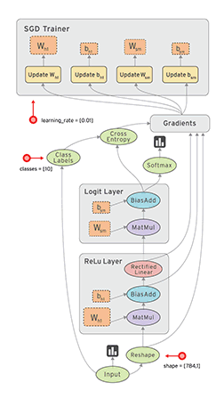
Deep Learning Approach
Design a model architecture
Define a loss function
Run the network letting the parameters and the data representations self-organize as to minimize this loss
End-to-end learning: no intermediate stages nor representations

Slide 36
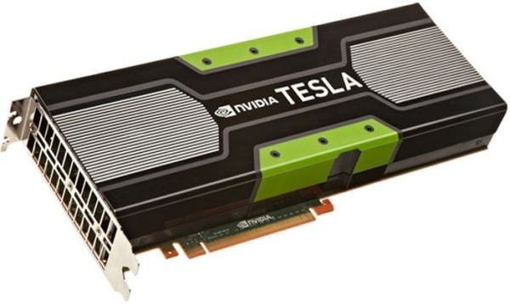
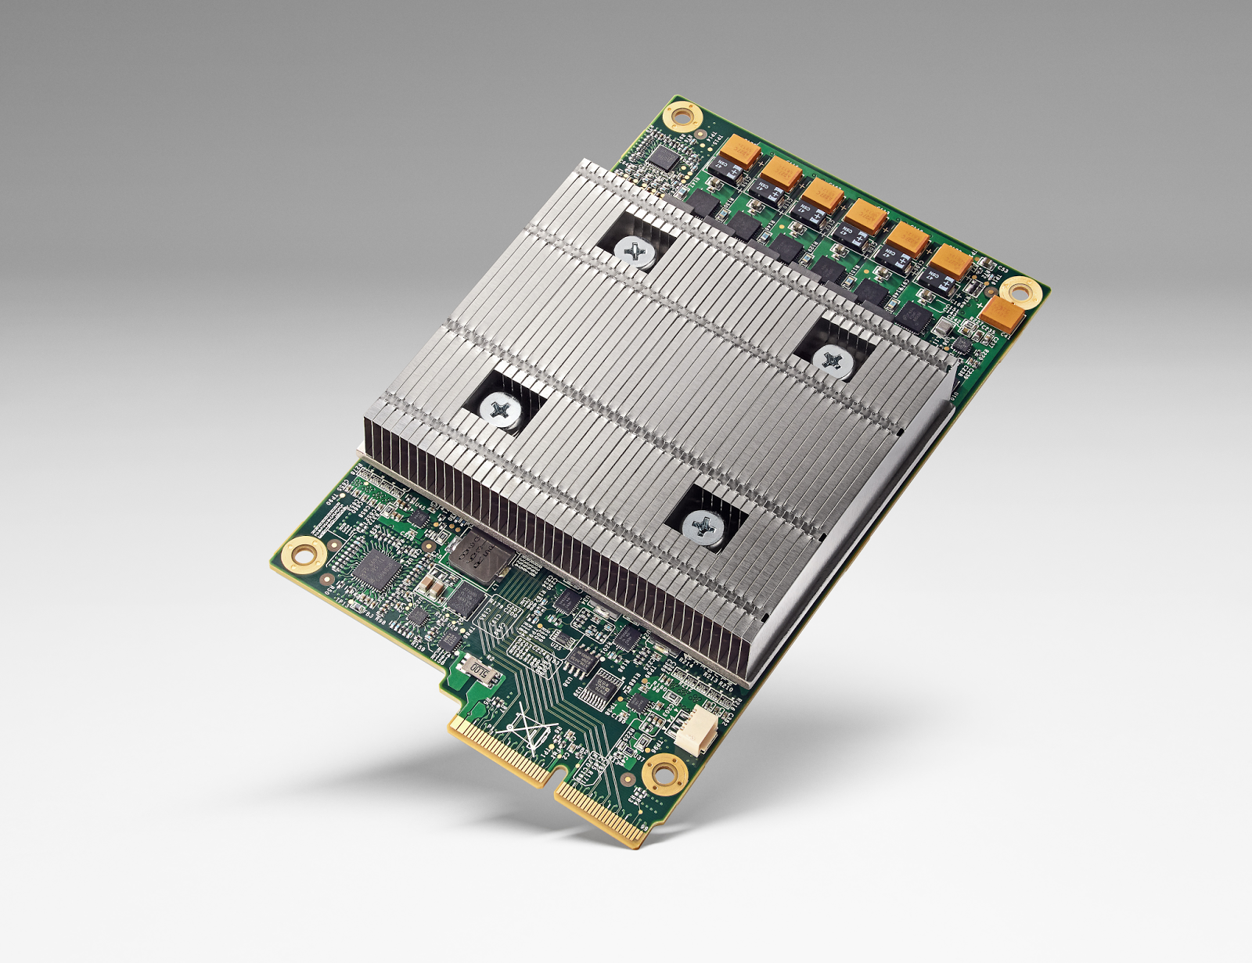
Technological Breakthroughs
Improved Machine Learning techniques
Large annotated datasets
More computing power
provided by:
graphical accelerators (GPU)
dedicated processors Tensor Processig Unit (TPU) by Google

Slide 37
ML Exploits Parallelism
Stochastic Gradient Descent
Remarkably simple
Single family of algorithms
Can be parallelized
  Asynchronous Stochastic Gradient Descent
No need to protect shared memory accesses
Low precision (half, single) is enough
Domain Specific Architecture
  David Patterson expects new golden age for DSA
Potentially can still grow at Moore law rates

Slide 38
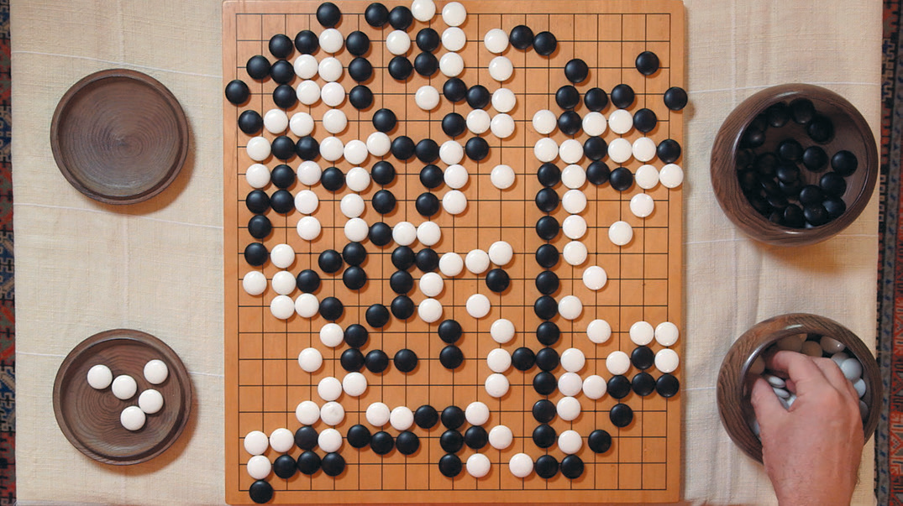
AlphaGo
Exploiting Deep Learning and Reinforcement Learning, running on TPU equipped machines, the program AlphaGo by DeepMind has beaten the world champion at the game of Go, on March 9, 2016.
The story has been
told in a movie.
AlphaGo evolved into
AlphaGo Zero in 2017,
which learns by itself,
without playing with
humans.

Slide 39
How Deep are Deep Neural Networks?
Complexity of Deep Learning system grows at non-linear rate
Year | Network | Layer
2012 | AlexNet | 8
2014 | GoogLeNet | 22
2016 | ResNet | 129
2017 | MS | 350

Slide 40
Training Costs
Training costs fo neural machine translation
Model | BLEU (en-fr) | Training Cost (FLOPS) | Time (days)
ConvS2S | 40.56 | 1.5 10²⁰
MOE | 40.56 | 1.2 10²⁰
ConvS2S Ensemble | 41.29 | 1.2 10²¹ | 35

Slide 41
Tsunami of Deep Learning on NLP

Slide 42
Vector Representation of Words
From discrete to distributed representation
Word meanings are dense vectors of weights in a high dimensional space
Algebraic properties
Background
  Philosophy: Hume, Wittgenstein
  Linguistics: Firth, Harris
  Statistics ML: Feature vectors
”You shall know a word by the company it keeps”
(Firth, 1957).

Slide 43
Neural Machine Translation (NMT)
Frase tradotta
the poor don’t have any money <END>
argmax
argmax
argmax
argmax
argmax
argmax
argmax
Encoder RNN
Decoder RNN
les pauvres sont démunis
<START> the poor don’t have any money
Frase da tradurre (input)
Decoder RNN è Language Model che genera
la frase tradotta sulla base dell’encoding.
Encoder RNN produce
una codifica della
frase da tradurre

Slide 44
NMT with attention
Attention
output
the
Concatenate attention output
with decoder hidden state, then
use to compute ŷ₁ as before
Attention
distribution
ŷ₁
Attention
scores
Encoder RNN
Decoder RNN
les pauvres sont démunis
<START>

Slide 45
Machine Translation Quality

Slide 46
NMT: best success history of Deep Learning
Neural Machine Translation went from research prototype in 2014 to production in 2016
2014: First published article on seq2seq (transform sequence into sequence)
2016: Google Translate moves from SMT to NMT
Amazing!
  SMT systems, build by hundreds of engineers over many years, overtaken by NMT systems trained by a few developers in a few months

Slide 47
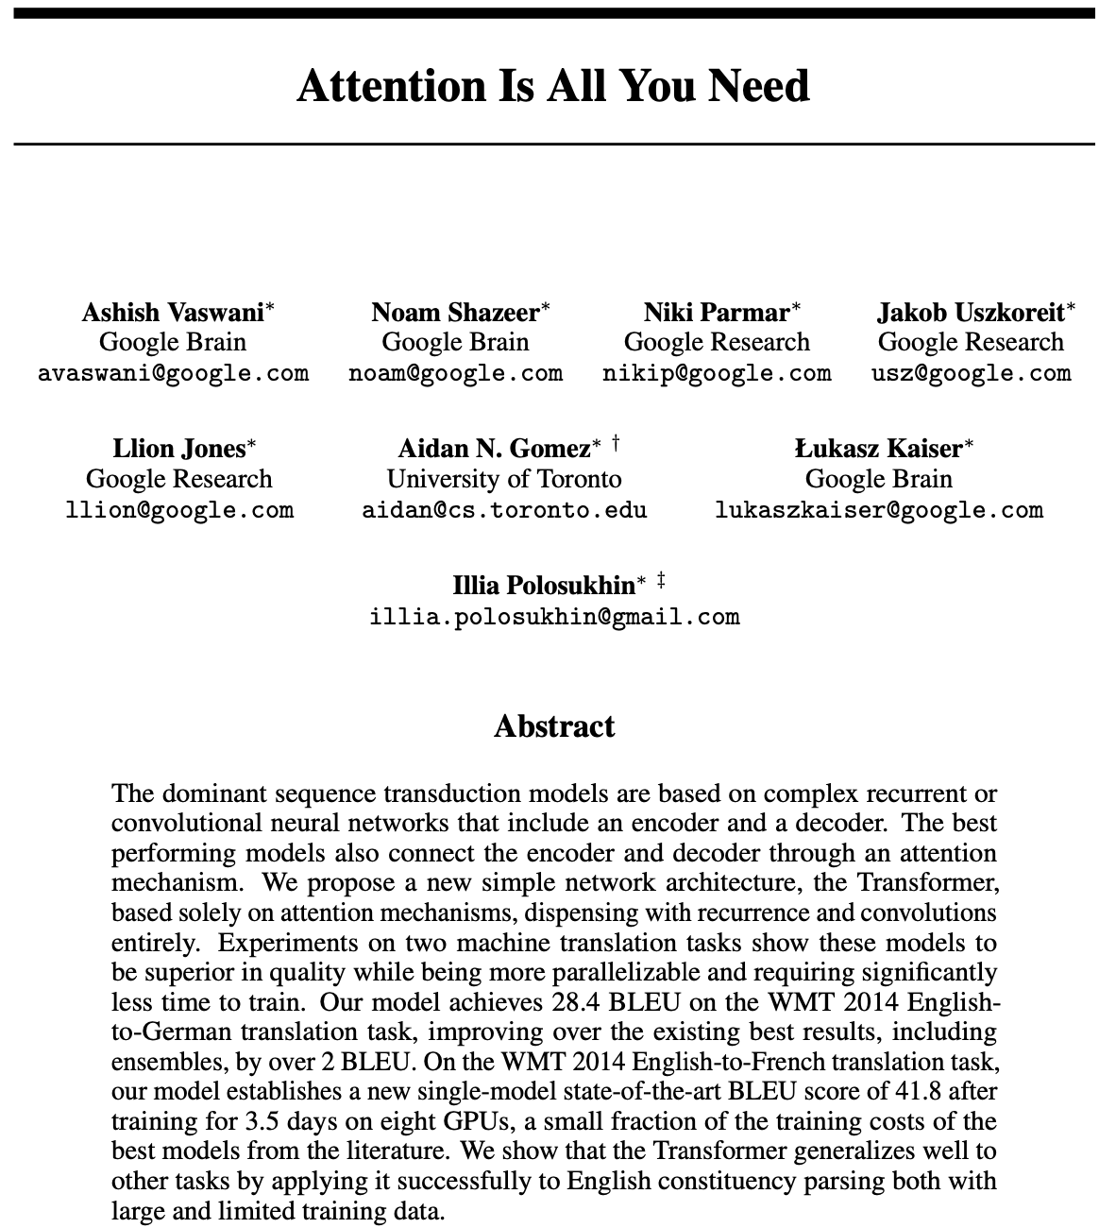
Progress in 2018
ELMo
bidirectional LSTMs trained on a language modeling objective
GPT-2
Transformer instead of bi-LSTM
Attention is all you need
BERT Transformer Model
BERT inspired transformet models take NLP by storm

Slide 48
GPT-2
OpenAI annunces a language model so good at text generation that they decide not to publish it.
The model is capable of performing reading comprehension, machine translation, question answering, and summarization—with just fine tuning.
In a shocking finding, scientist discovered a herd of unicorns living in a remote, previously unexplored valley, in the Andes Mountains.
The scientist named the population, after their distinctive horn, Ovid’s Unicorn. These four-horned, silver-white unicorns were previously unknown to science.
Now, after almost two centuries, the mystery of what sparked this odd phenomenon is finally solved.

Slide 49
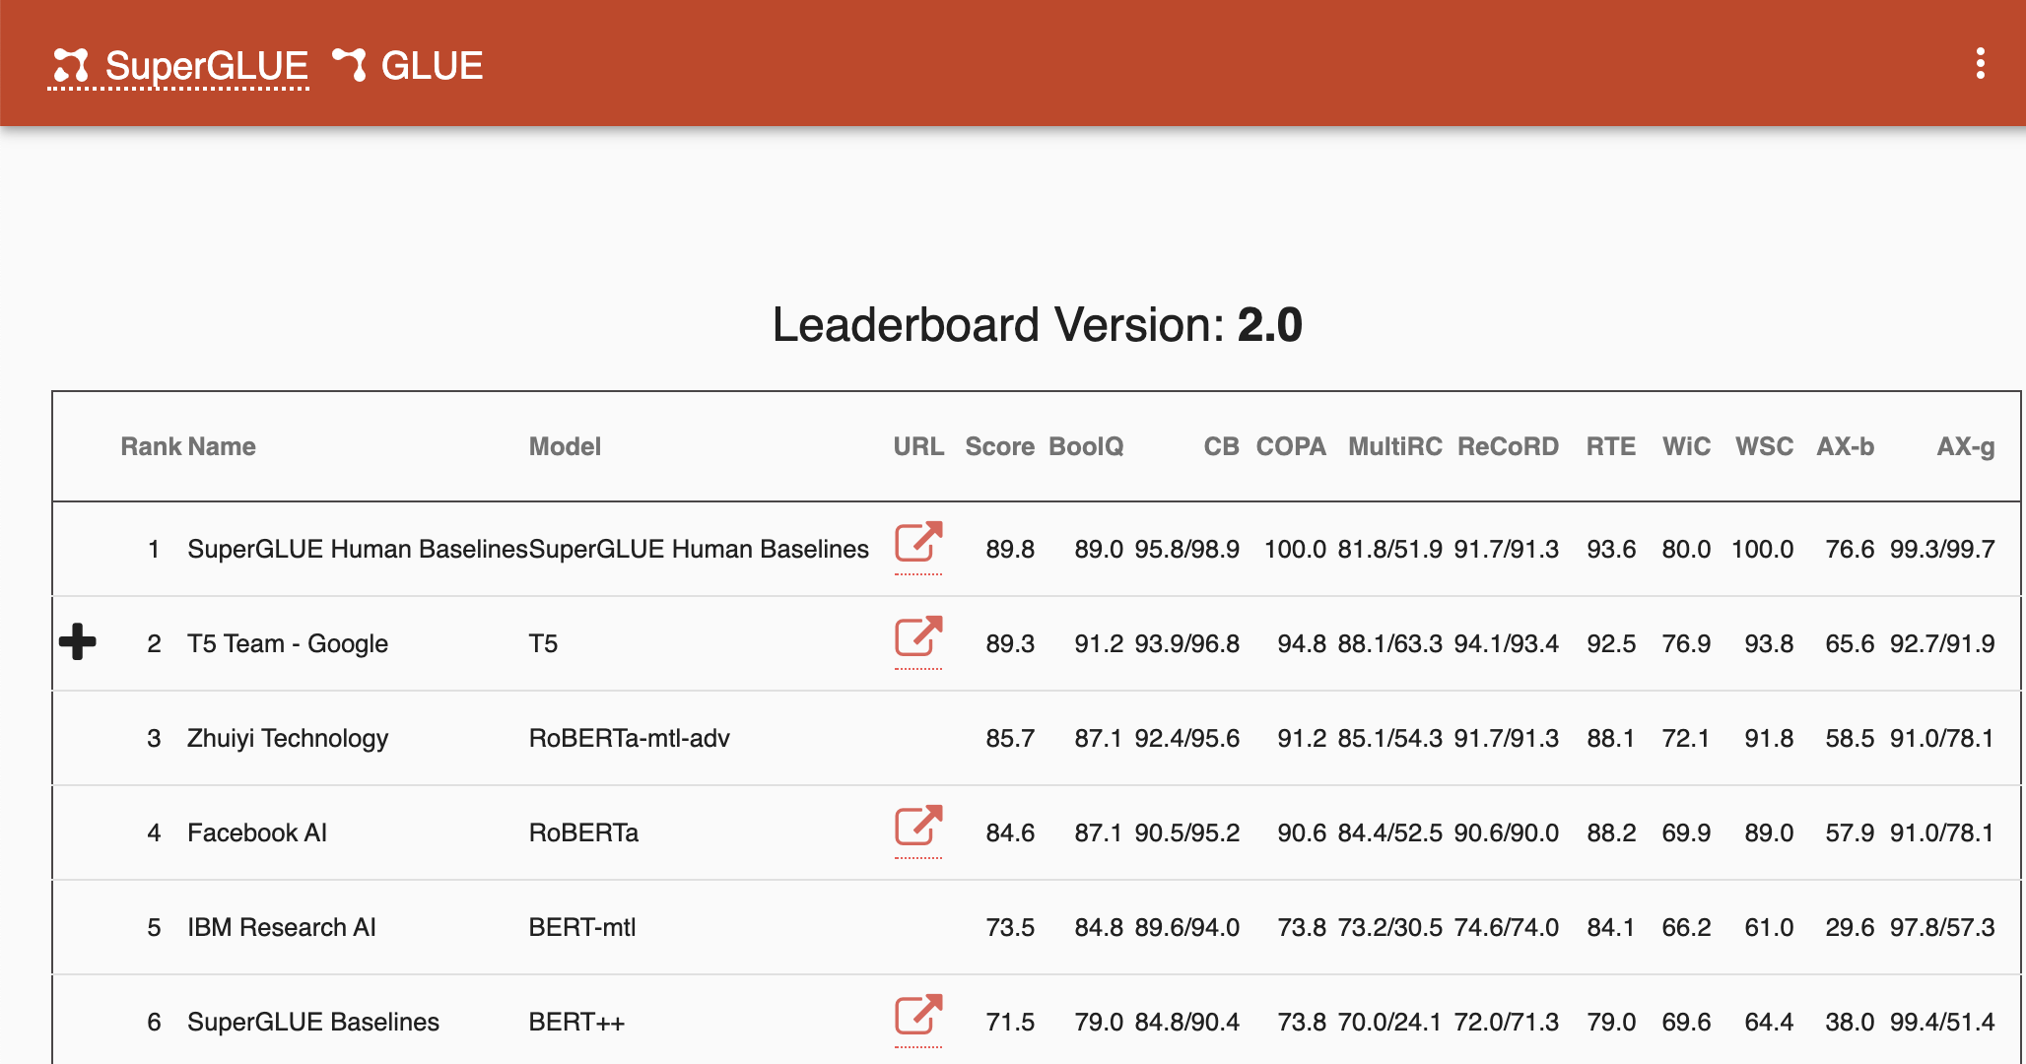
SuperGlue: benchmark on 10 NLP tasks

Slide 50
Training Huge Models
Model | # Parameters
Medium-sized LSTM | 10M
ELMo | 90M
GPT | 110M
BERT-Large | 320M
GPT-2 | 1.5B
XLM-R | 5.5B
Honeybee brain | ~1B synapses
Required 500 GPUs

Slide 51
Language Model Sizes
Source: https://arxiv.org/pdf/1911.02116.pdf

Slide 52
Digression

Slide 53
Data Science vs Artificial Intelligence
Both use Big Data
Different kinds and different use
Statistical Analysis of Big Data use raw data and extract correlations or statistical indicators
AI needs data annotated by humans, from which to learn behaviors to perform similar tasks in other situations
Human in the loop in data used for ML in AI:
  data produced by humans and annotated by humans, enter the learning cycle of human behaviors

Slide 54
Difference between Data Science, ML and AI
Statistics produces correlations
Machine learning produces predictions
Artificial Intelligence produces behaviors
Data science produces insights
See David Robinson’s post
A model is required to make predictions
Example:
  Statistics about whether are not enough to make weather forecasting
  An atmosphere model is needed for forecasting

Slide 55
Human in the Loop
Data Science exploits human in the end, whose intelligence is involved for sifting among statistical correlation hints to produce insights. Intelligence lays in the humans that interpret the output of statistical analysis.
ML provides generalizations that can be used to make predictions
AI uses ML with human in the loop to extract a model of a human intelligence ability. AI embeds the human intelligence in the system itself.
Chris Manning:
When you take a product off the supermarket shelf, data is collected and stored into logs.
Analysis proceeds from such business process exhaust data.
With language human has some information to communicate and construct a message to convey meaning to other humans.
Deliberate form of expressing intent, facts, opinion, etc.

Slide 56
Text Analytics vs. Text Mining
Text Analytics
Text Mining
Need to analyze large amounts of text to discover useful information
Examples:
  monitoring how the public discusses a product in social media
  Anti-terrorism intelligence
  Sentiment analysis
The process of deriving high-quality information from text
High-quality information is typically derived through the devising of patterns and trends through means such as statistical pattern learning
aims to turn text into data for analysis, via application of natural language processing (NLP) and analytical methods.

Slide 57
Role of Data

Slide 58
Unreasonable Effectiveness of Data
Halevy, Norvig, and Pereira argue that we should stop acting as if our goal is to author extremely elegant theories, and instead embrace complexity and make use of the best ally we have: the unreasonable effectiveness of data.
A simpler technique on more data beat a more sophisticated technique on less data.
Language in the wild, just like human behavior in general, is messy.

Slide 59
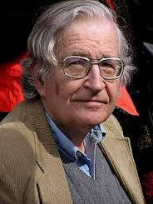

Scientific Dispute: is it science?
Prof. Noam Chomsky, Linguist, MIT
There's been a lot of work on trying to apply statistical models to various linguistic problems. I think there have been some successes, but a lot of failures.
Peter Norvig, Director of research, Google
Many phenomena in science are stochastic, and the simplest model of them is a probabilistic model; I believe language is such a phenomenon and therefore that probabilistic models are our best tool for representing facts about language, for algorithmically processing language, and for understanding how humans process language.

Slide 60
Unreasonable Effectivenss of Deep Learning in AI
Terrence J. Sejnowski
Although applications of deep learning networks to real world problems have become ubiquitous, our understanding of why they are so effective is lacking. These empirical results should not be possible according to sample complexity in statistics and non-convex optimization theory. However, paradoxes in the training and effectiveness of deep learning networks are being investigated and insights are being found in the geometry of high-dimensional spaces.
https://arxiv.org/pdf/2002.04806.pdf

Slide 61
HLT in Industry

Slide 62
HLT in Industry
Advanced Search
Advertisement, preference analysis
Machine Translation
Speech Interfaces
Assistants, Chatbots:
  Customer support
  Controlling devices, cars
  Home devices (Amazon, Google, Apple)
  Sales assistants

Slide 63
Dependency Parsing
DeSR is online since 2007
Stanford Parser
Google Parsey McParseFace in 2016

Slide 64
Google
“At Google, we spend a lot of time thinking about how computer systems can read and understand human language in order to process it in intelligent ways.”
Parser used to analyze most of text processed
Parser used in Machine Translation

Slide 65
Apple SIRI
ASR (Automated Speech Recognition) integrated in mobile phone
Special signal processing chip for noise reduction
Custom GPU
SIRI ASR
Cloud service for analysis
Integration with applications

Slide 66
Google Voice Actions
Google: what is the population of Rome?
Google: how tall is Berlusconi
How old is Lady Gaga
Who is the CEO of Tiscali
Who won the Champions League
Send text to Gervasi Please lend me your tablet
Navigate to Palazzo Pitti in Florence
Call Antonio Cisternino
Map of Pisa
Note to self publish course slides
Listen to Dylan

Slide 67
Personal Assistants
Siri, Alexa, Google Home
Jibo, by Roberto Pieraccini, formerly from CSELT, Torino
They will invade our houses, behaving as mediators, salespersons, advisers, entertaining us, etc.

Slide 68
Why to study human language?

Slide 69
AI is fascinating since it is a discipline where the mind studies itself.
Luigi Stringa, director FBK

Slide 70
Challenge: to teach natural language to computers
Children learn to speak naturally, by interacting with others
Nobody teaches them grammar
Is it possible to let computer learn language in a similarly natural way?

Slide 71
Thirty Million Words
The number of words a child hears in early life will determine their academic success and IQ in later life.
Researchers Betty Hart and Todd Risley (1995) found that children from professional families heard thirty million more words in their first 3 years
http://www.youtube.com/watch?v=qLoEUEDqagQ

Slide 72
Language and Intelligence
“Understanding cannot be measured by external behavior; it is an internal metric of how the brain remembers things and uses its memories to make predictions”.
“The difference between the intelligence of humans and other mammals is that we have language”.
  Jeff Hawkins, “On Intelligence”, 2004

Slide 73
Hawkins’ Memory-Prediction Framework
The brain uses vast amounts of memory to create a model of the world.
Everything you know and have learned is stored in this model.
The brain uses this memory-based model to make continuous predictions of future events.
It is the ability to make predictions about the future that is the crux of intelligence.

Slide 74
A Current Challenge for AI
Overcome the dychotomy between perception and reasoning
Perception is effective at exploiting Deep Learning
Reasoning has been done with symbolic approaches
Daniel Kahneman: Thinking, Fast and Slow
  System 1: immediate, reactive, fast
  System 2: logical, conscious, slow
Challenge: learning to reason, staying within the same embeddings space

Slide 75
Knowledge Based Approach
Common Sense requires an immense amount of knowledge about the world
Mostly subjective and intuitive: hard and complex to formalize
Computer can apply logical inference rules to statements in a formal language:
  Logical inference is computationally expensive
  Rules can be hundreds of thousands

Slide 76
Machine Learning
Relies on feature representation
Input is transformed into a vector of features
Designing features for a complex task requires a great deal of human time and effort
Feature selection or feature engineering
Possible solution: learning to learn
Feature | NER
Current Word | 
Previous Word | 
Next Word | 
Current Word Character n-gram | all
length | 
Current POS Tag | 
Surrounding POS Tag Sequence | 
Current Word Shape | 
Surrounding Word Shape Sequence | 
…
Features for finding
named entities like locations or
organization names (Finkel et al., 2010

Slide 77
Deep Learning
Deep learning is a kind of machine learning that relies on representation learning
End-to-end task learning capability
Representation Learning attempts to learn automatically good representations
Deep Learning algorithms aim at producing representations at several levels of abstraction
Automatically from raw data
  (e.g. sound, pixels, characters, or words)
Rely on Machine Learning to optimize weights to best make a final prediction

Slide 78
Deep Learning for Speech
The first breakthrough results of “deep learning” on large datasets happened in speech recognition
Context-Dependent Pre-trained Deep Neural Networks for Large Vocabulary Speech Recognition Dahl et al. (2010)
Acoustic model and WER | RT03S FSH | Hub5 SWB
Traditional features | 27.4 | 23.6
Deep Learning | 18.5 (−33%) | 16.1 (−32%)

Slide 79
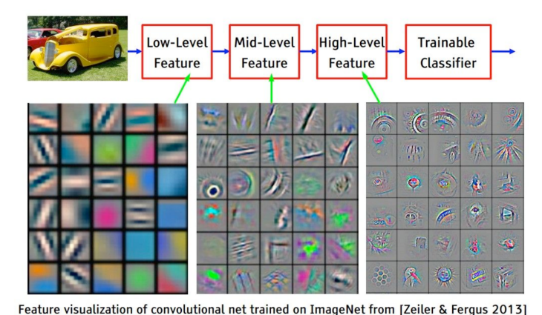
Deep Learning for Computer Vision
ImageNet Classification with Deep Convolutional Neural Networks by Krizhevsky, Sutskever, & Hinton, 2012, U. Toronto. -37% error

Slide 80
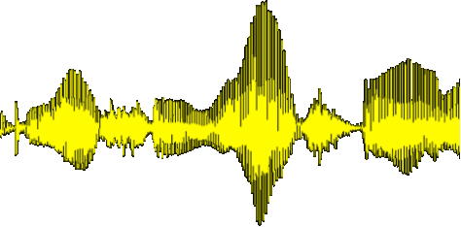
Deep Learning for NLP
Human language is a symbolic/discrete communication system
Symbols/Concepts may have different encodings:
Deep Learning explores a continuous encoding
sound | continuous
gesture | continuous
image | continuous
text | discrete
Afg a ghg ahj ajk al kl akl akla kla kl akl akl akl w io sd jio e op eo po eop e oppo po e[ p[p[pe p[ p[p

Slide 81
Deep Learning Success
Deep Learning has grown in success and popularity, largely due to:
  more powerful computers
    Faster CPUs and GPUs
  larger datasets
  better techniques to train deep networks
    Libraries
    Transferring models between tasks
    Regularization and optimization methods

Slide 82
Linguistic Tasks
Easy
  Spell Checking
  Keyword Search
  Finding Synonyms
Medium
  Parsing information from websites, documents, etc.
Hard
  Machine Translation
  Semantic Analysis (What is the meaning of query statement?)
  Coreference (e.g. What does "he" or "it" refer to given a document?)
  Question Answering.

Slide 83
Linguistic Applications
So far self referential: from language to language
  Classification
  Extraction
  Summarization
  Translation
More challenging:
  Derive conclusion
  Perform actions
Challenge:
  Find a universal learning mechanism capable of learning from observations and interactions, adequate to make predictions
  Yann LeCunn. How could machines learn as efficiently as humans?

Slide 84
NLP is Difficult

Slide 85
NLP is hard
Natural language is:
  highly ambiguous at all levels
  complex and subtle use of context to convey meaning
  fuzzy?, probabilistic
  involves reasoning about the world
  a key part of people interacting with other people (a social system):
    persuading, insulting and amusing them
But NLP can also be surprisingly easy sometimes:
  rough text features can often do half the job
  Information Retrieval and similar superficial techniques have been in widespread use

Slide 86
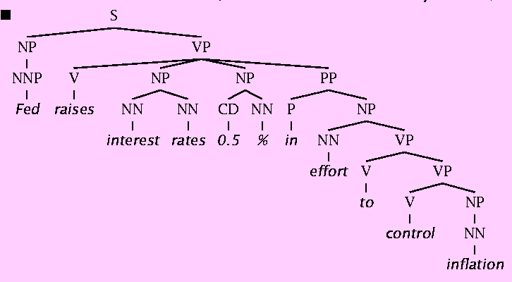
Natural Language Understanding is difficult
The hidden structure of language is highly ambiguous
Structures for: Fed raises interest rates 0.5% in effort to control inflation (NYT headline 5/17/00)
Slide by C. Manning

Slide 87
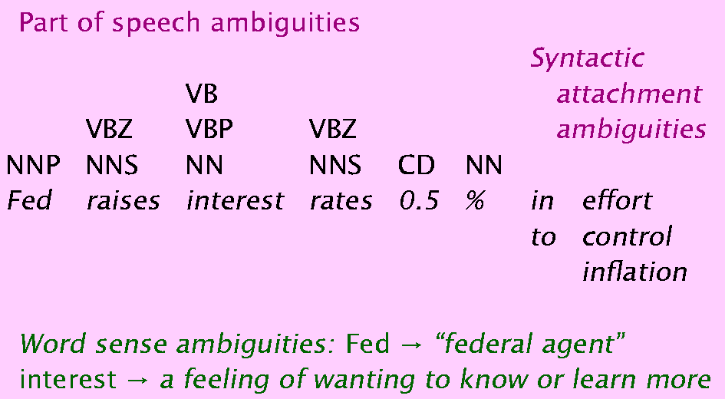
Where are the ambiguities?
Slide by C. Manning

Slide 88
Newspaper Headlines
Minister Accused Of Having 8 Wives In Jail
Pope’s baby steps on gays
Juvenile Court to Try Shooting Defendant
Teacher Strikes Idle Kids
China to Orbit Human on Oct. 15
Local High School Dropouts Cut in Half
Red Tape Holds Up New Bridges
Clinton Wins on Budget, but More Lies Ahead
Hospitals Are Sued by 7 Foot Doctors
Police: Crack Found in Man's Buttocks

Slide 89
Coreference Resolution
U: Where is The Green Hornet playing in Mountain View?
S: The Green Hornet is playing at the Century 16 theater.
U: When is it playing there?
S: It’s playing at 2pm, 5pm, and 8pm.
U: I’d like 1 adult and 2 children for the first show.
How much would that cost?
Knowledge sources:
  Domain knowledge
  Discourse knowledge
  World knowledge

Slide 90
Hidden Structure of Language
Going beneath the surface…
  Not just string processing
  Not just keyword matching in a search engine
    Search Google on “tennis racquet” and “tennis racquets” or “laptop” and “notebook” and the results are quite different …
    though these days Google does lots of subtle stuff beyond keyword matching itself
  Not just converting a sound stream to a string of words
    Like Nuance/IBM/Dragon/Philips speech recognition
To recover and manipulate at least some aspects of language structure and meaning

Slide 91
Deep Learning for NLP
Achieving goals of NLP by using representation learning and deep learning to build end-to-end systems

Slide 92
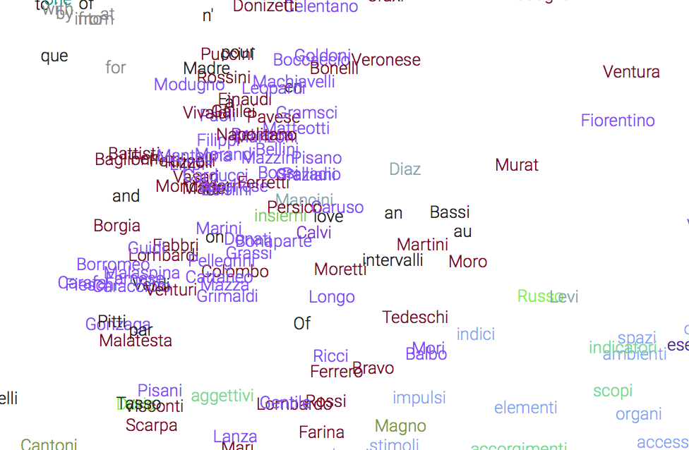
Continuous representation of Words
Learning vectors in large dimensional space that represents all aspects of word meaning
Word embeddings

Slide 93
Word Similarities
Nearest word to ‘rana’:
farfalla
tartaruga
delfino
zampa
scimmia

Slide 94
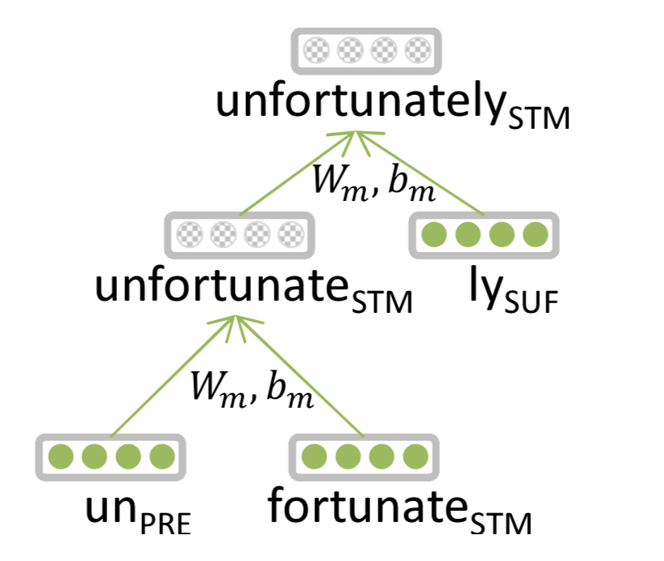
Entails Morphology
Words are made of morphemes:
  Prefix stem suffix
  un interest ed
DL:
  Every morpheme is a vector
  A NN combines vectors
  Luong et al. 2013

Slide 95
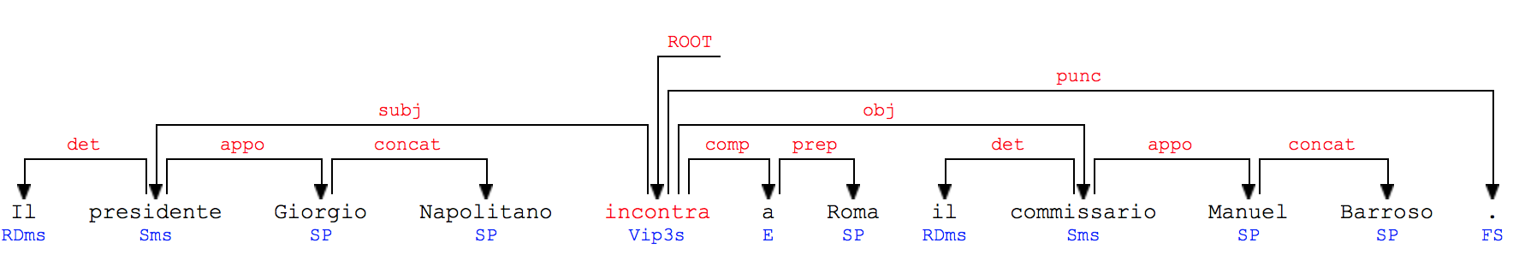
Parsing for Sentence Structure
Dependency Parser can determine grammatical structure of sentences
Useful for interpretation and relation extraction
See demo

Slide 96
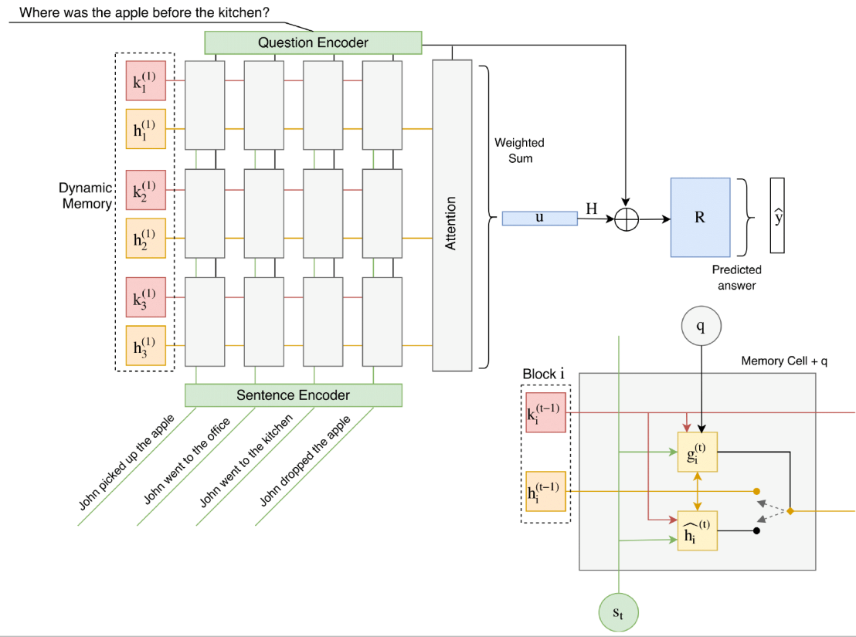
Question Answering
Traditional: A lot of feature engineering to capture world and other knowledge, e.g., regular expressions, Berant et al. (2014)
Deep Learning: embeddings represent words, a Recurrent Neural Network extracts entities and their relations and output module extracts the answer.
Madotto, Attardi. 2017. Question Dependent Recurrent Entity Network for QA

Slide 97
Neural Reasoner
Next frontier for AI
Overcome the dichotomy between
  Perceptive Tasks (voice, images): Deep Learning
  Inference: rule-based systems, logic
Single Neural Network Model for both tasks
Learning like children, who do not know neither grammar nor differential equations for:
  Learning to speak interacting with adults
  Learn a simple model of the physical world starting from perceptual experiences

