Slide 1

Introduction to TensorFlow
Adapted from slides by
Chip Huyen
CS224N
Stanford University

Slide 2
TensorFlow
Machine Learning Framework
Most popular among the Open Source ML libraries

Slide 3
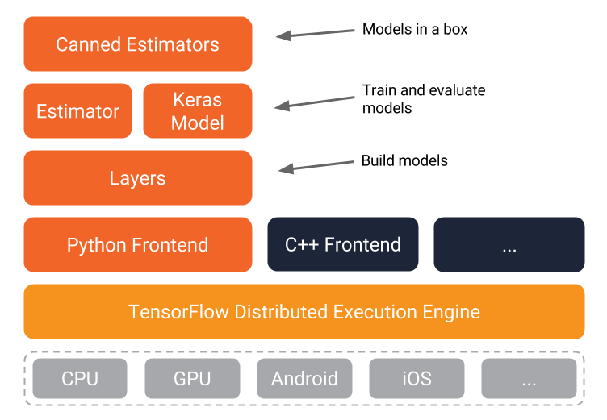
TensorFlow Architecture
High-Level
TensorFlow API
Mid-Level
TensorFlow API
Low-Level
TensorFlow API
TensorFlow Kernel
Devices

Slide 4
TensorFlow Execution Modes
Graph Execution
Eager Execution (default in TF 2.0)
Operations construct a computational graph to be run later.
Benefits:
  Distributed training
  Performance optimizations
  More suitable for production deployment.
Imperative programming environment that evaluates operations immediately, without building graphs
Operations return concrete values
Benefits:
  An intuitive interface
  Easier debugging
  Control flow in Python instead of graph control flow

Slide 5
Graphs and Computations
TensorFlow Graph Execution separates definition of computations from their execution
Phase 1: assemble a graph
Phase 2: use a session to execute operations in the graph.

Slide 6
Benefits of Graphs
Save computation. Only run subgraphs that lead to the values you want to fetch.
Break computation into small, differential pieces to facilitate auto-differentiation
Facilitate distributed computation, spread the work across multiple CPUs, GPUs, TPUs, or other devices
Many common machine learning models are taught and visualized as directed graphs

Slide 7
TensorFlow Computation Graph
Placeholders, variables used in place of inputs to feed to the graph
Variables, model variables that are going to be optimized to make model perform better
Model, a mathematical function that calculates output based on placeholder and model variables
Loss Measure, guide for optimization of model variables
Optimization Method, update method for tuning model variables
Session, a runtime where operation nodes are executed and tensors are evaluated

Slide 8
Tensors
An n-dimensional array
0-d tensor: scalar (number)
1-d tensor: vector
2-d tensor: matrix
and so on

Slide 9
Data Flow Graph
import tensorflow as tf
a = tf.add(3, 5)
TF automatically names the nodes when you don’t explicitly name them.
x = 3
y = 5

Slide 10
Data Flow Graph
import tensorflow as tf
a = tf.add(3, 5)
print(a)
>> Tensor("Add:0", shape=(), dtype=int32)
(Not 8)

Slide 11
Automatic Differentiation

Slide 12
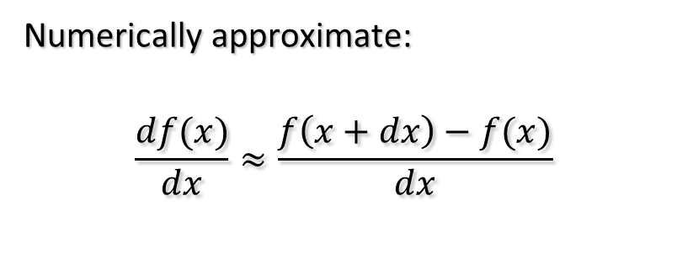
Differentiation
Manual
Numeric
def f(x):
return sin(x**2)
def df(x):
return 2*x*cos(x**2)
Numerically approximate:
$$\frac{df(x)}{dx}≈\frac{f\left(x+dx\right)−f(x)}{dx}$$
Symbolic (Matlab)
Automatic
syms f(x)
f(x) = sin(x^2);
df = diff(f,x)
df(2)
ans = 4 * cos(4)

Slide 13
Graphs = Symbolic Expression
TensorFlow supports automatic differentiation
TF uses reverse mode automatic differentiation
TensorFlow automatically builds the backpropagation graph
TensorFlow runtime automatically partitions the graph and distributes the execution on multiple devices.
So the gradient computation in TensorFlow will also be distributed to run on multiple devices

Slide 14
Graph = Symbolic Expression
Programming
Symbolic Computing
variables hold values and operations compute values
Variables represent themselves, with a name and a type
Operations build expressions
  x = 3
  y = 5
  x + y
  8
  x = tf.constant(3)
  y = tf.constant(5)
  x + y
  Tensor("Add:0", shape=(), dtype=int32)
Overloaded + operator
x
y
Add
type: int32
3
+
5
= 8
Constant
type: int32
value: 3
Constant
type: int32
value: 5

Slide 15
Tensors
A Tensor object represents a partially defined computation that will eventually produce a value
Types of tensors:
  tf.Variable
  tf.constant
  tf.SparseTensor
  >>> a = tf.constant(10)
  >>> b = tf.constant(7)
  >>> a+b
  <tf.Tensor: id=2, shape=(), dtype=int32, numpy=10>
  >>> (a+b).numpy()
  17

Slide 16
Symbolic Computations
Expressions can be transformed, before being evaluated
In particular symbolic differentiation can be computed
TensorFlow applies differentiation rules for known functions or composition thereof by applying the chain rule

Slide 17
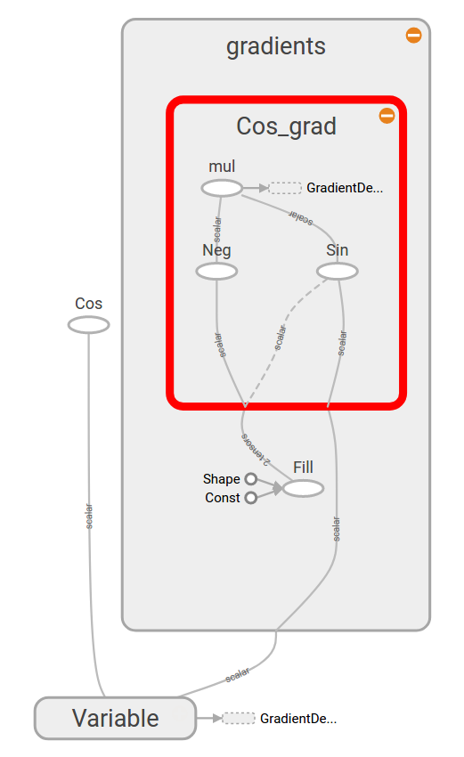
Automatic Differentiation
Consider this code:
That involves the expression
cos(x)
The derivative wrt x is
−sin(x)
The graph on the right contains both expressions
The derivative was automatically computed by TensorFlow
x = tf.Variable(3.0)
y = tf.cos(x)

Slide 18
Obtaining the Gradients
The GradientTape allows us to track TensorFlow computations and calculate gradients w.r.t. some given variables.
Here is how to define the derivative of square():
def square(x):
return tf.multiply(x, x)
def grad(x):
with tf.GradientTape() as t:
return t.gradient(square(x), x)
square(3.).numpy() # x^2 = 9.
grad(3.).numpy() # 2 * x = 6.

Slide 19
Obtaining the Gradients (TF 1)
The tfe.gradients_function takes a Python function and returns all its partial derivatives with respect to its inputs.
Here is the derivative of square():
tfe = tf.contrib.eager
def square(x):
return tf.multiply(x, x)
grad = tfe.gradients_function(square)
square(3.).numpy() # x^2 = 9.
grad(3.).numpy() # 2 * x = 6.

Slide 20
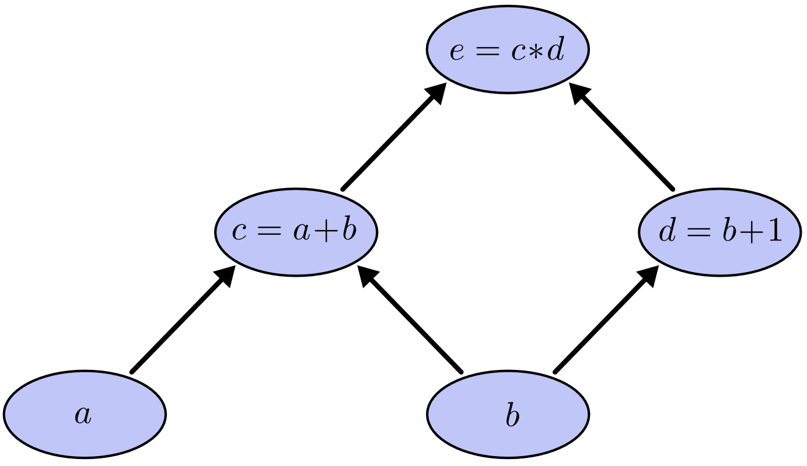
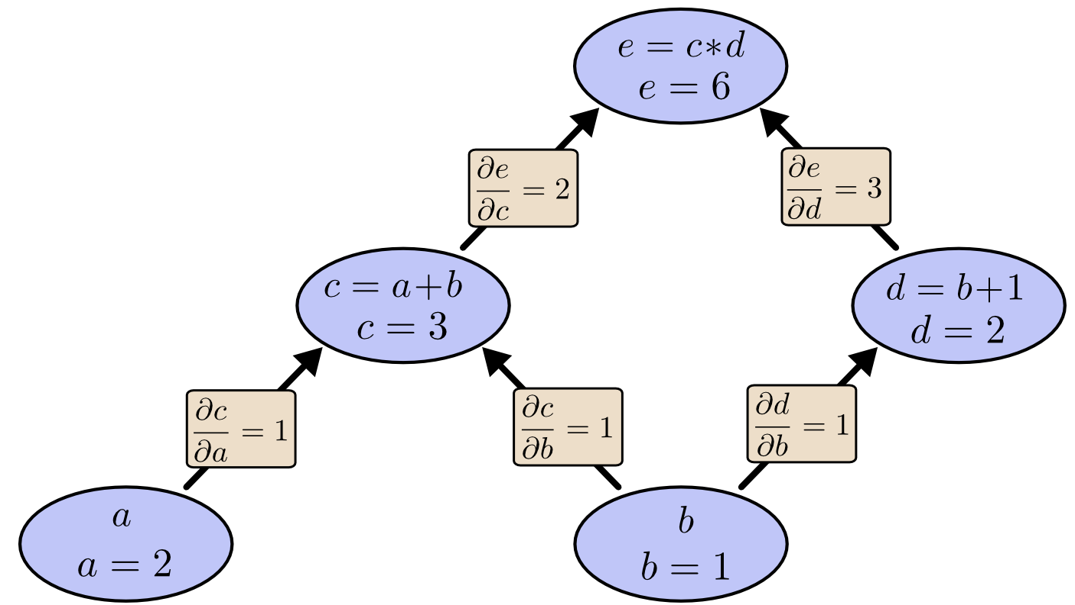
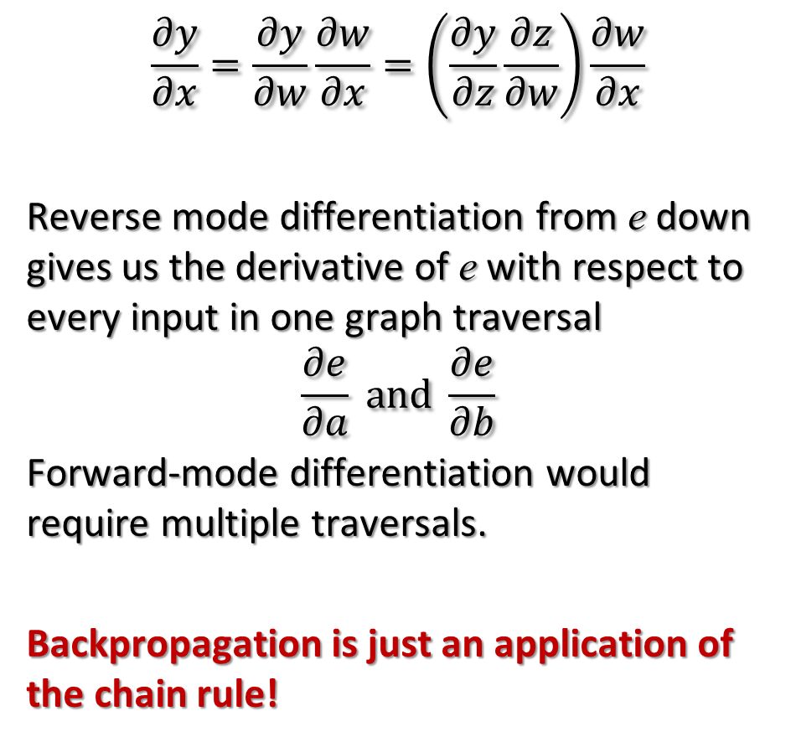
Reverse Accumulation Auto Differentiation
$$\frac{∂y}{∂x}=\frac{∂y}{∂w}\frac{∂w}{∂x}=\left(\frac{∂y}{∂z}\frac{∂z}{∂w}\right)\frac{∂w}{∂x}$$
Reverse mode differentiation from e down gives us the derivative of e with respect to every input in one graph traversal
$$\frac{∂e}{∂a} and \frac{∂e}{∂b}$$
Forward-mode differentiation would require multiple traversals.
Backpropagation is just an application of the chain rule!
traverses the chain rule from outside to inside
http://colah.github.io/posts/2015-08-Backprop/

Slide 21
Abstract Class providing Interface for Backpropagation

Slide 22


Implementation: forward/backward API
$$\frac{∂L}{∂z}$$
$$\frac{∂L}{∂x}$$

Slide 23
Built-in Gradients
Code from:
https://github.com/tensorflow/tensorflow/blob/master/tensorflow/python/ops/math_grad.py
@ops.RegisterGradient("Cos")
def _CosGrad(op, grad):
"""Returns grad * -sin(x)."""
x = op.inputs[0]
with ops.control_dependencies([grad]):
x = math_ops.conj(x)
return -grad * math_ops.sin(x)

Slide 24
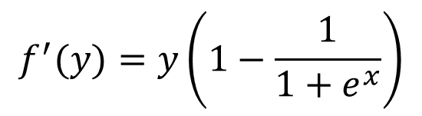

Custom Gradients
Allow providing a more efficient or more numerically stable gradient for a function
@tf.custom_gradient
def log1pexp(x):
e = tf.exp(x)
def grad(dy):
return dy * (1 - 1 / (1 + e))
return tf.log(1 + e), grad
def grad_log1pexp(x):
with GradientTape() as t:
return t.gradient(log1pexp(x), x)
# Gradient computation at x=100 avoids instability.
>>> grad_log1pexp(100.)
[1.0]
$$f\left(x\right)=log⁡(1+e^{x})$$
$$f^{′}(y)=y\left(1−\frac{1}{1+e^{x}}\right)$$
Value computed during forward evaluation

Slide 25
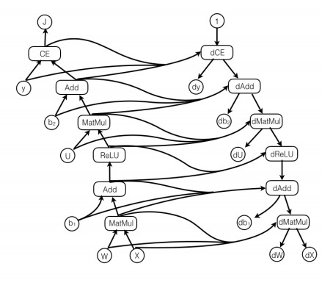

A Full Example
Graph for the computation of:
$$h=ReLU\left(Wx+ b_{1}\right) \\ \hat{y}=softmax\left(Uh+b_{2}\right) \\ J=CE\left(y,\hat{y}\right)=−\sum_{i}{y_{i}\log{{\hat{y}}_{i}}}$$
Forward pass
Backward pass

Slide 26
Autograph

Slide 27
tf.function
tf.function allows you to transform a subset of Python syntax into portable, high-performance TensorFlow graphs.
AutoGraph lets you write graph code using natural Python syntax.
AutoGraph transforms code written in Python’s classic syntax structure into TensorFlow graph-compatible code.
AutoGraph allows getting peak performance and making a model deployable anywhere
The tf.function decorator
When you annotate a function with tf.function, you can still call it like any other function. But it will be compiled into a graph, which means you get the benefits of faster execution, running on GPU or TPU, or exporting to SavedModel.

Slide 28
lstm_cell = tf.keras.layers.LSTMCell(10)
def fn(input, state):
return lstm_cell(input, state)
input = tf.zeros([10, 10]); state = [tf.zeros([10, 10])] * 2 lstm_cell(input, state); fn(input, state) # warm up
# benchmark
timeit.timeit(lambda: lstm_cell(input, state), number=10) # 0.03

Slide 29
Let’s make this faster
lstm_cell = tf.keras.layers.LSTMCell(10)
@tf.function
def fn(input, state):
return lstm_cell(input, state)
input = tf.zeros([10, 10]); state = [tf.zeros([10, 10])] * 2
lstm_cell(input, state); fn(input, state) # warm up
# benchmark
timeit.timeit(lambda: lstm_cell(input, state), number=10) # 0.03 timeit.timeit(lambda: fn(input, state), number=10) # 0.004

Slide 30
Autograph makes this possible
@tf.function def f(x):
while tf.reduce_sum(x) > 1:
x = tf.tanh(x)
return x
# you never need to run this (unless curious)
print(tf.autograph.to_code(f))

Slide 31
Generated code
def tf__f(x):
def loop_test(x_1):
with ag__.function_scope('loop_test’):
return ag__.gt(tf.reduce_sum(x_1), 1)
def loop_body(x_1):
with ag__.function_scope('loop_body'):
with ag__.utils.control_dependency_on_returns(tf.print(x_1)):
tf_1, x = ag__.utils.alias_tensors(tf, x_1)
x = tf_1.tanh(x)
return x,
x = ag__.while_stmt(loop_test, loop_body, (x,), (tf,))
return x

Slide 32
Area of circle
r = tf.Variable(10.0, name="r")
@tf.function
def area(r):
circle = 3.14*(r**2.00)
return circle
tf.autograph.to_code(area.python_function)
def tf__area(r):
circle = 3.14 * r ** 2.0
do_return = True
retval_ = circle
cond = ag__.is_undefined_return(retval_)
def get_state():
return ()
def set_state(_):
pass
def if_true():
return None
def if_false():
return retval_
retval_ = ag__.if_stmt(cond, if_true, if_false,
get_state, set_state)
return retval_

Slide 33
>>> area(60)
<tf.Tensor: id=13, shape=(), dtype=float32, numpy=11304.0>
>>> area(tf.constant(100.0))
tf.Tensor(7850.0005, shape=(), dtype=float32)

Slide 34
Graphs

Slide 35
Getting the value of a Tensor
Expressions return computation graphs
import tensorflow as tf
a = tf.add(3, 5)
a.numpy()
>> 8

Slide 36
Subgraphs
x = 2
y = 3
add_op = tf.add(x, y)
mul_op = tf.multiply(x, y)
useless = tf.multiply(x, add_op)
pow_op = tf.pow(add_op, mul_op)
z = pow_op.numpy()
Because we only want the value of pow_op and pow_op doesn’t depend on useless, session won’t compute value of useless
→ save computation

Slide 37
Subgraphs
Possible to break graphs into several chunks and run them in parallel across multiple CPUs, GPUs, TPUs, or other devices
Example: AlexNet
Graph from Hands-On Machine Learning with Scikit-Learn and TensorFlow

Slide 38
Distributed Computation
To put part of a graph on a specific CPU or GPU:
# Create a graph.
with tf.device("/device:GPU:1"):
a = tf.constant([1.0, 2.0, 3.0, 4.0, 5.0, 6.0], name='a’)
b = tf.constant([1.0, 2.0, 3.0, 4.0, 5.0, 6.0], name='b’)
c = tf.multiply(a, b)
# Run the op.
c.numpy()

Slide 39
Going big: Multi-GPU
import tf.keras as keras
# Each variable in the model is mirrored across all the GPUs
strategy = tf.distribute.MirroredStrategy()
with strategy.scope():
model = keras.models.Sequential([
keras.layers.Dense(64, input_shape=[10]),
keras.layers.Dense(64, activation='relu’),
keras.layers.Dense(10, activation='softmax')])
model.compile(optimizer='adam’,
loss='categorical_crossentropy’
metrics=['accuracy'])

Slide 40
TensorBoard

Slide 41
Visualize execution with TensorBoard
Create the summary writer after graph definition and before running the session
import tensorflow as tf
a = tf.constant(2, name='a')
b = tf.constant(3, name='b')
x = tf.add(a, b, name='add')
writer = tf.summary.FileWriter('./graphs’, tf.get_default_graph())
print(x.numpy())
writer.close() # close the writer when you’re done using it

Slide 42
Run TensorBoard
$ python [yourprogram].py
$ tensorboard --logdir="./graphs" --port 6006
Then open your browser and go to: http://localhost:6006/

Slide 44
Constants, Sequences, Variables, Ops

Slide 45
Constants
import tensorflow as tf
a = tf.constant([2, 2], name='a')
b = tf.constant([[0, 1], [2, 3]], name='b')
x = tf.multiply(a, b, name='mul’)
>>> x.numpy()
[[0 2]
[4 6]]

Slide 46
Tensor constructors
tf.zeros([2, 3], tf.int32) ==> [[0, 0, 0], [0, 0, 0]]
# input_tensor is [[0, 1], [2, 3], [4, 5]]
tf.zeros_like(input_tensor) ==> [[0, 0], [0, 0], [0, 0]]
tf.fill([2, 3], 8) ==> [[8, 8, 8], [8, 8, 8]]

Slide 47
Sequences
tf.lin_space(start, stop, num, name=None)
tf.lin_space(10.0, 13.0, 4) ==> [10. 11. 12. 13.]
tf.range(start, limit=None, delta=1, dtype=None, name='range')
tf.range(3, 18, 3) ==> [3 6 9 12 15]
tf.range(5) ==> [0 1 2 3 4]

Slide 48
Random Sequences
tf.random_normal()
tf.truncated_normal()
tf.random_uniform()
tf.random_shuffle()
tf.random_crop()
tf.multinomial()
tf.random_gamma()
Initialize seed at the beginning of a program to ensure replicability of experiments:
tf.set_random_seed(seed)

Slide 49
Constants in Graphs
Constants are stored in graph
This makes loading graphs expensive when constants are big
Only use constants for primitive types
Use variables or readers for more data that requires more memory

Slide 50
Variables
create variables with tf.Variable
s = tf.Variable(2, name="scalar")
m = tf.Variable([[0, 1], [2, 3]], name="matrix")
W = tf.Variable(tf.zeros([784,10]))
create variables with tf.get_variable
s = tf.get_variable("scalar", initializer=tf.constant(2))
m = tf.get_variable("matrix", initializer=tf.constant([[0, 1], [2, 3]]))
W = tf.get_variable("big_matrix", shape=(784, 10),
initializer=tf.zeros_initializer())

Slide 51
Assignment
x = tf.Variable(10)
x.assign(100)
x.numpy()
>> 10
x.assign(100)
x.numpy()
>> 100
W.assign(100) creates an assign op.
That op needs to be executed in a session to take effect.

Slide 52
Optimizers

Slide 53
Session looks at all trainable variables that loss depends on and updates them according to an optimizer
optimizer = tf.train.GradientDescentOptimizer(learning_rate=0.01).minimize(loss)
_, l = sess.run([optimizer, loss], feed_dict={X: x, Y:y})

Slide 54
Trainable Variable
tf.Variable(initial_value=None, trainable=True,...)
Specify if a variable should be trained or not
By default, all variables are trainable

Slide 55
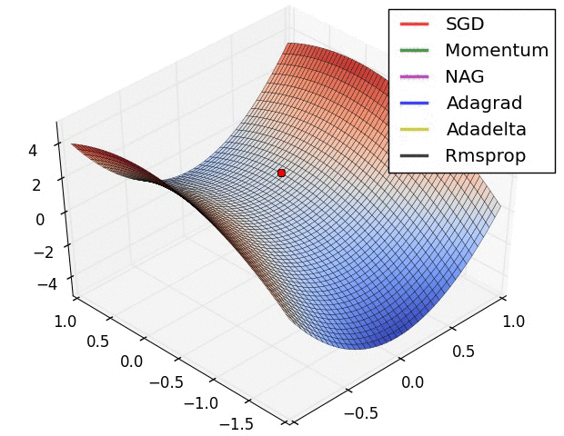
Available Optimizers
tf.train.GradientDescentOptimizer
tf.train.AdagradOptimizer
tf.train.MomentumOptimizer
tf.train.AdamOptimizer
tf.train.FtrlOptimizer
tf.train.RMSPropOptimizer
...
Optimization algorithms visualized over time in 3D space. (Source: Stanford class CS231n, MIT License)

Slide 56
Training

Slide 57
Create variables and constants (e.g. X, Y, W, b)
Assemble the graph
  Define the output, e.g.:
  Y_predicted = w * X + b
  Specify the loss function, e.g.:
  loss = tf.square(Y - Y_predicted, name='loss’)
Create an optimizer, e.g.:
opt = tf.train.GradientDescentOptimizer(learning_rate=0.001)
optimizer = opt.minimize(loss)
Train the model
  Initialize variables
  Run optimizer, feeding data into variables and placeholders

Slide 58
Logging Execution
writer = tf.summary.FileWriter('./graphs/linear_reg', sess.graph)

Slide 59
tf.data

Slide 60
Do inference directly with data
tf.data.Dataset
tf.data.Iterator

Slide 61
Store data in tf.data.Dataset
Store data in tf.data.Dataset
Load data from files
tf.data.Dataset.from_tensor_slices((features, labels))
dataset = tf.data.Dataset.from_tensor_slices((data[:,0], data[:,1]))
print(dataset.output_types) # >> (tf.float32, tf.float32)
print(dataset.output_shapes) # >> (TensorShape([]), TensorShape([]))
tf.data.TextLineDataset(filenames)
tf.data.FixedLengthRecordDataset(filenames)
tf.data.TFRecordDataset(filenames)

Slide 62
Iterate through data
Create an iterator to iterate through samples in Dataset
iterator = dataset.make_one_shot_iterator()
Iterates through the dataset exactly once. No need to initialization.
iterator = dataset.make_initializable_iterator()
Iterates through the dataset as many times as we want. Need to initialize with each epoch.

Slide 63
tf.data.Iterator
iterator = \ dataset.make_one_shot_iterator()
X, Y = iterator.get_next()
with tf.Session() as sess:
print(sess.run([X, Y]))
print(sess.run([X, Y]))
print(sess.run([X, Y]))
iterator = \ dataset.make_initializable_iterator()
...
for i in range(100):
sess.run(iterator.initializer)
total_loss = 0
try:
while True:
sess.run([optimizer])
except tf.errors.OutOfRangeError:
pass

Slide 64
Handling data
dataset = dataset.shuffle(1000)
dataset = dataset.repeat(100)
dataset = dataset.batch(128)
# convert each element of dataset to one_hot vector
dataset = dataset.map(lambda x: tf.one_hot(x, 10))

Slide 65
Variable Sharing

Slide 66
def two_hidden_layers(x):
w1 = tf.Variable(tf.random_normal([100, 50]), name='h1_weights’)
b1 = tf.Variable(tf.zeros([50]), name='h1_biases’)
h1 = tf.matmul(x, w1) + b1
w2 = tf.Variable(tf.random_normal([50, 10]), name='h2_weights’)
b2 = tf.Variable(tf.zeros([10]), name='2_biases’)
logits = tf.matmul(h1, w2) + b2
return logits
logits1 = two_hidden_layers(x1)
logits2 = two_hidden_layers(x2)
What will happen if we
make these two calls?

Slide 67
Sharing Variable: The problem
Two sets of variables are
created.
You want all your inputs to use the same weights and biases!

Slide 68
tf.get_variable()
tf.get_variable(<name>, <shape>, <initializer>)
If a variable with <name> already exists, reuse it
If not, initialize it with <shape> using <initializer>

Slide 69
tf.get_variable()
def two_hidden_layers(x):
assert x.shape.as_list() == [200, 100]
w1 = tf.get_variable("h1_weights", [100, 50], initializer=tf.random_normal_initializer())
b1 = tf.get_variable("h1_biases", [50], initializer=tf.constant_initializer(0.0))
h1 = tf.matmul(x, w1) + b1
assert h1.shape.as_list() == [200, 50]
w2 = tf.get_variable("h2_weights", [50, 10], initializer=tf.random_normal_initializer())
b2 = tf.get_variable("h2_biases", [10], initializer=tf.constant_initializer(0.0))
logits = tf.matmul(h1, w2) + b2
return logits
logits1 = two_hidden_layers(x1)
logits2 = two_hidden_layers(x2)
logits1 = two_hidden_layers(x1)
logits2 = two_hidden_layers(x2)
ValueError: Variable h1_weights already exists,
disallowed. Did you mean to set reuse=True in
VarScope?

Slide 70
tf.variable_scope()
def two_hidden_layers(x):
assert x.shape.as_list() == [200, 100]
w1 = tf.get_variable("h1_weights", [100, 50], initializer=tf.random_normal_initializer())
b1 = tf.get_variable("h1_biases", [50], initializer=tf.constant_initializer(0.0))
h1 = tf.matmul(x, w1) + b1
assert h1.shape.as_list() == [200, 50]
w2 = tf.get_variable("h2_weights", [50, 10], initializer=tf.random_normal_initializer())
b2 = tf.get_variable("h2_biases", [10], initializer=tf.constant_initializer(0.0))
logits = tf.matmul(h1, w2) + b2
return logits
logits1 = two_hidden_layers(x1)
logits2 = two_hidden_layers(x2)
with tf.variable_scope('two_layers') as scope:
logits1 = two_hidden_layers(x1)
scope.reuse_variables()
logits2 = two_hidden_layers(x2)
Put your variables within a scope and reuse all
variables within that scope

Slide 71
tf.variable_scope()
Only one set of variables, all within the variable scope
“two_layers”
They take in two different inputs

Slide 72
Auto Reuse
def fully_connected(x, output_dim, scope):
with tf.variable_scope(scope, reuse=tf.AUTO_REUSE) as scope:
w = tf.get_variable("weights", [x.shape[1], output_dim], \
initializer=tf.random_normal_initializer())
b = tf.get_variable("biases", [output_dim], initializer=tf.constant_initializer(0.0))
return tf.matmul(x, w) + b
def two_hidden_layers(x):
h1 = fully_connected(x, 50, 'h1’)
h2 = fully_connected(h1, 10, 'h2’)
with tf.variable_scope('two_layers') as scope:
logits1 = two_hidden_layers(x1)
logits2 = two_hidden_layers(x2)
Fetch variables if they already exist
Else, create them

Slide 74
Saves and Checkpoints

Slide 75
Saving the Session, not the Graph
tf.train.Saver.save(sess, save_path, global_step=None...)
tf.train.Saver.restore(sess, save_path)

Slide 76
Periodic Checkpoints
# define model
model = SkipGramModel(params)
# create a saver object
saver = tf.train.Saver()
with tf.Session() as sess:
for step in range(training_steps):
sess.run([optimizer])
# save model every 1000 steps
if (step + 1) % 1000 == 0:
saver.save(sess, 'checkpoint_directory/model_name’,
global_step=step)

Slide 77
tf.train.Saver
Can also choose to save certain variables
v1 = tf.Variable(..., name='v1')
v2 = tf.Variable(..., name='v2’)
You can save your variables in one of three ways:
saver = tf.train.Saver({'v1': v1, 'v2': v2})
saver = tf.train.Saver([v1, v2])
saver = tf.train.Saver({v.op.name: v for v in [v1, v2]}) # similar to a dict

Slide 78
Restore
saver.restore(sess, 'checkpoints/skip-gram-99999’)
Restore latest checkpoint
# check if there is checkpoint
ckpt = tf.train.get_checkpoint_state('checkpoints')
# check if there is a valid checkpoint path
if ckpt and ckpt.model_checkpoint_path:
saver.restore(sess, ckpt.model_checkpoint_path)
Still need to build graph first
checkpoint file keeps track of the latest checkpoint
restore checkpoints only when there is a valid checkpoint path

Slide 79
Progress Summary

Slide 80
Create Summaries
with tf.name_scope("summaries"):
tf.summary.scalar("loss", self.loss)
tf.summary.scalar("accuracy", self.accuracy)
tf.summary.histogram("histogram loss", self.loss)
summary_op = tf.summary.merge_all()
merge them all into one summary op to make managing them easier

Slide 81
Run with the rest
loss_batch, _, summary = sess.run([loss,
optimizer,
summary_op])
Like everything else in TF, summaries are ops.
For the summaries to be built, you have to run them in a session

Slide 82
Write them to file
writer.add_summary(summary, global_step=step)
Need global step here so the model knows
what summary corresponds to what step

Slide 83
Putting it all together
tf.summary.scalar("loss", self.loss)
tf.summary.histogram("histogram loss", self.loss)
summary_op = tf.summary.merge_all()
saver = tf.train.Saver() # defaults to saving all variables
with tf.Session() as sess:
sess.run(tf.global_variables_initializer())
ckpt = tf.train.get_checkpoint_state(os.path.dirname('checkpoints/checkpoint’))
if ckpt and ckpt.model_checkpoint_path:
saver.restore(sess, ckpt.model_checkpoint_path)
writer = tf.summary.FileWriter('./graphs', sess.graph)
for index in range(10000):
...
loss_batch, _, summary = sess.run([loss, optimizer, summary_op])
writer.add_summary(summary, global_step=index)
if (index + 1) % 1000 == 0:
saver.save(sess, 'checkpoints/skip-gram', index)

Slide 84
Visualize on TensorBoard

Slide 85
Compare Experiments

Slide 86
Global Step
global_step = tf.Variable(0,
dtype=tf.int32,
trainable=False,
name='global_step')
optimizer = tf.train.AdamOptimizer(lr).minimize(loss, global_step=global_step)
Global step
Need to tell optimizer to increment global step
This can also help your optimizer know when
to decay learning rate

Slide 87
Novelties

Slide 88

Swift for TensorFlow

