Slide 1
Sentiment Classification
Università di Pisa
Human Language Technologies
Giuseppe Attardi

Slide 2
Unsupervised Sentiment Classification
Unsupervised methods do not require labeled examples.
Knowledge about the task is usually added by using lexical resources and
hard-coded heuristics, e.g.:
Lexicons + patterns: VADER
Patterns + Simple language model: SO-PMI
Neural language models have been found that they learn to recognize
sentiment with no explicit knowledge about the task.

Slide 3
Supervised/unsupervised
Supervised learning methods are the most commonly used one, yet also
some unsupervised methods have been successfully.
Unsupervised methods rely on the shared and recurrent characteristics of the
sentiment dimension across topics to perform classification by means of
hand-made heuristics and simple language models.
Supervised methods rely on a training set of labeled examples that describe
the correct classification label to be assigned to a number of documents.
A learning algorithm then exploits the examples to model a general
classification function.

Slide 4
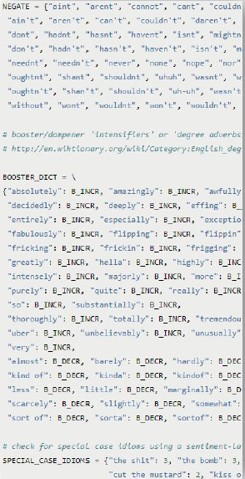
VADER
VADER (Valence Aware Dictionary for sEntiment Reasoning) uses a curated lexicon derived from well known sentiment lexicons that assigns a positivity/negativity score to 7k+ words/emoticons.
It also uses a number of hand-written pattern matching rules (e.g., negation, intensifiers) to modify the contribution of the original word scores to the overall sentiment of text.
Hutto and Gilbert. VADER: A Parsimonious Rule-based Model for Sentiment Analysis of Social Media Text. ICWSM 2014.
VADER is integrated into NLTK

Slide 5
The classification pipeline
The elements of a classification pipeline are:
Tokenization
Feature extraction
Feature selection
Weighting
Learning
Steps from 1 to 4 define the feature space and how text is converted into vectors.
Step 5 creates the classification model.

Slide 6
Scikit-learn
The scikit-learn library defines a rich number of data processing and machine learning algorithms.
Most modules in scikit implement a 'fit-transform' interface:
fit method learns the parameter of the module from input data
transform method apply the method implemented by the module to the data
fit_transform does both actions in sequence and is useful to connect modules in a pipeline.

Slide 7
Sentiment Analysis on Tweets

Slide 8
Evolution
SemEval Shared Task Competition
2013, Task 2
2014, Task 9
2015, Task 10
2016
2017
Evolution of technology:
Top system in 2013: SVM with sentiment lexicons and many lexical features
Top system in 2016: CNN with word embeddings
In 2017: most systems used CNN or variants

Slide 9
SemEval 2013, Task 2
Best Submission:
TNRC-Canada: Building the State-of-the-Art in Sentiment Analysis of Tweets, Saif M. Mohammad, Svetlana Kiritchenko, and Xiaodan Zhu, In Proceedings of the seventh international workshop on Semantic Evaluation Exercises (SemEval-2013), June 2013, Atlanta, USA.

Slide 10
SemEval 2015 – Task 10
Best Submission:
A. Severyn, A. Moschitti. 2015. UNITN: Training Deep Convolutional Neural Network for Twitter Sentiment Classification. Proceedings of the 9th International Workshop on Semantic Evaluation (SemEval 2015), pages 464–469, Denver, Colorado, June 4-5, 2015. https://www.aclweb.org/anthology/S15-2079

Slide 11
Deep Learning for Sentiment Analysis

Slide 12
Convolutional Neural Network
A convolutional layer in a NN is composed by a set of filters.
A filter combines a "local" selection of input values into an output value.
All filters are "sweeped" across all input.
During training each filter specializes into recognizing some kind of relevant combination of features.
CNNs work well on stationary features, i.e., those independent from position.
A filter using a window length of 5 is applied to all the sequences of 5 words in a text.
3 filters using a window of 5 applied to a text of 10 words produce 18 output values. Why?
Filters have additional parameters that define their behavior at the start/end of documents (padding), the size of the sweep step (stride), the possible presence of holes in the filter window (dilation).

Slide 13
CNN for Sentiment Classification
S
Not
going
to
the
beach
tomorrow
:-(
-
-
+
embeddings
for each word
convolutional layer with
multiple filters
max over time pooling
Multilayer perceptron
with dropout
Embeddings Layer, R^{d} (d = 300)
Convolutional Layer with Relu activation
Multiple filters of sliding windows of various sizes h
c_{i} = f(F ⊗ S_{i:i+h−1} + b)
max-pooling layer
dropout layer
linear layer with tanh activation
softmax layer
Frobenius elementwise
matrix product

Slide 14
Distant Supervision
A. Severyn and A. Moschitti, UNITN at SemEval 2015 Task 10.
Word embeddings from plain text are completely clueless about their sentiment behavior
Distant supervision approach using our convolutional neural network to further refine the embeddings
Collected 10M tweets treating tweets containing positive emoticons, used as distantly supervised labels to train sentiment-aware embeddings

Slide 15
Results of UNITN on SemEval 2015
Phrase-level subtask A
Dataset | Score | Rank
Twitter 15 | 84.79 | 1
Message-level subtask B
Dataset | Score | Rank
Twitter 15 | 64.59 | 2

Slide 16
Sentiment Specific Word Embeddings
Sentiment Specific Word Embeddings
Uses an annotated corpus with polarities (e.g. tweets)
SS Word Embeddings achieve SotA accuracy on tweet sentiment classification
G. Attardi, D. Saertiano. UniPi at SemEval 2016 Task 4: Convolutional Neural Networks for Sentiment Classification. https://www.aclweb.org/anthology/S/S16/S16-1033.pdf
LM likelihood + Polarity
U
the cat sits on

Slide 17
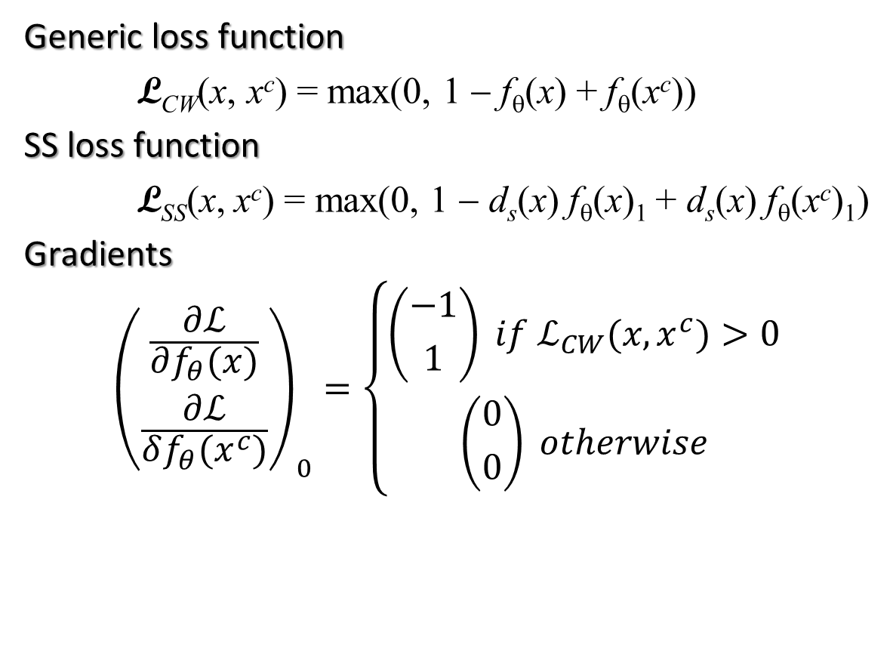
Learning SS Embeddings
Generic loss function
L_{CW}(x, x^{c}) = max(0, 1 − f_{θ}(x) + f_{θ}(x^{c}))
SS loss function
L_{SS}(x, x^{c}) = max(0, 1 − d_{s}(x) f_{θ}(x)₁ + d_{s}(x) f_{θ}(x^{c})₁)
Gradients
$${\left({\frac{∂ℒ}{∂f_{θ}(x)} \atop \frac{∂ℒ}{δf_{θ}(x^{c})}}\right)}_{0}=\left\{\begin{aligned}\left({−1 \atop 1}\right) if ℒ_{CW}(x, x^{c})>0 \\ \left({0 \atop 0}\right) otherwise\end{aligned}\right.$$
x is a sentence and x^{c} is a corrupted sentence, obtained by replacing the center word with a random word
f(x) ∈ {0, 1}²
is the function computed by the network
$$d_{s}\left(x\right)∈\{1,−1\}$$
represents the polarity of x

Slide 18
Semeval 2015 Sentiment on Tweets
Team | Phrase Level Polarity | Tweet
Attardi (unofficial) |  | 67.28
UNITN | 84.79 | 64.59
KLUEless | 84.51 | 61.20
IOA | 82.76 | 62.62
WarwickDCS | 82.46 | 57.62
Webis |  | 64.84

Slide 19
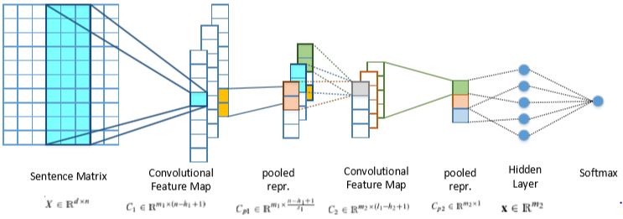
SwissCheese at SemEval 2016
Three-phase procedure:
creation of word embeddings for initialization of the ﬁrst layer. Word2vec on an unlabeled corpus of 200M tweets.
distant supervised phase, where the network weights and word embeddings are trained to capture aspects related to sentiment. Emoticons used to infer the polarity of a balanced set of 90M tweets.
supervised phase, where the network is trained on the provided supervised training data.

Slide 20
Ensemble of Classifiers
Ensemble of classiﬁers
combining the outputs of two 2-layer CNNs having similar architectures but differing in the choice of certain parameters (such as the number of convolutional ﬁlters).
networks were also initialized using different word embeddings and used slightly different training data for the distant supervised phase.
A total of 7 outputs were combined

Slide 21
Results
 | 2013 |  | 2014 |  |  | 2015 | 2016 Tweet
 | Tweet | SMS | Tweet | Sarcasm | Live-Journal | Tweet | Avg F1 | Acc
SwissCheese Combination | 70.0₅ | 63.7₂ | 71.6₂ | 56.6₁ | 69.5₇ | 67.1₁ | 63.3₁ | 64.6₁
SwissCheese single | 67.00 |  | 69.12 | 62.00 | 71.32 | 61.01 | 57.19
UniPI | 59.2₁₈ | 58.5₁₁ | 62.7₁₈ | 38.1₂₅ | 65.4₁₂ | 58.6₁₉ | 57.1₁₈ | 63.9₃
UniPI SWE | 64.2 | 60.6 | 68.4 | 48.1 | 66.8 | 63.5 | 59.2 | 65.2

Slide 22
Breakdown over all test sets
SwissCheese | Prec. | Rec. | F1
positive | 67.48 | 74.14 | 70.66
negative | 53.26 | 67.86 | 59.68
neutral | 71.47 | 59.51 | 64.94
Avg F1 |  |  | 65.17
Accuracy |  |  | 64.62
UniPI 3 | Prec. | Rec. | F1
positive | 70.88 | 65.35 | 68.00
negative | 50.29 | 58.93 | 54.27
neutral | 68.02 | 68.12 | 68.07
Avg F1 |  |  | 61.14
Accuracy |  |  | 65.64

Slide 23
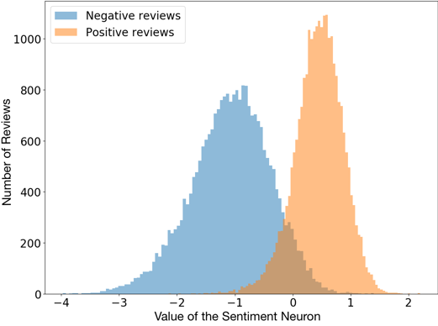
Sentiment Classification from a single neuron
A char-level LSTM with 4096 units has been trained on 82 millions reviews from Amazon.
The model is trained only to predict the next character in the text
After training one of the units had a very high correlation with sentiment, resulting in state-of-the-art accuracy when used as a classifier.
The model can be used to generate text.
By setting the value of the sentiment unit, one can control the sentiment of the resulting text.
Blog post - Radford et al. Learning to Generate Reviews and Discovering Sentiment. Arxiv 1704.01444

