Slide 1
Convolutional Neural Networks for NLP
Università di Pisa
Human Language Technologies
Giuseppe Attardi
Slides from Christopher Manning

Slide 2
Idea
Main CNN idea:
What if we compute vectors for every possible word subsequence of a certain length?
Example: “tentative deal reached to keep government open” computes vectors for:
tentative deal reached, deal reached to, reached to keep, to keep government, keep government open
Regardless of whether phrase is grammatical
Not very linguistically or cognitively plausible
Then group them afterwards
Slide from Chris Manning

Slide 3
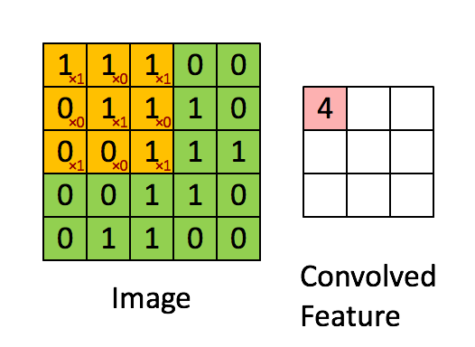
CNN
Convolution is classically used to extract features from images
Models position-invariant identification
2d example
Yellow color and red numbers show filter (=kernel) weights
Green shows input
Pink shows output
Slide from Chris Manning

Slide 4
A 1D convolution for text
Not | 0.2 | 0.1 | −0.3 | 0.4
going | 0.5 | 0.2 | −0.3 | −0.1
to | −0.1 | −0.3 | −0.2 | 0.4
the | 0.3 | −0.3 | 0.1 | 0.1
beach | 0.2 | −0.3 | 0.4 | 0.2
tomorrow | 0.1 | 0.2 | −0.1 | −0.1
:-( | −0.4 | −0.4 | 0.2 | 0.3
w1,w2,w3 | −1.0
w2,w3,w4 | −0.5
w3,w4,w5 | −3.6
w4,w5,w6 | −0.2
w5,w6,w7 | 0.3
0.0 | 0.50
0.5 | 0.38
-2.6 | 0.93
0.8 | 0.31
1.3 | 0.21
+ bias ➔ non-linearity
Apply a filter (or kernel) of size 3
3 | 1 | 2 | −3
−1 | 2 | 1 | −3
1 | 1 | −1 | 1

Slide 5
1D convolution for text with padding
0 | 0.0 | 0.0 | 0.0 | 0.0
Not | 0.2 | 0.1 | −0.3 | 0.4
going | 0.5 | 0.2 | −0.3 | −0.1
to | −0.1 | −0.3 | −0.2 | 0.4
the | 0.3 | −0.3 | 0.1 | 0.1
beach | 0.2 | −0.3 | 0.4 | 0.2
tomorrow | 0.1 | 0.2 | −0.1 | −0.1
:-( | −0.4 | −0.4 | 0.2 | 0.3
0 | 0.0 | 0.0 | 0.0 | 0.0
0,w1,w2 | −0.6
w1,w2,w3 | −1.0
w2,w3,w4 | −0.5
w3,w4,w5 | −0.1
w4,w5,w6 | −0.2
w5,w6,w7 | 0.3
w6,w7,0 | −0.5
Apply a filter (or kernel) of size 3
3 | 1 | 2 | −3
−1 | 2 | 1 | −3
1 | 1 | −1 | 1

Slide 6
3D channel convolution with padding
0 | 0.0 | 0.0 | 0.0 | 0.0
Not | 0.2 | 0.1 | −0.3 | 0.4
going | 0.5 | 0.2 | −0.3 | −0.1
to | −0.1 | −0.3 | −0.2 | 0.4
the | 0.3 | −0.3 | 0.1 | 0.1
beach | 0.2 | −0.3 | 0.4 | 0.2
tomorrow | 0.1 | 0.2 | −0.1 | −0.1
:-( | −0.4 | −0.4 | 0.2 | 0.3
0 | 0.0 | 0.0 | 0.0 | 0.0
0,w1,w2 | −0.6 | 0.2 | 1.4
w1,w2,w3 | −1.0 | 1.6 | −1.0
w2,w3,w4 | −0.5 | −0.1 | 0.8
w3,w4,w5 | −3.6 | 0.3 | 0.3
w4,w5,w6 | −0.2 | 0.1 | 1.2
w5,w6,w7 | 0.3 | 0.6 | 0.9
w6,w7,0 | −0.5 | −0.9 | 0.1
Apply 3 filters (or kernel) of size 3
3 | 1 | 2 | −3
−1 | 2 | 1 | −3
1 | 1 | −1 | 1
1 | 0 | 0 | 1
1 | 0 | −1 | −1
0 | 1 | 0 | 1
1 | −1 | 2 | −1
1 | 0 | −1 | 3
0 | 2 | 2 | 1

Slide 7
conv1d, padded, with max pooling over time
0 | 0.0 | 0.0 | 0.0 | 0.0
Not | 0.2 | 0.1 | −0.3 | 0.4
going | 0.5 | 0.2 | −0.3 | −0.1
to | −0.1 | −0.3 | −0.2 | 0.4
the | 0.3 | −0.3 | 0.1 | 0.1
beach | 0.2 | −0.3 | 0.4 | 0.2
tomorrow | 0.1 | 0.2 | −0.1 | −0.1
:-( | −0.4 | −0.4 | 0.2 | 0.3
0 | 0.0 | 0.0 | 0.0 | 0.0
0,w1,w2 | −0.6 | 0.2 | 1.4
w1,w2,w3 | −1.0 | 1.6 | −1.0
w2,w3,w4 | −0.5 | −0.1 | 0.8
w3,w4,w5 | −3.6 | 0.3 | 0.3
w4,w5,w6 | −0.2 | 0.1 | 1.2
w5,w6,w7 | 0.3 | 0.6 | 0.9
w6,w7,0 | −0.5 | −0.9 | 0.1
Max pool | 0.3 | 1.6 | 1.4
Apply 3 filters (or kernel) of size 3
3 | 1 | 2 | −3
−1 | 2 | 1 | −3
1 | 1 | −1 | 1
1 | 0 | 0 | 1
1 | 0 | −1 | −1
0 | 1 | 0 | 1
1 | −1 | 2 | −1
1 | 0 | −1 | 3
0 | 2 | 2 | 1

Slide 8
conv1d, padded, average pooling over time
0 | 0.0 | 0.0 | 0.0 | 0.0
Not | 0.2 | 0.1 | −0.3 | 0.4
going | 0.5 | 0.2 | −0.3 | −0.1
to | −0.1 | −0.3 | −0.2 | 0.4
the | 0.3 | −0.3 | 0.1 | 0.1
beach | 0.2 | −0.3 | 0.4 | 0.2
tomorrow | 0.1 | 0.2 | −0.1 | −0.1
:-( | −0.4 | −0.4 | 0.2 | 0.3
0 | 0.0 | 0.0 | 0.0 | 0.0
0,w1,w2 | −0.6 | 0.2 | 1.4
w1,w2,w3 | −1.0 | 1.6 | −1.0
w2,w3,w4 | −0.5 | −0.1 | 0.8
w3,w4,w5 | −3.6 | 0.3 | 0.3
w4,w5,w6 | −0.2 | 0.1 | 1.2
w5,w6,w7 | 0.3 | 0.6 | 0.9
w6,w7,0 | −0.5 | −0.9 | 0.1
average | −0.87 | 0.26 | 0.53
Apply 3 filters (or kernel) of size 3
3 | 1 | 2 | −3
−1 | 2 | 1 | −3
1 | 1 | −1 | 1
1 | 0 | 0 | 1
1 | 0 | −1 | −1
0 | 1 | 0 | 1
1 | −1 | 2 | −1
1 | 0 | −1 | 3
0 | 2 | 2 | 1

Slide 9
conv1d, padded, average pooling, stride = 2
0 | 0.0 | 0.0 | 0.0 | 0.0
Not | 0.2 | 0.1 | −0.3 | 0.4
going | 0.5 | 0.2 | −0.3 | −0.1
to | −0.1 | −0.3 | −0.2 | 0.4
the | 0.3 | −0.3 | 0.1 | 0.1
beach | 0.2 | −0.3 | 0.4 | 0.2
tomorrow | 0.1 | 0.2 | −0.1 | −0.1
:-( | −0.4 | −0.4 | 0.2 | 0.3
0 | 0.0 | 0.0 | 0.0 | 0.0
0,w1,w2 | −0.6 | 0.2 | 1.4
w2,w3,w4 | −0.5 | −0.1 | 0.8
w4,w5,w6 | −0.2 | 0.1 | 1.2
w6,w7,0 | −0.5 | −0.9 | 0.1
Max p | −0.2 | 0.2 | 1.4
Apply 3 filters (or kernel) of size 3
3 | 1 | 2 | −3
−1 | 2 | 1 | −3
1 | 1 | −1 | 1
1 | 0 | 0 | 1
1 | 0 | −1 | −1
0 | 1 | 0 | 1
1 | −1 | 2 | −1
1 | 0 | −1 | 3
0 | 2 | 2 | 1

Slide 10
Convolutional Neural Network
A convolutional layer in a NN is composed by a set of filters.
A filter combines a "local" selection of input values into an output value.
All filters are "sweeped" across all input.
During training each filter specializes into recognizing some kind of relevant combination of features.
CNNs work well on stationary features, i.e., those independent from position.
A filter using a window length of 5 is applied to all the sequences of 5 words in a text.
3 filters using a window of 5 applied to a text of 10 words produce 18 output values. Why?
Filters have additional parameters that define their behavior at the start/end of documents (padding), the size of the sweep step (stride), the possible presence of holes in the filter window (dilation).

Slide 11
Convolutiona Neural Network

Slide 12
Single Layer CNN for Sentence Classification
Yoon Kim (2014): Convolutional Neural Networks for Sentence Classification. EMNLP 2014. https://arxiv.org/pdf/1408.5882.pdf
A variant of convolutional NNs of Collobert, Weston et al. (2011) Natural Language Processing (almost) from Scratch.
Goal: Sentence classification:
Mainly positive or negative sentiment of a sentence
Other tasks like:
Subjective or objective language sentence
Question classification: about person, location, number, ...

Slide 13
CNN for Sentiment Classification
S
Not
going
to
the
beach
tomorrow
:-(
-
-
+
embeddings
for each word
convolutional layer with
multiple filters
max over time pooling
Multilayer perceptron
with dropout
Embeddings Layer, R^{d} (d = 300)
Convolutional Layer with Relu activation
Multiple filters of sliding windows of various sizes h
c_{i} = f(F ⊗ S_{i:i+h−1} + b)
max-pooling layer
dropout layer
linear layer with tanh activation
softmax layer
Frobenius elementwise
matrix product

Slide 14
Code
See notebook:
http://attardi-4.di.unipi.it:8000/hub/user-redirect/lab/tree/HLT/CnnNLP.ipynb

Slide 15
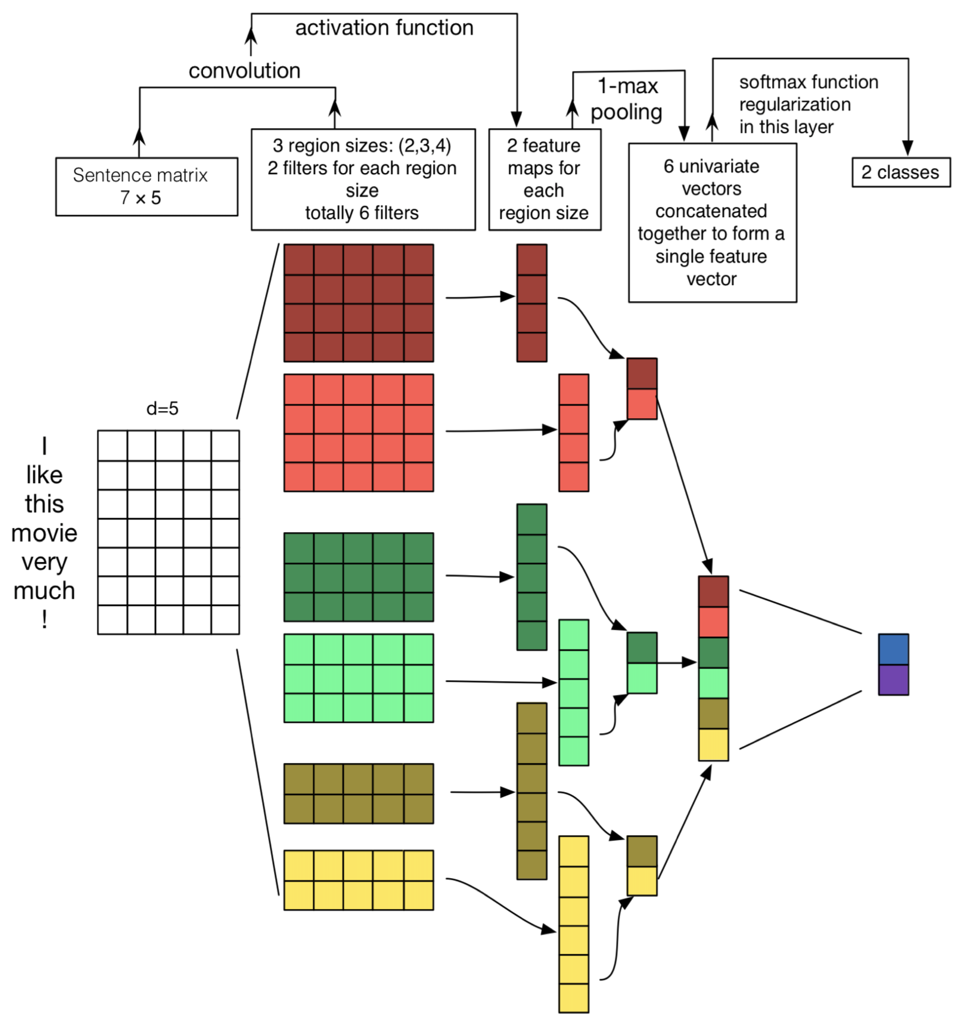
Follow up
Zhang and Wallace (2015) A Sensitivity Analysis of (and Practitioners’ Guide to) Convolutional Neural Networks for Sentence Classification
https://arxiv.org/pdf/1510.03820.pdf

Slide 16
Regularization
Use Dropout: Create masking vector r of Bernoulli random variables with probability p (a hyperparameter) of being 1
Delete features during training (Dense + Dropout):
$$h=W\left(r\text{⊗}z\right)+b$$
Reasoning: Prevents overfitting (Srivastava, Hinton, et al. 2014)
At test time, no dropout, scale final vector by probability p
$$\hat{W}=pW$$
Benefits:
Dropout gives 2–4 % accuracy improvement

Slide 17
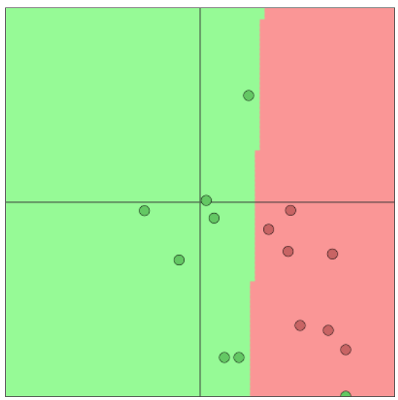
A pitfall when fine-tuning word vectors
Setting: We are training a logistic regression classification model for movie review sentiment using single words.
In the training data we have “TV” and “telly”
In the testing data we have “television”
The pre-trained word vectors have all three similar:
Question: What happens when we update the word vectors?
TV
telly
television

Slide 18
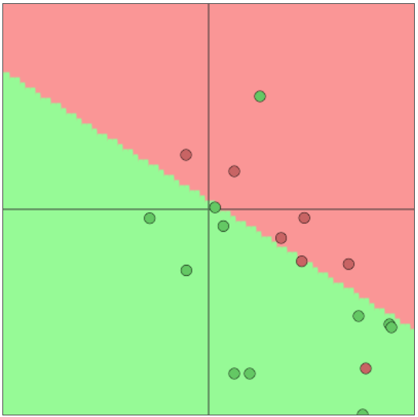
A pitfall when fine-tuning word vectors
Question: What happens when we update the word vectors?
Answer:
Those words that are in the training data move around
“TV”and“telly”
Words not in the training data stay where they were
“television”
TV
telly
television

Slide 19
What to do
Question: Should I use available “pre-trained” word vectors Answer:
Almost always, yes!
They are trained on a huge amount of data, and so they will know about words not in your training data and will know more about words that are in your training data
Have 100s of millions of words of data? Okay to start random
Question: Should I update (“fine tune”) my own word vectors?
• Answer:
If you only have a small training data set, don’t train the word
vectors
If you have have a large dataset, it probably will work better to
train = update = fine-tune word vectors to the task

