Slide 1

Recurrent Neural Networks (RNN)
Università di Pisa
Human Language Technologies
Giuseppe Attardi
Some slides from Arun Mallya

Slide 2
Recurrent
RNNs are called recurrent because they perform the same task for every element of a sequence, with the output depending on the previous values.
RNNs have a “memory” which captures information about what has been calculated so far.
In theory RNNs can make use of information in arbitrarily long sequences.

Slide 3
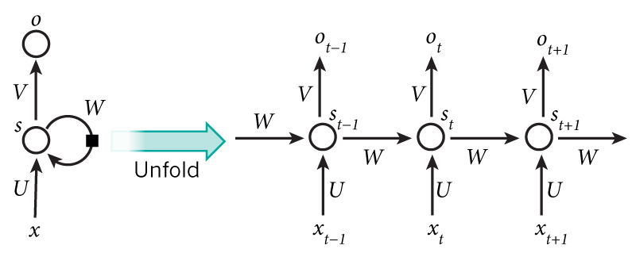
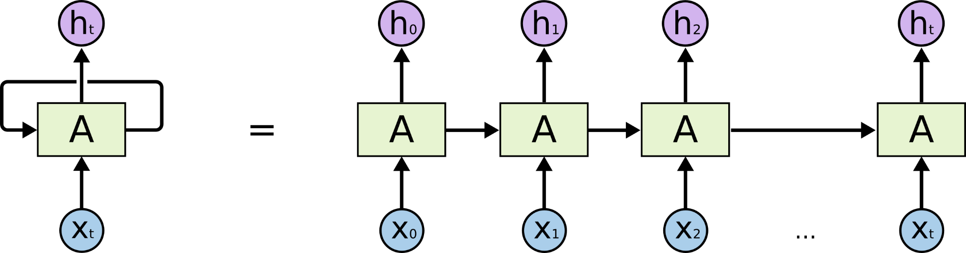
Recurrent Neural Network

Slide 4
Hidden Units
The hidden state s_{t} represents the memory of the network.
s_{t} captures information about what happened in all the previous time steps.
The output o_{t} is calculated solely based on the memory at time t.
s_{t} typically can’t capture information from too many time steps ago.
Unlike a traditional deep neural network, which uses different parameters at each layer, a RNN shares the same parameters (U, V, W above) across all steps.
This reflects the fact that we are performing the same task at each step, just with different inputs. This greatly reduces the total number of parameters we need to learn.

Slide 5
RNN Pro/Cons
RNN Advantages:
  Can process input of any length
  Model size doesn’t increase for longer input
  Computation for step t can (in theory) use information from many steps back
  Weights are shared across timesteps → representations are shared
RNN Disadvantages:
  Recurrent computation is slow
  In practice, difficult to access information from many steps back
Slide by Richard Socher

Slide 6
How do RNN reduce complexity?
h and h’ are vectors with the same dimension
Given function f: h’, y = f(h, x)
y₁
y₂
y₃
h₀
f
h₁
f
h₂
f
h₃
……
x₁
x₂
x₃
No matter how long the input/output sequence is, we only need one function f.
If f’s are different, then it becomes a feedforward NN.

Slide 7
Deep RNN
RNNs with multiple hidden layers
y₁
y₂
y₃
y₄
y₅
y₆
x₁
x₂
x₃
x₄
x₅
x₆
Slide by Arun Mallya

Slide 8
Bidirectional RNN
RNNs can process the input sequence in both forward and reverse direction
y₁
y₂
y₃
y₄
y₅
y₆
x₁
x₂
x₃
x₄
x₅
x₆
Popular in speech recognition and NLP

Slide 9
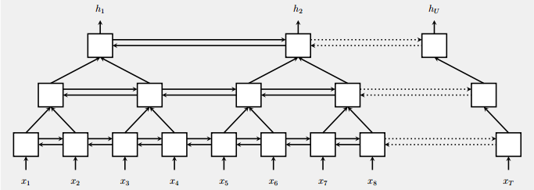
Pyramid RNN
Significantly speed up training
Reducing the number of time steps
Bidirectional
RNN
W. Chan, N. Jaitly, Q. Le and O. Vinyals, “Listen, attend and spell: A neural network for large vocabulary conversational speech recognition,” ICASSP, 2016

Slide 10
Vanilla RNN
y
h'
W
^{h}
U
x
= σ( + + b)
h
f
h'
y
V
^{h’}
= σ( )
x
Note, y is computed from h’

Slide 11

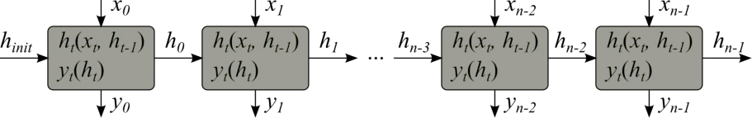
Vanilla RNN
h_{t} = σ(W_{ih} x_{t} + U h_{t−1} + b)
y_{t} = σ(W₀ h_{t})
Unfolding the network in time

Slide 12
RNN Training

Slide 13
RNN Training
Target: obtain the network parameters that optimize the cost function Cost functions: log loss, mean squared root error etc…
Tasks:
  For each timestep of the input sequence x predict output y (synchronously)
  For the input sequence x predict the scalar value of y (e.g., at end of sequence)
  For the input sequence x of length L_{x} generate the output sequence y of different length L_{y}
Methods
Backpropagation:
Others:
Reliable and controlled convergence
Supported by most of ML frameworks
Evolutionary methods, expectation maximization, non-parametric methods, particle swarm optimization
Research

Slide 14
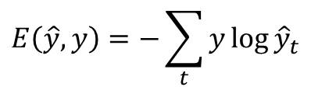
Back-propagation Through Time
h_{t} = σ(W_{ih} x_{t} + U h_{t−1} + b)
y_{t} = σ(W₀ h_{t})
_{Cross Entropy Loss:}
$$E\left(\hat{y},y\right)=−\sum_{t}{y\log{{\hat{y}}_{t}}}$$
Unfold the network.
Repeat for the train data:
  Given some input sequence 𝒙
  For t in 0, N-1:
    Forward-propagate
    Initialize hidden state to the past value 𝒉_{𝑡−1}
    Obtain output sequence 𝒚
    Calculate error E(y, y)
    Back-propagate error across the unfolded network
    Average the weights
    Compute next hidden state value 𝒉_{𝑡}

Slide 15
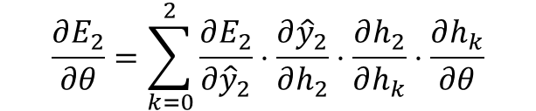
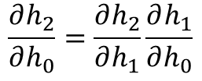
Back-propagation Through Time
E₀
E₁
E₂
y₀
y₁
y₂
ŷ₀
ŷ₁
ŷ₂
h_{init}
Timestep 0
h₀
Timestep 1
h₁
Timestep 2
h₂
x₀
x₁
x₂
Apply chain rule:
$$\frac{∂h_{2}}{∂h_{0}}=\frac{∂h_{2}}{∂h_{1}}\frac{∂h_{1}}{∂h_{0}}$$
$$\frac{∂E_{2}}{∂θ}=\sum_{k=0}^{2}{\frac{∂E_{2}}{∂{\hat{y}}_{2}}}⋅\frac{∂{\hat{y}}_{2}}{∂h_{2}}⋅\frac{∂h_{2}}{∂h_{k}}⋅\frac{∂h_{k}}{∂θ}$$
For time 2:
𝜽 - Network parameters

Slide 16
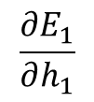
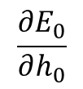
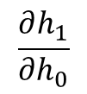
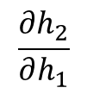
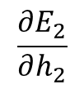
Back-propagation Through Time
E₀
E₁
$$\frac{∂E_{1}}{∂h_{1}}$$
E₂
$$\frac{∂E_{2}}{∂h_{2}}$$
y₀
$$\frac{∂E_{0}}{∂h_{0}}$$
y₁
y₂
ŷ₀
ŷ₁
ŷ₂
h_{init}
Timestep 0
h₀
Timestep 1
h₁
Timestep 2
h₂
x₀
$$\frac{∂h_{1}}{∂h_{0}}$$
x₁
$$\frac{∂h_{2}}{∂h_{1}}$$
x₂

Slide 17
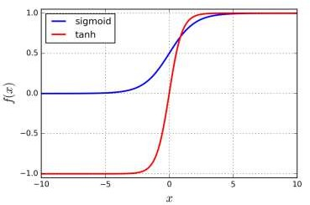
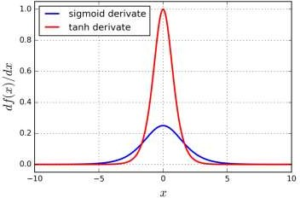





Problem: vanishing gradients
Gradient close to 0
Saturation
Saturated neurons gradients → 0
𝝏𝒉_{𝑡}
𝝏𝒉_{𝑡}
𝝏𝒉₃ 𝝏𝒉₂
𝝏𝒉₁
=
∙ ⋯ ∙
∙ ∙
𝝏𝒉₀
^{𝝏𝒉}𝑡−1
𝝏𝒉₂ 𝝏𝒉₁ 𝝏𝒉₀
Decays exponentially
Network stops learning, can’t update
Impossible to learn correlations between temporally distant events
Drive previous layers gradients to 0
(especially for far time-steps)
Known problem for deep feed-forward networks.
For recurrent networks (even shallow) makes impossible to learn long-term dependencies!
Smaller weight parameters leads to faster gradients vanishing.
Very big initial parameters make the gradient descent to diverge fast (explode).

Slide 18
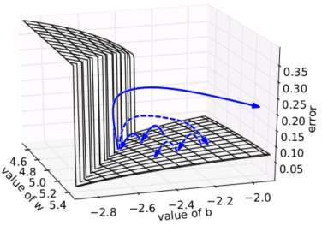
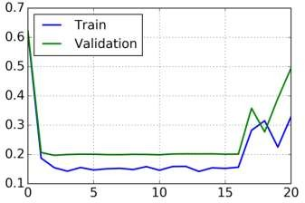
Problem: exploding gradients
Large increase in the norm of the gradient during training
Diagnostics: NaNs; Cost function large fluctuations
Pascanou R. et al, On the difficulty of training recurrent neural networks. arXiv (2012)
Network can not converge and
weight parameters do not stabilize
Solutions:
Use gradient clipping
Try reduce learning rate
Change loss function by setting constrains on weights (L1/L2 norms)

Slide 19
Problems with Vanilla RNN
When dealing with a time series, it tends to forget old information.
When there is a distant relationship of unknown length, we wish to have a “memory” to it.
Vanishing gradient problem.

Slide 20
LSTM (Long Short Term Memory)

Slide 21
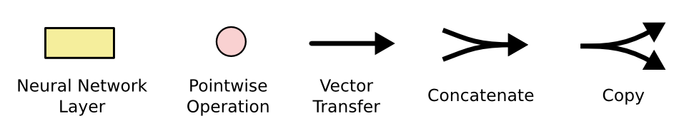
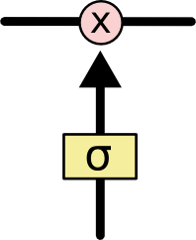
The sigmoid layer outputs numbers between 0-1 determine how much
each component should be let through. Pink X gate is point-wise multiplication.

Slide 22
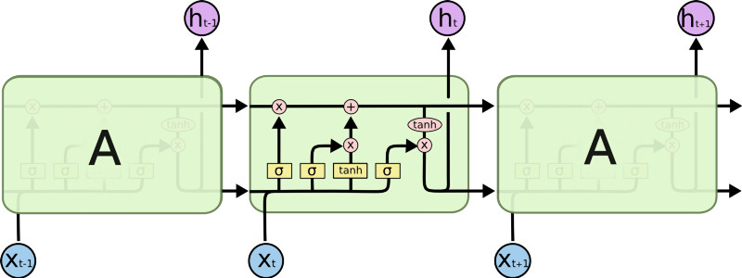
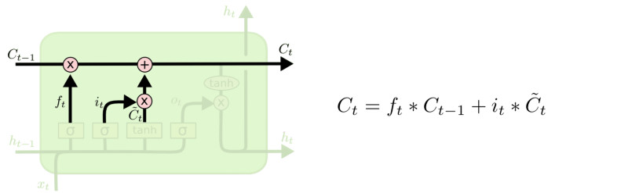
LSTM
Output gate
Controls what
goes into output
This sigmoid gate
determines how much
information goes thru
This decides what info
Is to add to the cell state
C_{t-1}
h_{t-1}
Forget input
gate gate
The core idea is this cell state C_{t}, it is changed slowly, with only minor linear interactions. It is very easy for information to flow along it unchanged.
Why sigmoid or tanh:
Sigmoid: 0,1 gating as switch.
Vanishing gradient problem in
LSTM is handled already.
ReLU replaces tanh ok?

Slide 23
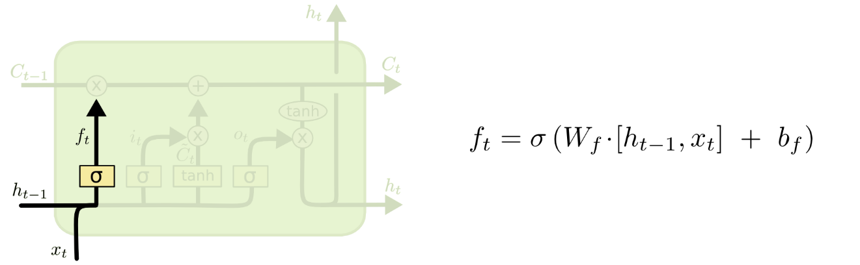
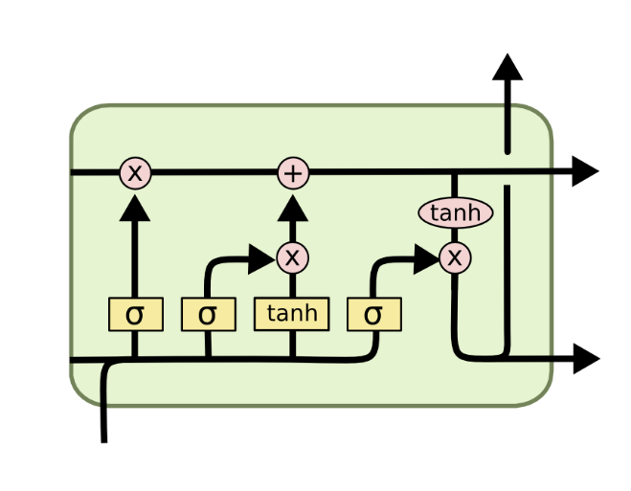
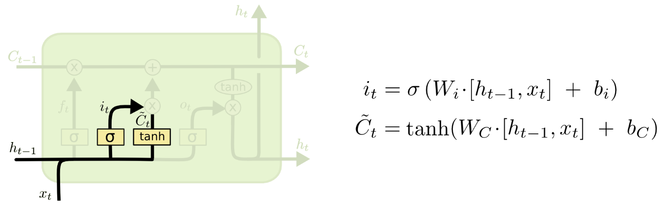
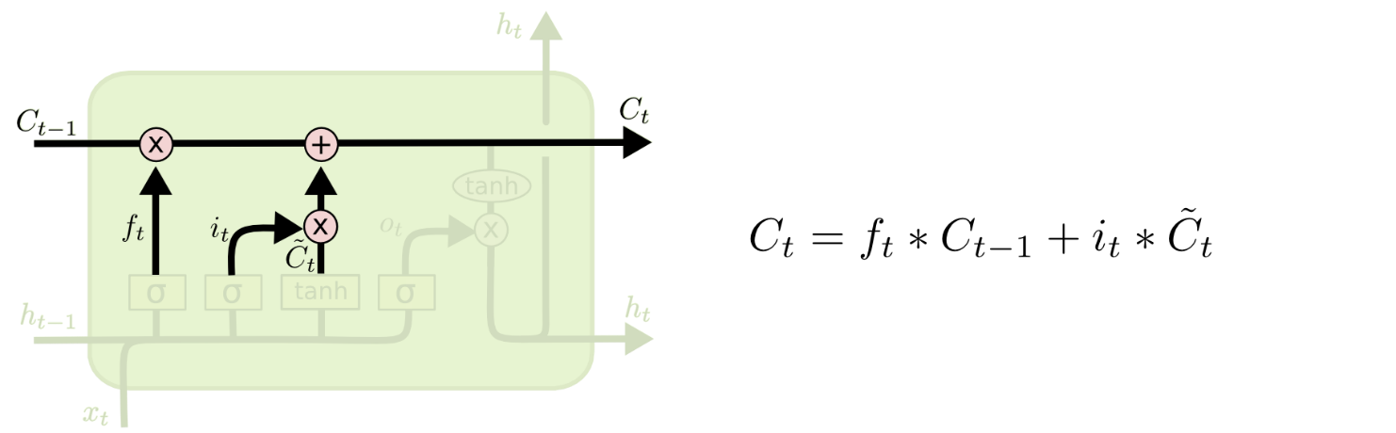
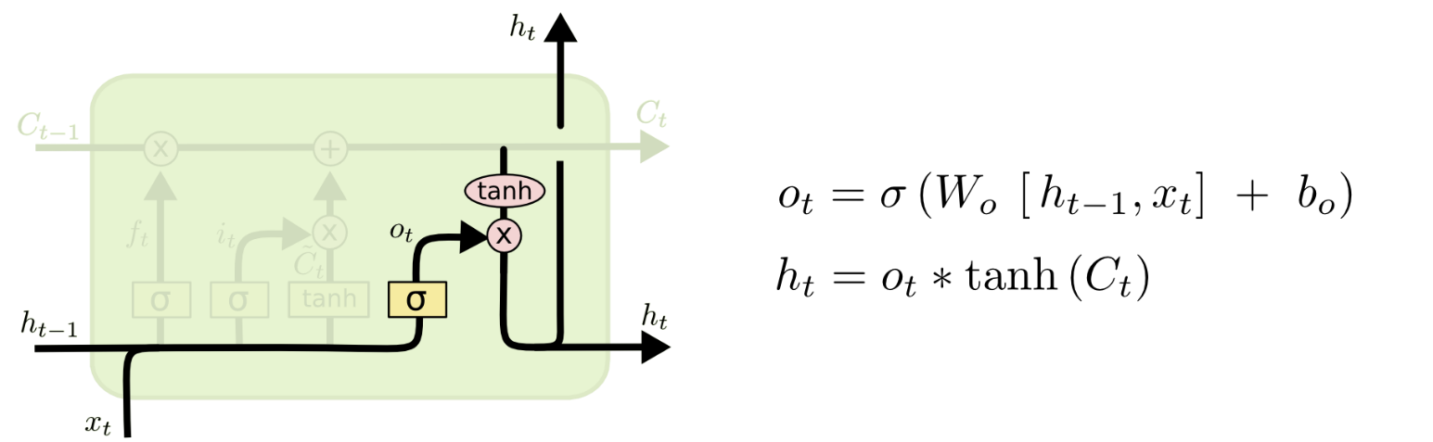
i_{t} decides what component
is to be updated.
C’_{t} provides change contents
Updating the cell state
Decide what part of the cell
state to output

Slide 24
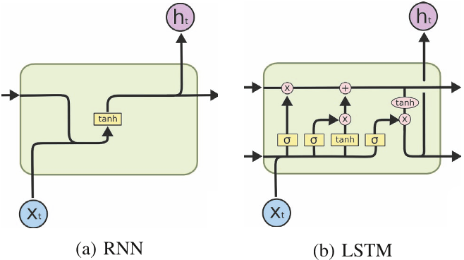
RNN vs LSTM

Slide 25
LSTM – Forward/Backward
Explore the equations for LSTM forward and backward computations:
Illustrated LSTM Forward and Backward Pass

Slide 26
Information Flow in a LSTM
x^{t}
z
W
= tanh( )
h^{t-1}
These 4 matrix
computation can
be done concurrently.
x^{t}
z^{i}
W^{i}
= σ( )
c^{t-1}
h^{t-1}
Controls
forget gate
Controls
input gate
Updating
information
Controls
Output gate
W^{f}
x^{t}
z^{f}
= σ( )
h^{t-1}
z^{f}
z^{i}
z
zº
x^{t}
zº
Wº
= σ( )
h^{t-1}
x^{t}
h^{t-1}

Slide 27

◉
Element-wise multiply
y^{t}
c^{t-1}
c^{t}
c^{t} = z^{f}  c^{t-1} + z^{i}z
◉
◉
tanh
h^{t} = zº  tanh(c^{t})
◉
y^{t} = σ(W’ h^{t})
z^{f}
z^{i}
z
zº
h^{t-1}
x^{t}
h^{t}
Information flow of LSTM

Slide 28

LSTM information flow
y^{t}
y^{t+1}
c^{t-1}
c^{t}
c^{t+1}
◉
◉
◉
◉
tanh
tanh
z^{f}
z^{i}
z
zº
z^{f}
z^{i}
z
zº
h^{t+1}
h^{t-1}
x^{t}
h^{t}
x^{t+1}

Slide 29
GRU

Slide 30
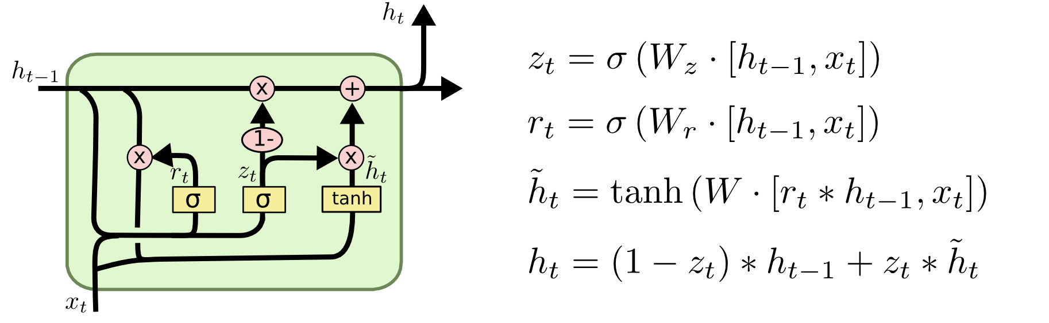
GRU – Gated Recurrent Unit
reset gate
Update gate
It combines the forget and input into a single update gate.
It also merges the cell state and hidden state.
Simpler than LSTM. There are many other variants too.
X,*: element-wise multiply

Slide 31
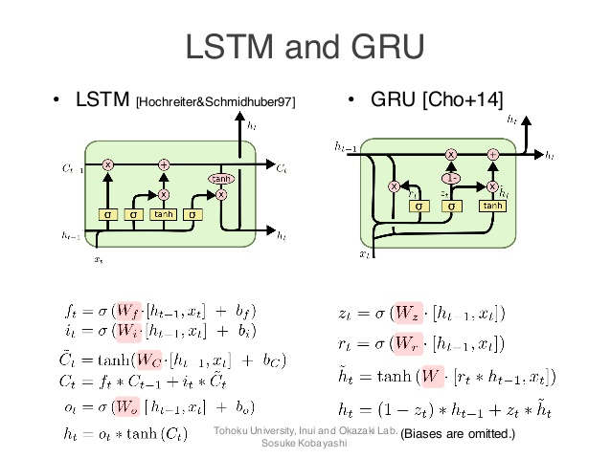
Both take x_{t} and h_{t-1} as inputs and compute h_{t} to pass along.
GRUs don't need the cell layer to pass values along.
The calculations within each iteration ensure that the h_{t} values being passed along either retain a high amount of old information or are jump-started with a high amount of new information.

Slide 32

How do GRU solve the vanishing gradient problem?
Is the problem with standard RNNs the naïve transition function?
$$h_{t}=f\left(W^{hh}h_{t−1}+ W^{hx}x_{t}\right)$$
It implies that the error must backpropagate through all the intermediate nodes:
Perhaps we can create shortcut connections:
h_{t}
h_{t+1}
h_{t+2}
h_{t+n}
h_{t}
h_{t+1}
h_{t+2}
h_{t+n}

Slide 33
Perhaps we can create adaptive shortcut connections.
Let the net prune unnecessary connections adaptively.
Through the gates mechanism
h_{t}
h_{t+1}
h_{t+2}
h_{t+n}

Slide 34
Feed-forward vs Recurrent Network
Feedforward network does not have input at each step
Feedforward network has different parameters for each layer
x
f₁
a¹
f₂
a²
f₃
a³
f₄
y
t is layer
a^{t} = f_{t}(a^{t-1}) = σ(W^{t}a^{t-1} + b^{t})
h⁰
f
h¹
f
h²
f
h³
f
g
y⁴
x¹
x²
x³
x⁴
t is time step
a^{t}= f(a^{t-1}, x^{t}) = σ(W^{h} a^{t-1} + W^{i}x^{t} + b^{i})

Slide 35
LSTM effective for all sequence problems
Very powerful, especially when stacked and made even deeper (each hidden layer is already computed by a deep internal network)
Most useful if you have lots and lots of data

Slide 36
Applications of LSTM / RNN

Slide 37
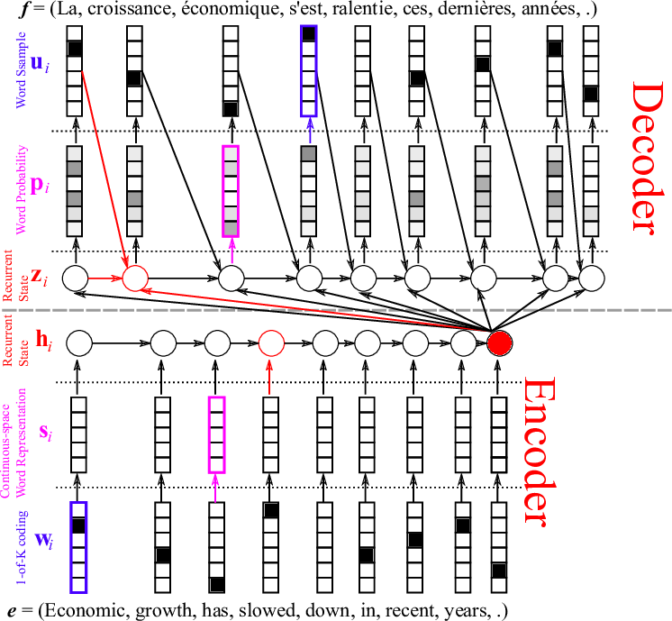
Neural machine translation
LSTM

Slide 38
Deep LSTMs at WMT 2016

Slide 39
Generating text with a RNN Language Model
You can train a RNN-LM on any kind of text, then generate text in that style.
RNN-LM trained on Obama speeches:

Slide 40
Generating text with a RNN Language Model
You can train a RNN-LM on any kind of text, then generate text in that style.
RNN-LM trained on Harry Potter:

Slide 41
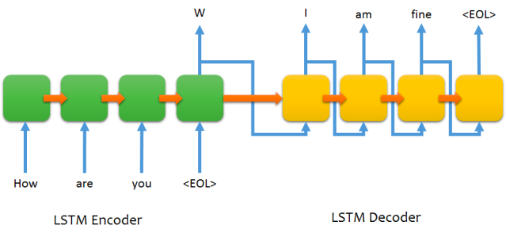
Sequence to sequence chat model

Slide 42

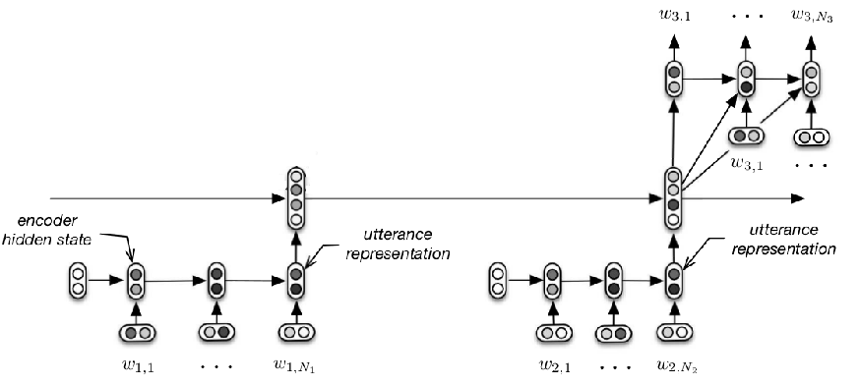
Chat with context
M: Hi
M: Hello
U: Hi
M: Hi
M: Hello
U: Hi
Serban, Iulian V., Alessandro Sordoni, Yoshua Bengio, Aaron Courville, and Joelle Pineau, 2015 "Building End-To-End Dialogue Systems Using Generative Hierarchical Neural Network Models.

Slide 43
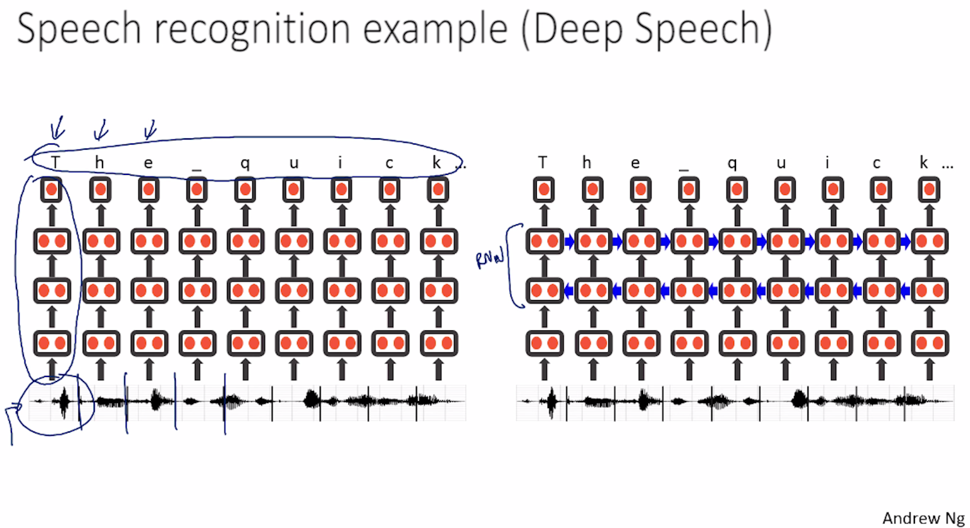
Baidu’s speech recognition using RNN

Slide 44
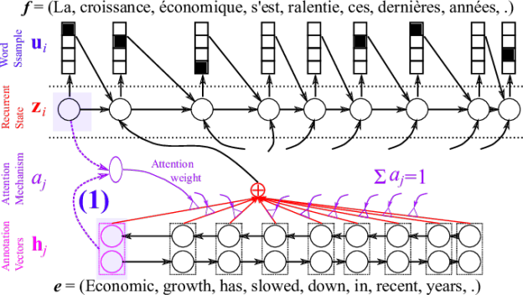
Attention Mechanism in MT

Slide 45

Image caption generation using attention
A vector for each region
z⁰ is initial parameter, it is also learned
match
z⁰
0.7
CNN
filter
filter
filter
filter
filter
filter
filter
filter
filter
filter
filter
filter

Slide 46
Image Caption Generation
Word 1
A vector for each region
z⁰
z¹
Attention to
a region
weighted sum
CNN
filter
filter
filter
filter
filter
filter
0.7
0.1
0.1
0.1
0.0
0.0
filter
filter
filter
filter
filter
filter

Slide 47
Image Caption Generation
Word 1
Word 2
A vector for each region
z²
z⁰
z¹
weighted sum
CNN
filter
filter
filter
filter
filter
filter
0.0
0.8
0.2
0.0
0.0
0.0
filter
filter
filter
filter
filter
filter

Slide 48
Image Caption Generation
Kelvin Xu, Jimmy Ba, Ryan Kiros, Kyunghyun Cho, Aaron Courville, Ruslan Salakhutdinov, Richard Zemel, Yoshua Bengio, “Show, Attend and Tell: Neural Image Caption Generation with Visual Attention”, ICML, 2015
Notes:
Caption generation story like
How to do story like !!!!!!!!!!!!!!!!!!
http://www.cs.toronto.edu/~mbweb/
https://github.com/ryankiros/neural-storyteller

Slide 49
Image Caption Generation
Kelvin Xu, Jimmy Ba, Ryan Kiros, Kyunghyun Cho, Aaron Courville, Ruslan Salakhutdinov, Richard Zemel, Yoshua Bengio, “Show, Attend and Tell: Neural Image Caption Generation with Visual Attention”, ICML, 2015
Notes:
滑板相關詞
skateboarding
查看全部
skateboard
¹ Dr.eye譯典通
KK [ˋsket͵bord] DJ [ˋskeitbɔ:d]

Slide 50
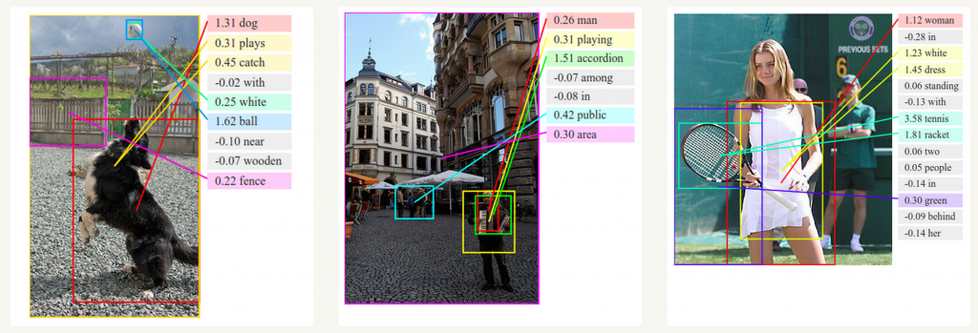
Image Caption Generation
Deep Visual-Semantic Alignments for Generating Image Descriptions. Source: http://cs.stanford.edu/people/karpathy/deepimagesent/Training RNNs

Slide 51
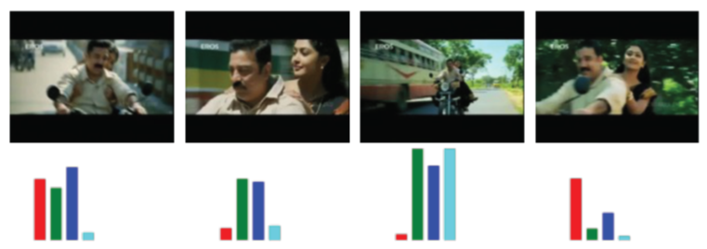
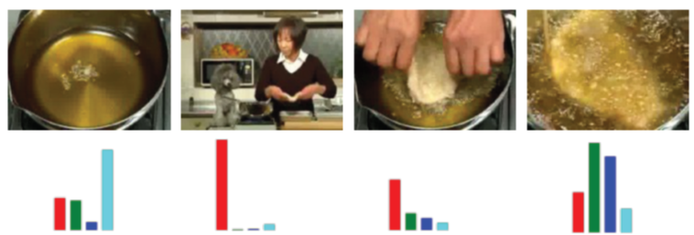

Li Yao, Atousa Torabi, Kyunghyun Cho, Nicolas Ballas, Christopher Pal, Hugo Larochelle, Aaron Courville, “Describing Videos by Exploiting Temporal Structure”, ICCV, 2015
Notes:
Another application is summarization

