Slide 1

Statistical Machine Translation
Università di Pisa
Human Language Technologies
Dipartimento di Informatica
Università di Pisa
Slides from Ray Mooney

Slide 2
What makes a good translation
Translators often talk about two factors we want to maximize:
Faithfulness or fidelity
  How close is the meaning of the translation to the meaning of the original
  Even better: does the translation cause the reader to draw the same inferences as the original would have
Fluency or naturalness
  How natural the translation is, just considering its fluency in the target language

Slide 3
Statistical MT: Faithfulness and Fluency formalized!
Best-translation of a source sentence S:
Developed by researchers who were originally in speech recognition at IBM
Called the IBM model
$$\hat{T}={argmax}_{T}{fluency(T)faithfulness(T,S)}$$

Slide 4
The IBM model
Those two factors might look familiar…
Yup, it’s Bayes rule:
$$\hat{T}={argmax}_{T}{fluency(T)faithfulness(T,S)}$$
$$\hat{T}={argmax}_{T}{P\left(T\right)P(S|T)}$$

Slide 5
More formally
Assume we are translating from a foreign language sentence F to an English sentence E:
  F = f₁, f₂, f₃,…, f_{m}
We want to find the best English sentence
  Ē = e₁, e₂, e₃,…, e_{n}
  Ē = argmax_{E} P(E|F)
  = argmax_{E} P(F|E)P(E)/P(F)
  = argmax_{E} P(F|E)P(E)
Translation Model
Language Model

Slide 6
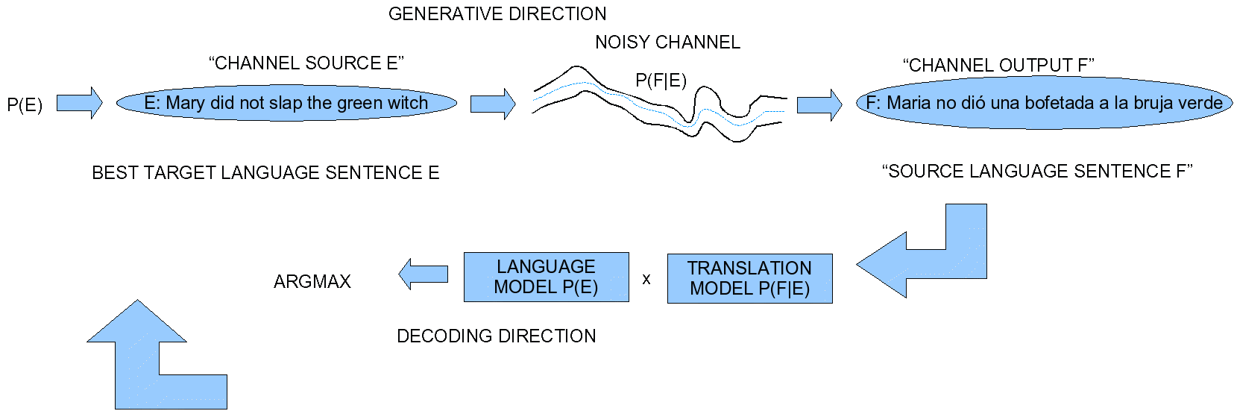
The noisy channel model for MT

Slide 7
Fluency: P(T)
How to measure that this sentence
  That car was almost crash onto me
is less fluent than this one:
  That car almost hit me
Answer: language models (N-grams!)
  For example P(hit|almost) > P(was|almost)
But can use any other more sophisticated model of grammar
Advantage: this is monolingual knowledge!

Slide 8
Faithfulness: P(S|T)
French: ça me plait [that me pleases]
English:
  that pleases me - most fluent
  I like it
  I’ll take that one
How to quantify this?
Intuition: degree to which words in one sentence are plausible translations of words in other sentence
  Product of probabilities that each word in target sentence would generate each word in source sentence.

Slide 9
Faithfulness P(S|T)
Need to know, for every target language word, probability of it mapping to every source language word.
How do we learn these probabilities?
Parallel texts!
  Lots of times we have two texts that are translations of each other
  If we knew which word in Source text mapped to each word in Target text, we could just count!

Slide 10
Faithfulness P(S|T)
Sentence alignment:
  Figuring out which source language sentence maps to which target language sentence
Word alignment
  Figuring out which source language word maps to which target language word

Slide 11
Big Point about Faithfulness and Fluency
Job of the faithfulness model P(S|T) is just to model “bag of words”; which words come from say English to Italian
P(S|T) doesn’t have to worry about internal facts about Italian word order: that’s the job of P(T)
P(T) can do bag generation: put the following words in order (from Kevin Knight)
  have programming a seen never I language better
  actual the hashing is since not collision-free usually the is less perfectly the of somewhat capacity table

Slide 12
P(T) and bag generation: the answer
“Usually the actual capacity of the table is somewhat less, since the hashing is not prefectly collision-free”
How about:
  loves Mary John

Slide 13
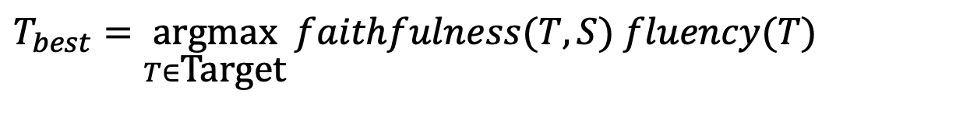
Picking a Good Translation
A good translation should be faithful
  convey information and tone of original source sentence.
A good translation should be fluent
  grammatical and readable in the target language.
Final objective:
$$T_{best}=\underset{T∈\text{Target}}{\text{argmax}} faithfulness(T,S) fluency(T)$$

Slide 14
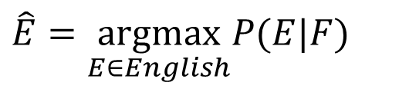
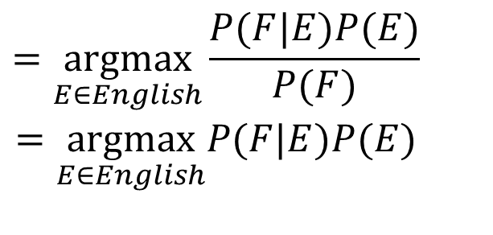
Bayesian Analysis of Noisy Channel
$$\hat{E}=\underset{E∈English}{\text{argmax}}P(E|F)$$
$$\begin{matrix}=\underset{E∈English}{\text{argmax}}\frac{P(F|E)P(E)}{P(F)} \\ =\underset{E∈English}{\text{argmax}}P(F|E)P(E)\end{matrix}$$
Translation Model Language Model
A decoder determines the most probable
translation Ȇ given F

Slide 15
Three Problems for Statistical MT
Language model
  Given an English string e, assigns P(e) by a formula s.t.
  good English string -> high P(e)
  random word sequence -> low P(e)
Translation model
  Given a pair of strings <f, e>, assigns P(f | e) by a formula s.t.
  <f,e> look like translations -> high P(f | e)
  <f,e> don’t look like translations -> low P(f | e)
Decoding algorithm
  Given a language model, a translation model, and a new sentence f … find translation e maximizing P(e) * P(f | e)
Slide from Kevin Knight

Slide 16
The Classic Language Model: Word N-Grams
Goal of the language model -- choose among:
  He is on the soccer field
  He is in the soccer field
  Is table the on cup the
  The cup is on the table
  Rice shrine
  American shrine
  Rice company
  American company
Slide from Kevin Knight

Slide 17
Language Model
Use a standard n-gram language model for P(E).
Can be trained on a large, unsupervised mono-lingual corpus for the target language E.
Could use a more sophisticated PCFG language model to capture long-distance dependencies.
Terabytes of web data have been used to build a large 5-gram model of English.
Slide from Ray Mooney

Slide 18
Phrase Based Machine Translation

Slide 19
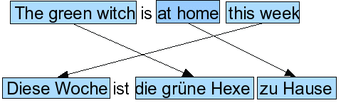
Intuition of phrase-based translation (Koehn et al. 2003)
Generative story has three steps
  Group words into phrases
  Translate each phrase
  Move the phrases around
Slide from Ray Mooney

Slide 20
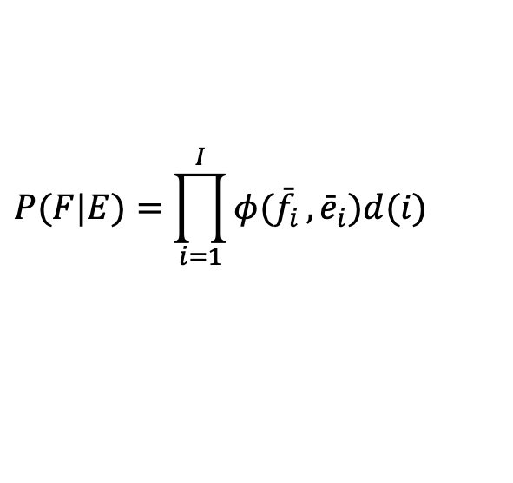
Phrase-Based Translation Model
P(F | E) is modeled by translating phrases in E to phrases in F.
First segment E into a sequence of phrases ē₁,…,ē_{I}
Then translate each phrase ē_{i}, into f_{i}, based on translation probability φ(f_{i} | ē_{i})
Then reorder translated phrases based on distortion probability d(i) for the i-th phrase. (distortion = how far the phrase moved)
$$P(F|E)=\prod_{i=1}^{I}{φ({\bar{f}}_{i}},{\bar{e}}_{i})d(i)$$
Slide from Ray Mooney

Slide 21
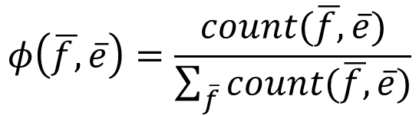
Translation Probabilities
Assuming a phrase aligned parallel corpus is available or constructed that shows matching between phrases in E and F.
Then compute (MLE) estimate of φ based on simple frequency counts:
$$φ\left(\overline{f,}\overline{e}\right)=\frac{count(\overline{f,}\overline{e})}{\sum_{\overline{f}}{count(\overline{f,}\overline{e})}}$$
Slide from Ray Mooney

Slide 22
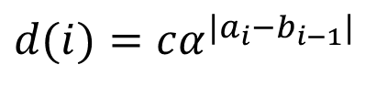
Distortion Probability
A measure of distance between positions of a corresponding phrase in the 2 languages.
“What is the probability that a phrase in position X in the English sentences moves to position Y in the Spanish sentence?”
Measure distortion of phrase i as the distance between the start of the f phrase generated by ē_{i}, (a_{i}) and the end of the f phrase generated by the previous phrase ē_{i-1}, (b_{i-1}).
Typically assume the probability of a distortion decreases exponentially with the distance of the movement.
$$d(i)=cα^{|a_{i}−b_{i−1}|}$$
Set 0<α<1 based on fit to phrase-aligned training data
Then set c to normalize d(i) so it sums to 1.

Slide 23
Sample Translation Model
Position | 1 | 2 | 3 | 4 | 5 | 6
English | Mary | did not | slap | the | green | witch
Spanish | Maria | no | dió una bofetada a | la | bruja | verde
a_{i}−b_{i−1} | 1 | 1 | 1 | 1 | 2 | -1
verde - la
bruja - verde
Slide from Ray Mooney

Slide 24
Phrase-based MT
Language model P(E)
Translation model P(F|E)
  Model
  How to train the model
Decoder: finding the sentence E that is most probable

Slide 25
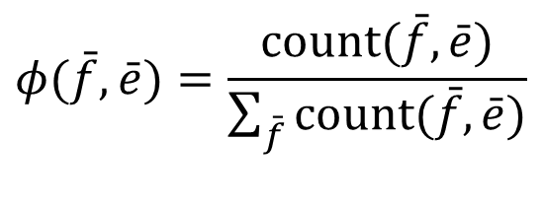
Training P(F|E)
What we mainly need to train is φ(f_{j}|e_{i})
Suppose we had a large bilingual training corpus
  A bitext
  In which each English sentence is paired with a Spanish sentence
And suppose we knew exactly which phrase in Spanish was the translation of which phrase in the English
We call this a phrase alignment
If we had this, we could just count-and-divide:
$$φ(\bar{f},\bar{e})=\frac{\text{count}(\bar{f},\bar{e})}{\sum_{\bar{f}}{\text{count}(\bar{f},\bar{e})}}$$

Slide 26
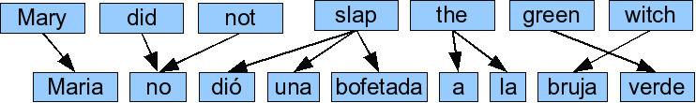
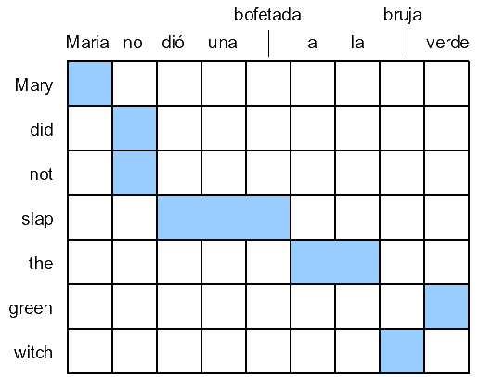
But we don’t have phrase alignments
What we have instead are word alignments:
(actually the word alignments we have are more restricted than this, as we’ll see in two slides)

Slide 27
Getting phrase alignments
To get phrase alignments:
  We first get word alignments
  Then we “symmetrize” the word alignments into phrase alignments

Slide 28
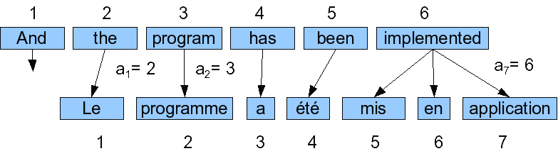
How to get Word Alignments
Word alignment: a mapping between the source words and the target words in a set of parallel sentences.
Restriction: each foreign word comes from exactly one English word
Advantage: represent an alignment by the index of the English word that the French word comes from
Alignment above is thus 2,3,4,5,6,6,6

Slide 29
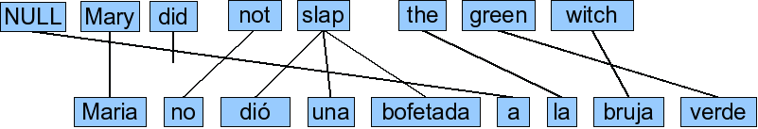
One addition: spurious words
A word in the foreign sentence that does not align with any word in the English sentence is called a spurious word.
We model these by pretending they are generated by an English word e₀:

Slide 30
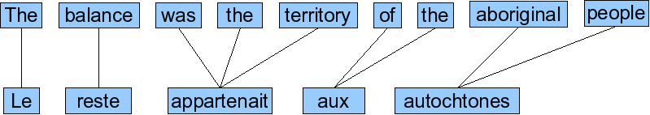
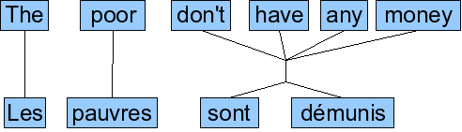
More sophisticated models of alignment

Slide 31
One to Many Alignment
To simplify the problem, typically assume each word in F aligns to 1 word in E (but assume each word in E may generate more than one word in F).
Some words in F may be generated by the NULL element of E.
Therefore, alignment can be specified by a vector A giving, for each word in F, the index of the word in E which generated it.
0 1 2 3 4 5 6
NULL Mary didn’t slap the green witch.
Maria no dió una bofetada a la bruja verde.
1 2 3 3 3 0 4 6 5

Slide 32
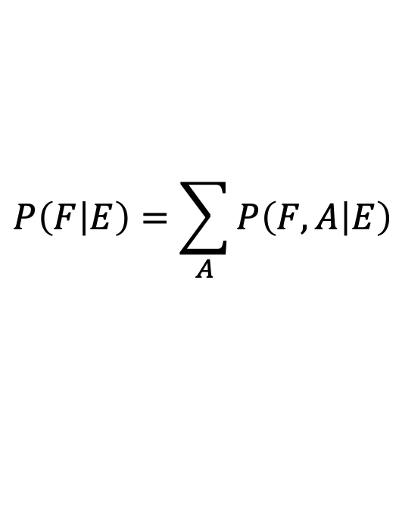
Computing word alignments: IBM Model 1
For phrase-based machine translation:
  We need a word-alignment
  To extract a set of phrases
A word alignment model gives us P(F,E)
We want this to train our phrase probabilities φ(f_{j}|e_{i}) as part of P(F|E)
A word-alignment model allows to compute the translation probability P(F|E) by summing the probabilities of all possible (l +1)^{m} ‘hidden’ alignments A between F and E:
$$P\left(F | E\right)=\sum_{A}{P\left(F,A | E\right)}$$

Slide 33
IBM Model 1
First model proposed in seminal paper by Brown et al. in 1993 as part of CANDIDE, the first complete SMT system.
Assumes following simple generative model of producing F from E = e₁, e₂, …e_{I}
  Choose length, J, of F sentence: F = f₁, f₂, …f_{J}
  Choose a 1 to many alignment A = a₁, a₂, …a_{J}
  For each position in F, generate a word f_{j} from the aligned word in E: e_{aj}
Slide from Ray Mooney

Slide 34
Sample IBM Model 1 Generation
0 1 2 3 4 5 6
NULL Mary didn’t slap the green witch.
Maria
no
dió
una
bofetada
a
la
bruja
verde.
1 2 3 3 3 0 4 6 5
Slide from Ray Mooney

Slide 35
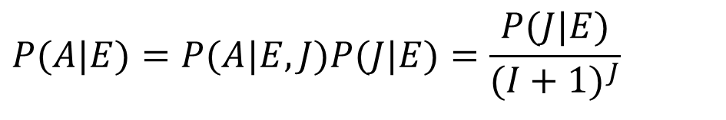
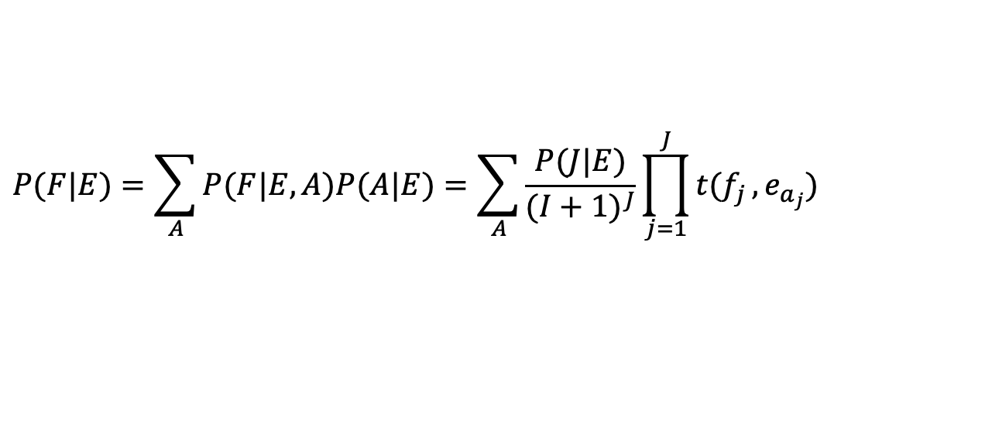
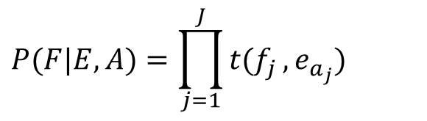
Computing P(F|E) in IBM Model 1
Assume some length distribution P(J | E)
Assume all alignments are equally likely. Since there are (I + 1)^{J} possible alignments:
$$P(A|E)=P(A|E,J)P(J|E)=\frac{P(J|E)}{(I+1)^{J}}$$
Assume t(f_{x},e_{y}) is the probability of translating e_{y} as f_{x}, therefore:
$$P(F|E,A)=\prod_{j=1}^{J}{t(f_{j}},e_{a_{j}})$$
Determine P(F | E) by summing over all alignments:
$$P(F|E)=\sum_{A}{P(F|E,A)P(A|E)}=\sum_{A}{\frac{P(J|E)}{(I+1)^{J}}}\prod_{j=1}^{J}{t(f_{j}},e_{a_{j}})$$

Slide 36
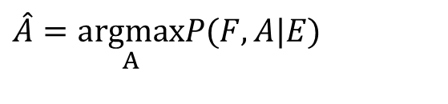
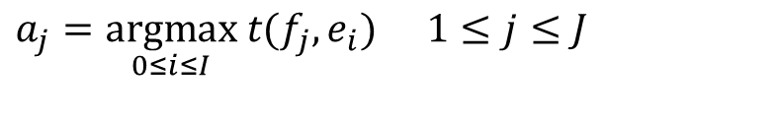
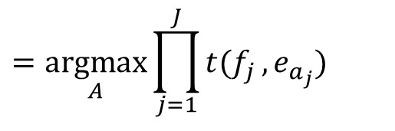
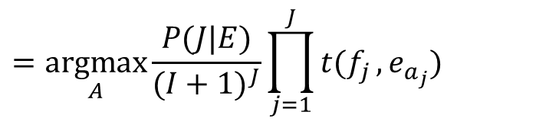
Decoding for IBM Model 1
Goal is to find the most probable alignment given a parameterized model.
$$\hat{A}=\underset{A}{\text{argmax}}P(F,A|E)$$
$$=\underset{A}{\text{argmax}}\frac{P(J|E)}{(I+1)^{J}}\prod_{j=1}^{J}{t(f_{j}},e_{a_{j}})$$
$$=\underset{A}{\text{argmax}}\prod_{j=1}^{J}{t(f_{j}},e_{a_{j}})$$
Since translation choice for each position j is independent,
the product is maximized by maximizing each term:
$$\begin{matrix}a_{j}=\underset{0≤i≤I}{\text{argmax}} t(f_{j},e_{i}) & 1≤j≤J\end{matrix}$$

Slide 37
Training alignment probabilities
Step 1: get a parallel corpus
  Hansards
    Canadian parliamentary proceedings, in French and English
    Hong Kong Hansards: English and Chinese
  Europarl
Step 2: sentence alignment
Step 3: use EM (Expectation Maximization) to train word alignments

Slide 38
Step 1: Parallel corpora
Example from DE-News (8/1/1996)
English | German
Diverging opinions about planned tax reform | Unterschiedliche Meinungen zur geplanten Steuerreform
The discussion around the envisaged major tax reform continues . | Die Diskussion um die vorgesehene grosse Steuerreform dauert an .
The FDP economics expert , Graf Lambsdorff , today came out in favor of advancing the enactment of significant parts of the overhaul , currently planned for 1999 . | Der FDP - Wirtschaftsexperte Graf Lambsdorff sprach sich heute dafuer aus , wesentliche Teile der fuer 1999 geplanten Reform vorzuziehen .
Slide from Christof Monz

Slide 39
Step 2: Sentence Alignment
The old man is happy. He has fished many times. His wife talks to him. The fish are jumping. The sharks await.
Intuition:
- use length in words or chars
- together with dynamic programming
- or use a simpler MT model
El viejo está feliz porque ha pescado muchos veces. Su mujer habla con él. Los tiburones esperan.
Slide from Kevin Knight

Slide 40
Sentence Alignment
The old man is happy.
He has fished many times.
His wife talks to him.
The fish are jumping.
The sharks await.
El viejo está feliz porque ha pescado muchos veces.
Su mujer habla con él.
Los tiburones esperan.
Slide from Kevin Knight

Slide 41
Sentence Alignment
The old man is happy.
He has fished many times.
His wife talks to him.
The fish are jumping.
The sharks await.
El viejo está feliz porque ha pescado muchos veces.
Su mujer habla con él.
Los tiburones esperan.
Slide from Kevin Knight

Slide 42
Sentence Alignment
The old man is happy. He has fished many times.
His wife talks to him.
The sharks await.
El viejo está feliz porque ha pescado muchos veces.
Su mujer habla con él.
Los tiburones esperan.
Note that unaligned sentences are thrown out, and
sentences are merged in n-to-m alignments (n, m > 0).
Slide from Kevin Knight

Slide 43
Step 3: word alignments
We can bootstrap alignments from a sentence-aligned bilingual corpus
using the Expectation-Maximization (EM) algorithm

Slide 44
EM for training alignment probs
… la maison … la maison bleue … la fleur …
… the house … the blue house … the flower …
All word alignments equally likely
All P(french-word | english-word) equally likely
Slide from Kevin Knight

Slide 45
EM for training alignment probs
… la maison … la maison bleue … la fleur …
… the house … the blue house … the flower …
“la” and “the” observed to co-occur frequently,
so P(la | the) is increased.
Slide from Kevin Knight

Slide 46
EM for training alignment probs
… la maison … la maison bleue … la fleur …
… the house … the blue house … the flower …
“house” co-occurs with both “la” and “maison”, but
P(maison | house) can be raised without limit, to 1.0,
while P(la | house) is limited because of “the”
(pigeonhole principle)
Slide from Kevin Knight

Slide 47
EM for training alignment probs
… la maison … la maison bleue … la fleur …
… the house … the blue house … the flower …
settling down after another iteration
Slide from Kevin Knight

Slide 48
EM for training alignment probs
… la maison … la maison bleue … la fleur …
… the house … the blue house … the flower …
Inherent hidden structure revealed by EM training!
Slide from Kevin Knight

Slide 49
EM Algorithm for Word Alignment
Randomly set model parameters.
(making sure they represent legal distributions)
Until converge (i.e. parameters no longer change) do:
E Step: Compute the probability of all possible
alignments of the training data using the current model.
M Step: Use these alignment probability estimates to
re-estimate values for all of the parameters.
Note: Use dynamic programming (as in Baum-Welch)
to avoid explicitly enumerating all possible alignments
Notes:
49

Slide 50
IBM Model 1 and EM

Slide 51
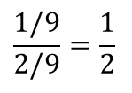
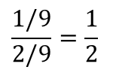
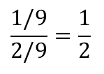
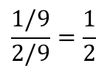
Sample EM Trace for Alignment
Training
Corpus
green house
casa verde
the house
la casa
 | verde | casa | la
green | 1/3 | 1/3 | 1/3
house | 1/3 | 1/3 | 1/3
the | 1/3 | 1/3 | 1/3
Translation
Probabilities
Assume uniform
initial probabilities
Compute
Alignment
Probabilities
P(a, f | e)
green house
casa verde
green house
casa verde
the house
la casa
the house
la casa
1/3 x 1/3 = 1/9
1/3 x 1/3 = 1/9
1/3 x 1/3 = 1/9
1/3 x 1/3 = 1/9
Normalize
to get
P(a, f | e)
$$\frac{1/9}{2/9}=\frac{1}{2}$$
$$\frac{1/9}{2/9}=\frac{1}{2}$$
$$\frac{1/9}{2/9}=\frac{1}{2}$$
$$\frac{1/9}{2/9}=\frac{1}{2}$$
Slide from Ray Mooney

Slide 52
Example cont.
green house
casa verde
green house
casa verde
the house
la casa
the house
la casa
1/2
1/2
1/2
1/2
Compute
weighted
translation
counts
 | verde | casa | la
green | 1/2 | 1/2 | 0
house | 1/2 | 1/2 + 1/2 | 1/2
the | 0 | 1/2 | 1/2
Normalize
rows to sum
to one to
estimate P(f | e)
 | verde | casa | la
green | 1/2 | 1/2 | 0
house | 1/4 | 1/2 | 1/4
the | 0 | 1/2 | 1/2
Slide from Ray Mooney

Slide 53
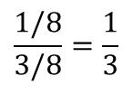
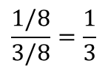
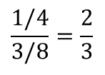
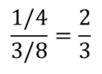
Example cont.
 | verde | casa | la
green | 1/2 | 1/2 | 0
house | 1/2 | 1/2 + 1/2 | 1/2
the | 0 | 1/2 | 1/2
Translation
Probabilities
Recompute
Alignment
Probabilities
P(a, f | e)
green house
casa verde
green house
casa verde
the house
la casa
the house
la casa
1/2 x 1/4=1/8
1/2 x 1/2=1/4
1/2 x 1/2=1/4
1/2 x 1/4=1/8
Normalize
to get
P(a, f | e)
$$\frac{1/8}{3/8}=\frac{1}{3}$$
$$\frac{1/4}{3/8}=\frac{2}{3}$$
$$\frac{1/4}{3/8}=\frac{2}{3}$$
$$\frac{1/8}{3/8}=\frac{1}{3}$$
Continue EM iterations until translation
parameters converge
Slide from Ray Mooney

Slide 54
IBM Model 1 and EM Algorithm
  initialize t(e|f) uniformly
  repeat
    set count(e|f) to 0 for all e, f
    set total(f) to 0 for all f
    for all sentence pairs (e_s, f_s)
    for all words e in e_s
    total_s = 0
    for all words f in f_s
    total_s += t(e|f)
    for all words e in e_s
    for all words f in f_s
    count(e|f) += t(e|f) / total_s
    total(f) += t(e|f) / total_s
    for all f in domain( total(.) )
    for all e in domain( count(.|f) )
    t(e|f) = count(e|f) / total(f)
  until convergence

Slide 55
Higher IBM Models
IBM Model 1 | lexical translation
IBM Model 2 | adds absolute reordering model
IBM Model 3 | adds fertility model
IBM Model 4 | relative reordering model
Only IBM Model 1 has global maximum
  training of a higher IBM model builds on previous model
Computationally biggest change in Model 3
  exhaustive count collection becomes computationally too expensive
  sampling over high probability alignments is used instead

Slide 56
Phrase-based Translation Model

Slide 57
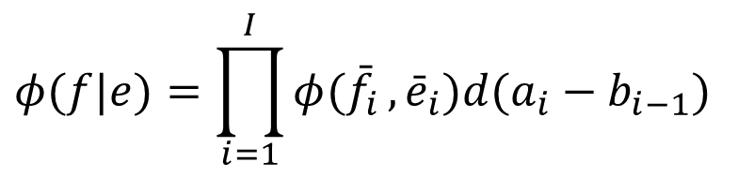
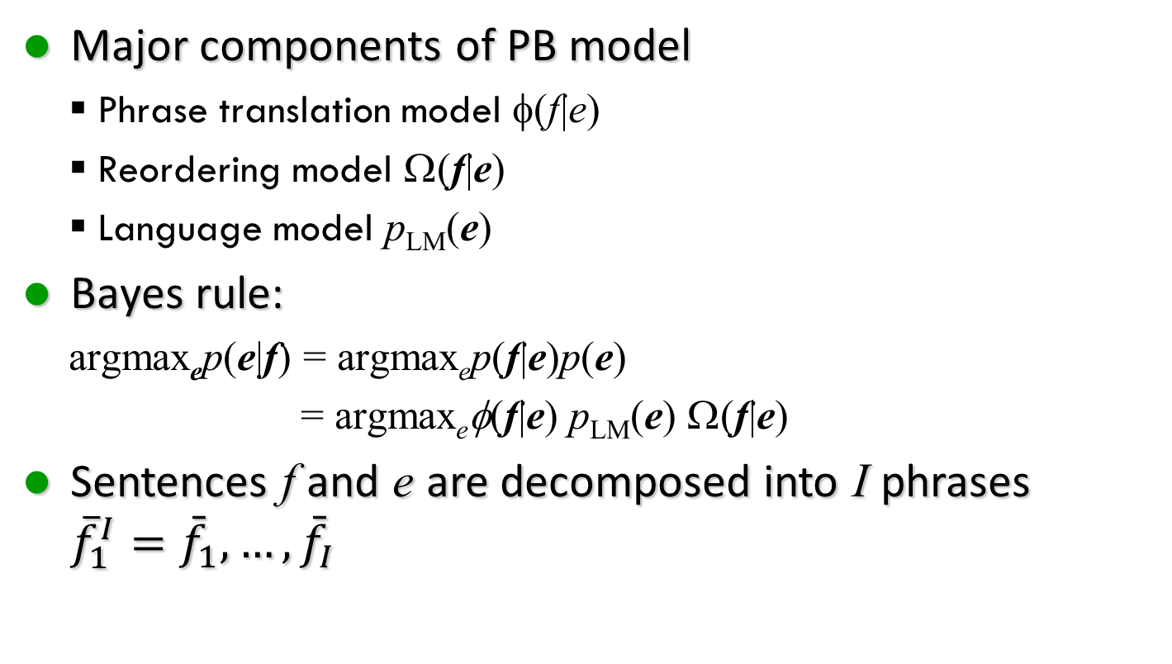
Phrase-based Translation Model
Major components of PB model
  Phrase translation model φ(f|e)
  Reordering model Ω(f|e)
  Language model p_{LM}(e)
Bayes rule:
  argmax_{e}p(e|f) = argmax_{e}p(f|e)p(e)
  = argmax_{e}φ(f|e) p_{LM}(e) Ω(f|e)
Sentences f and e are decomposed into I phrases ${{\overline{f}}_{1}^{I}=\bar{f}}_{1},…,{\bar{f}}_{I}$
$$φ(f|e)=\prod_{i=1}^{I}{φ({\bar{f}}_{i}},{\bar{e}}_{i})d(a_{i}−b_{i−1})$$

Slide 58
Benefits of PBMT
Many-to-many translation can handle non-compositional phrases
Use of local context in translation
The more data, the longer phrases can be learned

Slide 59
Phrase Translation Table
Phrase translations for den Vorschlag
English | φ(e|f) | English | φ(e|f)
the proposal | 0.6227 | the suggestions | 0.0114
's proposal | 0.1068 | the proposed | 0.0114
a proposal | 0.0341 | the motion | 0.0091
the idea | 0.025 | the idea of | 0.0091
this proposal | 0.0227 | the proposal , | 0.0068
proposal | 0.0205 | its proposal | 0.0068
of the proposal | 0.0159 | it | 0.0068
the proposals | 0.0159 | ... | ...

Slide 60
Phrase Alignment

Slide 61
Phrase Alignments from Word Alignments
Alignment algorithms produce one to many word translations
We know that words do not map one-to-one in translations
Better to map ‘phrases’, i.e. sequences of words, to phrases and probabilistically reorder them in translation
Combine E→F and F →E word alignments to produce a phrase alignment

Slide 62
Phrase Alignment Example
Spanish to English
 | Maria | no | dio | una | bofetada | a | la | bruja | verde
Mary
did
not
slap
the
green
witch
Slide from Ray Mooney

Slide 63
Phrase Alignment Example
English to Spanish
 | Maria | no | dio | una | bofetada | a | la | bruja | verde
Mary
did
not
slap
the
green
witch
Slide from Ray Mooney

Slide 64
Phrase Alignment Example
Intersection
 | Maria | no | dio | una | bofetada | a | la | bruja | verde
Mary
did
not
slap
the
green
witch
Slide from Ray Mooney

Slide 65
Symmetrizing
Add alignments from union to intersection
to produce a consistent phrase alignment
 | Maria | no | dio | una | bofetada | a | la | bruja | verde
Mary
did
not
slap
the
green
witch
Slide from Ray Mooney

Slide 66
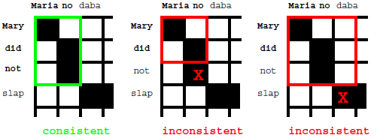
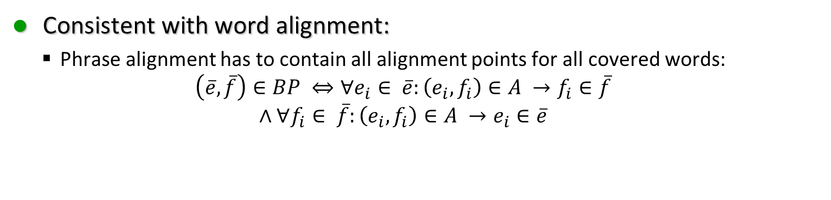
Consistent with word alignment
Consistent with word alignment:
  Phrase alignment has to contain all alignment points for all covered words:
  $$\left(\overline{e},\overline{f}\right)∈BP ⇔∀e_{i}∈ \overline{e}:\left(e_{i},f_{i}\right)∈A →f_{i}∈\overline{f}$$
  $$∧∀f_{i}∈ \overline{f}:\left(e_{i},f_{i}\right)∈A →e_{i}∈\overline{e}$$

Slide 67
Word Alignment Induced Phrases
 | Maria | no | dio | una | bofetada | a | la | bruja | verde
Mary
did
not
slap
the
green
witch
(Maria no, Mary did not), (no dio una bofetada, did not slap), (dio una bofetada a la, slap the), (bruja verde, green witch)
(Maria no dio una bofetada, Mary did not), (no dio una bofetada a la, did not slap the), (a la bruja verde, the green witch)

Slide 68
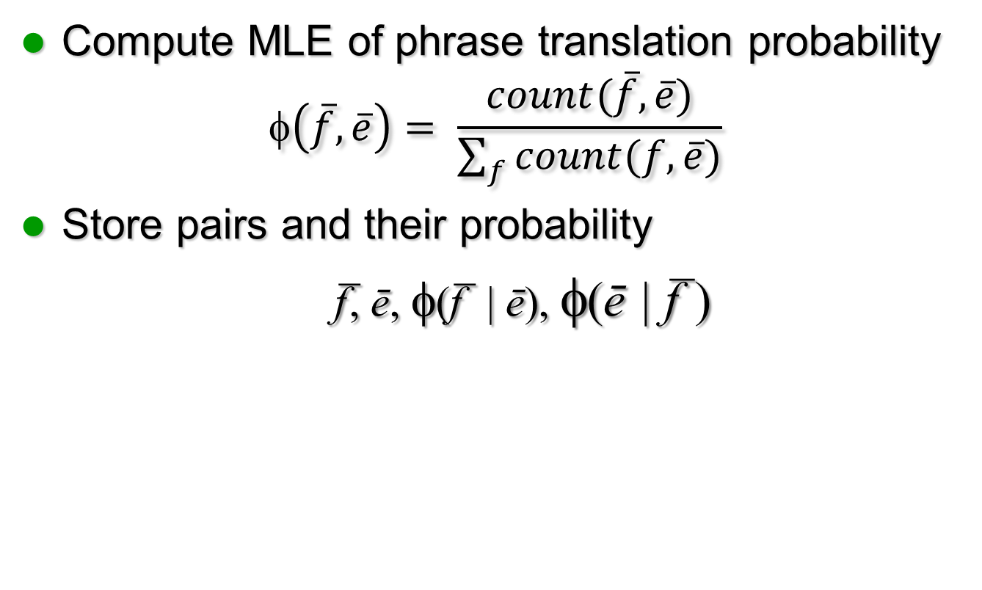
Phrase Translation Table

Slide 69
Sample phrase table from Moses (en-it)
f e φ(f|e) lex(f|e) φ(e|f) lex(e|f) Alignments (F-E)
! it definitively correct that ||| , che conferma ||| 0.0136986 5.6952e-07 1 4.68166e-17 ||| 0-0 4-1 1-2 ||| 73 1
! it depends ||| sono solo ||| 0.00107991 2.85796e-05 1 5.63319e-11 ||| 1-0 2-1 ||| 926 1
! it does not bode at all ||| , che non lascia presagire nulla di ||| 1 2.58282e-09 0.5 1.60281e-13 ||| 0-0 1-1 2-2 3-2 4-3 4-4 4-5 5-5 6-5 ||| 1 2
! it does not bode at all ||| , che non lascia presagire nulla ||| 1 2.20735e-08 0.5 1.60281e-13 ||| 0-0 1-1 2-2 3-2 4-3 4-4 4-5 5-5 6-5 ||| 1 2
! it does not ||| , che non ||| 0.000334448 0.000259527 1 1.16381e-08 ||| 0-0 1-1 2-2 3-2 ||| 2990 1
! it has become a ||| , che è diventata una ||| 0.2 6.20953e-07 1 3.72893e-08 ||| 0-0 1-1 1-2 2-2 3-3 4-4 ||| 5 1
! it has become ||| , che è diventata ||| 0.0588235 2.67744e-06 1 7.12714e-08 ||| 0-0 1-1 1-2 2-2 3-3 ||| 17 1
! it has not been implemented yet ||| e non è ancora stato applicato ||| 1 3.69476e-07 1 1.233e-10 ||| 0-0 3-1 1-2 2-2 6-3 4-4 5-5 ||| 1 1
! it has not ||| e non è ||| 0.000823045 0.000251293 1 4.8038e-08 ||| 0-0 3-1 1-2 2-2 ||| 1215 1
! it has ||| ! ||| 5.86751e-05 0.755472 0.5 1.82129e-05 ||| 0-0 ||| 17043 2
! it has ||| , che è ||| 0.000127307 7.00774e-05 0.5 1.41342e-07 ||| 0-0 1-1 1-2 2-2 ||| 7855 2
' access to cheap medicines ||| di accedere a farmaci a basso prezzo ||| 1 2.18888e-07 1 5.95807e-07 ||| 0-0 2-0 1-1 2-2 4-3 3-4 3-5 3-6 ||| 1 1
' access to credit ||| l' accesso al credito da parte ||| 1 5.13669e-09 0.333333 2.9826e-05 ||| 0-0 1-0 1-1 2-2 3-3 ||| 1 3
' access to credit ||| l' accesso al credito da ||| 1 2.01676e-06 0.333333 2.9826e-05 ||| 0-0 1-0 1-1 2-2 3-3 ||| 1 3
' access to credit ||| l' accesso al credito ||| 0.030303 0.000396314 0.333333 2.9826e-05 ||| 0-0 1-0 1-1 2-2 3-3 ||| 33 3
' access to satellite TV , ||| canali censurati ||| 0.166667 2.4734e-10 0.5 1.35061e-17 ||| 0-1 ||| 6 2

Slide 70
Decoding

Slide 71
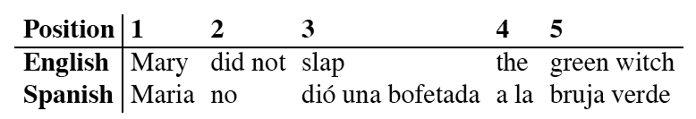
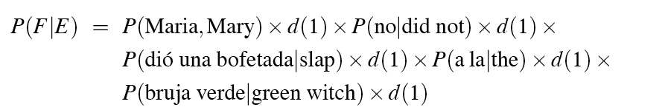
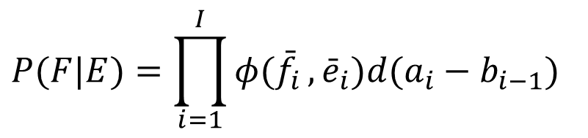
Translation model for PBMT
$$P(F|E)=\prod_{i=1}^{I}{φ({\bar{f}}_{i}},{\bar{e}}_{i})d(a_{i}−b_{i−1})$$
Let’s look at a simple example with no distortion

Slide 72
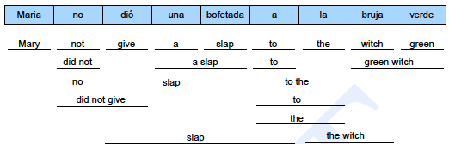
Translation Options
Look up possible phrase translations
  many different ways to segment words into phrases
  many different ways to translate each phrase

Slide 73
Hypothesis Expansion
e:
f: ---
p: 1
Start with empty hypothesis
  e: no English words
  f: no foreign words covered
  p: probability 1

Slide 74
Hypothesis Expansion
Maria | no |  | dió |  |  | una |  | bofetada |  |  | a |  |  | la |  |  | bruja |  | verde
Mary |  | not |  |  | give |  | a |  | slap |  |  | to |  |  | the |  |  | witch |  | green
 | did not |  |  |  |  | a slap |  |  |  |  |  |  | by |  |  |  | green witch
 | no |  |  | slap |  |  |  |  |  |  | to the
 | did not give |  |  |  |  |  |  |  |  |  | to
 |  |  | slap |  |  |  |  |  |  |  |  |  |  |  |  | the witch
e:
f: ---------
p: 1
e: Mary
f: *--------
p: .534
Pick translation option
Create hypothesis
  e: add English phrase Mary
  f: first foreign word covered
  p: 0.534

Slide 75
Hypothesis Expansion
Maria | no |  | dió |  |  | una |  | bofetada |  |  | a |  |  | la |  |  | bruja |  | verde
Mary |  | not |  |  | give |  | a |  | slap |  |  | to |  |  | the |  |  | witch |  | green
 | did not |  |  |  |  | a slap |  |  |  |  |  |  | by |  |  |  | green witch
 | no |  |  | slap |  |  |  |  |  |  | to the
 | did not give |  |  |  |  |  |  |  |  |  | to
 |  |  | slap |  |  |  |  |  |  |  |  |  |  |  |  | the witch
e:
f: ---------
p: 1
e: witch
f: -------*-
p: .182
e: Mary
f: *--------
p: .534
Add another hypothesis

Slide 76
Hypothesis Expansion
Maria | no |  | dió |  |  | una |  | bofetada |  |  | a |  |  | la |  |  | bruja |  | verde
Mary |  | not |  |  | give |  | a |  | slap |  |  | to |  |  | the |  |  | witch |  | green
 | did not |  |  |  |  | a slap |  |  |  |  |  |  | by |  |  |  | green witch
 | no |  |  | slap |  |  |  |  |  |  | to the
 | did not give |  |  |  |  |  |  |  |  |  | to
 |  |  | slap |  |  |  |  |  |  |  |  |  |  |  |  | the witch
e:
f: ---------
p: 1
e: witch
f: -------*-
p: .182
e: Mary
f: *--------
p: .534
e: slap
f: *-**----
p: .043
Add further hypothesis

Slide 77
Hypothesis Expansion
Maria | no |  | dió |  |  | una |  | bofetada |  |  | a |  |  | la |  |  | bruja |  | verde
Mary |  | not |  |  | give |  | a |  | slap |  |  | to |  |  | the |  |  | witch |  | green
 | did not |  |  |  |  | a slap |  |  |  |  |  |  | by |  |  |  | green witch
 | no |  |  | slap |  |  |  |  |  |  | to the
 | did not give |  |  |  |  |  |  |  |  |  | to
 |  |  | slap |  |  |  |  |  |  |  |  |  |  |  |  | the witch
e:
f: ---------
p: 1
e: witch
f: -------*-
p: .182
e: slap
f: *-**----
p: .043
e: Mary
f: *--------
p: .534
e: did not
f: **------
p: .043
e: slap
f: *****--
p: .015
e: the
f: ******--
p: .0942
e: green witch
f: ********
p: .0027
... until all foreign words covered
  and best hypothesis that covers all foreign words
  backtrack to read translation

Slide 78
Hypothesis Expansion
Maria | no |  | dió |  |  | una |  | bofetada |  |  | a |  |  | la |  |  | bruja |  | verde
Mary |  | not |  |  | give |  | a |  | slap |  |  | to |  |  | the |  |  | witch |  | green
 | did not |  |  |  |  | a slap |  |  |  |  |  |  | by |  |  |  | green witch
 | no |  |  | slap |  |  |  |  |  |  | to the
 | did not give |  |  |  |  |  |  |  |  |  | to
 |  |  | slap |  |  |  |  |  |  |  |  |  |  |  |  | the witch
e:
f: ---------
p: 1
e: witch
f: -------*-
p: .182
e: slap
f: *-**----
p: .043
e: Mary
f: *--------
p: .534
e: did not
f: **------
p: .043
e: slap
f: *****--
p: .015
e: the
f: ******--
p: .0942
e: green witch
f: ********
p: .0027
Adding more hypothesis
Explosion of search space

Slide 79
Explosion of search space
Number of hypotheses is exponential with respect to sentence length
Decoding is NP-complete [Knight, 1999]
Need to reduce search space
  risk free: hypothesis recombination
  risky: histogram/threshold pruning

Slide 80
Hypothesis Recombination
Different paths to the same translation

Slide 81
Hypothesis Recombination
Different paths to the same partial translation
Combine paths
  drop weaker path
  keep pointer from weaker path (for lattice generation)

Slide 82
Hypothesis Recombination
Recombined hypotheses do not have to match completely
No matter what is added, weaker path can be dropped, if:
  last two English words match (matters for language model)
  foreign word coverage vectors match (affects future path)

Slide 83
Hypothesis Recombination
Recombined hypotheses do not have to match completely
No matter what is added, weaker path can be dropped, if:
  last two English words match (matters for language model)
  foreign word coverage vectors match (affects future path)
Combine paths

Slide 84
Pruning
Hypothesis recombination is not sufficient
  Heuristically discard weak hypotheses early
Organize Hypothesis in stacks, e.g. by
  same foreign words covered
  same number of foreign words covered
  same number of English words produced
Compare hypotheses in stacks, discard bad ones
  histogram pruning: keep top n hypotheses in each stack (e.g., n=100)
  threshold pruning: keep hypotheses that are at most times the cost of best hypothesis in stack (e.g., = 0.001)

Slide 85
Hypothesis Stack
Organization of hypothesis into stacks
  here: based on number of foreign words translated
  during translation all hypotheses from one stack are expanded
  expanded Hypotheses are placed into stacks

Slide 86
Comparing Hypothesis
Comparing hypotheses with same number of foreign words covered
Hypothesis that covers easy part of sentence is preferred
Need to consider future cost of uncovered parts

Slide 87
Future Cost Estimation: Step 2
a la
to the
Estimate cost to translate remaining part of input
Step 1: estimate future cost for each translation option
  look up translation model cost
  estimate language model cost (no prior context)
  ignore reordering model cost
→ LM * TM = p(to) * p(the|to) * p(to the|a la)

Slide 88
Future Cost Estimation: Step 2
a la
to the
cost: 0.0372
to
cost: 0.0299
the
cost: 0.0354
Step 2: find cheapest cost among translation options

Slide 89
Future Cost Estimation: Step 3
Step 3: find cheapest future cost path for each span
  can be done efficiently by dynamic programming
  future cost for every span can be pre-computed

Slide 90
Application
Use future cost estimates when pruning hypotheses
For each uncovered contiguous span:
  look up future costs for each maximal contiguous uncovered span
  add to actually accumulated cost for translation option for pruning

Slide 91
Limits on Reordering
Reordering may be limited
  Monotone Translation: No reordering at all
  Only phrase movements of at most n words
Reordering limits speed up search (polynomial instead of exponential)
Current reordering models are weak, so limits improve translation quality

Slide 92
Sample N-Best List
Translation ||| Reordering LM TM WordPenalty ||| Score
this is a small house ||| 0 -27.0908 -1.83258 -5 ||| -28.9234
this is a little house ||| 0 -28.1791 -1.83258 -5 ||| -30.0117
it is a small house ||| 0 -27.108 -3.21888 -5 ||| -30.3268
it is a little house ||| 0 -28.1963 -3.21888 -5 ||| -31.4152
this is an small house ||| 0 -31.7294 -1.83258 -5 ||| -33.562
it is an small house ||| 0 -32.3094 -3.21888 -5 ||| -35.5283
this is an little house ||| 0 -33.7639 -1.83258 -5 ||| -35.5965
this is a house small ||| -3 -31.4851 -1.83258 -5 ||| -36.3176
this is a house little ||| -3 -31.5689 -1.83258 -5 ||| -36.4015
it is an little house ||| 0 -34.3439 -3.21888 -5 ||| -37.5628
it is a house small ||| -3 -31.5022 -3.21888 -5 ||| -37.7211
this is an house small ||| -3 -32.8999 -1.83258 -5 ||| -37.7325
it is a house little ||| -3 -31.586 -3.21888 -5 ||| -37.8049
this is an house little ||| -3 -32.9837 -1.83258 -5 ||| -37.8163
the house is a little ||| -7 -28.5107 -2.52573 -5 ||| -38.0364
the is a small house ||| 0 -35.6899 -2.52573 -5 ||| -38.2156

Slide 93
Evaluation

Slide 94
Evaluating MT
Human subjective evaluation is the best but is time-consuming and expensive.
Automated evaluation comparing the output to multiple human reference translations is cheaper and correlates with human judgements.
Slide from Ray Mooney

Slide 95
Human Evaluation of MT
Ask humans to estimate MT output on several dimensions.
  Fluency: Is the result grammatical, understandable, and readable in the target language.
  Fidelity: Does the result correctly convey the information in the original source language.
    Adequacy: Human judgment on a fixed scale.
      Bilingual judges given source and target language.
      Monolingual judges given reference translation and MT result.
    Informativeness: Monolingual judges must answer questions about the source sentence given only the MT translation (task-based evaluation).
Slide from Ray Mooney

Slide 96
Computer-Aided Translation Evaluation
Edit cost: Measure the number of changes that a human translator must make to correct the MT output.
  Number of words changed
  Amount of time taken to edit
  Number of keystrokes needed to edit
Slide from Ray Mooney

Slide 97
Automatic Evaluation of MT
Collect one or more human reference translations of the source.
Compare MT output to these reference translations.
Score result based on similarity to the reference translations.
  BLEU
  NIST
  TER
  METEOR
Slide from Ray Mooney

Slide 98
BLEU
Determine number of n-grams of various sizes that the MT output shares with the reference translations.
Compute a modified precision measure of the n-grams in MT result.
Slide from Ray Mooney

Slide 99
Multiple Reference Translations
Reference translation 1:
The U.S. island of Guam is maintaining a high state of alert after the Guam airport and its offices both received an e-mail from someone calling himself the Saudi Arabian Osama bin Laden and threatening a biological/chemical attack against public places such as the airport .
Reference translation 1:
The U.S. island of Guam is maintaining a high state of alert after the Guam airport and its offices both received an e-mail from someone calling himself the Saudi Arabian Osama bin Laden and threatening a biological/chemical attack against public places such as the airport .
Reference translation 2:
Guam International Airport and its offices are maintaining a high state of alert after receiving an e-mail that was from a person claiming to be the wealthy Saudi Arabian businessman Bin Laden and that threatened to launch a biological and chemical attack on the airport and other public places .
Reference translation 2:
Guam International Airport and its offices are maintaining a high state of alert after receiving an e-mail that was from a person claiming to be the wealthy Saudi Arabian businessman Bin Laden and that threatened to launch a biological and chemical attack on the airport and other public places .
Machine translation:
The American [?] international airport and its the office all receives one calls self the sand Arab rich business [?] and so on electronic mail , which sends out ; The threat will be able after public place and so on the airport to start the biochemistry attack , [?] highly alerts after the maintenance.
Machine translation:
The American [?] international airport and its the office all receives one calls self the sand Arab rich business [?] and so on electronic mail , which sends out ; The threat will be able after public place and so on the airport to start the biochemistry attack , [?] highly alerts after the maintenance.
Reference translation 3:
The US International Airport of Guam and its office has received an email from a self-claimed Arabian millionaire named Laden , which threatens to launch a biochemical attack on such public places as airport . Guam authority has been on alert .
Reference translation 3:
The US International Airport of Guam and its office has received an email from a self-claimed Arabian millionaire named Laden , which threatens to launch a biochemical attack on such public places as airport . Guam authority has been on alert .
Reference translation 4:
US Guam International Airport and its office received an email from Mr. Bin Laden and other rich businessman from Saudi Arabia . They said there would be biochemistry air raid to Guam Airport and other public places . Guam needs to be in high precaution about this matter .
Reference translation 4:
US Guam International Airport and its office received an email from Mr. Bin Laden and other rich businessman from Saudi Arabia . They said there would be biochemistry air raid to Guam Airport and other public places . Guam needs to be in high precaution about this matter .
Slide from Bonnie Dorr

Slide 100
BLEU Example
Cand 1: Mary no slap the witch green
Cand 2: Mary did not give a smack to a green witch.
Ref 1: Mary did not slap the green witch.
Ref 2: Mary did not smack the green witch.
Ref 3: Mary did not hit a green sorceress.
Cand 1 Unigram Precision: 5/6
Slide from Ray Mooney

Slide 101
BLEU Example
Cand 1: Mary no slap the witch green.
Cand 2: Mary did not give a smack to a green witch.
Ref 1: Mary did not slap the green witch.
Ref 2: Mary did not smack the green witch.
Ref 3: Mary did not hit a green sorceress.
Cand 1 Bigram Precision: 1/5
Slide from Ray Mooney

Slide 102
BLEU Example
Cand 1: Mary no slap the witch green.
Cand 2: Mary did not give a smack to a green witch.
Ref 1: Mary did not slap the green witch.
Ref 2: Mary did not smack the green witch.
Ref 3: Mary did not hit a green sorceress.
Clip match count of each n-gram to maximum
count of the n-gram in any single reference
translation
Cand 2 Unigram Precision: 7/10
Slide from Ray Mooney

Slide 103
BLEU Example
Cand 1: Mary no slap the witch green.
Cand 2: Mary did not give a smack to a green witch.
Ref 1: Mary did not slap the green witch.
Ref 2: Mary did not smack the green witch.
Ref 3: Mary did not hit a green sorceress.
Cand 2 Bigram Precision: 3/9 =1/3
Slide from Ray Mooney

Slide 104
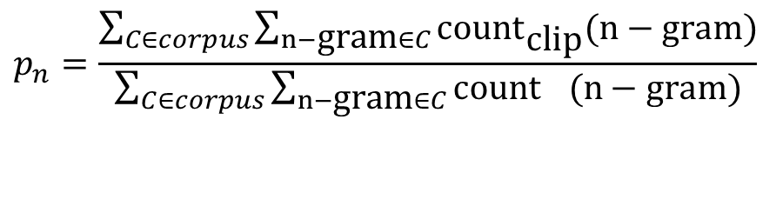
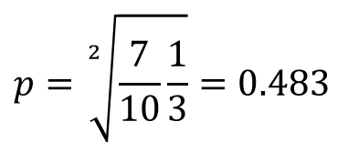
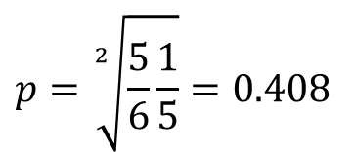
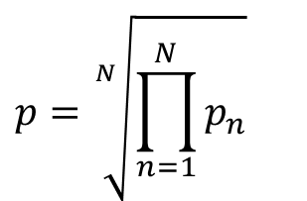
Modified N-Gram Precision
Average n-gram precision over all n-grams up to size N (typically 4) using geometric mean.
$$p=\sqrt[N]{\prod_{n=1}^{N}{p_{n}}}$$
$$p_{n}=\frac{\sum_{C∈corpus}{\sum_{n−\text{gram}∈C}{\text{coun}{\text{t}}_{\text{clip}}(n−\text{gram})}}}{\sum_{C∈corpus}{\sum_{n−\text{gram}∈C}{\text{coun}{\text{t}}_{}(n−\text{gram})}}}$$
$$p=\sqrt[2]{\frac{5}{6}\frac{1}{5}}=0.408$$
Cand 1:
$$p=\sqrt[2]{\frac{7}{10}\frac{1}{3}}=0.483$$
Cand 2:
Slide from Ray Mooney

Slide 105
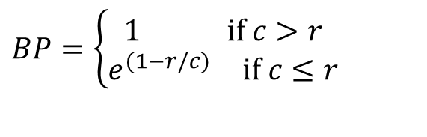
Brevity Penalty
Not easy to compute recall to complement precision since there are multiple alternative gold-standard references and don’t need to match all of them.
Instead, use a penalty for translations that are shorter than the reference translations.
Define effective reference length, r, for each sentence as the length of the reference sentence with the largest number of n-gram matches. Let c be the candidate sentence length.
$$BP=\left\{\begin{matrix}\begin{matrix}1 & \text{if} c>r\end{matrix} \\ \begin{matrix}e^{(1−r/c)} & \text{if} c≤r\end{matrix}\end{matrix}\right.$$
Slide from Ray Mooney

Slide 106


BLEU Score
Final BLEU Score: BLEU = BP × p
Cand 1: Mary no slap the witch green.
  Best Ref: Mary did not slap the green witch.
  Cand 2: Mary did not give a smack to a green witch.
  Best Ref: Mary did not smack the green witch.
$$c=6, r=7, BP=e^{(1−7/6)}=0.846$$
$$BLEU=0.846×0.408=0.345$$
$$c=10, r=7, BP=1$$
$$BLEU=1×0.483=0.483$$
Slide from Ray Mooney

Slide 107
BLEU Score Issues
BLEU has been shown to correlate with human evaluation when comparing outputs from different SMT systems.
However, it does not correlate with human judgments when comparing SMT systems with manually developed MT (Systran) or MT with human translations.
Other MT evaluation metrics have been proposed that claim to overcome some of the limitations of BLEU.
Slide from Ray Mooney

Slide 108
BLEU Tends to Predict Human Judgments
(variant of BLEU)
slide from G. Doddington

Slide 109
Syntax-Based Statistical Machine Translation
Recent SMT methods have adopted a syntactic transfer approach.
Improved results demonstrated for translating between more distant language pairs, e.g. Chinese/English.
Slide from Ray Mooney

Slide 110
Synchronous Grammar
Multiple parse trees in a single derivation.
Used by (Chiang, 2005; Galley et al., 2006).
Describes the hierarchical structures of a sentence and its translation, and also the correspondence between their sub-parts.
Slide from Ray Mooney

Slide 111
Synchronous Productions
Has two RHSs, one for each language
Chinese:
English:
X → X 是甚麼 / What is X
Slide from Ray Mooney

Slide 112
Syntax-Based MT Example
Input: 俄亥俄州的首府是甚麼？
Slide from Ray Mooney

Slide 113
Syntax-Based MT Example
X
X
Input: 俄亥俄州的首府是甚麼？
Slide from Ray Mooney

Slide 114
Syntax-Based MT Example
X
X
X 是甚麼
What is X
Input: 俄亥俄州的首府是甚麼？
X → X 是甚麼 / What is X
Slide from Ray Mooney

Slide 115
Syntax-Based MT Example
X
X
X 是甚麼
What is X
X 首府
the capital X
Input: 俄亥俄州的首府是甚麼？
X → X 首府 / the capital X
Slide from Ray Mooney

Slide 116
Syntax-Based MT Example
X
X
X 是甚麼
What is X
X 首府
the capital X
X 的
of X
Input: 俄亥俄州的首府是甚麼？
X → X 的 / of X
Slide from Ray Mooney

Slide 117
Syntax-Based MT Example
X
X
X 是甚麼
What is X
X 首府
the capital X
X 的
of X
俄亥俄州
Ohio
Input: 俄亥俄州的首府是甚麼？
X → 俄亥俄州 / Ohio
Slide from Ray Mooney

Slide 118
Syntax-Based MT Example
X
X
X 是甚麼
What is X
X 首府
the capital X
X 的
of X
俄亥俄州
Ohio
Input: 俄亥俄州的首府是甚麼？
Output: What is the capital of Ohio?
Slide from Ray Mooney

Slide 119
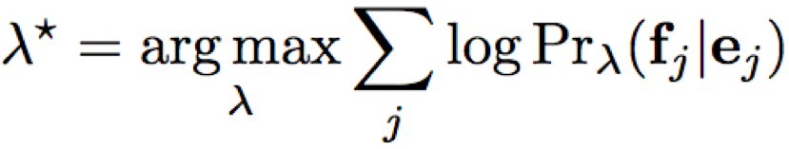
Synchronous Derivations and Translation Model
Need to make a probabilistic version of synchronous grammars to create a translation model for P(F | E).
Each synchronous production rule is given a weight λ_{i} that is used in a maximum-entropy (log linear) model.
Parameters are learned to maximize the conditional log-likelihood of the training data.
Slide from Ray Mooney

Slide 120
MERT

Slide 121
Minimum Error Rate Training
No longer use the noisy channel model
  Noisy channel model is not trained to directly minimize the final MT evaluation metric, e.g. BLEU.
MERT: train a logistic regression classifier to directly minimize the final evaluation metric on the training corpus by using various features of a translation.
  Language model: P(E)
  Translation mode: P(F | E)
  Reverse translation model: P(E | F)
Slide from Ray Mooney

Slide 122
Conclusions
Modern MT
  Phrase table: derived by symmetrizing word alignments on a sentence-aligned parallel corpus
  Statistical phrase translation model P(F|E)
  Language model P(E)
All these combined in a logistic regression classifier trained to minimize error rate.
Current research: syntax based SMT
Next: Neural Machine Translation
Slide from Ray Mooney

