Slide 1

Neural Machine Translation
Università di Pisa
Adapted from slides by
Abigail See
Stanford University

Slide 2
1990s-2010s: Statistical Machine Translation
SMT is a huge research field
  The best systems are extremely complex
  Hundreds of important details, too many to mention
  Systems have many separately-designed subcomponents
  Lots of feature engineering
    Need to design features to capture particular language phenomena
Require compiling and maintaining extra resources
  Like tables of equivalent phrases
Lots of human effort to maintain
  Repeated effort for each language pair!

Slide 3
2014: Neural Machine Translation
Huge Impact on
Machine Translation Research

Slide 4
What is Neural Machine Translation
Neural Machine Translation (NMT) is a way to do Machine Translation with a single neural network
The neural network architecture is called sequence-to-sequence (aka seq2seq) and it involves two RNNs.

Slide 5
Neural Machine Translation (NMT)
The sequence to sequence model
Target sentence (output)
Encoding of the source sentence.
Provides initial hidden state
for Decoder RNN.
the poor don’t have any money <END>
argmax
argmax
argmax
argmax
argmax
argmax
argmax
Encoder RNN
Decoder RNN
les pauvres sont démunis
<START> the poor don’t have any money
Source sentence (input)
Decoder RNN is a Language Model that generates
target sentence conditioned on encoding.
Encoder RNN produces
an encoding of the
source sentence.
Note: This diagram shows test time behavior:
decoder output is fed in as next step’s input

Slide 6
Neural Machine Translation (NMT)
The sequence-to-sequence model is an example of a Conditional Language Model.
  Language Model because the decoder is predicting the next word of the target sentence y
  Conditional because its predictions are also conditioned on the source sentence x
NMT directly calculates P(y|x):
P(y|x) = P(y₁|x) P(y₂|y₁, x) P(y₃|y₁, y₂, x) …, P(y_{T}|y₁,…, y_{T-1}, x)
Question: How to train a NMT system?
Answer: Get a big parallel corpus…
Probability of next target word, given
target words so far and source sentence x

Slide 7
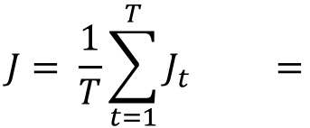
Training a Neural Machine Translation system
= negative log
prob of “the”
= negative log
prob of “have”
= negative log
prob of <END
$$J= \frac{1}{T}\sum_{t=1}^{T}{J_{t}} =$$
J₁ + J₂ + J₃ + J₄ + J₅ + J₆ + J₇
ŷ₁ ŷ₂ ŷ₃ ŷ₄ ŷ₅ ŷ₆ ŷ₇
Encoder RNN
Decoder RNN
les pauvres sont démunis
<START> the poor don’t have any money
Source sentence (from corpus)
Target sentence (from corpus)
Seq2seq is optimized as a single system.
Backpropagation operates “end to end”

Slide 8
Better-than-greedy decoding?
We showed how to generate (or “decode”) the target sentence by taking argmax on each step of the decoder
This is greedy decoding (take most probable word on each step)
Problems?
the poor don’t have any money <END>
argmax
argmax
argmax
argmax
argmax
argmax
argmax
<START> the poor don’t have any money

Slide 9
Better-than-greedy decoding?
Greedy decoding has no way to undo decisions!
  les pauvres sont demunis (the poor don’t have any money)
  → the ____
  → the poor ____
  → the poor are ____
Better option: use beam search (a search algorithm) to explore several hypotheses and select the best one

Slide 10
Beam search decoding
Ideally we want to find y that maximizes
P(y|x) = P(y₁|x) P(y₂|y₁, x) P(y₃|y₁, y₂, x) …, P(y_{T}|y₁,…, y_{T-1}, x)
We could try enumerating all y →too expensive!
  Complexity O(V^{T}) where V is vocab size and T is target sequence length
Beam search: On each step of decoder, keep track of the k most probable partial translations
  k is the beam size (in practice around 5 to 10)
  Not guaranteed to find optimal solution
  But much more efficient!

Slide 11
Beam search decoding: example
Beam size = 2
always
in
are
not
poor
with
the
don’t
have
money
people
any
take
funds
<START>
enough
money
person
funds
poor
a
but
person

Slide 12
Pro/Cons of NMT wrt SMT
Benefits
Disadvantages
Better performance
  More fluent
  Better use of context
  Better use of phrase similarities
A single neural network to be optimized end-to-end
  No subcomponents to be individually optimized
Requires much less human engineering effort
  No feature engineering
  Same method for all language pairs
NMT is less interpretable
  Hard to debug
NMT is difficult to control
  For example, can’t easily specify rules or guidelines for translation
  Safety concerns!

Slide 13
MT progress over time
[Edinburgh En-De WMT newstest2013 Cased BLEU; NMT 2015 from U. Montréal
Source: http://www.meta-net.eu/events/meta-forum-2016/slides/09_sennrich.pdf

Slide 14
NMT: the biggest success story of NLP Deep Learning
Neural Machine Translation went from a fringe research activity in 2014 to the leading standard method in 2016
2014: First seq2seq paper published
2016: Google Translate switches from SMT to NMT
This is amazing!
  SMT systems, built by hundreds of engineers over many years, outperformed by NMT systems trained by a handful of engineers in a few months

Slide 15
Is MT a solved problem?
Nope!
Many difficulties remain:
  Out-of-vocabulary words
  Domain mismatch between train and test data
  Maintaining context over longer text
  Low-resource language pair

Slide 16
NMT research continues
NMT is the flagship task for NLP Deep Learning
NMT research has pioneered many of the recent innovations of NLP Deep Learning
In 2018: NMT research continues to thrive
  Researchers have found many, many improvements to the “vanilla” seq2seq NMT system we’ve presented today
  But one improvement is so integral that it is the new vanilla…
  ATTENTION

Slide 17
Neural Machine Translation (NMT)
Target sentence (output)
Encoding of the source sentence.
the poor don’t have any money <END>
argmax
argmax
argmax
argmax
argmax
argmax
argmax
Encoder RNN
Decoder RNN
les pauvres sont démunis
<START> the poor don’t have any money
Source sentence (input)
Problems with this architecture?

Slide 18
Attention
Attention provides a solution to the bottleneck problem.
Core idea: on each step of the decoder, focus on a particular part of the source sequence
First we will show via diagram (no equations), then we will show with equation

Slide 19
Sequence-to-sequence with attention
dot product
Attention
scores
Encoder RNN
Decoder RNN
les pauvres sont démunis
<START>

Slide 20
Sequence-to-sequence with attention
On this decoder timestep, we’re
mostly focusing on the first
encoder hidden state (”les”
Attention
distribution
Take softmax to turn the scores
into a probability distrìbution
Attention
scores
Encoder RNN
Decoder RNN
les pauvres sont démunis
<START>

Slide 21
Sequence-to-sequence with attention
Attention
output
Use the attention distribution to take a
weighted sum of the encoder hidden
states.
Attention
distribution
The attention output mostly contains
information the hidden states that
received high atten
Attention
scores
Encoder RNN
Decoder RNN
les pauvres sont démunis
<START>

Slide 22
Sequence-to-sequence with attention
Attention
output
the
Concatenate attention output
with decoder hidden state, then
use to compute ŷ₁ as before
Attention
distribution
ŷ₁
Attention
scores
Encoder RNN
Decoder RNN
les pauvres sont démunis
<START>

Slide 23
Sequence-to-sequence with attention
Attention
output
poor
Attention
distribution
ŷ₂
Attention
scores
Encoder RNN
Decoder RNN
les pauvres sont démunis
<START> the

Slide 24
Sequence-to-sequence with attention
Attention
output
don’t
Attention
distribution
ŷ₃
Attention
scores
Encoder RNN
Decoder RNN
les pauvres sont démunis
<START> the poor

Slide 25
Sequence-to-sequence with attention
Attention
output
have
Attention
distribution
ŷ₄
Attention
scores
Encoder RNN
Decoder RNN
les pauvres sont démunis
<START> the poor don’t

Slide 26
Sequence-to-sequence with attention
Attention
output
any
Attention
distribution
ŷ₅
Attention
scores
Encoder RNN
Decoder RNN
les pauvres sont démunis
<START> the poor don’t have

Slide 27
Sequence-to-sequence with attention
Attention
output
money
Attention
distribution
ŷ₆
Attention
scores
Encoder RNN
Decoder RNN
les pauvres sont démunis
<START> the poor don’t have any money

Slide 28
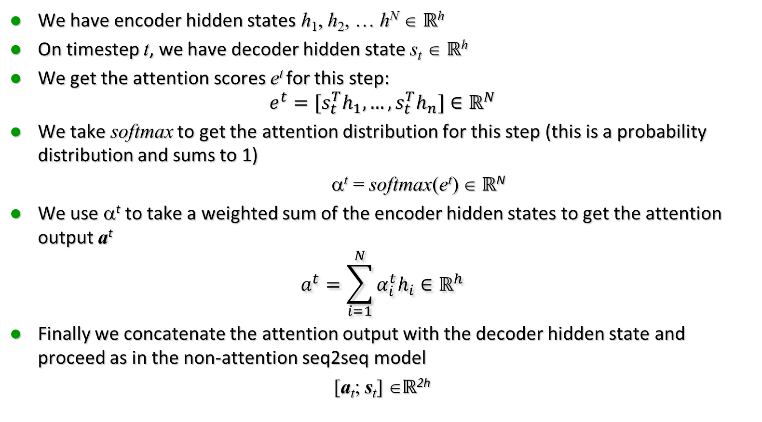
Attention in Equations
We have encoder hidden states h₁, h₂, … h^{N} ∈ $ℝ$^{h}
On timestep t, we have decoder hidden state s_{t} ∈ $ℝ$^{h}
We get the attention scores e^{t} for this step:
$$e^{t}=[s_{t}^{T}h_{1},…,s_{t}^{T}h_{n}]∈ℝ^{N}$$
We take softmax to get the attention distribution for this step (this is a probability distribution and sums to 1)
α^{t} = softmax(e^{t}) ∈ ℝ^{N}
We use α^{t} to take a weighted sum of the encoder hidden states to get the attention output a^{t}
$$a^{t}=\sum_{i=1}^{N}{α_{i}^{t}h_{i}}∈ℝ^{h}$$
Finally we concatenate the attention output with the decoder hidden state and proceed as in the non-attention seq2seq model
[a_{t}; s_{t}] ∈ℝ^{2h}

Slide 29
Attention is great
Attention significantly improves NMT performance
  It’s very useful to allow decoder to focus on certain parts of the source
Attention solves the bottleneck problem
  Attention allows decoder to look directly at source; bypass bottleneck
Attention helps with vanishing gradient problem
  Provides shortcut to faraway states
Attention provides some interpretability
  By inspecting attention distribution, we can
  see what the decoder was focusing on
  We get alignment for free!
  This is cool because we never explicitly trained
  an alignment system
  The network just learned alignment by itself

Slide 30
Sequence to sequence is versatile
Sequence-to-sequence is useful for more than just MT
Many NLP tasks can be phrased as sequence-to-sequence:
  Summarization (long text → short text)
  Dialogue (previous utterances → next utterance)
  Parsing (input text → output parse as sequence)
  Code generation (natural language → Python code)
canto del cigno

Slide 31
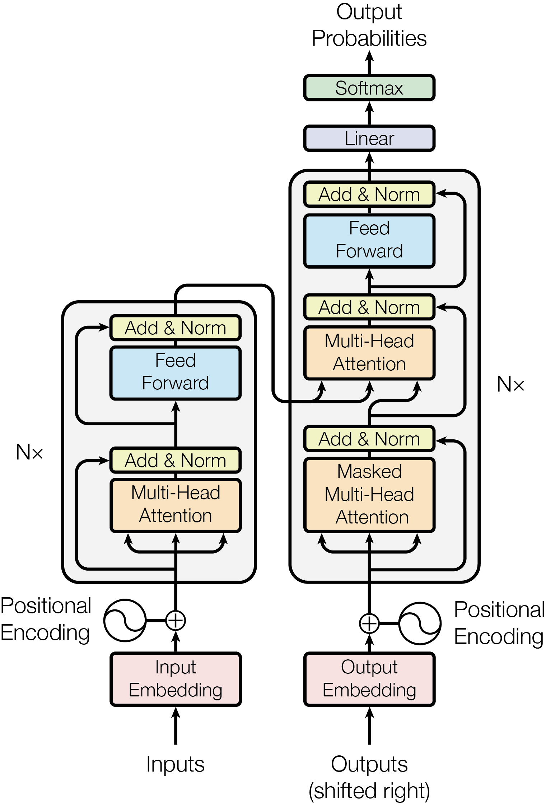
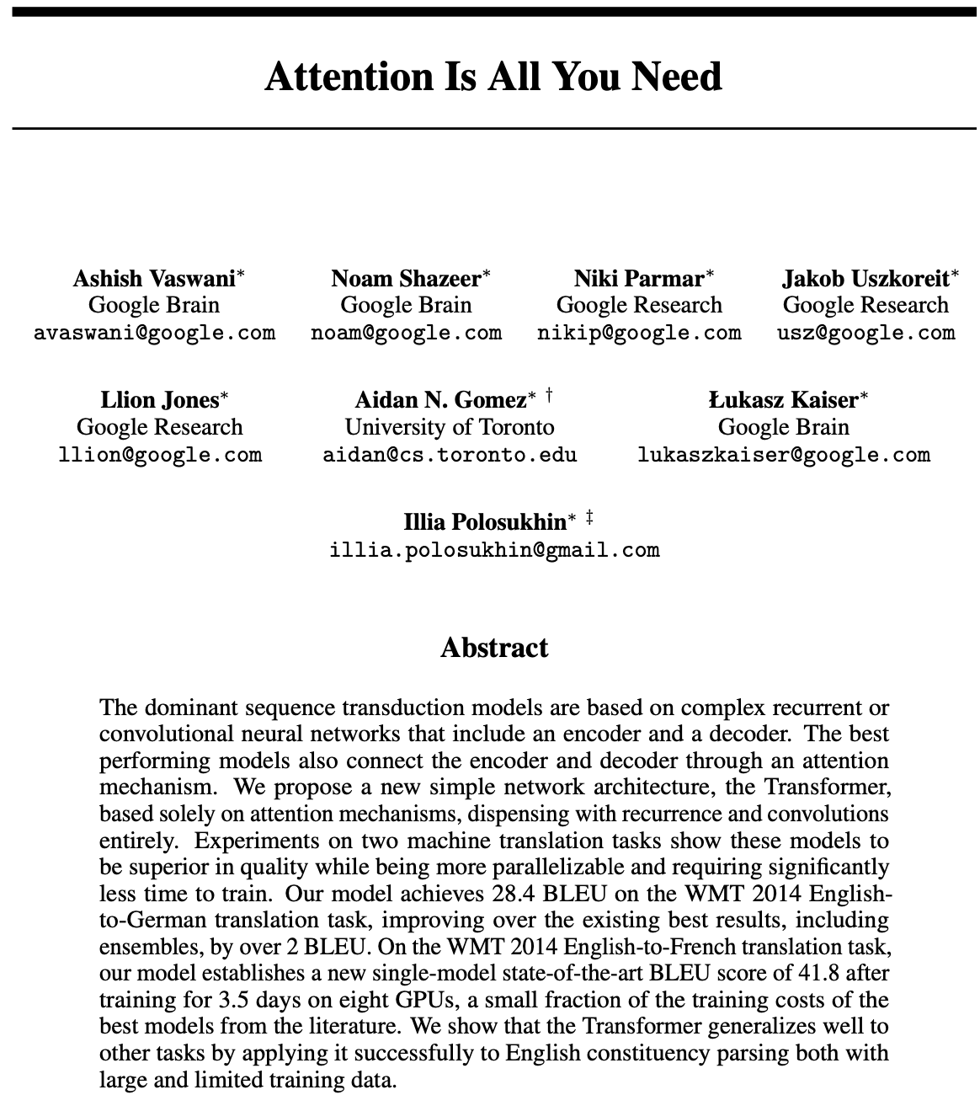
Attention is all you need

Slide 32
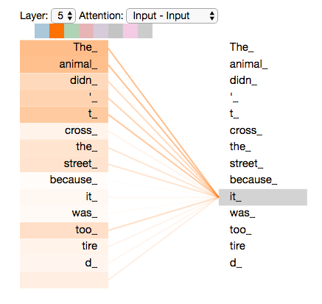
Self Attention per contestualizzare le parole
Un limitedei word emeddings era che a una parola corrispondeva un solo vettore, nonostante una parola possa avere molti significati
Attention consente di introdurre nella rappresentazione delle parole il contesto in cui appare
Consente di osservare altre parole della frase
Esempio: associa la parola “it” ad “animal”

Slide 33
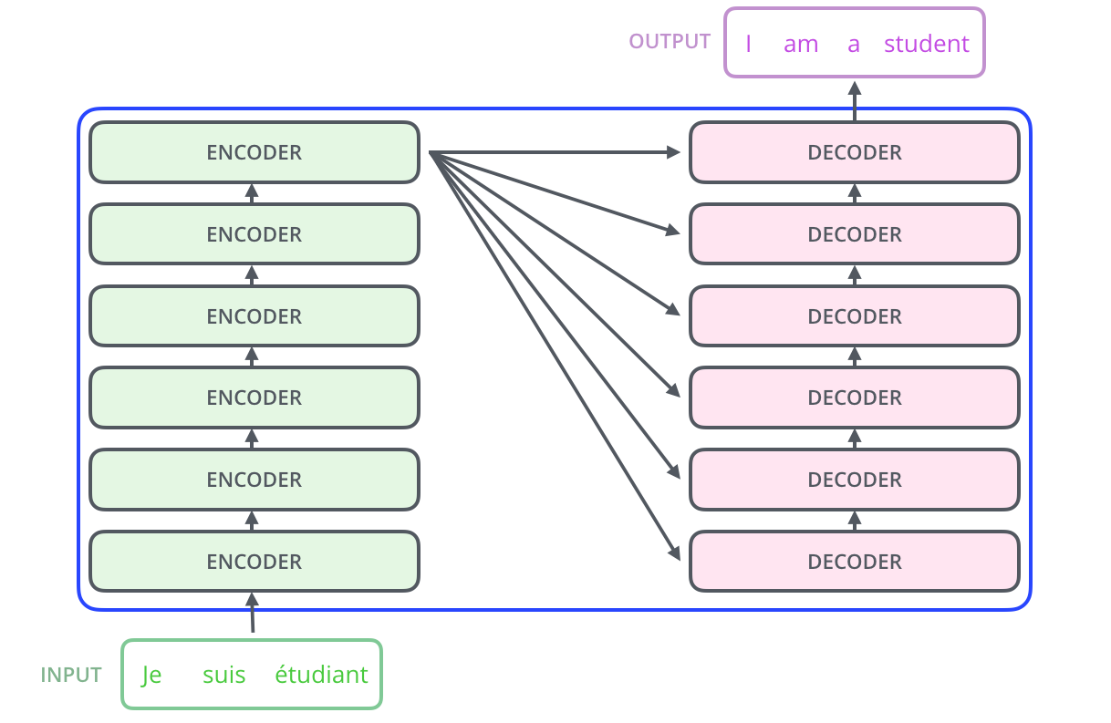
Machine Translation
The encoding component is a stack of encoders
The decoding component is a stack of decoders of the same number.

Slide 34
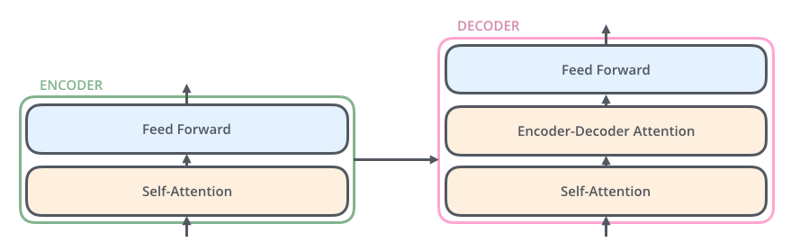
Self Attention + Encoder-Decoder Attention
Self attention contestualizza all’interno di ciascuna frase
Encoder-Decoder Attention aiuta a focalizzare le parti rilevanti dell’altra frase

Slide 35
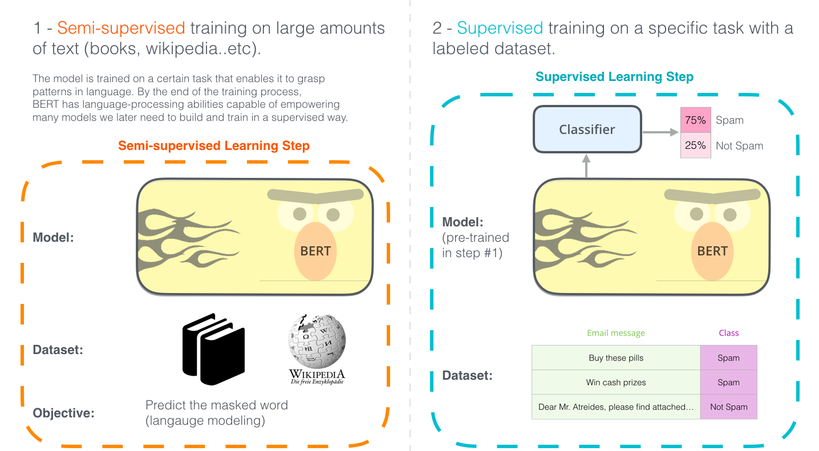
Applicazione ad altri task

Slide 36
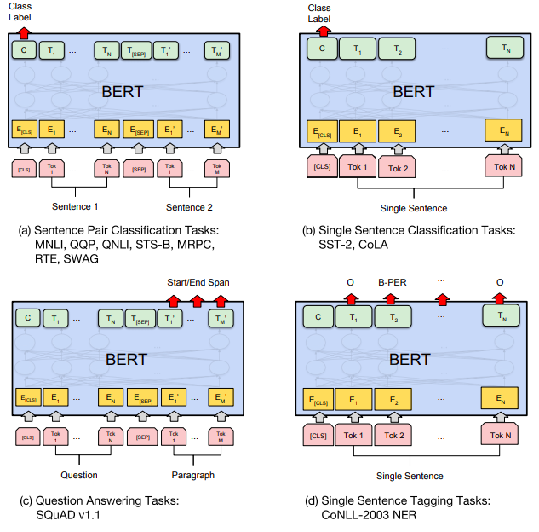
Task Specific Models
Transformer + Extra Layer fine tuned to task

Slide 37
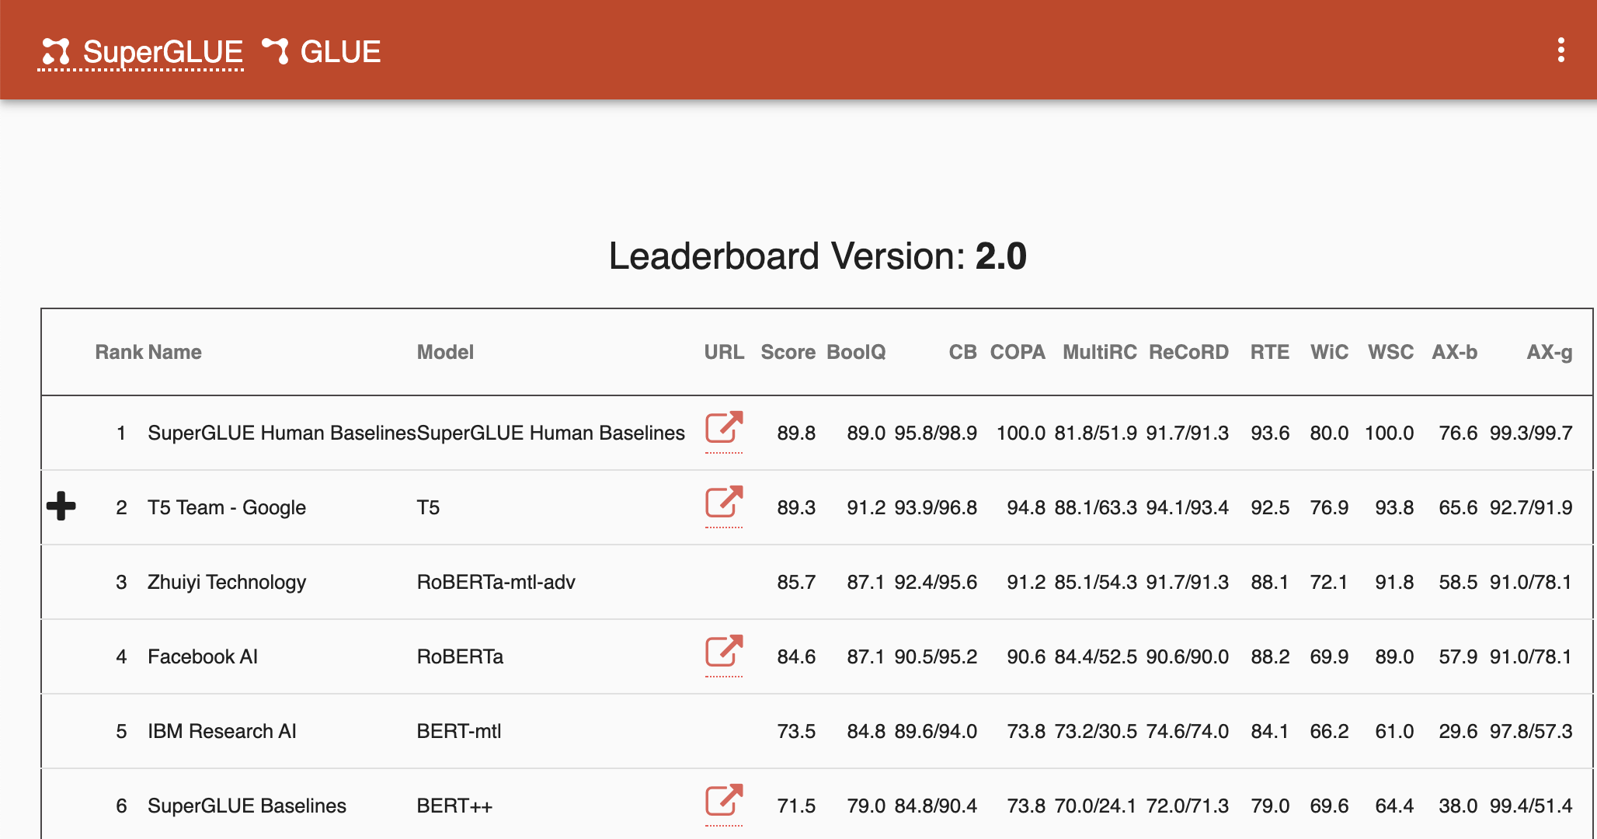
SuperGlue: benchmark on 10 tasks

Slide 38
Transformer Models
BERT (Google)
XLNET (Google/CMU)
RoBERTa (Facebook)
DistillBERT (HuggingFace)
CRTL (Salesforce)
GPT-2 (OpenAI)
ALBERT (Google)
Megatron (NVIDIA)

Slide 39
Dimensioni
Model | Dimensioni | Parametri
BERT | 24-layer, 1024-hidden, 16-heads. | 340M
GPT-2 | 48-layer, 1600-hidden, 25-heads | 1558M
Transformer XL | 18-layer, 1024-hidden, 16-heads,. | 257M
XLM | 12-layer, 1024-hidden, 8-heads
RoBERTa | 24-layer, 1024-hidden, 16-heads | 355M
DistilBERT | 6-layer, 768-hidden, 12-heads | 134M
CTRL | 48-layer, 1280-hidden, 16-heads | 1.6B
alBERT | 12 repeating layer, 128 embedding, 4096-hidden, 64-heads | 223M
T5 | 24-layers, 1024-hidden-state, 65536 feed-forward hidden-state, 128-heads | 11B

Slide 40
Google Neural MT Architecture
Training: 3 weeks on 100 TPUs

Slide 41
MT State of the Art
Language | Model | BLEU
EN-DE | Transformer Big + BT (Edunov et al., 2018) | 35.0
EN-DE | Transformer Big (Vaswani et al., 2017) | 28.4
EN-FR | DeepL | 45.9
EN-FR | Transformer Big (Vaswani et al., 2017) | 41.0

Slide 42
Training Costs
Costs of training a NMT model
Model | BLEU (en-fr) | Training Cost (FLOPS) | Time
ConvS2S | 40.56 | 1.5 10²⁰
MOE | 40.56 | 1.2 10²⁰
ConvS2S Ensemble | 41.29 | 1.2 10²¹ | 35 gg

Slide 43
Multilingual Translation

Slide 44
Monolingual Translation
En-Es Encoder
En-Es Decoder
One Encoder-Decoder for eachh language pair
En-Nl Encoder
En-Nl Decoder
En-Fr Encoder
En-Fr Decoder

Slide 45
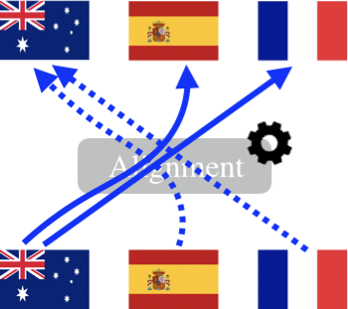
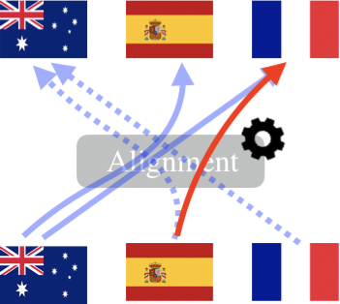
Multilingual Zero-shot Translation

Slide 46
Multilanguage NMT
NMT
Multilingual NMT
Hello, how are you? ->
Hola, ¿cómo estás?
<2es>Hello, how are you? ->
Hola, ¿cómo estás?
Only target language
L’input is irrelevant
Able of translating between any language pair

Slide 47
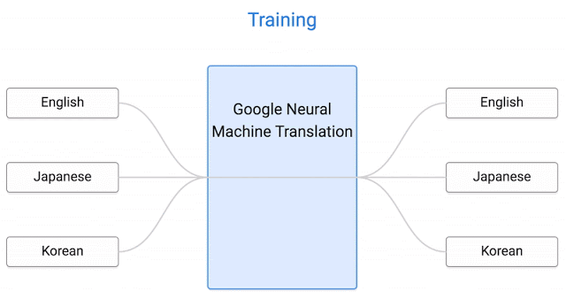
Zero-shot translation
Simple: one single modello
Zero-shot translation
Halves the time il wrt bridging with intermediate language
Deals with languages with lsmall resources

Slide 48
Word Piece Model
words: Jet makers feud over seat width with big orders at stake
wordpieces: _J et _makers _fe ud _over _seat _width _with _big _orders _at _stake
Reduces the number of tokens in the vocabolary da 130.000 a 30.000

Slide 49
Visualizzation of translations
one sentence in 3 languages
one sentence in 3 languages in 3 colors
translated sentences colored by their meaning

Slide 50
Quality: BLEU Score
Model | Single | Multi | Multi | Multi | Multi
#nodes | 1024 | 1024 | 1280 | 1536 | 1792
#params | 3B | 255M | 367M | 499M | 650M
Prod English→Japanese | 23.66 | 21.10 | 21.17 | 21.72 | 21.70
Prod English→Korean | 19.75 | 18.41 | 18.36 | 18.30 | 18.28
Prod Japanese→English | 23.41 | 21.62 | 22.03 | 22.51 | 23.18
Prod Korean→English | 25.42 | 22.87 | 23.46 | 24.00 | 24.67
Prod English→Spanish | 34.50 | 34.25 | 34.40 | 34.77 | 34.70
Prod English→Portuguese | 38.40 | 37.35 | 37.42 | 37.80 | 37.92
Prod Spanish→English | 38.00 | 36.04 | 36.50 | 37.26 | 37.45
Prod Portuguese→English | 44.40 | 42.53 | 42.82 | 43.64 | 43.87
Prod English→German | 26.43 | 23.15 | 23.77 | 23.63 | 24.01
Prod English→French | 35.37 | 34.00 | 34.19 | 34.91 | 34.81
Prod German→English | 31.77 | 31.17 | 31.65 | 32.24 | 32.32
Prod French→English | 36.47 | 34.40 | 34.56 | 35.35 | 35.52
ave diff | - | -1.72 | -1.43 | -0.95 | -0.76
vs single | - | -5.6% | -4.7% | -3.1% | -2.5%

Slide 51
Does it understand meaning of sentences?
NMT does not attempt to capture maning of phrases
  Example on GPT-2
    Two plus two is …
      a three, five is a six seven
      the result of a simple equation, and the
      four, and two plus three is four
Does it understand at least grammar?
  Neither, attempts to use have not been much successful

Slide 52
Conclusions
We learned the history of Machine Translation (MT)
Since 2014, Neural MT rapidly replaced intricate Statistical MT
Sequence-to-sequence is the architecture for NMT (uses 2 RNNs)
Attention is a way to focus on particular parts of the input
  Improves sequence-to-sequence a lot!
These models have inspired the Transformer Model (12 Layer), that produced SoTA solutions for many tasks, besides MT
NMT does surprisingly well, considering that it does not yet understands the texts that translates
Multilingual translation is possible with zero-shot learning

