Slide 1

Transformer and BERT
Università di Pisa
Human Language Technologies
Dipartimento di Informatica
Giuseppe Attardi
Pictures from Jay Alamma

Slide 2
Motivations
Sequence to sequence models with attention are quite effective in transduction tasks
Their sequential nature limits though parallelism
The Transformer transduction model relies entirely on self-attention to compute representations of its input and output
It does not use sequence aligned RNNs nor convolutions
Training costs are reduced by 1-2 orders of magnitude

Slide 3
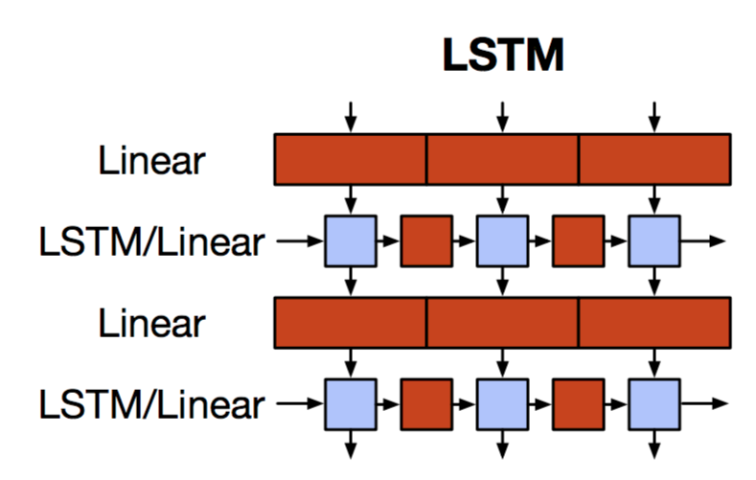
The Motivation for Transformers
We want parallelization but RNNs are inherently sequential
Despite LSTMs, RNNs generally need attention mechanism to deal with long range dependencies – path length between states grows with distance otherwise
But if attention gives us access to any state... maybe we can just use attention and don’t need the RNN?
And then NLP can have deep models
Slide from Chris Manning

Slide 4
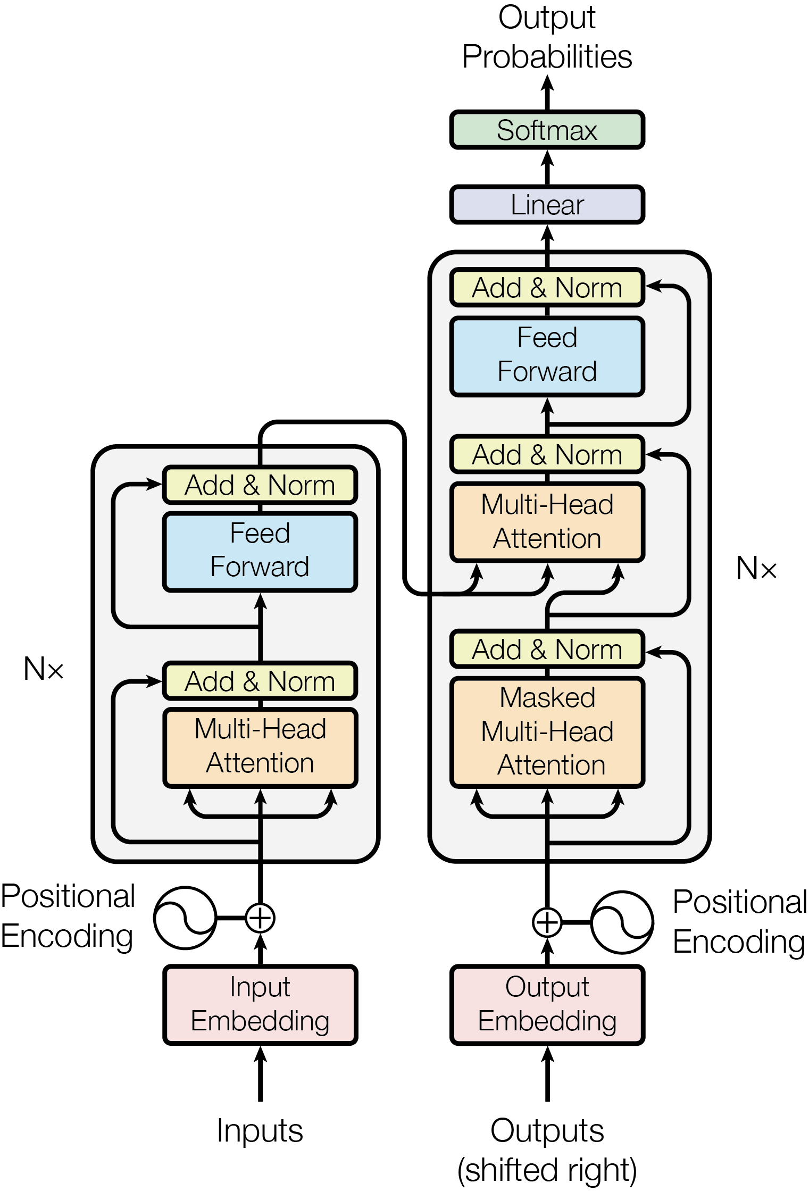
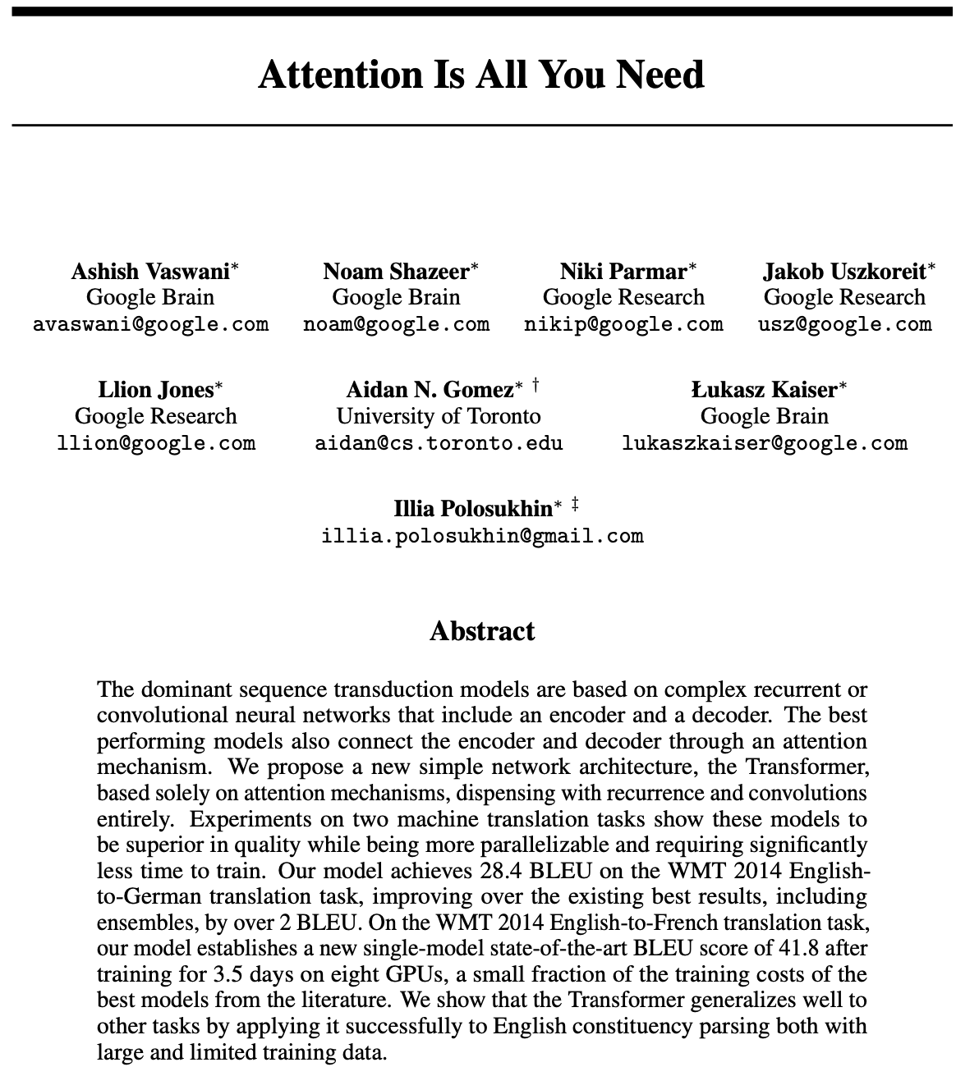
Attention is all you need

Slide 5
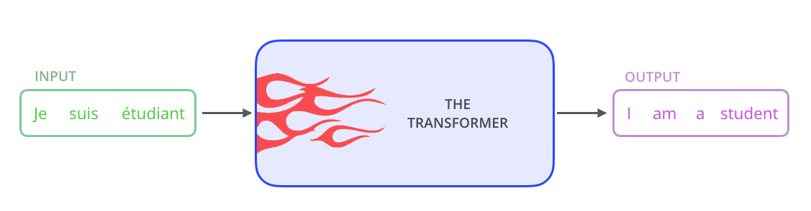
Transformer Model
The encoder maps an input sequence of symbol representations (x1, ..., xn) to a sequence of continuous representations z = (z1, ..., zn).
Given z, the decoder then generates an output sequence (y1, ..., ym) of symbols one element at a time.
At each step the model is auto-regressive, consuming the previously generated symbols as additional input when generating the next.

Slide 6
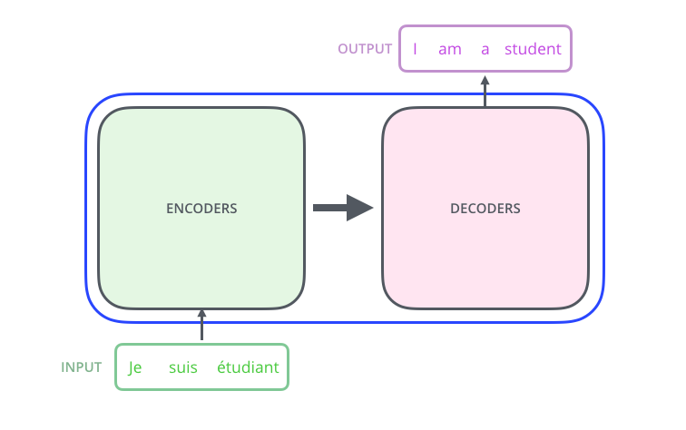
Architecture Overview

Slide 7
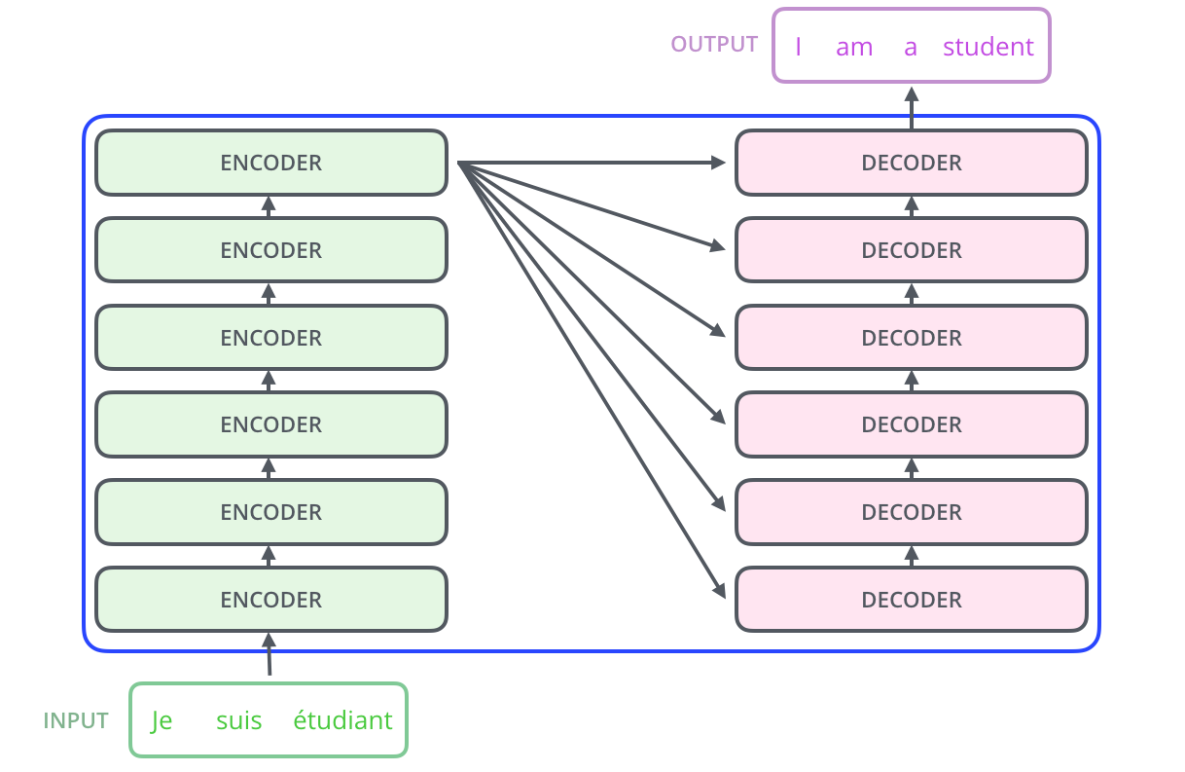
Machine Translation
The encoding component is a stack of encoders
The decoding component is a stack of decoders of the same number.

Slide 8
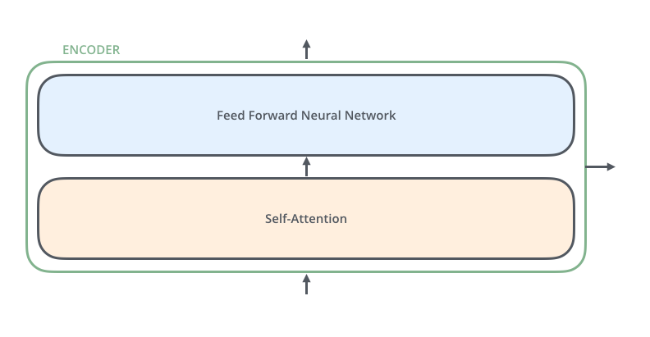
Encoder

Slide 9
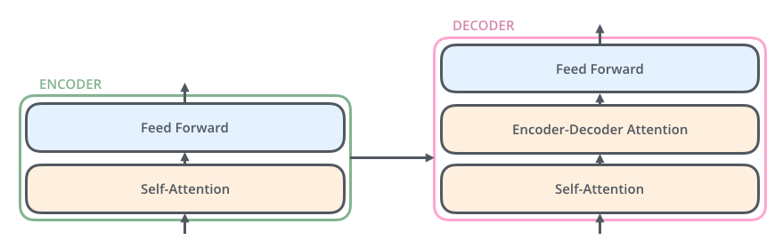
Self Attention
The encoder’s inputs first flow through a self-attention layer – a layer that helps the encoder look at other words in the input sentence as it encodes a specific word.
The outputs of the self-attention layer are fed to a feed-forward neural network. The exact same feed-forward network is independently applied to each position.
The decoder has both those layers, but between them is an attention layer that helps the decoder focus on relevant parts of the input sentence

Slide 10
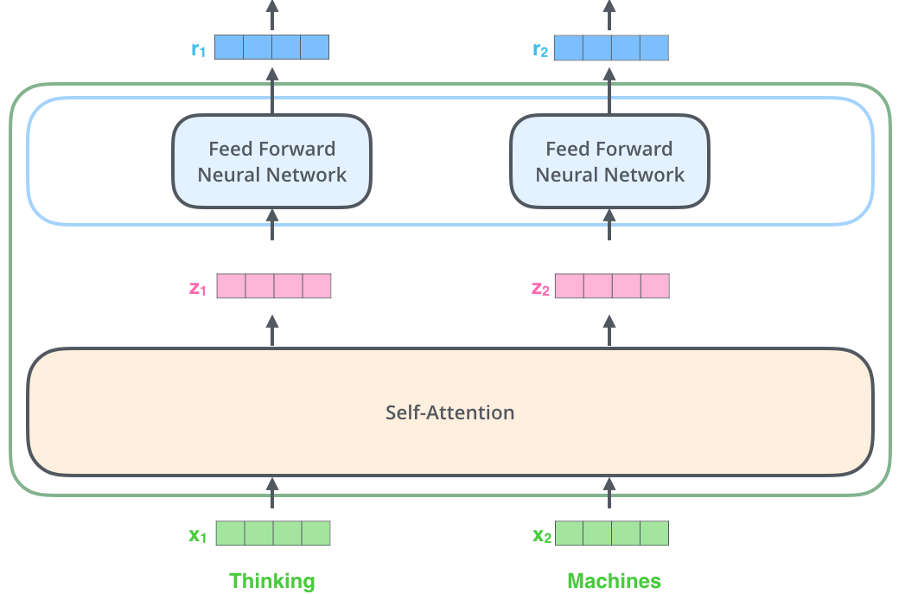
Word Embeddings
each input word is turned into a word embedding vector
vectors flow through each of the two layers of the encoder
the word in each position flows through its own path in the encoder
There are dependencies between these paths in the self-attention layer
The feed-forward layers are independent and thus the various paths can be executed in parallel

Slide 11
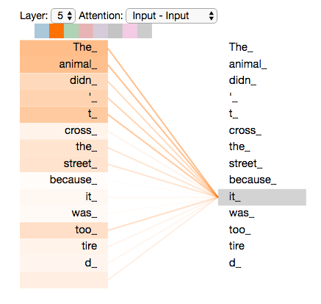
Self Attention
As the model processes each word, self attention allows it to look at other words in the input sequence for clues that can help lead to a better encoding for this word.
When the model is processing the word “it”, self-attention allows it to associate “it” with “animal”.
Self-attention allows the Transformer to bake into one word hidden vector the “understanding” of other relevant words

Slide 12
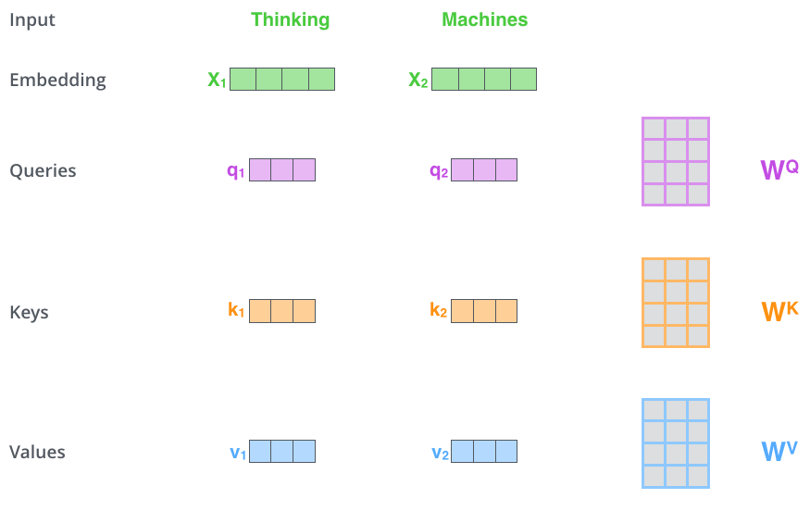
Self-Attention in Detail
qi = WQXi
ki = WK Xi
vi = WV Xi
For each word, we create a Query vector, a Key vector, and a Value vector.
These vectors are created by multiplying the embedding by three matrices that were trained during the training process.

Slide 13
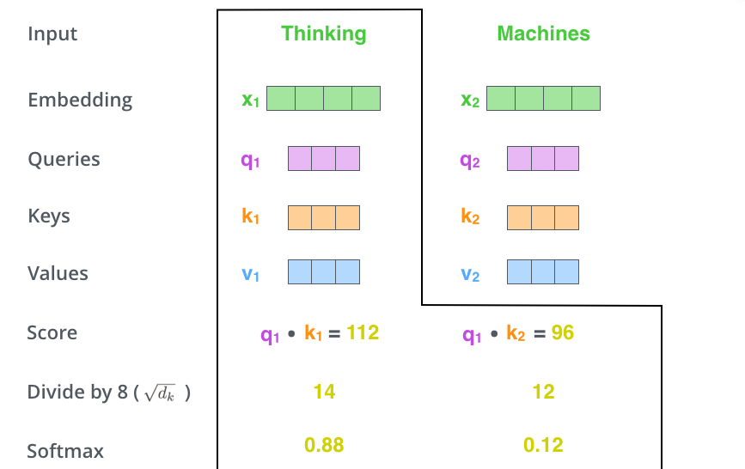
Score Calculation
The softmax score determines how much each word will be contribute to this position.
The word at this position will have the highest softmax score, but sometimes it’s useful to attend to other words that are relevant to the current position.

Slide 14
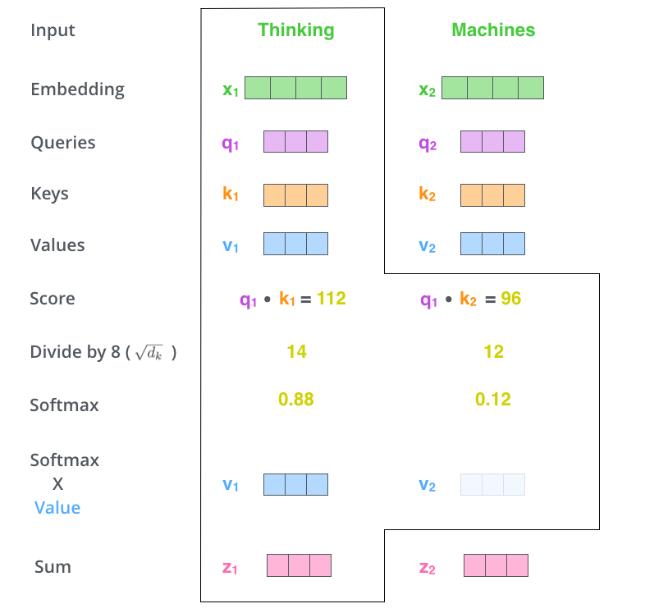
Self-Attention Output
Q = WQ X
K = WK X
V = WV X
Z = softmax(Q KT) V

Slide 15
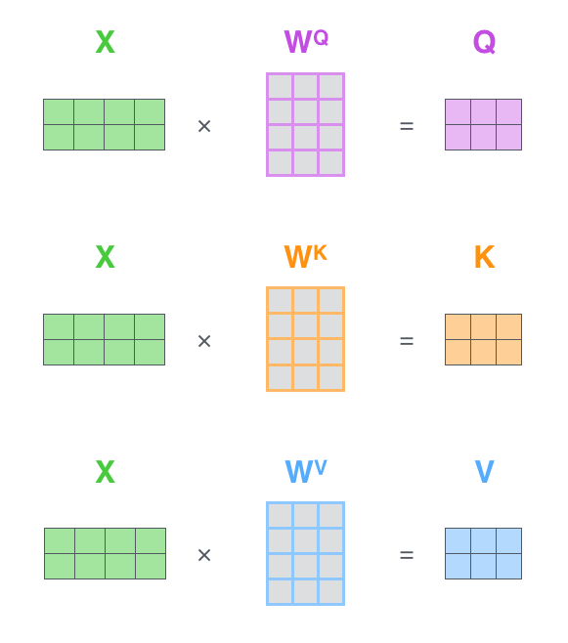
Matrix Computation
pack the vectors into a matrix X, and multiplying it by the weight matrices (WQ, WK, WV) as a single matrix operation

Slide 16
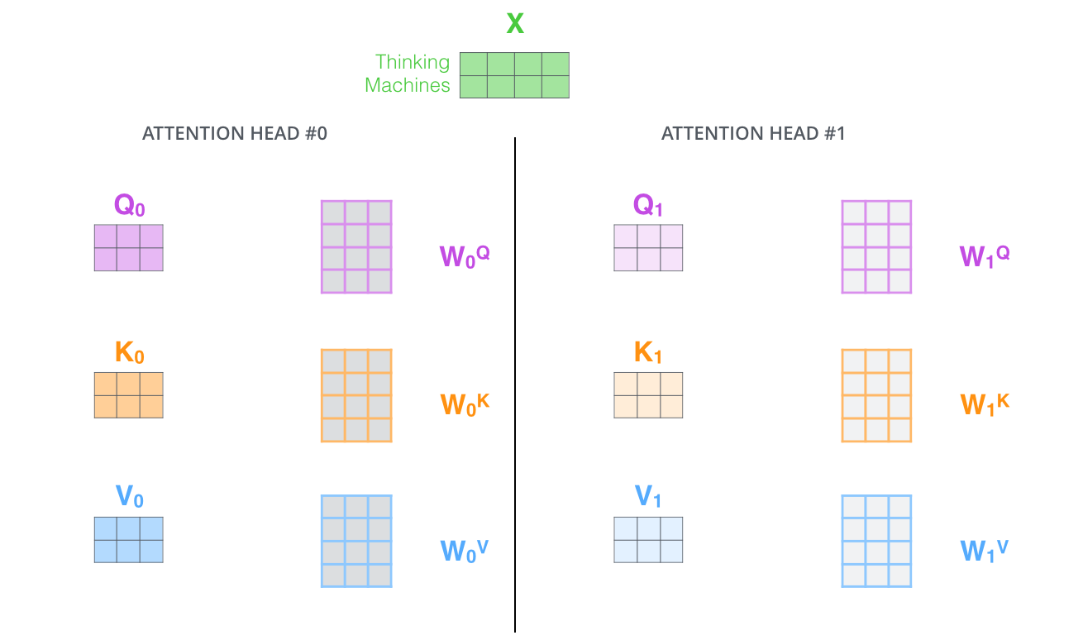
Multi-Head Attention
With simple self-attention: Only one way for a word to interact with others
Expands the model’s ability to focus on different positions
Multiple sets of Query/Key/Value weight matrices
Apply attention, then concatenate outputs and pipe through linear layer

Slide 17



Combine the heads
Concatenate all the attention heads
x
=

Slide 18
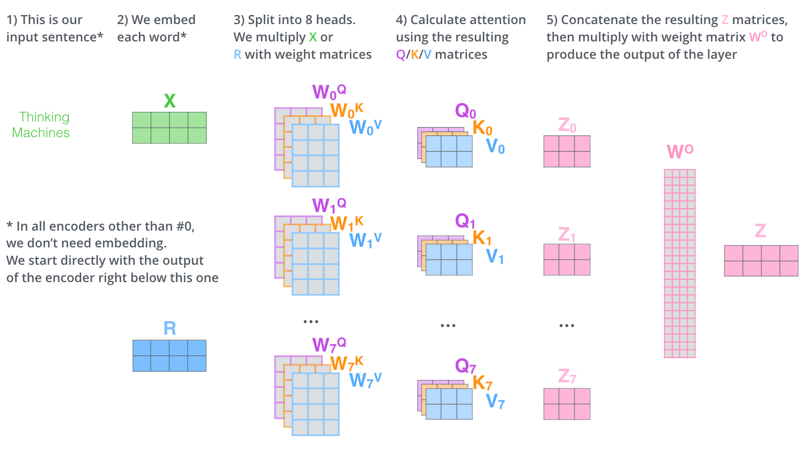
All together

Slide 19
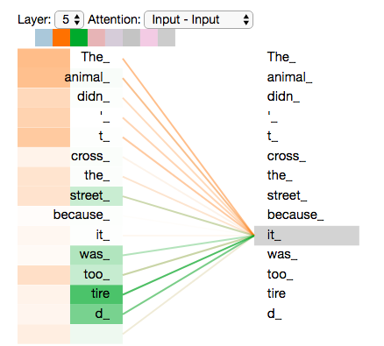
Attention Focus
Where the different attention heads are focusing while encoding the word “it” in our example sentence:
  one attention head is focusing most on "the animal"
  another is focusing on "tired"

Slide 20
Point-wise Feed-Forward Network
Two linear transformations with a ReLU activation in between
FFN(x) = max(0, xW1 + b1)W2 + b2

Slide 21
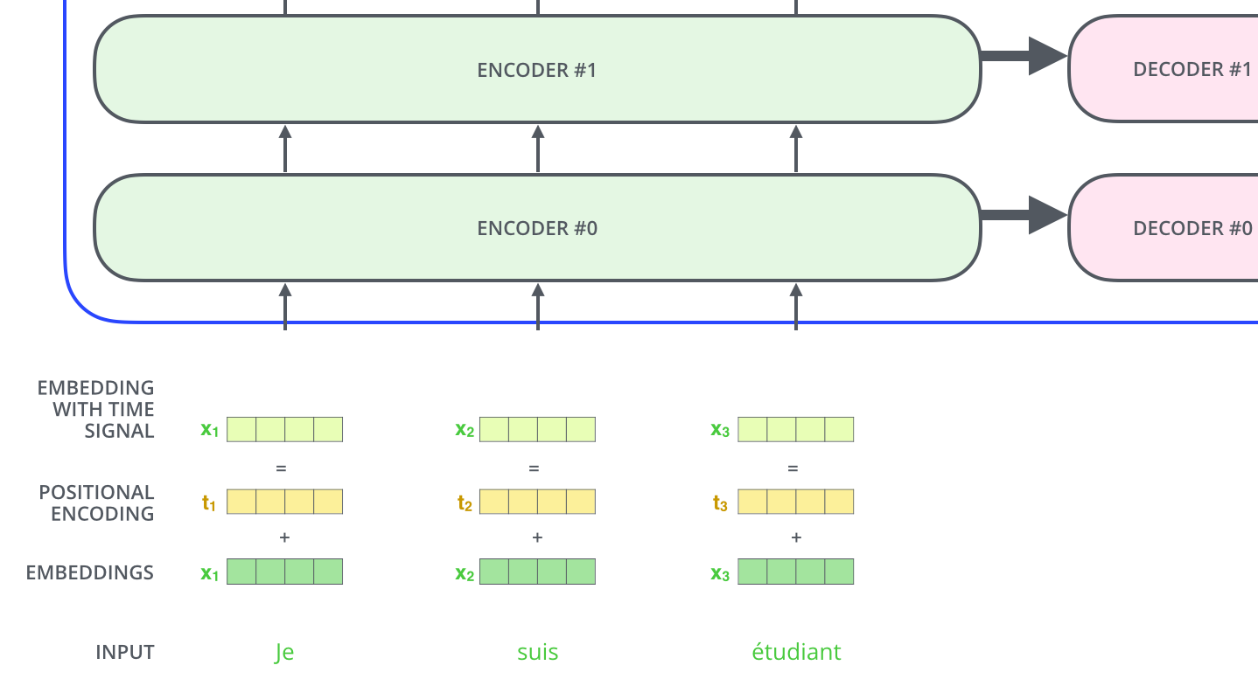
Encoding the positions
the model described so far has no way to account for the order of the words in the input sequence.
add a vector to each input, learned through training, which helps to determine the position of each word, or the distance between different words in the sequence.

Slide 22
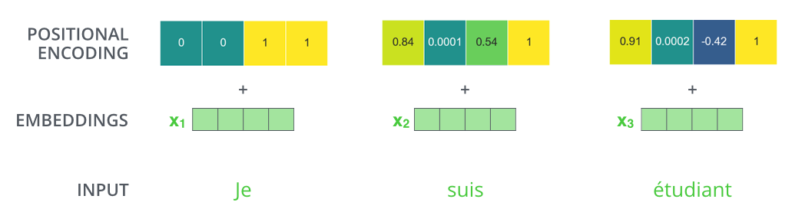
Example of Positional Encoding
Positional encoding of size 4
PE(pos,2i) = sin(pos/100002i/dmodel)
PE(pos,2i+1) = cos(pos/100002i/dmodel)

Slide 23
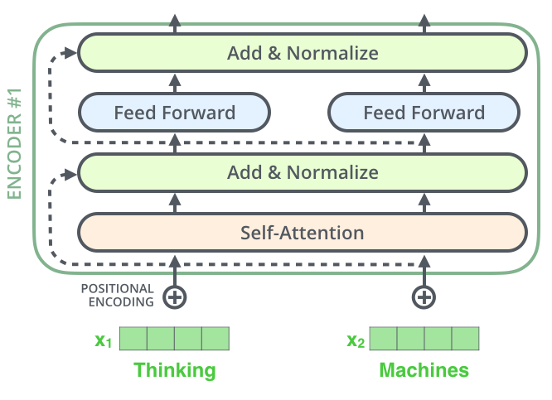
Residual Connections
Each sub-layer (self-attention, FFNN) in each encoder has a residual connection around it, and is followed by a layer-normalization step

Slide 24
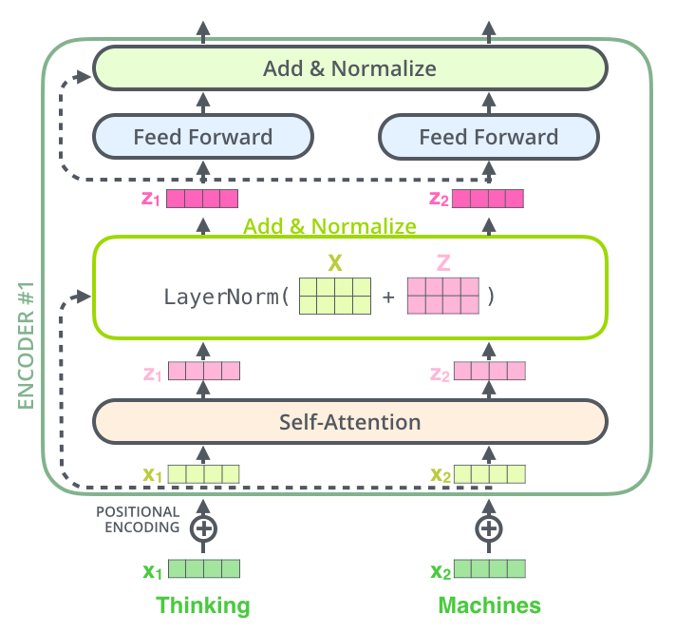
Layer Normalization

Slide 25
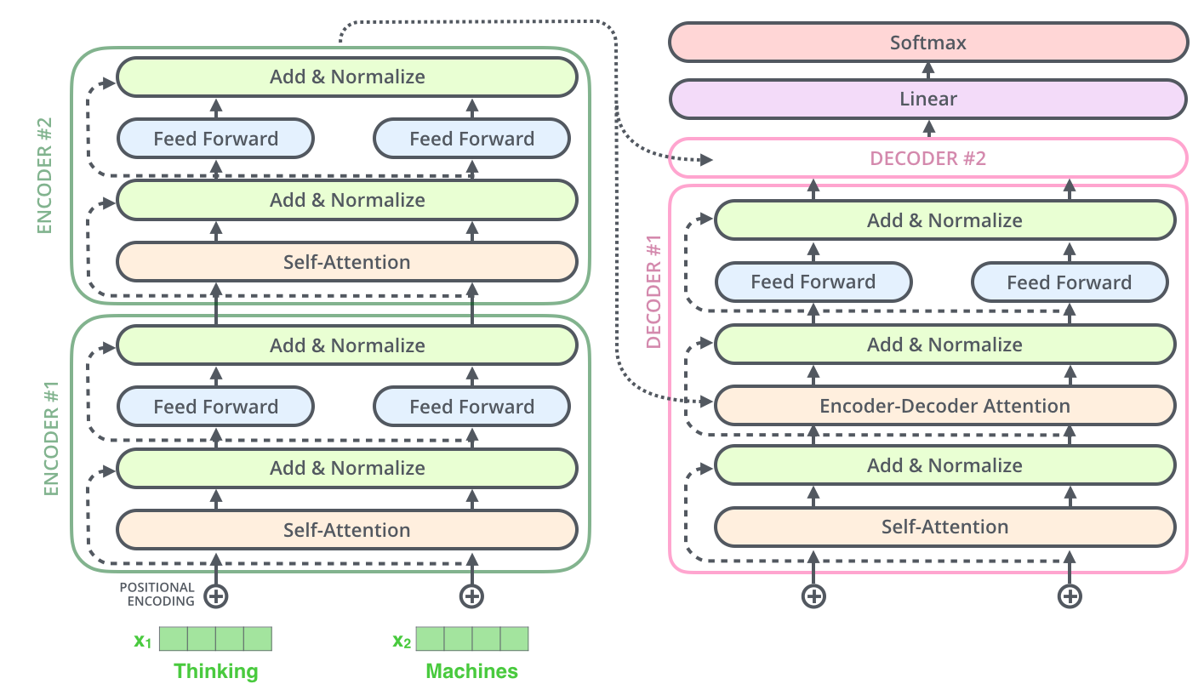
Summary

Slide 26
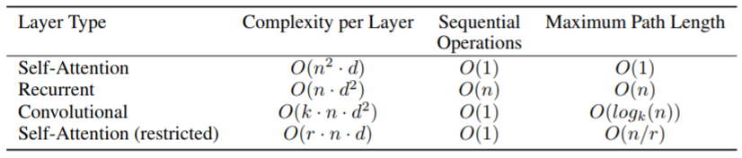
Why Self-Attention
Learning long-range dependencies is a key challenge in many sequence transduction tasks.
A self-attention layer connects all positions with a constant number of sequentially executed operations, whereas a recurrent layer requires O(n) sequential operations.
In terms of computational complexity, self-attention layers are faster than recurrent layers when the sequence length n is smaller than the representation dimensionality d

Slide 27
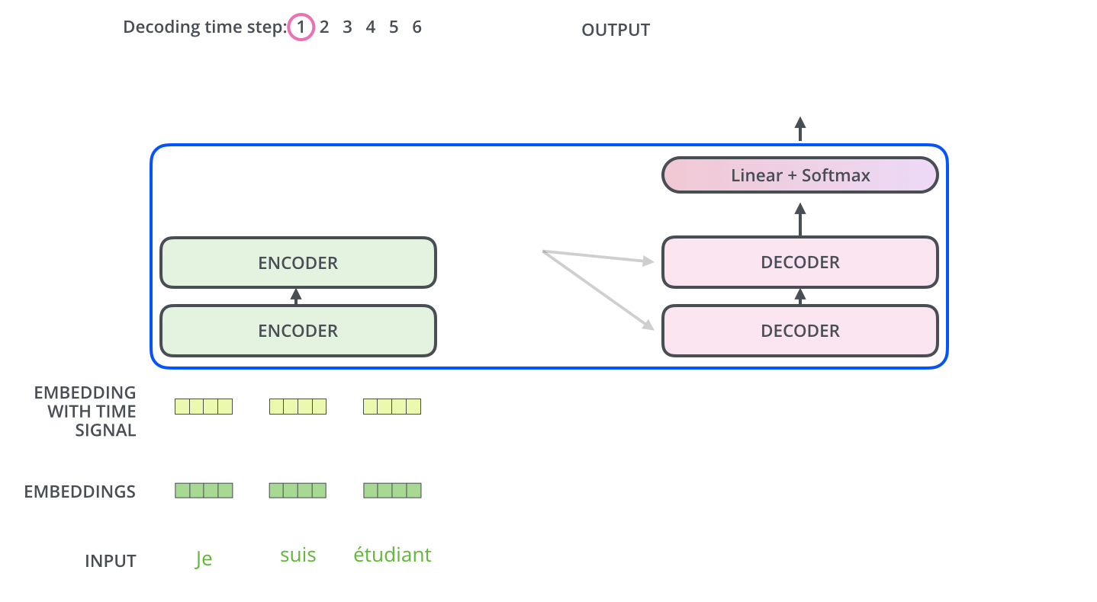
Encoder
The output of the top encoder is transformed into a set of attention vectors K and V.
These are used by each decoder in its “encoder-decoder attention” layer, helping focusing on appropriate places in the input sequence

Slide 28
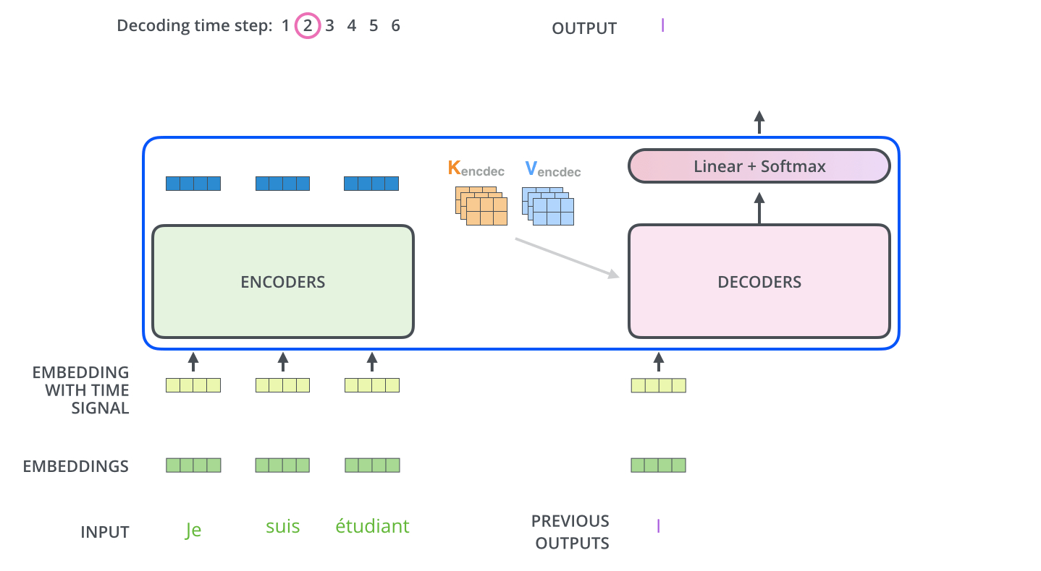
The Decoder

Slide 29
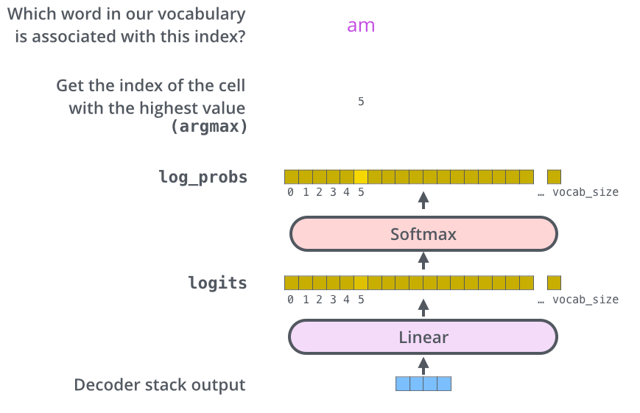
Final Layer and Softmax Layer

Slide 30
Extracting the Output
The Linear layer is a simple fully connected neural network that projects the vector produced by the stack of decoders, into a larger vector called a logits vector.
Let’s assume that the vocabulary consists of 10,000 unique English words. This would make the logits vector 10,000 cells wide – each cell corresponding to the score of a unique word.
The softmax layer turns those scores into probabilities (all positive, all add up to 1.0).
The cell with the highest probability is chosen, and the word associated with it is produced as the output for this time step.

Slide 31
Beam Search
Beam search is used to explore a few alternative output sequences with the highest scores
At the end, the highest scoring sequence is selected

Slide 32
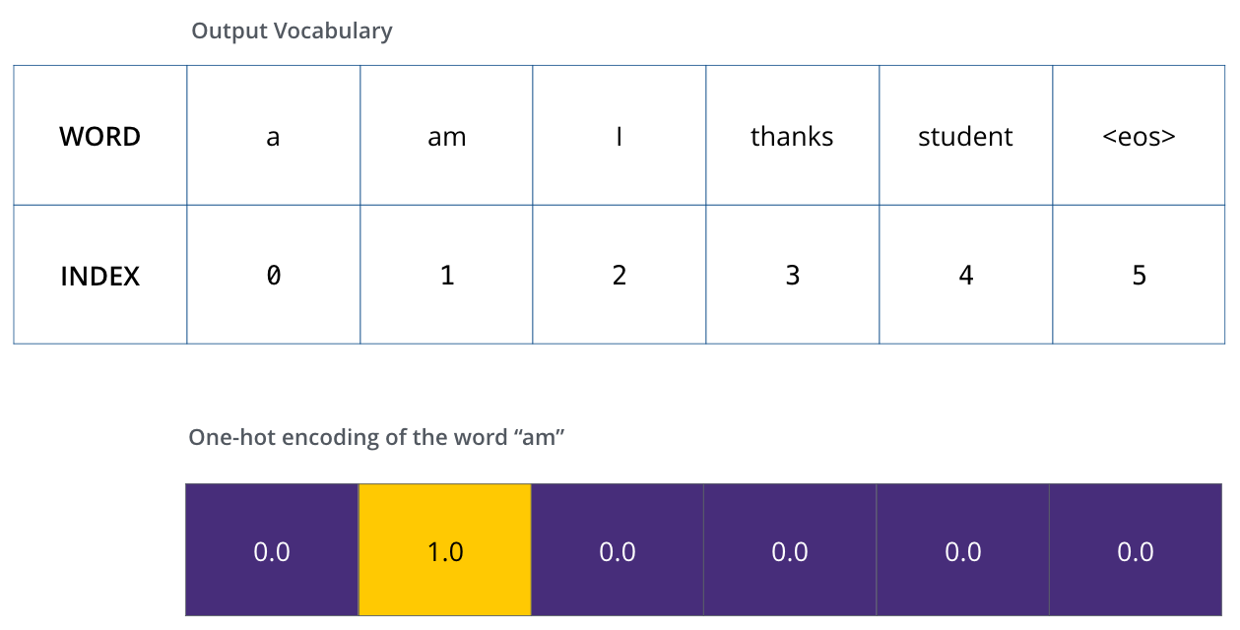
Training
assume the vocabulary only contains six words(“a”, “am”, “i”, “thanks”, “student”, and “<eos>

Slide 33
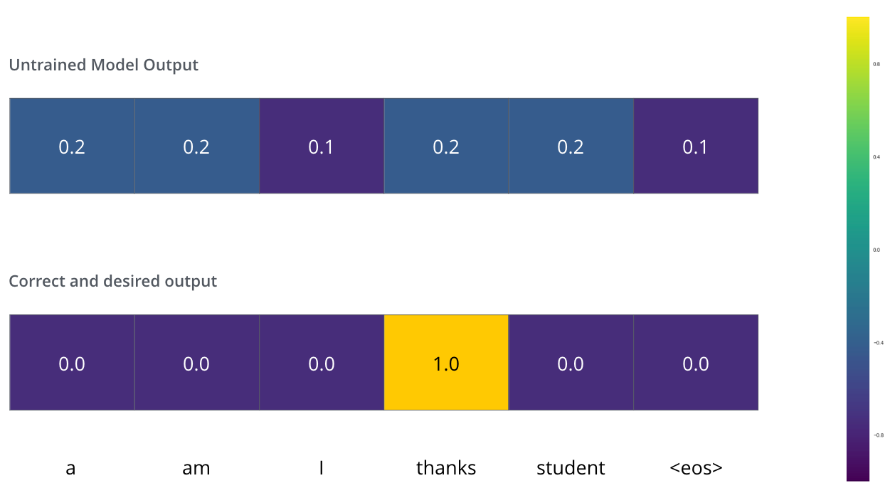
Loss Function
Cross entropy
Gradient of cross entropy is just the difference between the expected and predicted vectors

Slide 34
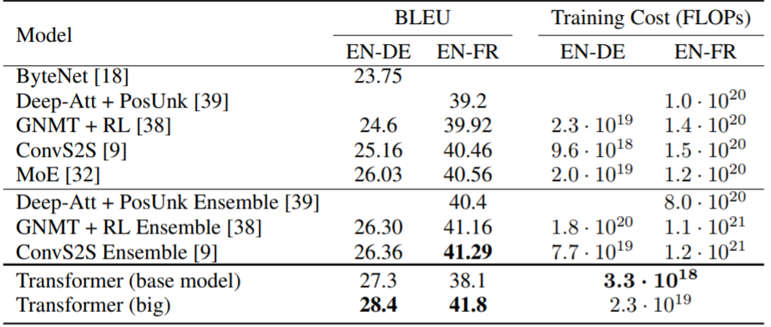
Machine Translation
On both WMT 2014 English-to-German and WMT 2014 English-to-French translation tasks, the Transformer achieves a new state of the art

Slide 35
References
Attention Is All You Need
Transformer: A Novel Neural Network Architecture for Language Understanding
The Illustrated Transformer

Slide 36
BERT
Bidirectional Embeddings for Transformer

Slide 37
BERT
http://jalammar.github.io/illustrated-bert/
Notebook
  https://colab.research.google.com/drive/1RhmL0BqNe52FEbdSyLpkfVuCZxE7b5ke

Slide 38
Problem with Previous Methods
Problem: Language models only use left context or right context, but language understanding is bidirectional.
Why are LMs unidirectional?
Reason 1: Directionality is needed to generate a well-formed probability distribution.
  We don’t care about this.
Reason 2: Words can “see themselves” in a bidirectional encoder.
Slide from Jacob Delvin

Slide 39
Masked LM
Solution: Mask out k% of the input words, and then predict the masked words
  Typically k = 15%
store gallon
the man went to the [MASK] to buy a [MASK] of milk
Too little masking: Too expensive to train
Too much masking: Not enough context
Slide from Jacob Delvin

Slide 40
Masked LM
Problem: Mask token never seen at fine-tuning
Solution: 15% of the words to predict, but don’t replace with [MASK] 100% of the time. Instead:
80% of the time, replace with [MASK]
  went to the store → went to the [MASK]
10% of the time, replace random word
went to the store → went to the running
10% of the time, keep same
went to the store → went to the store
Slide from Jacob Delvin

Slide 41

Next Sentence Prediction
To learn relationships between sentences, predict whether Sentence B is actual sentence that follows Sentence A, or a random sentence
Slide from Jacob Delvin

Slide 42
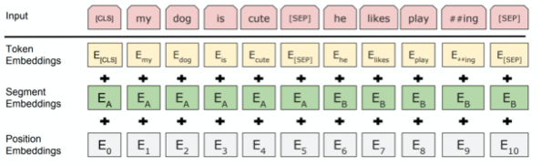
Input Representation
Use 30,000 WordPiece vocabulary on input.
Each token is sum of three embeddings
Single sequence is much more efficient.
Slide from Jacob Delvin

Slide 43

Unidirectional vs. Bidirectional Models
Unidirectional context
Build representation incrementally
Bidirectional context
Words can “see themselves”
open a bank
open a bank
Layer 2
Layer 2
Layer 2
Layer 2
Layer 2
Layer 2
Layer 1
Layer 1
Layer 1
Layer 1
Layer 1
Layer 1
<s> open a
<s> open a
Slide from Jacob Delvin

Slide 44
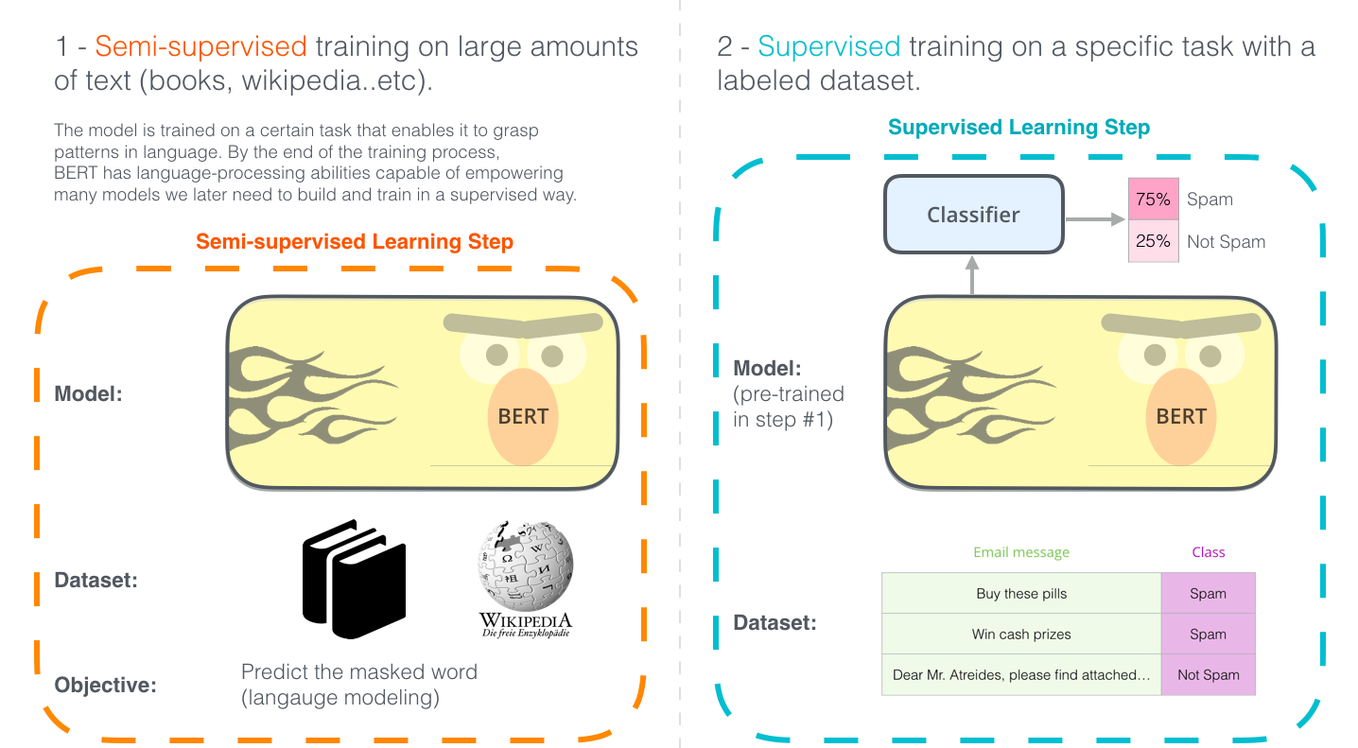
Two Step Development

Slide 45
Pre-training Tasks
Masked LM
Next Sentence Prediction
train a deep bidirectional representation, masking some percentage of the input tokens at random, and then predicting those masked tokens
the final hidden vectors corresponding to the mask tokens are fed into an output softmax over the vocabulary, as in a standard LM
In order to train a model that understands sentence relationships, we pre-train for a binarized next sentence prediction task generated from any corpus
50% of the time B is the actual next sentence that follows A and 50% of the time it is a random sentence

Slide 46
Masked LM

Slide 47
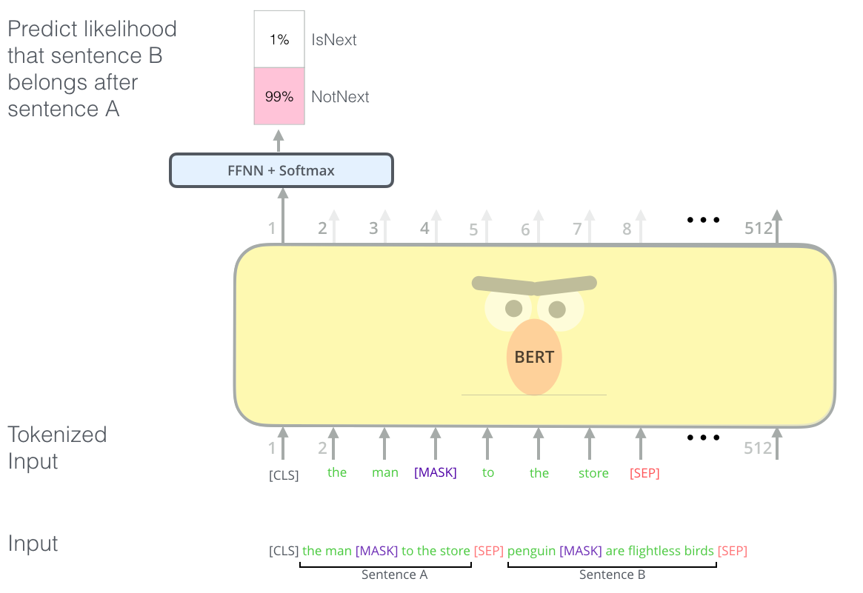
Next Sentence Prediction

Slide 48

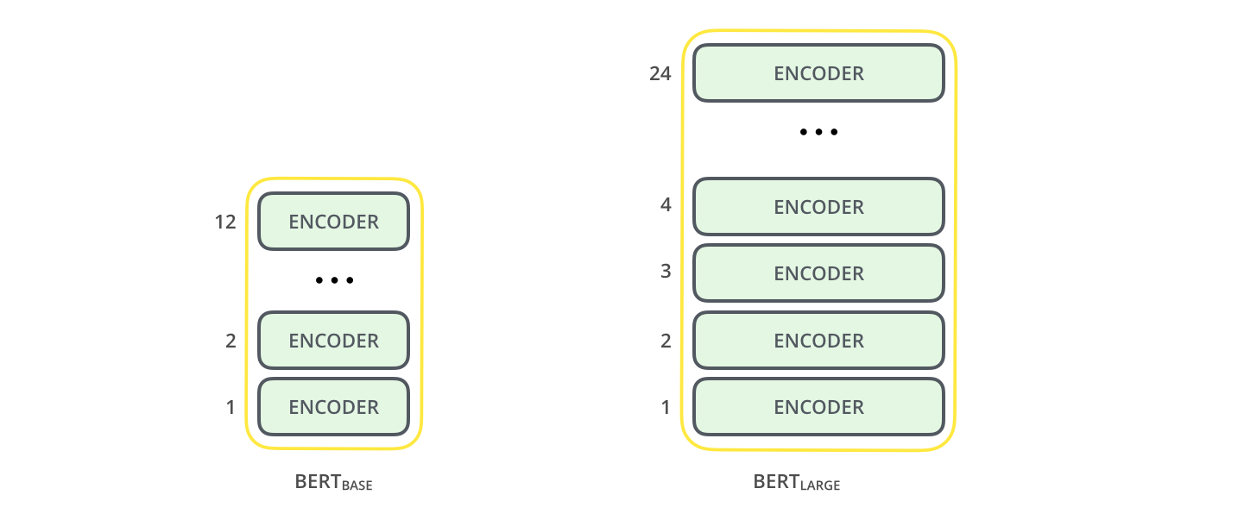
Model Architecture
BERT BASE – Comparable in size to the OpenAI Transformer in order to compare performance
BERT LARGE – A huge 12 layer model which achieved the state of the art results
BERT is basically a trained Transformer Encoder stack.

Slide 49
Model Details
Data: Wikipedia (2.5B words) + BookCorpus (800M words)
Batch Size: 131,072 words (1024 sequences * 128 length or 256 sequences * 512 length)
Training Time: 1M steps (~40 epochs)
Optimizer: AdamW, 1e-4 learning rate, linear decay
BERT-Base: 12-layer, 768-hidden, 12-head
BERT-Large: 24-layer, 1024-hidden, 16-head
Trained on 4x4 or 8x8 TPU slice for 4 days
Slide from Jacob Delvin

Slide 50
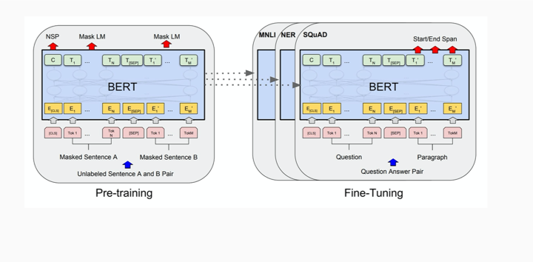
Fine Tuning Procedure

Slide 51
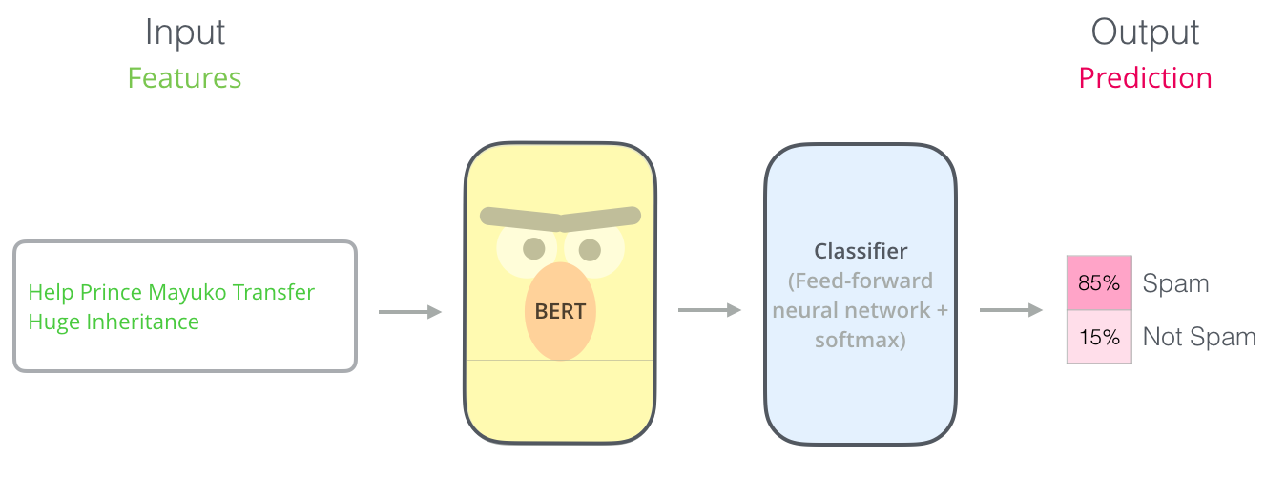
Example: Sentence Classification

Slide 52
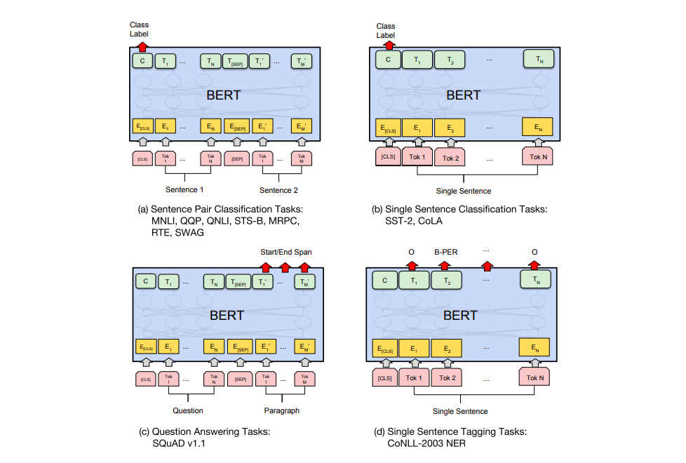
Task Specific Models

Slide 53
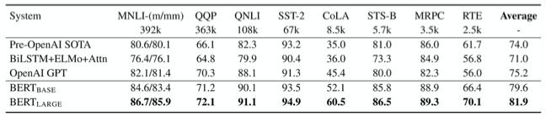
GLUE Results
MultiNLI
Premise: Hills and mountains are especially sanctified in Jainism.
Hypothesis: Jainism hates nature.
Label: Contradiction
CoLa
Sentence: The wagon rumbled down the road. Label: Acceptable
Sentence: The car honked down the road.
Label: Unacceptable
Slide from Jacob Delvin

Slide 54


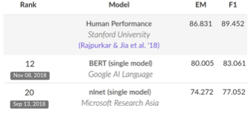
SQUAD 2.0
Use token 0 ([CLS]) to emit logit for “no answer”.
“No answer” directly competes with answer span.
Threshold is optimized on dev set.
Slide from Jacob Delvin

Slide 55
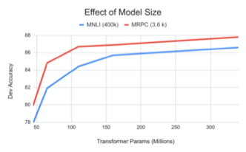
Effects of Model Size
Big models help a lot
Going from 110M -> 340M params helps even on datasets with 3,600 labelled examples
Improvements have not asymptoted
Slide from Jacob Delvin

Slide 56
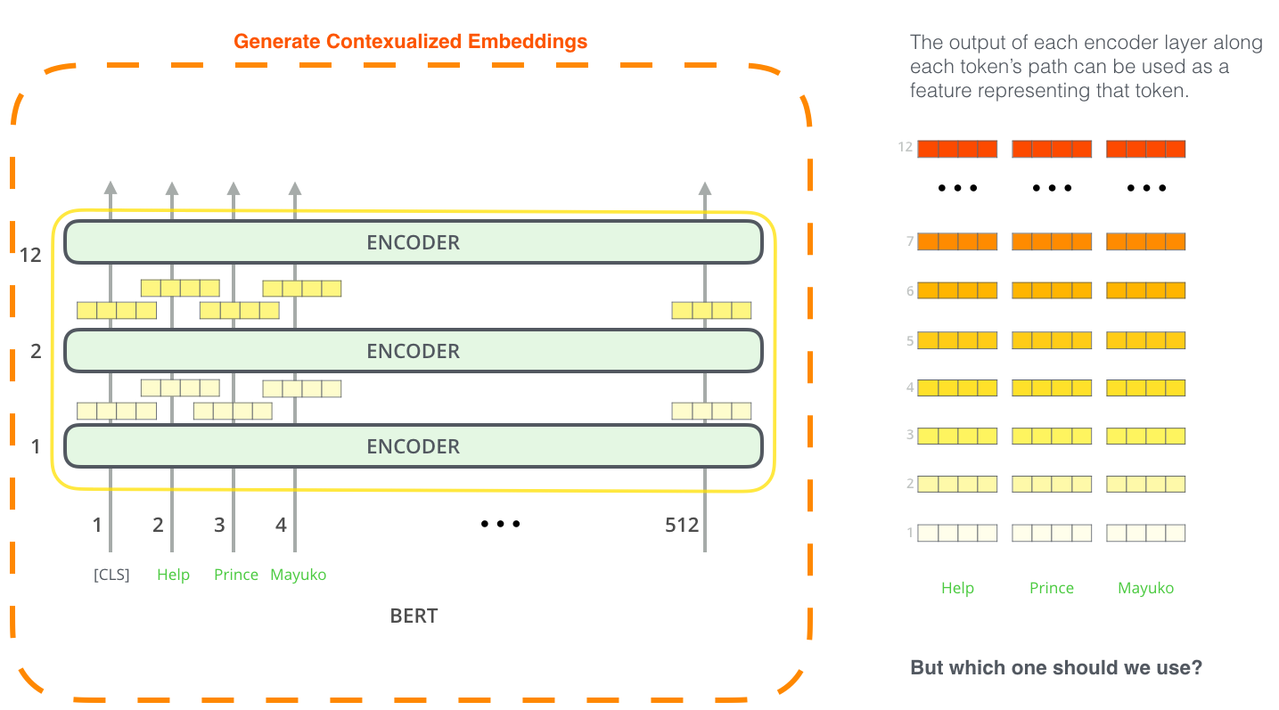
BERT for Contextualized Word Embeddings

Slide 57
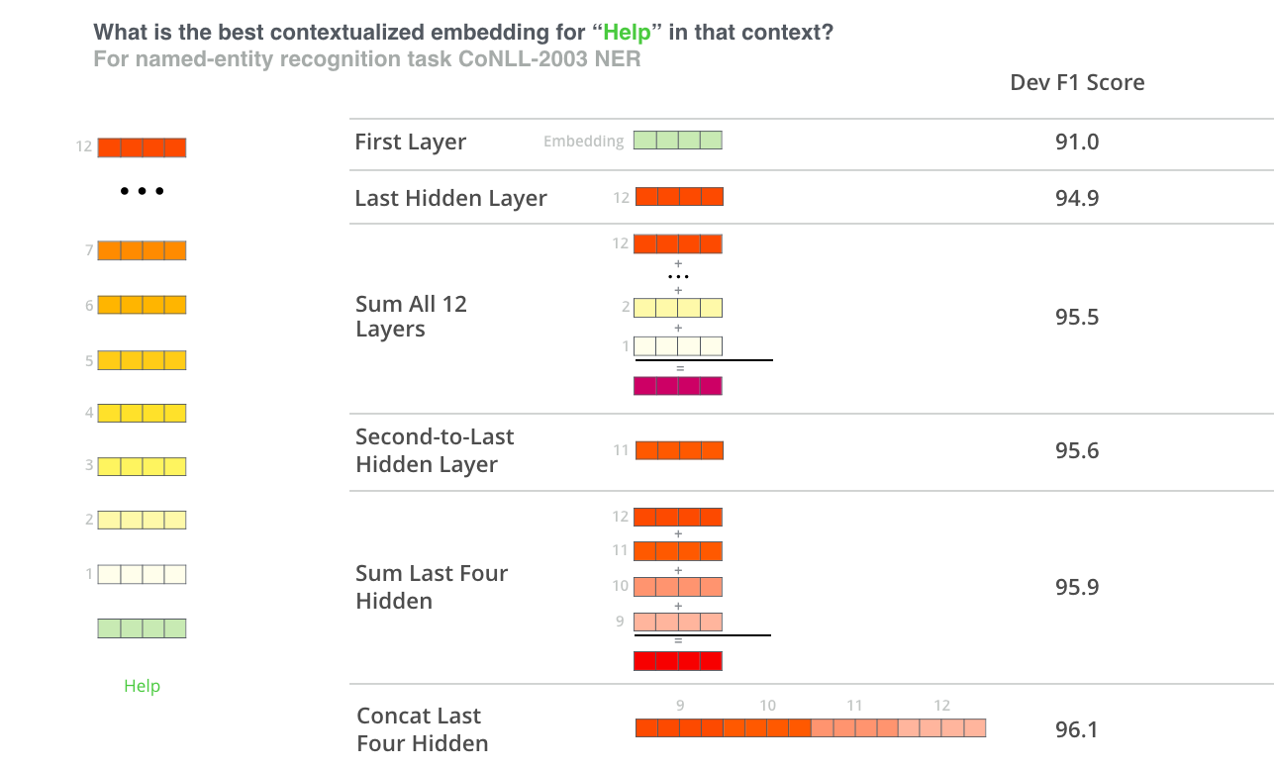
Which Layers

Slide 58
References
The Illustrated BERT, ELMo, and co. (How NLP Cracked Transfer Learning)
BERT

Slide 59
Post BERT

Slide 60
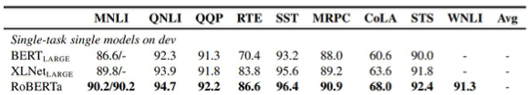
RoBERTa
RoBERTa: A Robustly Optimized BERT Pretraining Approach (Liu et al, University of Washington and Facebook, 2019)
Trained BERT for more epochs and/or on more data
  Showed that more epochs alone helps, even on same data
  More data also helps
Improved masking and pre-training data slightly
Slide from Jacob Delvin

Slide 61
XLNet
XLNet: Generalized Autoregressive Pretraining for Language Understanding (Yang et al, CMU and Google, 2019)
Innovation #1: Relative position embeddings
  Sentence: John ate a hot dog
  Absolute attention: “How much should dog attend to hot (in any position), and how much should dog in position 4 attend to the word in position 3? (Or 508 attend to 507, ...)”
  Relative attention: “How much should dog attend to hot (in any position) and how much should dog attend to the previous word?”
Slide from J. Delvin

Slide 62
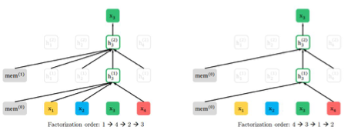
XLNet
Innovation #2: Permutation Language Modeling
  In a left-to-right language model, every word is predicted based on all of the words to its left
  Instead: Randomly permute the order for every training sentence
  Equivalent to masking, but many more predictions per sentence
  Can be done efficiently with Transformers
Slide from J. Delvin

Slide 63
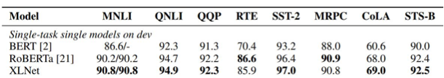
XLNet
Also used more data and bigger models, but showed that innovations improved on BERT even with same data and model size
XLNet results:
Slide from J. Delvin

Slide 64
ALBERT
ALBERT: A Lite BERT for Self-supervised Learning of Language Representations (Lan et al, Google and TTI Chicago, 2019)
Innovation #1: Factorized embedding parameterization
  Use small embedding size (e.g., 128) and then project it to Transformer hidden size (e.g., 1024) with parameter matrix
1024
x
100k
128
x
100k
1024
x
128
vs
x
Slide from J. Delvin

Slide 65


ALBERT
Innovation #2: Cross-layer parameter sharing
  Share all parameters between Transformer layers
Results:
ALBERT is light in terms of parameters, not speed
Slide from J. Delvin

Slide 66
T5
Exploring the Limits of Transfer Learning with a Unified Text-to-Text Transformer (Raffel et al, Google, 2019)
Ablated many aspects of pre-training:
  Model size
  Amount of training data
  Domain/cleanness of training data
  Pre-training objective details (e.g., span length of masked text)
  Ensembling
  Finetuning recipe (e.g., only allowing certain layers to finetune)
  Multi-task training
Slide from J. Delvin

Slide 67
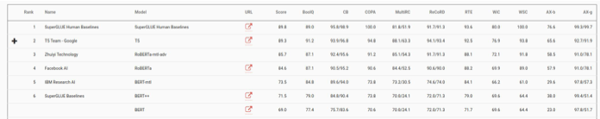
T5
Conclusions:
  Scaling up model size and amount of training data helps a lot
  Best model is 11B parameters (BERT-Large is 330M), trained on 120B words of cleaned common crawl text
  Exact masking/corruptions strategy doesn’t matter that much
  Mostly negative results for better finetuning and multi-task strategies
T5 results:
Slide from J. Delvin

Slide 68
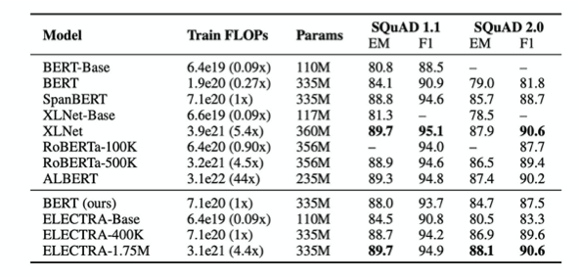
Compute
SoTA requires lots of cxompute
Slide from J. Delvin

Slide 69
Distillation

Slide 70


Applying to production
BERT and other pre-trained language models are extremely large and expensive
How are companies applying them to low-latency production services?
Slide from J. Delvin

Slide 71
Distillation
Answer: Distillation (a.k.a., model compression)
Idea has been around for a long time:
  Model Compression (Bucila et al, 2006)
  Distilling the Knowledge in a Neural Network (Hinton et al, 2015)
Simple technique:
  Train “Teacher”: Use SOTA pre-training + fine-tuning technique to train model with maximum accuracy
  Label a large amount of unlabeled input examples with Teacher
  Train “Student”: Much smaller model (e.g., 50x smaller) which is trained to mimic Teacher output
  Student objective is typically Mean Square Error or Cross Entropy
Slide from J. Delvin

Slide 72
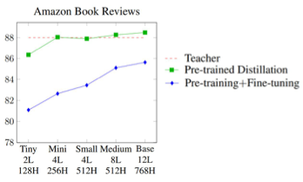
Distillation
Example distillation results
  50k labeled examples, 8M unlabeled examples
Distillation works much better than pre-training + fine-tuning with smaller model
Well-Read Students Learn Better: On the Importance of Pre-training Compact Models (Turc et al, 2020)
Slide from J. Delvin

Slide 73
Distillation
Why does distillation work so well? A hypothesis:
  Language modeling is the “ultimate” NLP task in many ways
    I.e., a perfect language model is also a perfect question answering/entailment/sentiment analysis model
  Training a massive language model learns millions of latent features which are useful for these other NLP tasks
  Finetuning mostly just picks up and tweaks these existing latent features
  This requires an oversized model, because only a subset of the features are useful for any given task
  Distillation allows the model to only focus on those features
  Supporting evidence: Simple self-distillation (distilling a smaller BERT model) doesn’t work
Slide from J. Delvin

Slide 74
Conclusions
Pre-trained bidirectional language models work incredibly well
However, the models are extremely expensive
Improvements (unfortunately) seem to mostly come from even more expensive models and more data
The inference/serving problem is mostly “solved” through distillation
Slide from J. Delvin

