Slide 1
BERT
Università di Pisa
Human Language Technologies
Dipartimento di Informatica
Giuseppe Attardi

Slide 2
BERT: Bidirectional Embeddings for Transformer
Illustrated BERT:
http://jalammar.github.io/illustrated-bert/
Notebook:
https://colab.research.google.com/drive/1hMLd5-r82FrnFnBub-B-fVW78Px4KPX1

Slide 3
Problem with Previous Methods
Problem: Language models only use left context or right context, but language understanding is bidirectional.
Why are LMs unidirectional?
Reason 1: Directionality is needed to generate a well-formed probability distribution.
We don’t care about this.
Reason 2: Words can “see themselves” in a bidirectional encoder.
Slide from Jacob Delvin

Slide 4
What makes BERT different?
BERT is the first, deeply bidirectional, unsupervised language representation, pre-trained using only a plain text corpus
Pre-trained representation
Context free
word2vedc, GloVE
Contextual
unidirectional
GPT
biidirectional
ElMO (shallow), BERT

Slide 5
Masked LM
Solution: Mask out k% of the input words, and then predict the masked words
Typically k = 15%
store gallon
the man went to the [MASK] to buy a [MASK] of milk
Too little masking: Too expensive to train
Too much masking: Not enough context
Slide from Jacob Delvin

Slide 6
Masked LM
Problem: Mask token never seen at fine-tuning
Solution: 15% of the words to predict, but don’t replace with [MASK] 100% of the time. Instead:
80% of the time, replace with [MASK]
went to the store → went to the [MASK]
10% of the time, replace random word went to the store → went to the running
10% of the time, keep same went to the store → went to the store
Slide from Jacob Delvin

Slide 7
Next Sentence Prediction
To learn relationships between sentences, predict whether Sentence B is actual sentence that follows Sentence A, or a random sentence
Slide from Jacob Delvin

Slide 8
Input Representation
Hidden state corresponding to [CLS] will be used as the sentence representation
Use 30,000 WordPiece vocabulary on input.
Each token is sum of three embeddings
Single sequence is much more efficient.
Slide from Jacob Delvin

Slide 9
WordPiece
BERT uses a variant of the wordpiece model
wordpieces give a good balance between the flexibility of single characters and the efficiency of full words for decoding, and also sidesteps the need for special treatment of unknown words.
(Relatively) common words are in the vocabulary:
at, fairfax, 1910s
Other words are built from wordpieces:
hypatia = h ##yp ##ati ##a
Wordpiece Model:
Given a training corpus and a number of desired tokens D, select D wordpieces such that the resulting corpus is minimal in the number of wordpieces when segmented according to the chosen wordpiece model.
If you’re using BERT in an otherwise word based model, you have to deal with this

Slide 10
BERT Tokenizer
from transformers import BertModel, BertTokenizer tokenizer = BertTokenizer.from_pretrained('bert-base-uncased')
model = BertModel.from_pretrained('bert-base-uncased’)
wps_ids = tokenizer.encode("Hypatia was a mathematician"))
wordpieces = tokenizer.convert_ids_to_tokens(wps_ids)
['[CLS]', 'h', '##yp', '##ati', '##a', 'was', 'a', 'mathematician', '[SEP]']

Slide 11
Unidirectional vs. Bidirectional Models
Unidirectional context
Build representation incrementally
Bidirectional context
Words can “see themselves”
open a bank
open a bank
Layer 2
Layer 2
Layer 2
Layer 2
Layer 2
Layer 2
Layer 1
Layer 1
Layer 1
Layer 1
Layer 1
Layer 1
<s> open a
<s> open a
Slide from Jacob Delvin

Slide 12
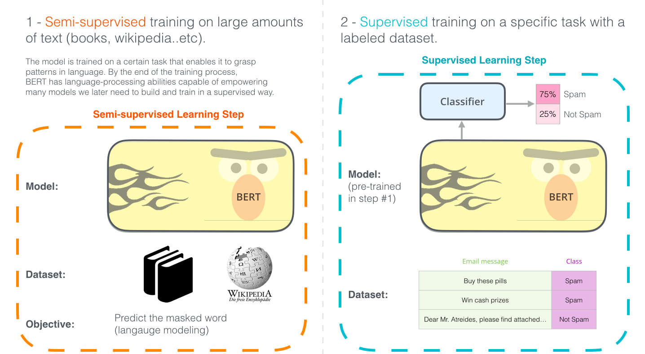
Two Step Development

Slide 13
Pre-training Tasks
Masked LM
Next Sentence Prediction
train a deep bidirectional representation, masking some percentage of the input tokens at random, and then predicting those masked tokens
the final hidden vectors corresponding to the mask tokens are fed into an output softmax over the vocabulary, as in a standard LM
In order to train a model that understands sentence relationships, we pre-train for a binarized next sentence prediction task generated from any corpus
50% of the time B is the actual next sentence that follows A and 50% of the time it is a random sentence

Slide 14
Masked LM
Randomly select 15% of tokens (up to 20 per seq)
For 80% of the time:
Replace the word with the [MASK] token
For 10% of the time:
Replace the word with a random word
For 10% of the time
Keep the word unchanged

Slide 15
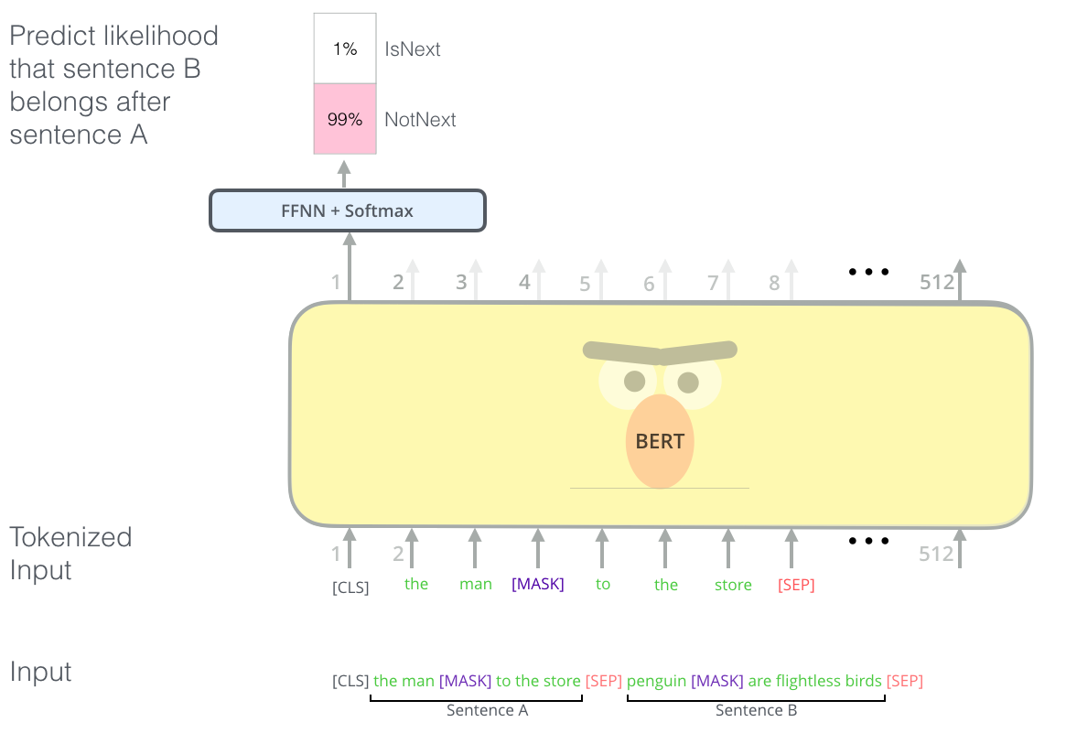
Next Sentence Prediction
Binary classification
Randomly select a split over sentences:
Use one as sentence A
For 50% of the time:
Sample random sentence split from another document as sentence B.
For 50% of the time:
Use the actual sentences as sentence B.
Masking (Truncate([segment A, segment B]))

Slide 16
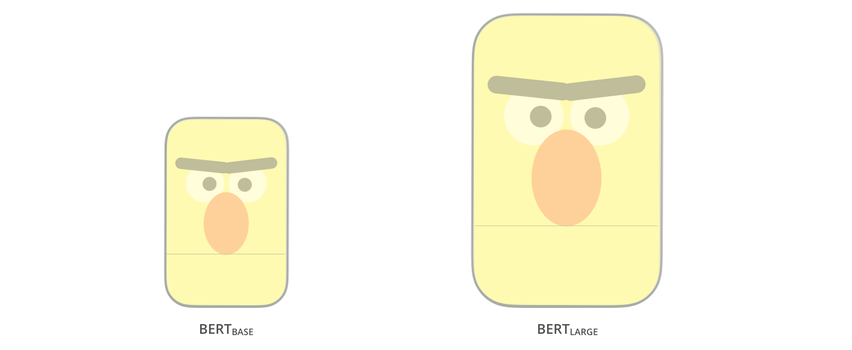
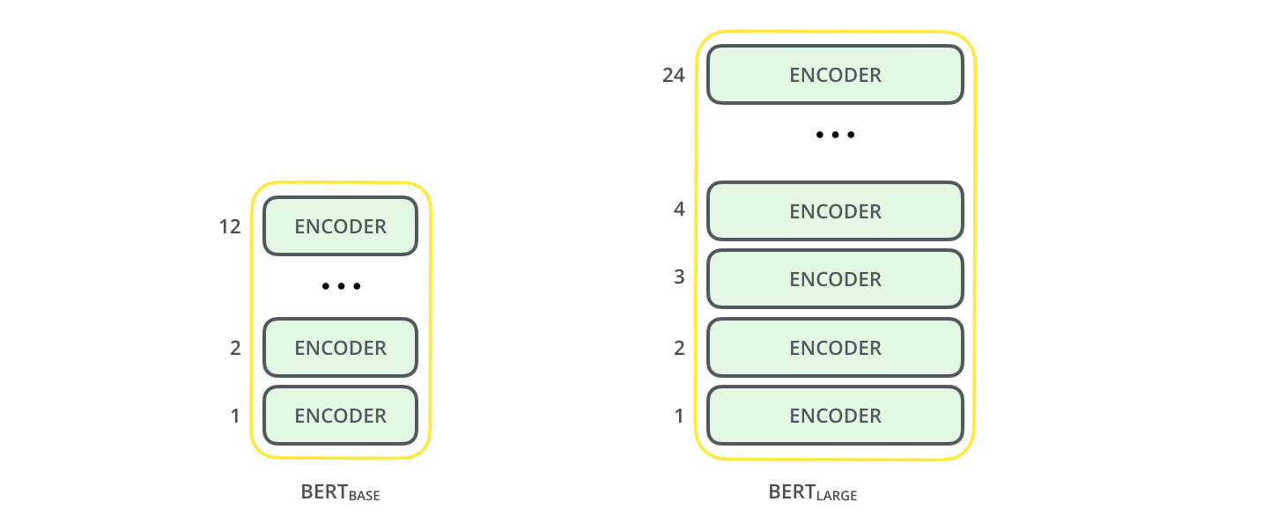
Model Architecture
BERT BASE – 12 layer model Comparable in size to the OpenAI Transformer in order to compare performance
BERT LARGE – A huge 24 layer model which achieved the state of the art results
BERT is basically a trained Transformer Encoder stack.

Slide 17
Model Details
Data: Wikipedia (2.5B words) + BookCorpus (800M words)
Batch Size: 131,072 words (1024 sequences * 128 length or 256 sequences * 512 length)
Training Time: 1M steps (~40 epochs)
Optimizer: AdamW, 1e-4 learning rate, linear decay
BERT-Base: 12-layer, 768-hidden, 12-head
BERT-Large: 24-layer, 1024-hidden, 16-head
Trained on 4x4 or 8x8 TPU slice for 4 days
Slide from Jacob Delvin

Slide 18
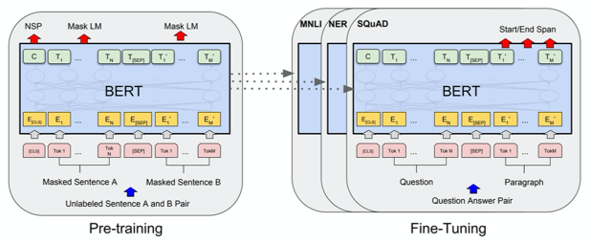
Fine Tuning Procedure

Slide 19
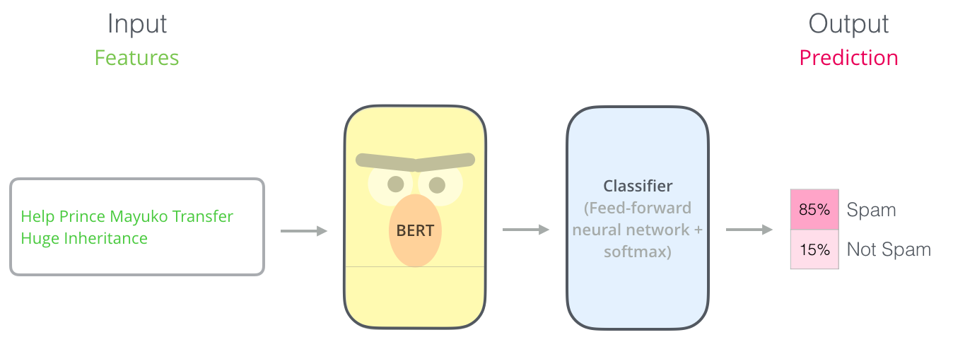
Example: Sentence Classification

Slide 20
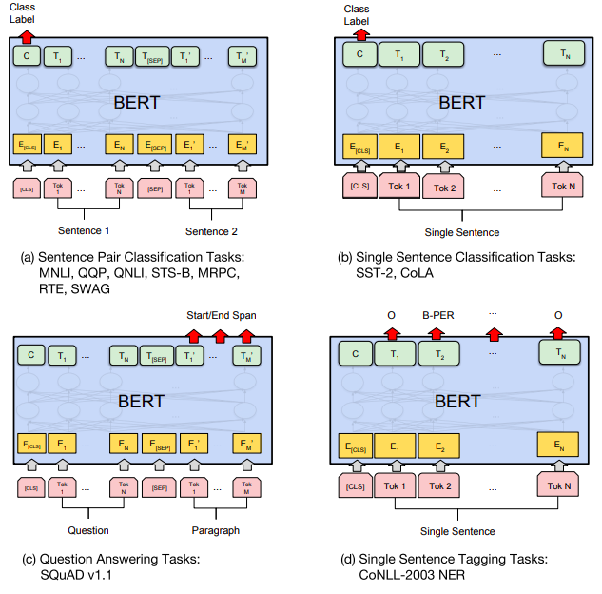
Task Specific Models

Slide 21
Evaluation of BERT
General Language Understanding Evaluation (GLUE) benchmark: Standard split of data to train, validation, test, where labels for the test set is only held in the server.
Sentence pair tasks
MNLI, Multi-Genre Natural Language Inference
QQP, Quora Question Pairs
QNLI, Question Natural Language Inference
STS-B The Semantic Textual Similarity Benchmark
MRPC Microsoft Research Paraphrase Corpus
RTE Recognizing Textual Entailment
WNLI Winograd NLI is a small natural language inference dataset
Single sentence classification
SST-2 The Stanford Sentiment Treebank
CoLA The Corpus of Linguistic Acceptability

Slide 22
GLUE Results
MultiNLI
Premise: Hills and mountains are especially sanctified in Jainism. Hypothesis: Jainism hates nature. Label: Contradiction
CoLa
Sentence: The wagon rumbled down the road. Label: Acceptable
Sentence: The car honked down the road.
Label: Unacceptable
Slide from Jacob Delvin

Slide 23
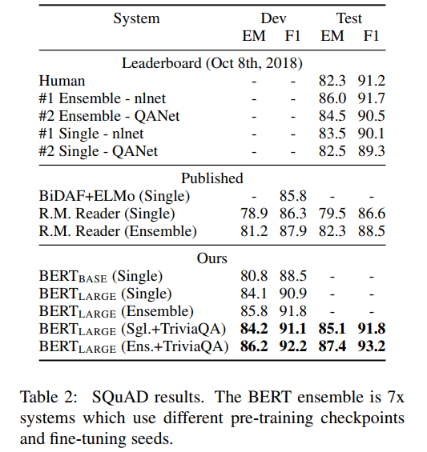
SQUAD
The Stanford Question Answering Dataset (SQuAD) is a collection of 100k question/answer pairs posed by crowdworkers on a set of Wikipedia articles
Input Question:
Where do water droplets collide with ice to make precipitation?
Input Paragraph:
Precipitation forms as smaller droplets coalesce with collision with other rain drops or ice cristals within a cloud
Answer:
within a cloud
Too easy: answer always present

Slide 24
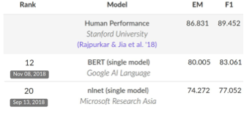
SQUAD 2.0
What action did the US begin that started the second oil shock?
Ground Thruth Answers: <No Answer>
Prediction: <No Answer>
Use token 0 ([CLS]) to emit logit for “no answer”
“No answer” directly competes with answer span
Threshold is optimized on dev set
Slide from Jacob Delvin

Slide 25
Effect of pre-training tasks
Masked LM (compared to left-to-right LM) is very important on some tasks, Next Sentence Prediction is important on other tasks.
Left-to-right model does very poorly on word-level task (SQuAD), although this is mitigated by BiLSTM

Slide 26
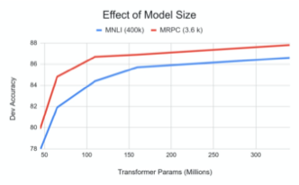
Effects of Model Size
Big models help a lot
Going from 110M -> 340M params helps even on datasets with 3,600 labelled examples
Improvements have not asymptoted
Slide from Jacob Delvin

Slide 27
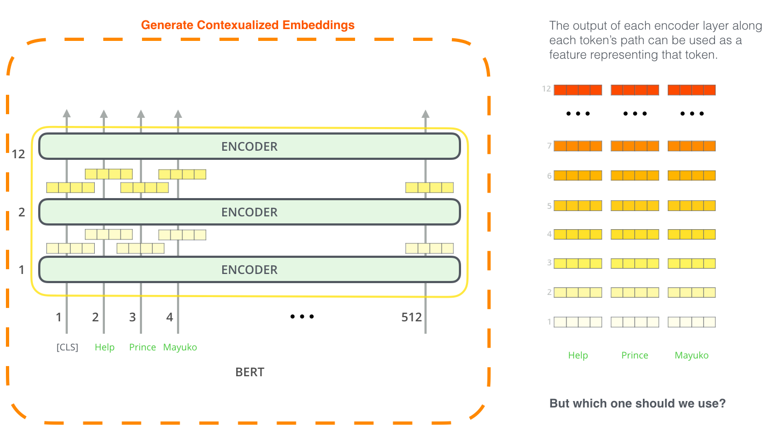
BERT for Contextualized Word Embeddings

Slide 28
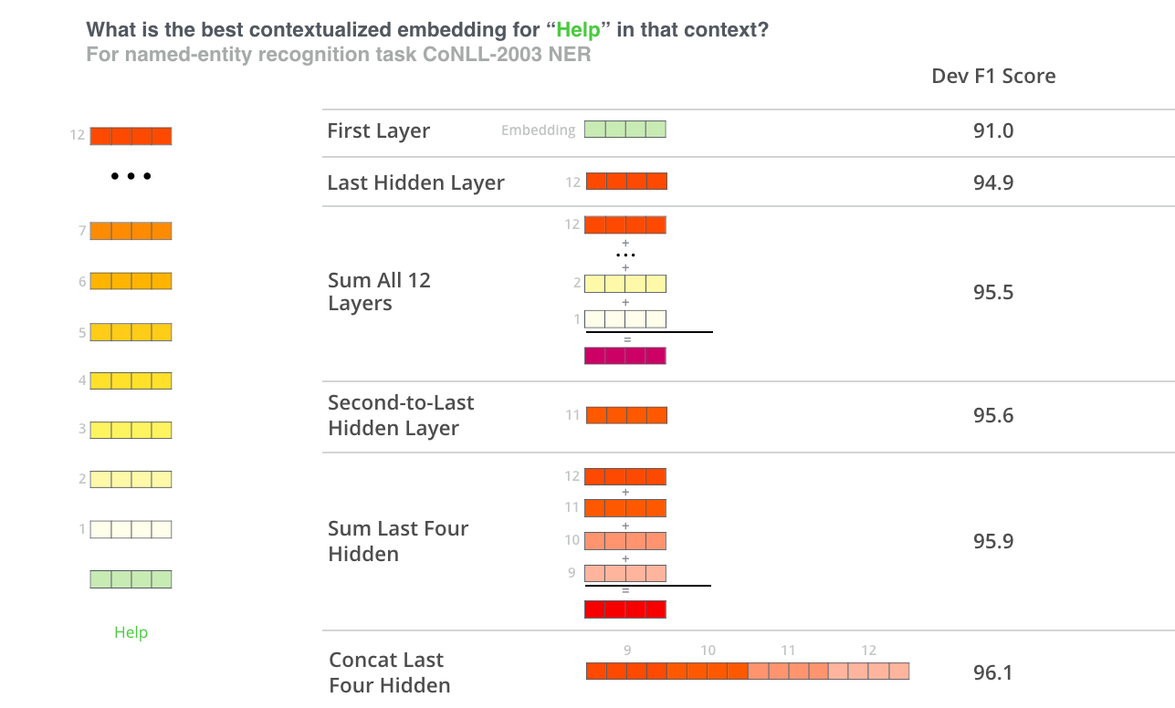
Which Layers

Slide 29
References
The Illustrated BERT, ELMo, and co. (How NLP Cracked Transfer Learning)
BERT

Slide 30
Post BERT

Slide 31
RoBERTa
RoBERTa: A Robustly Optimized BERT Pretraining Approach (Liu et al, University of Washington and Facebook, 2019)
Trained BERT for more epochs and/or on more data
Showed that more epochs alone helps, even on same data
More data also helps
Improved masking and pre-training data slightly
Slide from Jacob Delvin

Slide 32
XLNet
XLNet: Generalized Autoregressive Pretraining for Language Understanding (Yang et al, CMU and Google, 2019)
Innovation #1: Relative position embeddings
Sentence: John ate a hot dog
Absolute attention: “How much should dog attend to hot (in any position), and how much should dog in position 4 attend to the word in position 3? (Or 508 attend to 507, ...)”
Relative attention: “How much should dog attend to hot (in any position) and how much should dog attend to the previous word?”
Slide from J. Delvin

Slide 33
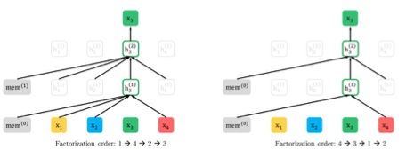
XLNet
Innovation #2: Permutation Language Modeling
In a left-to-right language model, every word is predicted based on all of the words to its left
Instead: Randomly permute the order for every training sentence
Equivalent to masking, but many more predictions per sentence
Can be done efficiently with Transformers
Slide from J. Delvin

Slide 34
XLNet
Also used more data and bigger models, but showed that innovations improved on BERT even with same data and model size
XLNet results:
Slide from J. Delvin

Slide 35
ALBERT
ALBERT: A Lite BERT for Self-supervised Learning of Language Representations (Lan et al, Google and TTI Chicago, 2019)
Innovation #1: Factorized embedding parameterization
Use small embedding size (e.g., 128) and then project it to Transformer hidden size (e.g., 1024) with parameter matrix
1024
x
100k
128
x
100k
1024
x
128
vs
x
Slide from J. Delvin

Slide 36
ALBERT
Innovation #2: Cross-layer parameter sharing
Share all parameters between Transformer layers
Results:
ALBERT is light in terms of parameters, not speed
Slide from J. Delvin

Slide 37
T5
Exploring the Limits of Transfer Learning with a Unified Text-to-Text Transformer (Raffel et al, Google, 2019)
Ablated many aspects of pre-training:
Model size
Amount of training data
Domain/cleanness of training data
Pre-training objective details (e.g., span length of masked text)
Ensembling
Finetuning recipe (e.g., only allowing certain layers to finetune)
Multi-task training
Slide from J. Delvin

Slide 38
T5
Conclusions:
Scaling up model size and amount of training data helps a lot
Best model is 11B parameters (BERT-Large is 330M), trained on 120B words of cleaned common crawl text
Exact masking/corruptions strategy doesn’t matter that much
Mostly negative results for better finetuning and multi-task strategies
T5 results:
Slide from J. Delvin

Slide 39
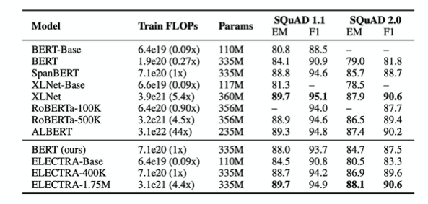
Compute
SoTA requires lots of cxompute
Slide from J. Delvin

Slide 40
Distillation

Slide 41
Applying to production
BERT and other pre-trained language models are extremely large and expensive
How are companies applying them to low-latency production services?
Slide from J. Delvin

Slide 42
Distillation
Answer: Distillation (a.k.a., model compression)
Idea has been around for a long time:
Model Compression (Bucila et al, 2006)
Distilling the Knowledge in a Neural Network (Hinton et al, 2015)
Simple technique:
Train “Teacher”: Use SOTA pre-training + fine-tuning technique to train model with maximum accuracy
Label a large amount of unlabeled input examples with Teacher
Train “Student”: Much smaller model (e.g., 50x smaller) which is trained to mimic Teacher output
Student objective is typically Mean Square Error or Cross Entropy
Slide from J. Delvin

Slide 43
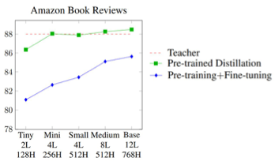
Distillation
Example distillation results
50k labeled examples, 8M unlabeled examples
Distillation works much better than pre-training + fine-tuning with smaller model
Well-Read Students Learn Better: On the Importance of Pre-training Compact Models (Turc et al, 2020)
Slide from J. Delvin

Slide 44
Distillation
Why does distillation work so well? A hypothesis:
Language modeling is the “ultimate” NLP task in many ways
I.e., a perfect language model is also a perfect question answering/entailment/sentiment analysis model
Training a massive language model learns millions of latent features which are useful for these other NLP tasks
Finetuning mostly just picks up and tweaks these existing latent features
This requires an oversized model, because only a subset of the features are useful for any given task
Distillation allows the model to only focus on those features
Supporting evidence: Simple self-distillation (distilling a smaller BERT model) doesn’t work
Slide from J. Delvin

Slide 45
Conclusions
Pre-trained bidirectional language models work incredibly well
However, the models are extremely expensive
Improvements (unfortunately) seem to mostly come from even more expensive models and more data
The inference/serving problem is mostly “solved” through distillation
Slide from J. Delvin

