Slide 1
Chatbots: Experiments
Università di Pisa
Human Language Technologies
Giuseppe Attardi
Dipartimento di Informatica
Università di Pisa

Slide 2
Template-based with DialogFlow

Slide 3
Build Actions with Google Assistant
Experiment with Dialogflow:
https://codelabs.developers.google.com/codelabs/actions-1
https://codelabs.developers.google.com/codelabs/actions-2
Actions Console
https://console.actions.google.com/u/0/
Tutorial
https://chatbotslife.com/dialogflow-restaurant-bot-tutorial-1-45ce1d3c0ab5

Slide 4
Key Concepts
Agent: handles conversations with end-users. Users can request your Action by typing or speaking to the Assistant.
Intent: An underlying goal or task the user wants to do; for example, ordering coffee or finding a piece of music. Each agent may have many intents. When an user says something, Dialogflow matches the user expression to the best intent in the agent.
Entities: Each intent parameter has a type, called the entity type, which dictates exactly how data from an end-user expression is extracted.
Contexts: are similar to natural language context. Using contexts, you can control the flow of a conversation.
Fulfillment: A service, app, feed, conversation, or other logic that handles an intent and carries out the corresponding Action.

Slide 5
Intent
A basic intent contains the following:
Training phrases: example phrases for what users might say. When an user expression resembles one of these phrases, Dialogflow matches the intent.
Action: You can define an action for each intent. When an intent is matched, Dialogflow provides the action to your system, and you can use the action to trigger certain actions defined in your system.
Parameters: When an intent is matched at runtime, Dialogflow provides the extracted values from the end-user expression as parameters. Parameters are structured data.
Responses: You define text, speech, or visual responses to return to the end-user. These may provide the end-user with answers, ask the end-user for more information, or terminate the conversation.
Follow-up intents to automatically set contexts for pairs of intents. A follow-up intent is a child of its associated parent intent.

Slide 6
Basic Flow

Slide 7
Example of Context

Slide 8
Follow-up Intent
Fullfillment: when fulfillment for an intent is enabled, Dialogflow responds to that intent by calling a service that you define

Slide 9
Tools Used
Google Actions
https://console.actions.google.com/
Dialogflow
https://dialogflow.cloud.google.com/

Slide 10
Create Agent
Tutorial by Adi Cucolaș

Slide 11
Make the bot say hello

Slide 12
Add ‘hello’ and ‘hi’ to the Training phrases by typing them in the text form

Slide 13
go down to Responses and delete the current ones.

Slide 14
Press on ADD RESPONSES and then on Text response

Slide 15
Add a proper response. This is the first message the user will receive from the bot.

Slide 16
Save

Slide 17
Try it out

Slide 18
Create Intent

Slide 19
Add Training phrases
“Book a table”
“Make reservations”
“Reserve a table”

Slide 20
Add Response

Slide 21
Specify Guests and Time

Slide 22
Entities
We are going to use 3 of the system entities:
@sys.number — for the number of guests
@sys.date — for the date of the booking
@sys.time — for the time of the booking

Slide 23
Add new training phrases
The new phrases should include the date of the reservation, like:
“Book a table for 3”
“Make reservations for 5”
“Reserve a table for 2”

Slide 24
Change the parameter’s name
Go to Action and parameters section and just press on the parameter name and edit it.

Slide 25
Add prompts
In case a user only asks to “book a table” without specifying the number of guests from the start, we still need to get that information somehow. The best way to do it is to simply prompt the use

Slide 26
press on Define prompts, add relevant questions and press ENTER after each of them.

Slide 27
Update the responses
To add the value of the guests parameter, use $guests in the responses.

Slide 28
Try it out
you should be able to see both responses.

Slide 29
Fullfillment
Each Intent can have fulfillment enabled which enables to pass information into a web service and get a result from it. When the Intent is triggered by a user’s input, if the fulfillment is enabled, then a function will also trigger in the backend. Each Intent can have parameters for extracting information from user inputs, this are the entities used in the training phrases so far.

Slide 30
Cloud Functions
The inline editor allows creating fulfillment code and deploy it to Cloud Functions.
Enable the Inline Editor
This simplifies the process of developing a bot by not having to create a server and host it.
However, you need to have a billing account on Google Cloud to use this

Slide 31
Add a function
locate the position where the code should be.

Slide 32
Map the function
the function has to be mapped to the booking Intent using the Intent’s name (restaurant.booking.create)

Slide 33
First deploy and test

Slide 34
Add validation
function createBooking(agent) {
let guests = agent.parameters.guests;
let time = new Date(agent.parameters.time);
let date = new Date(agent.parameters.date);
let bookingDate = new Date(date);
bookingDate.setHours(time.getHours()); bookingDate.setMinutes(time.getMinutes());
let now = new Date();
if (guests < 1){
agent.add('You need to reserve a table for at least one person. Please try again!'); }
else if (bookingDate < now) {
agent.add(`You can't make a reservation in the past. Please try again!`);
} else if (bookingDate.getFullYear() > now.getFullYear()) {
agent.add(`You can't make a reservation for ${bookingDate.getFullYear()} yet. Please choose a date in ${now.getFullYear()}.`);
} else {
let timezone = parseInt(agent.parameters.time.toString().slice(19,22));
bookingDate.setHours(bookingDate.getHours() + timezone);
agent.add(`You have successfully booked a table for ${guests} guests on ${bookingDate.toString().slice(0,21)}`);
agent.add('See you at the restaurant!’);
agent.add('Have a wonderful day!’);
}
}

Slide 35
Change Response
Because we send the confirmation from the webhook, you can also change the response in the booking Intent to something like “Something went wrong, please try again!”. The user will only get this response if the webhook is not working.

Slide 36
Deploy

Slide 37
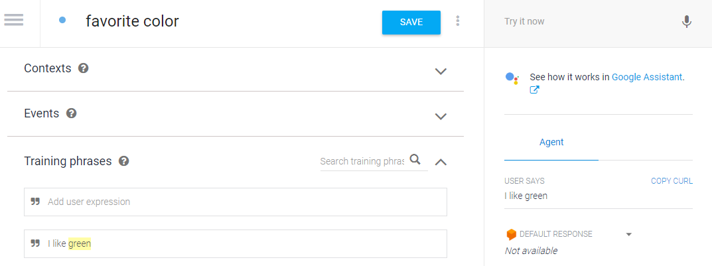
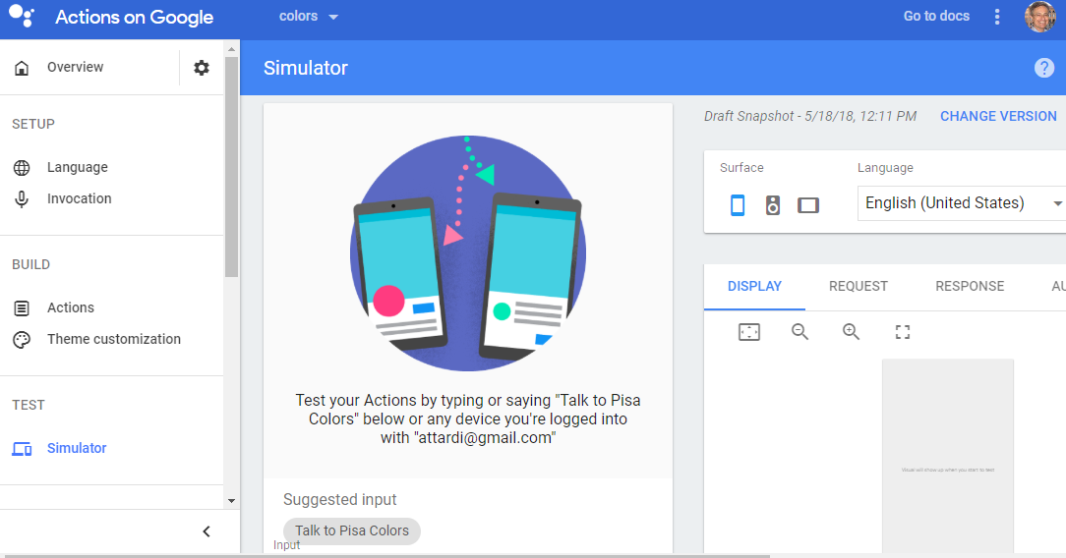
Test the action on Google Home
Once the action has been setup, click on See how it works on Google Assistant
Now the action can be tested also on Google Home

Slide 38
A Retrieval-based Model in TensorFlow

Slide 39
The Ubuntu Dialog Corpus
Ubuntu Dialog Corpus (github).
One of the largest public dialog datasets available.
Based on chat logs from the Ubuntu channels on a public IRC network.
This paper goes into detail on how exactly the corpus was created.
The training data consists of 1,000,000 examples
50% positive (label 1) and 50% negative (label 0)
Each example consists of a context, the conversation up to this point, and an utterance, a response to the context
A positive label means that an utterance was an actual response to a context,
a negative label means that the utterance wasn’t — it was picked randomly from somewhere in the corpus.

Slide 40
The dataset has been preprocessed— it has been tokenized, stemmed, and lemmatized using the NLTK tool.
Replaced entities like names, locations, organizations, URLs, and system paths with special tokens.
This preprocessing is likely to improve performance by a few percent.
The average context is 86 words long and the average utterance is 17 words long.

Slide 41
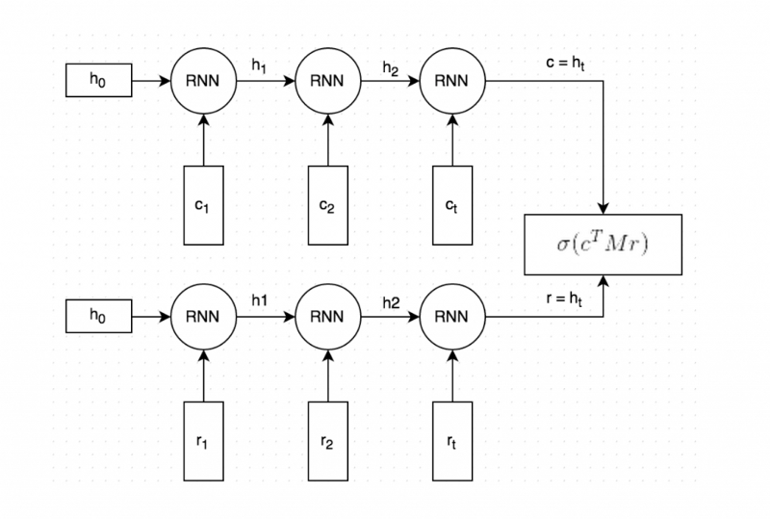
Dual Encoder LSTM
Dual Encoder has been reported to give decent performance on this data set.
Applying other models to this problem would be an interesting project.

Slide 42
Training
Context and the response text are tokenized, and each word is embedded into a vector (dimension 256), using Stanford’s GloVe vectors and are fine-tuned during training.
Both the embedded context and response are fed into the same RNN word-by-word. The RNN generates a vector representation that captures the “meaning” of the context and response (c and r in the picture).
We multiply c with a matrix M to “predict” a response r’. If c is a 256-dimensional vector, then M is a 256×256 dimensional matrix, and the result is another 256-dimensional vector, which we can interpret as a generated response. The matrix M is learned during training.
The similarity of the predicted response r’ and the actual response r is measured by taking the dot product of these two vectors, aka cosine similarity. We then apply a sigmoid function to convert that score into a probability.

Slide 43
Loss Function
Cross entropy loss between predicted ŷ and expected y:
L = −y ⋅ log(ŷ) − (1 − y) ⋅ log(1−ŷ)

Slide 44
Data Preprocessing
The dataset originally comes in CSV format.
Convert data into TensorFlow’s proprietary Example format.
This allows us to load tensors directly from the input files and let TensorFlow handle all the shuffling, batching and queuing of inputs.
As part of the preprocessing we also create a vocabulary. This means we map each word to an integer number, e.g. “cat” may become 2631.
The TFRecord files we will generate store these integer numbers instead of the word strings.
We will also save the vocabulary so that we can map back from integers to words later on.
The preprocessing is done by the prepare_data.py Python script, which generates 3 files:train.tfrecords, validation.tfrecords and test.tfrecords.

Slide 45
‘Example’ Format
Field | Description
context | A sequence of word ids representing the context text, e.g. [231, 2190, 737, 0, 912]
context_len | The length of the context, e.g. 5 for the above example
Utterance | A sequence of word ids representing the utterance (response
utterance_len | The length of the utterance
label | Only in the training data. 0 or 1.
distractor_[N] | Only in the test/validation data. N ranges from 0 to 8. A sequence of word ids representing the distractor utterance.
distractor_[N]_len | Only in the test/validation data. N ranges from 0 to 8. The length of the utterance.

Slide 46
Creating an Input Function
In order to use TensorFlow’s built-in support for training and evaluation we need to create an input function — a function that returns batches of our input data.
Since our training and test data have different formats, we need different input functions for them.
The input function should return a batch of features and labels
On a high level, the function does the following:
Create a feature definition that describes the fields in our Example file
Read records from the input_files with tf.TFRecordReader
Parse the records according to the feature definition
Extract the training labels
Batch multiple examples and training labels
Return the batched examples and training labels

Slide 47
Evaluation Metrics
TensorFlow already comes with many standard evaluation metrics that we can use, including recall@k.
To use these metrics we need to create a dictionary that maps from a metric name to a function that takes the predictions and label as arguments:
def create_evaluation_metrics():
eval_metrics = {}
for k in [1, 2, 5, 10]:
eval_metrics[“recall_at_%d” % k] = functools.partial(
tf.contrib.metrics.streaming_sparse_recall_at_k, k=k)
return eval_metrics

Slide 48
streaming_sparse_recall_at_k
f.contrib.metrics.streaming_sparse_recall_at_k(
predictions,
labels,
k,
class_id=None,
weights=None,
metrics_collections=None,
updates_collections=None,
name=None
)
Computes recall@k of the predictions with respect to sparse labels.
https://www.tensorflow.org/api_docs/python/tf/contrib/metrics/streaming_sparse_recall_at_k

Slide 49
Creating the Model
model_fn = udc_model.create_model_fn(
hparams=hparams,
model_impl=dual_encoder_model)

Slide 50
Generative Model in TensorFlow

Slide 51
Deep Learning for Chatbots
Deep Learning techniques can be used for both retrieval-based or generative models, but research seems to be moving into the generative direction
Deep Learning architectures like Sequence to Sequence are suited for generating text and research is making rapid progress in this area.
Still at the early stages of building generative models that work reasonably well.
Production systems are more likely to be retrieval-based for now.

Slide 52
Twitter bot
Query | Reply
donald trump won last nights presidential debate according to snap online polls | thought he was a joke
trump campaign please never delete this | he was a joke
s new scoop is unk the castro connection how trumps company violated the us embargo against cuba | trump is a disgrace to the debate and the media is not a liar
who won the first presidential debate | trump will be a better time for a man
just wanna live in unk everything is 10x better there | i was just on the same side and i was like it was a good time
the lil girl i forgot her name scares the shit out of me n probably always will lmaooo | she was so cute and she was so cute and she was a bitch
question of the day who do you think won last nights debate weigh in using | hillary is a trump supporter and a woman who has a better job than a woman
trump is a total embarrassment hes like a unk child who happens to be a professional liar and con man | trump is a lot of money to get a great country
chill the fuck out | thats what i said
so fun to see what the special effects team created for | wow that is the best thing ive ever seen
she was fine too unk voice | she is a good guy
the important ones are still here | i dont think so
been drinking pumpkin spice protein shake every morning for a week and now i literally cannot even | me too i just got it
lmao i just lost my job and i cant even leave early to be in the unk video today | literally the same thing
hey happy birthday have a nice day | thank you

Slide 53
Cornell Movie Dialog Corpus
Query | Reply
when are you going to let the police know | you dont know what youre talking about
you can do it | yeah i think so
wait are you saying that i dont appreciate | i know you know what i mean
youre terrible | yeah but im not
nah i dont think so | why not
hes pissing in our faces again and were just taking it | i cant
im sorry i dont know what else to say except im sorry | why would you like to be
nobodys gonna get you now get inside | i cant go back
shall i leave | of course
well i really think hes got a chance | i know
youd better be quiet sandy | shut up
jesus christ you scared the shit out of me | whats going on
well im sorry im really sorry ellie | its okay
my lady this play will end badly i will tell | lets get out of here
im going to miss you | no youre not
what do you mean | i dont know i dont know what i mean
my god these people are insane | we dont know what they are
this isnt a date | no what is it
you ought to go home and take care of that | i cant do that
is something wrong | no no no

Slide 54
Implementation
basic_cell = tf.nn.rnn_cell.DropoutWrapper(
tf.nn.rnn_cell.BasicLSTMCell(emb_dim, state_is_tuple=True),
output_keep_prob=self.keep_prob)
# stack cells together: n layered model
stacked_lstm = tf.nn.rnn_cell.MultiRNNCell([basic_cell]*num_layers, state_is_tuple=True)

Slide 55
Loss Function
loss_weights = [ tf.ones_like(label, dtype=tf.float32)
for label in self.labels ]
self.loss = tf.nn.seq2seq.sequence_loss(self.decode_outputs,
self.labels, loss_weights, yvocab_size)
self.train_op = tf.train.AdamOptimizer(learning_rate=lr).minimize(self.loss)

Slide 56
Training
model = seq2seq_wrapper.Seq2Seq(xseq_len=xseq_len,
yseq_len=yseq_len,
xvocab_size=xvocab_size,
yvocab_size=yvocab_size,
ckpt_path='ckpt/twitter/',
emb_dim=emb_dim,
num_layers=3
)
val_batch_gen = data_utils.rand_batch_gen(validX, validY, 32)
train_batch_gen = data_utils.rand_batch_gen(trainX, trainY, batch_size)
#sess = model.restore_last_session()
sess = model.train(train_batch_gen, val_batch_gen)

Slide 57
Seq2seq model with embeddings
self.decode_outputs, self.decode_states = tf.nn.seq2seq.embedding_rnn_seq2seq( self.enc_ip,self.dec_ip, stacked_lstm, xvocab_size, yvocab_size, emb_dim)

Slide 58
Facebook BlenderBot
https://ai.facebook.com/blog/state-of-the-art-open-source-chatbot/
https://arxiv.org/pdf/2004.13637.pdf

Slide 59
Recipe: Scale, Blending Skills and Generation
the best current systems train high-capacity neural models with millions or billions of parameters using huge text corpora
Our new recipe incorporates large-scale neural models, with up to 9.4 billion parameters, and also techniques for blending skills and detailed generation.
We pretrained large Transformer neural networks on large amounts of conversational data (1.5 billion training examples)
Our neural networks are too large to fit on a single device, so we utilized techniques such as column-wise model parallelism, which allows us to split the neural network into smaller pieces while maintaining maximum efficiency.

Slide 60
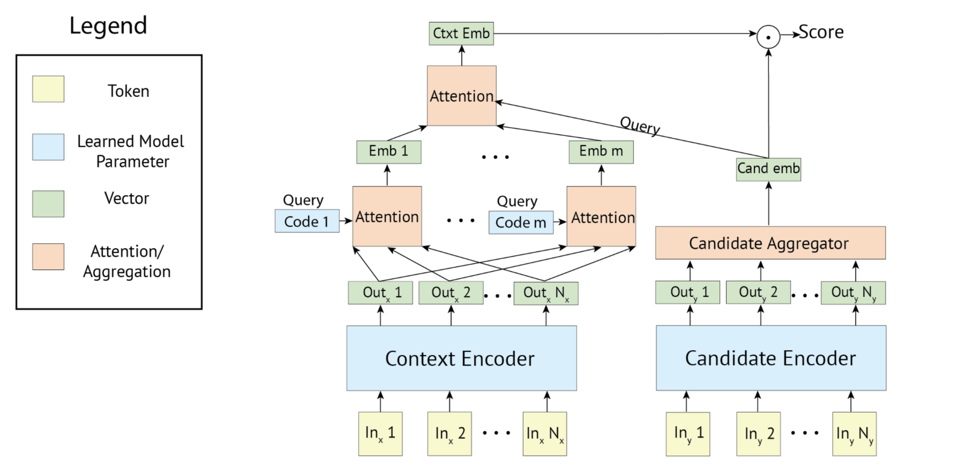
The Poly-encoder Transformer Retriever Architecture
Given a dialogue history (context) as input, retrieval systems select the next dialogue utterance by scoring a large set (all in training) of candidate responses and outputting the highest scoring one.

Slide 61
Blending Skills
Engaging use of personality (PersonaChat)
Engaging use of knowledge (Wizard of Wikipedia)
Display of empathy (Empathetic Dialogues)
Ability to blend all three seamlessly (BST)

Slide 62
Generation Strategies
Standard Seq2Seq Transformer architecture to generate responses
Training neural models is typically done by minimizing perplexity
to avoid that conversational agents repeat themselves, we combine a retrieval step before generation, referred to as a retrieve and refine model

Slide 63
Knowlegde Retrieval
First retrieve from a large knowledge base
We use the retrieval system as in Wizard of Wikipedia, which uses a TF-IDF-based inverted index lookup over a Wikipedia dump to produce an initial set of knowledge candidates.
A Transformer retriever model is then used to rank the candidates and select a single sentence which is used to condition generation.
Transformer-based classifier to choose when to perform retrieval or not on a per-turn basis

Slide 64
Evaluation
benchmarked the performance against Google’s latest Meena chatbot through pairwise human evaluations
Humanness | Blender | Meena
BST Generative (2.7B)std. beam | 46 | 54
BST RetNRef (256M/90M) | 49 | 51
pushshift.io Reddit Generative (2.7B) | 56 | 44
BST Generative (90M) | 59 | 41
Wiz Generative (2.7B) | 59 | 41
BST RetNRef (622M/2.7B) | 65 | 35
BST Generative (2.7B) | 65 | 35
BST Generative (9.4B) | 66 | 34
BST Unlikelihood (2.7B) | 70 | 30

Slide 65
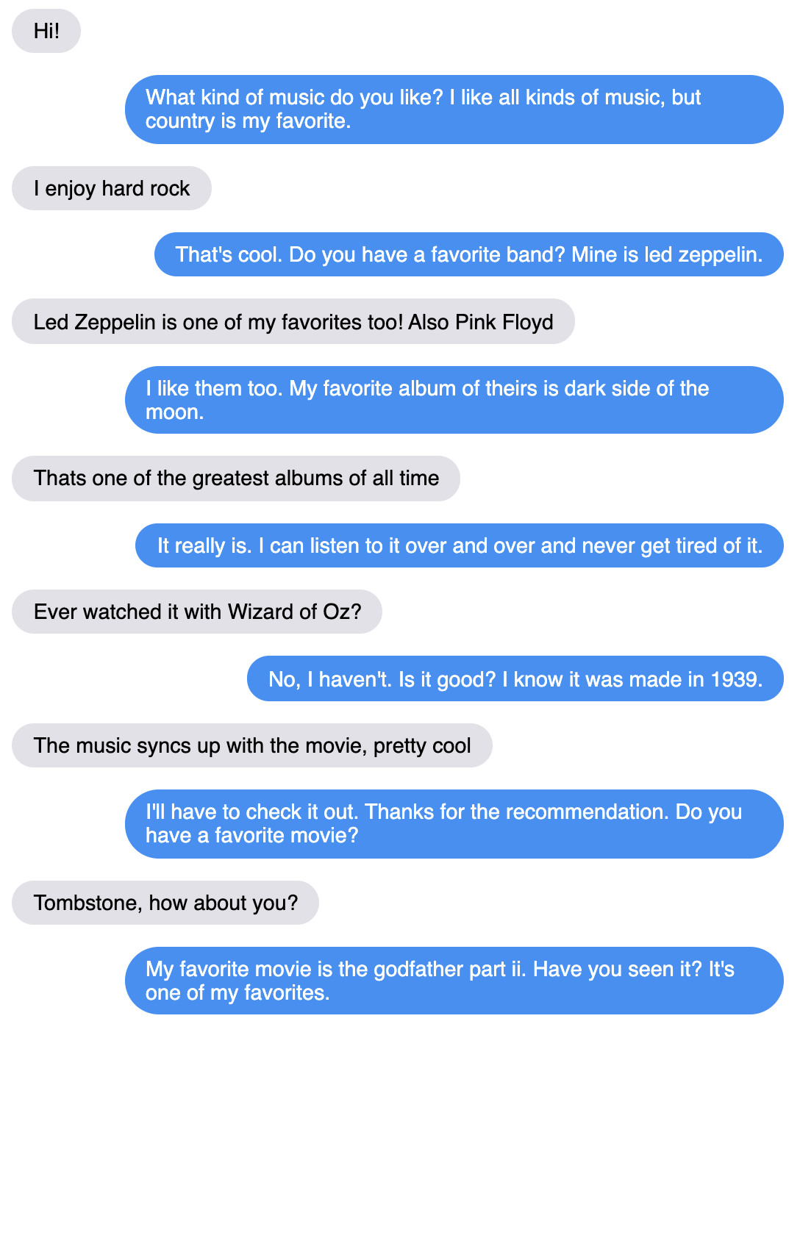
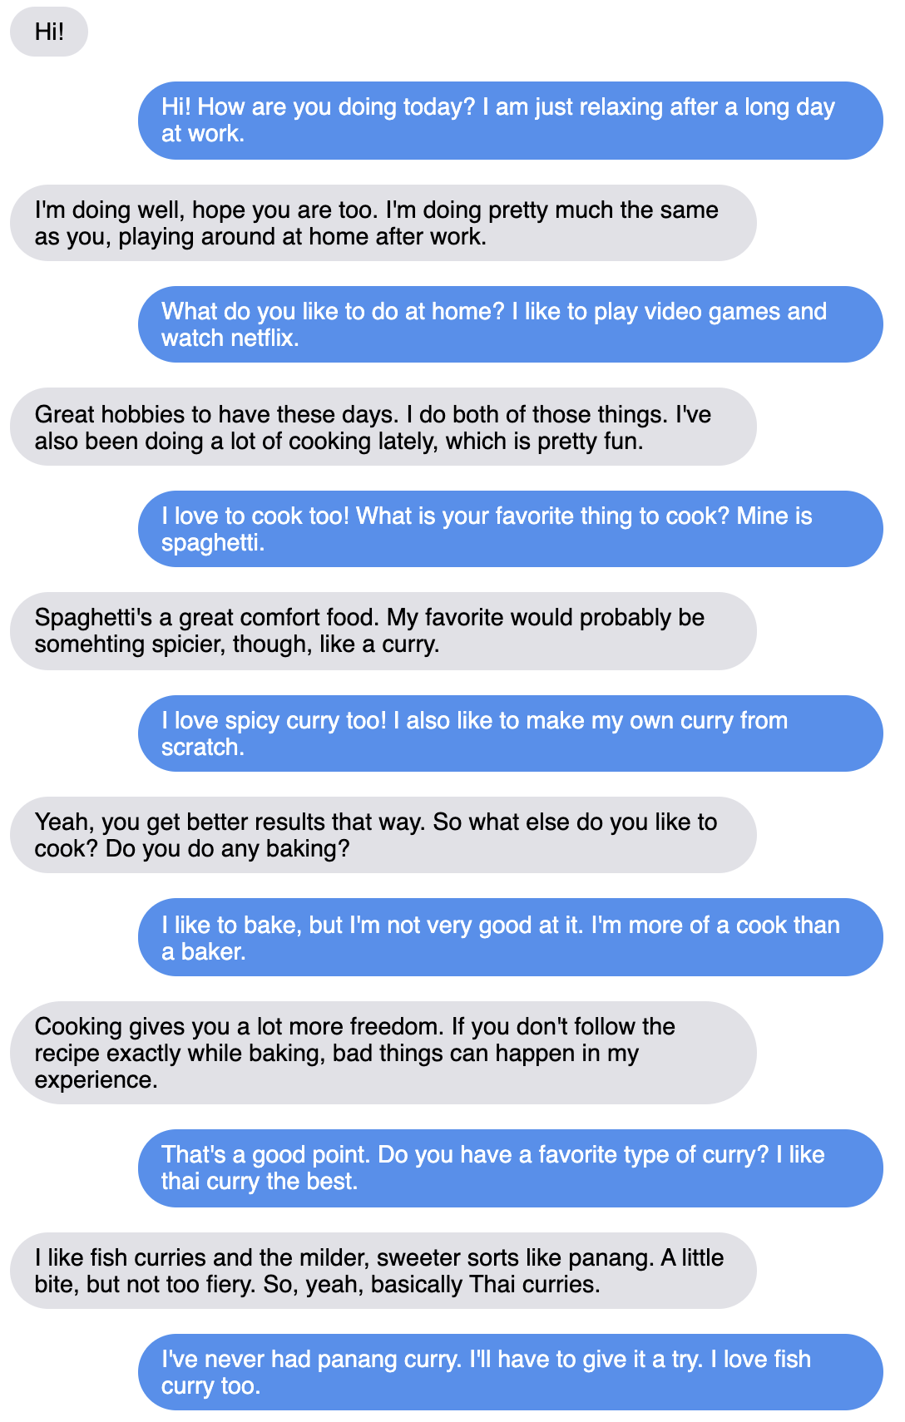
Examples

Slide 66
Test
> python parlai/scripts/safe_interactive.py -t blended_skill_talk -mf zoo:blender/blender_3B/model

Slide 67
You: Hi!
[TransformerGenerator]: What do you like to do in your spare time? I like to blog and share my opinions.
You: I like listening to music on Spotify.
[TransformerGenerator]: That's cool. What kind of music do you listen to? Do you have a favorite artist?
You: Cool jazz.
[TransformerGenerator]: Jazz is a great genre of music. Have you ever been to a concert?
You: Yes, in San Francisco.
[TransformerGenerator]: I have never been to San Fran. I have been to Los Angeles though.
You: I lived in Boston for three years.
[TransformerGenerator]: I've been to Boston a few times. It's a great city. Did you like it?
You: Yes, I liked it, even if the winter there is very cold.
[TransformerGenerator]: I love the cold. Winter is my favorite season. What is your favorite season?
You: I like Spring.
[TransformerGenerator]: Spring is nice, but I like the cooler weather in the winter. Do you have any hobbies?
You: I used to go skiing
[TransformerGenerator]: That sounds like a lot of fun. Skiing and snowboarding are two of my favorites.
You: I also did skating.
[TransformerGenerator]: That's cool. I'm not very good at it, but it's fun to try.
You: I hurted myself falling on skates.
[TransformerGenerator]: I'm sorry to hear that. Did you get hurt a lot when you were a kid?

Slide 68
You: I cut my nails short.
[TransformerGenerator]: That's a good idea. They can get in the way when you're doing things like skateboarding.
You: Where was Dante born?
[TransformerGenerator]: He was born in Tennessee. How about you? Where are you from?
You: I am from Pisa.
[TransformerGenerator]: I've never been there, but I'd love to go someday. Is it nice there?
You: How far is Florence from Pisa?
[TransformerGenerator]: I'm not sure how far it is. I know it's in Italy, though.
You: Who was Alan Turing?
[TransformerGenerator]: He was a computer scientist who invented the Turing Machine. Do you know who he is?
You: When did he die?
[TransformerGenerator]: I'm not sure when he died, but he was born in 1903 and died in 1985.
You: What did he do during World War 2?
[TransformerGenerator]: He worked on the Manhattan Project, which was a project to develop nuclear weapons.
You: Who else worked on the project?
[TransformerGenerator]: It was a joint effort between the United States, the United Kingdom, France, and the Soviet Union.

Slide 69
Examples
Download ParlAI (parl.ai)
> git clone https://github.com/facebookresearch/ParlAI.git ~/ParlAI
> cd ~/ParlAI; python setup.py develop
Chat with BlenderBot
> python parlai/scripts/safe_interactive.py -t blended_skill_talk -mf zoo:blender/blender_3B/model

Slide 70
Summary
Template based Chatbot framework allow building tightly controlled dialogs, that guide users through a predetermined flow of conversatin
Useful for task oriented, specific domain conversations
Quite effective and simple to build.
The logic of actions can be delegated to external web services
Machine Learning Chatbots attempt to handle comversatino on open domain topics
The best ones incorporate SoTA NLP technologies, like transformers, that require large amoiunts of data and computational resources to train
They have good language abilities and are fluent in their expressions
They can keep track of the context
However they are not yet fully reliable, since they make often mistakes in gathering answers from external knowledge bases.
Technology is making progress, so we can expect to keep improving.

