Slide 1

Trends and Future of NLP
Università di Pisa
Some slides from Kevin Clark

Slide 2
Evolution of the Field
NLP started in the late ‘40s with huge expectations by linguists to quickly achieve significant goals
Reality was much more difficult than expected and results were modest
First relevant breakthrough in the ‘90 with introduction of statistical methods
More recent breakthrough in 2010’s with adoption of Deep Learning
Significant successes in performing single tasks, close to human level capabilities
Neural Machine Translation since 2015 has become SoTA approach

Slide 3
DL at NLP Conferences

Slide 4
Major Elements
Distributed Representations
  Word Embeddings
  Character/ngram Embeddings
Pretrain on unlabeled data
  Transfer Learning, e.g. from large MT parallel corpora
Multitask learning
CNN
Recurrent Neural Networks
  LSTM/BiLSTM/GRU
Attention Mechanism
Reinforcement Learning for sequence generation
Memory Augmented Networks

Slide 5
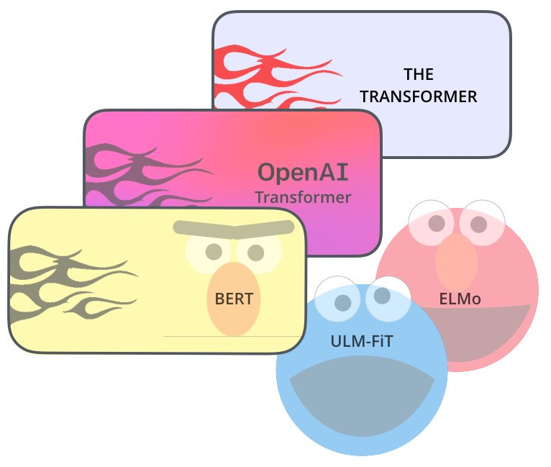
Advances in the last 5 years
Seq2seq
Attention
Large scale QA/reading comprehension datasets
Tensorflow and PyTorch

Slide 6
Applications
Image Captioning
Neural Image QA

Slide 7
Attention Mechanism
Applied to NMT
Effective in Aspect Based Sentiment/Topic Classification

Slide 8
Assessing Deep Learning for NLP

Slide 9
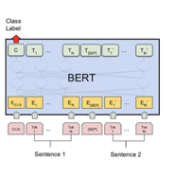
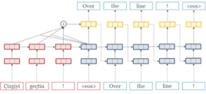
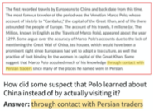
Neural Networks Effectiveness
Machine Translation
Language Modeling
Question Answering
It’s wild that any of our models work at all
  Their behavior is an emergent property of data and our design decisions
  Accuracy on a held out test set is not sufficient to fully characterize them
Slide from J Hewitt

Slide 10
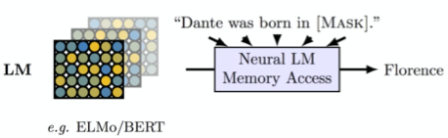
Question: Do LMs memorize factual relations?
Check if most likely word under the LM is a correct answer.
Eval: % of these relations for which this holds

Slide 11
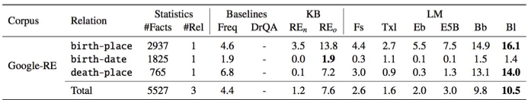
Question: Do LMs memorize factual relations?
Baseline: Return word that shows up most with the subject (Dante) and the relation (born in)
BERT-base and BERT-large: memorize a surprising number of facts
Khandelwal et al., 2018]

Slide 12
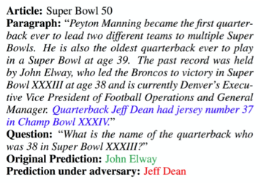
Understanding models by breaking them
Question: Are our models robust to innocuous changes in their input?
By robust, in this case we mean their outputs do not change.
The performance of this QA model on this input looks good!

Slide 13
Understanding models by breaking them
Question: Are our models robust to innocuous changes in their input?
By robust, in this case we mean their outputs do not change.
The performance of this QA model on this input looks good!
This sentence is irrelevant; adding it does not change the answer.
But it changes the model’s prediction :(
Interpretation: model is not really working

Slide 14

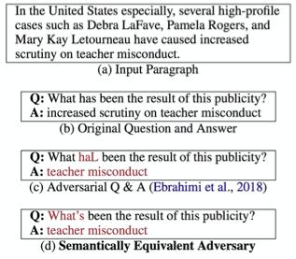
Understanding models by breaking them
Question: Are our models robust to innocuous changes in their input?
The performance of this QA model on this input looks good!
This typo is annoying, but a reasonable language learner would be robust to it.
[Ribeiro et al., 2018]

Slide 15
Understanding models by breaking them
Question: Are our models robust to innocuous changes in their input?
The performance of this QA model on this input looks good!
This typo is annoying, but a reasonable language learner would be robust to it.
Changing what has to what’s should never change the answer
[Ribeiro et al., 2018]

Slide 16
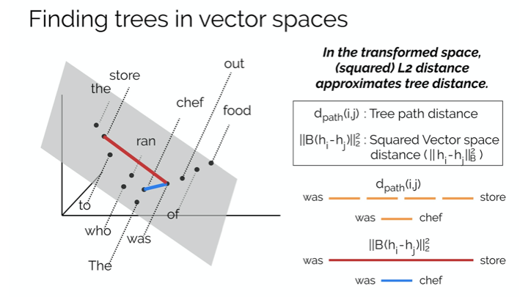

Slide 17
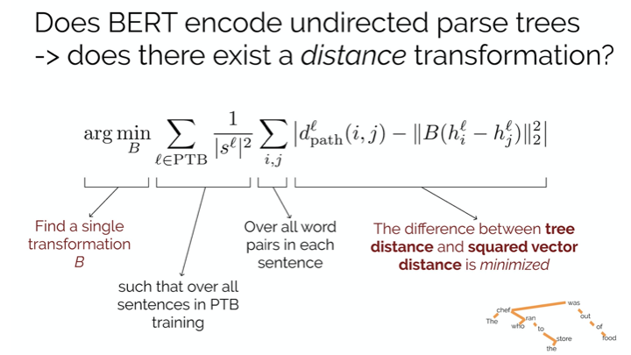

Slide 18
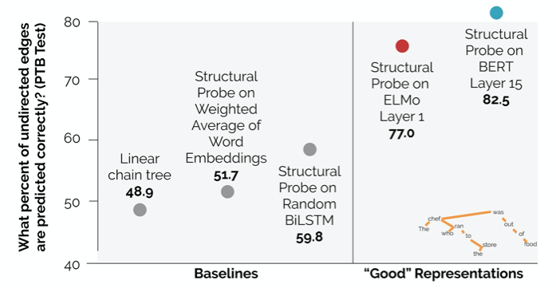
Trees are eccoded in trained representations

Slide 19
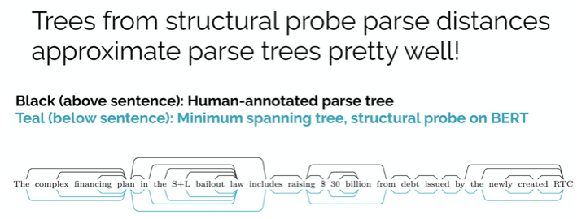

Slide 20
Remarks
Neural models are complex, fascinating objects that we don’t currently understand, but we’re making strides to understand them better!
A wide variety of analysis methods have been developed, for:
  Understanding a model’s behavior on specific phenomena
  Understanding what a model learns about a topic or task
  Understanding what seemingly innocuous input changes make a model fail
  Many other things, with more coming every day!
These methods can be integrated into your future NLP projects!

Slide 21
Inference From Memory

Slide 22
Current State
Seq2Seq models based on BiLSTM and attention mechanisms have become quite popular, and used everywhere
Neural methods are leading to a renaissance for all language generation tasks (i.e., MT, dialog, QA, summarization, …)
Real scientific question of whether we need explicit, localist language and knowledge representations and inferential mechanisms

Slide 23
Memory and Inference
Still have very primitive methods for building and accessing memories or knowledge
Current models have almost nothing for developing and executing goals and plans
Difficult to collect and count:
  “How many people are in the picture?”

Slide 24
Inter-sentence
We still have quite inadequate abilities for understanding and using inter-sentential relationships.
We still can’t, at a large scale, do elaborations from a situation using common sense knowledge BUT also have bias
Slide from R. Socher

Slide 25
The Limits of Single Task Learning
Great performance improvements
Projects start from random
Single unsupervised task can’t fix it
We will never get to a truly general NLP model this way.
Slide from R. Socher

Slide 26
Multiple Tasks
How to express different tasks in the same framework, e.g.
  Sequence tagging: aspect specific sentiment
  Text classification: dialogue intent classification
  Seq2seq: machine translation, summarization, etc.

Slide 27
Obstacle: Joint Many-task Learning
Fully joint multitask learning* is hard:
  Usually restricted to lower layers
  Usually helps only if tasks are related
  Often hurts performance if tasks are not related
  We lose powerful accuracy improvement techniques such as task-specific architecture and hyperparameter tuning
(*) same decoder/classifier and not only transfer learning with source target task pairs, no swappable modeling blocks per task

Slide 28
Deep Linguistic Analysis
Really needed?
Parse Tree representation is useful?
Can’t LSTM be enough to represent long term dependencies?
See Fujitsu AI-NLP Challenge

Slide 29
Deep Sequence Models
Yoav Goldberg. 2017. Capturing Dependency Syntax with “Deep” Sequential Models. DepLing 2017.
Recurrent neural networks (RNNs), are shown to be effective for a variety of language processing tasks.
Somewhat surprisingly, these seemingly purely sequential models are very capable at modeling syntactic phenomena, and using them result in very strong dependency parsers, for a variety of languages.
Empirical evidence for their capabilities of learning the subject-verb agreement relation in naturally occurring text, from relatively indirect supervision.

Slide 30
The 3 Equivalent NLP-Complete Super Tasks
Language modeling
Question answering
Dialogue systems

Slide 31
QA Completeness
Every task may be recast as a QA task
I: Jane has a baby in London.
Q: What are the named entities?
A: Jane-person, London-location
I: Jane has a baby in London.
A: NNP VBZ DT NN IN NNP
I: I think this book is fun.
Q: What is the French translation?
A: Je crois que ce livre est amusant.

Slide 32
QA Performance
Paper | Model | bAbI (Mean accuracy %) | Farbes (Accuracy %)
Fader et al. | Paraphrase-driven lexicon learning |  | 54
Bordes et al. | Weekly supervised embedding |  | 73
Weston et al. | Memory networks | 93.3 | 83
Sukhbaatar et al. | End-to-end memory networks | 88.4
Kumar et al | DMN | 93.6

Slide 33
Obstacle: Necessary Inputs to QA
We need to be able to understand text, images and databases to really answer all kinds of questions

Slide 34
Database QA
Question: Who was drafted with the 3rd pick of the 1st round?
Answer: Jayson Tatum

Slide 35
Seq2SQL

Slide 36
QA and counting

Slide 37
Obstacle: Architecture Engineering
We don’t yet know the right model architecture for comprehensive QA & joint multitask learning
Architecture Search is an active area of research but usually applied to simpler/known tasks, e.g.
A Flexible Approach to Automated RNN Architecture Generation, Stephen Merity, Martin Schrimpf, James Bradbury, Richard Socher. (ICLR 2018 Workshop Track)

Slide 38
Architecture Search

Slide 39

Inference
Difficult to obtain significant benefits from tree structure models
  Non GPUs friendly
  High sensitivity to parse errors
Convolutional Reasoning without trees
Christopher Manning at ICLR 2018. A Neural Network that can Reason.

Slide 40
Limits to Deep NLP
QA capable of comprehension
Multitask learning
Combined multimodal, logical and memory-based reasoning
Learning from few examples

Slide 41
Dialog Systems

Slide 42
Insufficient datasets
Even for English, most tasks have 100K or less labeled examples.
Even less data available for other languages.
  There are thousands of languages, hundreds with > 1 million native speakers
  <10% of people speak English as their first language
Increasingly popular solution: use unlabeled data.

Slide 43
Machine Translation: Pretrained models
Monolanguage corpora abund
Separately Train Encoder and Decoder as Language Models
Then Train Jointly on Bilingual Data

Slide 44
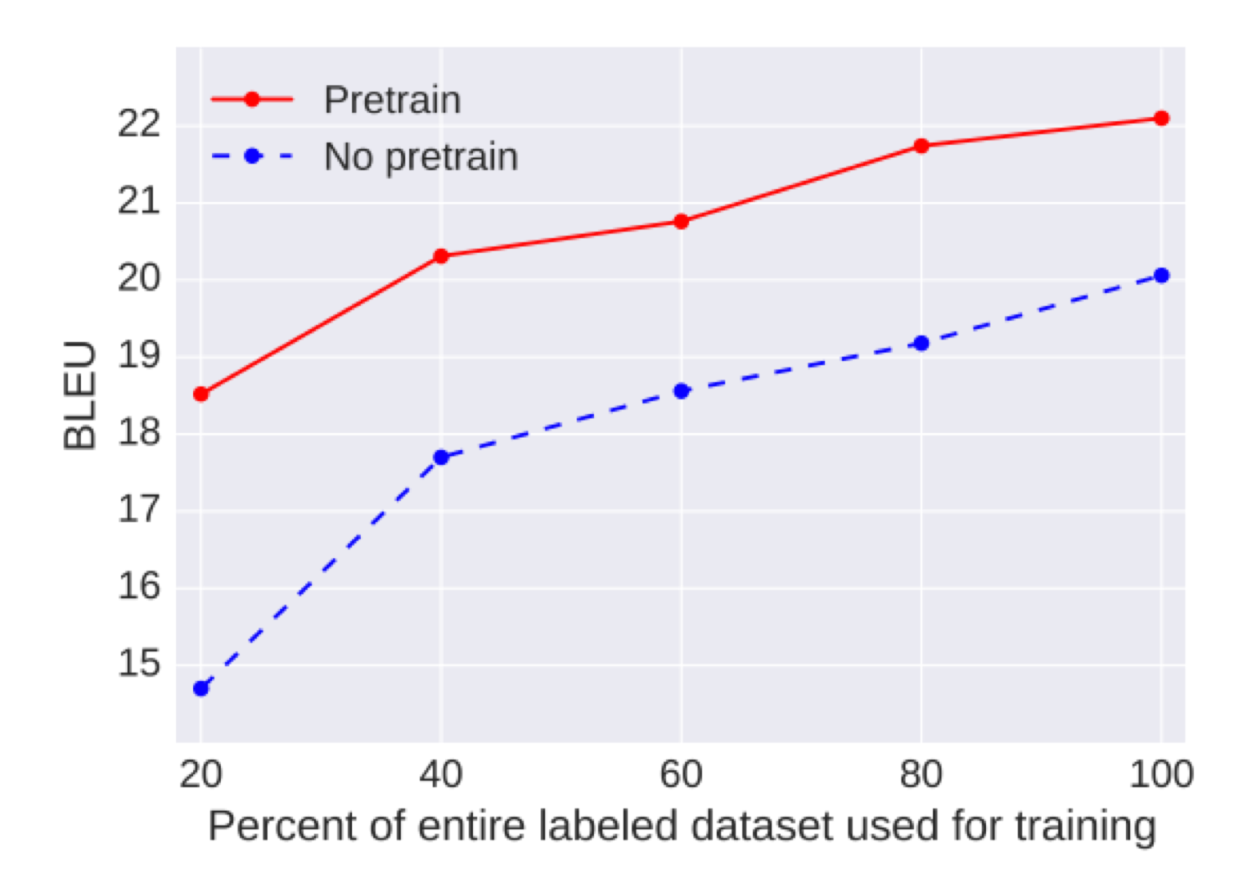
Pre-training
English -> German Results: 2+ BLEU point improvement

Slide 45
Self Training
Problem with pre-training: no “interaction” between the two languages during pre-training
Self-training: label unlabeled data to get noisy training examples
I traveled to Belgium
MT
Model
Je suis étudiant
I traveled to Belgium
Translation: Je suis étudiant
MT
Model
train

Slide 46
Self Training
Circular?
I traveled to Belgium
MT
Model
Je suis étudiant
I already knew that!
MT
Model
I traveled to Belgium
Translation: Je suis étudiant
train

Slide 47
Back-Translation
Have two machine translation models going in opposite directions (en -> fr) and (fr -> en)?
I traveled to Belgium
en -> fr
Model
Je suis étudiant
fr -> en
Model
Je suis étudiant
Translation: I traveled to Belgium
train
No longer circular
Models never see “bad” translations, only bad inputs

Slide 48
Large Scale Back-Translation
4.5M English-German sentence pairs and 226M monolingual sentences
Citation | Model | BLEU
Shazeer et al., 2017 | Best Pre-Transformer Result | 26.0
Vaswani et al., 2017 | Transformer | 28.4
Shaw et al, 2018 | Transformer + Improved Positional Embeddings | 29.1
Edunov et al., 2018 | Transformer + Back-Translation | 35.0

Slide 49
Huge Models and GPT-2

Slide 50
Training Huge Models
Model | # Parameters
Medium-sized LSTM | 10M
ELMo | 90M
GPT | 110M
BERT-Large | 320M
GPT=2 | 1.5B
Honey bee brain | ~1B synapses

Slide 51
General Trend in ML

Slide 52
Huge Models in Computer Vision
150M parameters

Slide 53
550M parameters in ImageNet

Slide 54
Training Huge Models
Better hardware
Data and Model paralllism

Slide 55
GPT-2
Just a really big Transformer LM
Trained on 40GB of text
  Quite a bit of effort going into making sure the dataset is good quality
  Take webpages from reddit links with high karma

Slide 56
What can GPT-2 do?
Obviously, language modeling (but very well)!
Gets state-of-the-art perplexities on datasets it’s not even trained on!

Slide 57
Zero-Shot Learning: no supervised training data!
  Ask LM to generate from a prompt
Reading Comprehension: <context> <question> A:
Summarization: <article> TL;DR:
Translation:
  <English sentence1> = <French sentence1>
  <English sentence 2> = <French sentence 2>
  …..
  <Source sentence> =
Question Answering: <question> A:

Slide 58
GPT-2 Results

Slide 59
How can GPT-2 be doing translation?
It’s just given a big corpus of text that’s almost all English

Slide 60
GPT-2 Question answering
Simple baseline: 1% accuracy
GPT-2: ~4% accuracy
Cherry-picked most confident results

Slide 61
When Models get bigger?
For several tasks performance seems to increase with log(model size)

Slide 62
Trend is clear

Slide 63
GPT Reaction

Slide 64
GPT-2 Reaction

Slide 65
GPT-2 Reaction
Some arguments for release:
Some arguments against:
This model isn’t much different from existing work
Not long until these models are easy to train
  And we’re already at this point for images/speech
Photoshop
Researchers should study this model to learn defenses
Dangerous PR Hype
Reproducibility is crucial for science
…
Danger of fake reviews, news comments, etc.
  Already done by companies and governments
Precedent
  Event if this model isn’t dangerous, later ones will be even better
Smaller model is being released
• ….

Slide 66
GPT-2 Reaction
Should NLP experts be the ones making these decisions?
  Experts on computer security?
  Experts on technology and society?
  Experts on ethics?
Need for more interdisciplinary science
Many other examples of NLP with big social ramifications, especially with regards to bias/fairness

Slide 67
High Impact Decisions
Growing interest in using NLP to help with high-impact decision making
  Judicial decisions
  Hiring
  Grading tests
Plus side: can quickly evaluate a machine learning system for some kinds of bias
However, machine learning reflects or even amplifies bias in training data
…which could lead to the creation of even more biased data

Slide 68
High-Impact Decisions

Slide 69
What did BERT “solve” and what do we work on next?

Slide 70
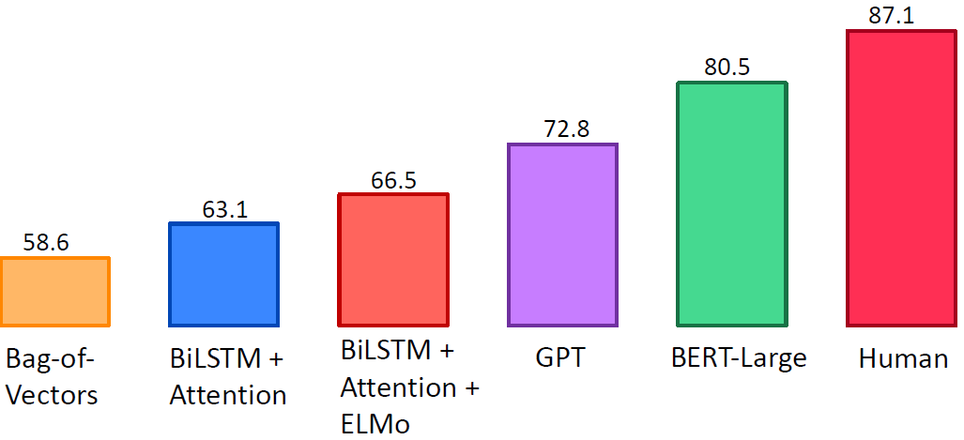
GLUE Benchmark Results

Slide 71
Death of Architecture Engineering?

Slide 72
Harder Natural Language Understanding
Reading comprehension…
  On longer documents or multiple documents
  That requires multi-hop reasoning
  Situated in a dialogue
Key problem with many existing reading comprehension datasets: People writing the questions see the context
  Not realistic
  Encourages easy questions

Slide 73
Multitask Learning
Another frontier of NLP is getting one model to perform many tasks. GLUE and DecaNLP are recent examples.
Multi-task learning yields improvements on top of BERT
BERT +
Multi-task

Slide 74
NLP in Industry
NLP is rapidly growing in industry as well. Two particularly big areas:
Dialogue
  Chatbots
  Customer service
Healthcare
  Understanding health records
  Understanding biomedical literature

Slide 75
Conclusions
Deep learning offers a way to harness large amount of computation and data with little engineering by hand
Overcome the limitations of relying on annotated data
Future models combining internal memory (bottom-up knowledge learned from the data) with an external memory (top-down knowledge learned from previous experiences)
Reinforcement learning methods applied to, e.g., dialogue systems.
Multimode learning, since language is often grounded on other signals
More Inference Capabilities, overcoming dichotomy of ML for perception tasks and symbolic reasoning for inference
NLP is reaching the point of having big social impact, making issues like bias and security increasingly important.

Slide 76
References
T. Youngy, D. Hazarikaz, S. Poria, Erik Cambria. Recent Trends in Deep Learning Based Natural Language Processing. arXiv:1708.02709v5 [cs.CL] 20 Feb 2018.

