Slide 1

Sequence Tagging
Università di Pisa
IP notice: slides from Dan Jurafsky

Slide 2
Outline
Markov Chains
Hidden Markov Models
Three Algorithms for HMMs
  The Forward Algorithm
  The Viterbi Algorithm
  The Baum-Welch (EM Algorithm)
Applications:
  The Ice Cream Task
  Part of Speech Tagging

Slide 3
Definitions
A Markov Chain (or Observable Markov Model)
  is a stochastic model describing a sequence of possible events in which the probability of each event depends only on the state attained in the previous event
A Markov Chain can be represented by a transition diagram, where:
  Each arc is labeled by a transition probability
  The sum of the probabilities leaving any arc must sum to one

Slide 4
Markov Chain for weather

Slide 5
Markov Chain for words

Slide 6
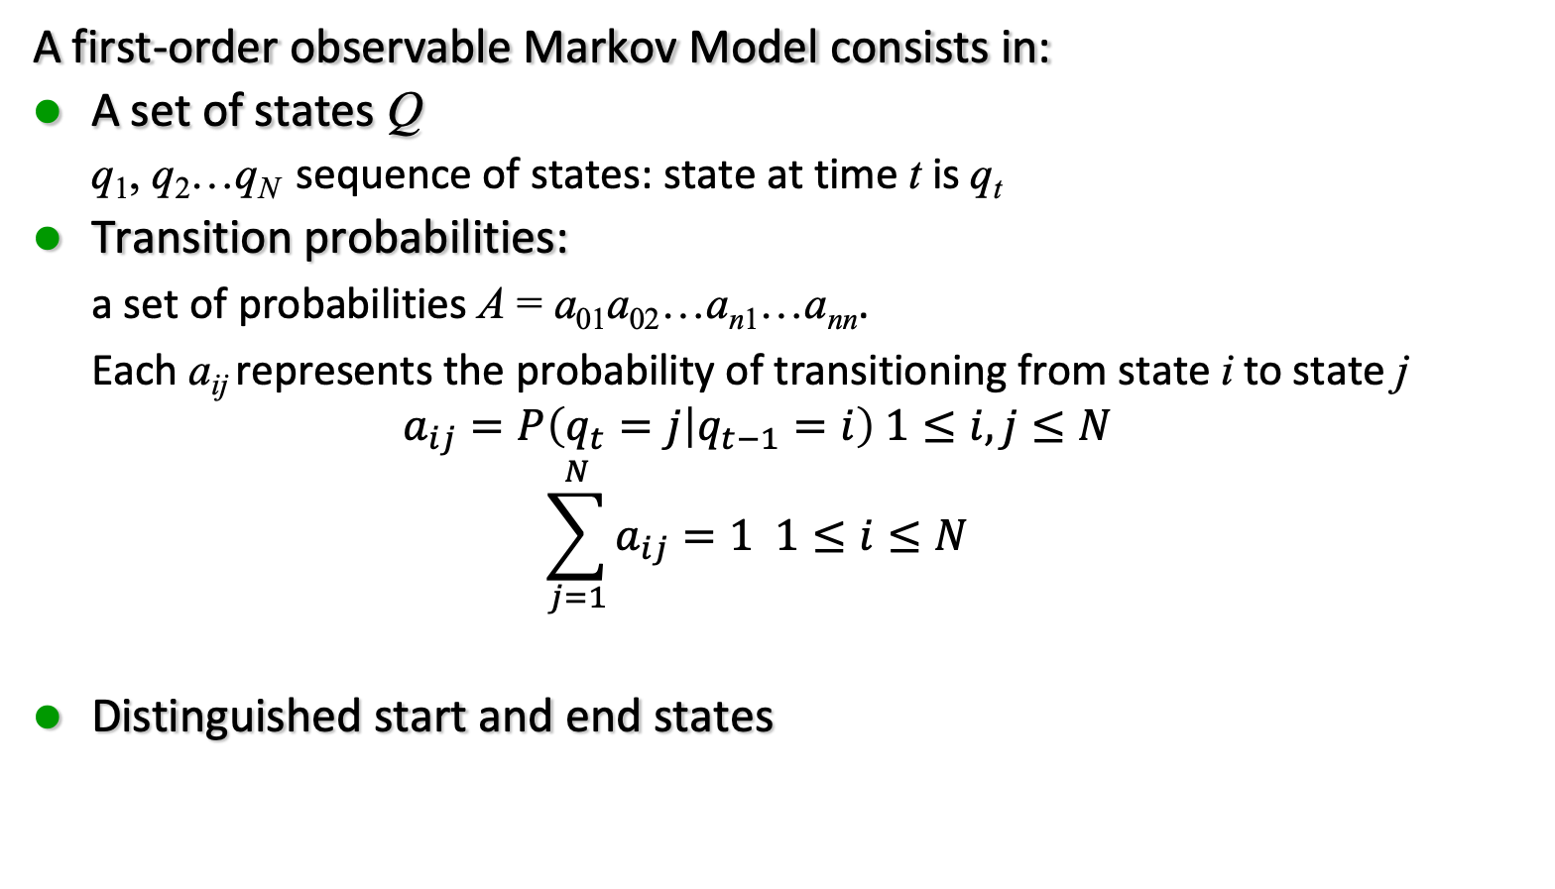
Markov Chain: definition
A first-order observable Markov Model consists in:
A set of states Q
  q₁, q₂…q_{N} sequence of states: state at time t is q_{t}
Transition probabilities:
  a set of probabilities A = a₀₁a₀₂…a_{n1}…a_{nn}.
  Each a_{ij} represents the probability of transitioning from state i to state j
  $$a_{ij}=P\left(q_{t}=j | q_{t−1}=i\right) 1≤i,j≤N$$
  $$\sum_{j=1}^{N}{a_{ij}=1 1≤i≤N}$$
Distinguished start and end states

Slide 7
Markov Chain
Markov Assumption:
Current state only depends on previous state
P(q_{i} | q₁ … q_{i-1}) = P(q_{i} | q_{i-1})

Slide 8
Another representation for start state
Instead of start state
Special initial probability vector π
  An initial distribution over probability of start states
Constraints:

Slide 9
The weather model using π

Slide 10
The weather model: specific example

Slide 11
Markov chain for weather
What is the probability of 4 consecutive warm days?
Sequence is warm-warm-warm-warm
i.e., state sequence is 3-3-3-3
P(3, 3, 3, 3) =
π₃a₃₃a₃₃a₃₃a₃₃ = 0.2 • (0.6)³ = 0.0432

Slide 12
How about?
Hot hot hot hot
Cold hot cold hot
What does the difference in these probabilities tell you about the real world weather info encoded in the figure?

Slide 13
Fun with Markov Chains
Markov Chains “Explained Visually”:
  http://setosa.io/ev/markov-chains
Snakes and Ladders:
  http://datagenetics.com/blog/november12011/
Candyland:
  http://www.datagenetics.com/blog/december12011/
Yahtzee:
  http://www.datagenetics.com/blog/january42012/
Chess pieces returning home and K-pop vs. ska:
  https://www.youtube.com/watch?v=63HHmjlh794

Slide 14
Hidden Markov Models

Slide 15
Hidden Markov Model
For Markov chains, the output symbols are the same as the states.
  See hot weather: we are in state hot
But in named-entity or part-of-speech tagging (and speech recognition)
  The output symbols are words
  But the hidden states are something else
    Part-of-speech tags
    Named entity tags
So we need an extension!
A Hidden Markov Model is an extension of a Markov chain in which the input symbols are not the same as the states.
This means we don’t know which state we are in.

Slide 16
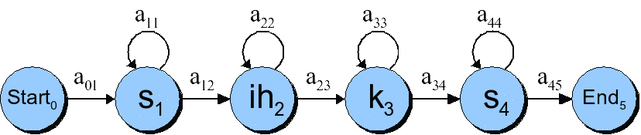
HMMs for speech: the word “six”
Observed outputs are phones (speech sound)
Hidden states are phonemes (unit of sound):
Loopbacks because
  a phone is ~100 milliseconds long
  An observation of speech every 10 ms
  So each phone repeats ~10 times (simplifying greatly)

Slide 17
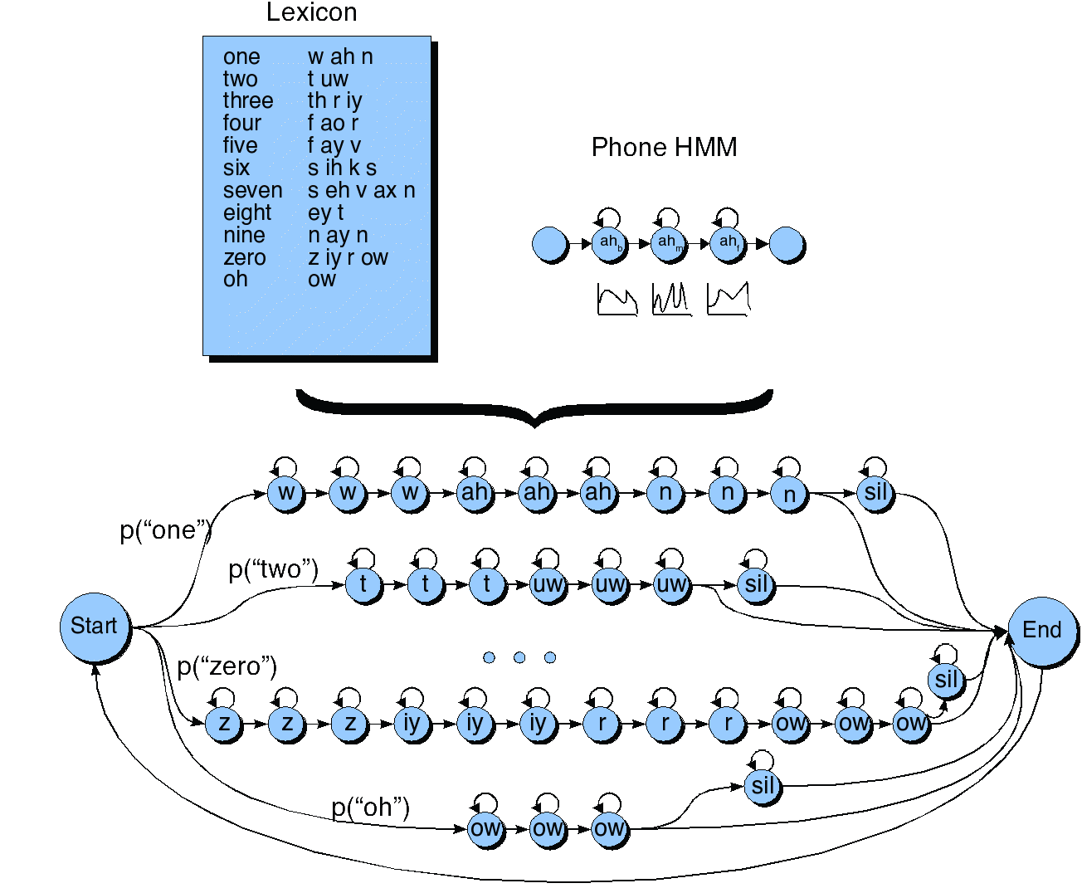
HMM for Speech: Recognizing Digits

Slide 18
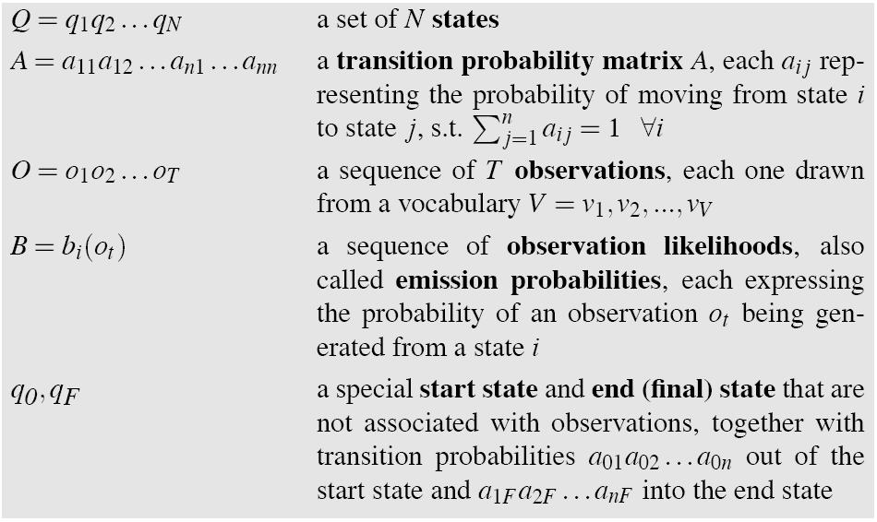
Hidden Markov Models

Slide 19
Assumptions
Markov assumption:
P(q_{i} | q₁ … q_{i-1}) = P(q_{i} | q_{i-1})
Output-independence assumption

Slide 20
HMM for Ice Cream
You are a climatologist in the year 2799
Studying global warming
You can’t find any records of the weather in Baltimore, MD for summer of 2008
But you find Jason Eisner’s diary
Which lists how many ice-creams Jason ate every date that summer
Our job: figure out how hot it was

Slide 21
Eisner task
Given
  Ice Cream Observation Sequence: 1,2,3,2,2,2,3…
Produce:
  Weather Sequence: H,C,H,H,H,C…

Slide 22
HMM for ice cream

Slide 23
Different types of HMM structure
Bakis = left-to-right
Ergodic =
fully-connected

Slide 24
The Three Basic Problems for HMMs
Problem 1 (Evaluation): Given the observation sequence O = (o₁o₂…o_{T}), and an HMM model Φ = (A, B), how do we efficiently compute P(O| Φ), the probability of the observation sequence, given the model
Problem 2 (Decoding): Given the observation sequence O = (o₁o₂…o_{T}), and an HMM model Φ = (A, B), how do we choose a corresponding state sequence Q = (q₁q₂…q_{T}) that is optimal in some sense (i.e., best explains the observations)
Problem 3 (Learning): How do we adjust the model parameters Φ = (A,B) to maximize P(O| Φ)?

Slide 25
Problem 1: computing the observation likelihood
Computing Likelihood: Given an HMM λ = (A, B) and an observation sequence O, determine the likelihood P(O, λ).
Given the following HMM:
How likely is the sequence 3 1 3?

Slide 26
How to compute likelihood
For a Markov chain, we just follow the states 3 1 3 and multiply the probabilities
But for an HMM, we don’t know what the states are!
So let’s start with a simpler situation.
Computing the observation likelihood for a given hidden state sequence
  Suppose we knew the weather and wanted to predict how much ice cream Jason would eat.
  i.e. P( 3 1 3 | H H C)

Slide 27

Computing likelihood of 3 1 3 given hidden state sequence

Slide 28
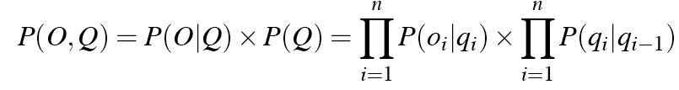
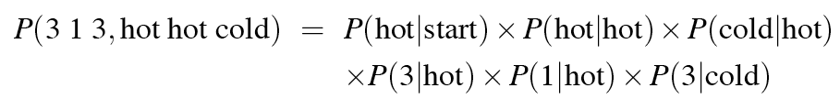
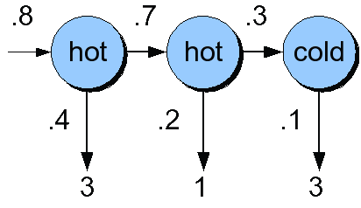
Computing joint probability of observation and state sequence

Slide 29

Computing total likelihood of 3 1 3
We would need to sum over
  Hot hot cold
  Hot hot hot
  Hot cold hot
  ….
How many possible hidden state sequences are there for this sequence?
How about in general for an HMM with N hidden states and a sequence of T observations?
  N^{T}
So we can’t just do separate computation for each hidden state sequence.

Slide 30
Instead: the Forward algorithm
A kind of dynamic programming algorithm
  Just like Minimum Edit Distance
  Uses a table to store intermediate values
Idea:
  Compute the likelihood of the observation sequence
  By summing over all possible hidden state sequences
  But doing this efficiently
    By folding all the sequences into a single trellis

Slide 31
The forward algorithm
The goal of the forward algorithm is to compute
P(o₁, o₂ … o_{T}, q_{T} = q_{F} | λ)
We’ll do this by recursion

Slide 32
The forward algorithm
Each cell of the forward algorithm trellis α_{t}(j)
  Represents the probability of being in state j
  After seeing the first t observations
  Given the automaton
Each cell thus expresses the following probability
α_{t}(j) = P(o₁, o₂ … o_{t}, q_{t} = j | λ)

Slide 33
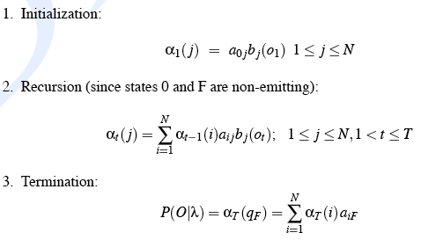
The Forward Recursion

Slide 34
The Forward Trellis

Slide 35
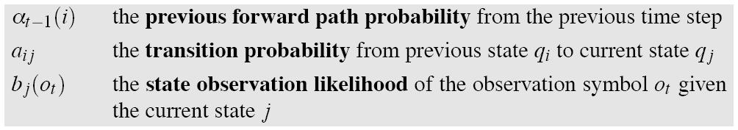
We update each cell

Slide 36
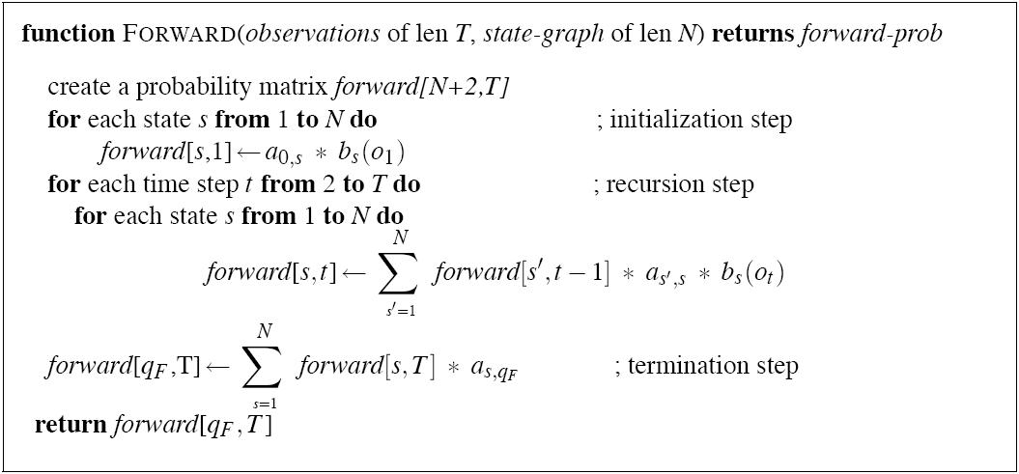
The Forward Algorithm

Slide 37
Decoding
Given an observation sequence
  3 1 3
and an HMM
The task of the decoder
  To find the best hidden state sequence
Given the observation sequence O = (o₁o₂…o_{T}), and an HMM model Φ = (A,B), how do we choose a corresponding state sequence Q=(q₁q₂…q_{T}) that is optimal in some sense (i.e., best explains the observations)

Slide 38
Decoding
One possibility:
  For each hidden state sequence Q
    HHH, HHC, HCH,
  Compute P(O|Q)
  Pick the highest one
Why not?
  N^{T}
Instead:
  The Viterbi algorithm
  Is again a dynamic programming algorithm
  Uses a similar trellis to the Forward algorithm

Slide 39


Viterbi intuition
We want to compute the joint probability of the observation sequence together with the best state sequence

Slide 40
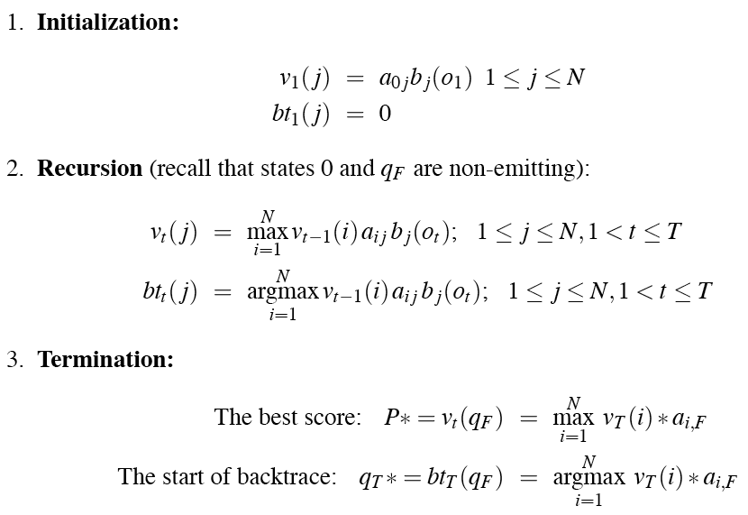
Viterbi Recursion

Slide 41
The Viterbi trellis

Slide 42
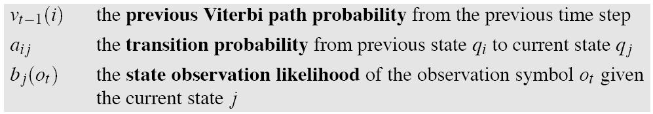
Viterbi intuition
Process observation sequence left to right
Filling out the trellis
Each cell:

Slide 43
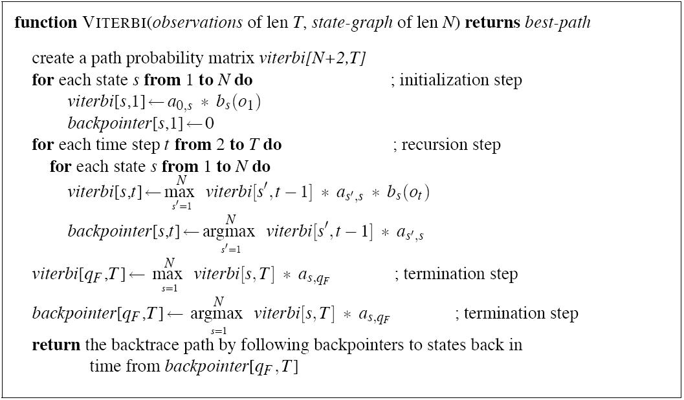
Viterbi Algorithm

Slide 44
Viterbi backtrace

Slide 45
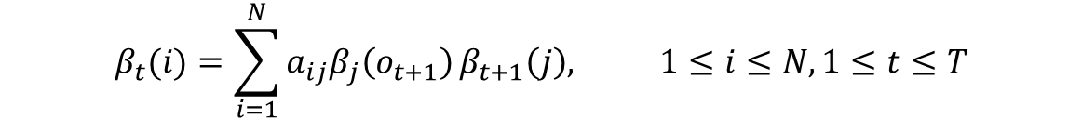
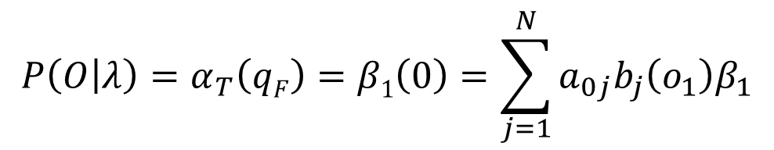
Training a HMM
Forward-backward or Baum-Welch algorithm (Expectation Maximization)
Backward probability (prob. of observations from t+1 to T)
βt(i) = P(o_{t+1}, o_{t+2}…o_{T} | q_{t} = i, λ)
β_{T}(i) = a_{i,F} 1 ≤ i ≤ N

Slide 46
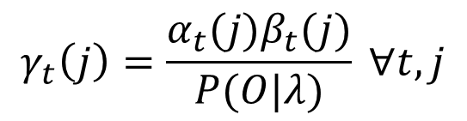
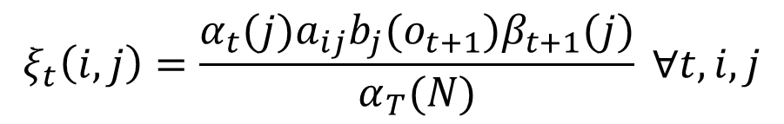
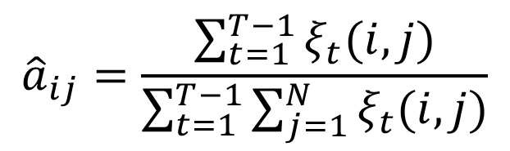
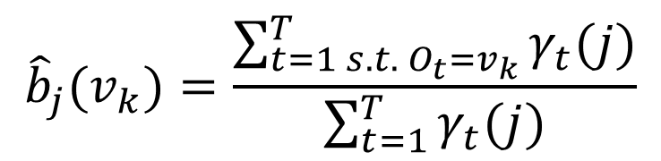
Baum-Welch Algorithm
function FORWARD-BACKWARD(observations of len T, output vocabulary V, hidden state set Q) returns HMM=(A,B)
initialize A and B
iterate until convergence
E-step
M-step
return A, B

Slide 47
HMM for Part of Speech Tagging

Slide 48
Part of speech tagging
8 (ish) traditional English parts of speech
  Noun, verb, adjective, preposition, adverb, article, interjection, pronoun, conjunction, etc.
  This idea has been around for over 2000 years (Dionysius Thrax of Alexandria, c. 100 B.C.)
  Called: parts-of-speech, lexical category, word classes, morphological classes, lexical tags, POS
  We’ll use POS most frequently
  Assuming that you know what these are

Slide 49
POS examples
N noun chair, bandwidth, pacing
V verb study, debate, munch
ADJ adj purple, tall, ridiculous
ADV adverb unfortunately, slowly,
P preposition of, by, to
PRO pronoun I, me, mine
DET determiner the, a, that, those

Slide 50
POS Tagging example
Word Tag
the DET
koala NOUN
put VERB
the DET
keys NOUN
on PREP
the DET
table NOUN

Slide 51
POS Tagging
Words often have more than one POS: back
  The back door = ADJ
  On my back = NOUN
  Win the voters back = ADV
  Promised to back the bill = VERB
The POS tagging problem is to determine the POS tag for a particular instance of a word.
These examples from Dekang Lin

Slide 52
POS tagging as a Sequence Classification task
We are given a sentence (an “observation” or “sequence of observations”)
  Secretariat is expected to race tomorrow
  She promised to back the bill
What is the best sequence of tags which corresponds to this sequence of observations?
Probabilistic view:
  Consider all possible sequences of tags
  Out of this universe of sequences, choose the tag sequence which is most probable given the observation sequence of n words w₁…w_{n}.

Slide 53

Getting to HMM
We want, out of all sequences of n tags t₁…t_{n} the single tag sequence such that P(t₁…t_{n}|w₁…w_{n}) is highest.
Hat ^ means “our estimate of the best one”
argmax_{x} f(x) means “the x such that f(x) is maximized”

Slide 54
Getting to HMM
This equation is guaranteed to give us the best tag sequence
But how to make it operational? How to compute this value?
Intuition of Bayesian classification:
  Use Bayes rule to transform into a set of other probabilities that are easier to compute

Slide 55
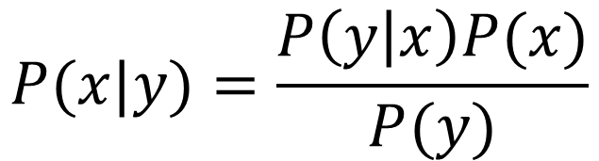
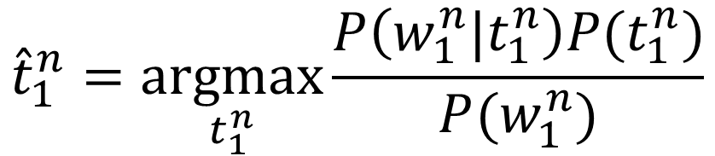
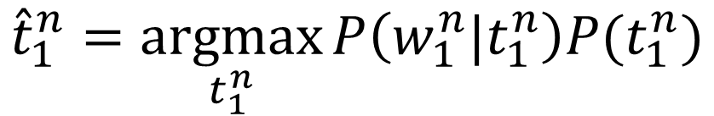
Using Bayes Rule
$$P(x|y)=\frac{P\left(y | x\right)P(x)}{P(y)}$$
$${\hat{t}}_{1}^{n}=\underset{t_{1}^{n}}{argmax}{\frac{P\left(w_{1}^{n}|t_{1}^{n}\right)P(t_{1}^{n})}{P(w_{1}^{n})}}$$
$${\hat{t}}_{1}^{n}=\underset{t_{1}^{n}}{argmax}{P\left(w_{1}^{n}|t_{1}^{n}\right)P(t_{1}^{n})}$$

Slide 56
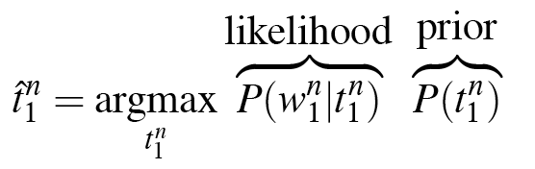
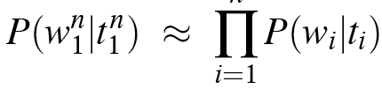
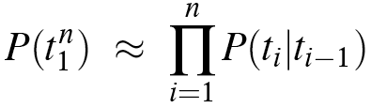
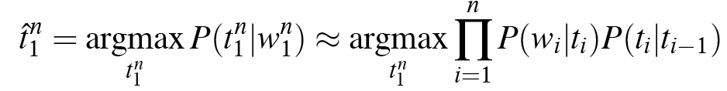
Likelihood and prior
Naïve Bayes assumption
n
Markov assumption

Slide 57
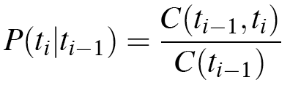
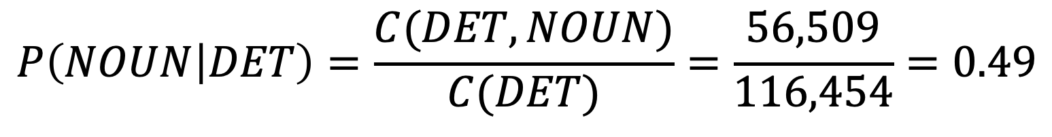
Two kinds of probabilities (1)
Tag transition probabilities P(t_{i}|t_{i-1})
  Determiners likely to precede adjectives and nouns
    That/DET flight/NOUN
    The/DET yellow/JADJ hat/NOUN
    So we expect P(NOUN|DET) and P(ADJ|DET) to be high
    But P(DET|ADJ) to be low
  Compute P(NOUN|DET) by counting in a labeled corpus:
$$P\left(NOUN | DET\right)=\frac{C(DET,NOUN)}{C(DET)}=\frac{56,509}{116,454}=0.49$$

Slide 58
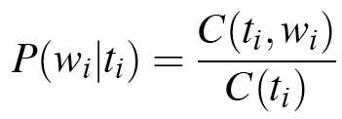
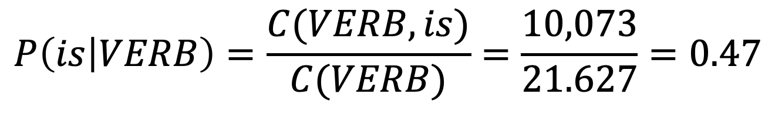
Two kinds of probabilities (2)
Word likelihood probabilities P(w_{i}|t_{i})
  VERB likely to be “is”
  Compute P(is|VERB) by counting in a labeled corpus:
$$P\left(is | VERB\right)=\frac{C(VERB,is)}{C(VERB)}=\frac{10,073}{21.627}=0.47$$

Slide 59
An Example: the word “race”
Varenne/NNP is/VBZ expected/VBN to/TO race/VB tomorrow/NR
People/NNS continue/VB to/TO inquire/VB the/DT reason/NN for/IN the/DT race/NN for/IN outer/JJ space/NN
How do we pick the right tag?

Slide 60
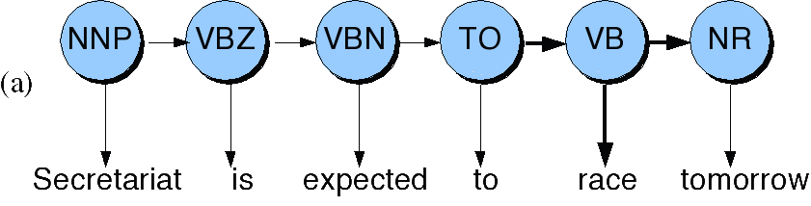
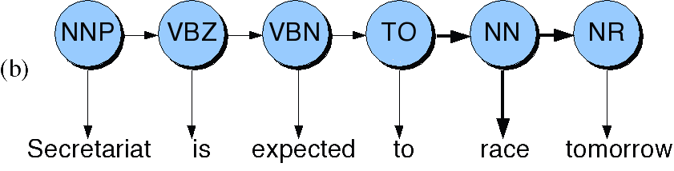
Disambiguating “race”
Varenne
Varenne

Slide 61
ML Estimation
P(NN|TO) = .00047 P(VB|TO) = 0.83 | Transition prob
P(race|NN) = 0.00057 P(race|VB) = 0.00012 | Emission prob
P(NR|VB) = 0.0027 P(NR|NN) = 0.0012 | Transition prob
P(VB|TO)P(race|VB)P(NR|VB) = .00000027
P(NN|TO)P(race|NN)P(NR|NN) =.00000000032
So we (correctly) choose the verb reading

Slide 62
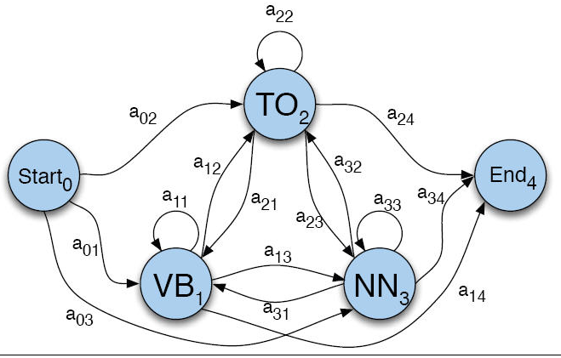
HMM for PoS tagging
Transitions probabilities A between the hidden states: tags

Slide 63
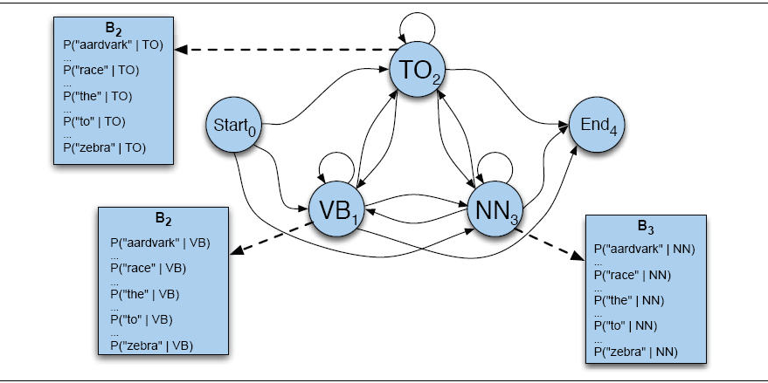
B observation likelihoods for POS HMM
Emission probabilities B: words

Slide 64
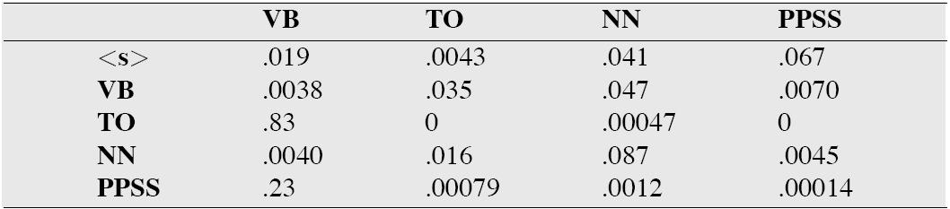
The A matrix for the POS HMM

Slide 65
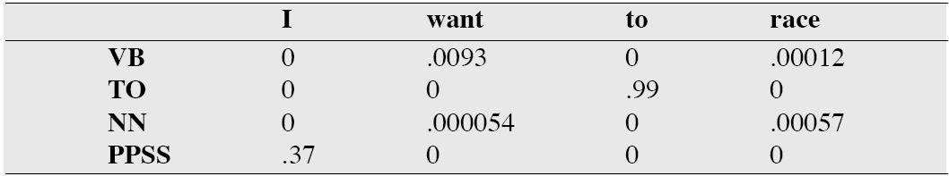
The B matrix for the POS HMM

Slide 66
Viterbi intuition: we are looking for the best ‘path’
S₁
S₂
S₃
S₄
S₅
Slide from Dekang Lin

Slide 67
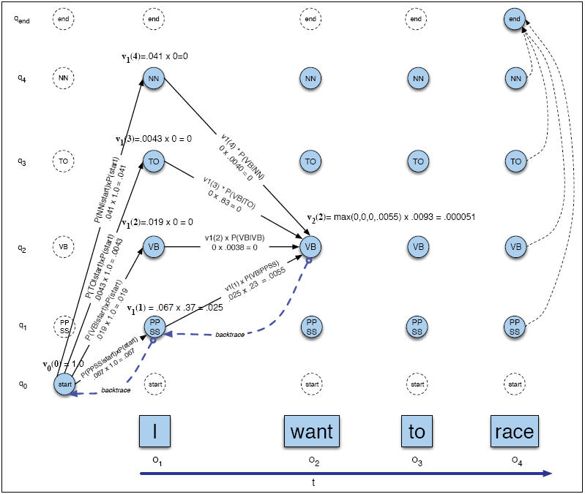
Viterbi example

Slide 68
Outline
Markov Chains
Hidden Markov Models
Three Algorithms for HMMs
  The Forward Algorithm
  The Viterbi Algorithm
  The Baum-Welch (EM Algorithm)
Applications:
  The Ice Cream Task
  Part of Speech Tagging
  Next time: Named Entity Tagging

