Slide 1
Neural Network Classification
Università di Pisa
Human Language Technologies
Università di Pisa

Slide 2
Classification
Define classes/categories
Label text
Extract features
Choose a classifier
Naive Bayes Classifier
Decision Trees
Maximum Entropy
SVM
Neural Network
…
Train it
Use it to classify new examples

Slide 3
Naïve Bayes
More powerful than Decision Trees
Decision Trees
Naïve Bayes
Every feature gets a say in determining
which label should be assigned to a given input value.
Slide from Heng Ji

Slide 4
Naïve Bayes: Strengths
Very simple model
Easy to understand
Very easy to implement
Can scale easily to millions of training examples (just need counts!)
Very efficient, fast training and classification
Modest space storage
Widely used because it works really well for text categorization
Linear, but non parallel decision boundaries
Slide from Heng Ji

Slide 5
Naïve Bayes: weaknesses
Naïve Bayes independence assumption has two consequences:
The linear ordering of words is ignored (bag of words model)
The words are independent of each other given the class:
President is more likely to occur in a context that contains election than in a context that contains poet
Naïve Bayes assumption is inappropriate if there are strong conditional dependencies between the variables
Nonetheless, Naïve Bayes models do well in a surprisingly large number of cases because often we are interested in classification accuracy and not in accurate probability estimations)
Does not optimize prediction accuracy
Slide from Heng Ji

Slide 6
The naivete of independence
Naïve Bayes assumption is inappropriate if there are strong conditional dependencies between the variables
Classifier may end up "double-counting" the effect of highly correlated features, pushing the classifier closer to a given label than is justified
Consider a name gender classifier
features ends-with(a) and ends-with(vowel) are dependent on one another, because if an input value has the first feature, then it must also have the second feature
For features like these, the duplicated information may be given more weight than is justified by the training set
Slide from Heng Ji

Slide 7
Decision Trees
Strengths
Weaknesses
capable to generate understandable rules
perform classification without requiring much computation
capable to handle both continuous and categorical variables
provide a clear indication of which features are most important for prediction or classification.
prone to errors in classification problems with many classes and relatively small number of training examples.
Since each branch in the decision tree splits the training data, the amount of training data available to train nodes lower in the tree can become quite small.
can be computationally expensive to train.
Need to compare all possible splits
Pruning is also expensive
Slide from Heng Ji

Slide 8
Linearly separable data
Linear Decision boundary
Class1
Class2
Slide from Heng Ji

Slide 9
Non linearly separable data
Class1
Class2
Slide from Heng Ji

Slide 10
Non linearly separable data
Non Linear Classifier
Class1
Class2
Slide from Heng Ji

Slide 11
Linear versus Non Linear algorithms
Linear or Non linear separable data?
We can find out only empirically
Linear algorithms (algorithms that find a linear decision boundary)
When we think the data is linearly separable
Advantages
Simpler, less parameters
Disadvantages
High dimensional data (like for NLP) is usually not linearly separable
Examples: Naïve Bayes,Perceptron, Max Emtropy, large margin
Note: we can use linear algorithms also for non linear problems (see Kernel methods)
Slide from Heng Ji

Slide 12
Linear versus Non Linear algorithms
Non Linear algorithms
When the data is non linearly separable
Advantages
More accurate
Disadvantages
More complicated, more parameters
Example: Kernel methods
Note: the distinction between linear and non linear applies also for multi-class classification (we’ll see this later)
Slide from Heng Ji

Slide 13
Simple linear algorithms
Perceptron algorithm
Linear
Binary classification
Online (process data sequentially, one data point at the time)
Mistake driven
Simple single layer Neural Networks
Slide from Heng Ji

Slide 14
Hyperplane
Hyperplane equation: wx + b = 0
wx + b > 0
wx + b = 0
-b/w₂
w
wx + b < 0

Slide 15
Vector of features
word is capitalized (Trump)
word made of digits (2016)
all upper (USA)
tree = <0, 0, 0>
Dylan = <1, 0, 0>
Binary features

Slide 16
Non binary features
Bag of words
“the presence of words in the document”
[2, 1, 1, 1, 1, 1]
“the absence of words in the document”
[2, 0, 1, 1, 1, 1, 1]
Use a dictionary to assign an index to each word:
dict[newword] = len(dict)

Slide 17
Linear Binary Classification
Data: {(x_{i}, y_{i})}_{i=1…n}
x in R^{d} (x is a vector in d-dimensional space)
feature vector
y in {-1,+1}
label (class, category)
Question:
Find a linear decision boundary:
wx + b (hyperplane)
such that the classification rule associated with it has minimal probability of error
classification rule:
y = sign(w x + b)
which means:
if wx + b > 0 then y = +1
if wx + b < 0 then y = -1
Gert Lanckriet, Statistical Learning Theory Tutorial

Slide 18
Linear Binary Classification
Find a good hyperplane
(w, b) in R^{d+1}
that correctly classifies data points as much as possible
In online fashion: one data point at the time, update weights as necessary
wx + b = 0
Classification Rule:
y = sign(wx + b)
G. Lanckriet, Statistical Learning Theory Tutorial

Slide 19
Perceptron

Slide 20
The Perceptron
Frank Rosenblatt (1962). Principles of Neurodynamics, Spartan, New York, NY.
Subsequent progress was inspired by the invention of learning rules inspired by ideas from neuroscience…
Rosenblatt’s Perceptron could automatically learn to categorise or classify input vectors into types.
It obeyed the following rule:
If the sum of the weighted inputs exceeds a threshold, output 1, else output 0.
Σx_{i} w_{i}
1 if Σ input_{i *} weight_{i} > threshold
0 if Σ input_{i *} weight_{i} < threshold
weights
sum
output
inputs
*

Slide 21
Binary Threshold Neurons
McCulloch-Pitts (1943)
First compute a weighted sum of the inputs from other neurons
Then output a 1 if the weighted sum exceeds the threshold.
$$z=\sum_{i}{x_{i}}w_{i}$$
y
1
0
z
$$θ$$

Slide 22
Perceptron as Single Layer Neural Network
Σ
$$b w_{1 } w_{2}$$
$$1 x_{1 }x_{2}$$
y = sign(wx + b)

Slide 23
Multi-layer Perceptron
x₁
x₂
Input
Output
x_{n}
Hidden layers

Slide 24
Properties of Architecture
No connections within a layer
No direct connections between input and output layers
Fully connected between layers
Often more than 3 layers
Number of output units need not equal number of input units
Number of hidden units per layer can be more or less than input or output units
Each unit is a perceptron
$$y_{i}=f(\sum_{j=1}^{m}{w_{ij}x_{j}+b_{i})}$$
Often include bias as an extra weight

Slide 25
What do each of the layers do?
1st layer draws linear boundaries
2nd layer combines the boundaries
3rd layer can generate arbitrarily complex boundaries

Slide 26
Layered Network (aka Deep Neural Network)
h₀
x
h₁
y
Input nodes
Output nodes
Hidden nodes
$$y_{i}=f(w_{i}^{l}{∙h}_{i})$$
Connections
$$h_{i}^{l+1}=f(w_{i}^{l}{∙h}_{i})$$
$$w_{i}^{l}$$
slide from G. Hinton

Slide 27
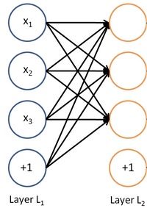
Matrix Notation for a Layer
W_{1,2}
z = Wx + b
a =f(z)
b₃

Slide 28
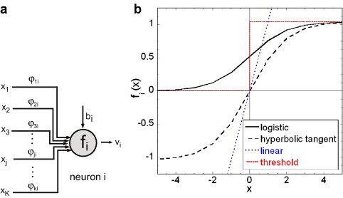
Activation Function
For each neuron, sum the inputs multiplied by their weights, and add the bias
The result is passed through an activation function, whose output feeds the next layer
Non-linearity needed to learn non-linear functions
Typical functions:
sigmoid function (as in logistic regression)
Hyperbolic tangent

Slide 29
Need for non linearities
Without non-linearities, deep neural networks can’t do anything more than a linear transform
Extra layers could just be compiled down into a single linear transform:
W₁ W₂ x = Wx
With more layers, they can approximate more complex functions
Universal Approximation Theorem: A 2-layer network can approximate any continuous function
The width of such networks has to be exponentially large

Slide 30
Perceptron Learning Rule
Assuming the problem is linearly separable, there is a learning rule that converges in a finite time
Motivation
A new (unseen) input pattern that is similar to an old (seen) input pattern is likely to be classified correctly

Slide 31
Learning Rule
Basic Idea
go over all existing data patterns, whose labeling is known, and check their classification with a current weight vector
If correct, continue
If not, add to the weights a quantity proportional to the product of the input pattern with the desired output y (+1 or -1)

Slide 32
Example: a simple problem
4 points, linearly separable
2
1.5
1
x₀ (-1,1/2)
x₁ (1,1/2)
0.5
●
○
0
y = +1
y = -1
-0.5
○
x₂ (1/2, -1/2)
x₃ (-1, -1)
-1
●
-1.5
-2
-2
-1.5
-1
-0.5
0
0.5
1
1.5
2

Slide 33
Initial Weights (random)
2
1.5
w₀ = (0, 1)
1
x₀ (-1,1/2)
x₃ (1,1/2)
0.5
●
○
0
-0.5
○
x₂ (1/2, -12)
x₁ (-1, -1)
-1
●
-1.5
-2
-2
-1.5
-1
-0.5
0
0.5
1
1.5
2

Slide 34
Updating Weights
Learning rule is:
w_{i+1} = w_{i} + $Δ$w_{i} $$Δw_{i}=ε x_{i}(y_{i}−{\hat{y}}_{i})$$
where:
$ε$ is learning rate (how much of the error to use in the correction)
x_{i} is misclassified point
ε = 1/5, w₀ = (0, 1), x₀ = (–1, ½)
Δw₀ = 1/5 (–1, ½) (–1 – sign(w₀ x₀))
= 1/5 (–1, 1/2) (–2)
= (2/5, –2/10)
w₁ = (0, 1) + (2/5, –2/10) = (2/5, 4/5)
Error: difference between expected value (y_{i}) and computed value (${\hat{y}}_{i}$)

Slide 35
First Correction
2
1.5
w₁ = (2/5, 4/5)
1
0.5
●
○
0
○
-0.5
-1
●
-1.5
-2

Slide 36
Updating Weights
Upper left point is still wrongly classified
w₂ = w₁ + Δw₁
$$Δw_{i}=ε x_{i}(y_{i}−{\hat{y}}_{i})$$
w₁ = (2/5, 4/5), x₁ = (1/2, −1/2)
Δw₁ = 1/5 (1/2, –1/2) (1 – sign(w₁ x₁))
w₂ = (2/5, 4/5) + 1/5 (1/2, –1/2) (2) = (3/5, 3/5)

Slide 37
Second Correction
2
1.5
w₂ = (3/5, 3/5)
1
0.5
●
○
0
○
-0.5
●
-1
-1.5
-2

Slide 38
Finish
All 4 points are classified correctly
Toy problem – only 2 updates required
Correction of weights was simply a
rotation of the separating hyper plane
Rotation can be applied to the right direction, but may require many updates

Slide 39
Deriving the delta rule
$$\hat{y}=w∙x+b$$
Define the error as the sum of squared residuals (SSR) over all training cases (~ Mean Squared Error)
Now differentiate to get error derivatives for weights
The batch delta rule changes the weights in proportion to their error derivatives summed over all training cases

Slide 40
The error surface
The error surface lies in a space with a horizontal axis for each weight and one vertical axis for the error.
For a linear neuron, it is a quadratic bowl
Vertical cross-sections are parabolas
Horizontal cross-sections are ellipses
E
w₁
w₂

Slide 41
Gradient Descent
Online learning zig-zags around the direction of steepest descent
constraint from
training case 1
w₁
constraint from
training case 2
w₂

Slide 42
Softmax Classifier

Slide 43
Logistic Regression
In language problems we are doing classification
Predicting one of a small set of discrete values
For binary classification $y∈\{1, −1\}$
Could we just use linear regression for this?
$$p\left(y | x\right)=\sum_{i=0}^{N}{w_{i}×x_{i}=w∙x}$$

Slide 44
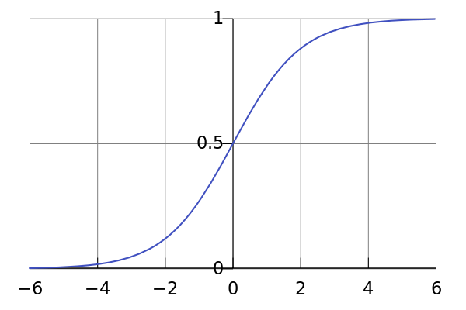
Logistic Regression
Not possible: the result doesn’t fall between 0 and 1
$$p\left(y | x\right)=w∙x$$
Use the sigmoid:
$$p\left(y|x\right)=σ\left(w∙x\right)=\frac{e^{w∙x}}{1+e^{w∙x}}$$
Logistic regression is like a perceptron with a sigmoid activation instead of sign
$$σ\left(x\right)$$

Slide 45
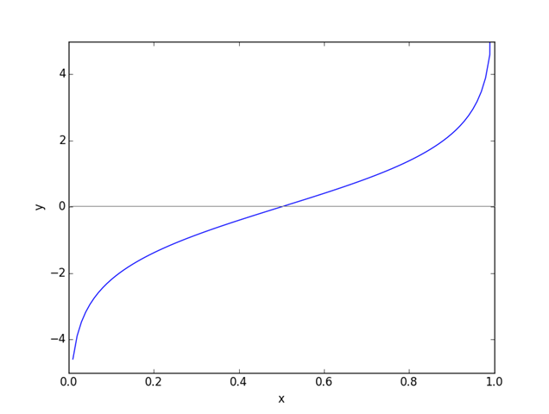
Logistic Function
$$logit\left(p\right)=log⁡(\frac{p}{1−p})$$
$${logit}^{−1}\left(x\right)=σ\left(x\right)=\frac{e^{x}}{1+e^{x}}$$
Sigmoid function: maps x to range [0-1]

Slide 46
Logistic Regression
How do we do classification?
Or:
$$\hat{y}=\underset{y}{argax}{p\left(y | x\right)}$$
$$\hat{y}=1 iff p\left(y=1 | x\right)>p(y=−1|x)$$
$$\frac{p(y=1|x)}{p(y=−1|x)}>1$$
$$\frac{p(y=1|x)}{1−p(y=1|x)}>1$$
$$\frac{\frac{e^{wx}}{1+e^{wx}}}{1−\frac{e^{wx}}{1+e^{wx}}}=\frac{\frac{e^{wx}}{1+e^{wx}}}{\frac{1}{1+e^{wx}}}=e^{wx}>1$$
$$wx>0$$
$$\hat{y}=\left\{\begin{aligned}1 if wx>0 \\ −1 if wx<0\end{aligned}\right.$$

Slide 47
Multinomial Logistic Regression
Multiple classes: weights w_{c} for each class c
Softmax takes a vector of real numbers and normalizes it into a probability distribution
$$p\left(c | x\right)=\frac{e^{w_{c}x}}{\sum_{c′∈C}{e^{w_{c′}x}}}=\underset{c}{softmax}{(z)}$$
$${z=(w}_{1}x,…,w_{C}x)$$
$${softmax(z)}_{i}=\frac{e^{z_{i}}}{\sum_{j}{e^{z_{j}}}}$$

Slide 48
Softmax/Logistic Regression
Train a classifier to learn a linear decision buondary (hyperplane)
Using softmax instead of sign as activation function
$$p\left(y|x\right)=\frac{e^{w_{y}x}}{\sum_{c}{e^{w_{c}x}}}$$

Slide 49
Training
For each training example (x,y), our objective is to maximize the probability of the correct class y
This is equivalent to minimizing the negative log probability of that class:
$$−\log\left(p\left(y|x\right)\right)=−log⁡(\frac{e^{w_{y}x}}{\sum_{c}{e^{w_{c}x}}})$$
Using log probability converts our objective function to sums, which is easier to work with on paper and in implementation.

Slide 50
Cross Entropy
Concept of “cross entropy” is from information theory
Let the true probability distribution be p
Let our computed model probability be q
The cross entropy is:
$$H\left(p,q\right)=\sum_{c}{p\left(c\right)log⁡(q\left(c\right))}$$
Assuming a ground truth (or true or gold or target) probability distribution that is 1 at the right class and 0 everywhere else:
p = [0,...,0,1,0,...0]
then:
Because of one-hot p, the only term left is the negative log probability of the true class
Maximizing the likelihood is the same as minimizing the cross entropy

Slide 51
Derivative of Cross Entropy Loss with Softmax
$$L(θ)=−\sum_{i}{y_{i}\log\left(p_{i}\right)}$$
$$\frac{∂L(θ)}{∂w_{c}}=−\sum_{i}{y_{i}}\frac{∂\log\left(p_{i}\right)}{∂w_{c}}=−\sum_{i}{y_{i}\frac{∂\log\left(p_{i}\right)}{∂p_{i}}\frac{∂\log\left(p_{i}\right)}{∂w_{c}}=}$$
$$−\sum_{i}{y_{i}\frac{1}{p_{i}}\frac{∂\log\left(p_{i}\right)}{∂w_{c}}}$$
From the derivative of softmax:
$$\frac{∂L(θ)}{∂w_{c}}=−y_{i}\left(1−p_{i}\right)−\sum_{k≠i}{y_{i}}\frac{1}{p_{k}}\left(−p_{k}p_{i}\right)=$$
$$p_{i}\left(y_{i}+\sum_{k≠i}{y_{k}}\right)−y_{i}=p_{i}−y_{i}$$
since $\sum_{i}{y_{i}}=1$

Slide 52
Experiments with Keras
See Jupyter notebook:
http://attardi-4.di.unipi.it:8000/user/attardi/notebooks/HLT/MLP.ipynb

Slide 53
Keras Modules
from keras.models import Sequential
from keras.layers import Dense, Activation, Input,
from keras.layers import Flatten, Embedding
# Parameters
num_words = 5000
maxlen = 80 # max sentence length
batch_size = 32
embedding_dims = 50

Slide 54
Binary Perceptron Classifier with Keras
model = Sequential()
# trick to build a one-hot representation
model.add(Embedding(5000, # size of vocabulary
50, # embeddings size
input_length=80, # max sentence length
embeddings_initializer='identity’,
trainable=False)) # do not train the embeddings
model.add(Flatten())
model.add(Dense(1)) # single value
model.add(Activation('sigmoid'))
model.compile(loss='binary_crossentropy',
optimizer='adam',
metrics=['accuracy’])

Slide 55
Load data
from keras import imdb
(x_train, y_train), (x_test, y_test) = imdb.load_data(num_words=max_words)
# pad sequences to the same length
from keras.preprocessing import sequence
x_train = sequence.pad_sequences(x_train, maxlen=maxlen)
x_test = sequence.pad_sequences(x_test, maxlen=maxlen)
# vocabulary
word_index = imdb.get_word_index()

Slide 56
Train the Model
model.fit(x_train, y_train,
batch_size=32,
epochs=10,
validation_data=(x_test, y_test))

Slide 57
Test the model
predictions = model.predict(x_test)
errors = y_test - predictions.round().flatten()
accuracy = len(errors[errors==0])/len(errors)

Slide 58
Traditional NLP
Parameters $θ$consists just W
$$θ=\left[\begin{matrix}W_{1} \\ … \\ W_{C}\end{matrix}\right]∈ℝ^{Cd}$$
LearnW by updates through the gradients
$$∇_{θ}J(θ)=\left[\begin{matrix}∇_{W_{1}} \\ … \\ ∇_{W_{C}}\end{matrix}\right]∈ℝ^{Cd}$$

Slide 59
Classification with Word Vectors
Tipically in NLP deep learning:
Learn both W and word vectors x
Learn both conventional parameters and representations
$$∇_{θ}J(θ)=\left[\begin{matrix}∇_{W_{1}} \\ … \\ \begin{aligned}∇_{W_{C}} \\ ∇_{W_{aardvark}} \\ … \\ ∇_{W_{zebra}}\end{aligned}\end{matrix}\right]∈ℝ^{Cd+Vd}$$
Very large set of parameters

Slide 60
Perceptron using Word Embeddings
model = Sequential()
model.add(Embedding(num_words,
50, # embeddings size
input_length=80)) # max sentence length
model.add(Flatten())
model.add(Dense(1)) # single value
model.add(Activation('sigmoid'))
model.compile(loss='binary_crossentropy',
optimizer='adam',
metrics=['accuracy’])

Slide 61
Perceptron using pre-trained Word Embeddings
# Load GloVe embeddings
import glove
glove_embeddings = glove.Glove.load_stanford(glove_6B_50d_path)
num_words = len(word_index) + 1 # +1 for padding
# Initialize with random weights
word_embeddings = np.random.uniform(-0.2, 0.2, (num_words, 50))
for word, i in word_index.items():
if i >= num_words:
continue
idx = glove_embeddings.dictionary.get(word)
if idx is not None:
# words not found in embeddings will have random weights
word_embeddings[i] = glove_embeddings.word_vectors[idx]

Slide 62
Perceptron using Pretrained Word Embeddings
model = Sequential()
model.add(Embedding(word_embeddings.shape[0],
word_embeddings.shape[1],
weights=[word_embeddings],
input_length=maxlen))
model.add(Flatten())
model.add(Dense(1)) # single value
model.add(Activation('sigmoid'))
model.compile(loss='binary_crossentropy',
optimizer='adam',
metrics=['accuracy’])

Slide 63
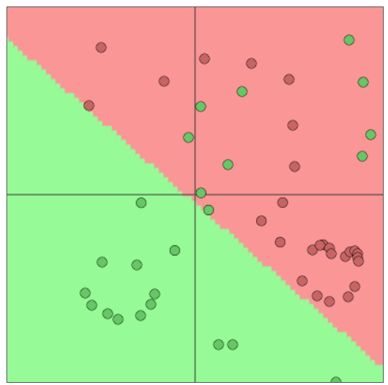
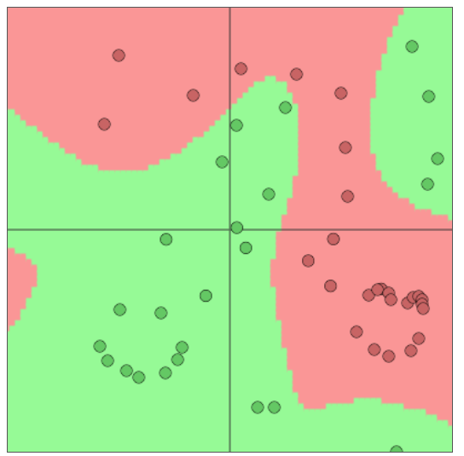
Multilayer Neural Networks
Neural network can approximate nonlinear decision boundaries
Slide from Matthew Lamm

Slide 64
Multilayer Perceptron
Introduce an additional layer in the softmax classifier with a non-linearity
MLPs are fundamental building blocks of more complex neural systems!
●
s = $σ$(z₁)
z₂ = W₂ x + b₂
a = f(z)
z = W₁ x + b₁
embeddings(x)
●●●●●●●●●●●●●●●
●●●●●●
●●●●●●
●●●●●●
●●●●●●
●●●●●●
This film was just brilliant
x

Slide 65
MLP with Pretrained Embeddings
model = Sequential()
model.add(Embedding(word_embeddings.shape[0],
word_embeddings.shape[1],
weights=[embedding_matrix],
input_length=maxlen,
trainable=False))
model.add(MaxPooling1D(pool_size=2, strides=1))
Model.add(Flatten())
model.add(Dense(10, activation='relu’)) # first layer
model.add(Dense(1, activation='sigmoid’)) # second layer
model.compile(optimizer='adam',
loss='binary_crossentropy',
metrics=['accuracy'])

Slide 66
MaxPooling1D
A convolution layer takes a pool of input vectors of the given pool_size.
These vectors are reduced to a single vector, in the case of MaxPooling1D by taking the largest value alon each dimension.
●●●●●●
●●●●●●
●●●●●●
●●●●●●
Output features
Max
●●●●●●
●●●●●●
●●●●●●
●●●●●●
●●●●●●
●●●●●●
pool size
●●●●●●
●●●●●●
●●●●●●
●●●●●●
●●●●●●
Input features
This film was just brilliant

