Slide 1

Sequence Tagging
Università di Pisa
Human Language Technologies
Master Program in Informatics
Thanks to Dan Jurafsky, Jim Martin, Ray Mooney, Tom Mitchell for slides

Slide 2
Outline
Sequence Tagging as Classification
Named Entities
IOB Tagging
A new classifier: Logistic Regression
  Logistic regression
  Multinomial logistic regression = MaxEnt
Why classifiers aren’t as good as sequence models
A new sequence model:
  MEMM = Maximum Entropy Markov Model

Slide 3
How do we apply classification to sequences?

Slide 4
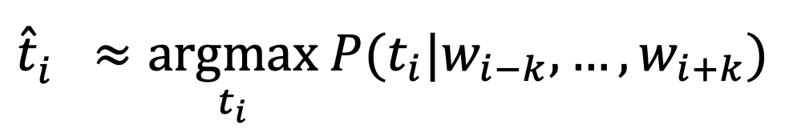
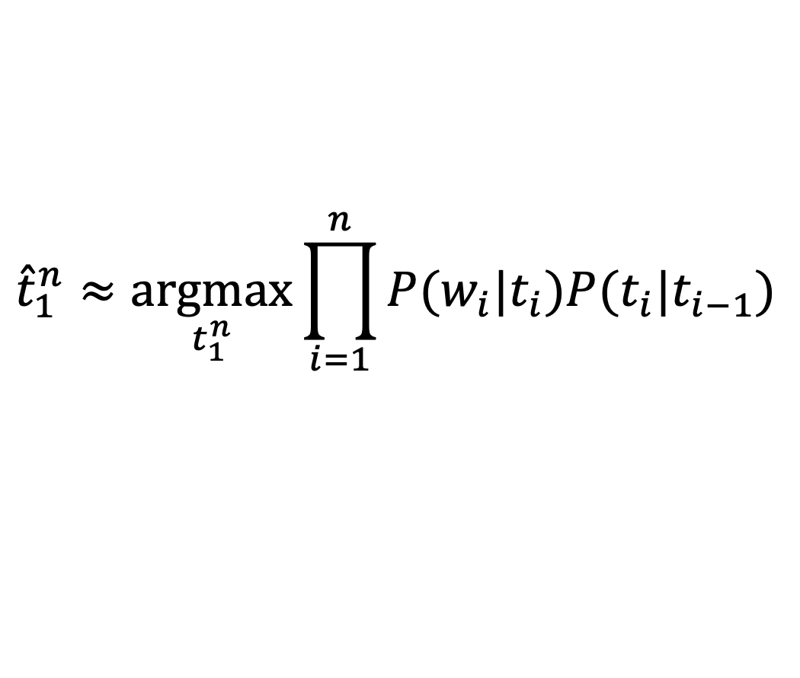
POS Tagging
As an HMM
As a sequence of classifiers
emission
transition
$${\hat{t}}_{1}^{n}≈\underset{t_{1}^{n}}{argmax}\prod_{i=1}^{n}{P(w_{i}|t_{i})P(t_{i}|t_{i−1})}$$
$${\hat{t}}_{i}^{}≈\underset{t_{i}}{argmax} P(t_{i}|w_{i−k},…,w_{i+k})$$

Slide 5
Sequence Labeling as Classification
Classify each token independently but use as input features, information about the surrounding tokens (sliding window).
John saw the saw and decided to take it to the table.
classifier
NNP

Slide 6
Sequence Labeling as Classification
Classify each token independently but use as input features, information about the surrounding tokens (sliding window).
John saw the saw and decided to take it to the table.
classifier
VBD
Slide from Ray Mooney

Slide 7
Sequence Labeling as Classification
Classify each token independently but use as input features, information about the surrounding tokens (sliding window).
John saw the saw and decided to take it to the table.
classifier
DT
Slide from Ray Mooney

Slide 8
Sequence Labeling as Classification
Classify each token independently but use as input features, information about the surrounding tokens (sliding window).
John saw the saw and decided to take it to the table.
classifier
NN
Slide from Ray Mooney

Slide 9
Sequence Labeling as Classification
Classify each token independently but use as input features, information about the surrounding tokens (sliding window).
John saw the saw and decided to take it to the table.
classifier
CC
Slide from Ray Mooney

Slide 10
Sequence Labeling as Classification
Classify each token independently but use as input features, information about the surrounding tokens (sliding window).
John saw the saw and decided to take it to the table.
classifier
VBD
Slide from Ray Mooney

Slide 11
Sequence Labeling as Classification
Classify each token independently but use as input features, information about the surrounding tokens (sliding window).
John saw the saw and decided to take it to the table.
classifier
TO
Slide from Ray Mooney

Slide 12
Sequence Labeling as Classification
Classify each token independently but use as input features, information about the surrounding tokens (sliding window).
John saw the saw and decided to take it to the table.
classifier
VB
Slide from Ray Mooney

Slide 13
Sequence Labeling as Classification
Classify each token independently but use as input features, information about the surrounding tokens (sliding window).
John saw the saw and decided to take it to the table.
classifier
PRP
Slide from Ray Mooney

Slide 14
Sequence Labeling as Classification
Classify each token independently but use as input features, information about the surrounding tokens (sliding window).
John saw the saw and decided to take it to the table.
classifier
IN
Slide from Ray Mooney

Slide 15
Sequence Labeling as Classification
Classify each token independently but use as input features, information about the surrounding tokens (sliding window).
John saw the saw and decided to take it to the table.
classifier
DT
Slide from Ray Mooney

Slide 16
Sequence Labeling as Classification
Classify each token independently but use as input features, information about the surrounding tokens (sliding window).
John saw the saw and decided to take it to the table.
classifier
NN
Slide from Ray Mooney

Slide 17
Using Outputs as Inputs
Better input features are usually the categories of the surrounding tokens, but these are not available yet
Can use category of either the preceding or succeeding tokens by going forward or back and using previous output
Slide from Ray Mooney

Slide 18
Forward Classification
John saw the saw and decided to take it to the table.
classifier
NNP
Slide from Ray Mooney

Slide 19
Forward Classification
NNP
John saw the saw and decided to take it to the table.
classifier
VBD
Slide from Ray Mooney

Slide 20
Forward Classification
NNP VBD
John saw the saw and decided to take it to the table.
classifier
DT
Slide from Ray Mooney

Slide 21
Forward Classification
NNP VBD DT
John saw the saw and decided to take it to the table.
classifier
NN
Slide from Ray Mooney

Slide 22
Forward Classification
NNP VBD DT NN
John saw the saw and decided to take it to the table.
classifier
CC
Slide from Ray Mooney

Slide 23
Forward Classification
NNP VBD DT NN CC
John saw the saw and decided to take it to the table.
classifier
VBD
Slide from Ray Mooney

Slide 24
Forward Classification
NNP VBD DT NN CC VBD
John saw the saw and decided to take it to the table.
classifier
TO
Slide from Ray Mooney

Slide 25
Forward Classification
NNP VBD DT NN CC VBD TO
John saw the saw and decided to take it to the table.
classifier
VB
Slide from Ray Mooney

Slide 26
Backward Classification
Disambiguating “to” in this case would be even easier backward.
DT NN
John saw the saw and decided to take it to the table.
classifier
IN
Slide from Ray Mooney

Slide 27
Backward Classification
Disambiguating “to” in this case would be even easier backward.
IN DT NN
John saw the saw and decided to take it to the table.
classifier
PRP
Slide from Ray Mooney

Slide 28
Backward Classification
Disambiguating “to” in this case would be even easier backward.
PRP IN DT NN
John saw the saw and decided to take it to the table.
classifier
VB
Slide from Ray Mooney

Slide 29
Backward Classification
Disambiguating “to” in this case would be even easier backward.
VB PRP IN DT NN
John saw the saw and decided to take it to the table.
classifier
TO
Slide from Ray Mooney

Slide 30
Backward Classification
Disambiguating “to” in this case would be even easier backward.
TO VB PRP IN DT NN
John saw the saw and decided to take it to the table.
classifier
VBD
Slide from Ray Mooney

Slide 31
Backward Classification
Disambiguating “to” in this case would be even easier backward.
VBD TO VB PRP IN DT NN
John saw the saw and decided to take it to the table.
classifier
CC
Slide from Ray Mooney

Slide 32
Backward Classification
Disambiguating “to” in this case would be even easier backward.
CC VBD TO VB PRP IN DT NN
John saw the saw and decided to take it to the table.
classifier
VBD
Slide from Ray Mooney

Slide 33
Backward Classification
Disambiguating “to” in this case would be even easier backward.
VBD CC VBD TO VB PRP IN DT NN
John saw the saw and decided to take it to the table.
classifier
DT
Slide from Ray Mooney

Slide 34
Backward Classification
Disambiguating “to” in this case would be even easier backward.
DT VBD CC VBD TO VB PRP IN DT NN
John saw the saw and decided to take it to the table.
classifier
VBD
Slide from Ray Mooney

Slide 35
Backward Classification
Disambiguating “to” in this case would be even easier backward.
VBD DT VBD CC VBD TO VB PRP IN DT NN
John saw the saw and decided to take it to the table.
classifier
NNP
Slide from Ray Mooney

Slide 36
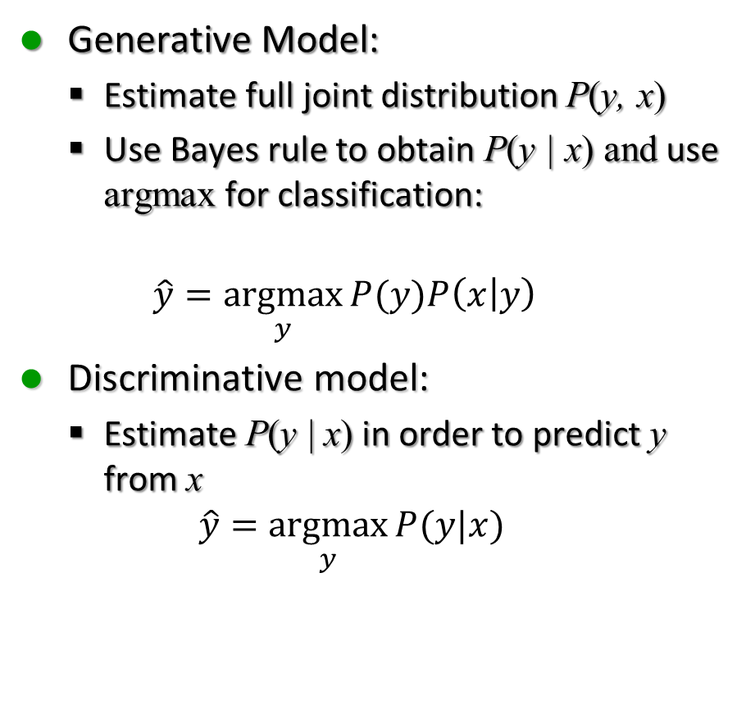
Discriminative vs Generative
Generative Model:
  Estimate full joint distribution P(y, x)
  Use Bayes rule to obtain P(y | x) and use argmax for classification:
  $$\hat{y}=\underset{y}{argmax}{P(y)P\left(x | y\right)}$$
Discriminative model:
  Estimate P(y | x) in order to predict y from x
  $$\hat{y}=\underset{y}{argmax}{P(y|x)}$$
Generative:
  Naïve Bayes
  HMM
Discriminative:
  Max Entropy, Logistic Regression
  Conditional Random Fields
  Support Vector Machines
  CNN

Slide 37


Naïve Bayes vs Logistic Regression
Naïve Bayes
Logistic Regression
Compute:
$${\hat{c}}_{j}=\underset{j}{argmax}{P(c_{j}|x)}$$
Using Bayes rule
$${\hat{c}}_{j}=\underset{j}{argmax}{P\left(c_{j}\right)P(x|c_{j})}$$
Compute posterior probability directly
$$P\left(c_{j}|x\right)=\frac{e^{w_{j}∙x}}{\sum_{i}{e^{w_{i}∙x}}}=\underset{j}{softmax}{(w_{j}∙x)}$$

Slide 38
How to do Sequence tagging?
Classifiers
Sequence Models
Naïve Bayes
Logistic Regression
HMMs
MEMMs
CRFs
Convolutional Neural Network
Sequence models work better

Slide 39
Logistic Regression

Slide 40
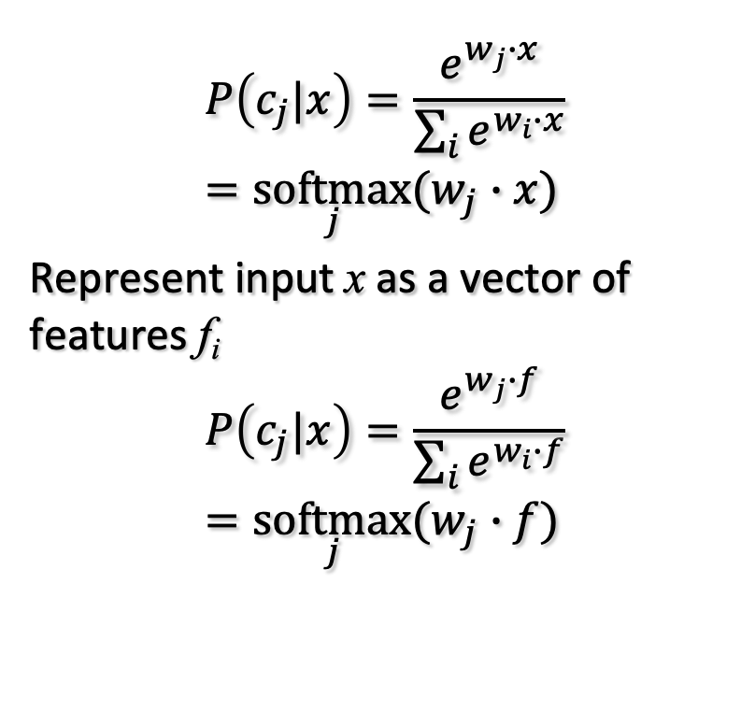
Logistic Regression
Model
Estimating the weights
$$P\left(c_{j}|x\right)=\frac{e^{w_{j}∙x}}{\sum_{i}{e^{w_{i}∙x}}}=\underset{j}{softmax}{(w_{j}∙x)}$$
Represent input x as a vector of features f_{i}
$$P\left(c_{j}|x\right)=\frac{e^{w_{j}∙f}}{\sum_{i}{e^{w_{i}∙f}}}=\underset{j}{softmax}{(w_{j}∙f)}$$
Gradient Iterative Scaling

Slide 41


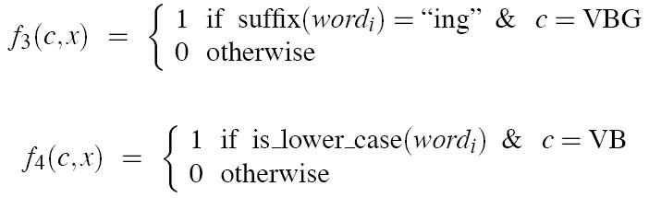
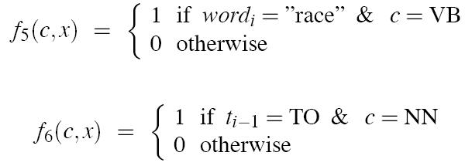
Features

Slide 42
POS Classifier in Keras
See notebook:
  http://attardi-4.di.unipi.it:8000/hub/user-redirect/lab/tree/HLT/POS%20Tagging.ipynb

Slide 43
Why classifiers are not as good as sequence models

Slide 44
Problems with using Classifiers for Sequence Labeling
It is not easy to integrate information from hidden labels on both sides
We make a hard decision on each token
  We should rather choose a global optimum
  The best labeling for the whole sequence
  Keeping each local decision as just a probability, not a hard decision

Slide 45
Probabilistic Sequence Models
Probabilistic sequence models allow integrating uncertainty over multiple, interdependent classifications and collectively determine the most likely global assignment
Common approaches
  Hidden Markov Model (HMM)
  Conditional Random Field (CRF)
  Maximum Entropy Markov Model (MEMM) is a simplified version of CRF
  Recurrent Neural Networks (RNN)

Slide 46
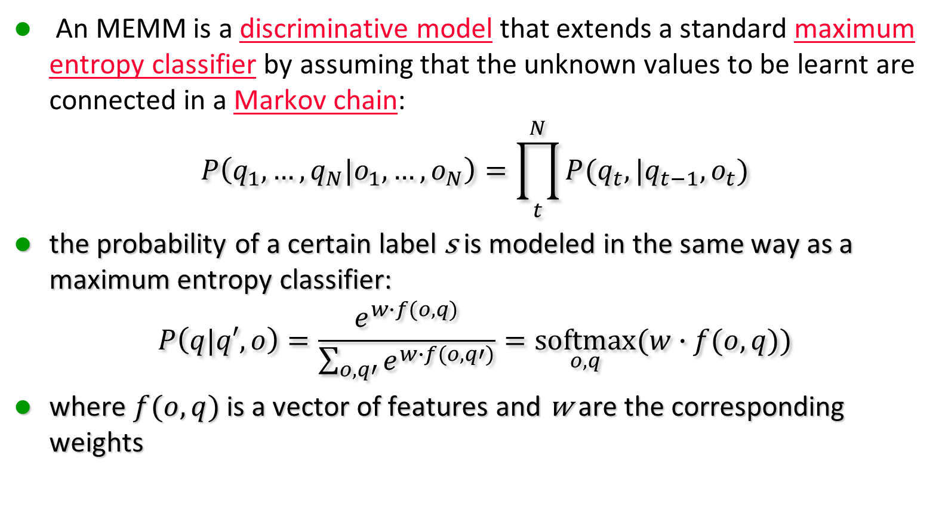
Maximum Entropy Markov Model
An MEMM is a discriminative model that extends a standard maximum entropy classifier by assuming that the unknown values to be learnt are connected in a Markov chain:
$$P\left(q_{1},…,q_{N}|o_{1},…,o_{N}\right)=\prod_{t}^{N}{P(q_{t},|q_{t−1},o_{t})}$$
the probability of a certain label s is modeled in the same way as a maximum entropy classifier:
$$P\left(q|q′,o\right)=\frac{e^{w∙f(o,q)}}{\sum_{o,q′}{e^{w∙f(o,q′)}}}=\underset{o,q}{softmax}{(w∙f(o,q))}$$
where $f(o,q)$ is a vector of features and w are the corresponding weights
Chain Rule +
Markov Assumption

Slide 47
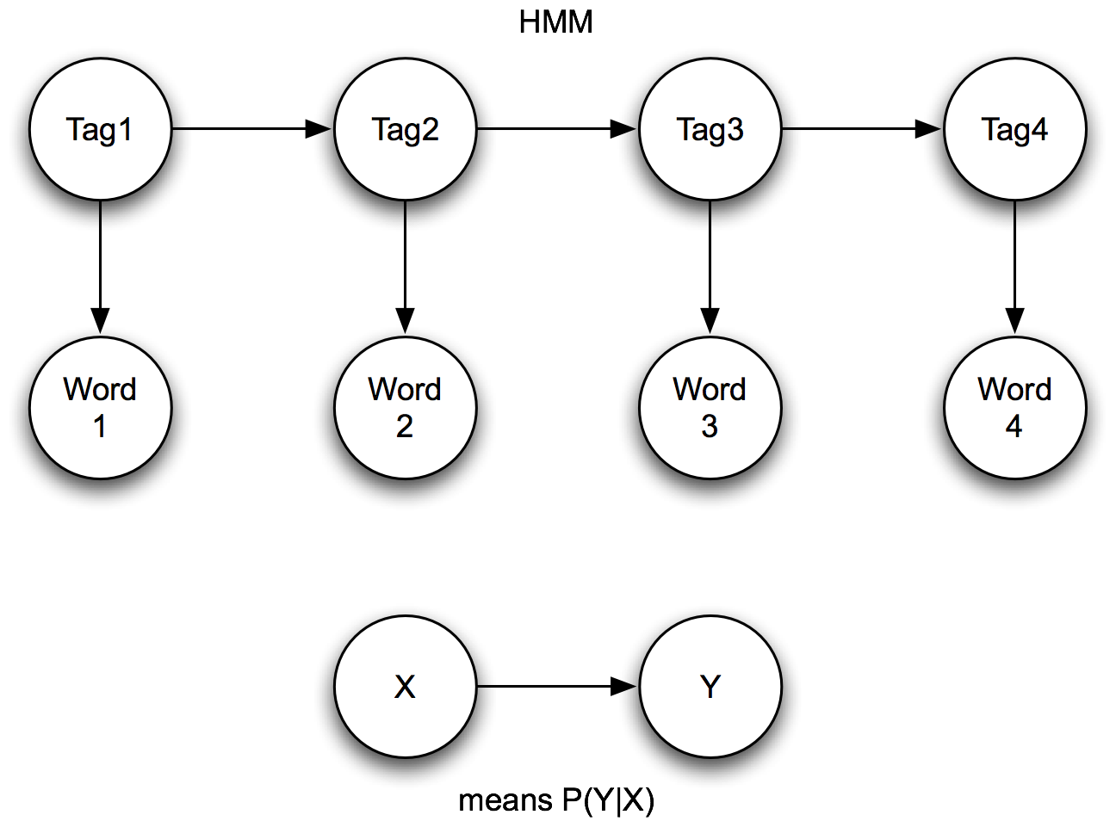
HMMs vs. MEMMs

Slide 48
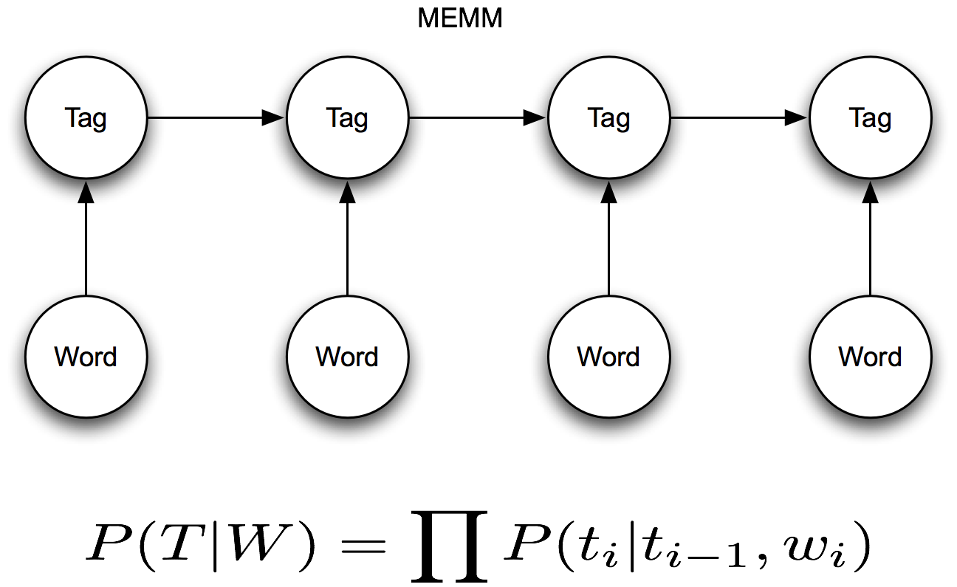
HMMs vs. MEMMs

Slide 49
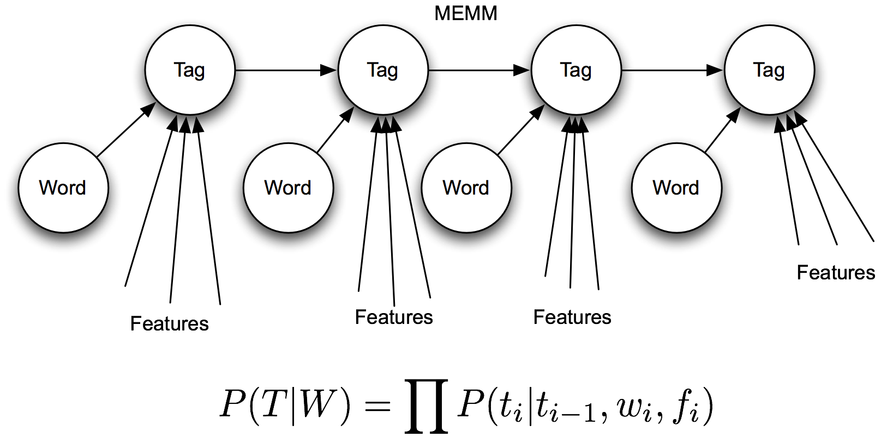
HMMs vs. MEMMs

Slide 50
HMM vs MEMM
Varenne
Varenne

Slide 51
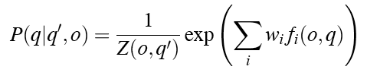


Viterbi in MEMMs
We condition on the observation AND the previous state:
HMM decoding:
which is the HMM version of:
MEMM decoding:

Slide 52
Decoding in MEMMs

Slide 53
Named Entity Tagging

Slide 54
Named Entity Tagging
CHICAGO (AP) — Citing high fuel prices, United Airlines said Friday it has increased fares by $6 per round trip on flights to some cities also served by lower-cost carriers. American Airlines, a unit AMR, immediately matched the move, spokesman Tim Wagner said. United, a unit of UAL, said the increase took effect Thursday night and applies to most routes where it competes against discount carriers, such as Chicago to Dallas and Atlanta and Denver to San Francisco, Los Angeles and New York.

Slide 55
Named Entity Tagging
CHICAGO (AP) — Citing high fuel prices, United Airlines said Friday it has increased fares by $6 per round trip on flights to some cities also served by lower-cost carriers. American Airlines, a unit AMR, immediately matched the move, spokesman Tim Wagner said. United, a unit of UAL, said the increase took effect Thursday night and applies to most routes where it competes against discount carriers, such as Chicago to Dallas and Atlanta and Denver to San Francisco, Los Angeles and New York.

Slide 56
Named Entity Recognition
Find the named entities and classify them by type
Typical approach
  Acquire training data
  Encode using IOB labeling
  Train a sequential supervised classifier
  Augment with pre- and post-processing using available list resources (census data, gazetteers, etc.)
Slide from Jim Martin

Slide 57
Temporal and Numerical Expressions
Temporals
  Find all the temporal expressions
  “May 1st”, "next Friday", "Easter eve", "my birthday"
  Normalize them based on some reference point
Numerical Expressions
  Find all the expressions
  Classify by type
  Normalize
Slide from Jim Martin

Slide 58
NE Types
Type | Tag | Sample Categories
People | PER | Individuals, fictional characters, small groups
Organizations | ORG | Companies, agencies, sport teams, parties, religious groups
Location | LOC | Physical extents, mountains, lakes, seas
Geo-political Entities | GPE | Countries, states, provinces, counties
Facility | FAC | Bridges, buildings, airports
Vehicles | VEH | Planes, trains, automobiles
Slide from Jim Martin

Slide 59
NE Types: Examples
Type | Examples
People | Turing is considered to be the father of modern computer science
Organizations | The IPCC said it is likely that future tropical cyclones will become more intense
Location | The Mt. Sanitas loop hike begins at the base of Sunshine Canyon.
Geo-political Entities | Palo Alto is looking at raising the fees for parking.
Facility | Drivers were advised to consider either the Tappon Zee Bridge or the Lincoln Tunnel.
Vehicles | The updated Mini Cooper retains its charm and agility.
Slide from Jim Martin

Slide 60
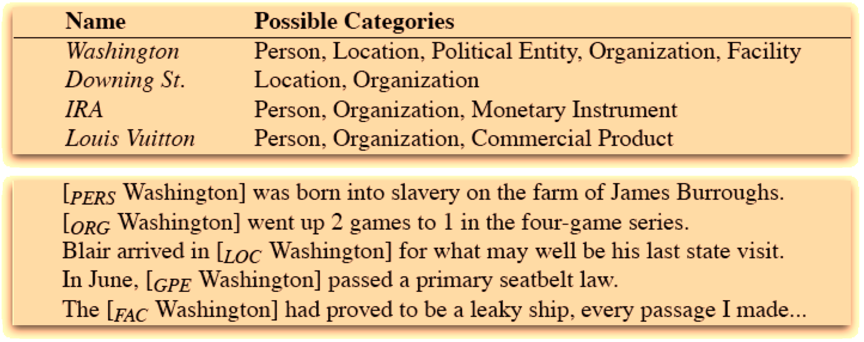
Ambiguity
Slide from Jim Martin

Slide 61
Biomedical Entities
Disease
Symptom
Drug
Body Part
Treatment
Enzime
Protein
Difficulty: discontiguous or overlapping mentions
  Abdomen is soft, nontender, nondistended, negative bruits

Slide 62
NER Approaches
As with partial parsing and chunking there are two basic approaches (and hybrids)
  Rule-based (regular expressions)
    Lists of names
    Patterns to match things that look like names
    Patterns to match the environments that classes of names tend to occur in.
  ML-based approaches
    Get annotated training data
    Extract features
    Train systems to replicate the annotation
Slide from Jim Martin

Slide 63
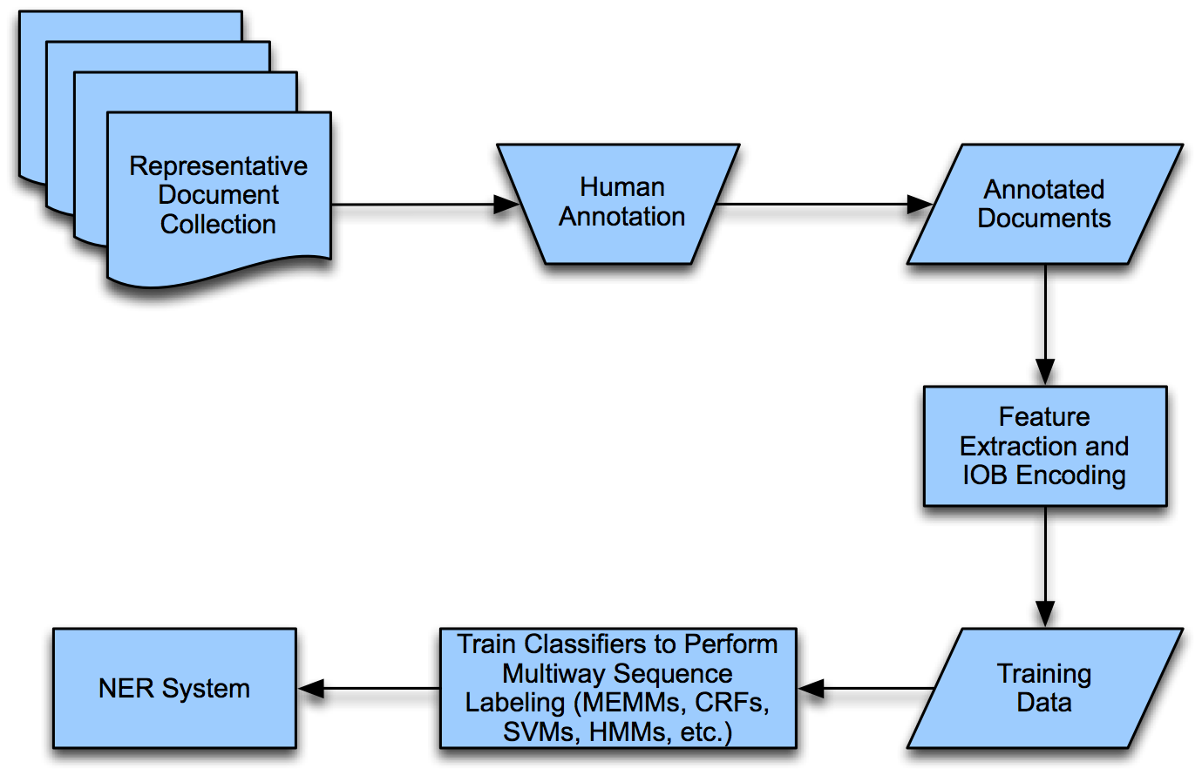
ML Approach
Slide from Jim Martin

Slide 64
Encoding for Sequence Labeling
We can use IOB encoding:
…United Airlines said Friday it has increased
  B_ORG I_ORG O O O O O
  the move , spokesman Tim Wagner said.
  O O O O B_PER I_PER O
How many tags?
  For N classes we have 2*N+1 tags
    An I and B for each class and one O for no-class
Each token in a text gets a tag
Can use simpler IO tagging if what?

Slide 65
NER Features
Token | Features |  |  | Label
American | NNP | B_{NP} | cap | B_{ORG}
Airlines | NNPS | I_{NP} | cap | I_{ORG}
, | PUNC | O | punc | O
a | DT | B_{NP} | lower | O
unit | NN | I_{NP} | lower | O
of | IN | B_{PP} | lower | O
AMR | NNP | B_{NP} | upper | B_{ORG}
Corp. | NNP | I_{NP} | cap_punc | I_{ORG}
, | PUNC | O | punc | O
immediately | RB | B_{ADV} | lower | O
matched | VBD | B_{VP} | lower | O
the | DT | B_{NP} | lower | O
move | NN | I_{NP} | lower | O
, | PUNC | O | punc | O
spokesman | NN | B_{NP} | lower | O
Tim | NNP | I_{NP} | cap | B_{ORG}
Wagner | NNP | I_{NP} | cap | I_{ORG}
said | VBD | B_{VP} | lower | O
. | PUNC | O | punc | O
Slide from Jim Martin

Slide 66
Feature Engineering
Zhou and Su (2002)
Agerri and Rigau (2016)
11 orthographic features (1 numeral, 2 numeral, 4 numeral, all caps, numerals and alphabets, contains underscore or not, etc.) a list of trigger words for the named entities (e.g., 36 trigger words and affixes, like river, for the location entity class), and a list of words (10000 for the person entity class) from various gazetteers.
orthography, character n-grams, lexicons, prefixes, suffixes, bigrams, trigrams, cluster features from the Brown corpus, Clark corpus and k-means clustering of word embeddings

Slide 67
State of the Art
Feature engineered ML | Dict | Accuracy
Li et al. (2005) SVM | Yes | 88.30
Passos et al. (2014) CRF | Yes | 90.90
Agerri and Rigau (2016) | Yes | 91.36
Feature-inferred NN Word
Collobert et al. (2011) Conv-CRF (SENNA+Gazetteer) | Yes | 89.59
Huang et al. (2015) Bi-LSTM+CRF+ (SENNA+Gazetteer) | Yes | 90.10
Feature-inferred NN Character
Gillick et al. (2015) – BTS | No | 86.50
Feature-inferred NN word + character
Chiu and Nichols (2015) | Yes | 91.62
Ma and Hovy (2016) | No | 91.21
Lample et al. (2016) | No | 90.94
V. Yadav, R, Bethard. A Survey of Recent Advances in NER from Deep NN models. Proc. of COLING 2018. 2018

Slide 68
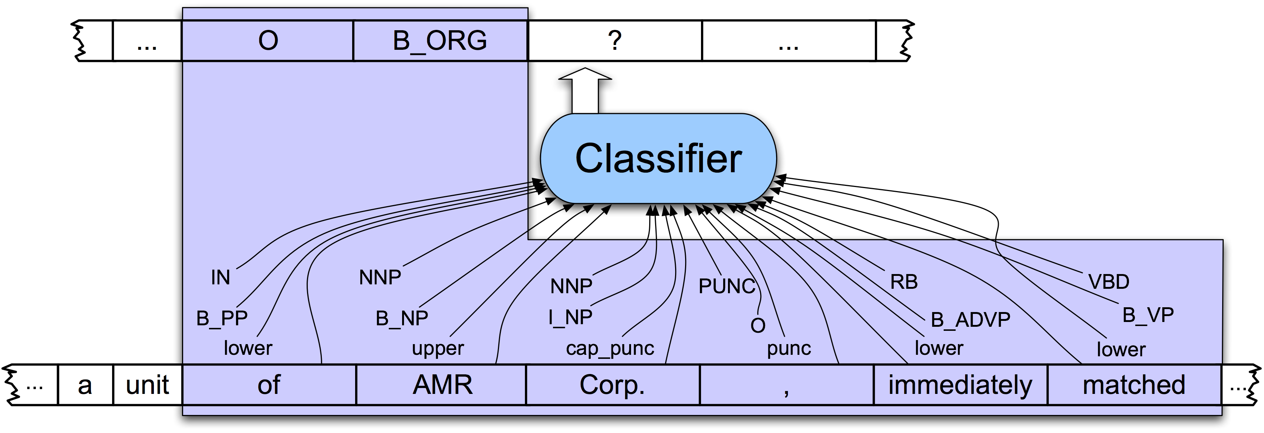
NER as Sequence Labeling

Slide 69
Outline
Sequence tagging as classification
Named Entities
IOB Tagging
A new classifier: Logistic Regression
  Logistic regression
  Multinomial logistic regression = MaxEnt
Why classifiers are not as good as sequence models
A new sequence model:
  MEMM = Maximum Entropy Markov Model

